Slide 1
4-Bar Locking Mechanism
Principles, Design, and Applications

Slide 2
Table of Contents
1. Introduction to 4-Bar Mechanisms
2. Types of 4-Bar Linkages
3. Locking Mechanism Fundamentals
4. Design Principles
5. Mathematical Analysis
6. Practical Applications
7. Design Considerations
8. Future Trends

Slide 3
What is a 4-Bar Mechanism?
Key Components:
A planar linkage system consisting of four rigid bars connected by pin joints
One bar is fixed (ground link), three are movable
Most fundamental closed-chain mechanism in mechanical engineering
Forms the basis for countless mechanical devices
Ground Link (Fixed)
Crank (Input link)
Coupler (Connecting link)
Rocker (Output link)
Four Pin Joints

Slide 4
Types of 4-Bar Linkages
Crank-Rocker
Double-Crank
Double-Rocker
Crank rotates fully, rocker oscillates
Both side links rotate completely
Both side links oscillate

Slide 5
Grashof's Criterion
s + l ≤ p + q
s = shortest link length
l = longest link length
p, q = intermediate link lengths
If satisfied: At least one link can rotate fully
If not satisfied: Double-rocker mechanism
Critical for determining mechanism behavior

Slide 6
What is a Locking Mechanism?
A locking mechanism temporarily holds a linkage in a specific position by creating a dead-center or toggle configuration.
Prevents unwanted motion in a mechanical system
Achieved when links become collinear (aligned)
Creates a mechanically stable position
Requires external force to unlock
Commonly used in toggle mechanisms

Slide 7
Toggle Position Principle
Toggle Characteristics:
Key Insight
Occurs at dead-center position
Mechanical advantage approaches infinity
Input motion produces minimal output
Self-locking under load
Bistable configuration possible
When three links become collinear, the transmission angle reaches 0° or 180°, creating a mechanically locked state.

Slide 8
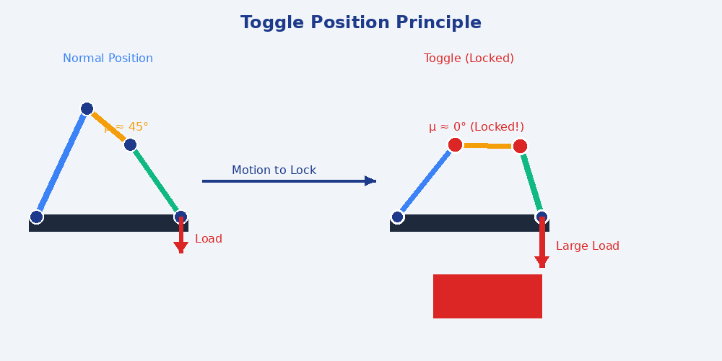
Continu……

Slide 9
Types of Locking in 4-Bar Systems
1
Over-Center Lock
Link passes through center, locks on opposite side
2
Under-Center Lock
Locks before reaching center position
3
Toggle Lock
Links align in straight configuration

Slide 10
Over-Center Locking Mechanism
Most common type in industrial applications
Link passes through alignment and locks beyond
Provides positive locking action
Requires reverse motion to unlock
High mechanical advantage at locked position
Used in clamps, presses, and latches
Advantages:
Self-maintaining lock
No power required to hold
Predictable behavior
Simple design

Slide 11
Key Design Parameters
Link Lengths
Determines range of motion and locking points
Transmission Angle
Affects force transmission efficiency
Mechanical Advantage
Force multiplication at different positions
Dead Point Location
Where mechanism achieves lock
Joint Clearances
Impacts precision and wear
Material Selection
Strength, stiffness, and durability

Slide 12
Transmission Angle
The transmission angle (μ) is the angle between the coupler and the output link.
Ideal range: 40° to 140°
At 0° or 180°: Toggle position
At 90°: Maximum efficiency
Poor angles cause vibration
Critical for force transmission
Warning
Poor transmission angles lead to binding, excessive forces, and premature wear in mechanical systems.

Slide 13
Mechanical Advantage in Locking
MA = Output Force / Input Force
Varies with link position throughout motion
Approaches infinity at toggle position
Maximum advantage occurs at dead center
In locked position, small input resists large output
Enables compact design for high force applications
Trade-off: High MA means low speed ratio

Slide 14
Mathematical Analysis
Position Analysis
Vector loop: r₁ + r₂ = r₃ + r₄
Velocity Analysis
ω₂ × r₂ = ω₃ × r₃ + ω₄ × r₄
Acceleration
α₂ × r₂ = α₃ × r₃ + α₄ × r₄ + ω₃² r₃ + ω₄² r₄
At toggle position, velocity equations reveal singularity indicating mechanical lock.

Slide 15
Force Analysis at Lock Position
Static equilibrium equations apply at lock
Sum of forces = 0, Sum of moments = 0
Pin reactions distribute load throughout structure
Axial forces dominate in locked configuration
Bending moments minimized at toggle
Critical for stress calculations and material selection
Key Consideration
Design links to handle maximum forces occurring during locking and unlocking transitions.

Slide 16
Practical Applications

Slide 17
Application: Toggle Clamps
Common Uses:
Features:
Welding fixtures
Assembly jigs
Machining operations
Woodworking
Quality inspection
Material handling
Rapid clamping action
High holding force
Hands-free operation
Repeatable positioning
Compact footprint
Low maintenance

Slide 18
Application: Aircraft Landing Gear
Over-center lock prevents collapse during landing
Withstands extreme impact forces
Actuator overcomes lock for retraction
Critical safety component
Redundant locking systems often employed
Must function in harsh environmental conditions
Safety Critical
Landing gear locking is subject to rigorous certification requirements and extensive testing.

Slide 19
Application: Locking Pliers (Vise-Grips)
Invented by William Petersen in 1924, locking pliers use a compound leverage system with an over-center toggle lock.
Mechanism:
Double 4-bar linkage with adjustable screw
Lock Action:
Handle overcomes toggle point to lock jaws
Adjustment:
Screw changes link geometry for different sizes
Release:
Lever releases over-center lock instantly
Advantage:
Hands-free clamping with tremendous force

Slide 20
Additional Applications
Adjustable Wrenches
Jaw locking mechanism
Folding Chairs/Tables
Leg stabilization
Hospital Beds
Position locking
Automotive Hood Latches
Safety closure
Press Brakes
Ram locking
Robotic Grippers
Object retention
Reclining Seats
Position hold
Convertible Top Mechanisms
Roof locking

Slide 21
Design Considerations
Wear & Fatigue
Manufacturing
Safety
Pin joint wear
Cyclic loading
Surface treatments
Material selection
Tolerances
Assembly
Cost efficiency
Scalability
Failure modes
Redundancy
Load limits
User protection

Slide 22
Joint Design & Lubrication
Pin joints are critical wear points
Clearance affects backlash and precision
Lubrication reduces friction and wear
Sealed bearings prevent contamination
Hardened surfaces increase life
Regular maintenance extends operational life
Common Joint Types:
Plain bearings (bushings)
Rolling element bearings
Self-lubricating bearings
Needle bearings

Slide 23
Material Selection
Steel Alloys
High strength, good fatigue resistance, economical
Aluminum
Lightweight, corrosion resistant, lower strength
Stainless Steel
Corrosion resistant, hygienic applications
Bronze
Excellent bearing properties, wear resistant
Composites
High strength-to-weight, corrosion resistant
Titanium
Aerospace applications, excellent strength-to-weight

Slide 24
Common Failure Modes
Pin Shear Failure:
Excessive load, undersized pins
Link Buckling:
Compression loads, slender members
Fatigue Cracking:
Cyclic loading, stress concentrations
Joint Wear:
Poor lubrication, contamination
Lock Failure:
Misalignment, over-travel
Binding:
Tolerance stack-up, deflection

Slide 25
Optimization Techniques
Link length optimization for desired motion
Minimize transmission angle variation
Weight reduction through topology optimization
FEA stress analysis for optimal cross-sections
Kinematic simulation for motion verification
Multi-objective optimization (force, speed, size)
Sensitivity analysis for tolerance allocation

Slide 26
CAD & Simulation Tools
Kinematic Analysis
ADAMS, Working Model, SAM
CAD Software
SolidWorks, CATIA, NX, Inventor
FEA Software
ANSYS, Abaqus, COMSOL
Motion Simulation
RecurDyn, Simscape, MapleSim

Slide 27
Testing & Validation
Static Load Testing
Verify strength and lock integrity
Fatigue Testing
Life prediction under cyclic loads
Motion Analysis
Validate kinematics and timing
Force Measurement
Confirm mechanical advantage
Wear Testing
Assess joint durability
Environmental Testing
Temperature, humidity, corrosion

Slide 28
Modern Trends & Innovations
Smart Mechanisms
Sensors for position, force, and wear monitoring
Additive Manufacturing
3D printed linkages with complex geometries
Soft Robotics
Compliant mechanisms with locking capabilities
Miniaturization
MEMS-scale locking mechanisms
Bio-inspired Design
Nature-inspired locking joints
Active Control
Electrically actuated locks with feedback

Slide 29
Future Directions
Integration with AI for predictive maintenance
Self-healing materials for extended life
Energy harvesting from mechanism motion
Metamaterial-based variable stiffness links
Quantum optimization for complex designs
Digital twins for real-time performance monitoring
Biomechanical integration (prosthetics, exoskeletons)

Slide 30
Key Takeaways
1
4-bar locking mechanisms provide reliable, passive holding force
2
Toggle position creates mechanical advantage approaching infinity
3
Transmission angle is critical for efficient force transmission
4
Wide range of applications from aerospace to consumer products
5
Proper design requires understanding of kinematics, dynamics, and materials

Slide 31
Thank You
4-Bar Locking Mechanisms

