Slide 1
A NEW ARTICULATED BOGIE SYSTEM
For Manual Mountain Stair Trolleys
Engineering Design & Analysis
100mm Radius Corner Navigation
February 2026

Slide 2
PRESENTATION OVERVIEW
1. Problem Statement & Application
2. Design Concept & Mechanism
3. Technical Specifications
4. Geometric Analysis & Calculations
5. Component Details
6. Materials & Manufacturing
7. Advantages & Benefits
8. Recommendations

Slide 3
THE CHALLENGE
APPLICATION
KEY REQUIREMENT
• Manual mountain stair trolley
• Steep elevation changes
• Multiple sharp 90° switchbacks
• Outdoor mountain environment
• No electrical power available
Navigate 100mm radius corners
This extremely tight radius
requires innovative wheel and
bogie configuration to prevent
binding while maintaining
stability on straight sections.

Slide 4
DESIGN CONCEPT
ARTICULATED DUAL-BOGIE SYSTEM
Two independent bogie assemblies connected by a universal joint, allowing
front and rear sections to articulate independently while maintaining
continuous contact with the track through sharp corners.
FRONT BOGIE
• 3-point contact
• 1 load wheel
• 2 guide rollers
PIVOT JOINT
• Universal joint
• ±40° rotation
• Telescoping shaft
REAR BOGIE
• Identical to front
• Same 3-point
• Symmetrical

Slide 5
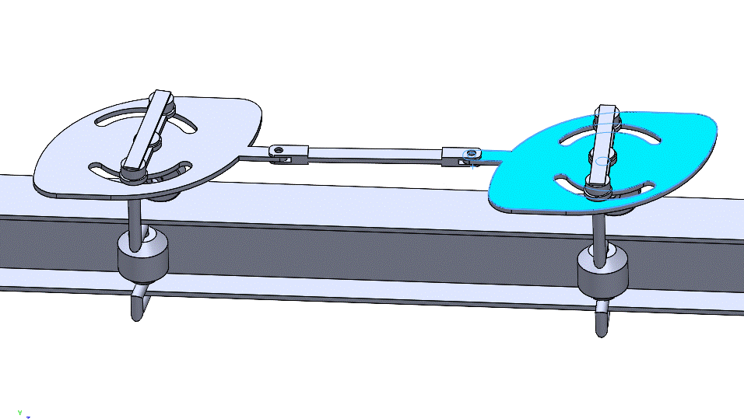
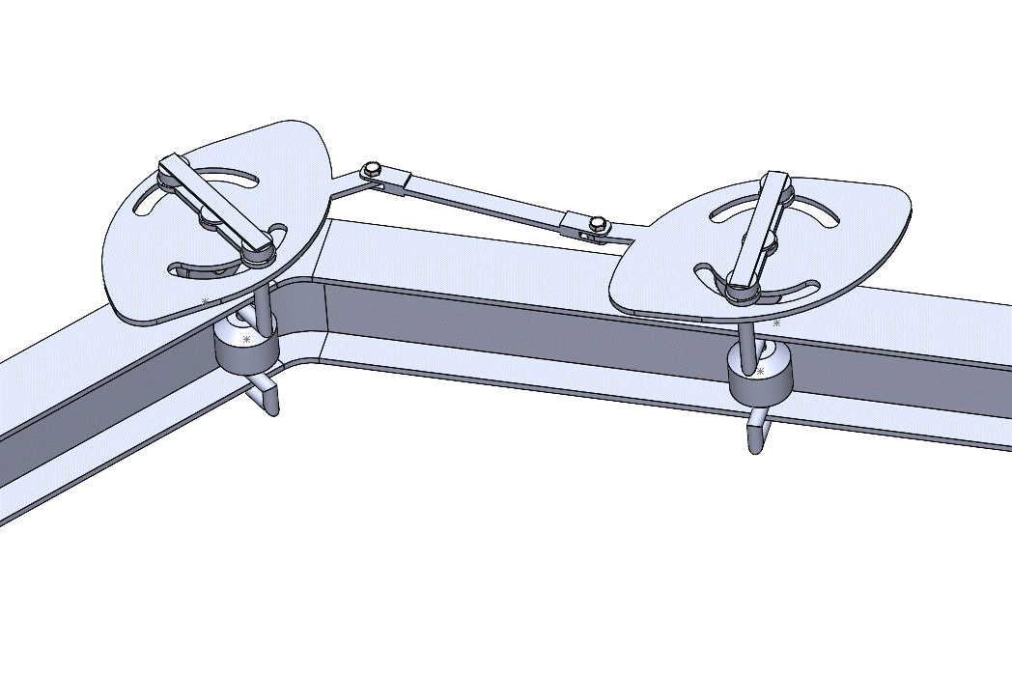
OPERATING PRINCIPLE
1
Corner Entry
2
Articulation
3
Guided Motion
Front bogie enters curve first and begins to pivot
Universal joint allows front to angle relative to rear
Guide rollers maintain contact with beam walls
4
Load Transfer
5
Rear Follow
6
Corner Exit
Central wheel continues to carry weight smoothly
Rear bogie follows the same path naturally
Bogies realign as trolley exits the curve

Slide 6
THREE-POINT CONTACT SYSTEM
Inspired by Woodpecker Router Circle Jig Design
2 GUIDE ROLLERS
1 CENTRAL LOAD WHEEL
• Mounted on sides
• Contact beam walls
• Provide lateral stability
• Prevent tilting/derailment
• 30-50mm diameter
• Polyurethane or nylon
• Carries 90% of weight
• Runs on beam bottom
• Larger diameter (80-120mm)
• V-groove or flanged profile
• Heavy-duty bearings
• Polyurethane tread

Slide 7
TECHNICAL SPECIFICATIONS
Wheelbase (L) | 220mm | Optimal for 100mm radius
Pivot Angle (max) | ±38° | At tightest corner
Minimum Corner Radius | 100mm | Navigable smoothly
Bogie Plate Length | 120-150mm | Per bogie assembly
Guide Roller Diameter | 40mm | Side contact wheels
Load Wheel Diameter | 100mm | Central bearing wheel
Guide Roller Spacing | 80-100mm | Matches beam width
U-Joint Travel | ±40° | With safety margin
Load Capacity | 150-200kg | Typical person + cargo

Slide 8
WHEELBASE CALCULATION
FORMULA
L_max = 2 × R × sin(θ/2)
Where: R = corner radius (100mm), θ = pivot angle
Wheelbase | Pivot Angle | Corner Performance | Status
180mm | 46° | Very tight, harsh | ⚠️
200mm | 41° | Good navigation | ✓
220mm | 38° | Smooth - OPTIMAL | ✓✓✓
250mm | 33° | Very smooth | ✓
300mm | 28° | Too gentle | ⚠️

Slide 9
GEOMETRIC ANALYSIS
For 220mm Wheelbase at 100mm Radius Corner:
CALCULATIONS
VERIFICATION
Chord length:
= 2 × 100 × sin(45°)
= 141.4mm
Required pivot angle:
sin(θ/2) = 141.4 / (2 × 220)
θ/2 = 18.8°
θ = 37.6° ≈ 38°
✓ Angle within U-joint capacity
(±40° available)
✓ No wheel interference
(280mm separation)
✓ Smooth transition
(progressive angle change)
✓ Stable on straights
(not too short)

Slide 10
COMPONENT DETAILS: BOGIE PLATE
SPECIFICATIONS
MATERIAL OPTIONS
Shape: Teardrop/Oval
Dimensions:
• Length: 120-150mm
• Width: 80-100mm
• Thickness: 10-15mm
Mounting Points:
• 2× guide roller holes (sides)
• 1× load wheel hole (center)
• 1× pivot connection (top)
Marine-Grade Aluminum
• 6061-T6 or 5083 alloy
• Lightweight (300-400g)
• Corrosion resistant
• Easy machining
Stainless Steel 304
• Maximum durability
• Heavier (800-1000g)
• Ultra-corrosion resistant
• Higher cost

Slide 11
COMPONENT DETAILS: UNIVERSAL JOINT
TYPE: CARDAN JOINT
ALTERNATIVE: BALL JOINT
Features:
• Double gimbal design
• ±40° articulation
• 20-30mm journal diameter
• Stainless steel 316
• Sealed & greased
• Load rating: 300kg+
Features:
• Spherical bearing
• Multi-directional
• Easier to achieve ±45°
• Similar to trailer hitch
• Self-aligning
• Good for prototyping

Slide 12
WHEELS & BEARING SPECIFICATIONS
Component | Size | Material | Bearing
Load Wheel | 100mm dia × 40mm | Polyurethane | Heavy-duty sealed
Guide Rollers | 40mm dia × 30mm | Nylon/Polyurethane | Sealed ball bearing
Load Wheel Hub | Steel/Aluminum | Anodized/Coated | IP67 rated
Wheel Profile | V-groove/Flanged | Custom machined | Precision fit
KEY DESIGN FEATURE: All bearings must be sealed (IP67) for mountain weather resistance

Slide 13
I-BEAM TRACK SYSTEM
MODULAR DESIGN
ADVANTAGES
Straight Sections:
• 2-4 meter lengths
• Box beam profile (100×50mm)
• Stainless steel 304
• Bolted flange connections
Corner Modules:
• Pre-fabricated 90° curves
• 100mm inner radius
• Reinforced at stress points
• Precision machined
✓ Easy transport up mountain
(short sections)
✓ On-site assembly
(bolted connections)
✓ Replaceable sections
(modular design)
✓ Adapts to terrain
(independent angles)
✓ Weather resistant
(stainless steel)

Slide 14
MATERIALS SELECTION
Optimized for Mountain Environment
Component | Material | Reason
Bogie Plates | Aluminum 6061-T6 | Lightweight, corrosion resistant
Universal Joint | Stainless 316 | Maximum corrosion resistance
Load Wheel Hub | Stainless 304 | Strength + corrosion resistance
Wheel Treads | Polyurethane | Grip, weather resistance, quiet
Guide Rollers | Nylon/Polyurethane | Low friction, self-lubricating
Bearings | Sealed SS bearings | IP67 rating, dirt/water proof
Fasteners | Stainless A4 | Won't rust, vibration resistant
Track Beam | Stainless 304 | Outdoor durability

Slide 15
MANUFACTURING & ASSEMBLY
FABRICATION
ASSEMBLY
QA/TESTING
• CNC machining
• Laser cutting
• Precision drilling
• Metal bending
• TIG welding
• Powder coating
• Install bearings
• Mount wheels
• Align bogies
• Install U-joint
• Adjust clearances
• Lubricate joints
• Wheel alignment
• Pivot angle test
• Load testing
• Corner navigation
• Bearing inspection
• Final adjustment

Slide 16
KEY ADVANTAGES
✓
Tight Radius
✓
Stable
Navigates 100mm radius - impossible with rigid bogie
3-point contact prevents tilting and derailment
✓
Weather Resistant
✓
Modular Track
Sealed bearings and stainless steel for mountain use
Easy transport and on-site assembly
✓
No Power Needed
✓
Simple Maintenance
Purely mechanical - works anywhere
Few moving parts, standard components

Slide 17
COMPARISON WITH ALTERNATIVES
Feature | This Design | Single Rigid Bogie | Cable Chain
Min. Radius | 100mm ✓ | >500mm ✗ | 75mm ✓
Complexity | Medium | Low | High
Maintenance | Low | Very Low | Medium
Cost | Medium | Low | High
Weather Resistance | Excellent ✓ | Good | Poor ✗
Load Capacity | High ✓ | High ✓ | N/A
Installation | Moderate | Easy | Complex

Slide 18
SIMILAR SYSTEMS IN USE
Railway Bogies
Curved Stairlifts
Train cars worldwide since 1874
Acorn, Stannah - residential/commercial
Overhead Cranes
Monorail Systems
Demag KBK - industrial material handling
Disney, airport transit systems
Mountain Funiculars
Theme Park Rides
Swiss Alps, ski resort transport
Roller coaster articulated trains

Slide 19
INSTALLATION CONSIDERATIONS
SITE PREPARATION
SAFETY FEATURES
Foundation:
• Concrete footings every 2-3m
• Level mounting surfaces
• Drainage considerations
Track Assembly:
• Start from bottom
• Work upward section by section
• Align corners precisely
• Torque all bolts to spec
Required:
• Mechanical brake system
• Anti-rollback ratchet/pawl
• Handrails on trolley platform
• Emergency stop capability
Recommended:
• Backup safety cable
• Load limiting mechanism
• Weather protection covers
• Regular inspection schedule

Slide 20
CONCLUSION
The articulated dual-bogie system provides an effective solution for
navigating tight 100mm radius corners on mountain stair tracks.
With proper materials selection, precision manufacturing, and
strategic IP protection, this design can successfully serve
manual mountain transportation needs.

