Slide 1
Ratchet and Pawl Mechanism
Design, Working Principle, and Applications

Slide 2
Table of Contents
1. Introduction to Ratchet Mechanism
2. Components and Construction
3. Working Principle
4. Types of Ratchet Mechanisms
5. Design Considerations
6. Applications in Industry
7. Advantages and Limitations
8. Future Developments

Slide 3
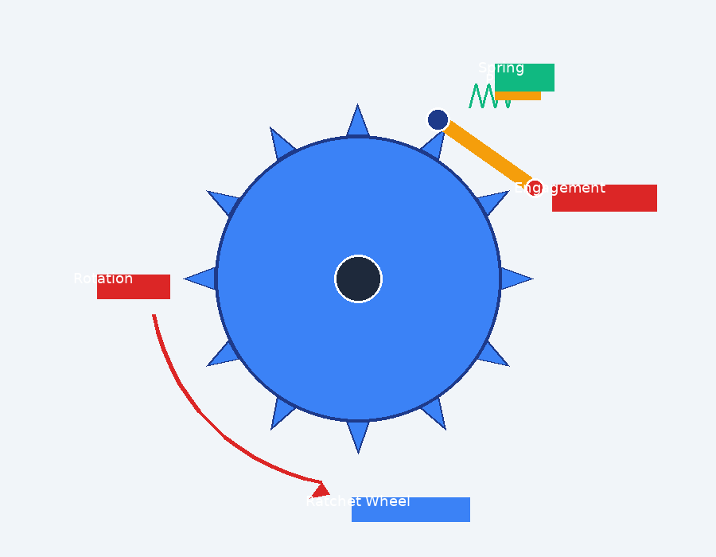
What is a Ratchet Mechanism?
A mechanical device that allows motion in one direction only
Consists of a toothed wheel (ratchet) and a pivoted catch (pawl)
Prevents backward motion through mechanical interference
Essential for unidirectional power transmission
Key Feature:
Allows rotation in one direction while preventing reverse motion through mechanical engagement between teeth and pawl.

Slide 4
History and Development
~1200s
Ancient Times
Used in medieval windmills and water wheels
1700s-1800s
Industrial Revolution
Refined for precision machinery and clocks
1900s
Modern Era
Precision ratchets in hand tools and mechanisms
2000s+
Contemporary
Advanced materials and micro-ratchets

Slide 5
Main Components
1
Ratchet Wheel
Hardened steel construction • Precision tooth geometry • Corrosion resistant finish
Toothed wheel with asymmetric teeth
2
Pawl
Spring-loaded design • Wear-resistant tip • Precise pivot point
Pivoted lever that engages teeth
3
Spring
Constant engagement force • Fatigue-resistant material • Adjustable tension
Maintains pawl engagement

Slide 6
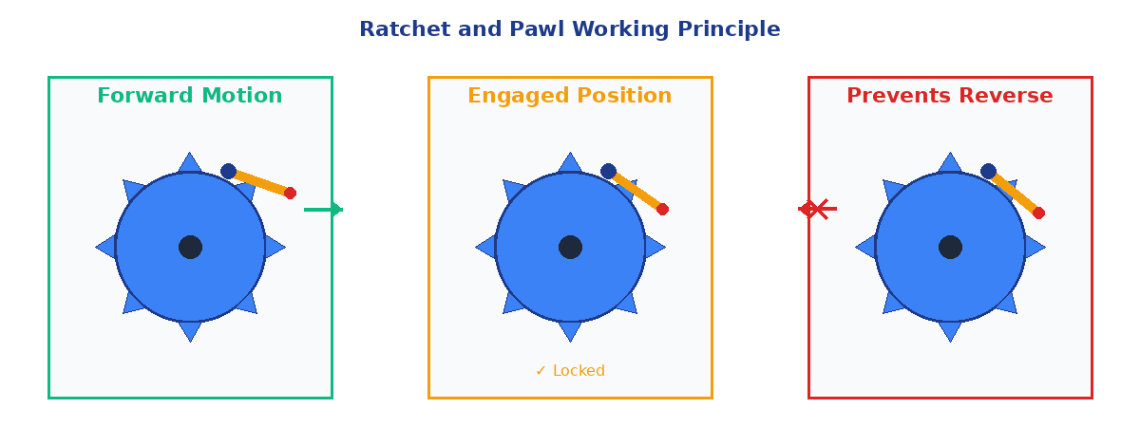
Working Principle
The pawl rides over teeth during forward rotation but engages to prevent reverse motion.

Slide 7
Operating Cycle
1
Forward Rotation
Ratchet wheel rotates in permitted direction
Pawl slides over sloped tooth faces
2
Pawl Engagement
Spring maintains contact with teeth
Pawl drops into tooth valley
3
Reverse Prevention
Pawl engages vertical tooth face
Mechanical lock prevents backward motion
4
Continuous Operation
Cycle repeats with each tooth
Incremental motion control achieved

Slide 8
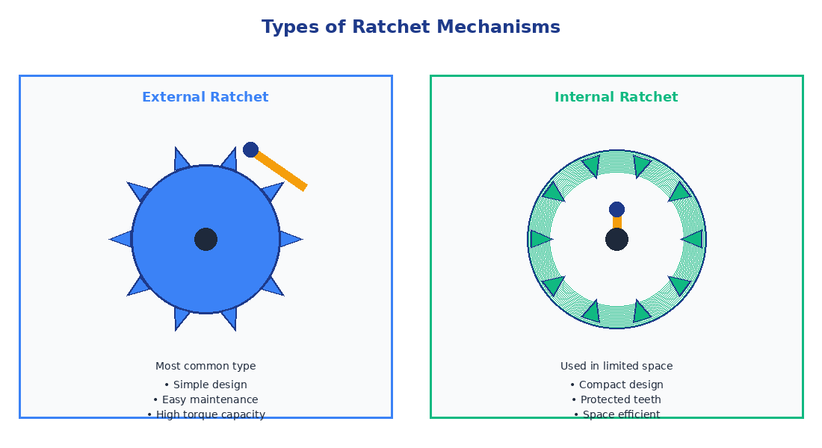
Types of Ratchet Mechanisms

Slide 9
External vs Internal Ratchets
Aspect | External Ratchet | Internal Ratchet
Design | Teeth on outer circumference | Teeth on inner circumference
Space | Requires more radial space | Compact, space-efficient
Strength | Higher torque capacity | Limited by ring thickness
Maintenance | Easy access for cleaning | Protected from debris
Applications | Winches, heavy machinery | Clocks, hand tools
Cost | Lower manufacturing cost | Higher precision required

Slide 10
Tooth Geometry and Design
Asymmetric tooth profile is critical for operation
Sloped face allows pawl to ride over during forward motion
Vertical face provides positive engagement for locking
Tooth pitch determines holding resolution
Material hardness affects wear resistance
Surface finish impacts noise and efficiency
Key Parameters:
• Pressure angle: 30-45°
• Tooth height: 0.3-0.5 × pitch
• Root radius: 0.2 × pitch
• Tip clearance: 0.1-0.15mm
• Hardness: 45-55 HRC

Slide 11
Materials and Manufacturing
Ratchet Wheel
Hardened Steel (SAE 4140)
Machining + Heat Treatment
Pawl
Tool Steel (D2, A2)
Precision Grinding
Spring
Spring Steel (AISI 1095)
Heat Treatment + Tempering
Housing
Cast Iron / Aluminum
Casting + Machining
Surface treatments: Nitriding, Carburizing, or Chrome Plating for enhanced wear resistance

Slide 12
Design Considerations
Load Capacity
Engagement
Reliability
Tooth strength analysis
Contact stress calculation
Factor of safety: 2-3
Peak vs continuous load
Spring force selection
Pawl pivot design
Engagement angle
Backlash control
Wear resistance
Fatigue life prediction
Lubrication strategy
Failure mode analysis

Slide 13
Applications
Practical Uses in Industry

Slide 14
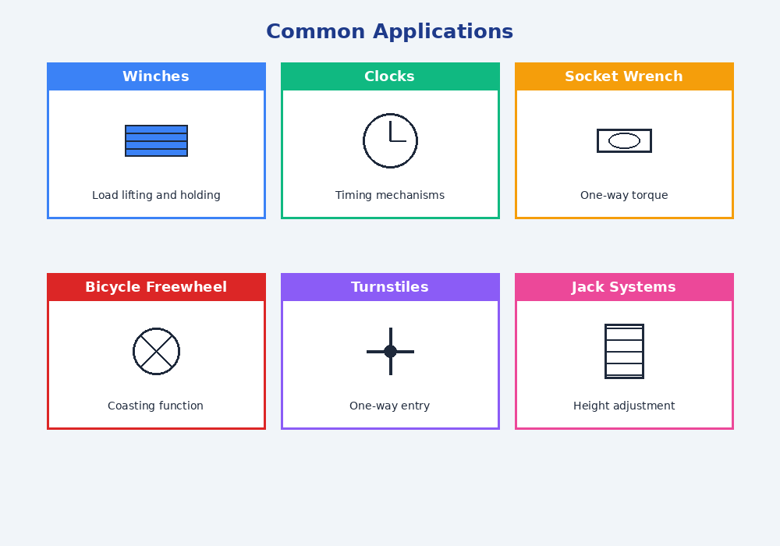
Common Applications

Slide 15
Application: Socket Wrenches
Allows continuous rotation in tightening direction
Small arc of motion required (5-10 degrees)
Reversible mechanism for loosening
Fine tooth pitch (36-72 teeth) for tight spaces
Quick release mechanism for socket changes
Advantages:
Faster than standard wrenches
Works in confined spaces
Reduces operator fatigue
Consistent torque application
Durable and reliable

Slide 16
Application: Winches and Hoists
Critical safety component in lifting equipment
Prevents load from dropping when handle released
Multiple pawls for redundancy in heavy-duty applications
Must withstand shock loads and vibration
Regular inspection required for safety compliance
Safety Critical
Types of Winches:
• Hand-operated winches
• Electric winches
• Hydraulic systems
• Marine applications

Slide 17
Application: Clock and Watch Mechanisms
Prevents mainspring from unwinding during winding
Ensures precise timekeeping through controlled energy release
Micro-ratchets with extremely fine tooth pitch
Precision manufacturing to minimize backlash
Often combined with click spring for audible feedback
Precision Requirements:
Tolerances in micrometers • Surface finish Ra < 0.2μm • Tooth error < 5 arc seconds

Slide 18
Application: Bicycle Freewheel
Function:
Allows wheel to rotate freely when pedaling stops (coasting)
Design:
Multiple pawls (2-6) for redundancy and smooth engagement
Engagement:
Rapid pickup when pedaling resumes (within 5-10 degrees)
Noise:
Characteristic clicking sound from pawl engagement
Maintenance:
Requires periodic lubrication and cleaning

Slide 19
Application: Industrial Machinery
Conveyor Systems
Position locking and indexing
Press Machines
Height adjustment and safety lock
Machine Tools
Feed mechanisms and positioning
Printing Presses
Paper feed control
Textile Machinery
Fabric tension control
Packaging Equipment
Product positioning

Slide 20
Additional Applications
Automotive parking brake systems
Adjustable furniture (reclining chairs, hospital beds)
Cable ties and zip ties
Measuring tapes with lock mechanisms
Seatbelt retractors
Fishing reels (anti-reverse)
Turnstiles and gates
Pipe wrenches
Cable pullers
Jacks and lifting devices

Slide 21
Advantages of Ratchet Mechanisms
✓
Simple Design
✓
Reliable Operation
Few moving parts, easy to manufacture and maintain
Mechanical engagement provides positive locking
✓
No Power Required
✓
Compact
Passive mechanism, works without external energy
Small size relative to load capacity
✓
Cost Effective
✓
Immediate Engagement
Low manufacturing and maintenance costs
Instant locking with minimal backlash

Slide 22
Limitations and Challenges
Wear and Tear
Tooth surfaces subject to impact and sliding wear
→ Use hardened materials, regular inspection
Backlash
Small amount of free play between teeth
→ Fine tooth pitch, precision manufacturing
Noise
Clicking sound during operation
→ Rubber dampers, optimized tooth geometry
One-Way Motion
Reversing requires disengaging mechanism
→ Reversible designs with selector switch
Load Concentration
High stress on engaged tooth
→ Multiple pawls, wider teeth

Slide 23
Maintenance and Care
Regular inspection of tooth wear patterns
Cleaning to remove dirt and debris
Appropriate lubrication (light oil for most applications)
Spring tension verification
Pawl pivot point inspection
Replacement when teeth show significant wear
Sound testing for unusual noises
Functional testing under load
Inspection Schedule
Daily: Visual check
Weekly: Function test
Monthly: Cleaning
Quarterly: Lubrication
Annually: Complete inspection

Slide 24
Testing and Quality Control
Dimensional Inspection
CMM, optical measurement
Hardness Testing
Rockwell, Vickers testing
Load Testing
Static and dynamic load application
Endurance Testing
Cyclic operation to failure
Noise Level Testing
Acoustic measurement
Engagement Testing
Backlash and pickup angle measurement

Slide 25
Modern Innovations
Advanced Materials
Micro-Ratchets
Ceramic composites, carbon fiber reinforced polymers
MEMS-scale devices for medical and electronic applications
Silent Operation
Smart Ratchets
Rubber-coated pawls, optimized tooth profiles
Sensors for wear detection and predictive maintenance
3D Printed Prototypes
Magnetic Ratchets
Rapid prototyping and custom designs
Non-contact designs using magnetic forces

Slide 26
Future Trends and Developments
Integration with IoT for condition monitoring
Self-lubricating materials for maintenance-free operation
Biomimetic designs inspired by nature
Variable engagement mechanisms for adjustable locking
Nano-scale ratchets for molecular machines
Adaptive systems with automatic wear compensation
Hybrid electric-mechanical ratchets
Augmented reality for maintenance and training

Slide 27
Design and Analysis Software
CAD Software
SolidWorks, CATIA, Inventor, Fusion 360
FEA Analysis
ANSYS, Abaqus, COMSOL Multiphysics
Motion Simulation
ADAMS, RecurDyn, MapleSim
Optimization
MATLAB, OptiStruct, modeFRONTIER

Slide 28
Safety Considerations
Regular inspection programs for critical applications
Load capacity clearly marked and never exceeded
Backup systems for safety-critical applications
Proper training for operators and maintenance personnel
Use of appropriate personal protective equipment
Compliance with relevant safety standards (OSHA, ANSI)
Documentation of maintenance and inspection history
Immediate replacement of worn components
⚠
Critical Safety Item
Never bypass or disable ratchet mechanisms in lifting or load-holding applications

Slide 29
Key Takeaways
1
Ratchet and pawl provides simple, reliable one-way motion control
2
Wide range of applications from hand tools to industrial machinery
3
Proper material selection and maintenance critical for longevity
4
Safety-critical component in lifting and load-holding applications
5
Continuous innovation with new materials and smart features

Slide 30
Thank You
Ratchet and Pawl Mechanism

