Slide 1
Skill Matrix For Employees Harvey Balls Diagram
 | Skills
 | Project Management | Writing | Public Speaking | Project Development | Accounting | Recruitment | Counseling
Team Member A
Team Member B
Team Member C
Team Member D
Team Member E
Team Member F
Team Member G
Team Member H
No Competence
Low Competence
Some Competence
High Competence
Expert
This slide is 100% editable. Adapt it to your needs and capture your audience's attention.

Slide 2
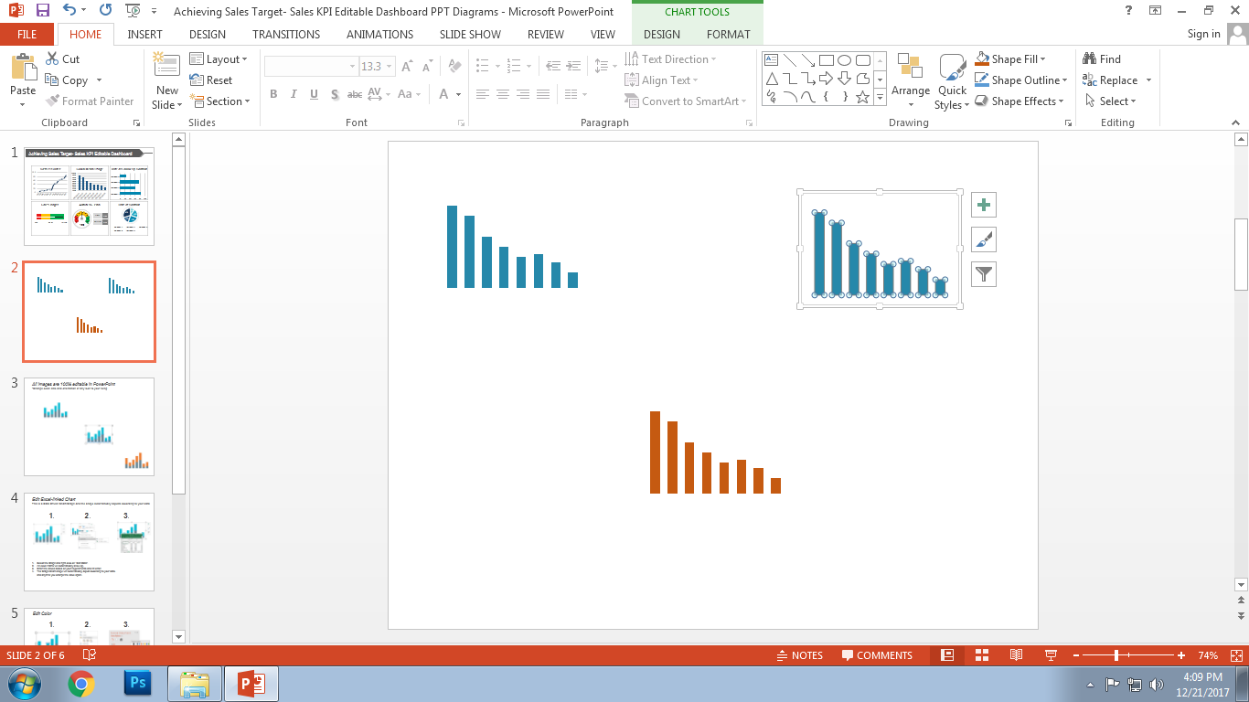
All images are 100% editable in PowerPoint
“Change color, size and orientation of any icon to your liking”

Slide 3
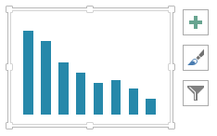
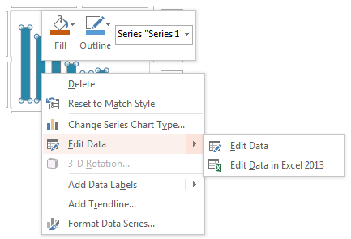
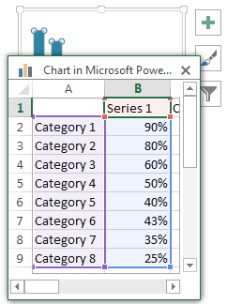
Edit Excel-linked Chart
This is a Data Driven Chart/Graph and the shape automatically adjusts according to your data
1
2
3
Select the Graph and right click on "Edit Data“.
An excel matrix will automatically show up.
Enter the values based on your requirements and hit enter.
The Graph/Chart shape will automatically adjust according to your data, and anytime you change the value again.

Slide 4
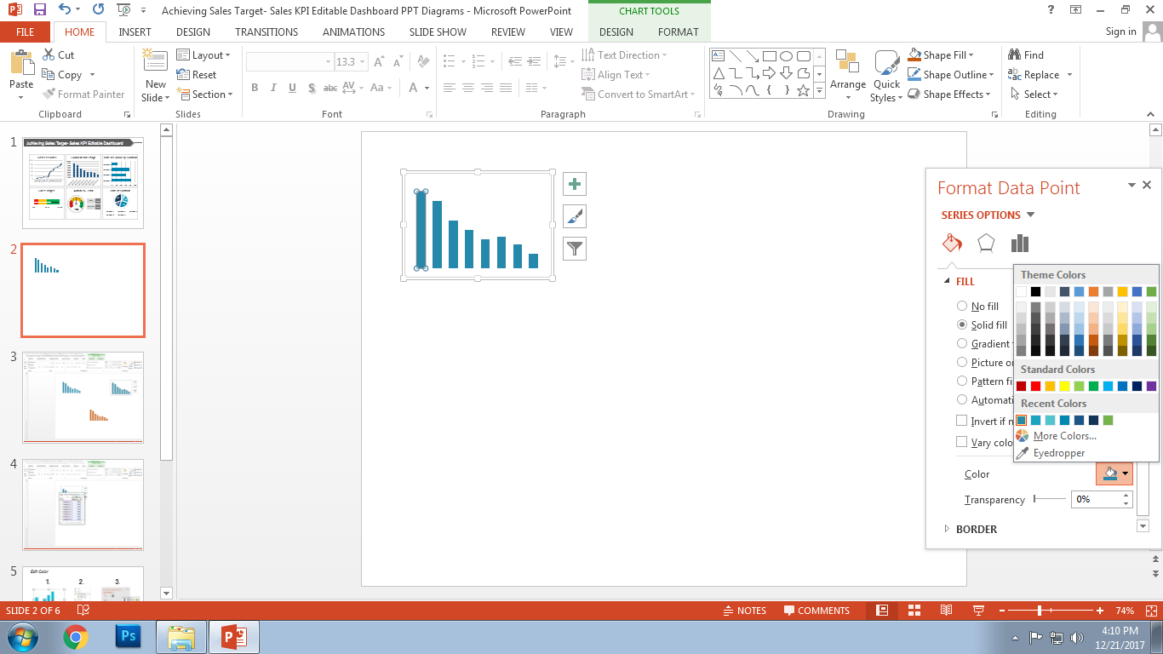
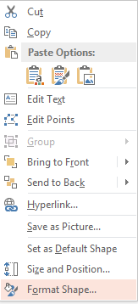
Edit Color
1
2
3
Select the shape to change the color and Right click the object (click any object which you want to change color)
Choose Format Data Series in the dialog box.
Choose “Fill” in the Format Shape box then “Solid” or “Gradient” depending on the appearance of the object. Change colour as shown in the picture.

Slide 5
Select From Thousands Of Editable Icons On Every Topic
These icons are available at the Icons section on www.slideteam.net

