Slide 1


CUSTOMER SEGMENTATION
USING K-MEANS
BY – ANSHU RAJ
EMAIL- 2018UMT1807@MNIT.AC,IN

Slide 2
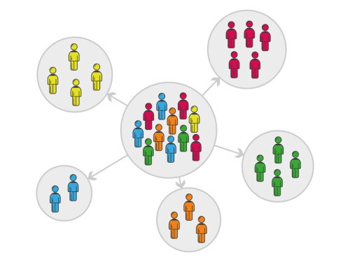
WHAT IS CUSTOMER SEGMENTATION?
Customer Segmentation is a popular application of unsupervised learning. Using clustering, identify segments of customers to target the potential user base. They divide customers into groups according to common characteristics like gender, age, interests, and spending habits so they can market to each group effectively. This illustrates how firms can construct novel and inventive approaches that provide great value.

Slide 3
DATASET DESCRIPTION
Data was provided by the Exposys Data Labs and can be downloaded using following URL.
The dataset contains 5 columns:
‘Customer Id’, ‘Gender’, ‘Age’, ‘Annual Income (k$)’, ‘Spending Score (1-100)’
URL - https://drive.google.com/file/d/19BOhwz52NUY3dg8XErVYglctpr5sjTy4

Slide 4
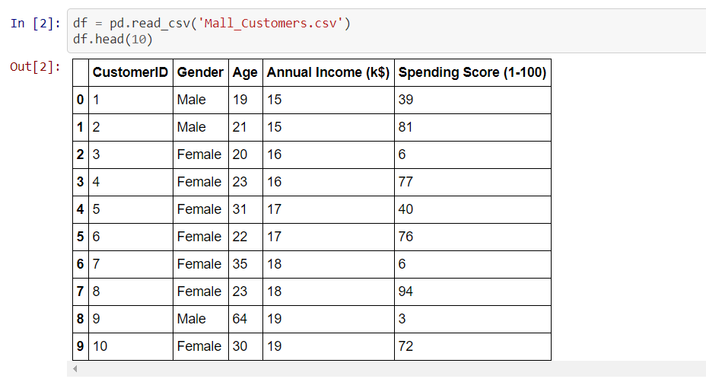
The dataset looks like this.

Slide 5
PURPOSE:
The purpose of this project is to build a clustering model for customer segmentation of mall customers so that a proper business model can be adopted to maximise sale in the mall.
OBJECTIVES:
The objectives of this course are as follows:
Implementing Clustering Algorithms to group the customers of a mall in customer dataset.
Identify the potential customer base for selling the product.

Slide 6
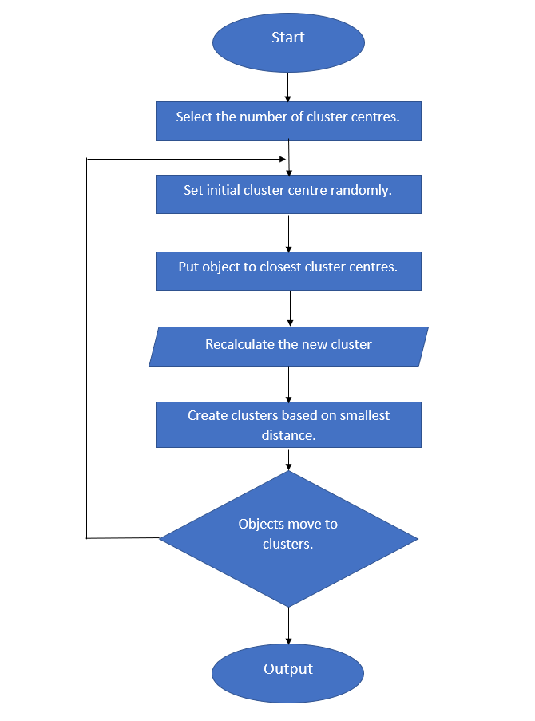
K – MEANS CLUSTERING ALGORITHMS:

Slide 7
Methodology
Jupyter notebook was used in this project to write the code and do the visualizations.
Following libraries were used in this project:
Pandas (version – 1.2.4)
Numpy (version – 1.20.3)
Matplotlib (version – 3.4.2)
Scikit-Learn (version – 0.24.2)
Seaborn (version – 0.11.1)

Slide 8
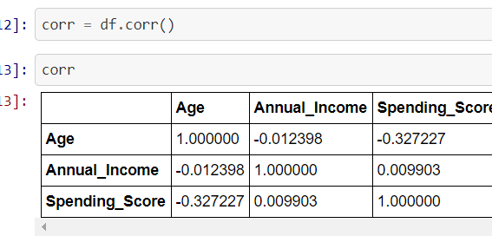
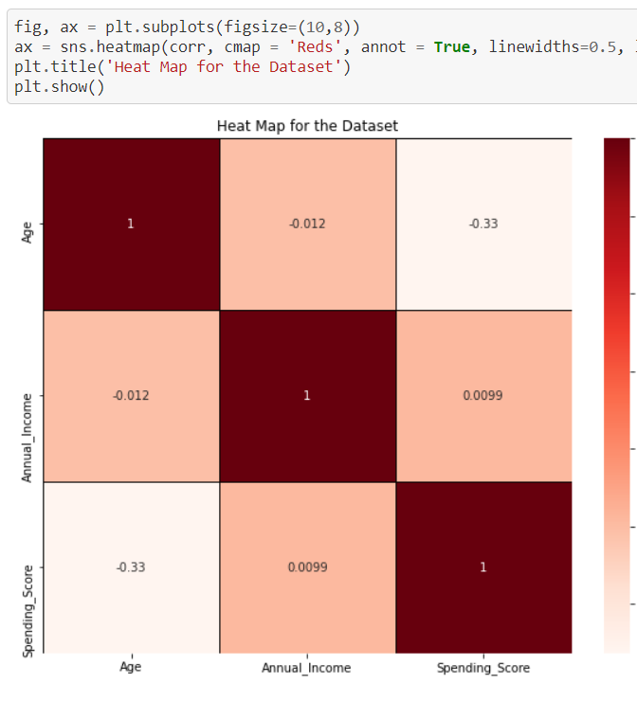
Exploratory Data Analysis
It is always good to check the correleation between the features of the datset.

Slide 9
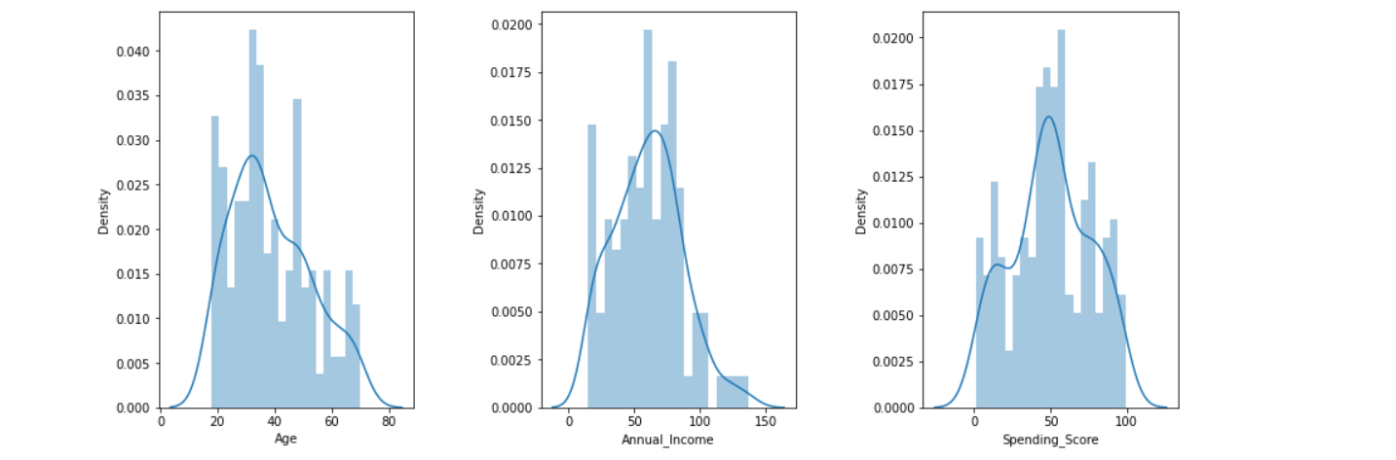
Next, let us visualize the data through distplot to get the sense of data distribution.
From the plots we can see that distribution of these values resembles a gaussian distribution, where the vast majority of the values lay in the middle with some exception in the extremes.

Slide 10
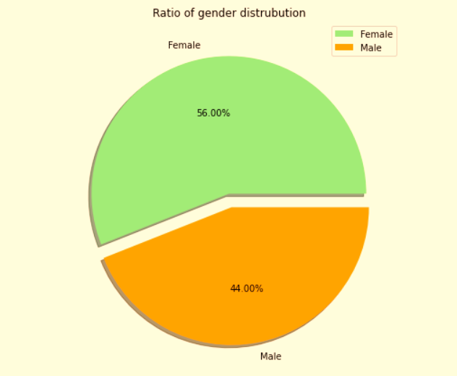
Gender Distribution

Slide 11
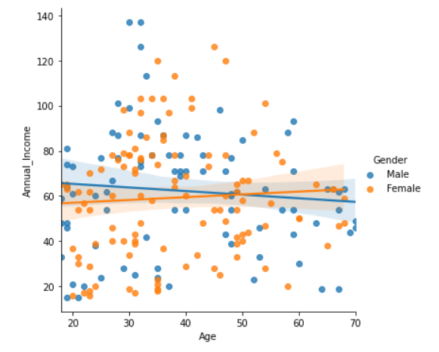
AGE AND ANNUAL INCOME

Slide 12
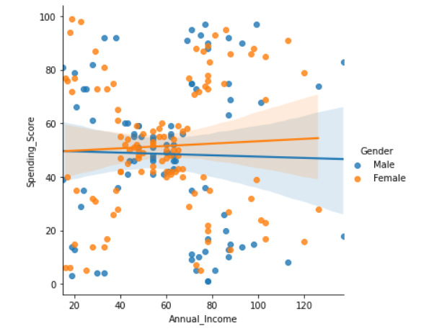
SPENDING SCORE AND ANNUAL INCOME

Slide 13
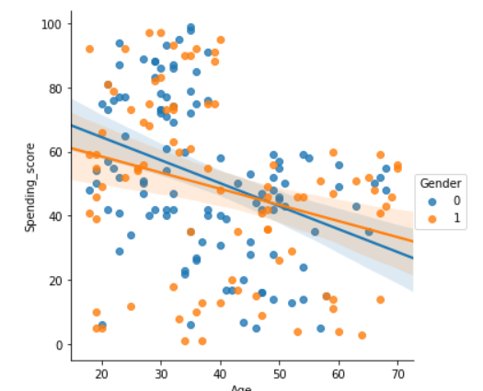
AGE AND SPENDING SCORE

Slide 14
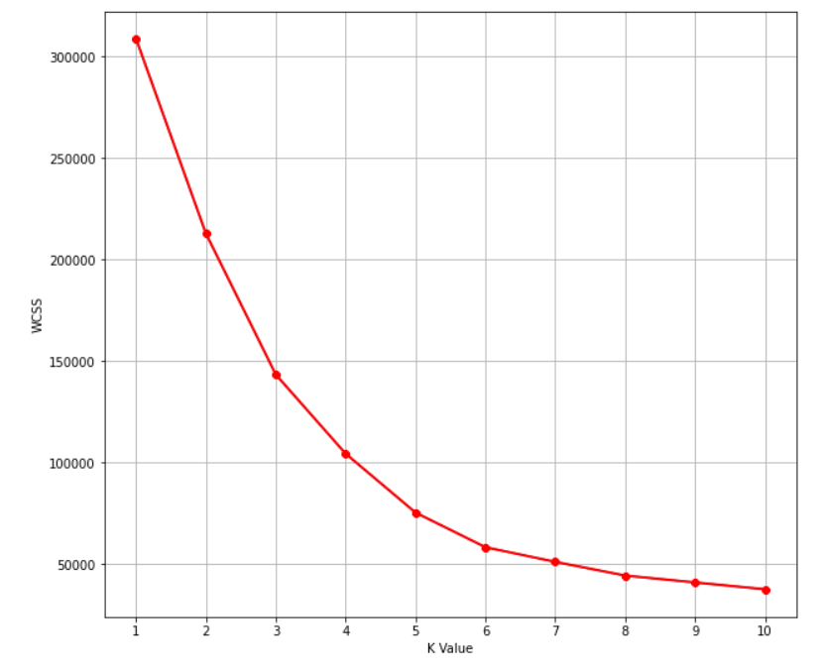
IMPLEMENTATION
THE ELBOW METHOD:

Slide 15
CLUSTERING:
In the process of clustering, we did not consider the gender factor anymore. The first main reason of why we did take this approach is because the difference between male and female in this data is not particularly high and making a gender differentiation won't provide any further information.

Slide 16
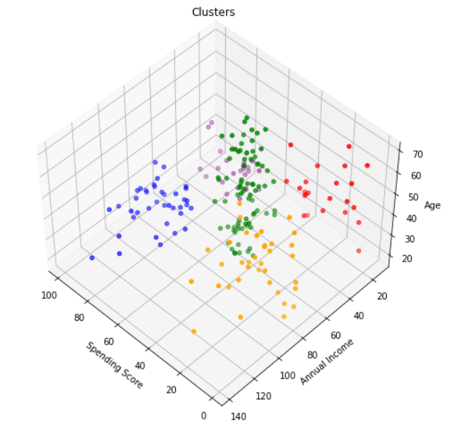
RESULT:
PURPLE CLUSTER
BLUE CLUSTER
GREEN CLUSTER
ORANGE CLUSTER
RED CLUSTER

Slide 17
CONCLUSION:
K-Means Clustering is a powerful technique in order to achieve a decent customer segmentation.
Customer segmentation is a good way to understand the behaviour of different customers and plan a good marketing strategy accordingly.
There is not a much difference between the spending score of men and women.
Observing the clustering plot, it can be clearly observed that the ones who spend more money in malls are young people(purple and blue cluster). They are the main target when it comes to marketing.
Although young people seem to be the ones spending the most, we can't forget there are more people we have to consider, like people who belong to the pink cluster, they are what we would commonly name after "middle class" and it seems to be the biggest cluster.

