Slide 1

Credit Card Consumption Prediction
BY – BIPIN KUMAR
EMAIL- Bipin07bn@gmail.com

Slide 2
PROBLEM STATEMENT
A regression problem where you need to predict the average spend of customers for the next 3 months.
Target Variable :
cc cons(Average Credit Card Spend in next three months)

Slide 3
01
Data Wrangling
Cleaning the raw data and making it useful for further analysis.
02
Data Exploration
Gaining insights from the data to find correlated features.
03
ML Model Implementation & Selection
Trying different ML models & selecting the best performing model.
04
Approach
Implementation on Data
Understanding the Best Model to Implement on the Test Data

Slide 4
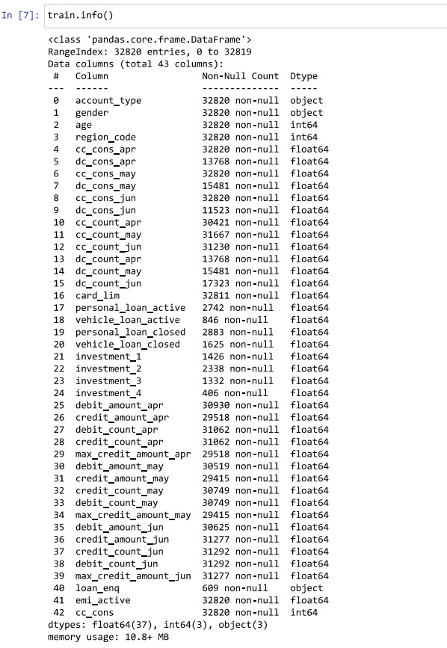
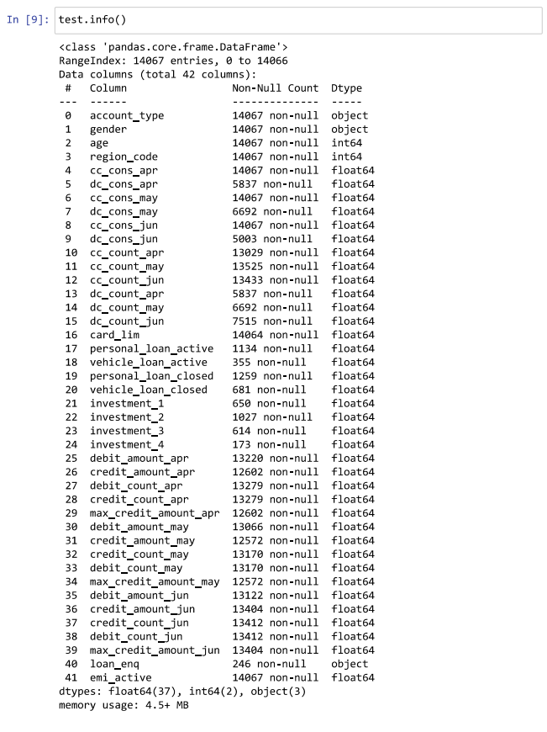
Structure of the Dataset
Training Data: (32820, 43)
Test Data: (14067, 42)

Slide 5
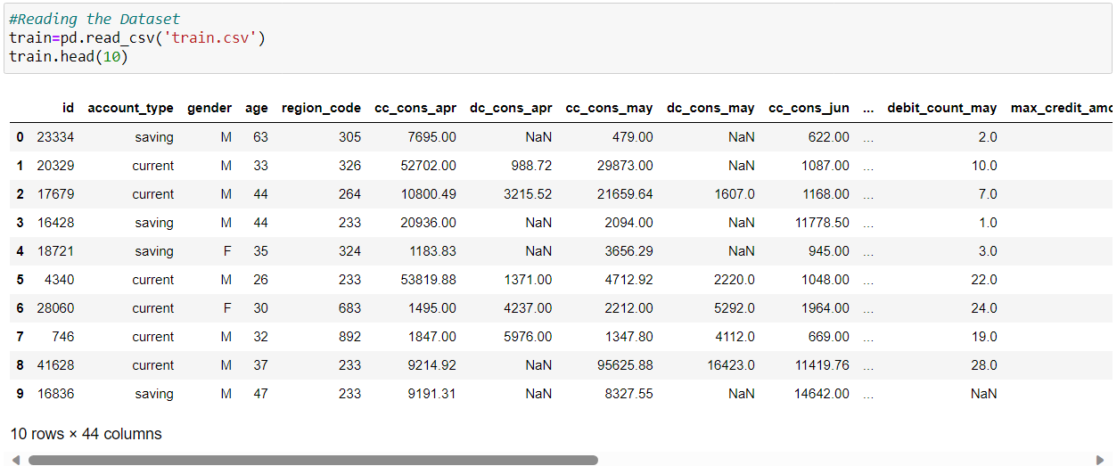
The dataset looks like this.

Slide 6
Attributes of the Dataset
(Target) Average Credit Card Spend in next three months
User ID
Unique id for each row.
Active emi
Account type
Loan enquiry
Account Type – current or saving
Maximum amount credited
Total amount credited
gender
Total amount debited
Gender of customer
Total investment
closed loan
Active loan
age
Age of customer
Maximum Credit Card Limit
Number of debit card transactions
region_code
Code assigned to region of residence
Number of credit card transactions
Credit card spend
Debit card
spend

Slide 7
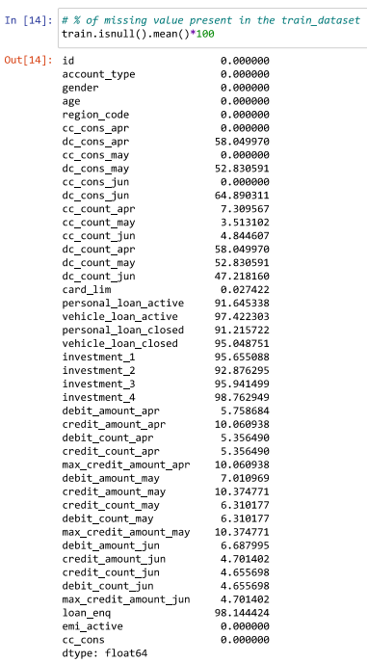
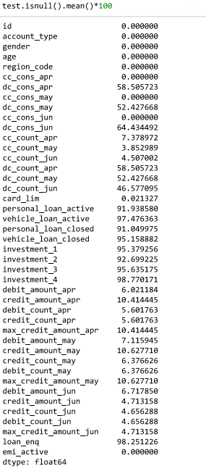
Data Wrangling
Cleaning the raw data and making it useful for further analysis.
Training Data
Test Data
Some columns have more than 50% to 90% Missing Value in the both training and testing Dataset

Slide 8
Combine Investments
Since individual investment
columns have a high percentage
of null values, consider
combining them to reduce null values.
Combine Loans
Similar to investments, combine both active and closed loans to reduce null values.

Slide 9
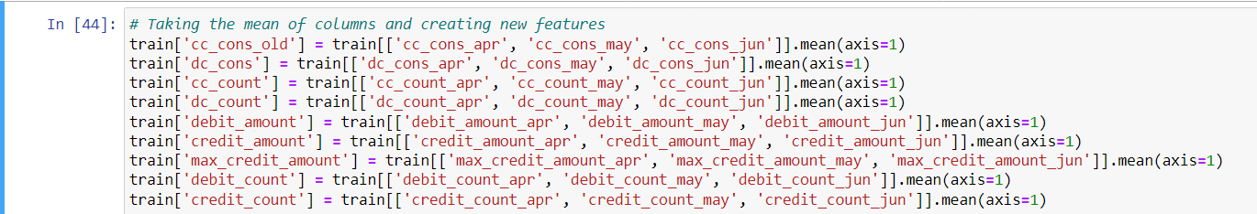
Aggregate Credit and Debit Card Features
Features related to credit and debit card consumption, counts, amounts, and maximum credit amount for different months have a high percentage of null values. Create new features by taking the mean of these values for all three individual months in both training and testing dataset.
By above these feature engineering steps, I aim to reduce the impact of null values and potentially create more informative features for your modeling task.

Slide 10
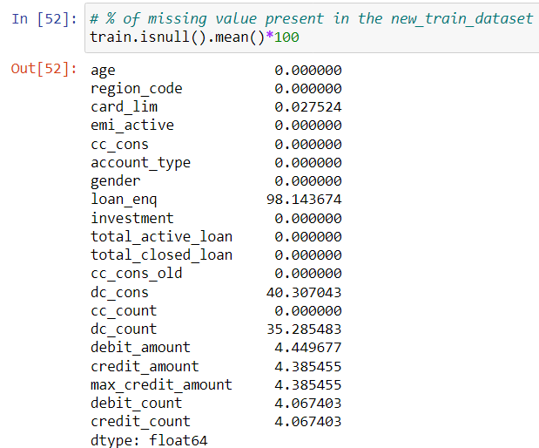
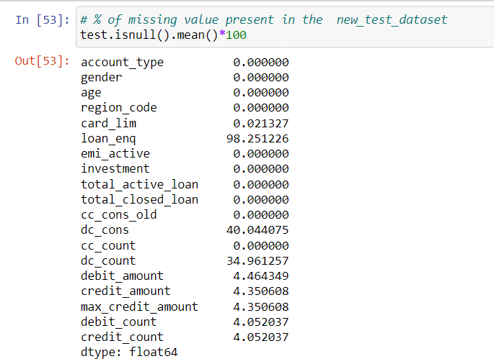
Percentage of missing value present in the new dataset
Loan Enquiry has still got 98% Null values in both test and train dataset.

Slide 11
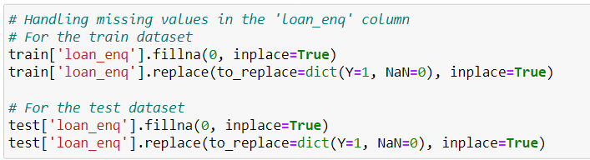
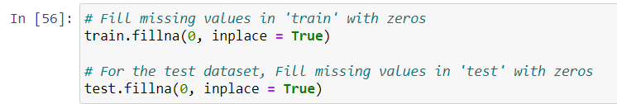
Replace Y with 1 and Nan with zero in Loan Enquiry .
After that identify columns with missing values and fill with zero.

Slide 12
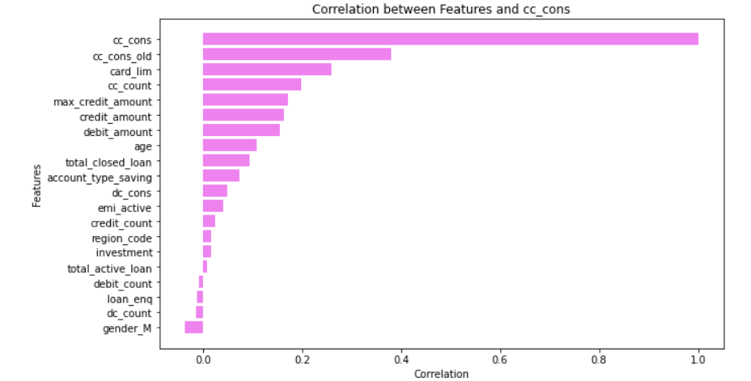
Exploratory Data Analysis
Correlation Matrix

Slide 13
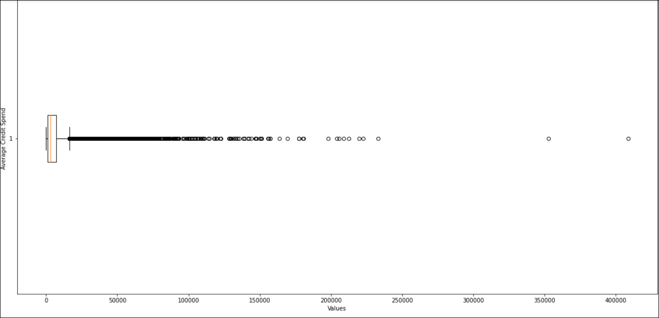

Exploratory Data Analysis
Outliers present in Data
we can observe that the consumption is not normally distributed. From the boxplot we can observe that the dataset has too many outliers. So lets try removing the outliers from the data
There are only 96 rows with value more than 100000 so drop these outliers

Slide 14
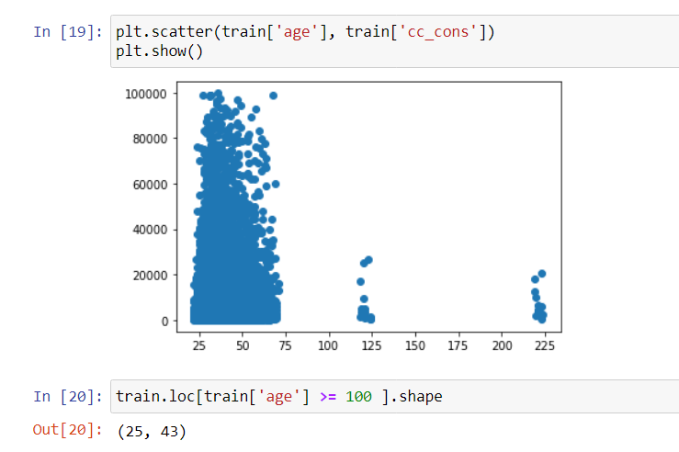
Exploratory Data Analysis
Outliers present in Data
There are only 25 rows with age more than 100 and also it is unreal so drop these outliers

Slide 15
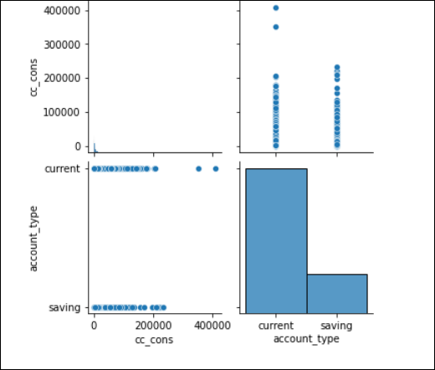
Exploratory Data Analysis
CC Consumptions and Account Type

Slide 16
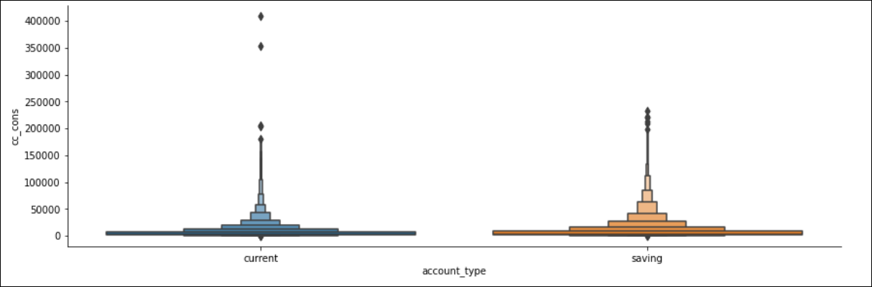
Exploratory Data Analysis
Mostly Happens in Current Account Type

Slide 17
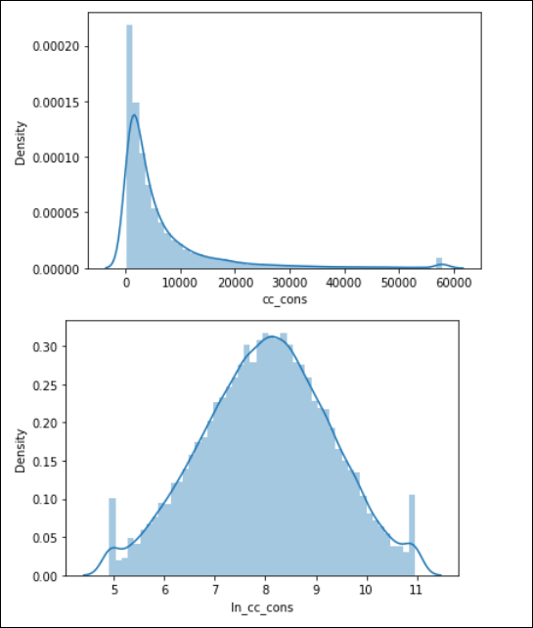
Exploratory Data Analysis
Credit Card Consumption is changed to Log Function Transformation

Slide 18
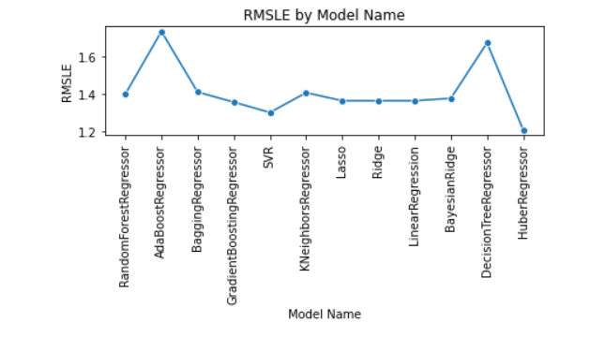
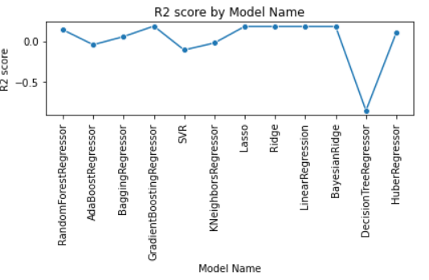
ML Model Implementation & Selection
Trying different ML models & selecting the best performing model.

Slide 19
Approached Models and Evaluation Scores
HUBER REGRESSION
Huber regression is a linear regression technique that uses a modified loss function to balance robustness against outliers and efficiency in parameter estimation. It iteratively adjusts model parameters to minimize the Huber loss and provides a linear model for predicting the target variable based on input features.
RMLSE using Huber Regression : 1.214381
R2 using Huber Regression : 0.105568

