Slide 1
AVR Family of Micro-Controllers
Developed by
Alf-Egil Bogen Vegard Wollan

Slide 2
What is AVR ?
Modified Harvard architecture 8-bit RISC single chip microcontroller
Complete System-on-a-chip
On Board Memory (FLASH, SRAM & EEPROM)
On Board Peripherals
Advanced (for 8 bit processors) technology
Developed by Atmel in 1996
First In-house CPU design by Atmel

Slide 3
AVR Family
8 Bit tinyAVR
Small package – as small as 6 pins
8 Bit megaAVR
Wide variety of configurations and packages
8 / 16 Bit AVR XMEGA
Second Generation Technology
32 Bit AVR UC3
Higher computational throughput

Slide 4
Presentation Overview
Processor core
Peripherals
Hardware Example – Polulu 3pi robot
Development Environments
Software Example - PID algorithm walkthrough

Slide 5
Processor Core
What is Harvard Architecture?
Before we can answer that…

Slide 6
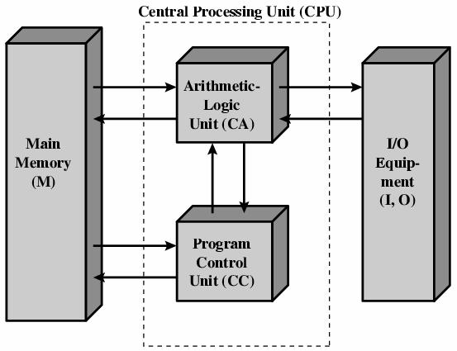
Von Neumann Model for Stored Program Computers

Slide 7
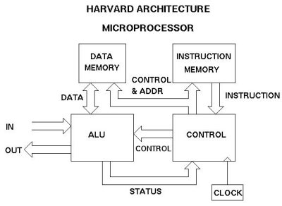
Harvard Architecture

Slide 8
Harvard Architecture Advantages
Separate instruction and data paths
Simultaneous accesses to instructions & data
Hardware can be optimized for access type and bus width.

Slide 9
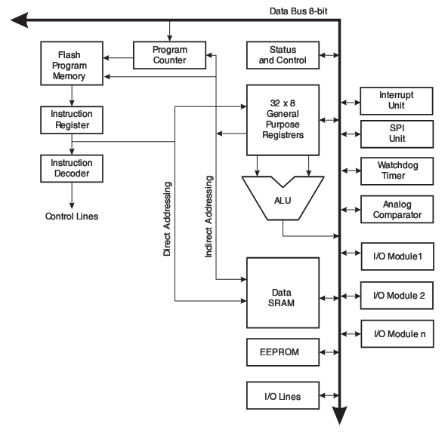
AVR Architecture

Slide 10
Modified Harvard Architecture
Special instructions can access data from program space.
Data memory is more expensive than program memory
Don’t waste data memory for non-volatile data

Slide 11
What is RISC?
Reduced Instruction Set Computer
As compared to Complex Instruction Set Computers, i.e. x86
Assumption: Simpler instructions execute faster
Optimized most used instructions
Other RISC machines: ARM, PowerPC, SPARC
Became popular in mid 1990s

Slide 12
Characteristics of RISC Processors
Faster clock rates
Single cycle instructions (20 MIPS @ 20 MHz)
Better compiler optimization
Typically no divide instruction in core

Slide 13
AVR Register File
32 8 Bit registers
Mapped to address 0-31 in data space
Most instructions can access any register and complete in one cycle
Last 3 register pairs can be used as 3 16 bit index registers
32 bit stack pointer

Slide 14
Register File
7
0
addr
R0
0x00
R1
0x01
R3
0x02
R4
0x03
R5
0x04
R6
0x05
•••
R26
0x1A
x register low byte
R27
0x1B
x register high byte
R28
0x1C
y register low byte
R29
0x1D
y register high byte
R30
0x1E
z register low byte
R31
0x1F
z register high byte

Slide 15
AVR Memory FLASH
Non-volatile program space storage
16 Bit width
Some devices have separate lockable boot section
At least 10,000 write/erase cycles

Slide 16
AVR Memories FLASH – Memory Map
ATmega 48
ATmega 88/168/328
0x000
0x000
Application Flash
Application Flash
0x1FFF
Boot Flash
0x3FFF
0x7FF
0x7FFF

Slide 17
AVR Memories SRAM
Data space storage
8 Bit width

Slide 18
AVR Memories SRAM - Memory Map
32 Registers
0x0000 – 0x001F
64 I/O Registers
0x0020 – 0x005F
160 External I/O Reg
0x00060– 0x00FF
Internal SRAM
(512/1024/2048x8)
0x0100
0x04FF/0x6FF/0x8FF
External SRAM

Slide 19
AVR Memories EEPROM
Electrically Erasable Programmable Read Only Memory
8 bit width
Requires special write sequence
Non-volatile storage for program specific data, constants, etc.
At least 100,000 write/erase cycles

Slide 20
AVR Memories
DEVICE | FLASH | EEPROM | SRAM
ATmega48A | 4K Bytes | 256 Bytes | 512 Bytes
ATmega48PA | 4K Bytes | 256 Bytes | 512 Bytes
ATmega88A | 8K Bytes | 512 Bytes | 1K Bytes
ATmega88PA | 8K Bytes | 512 Bytes | 1K Bytes
ATmega168A | 16K Bytes | 512 Bytes | 1K Bytes
ATmega168PA | 16K Bytes | 512 Bytes | 1K Bytes
ATmega328 | 32K Bytes | 1K Bytes | 2K Bytes
ATmega328P | 32K Bytes | 1K Bytes | 2K Bytes

Slide 21
Memory Mapped I/O Space
I/O registers visible in data space
I/O can be accessed using same instructions as data
Compilers can treat I/O space as data access
Bit manipulation instructions
Set/Clear single I/O bits
Only work on lower memory addresses

Slide 22
ALU – Arithmetic Logic Unit
Directly connected to all 32 general purpose registers
Operations between registers executed within a single clock cycle
Supports arithmetic, logic and bit functions
On-chip 2-cycle Multiplier

Slide 23
Instruction Set
131 instructions
Arithmetic & Logic
Branch
Bit set/clear/test
Data transfer
MCU control

Slide 24
Instruction Timing
Register ↔ register in 1 cycle
Register ↔ memory in 2 cycles
Branch instruction 1-2 cycles
Subroutine call & return 3-5 cycles
Some operations may take longer for external memory

Slide 25
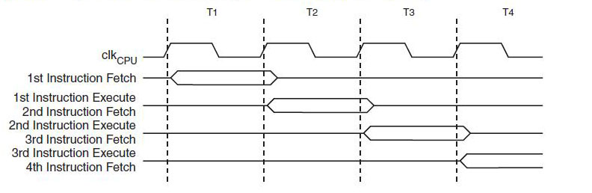
2-Stage Pipelined Execution

Slide 26
AVR Clock System
Clock control module generates clocks for memory and IO devices
Multiple internal clock sources
Provisions for external crystal clock source (max 20 MHz)
Default is internal RC 8 MHz oscillator with ÷ 8 prescale yielding 1 MHz CPU clock
Default is only 5-10% accurate

Slide 27
Clock Sources
Timer/Counter
Oscillator
Timer/
Counters
IO Modules
Crystal Oscillator
AVR
Clock
Control
ADC
External Clock
Clock
Mux
System Clock Prescaler
CPU Core
Low Freq Crystal Oscillator
÷ 8
RAM
Calibrated RC Oscillator
FLASH & EEPROM

Slide 28
Power Management
Multiple power down modes
Power down mode
Wake on external reset or watchdog reset
Power save mode
Wake on timer events
Several standby modes
Unused modules can be shut down

Slide 29
Reset Sources
Power on reset
External reset
Watchdog system reset
Brown out detect (BOD) reset

Slide 30
Interrupts
ATmega328 has 26 reset/interrupt sources
1 Reset source
2 External interrupt sources
I/O Pin state change on all 24 GPIO pins
Peripheral device events

Slide 31
Interrupt Vectors
Each vector is a 2 word jump instruction
Vectors start at program memory address 0
Reset vector is at address 0
Sample vector table:
Address Labels Code Comments
0x0000 jmp RESET ; Reset Handler
0x0002 jmp EXT_INT0 ; IRQ0 Handler
0x0004 jmp EXT_INT1 ; IRQ1 Handler
0x0006 jmp PCINT0 ; PCINT0 Handler
0x0008 jmp PCINT1 ; PCINT1 Handler
...

Slide 32
Fuses
Fuses configure system parameters
Clock selection and options
Boot options
Some IO pin configurations
Reset options
Three 8 bit fuse registers
Use caution! Some configurations can put the device in an unusable state!

Slide 33
ATmega Peripherals
23 General Purpose IO Bits
Two 8 bit & one 16 bit timer/counters
Real time counter with separate oscillator
6 PWM Channels
6 or 8 ADC channels (depends on package)
Serial USART
SPI & I²C Serial Interfaces
Analog comparator
Programmable watchdog timer

Slide 34
General Purpose IO Ports
Four 8 Bit IO Ports
Port A, Port B, Port C & Port D
Pins identified as PAx, PBx, PCx or PDx (x=0..7)
Each pin can be configured as:
Input with internal pull-up
Input with no pull-up
Output low
Output high

Slide 35
Alternate Port Functions
Most port pins have alternate functions
Internal peripherals use the alternate functions
Each port pin can be assigned only one function at a time

Slide 36
Timer / Counters
8/16 Bit register
Increments or decrements on every clock cycle
Can be read on data bus
Output feeds waveform generator
Clock Sources
Internal from clock prescaler
External Tn Pin (Uses 1 port pin)

Slide 37
Timer / Counters
Multiple Operating modes
Simple timer / counter
Output Compare Function
Waveform generator
Clear/set/toggle on match
Frequency control
Pulse Width Modulation (PWM)

Slide 38
Timer / Counter Block Diagram
DATA BUS
IRQ
=
Waveform
Generator
OCnA
TCCRnA
OCRnA
Tn
Clock
Select
TCNTn
IRQ
TCCRnB
OCRnB
=
Waveform
Generator
OCnB
DATA BUS

Slide 39
Controlling Frequency
Use Clear Timer on Compare Match (CTC) Mode
OCnx Toggles on Compare Match
TOP = OCRnx
0
OCnx
(toggle)

Slide 40
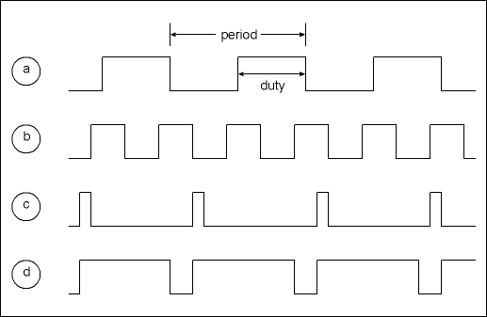
Pulse Width Modulation (PWM)
Dynamically change duty cycle of a waveform
Used to control motor speed

Slide 41
PWM with AVR Timers
Fast PWM Mode
Counter counts from BOTTOM (0) to MAX
Counter reset to 0 at MAX
OCnx cleared at TOP
OCnx set at BOTTOM

Slide 42
PWM Waveform Generation
Clear on
TOP
MAX
TOP
BOTTOM
Set on
BOTTOM
OCnx

Slide 43
Timer Capture Mode
Timer 1 has capture mode
Capture can be triggered by ICP1 pin or ACO from analog comparator
Capture event copies timer into input capture register ICR1
Can be used to time external events or measure pulse widths
Range finders generate pulse width proportional to distance

Slide 44
Analog to Digital Converter (ADC)
10 Bit Successive Approximation ADC
8 Channel multiplexer using port pins ADC0-7
Max conversion time 260 μsec.

Slide 45
Analog Comparator
Compares voltage between pins AIN0 and AIN1
Asserts AC0 when AIN0 > AIN1
AC0 can trigger timer capture function
Range finders indicate distance with pulse with
Timer capture mode can compute pulse width

Slide 46
Serial Peripheral Interface
Industry standard serial protocol for communication between local devices
Master/Slave protocol
3 Wire interface
Slaves addressed via Slave Select (SS) inputs

Slide 47
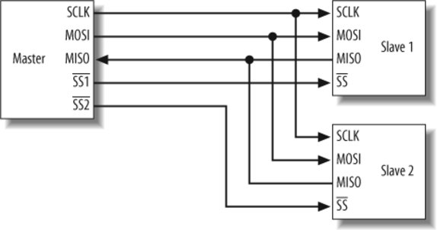
SPI Bus – Signal Descriptions
SCLK | Serial Clock
MOSI | Master Out Slave In
MISO | Master In Slave Out
SS | Slave Select

Slide 48
I²C Bus Interface
Industry standard serial protocol for communication between local devices
Master/Slave protocol
2 Wire interface
Byte oriented messages
Slave address embedded in command

Slide 49
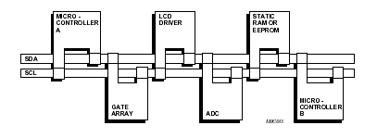
I²C Bus Signal Descriptions
SDA | Serial Data
SCL | Serial Clock

Slide 50
Typical SPI & I²C Devices
EEPROM
IO Expanders
Real Time Clocks
ADC & DAC
Temperature sensors
Ultrasonic range finders
Compass
Servo / Motor Controller
LED Display

Slide 51
USART
Universal Synchronous and Asynchronous serial Receiver and Transmitter
Full Duplex Operation
High Resolution Baud Rate Generator
Can provide serial terminal interface

Slide 52
Programming Memory - JTAG
Some chips have JTAG interface
Industry standard for debugging chips in circuit
Connect to special JTAG signals
Can program
FLASH
EEPROM
All fuses
Lock bits

Slide 53
Programming Memory - ISP
ISP (In-System Programmer)
Connect to 6 or 10 pin connector
SPI interface
Special cable required
Can program
FLASH
EEPROM
Some fuses
Lock bits

Slide 54
C / C++ / Assembler Tool chain
Linux
AVR-GCC
Based on GNU toolset
Open Source AVR-LIBC libraries
Windows
WIN-AVR
Port of AVR-GCC to Windows

Slide 55
IDEs
Linux
Editors & command line tools
Eclipse IDE
Windows
Atmel AVR Studio
Includes ISP programming support
Eclipse IDE

Slide 56
Other tools
STK 200/300/400/500
Atmel AVR starter kit and development system
Interfaces to AVR Studio
avrdude
Programming support for all memories

Slide 57
Arduino
Open source elections prototyping platform
Hardware
Based on Atmega (328 & others)
Software
Wiring language, based on c++
Boot loader
Arduino IDE

Slide 58
ATmega Families
ATmega 48/88/168/328
What we have been talking about
ATmega 164/324/644/1284
JTAG interface
All 4 IO Ports A,B,C & D
More memory

Slide 59
ATmega Packages
PDIP – Plastic Dual In-line Package
Good for hobbyists
TQFP – Thin Quad Flat Pack
Surface mount
MLF – MicroLeadFrame
28 & 32 pin
Surface mount / higher temperature

Slide 60
References
www.atmel.com
www.polulu.com
http://winavr.sourceforge.net
www.avrfreaks.net
www.wrighthobbies.net
www.eclipse.org
Just Google AVR

