Slide 1

Introduction to ML Workshop
By Bipin Dhoddamane Ravi

Slide 2
What will we learn
* Basic Pandas Dataframe and Numpy concepts
* Importing Data from a file
* Cleaning Up the data
* Visualize the data
* Use one hot encoding
* Normalizing the data
* Train Test the model using sklearn’s Linear Regression
* How good is the trained model?
* Implement Multivariate Linear Regression from scratch
* How well does it perform compared sklearns implementation

Slide 3

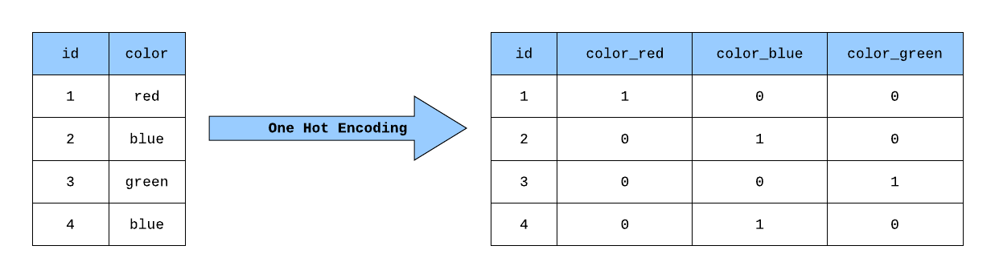
One Hot encoding

Slide 4
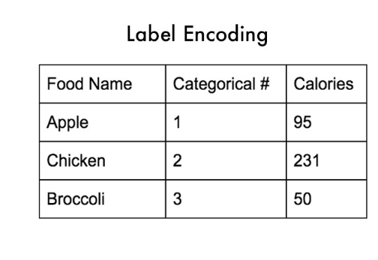
Why one Hot encoding
Many ML algorithms no not work with labels, and need numeric values in features and target.
Label Encoding may lead to the model miinterpreting ranks i.e Apple < Chicken < Brocooli

Slide 5
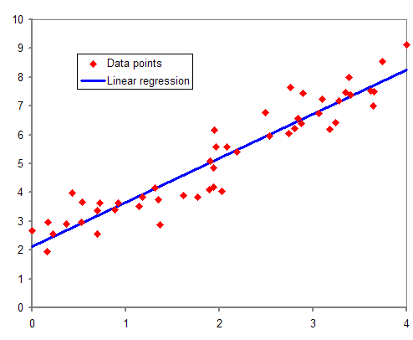
Linear Regression

Slide 6
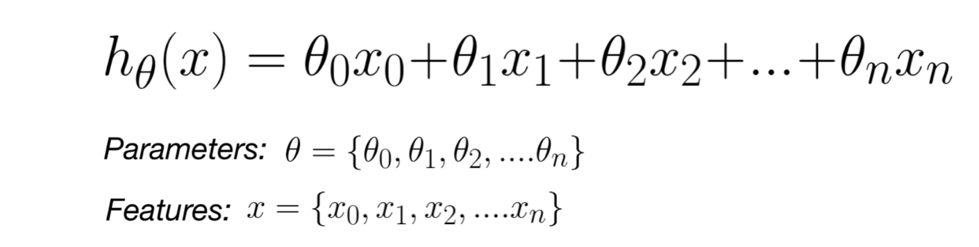
Linear Regression

Slide 7
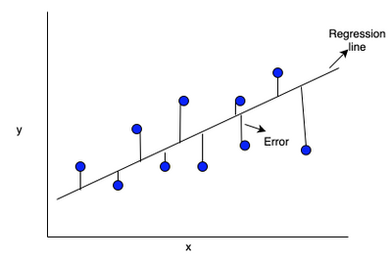
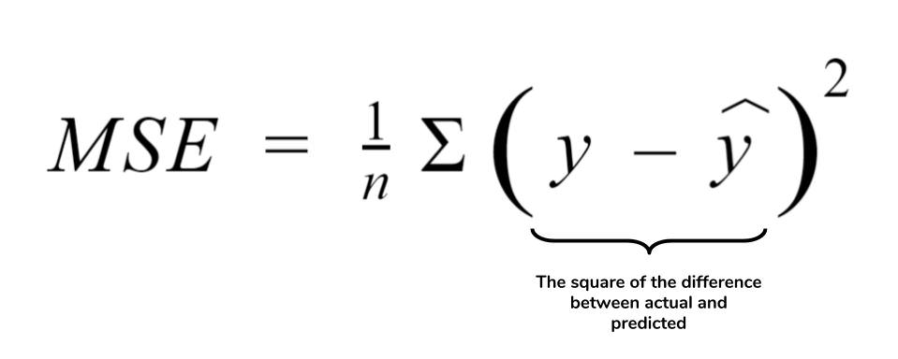
Mean Squared Error

Slide 8

Any questions?

