Slide 1
REI Hackathon 2015
A Team

Slide 2
Sections
Processes followed
Technologies Leveraged
Application Overview
Desktop Screenshots
Mobile Screenshots
Source Code Repository

Slide 3
Processes Followed
Agile
The application concept, design and development was followed by a Agile Process
The Trello board was used to record the user stories and follow the tasks for implementation
The team’s Trello board for Hackathon can be accessed at - https://trello.com/b/KRJhWh9M
Collaboration
The Collabedit online collaboration tool was used to share information and collaborate amongst the team
The team’s collaboration at Collabedit can be referred at – http://collabedit.com/5qmax

Slide 4









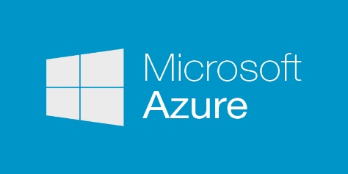
Technologies Leveraged
JavaScript Libraries
Development Environment
Collaboration Tools
Responsive
Source Control
Cloud Hosting
Automated Task Runner

Slide 5
Application Overview
Useful to study the mortgage lenders in the region
View top 10 institutions by number of approved and supported loans
View Approval and disapproval of loans by the institutions
View the denial reasons for disapproved loans by a institution and overall for the region
Mobile responsive
Cloud hosted
Open source

Slide 6
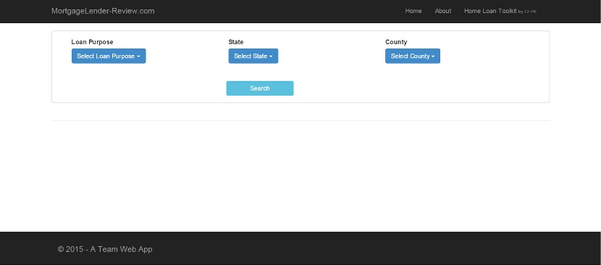
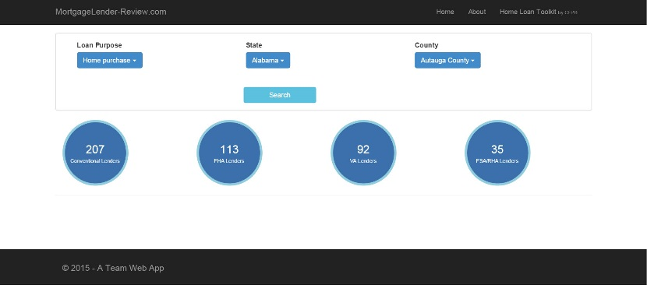
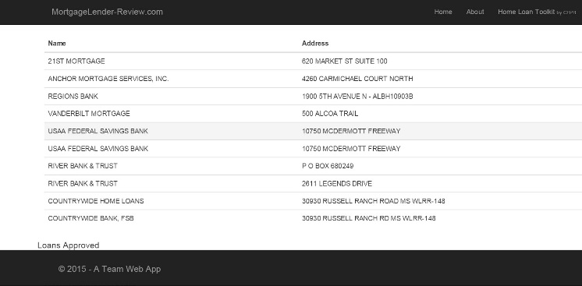
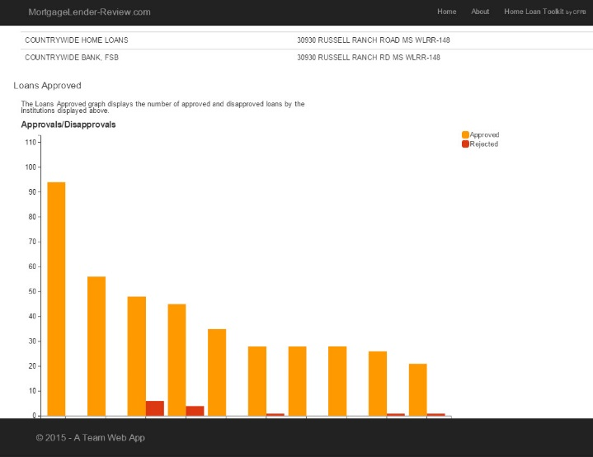
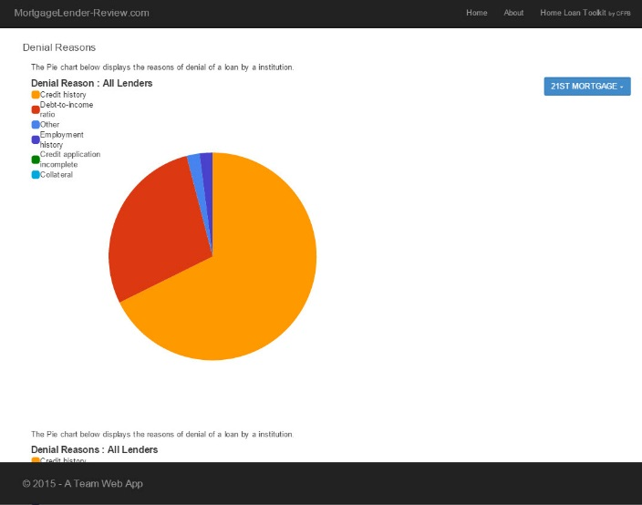
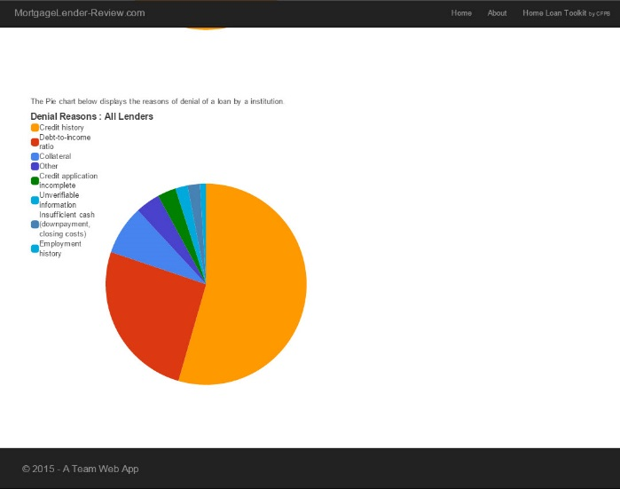
Desktop screenshots

Slide 7
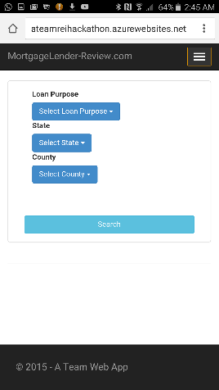
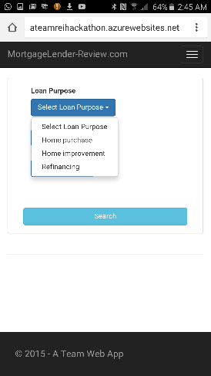
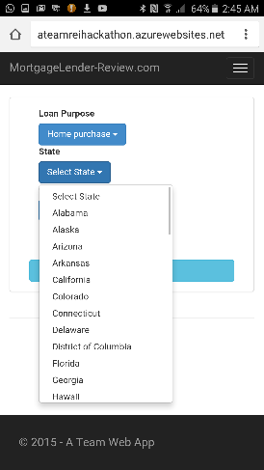
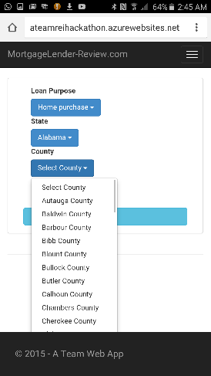
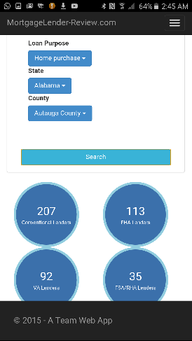
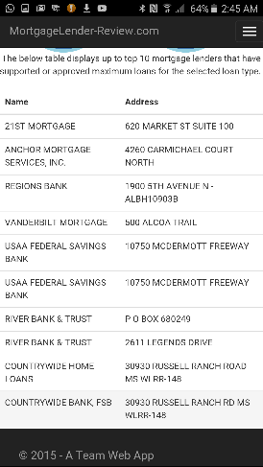
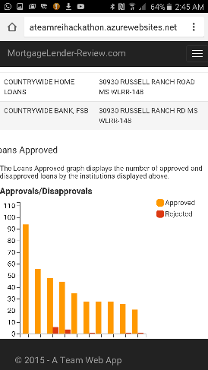
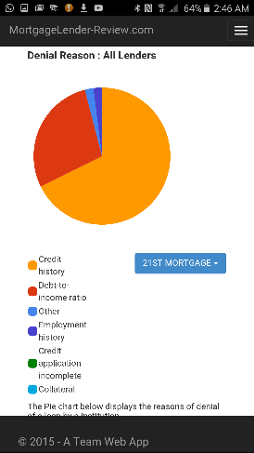
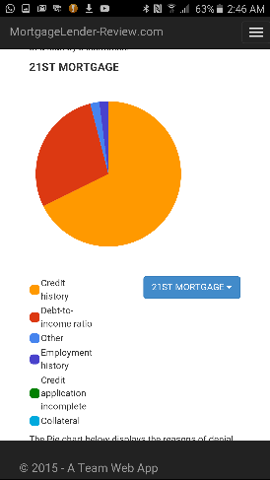
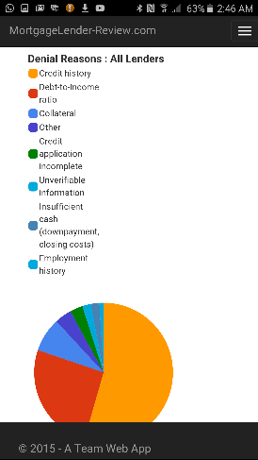
Mobile screenshots

Slide 8
Source Code Repository
The source code of the MortgageLender-Review.com is available for reference at the Github online repository:
https://github.com/REI-Systems/REISystems-Hackathon2015-A-Team

