Slide 1
ENTERPRISE PROOF OF CONCEPT
Governed MCP
Ecosystem
One client • one gateway • two API-only MCP servers • one traced diagnosis
Notes:
This revision applies the supplied MCP eligibility guardrails.
The decision remains a small internal diagnostic slice, not a platform rollout.
[Sources]
- User-supplied MCP conditions and limitations; reference consulted in-session and not embedded
[/Sources]

Slide 2
The POC is eligible only inside these guardrails
Internal engineering use only. MCP servers expose named, read-only API tools; they do not access databases, files, customer data, external services, or agents.
ALLOWED NOW
NOT ALLOWED
Enterprise-built and internally hosted
API tools only—no resources
Read-only internal data
Customer-facing or delegated access
External / third-party hosting
DB, filesystem, or AI-agent execution
2
Notes:
These are architecture constraints, not presentation preferences.
Treat 'no delegated access' as no downstream user-token delegation or customer delegation. An internal workforce user can still authenticate to the gateway if the enterprise identity team approves that pattern.
Treat 'internally hosted' as an enterprise policy definition. A private cloud landing zone is acceptable only when the policy owner explicitly classifies it as internal hosting.
[Sources]
- User-supplied MCP conditions and limitations; reference consulted in-session and not embedded
[/Sources]

Slide 3
One runtime path; registry stays in the control plane
CONNECT
CONTROL
EXECUTE
Approved IDE → Gateway
VS Code sends one internal request. Gateway authenticates and starts the trace.
Registry ⇢ Gateway policy
Signed tool metadata is published out of band. Gateway authorizes every call.
Gateway → MCP Server → API tool
Named read-only API calls only. No DB, filesystem, resources, or agents.
3
Notes:
The registry remains a control plane that publishes a signed tool-and-policy snapshot to the gateway.
Every initial and follow-up MCP call returns through the gateway.
The execution surface is limited to named read-only API tools. MCP resources, direct database access, filesystem access, generic HTTP, and server-side agents are out of scope.
[Sources]
- User-supplied MCP conditions and limitations; reference consulted in-session and not embedded
- https://modelcontextprotocol.io/specification/2025-11-25/basic/authorization
[/Sources]

Slide 4
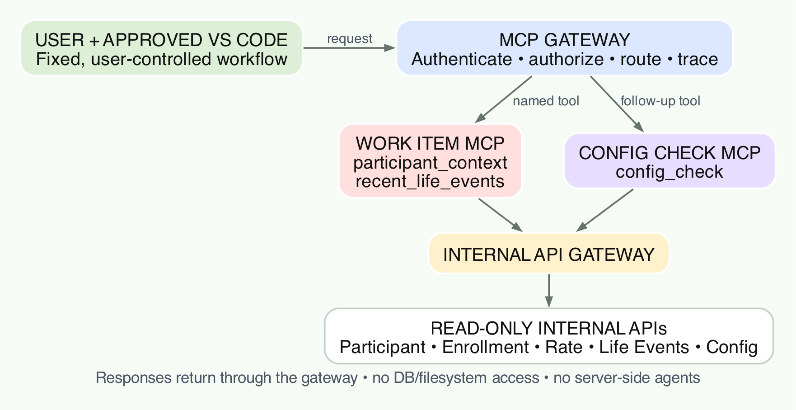
The diagnosis uses API tools only
Internally hosted • read-only internal APIs • no delegated downstream access.
4
Notes:
Constraint-compliant fictional sequence:
1. An approved internal user asks from VS Code why a synthetic work item has no enrollment details.
2. Work Item MCP exposes participant_context and recent_life_events. Both are named read-only wrappers over existing internal APIs.
3. The approved IDE correlates the returned evidence in a fixed, user-controlled workflow. The MCP servers do not host or invoke an agent.
4. If evidence is incomplete, the IDE sends a new config_check call through the gateway to Config Check MCP.
5. Config Check MCP calls the existing internal Config API through the internal API Gateway and returns a read-only result.
6. Every response returns through the MCP Gateway with trace and audit correlation.
There is no PostgreSQL MCP, direct database query, filesystem access, MCP resource, server-side AI agent, or agent-to-agent call in this POC.
[Sources]
- User-supplied MCP conditions and limitations and fictional Work Item scenario
[/Sources]

Slide 5
Three controls keep every tool inside the guardrails
Each layer has one job. No server can bypass the gateway or expand the allowed capability type.
Registry
Approved tools + versions
Schemas + risk class
Gateway
Identity + authorization
Route + trace
Server + API wrapper
Named read-only operations
No DB, files, resources, agents
5
Notes:
Registry: approved internal owners, named API tools, schemas, versions, and risk classification.
Gateway: workforce authentication, per-call authorization, route control, trace start, and denial evidence.
Server and wrapper: only the named read-only API operation. No generic SQL, generic HTTP, resources, filesystem, or agent invocation.
[Sources]
- User-supplied MCP conditions and limitations; reference consulted in-session and not embedded
[/Sources]

Slide 6
The POC is one vertical slice with three proof gates
Freeze the contract
One client, one gateway route, and named Work Item and Config Check API tools.
Run the diagnosis
Read participant and life-event APIs; if data is incomplete, follow the fixed config-check branch.
Produce evidence
Correlate the trace, prove denied paths, document gaps, and choose continue, refine, or stop.
CONTRACT
DIAGNOSE
EVIDENCE
6
Notes:
Gate 1 proves the approved contract contains only internal read-only API tools.
Gate 2 proves the fictional diagnosis using Work Item and Config Check MCP servers, without a database MCP or agent service.
Gate 3 produces trace, audit, and denial evidence for the enterprise review.
[Sources]
- User-supplied MCP conditions and limitations and fictional Work Item scenario
[/Sources]

Slide 7
Success is a useful diagnosis and a predictable denial
The POC must explain
the issue—and prove
what it refused.
An approved user asks why WI-DEMO-001 has no enrollment. The IDE gathers participant and life-event evidence through API tools. Missing data triggers an authorized Config Check call. The final explanation and every denial share one trace ID.
Approved API tools are visible
Work-item diagnosis succeeds
Config gap is identified
Unknown tool is denied
Direct server / DB access denied
7
Notes:
The success case demonstrates useful evidence correlation in the approved IDE workflow.
The denial cases demonstrate that unknown tools, direct MCP-server access, database access, and other disallowed capability types do not run.
All identifiers and data are fictional and synthetic.
[Sources]
- User-supplied MCP conditions and limitations and fictional Work Item scenario
[/Sources]

Slide 8
Everything stays inside the approved enterprise boundary
1 · INTERNAL CLIENT
Approved VS Code
Enterprise workforce SSO
Private enterprise access
2 · INTERNAL MCP RUNTIME
Gateway + registry snapshot
Two internal MCP servers
Workload identities
3 · INTERNAL API PATH
API tool → internal API Gateway
Read-only internal APIs
Trace + audit stay internal
CLIENT
RUNTIME
APIs
8
Notes:
Default hosting recommendation under these guardrails: deploy the gateway, registry snapshot, and MCP servers within the enterprise-controlled internal network and approved platform runtime.
Do not make Azure a POC dependency unless the enterprise policy owner confirms that the private Azure landing zone is classified as internally hosted rather than external or third-party hosting.
All enterprise data access occurs behind existing internal read-only APIs. The MCP layer receives no direct database or filesystem credentials.
Tracing and audit records remain inside approved enterprise telemetry systems.
[Sources]
- User-supplied MCP conditions and limitations; reference consulted in-session and not embedded
- https://modelcontextprotocol.io/specification/2025-11-25/basic/transports
[/Sources]

Slide 9
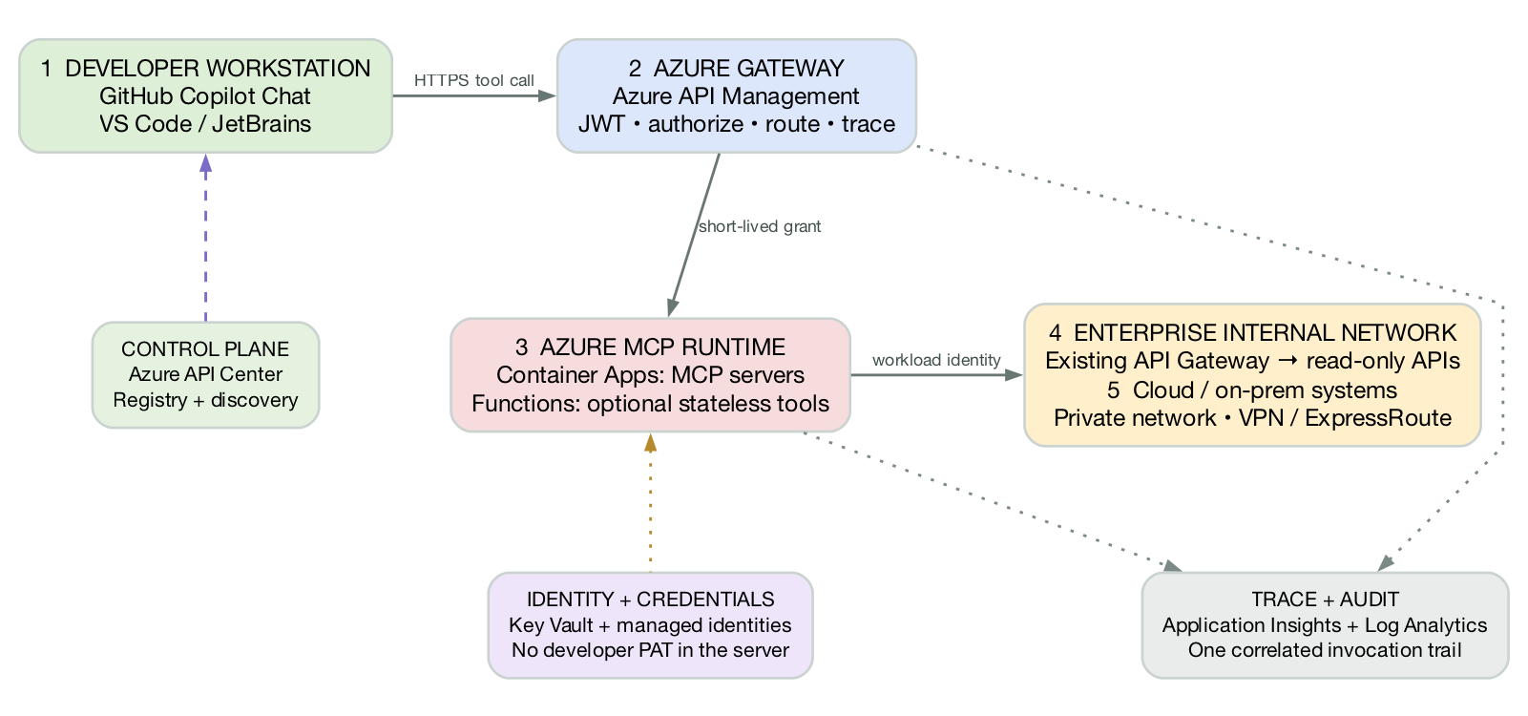
Azure hosts the MCP runtime; internal systems stay private
Copilot calls one governed endpoint. Registry, credentials, and traces remain separate controls.
9
Notes:
Runtime sequence:
1. The developer uses GitHub Copilot Chat in an approved IDE; no MCP server is installed on the workstation.
2. Azure API Center provides discovery metadata, but it is not part of the runtime request path.
3. Azure API Management authenticates the request, authorizes the named tool, starts the trace, and routes the call.
4. MCP servers run in Azure Container Apps. Azure Functions is optional for simple stateless tools.
5. The MCP server uses workload identity to call the existing internal API gateway and read-only APIs.
6. Private network connectivity reaches cloud or on-prem systems. Responses return through the same path.
7. Key Vault and managed identities protect credentials; Application Insights and Log Analytics retain the correlated trace and audit record.
[Sources]
- https://learn.microsoft.com/en-us/azure/api-management/mcp-server-overview
- https://learn.microsoft.com/en-us/azure/api-center/register-discover-mcp-server
- https://learn.microsoft.com/en-us/azure/container-apps/mcp-choosing-azure-service
[/Sources]

Slide 10
The user token stops at the gateway
AUTHENTICATE
AUTHORIZE
EXECUTE + TRACE
VS Code → Enterprise SSO → MCP Gateway
Workforce token is audience-bound to the gateway.
Gateway → policy → one-call grant
Bind actor, API tool, invocation_id, jti, and expiry.
MCP Server → API Gateway
Workload identity only. No user token or delegation. Trace + audit separately.
10
Notes:
The workforce access token is accepted only by the MCP Gateway and validated for its canonical audience.
The gateway creates a separate short-lived internal grant for one named API tool call. A retry or follow-up gets a new grant and jti.
MCP servers use approved workload identity to reach the internal API Gateway. They do not receive or forward the user's bearer token, and they do not use downstream OAuth delegation or OBO in this POC.
W3C trace context links spans; it is not authorization. Separate audit events record actor, tool, policy decision, outcome, and denial reason.
[Sources]
- User-supplied MCP conditions and limitations; reference consulted in-session and not embedded
- https://modelcontextprotocol.io/specification/2025-11-25/basic/authorization
- https://www.w3.org/TR/trace-context/
[/Sources]

Slide 11
Scale only inside the guardrails
Focused POC
One VS Code client, one gateway, signed registry snapshot, two internal MCP servers, API tools only, synthetic read-only data, and one trace.
Internal pilot
Expand to more approved internal APIs.
Add reliability, security monitoring, automated policy checks, and a clear support owner.
Separate governance decision
Customer data, DB / filesystem access, external hosting, or agents / A2A are not extensions of this POC.
POC
PILOT
EXCEPTION
11
Notes:
The POC and pilot may expand only through additional approved, internally hosted, read-only API tools.
Customer-facing access, customer data, direct database or filesystem access, external hosting, AI agents, and A2A/ARD require a separate policy and governance decision. They are not a natural next phase of this POC.
This keeps the immediate experiment honest while preserving A2A/ARD as a possible end-state topic if the guardrails change later.
[Sources]
- User-supplied MCP conditions and limitations and enterprise ecosystem context
[/Sources]

Slide 12
DECISION
Approve the diagnostic slice—
not a platform rollout
1 client • 1 gateway • 1 scenario
2 internal API-only MCP servers • no agents • synthetic read-only data
Continue / refine / stop
Notes:
Approve only the constraint-compliant diagnostic slice.
Continue, refine, or stop based on useful diagnosis, predictable denial, read-only API enforcement, internal hosting, and trace evidence.
[Sources]
- User-supplied MCP conditions and limitations and fictional Work Item scenario
[/Sources]

