Slide 1
Presenter
Sagar Bhusal
Developer at Zyaba Squad
Blockchain Researcher (Intern) Soriole, Netherland
IOE, Pulchowk ( BCT Final Year )
Bipin Khatiwada
AI Fellow at Fusemachines Nepal
Blockchain Researcher (Intern) Soriole, Netherland
IOE, Pulchowk ( BCT Final Year )

Slide 2
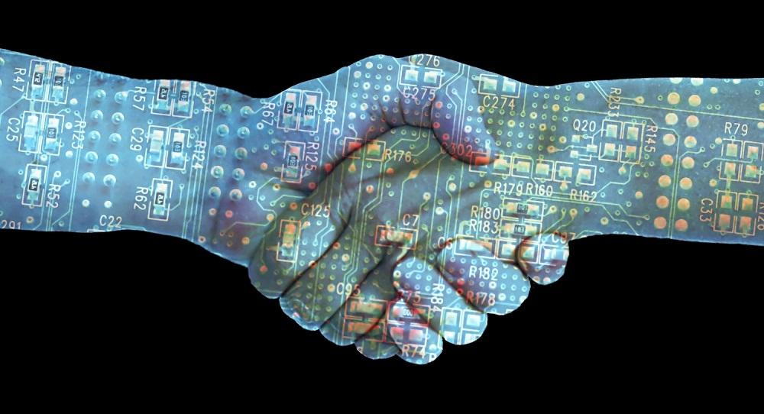
Blockchain and Future

Slide 3

TRUST

Slide 4
BLOCKCHAIN
Giant global spreedsheet that runs in millions of millions of computers recording any structure information
A blockchain is a continuously growing list of records, called blocks, which are linked and secured using cryptography

Slide 5
Pillars of Blockchain
Immutable
Secure
Authenticity
Decentralized
Shared publicly
Cheap
Automate
….

Slide 6
How Blockchain works??
World Biggest Blockchain is Bitcoin.

Slide 7
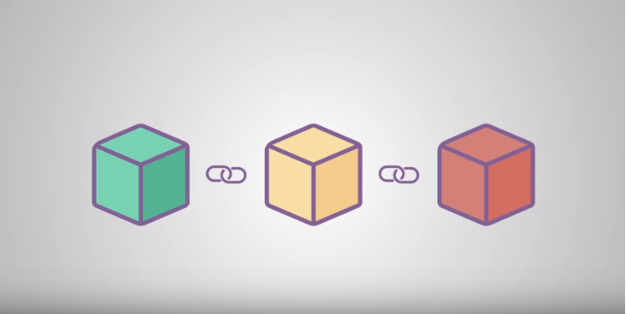
Chain of Blocks that contain Informations==Blockchain

Slide 8
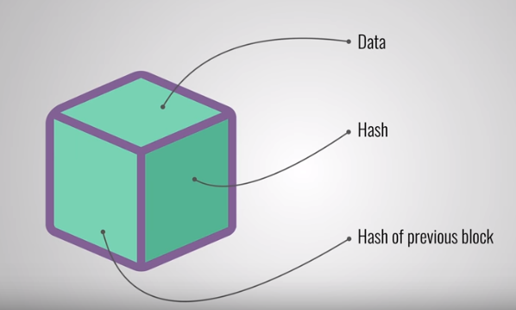
Data: depends on type of blockchain.
Hash: fingerprints,unique.
Hash of Previous Block: helps in creating chain.

Slide 9
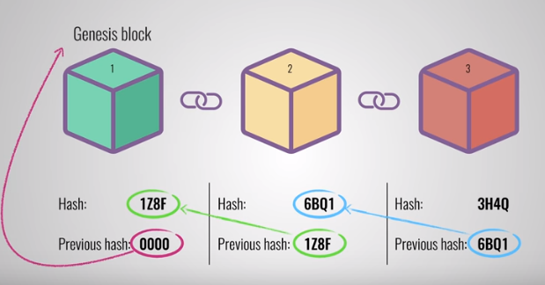
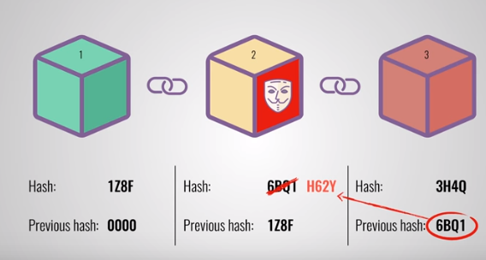

Slide 10
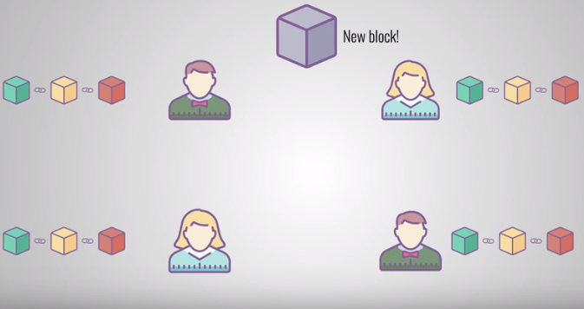
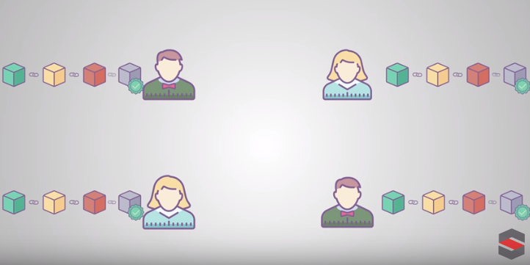

Slide 11
Blockchain Gift To Future
Benefits of the digital age have been asymmetrical.
Third party organization may no longer be necessary

Slide 12
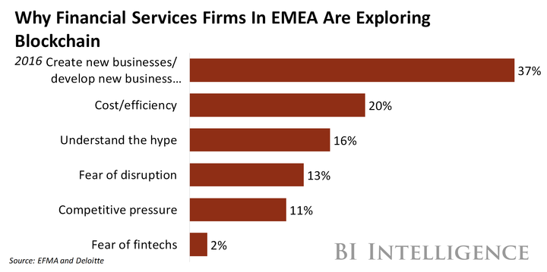
Banking, Finance and Fintech
Bitcoin is going to be world biggest bank with no single cash.

Slide 13
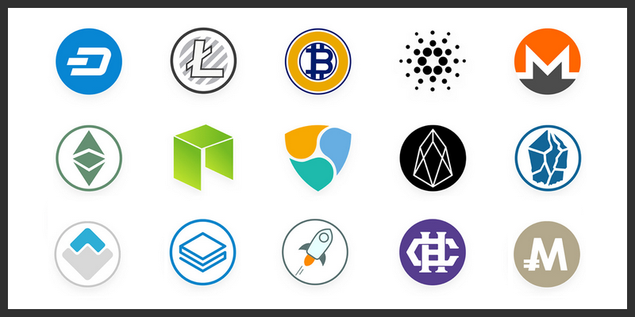
Cryptocurrency

Slide 14
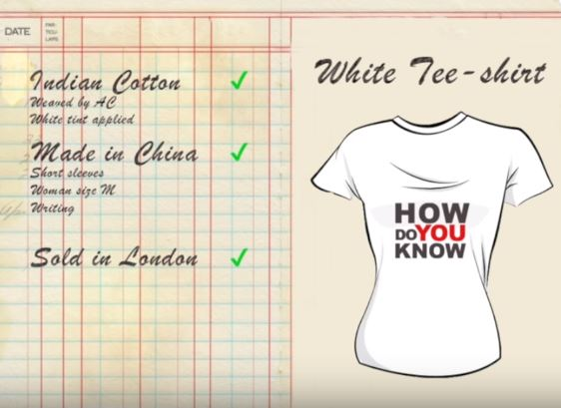
Supply Chain
How do you know originality of your ... ?
Coffee
painting
branded shoes
Picture Source: https://www.youtube.com/watch?v=FtK65VH5OBg

Slide 15
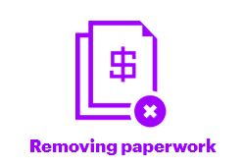
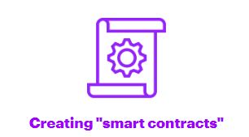
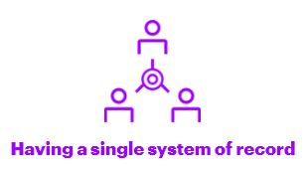
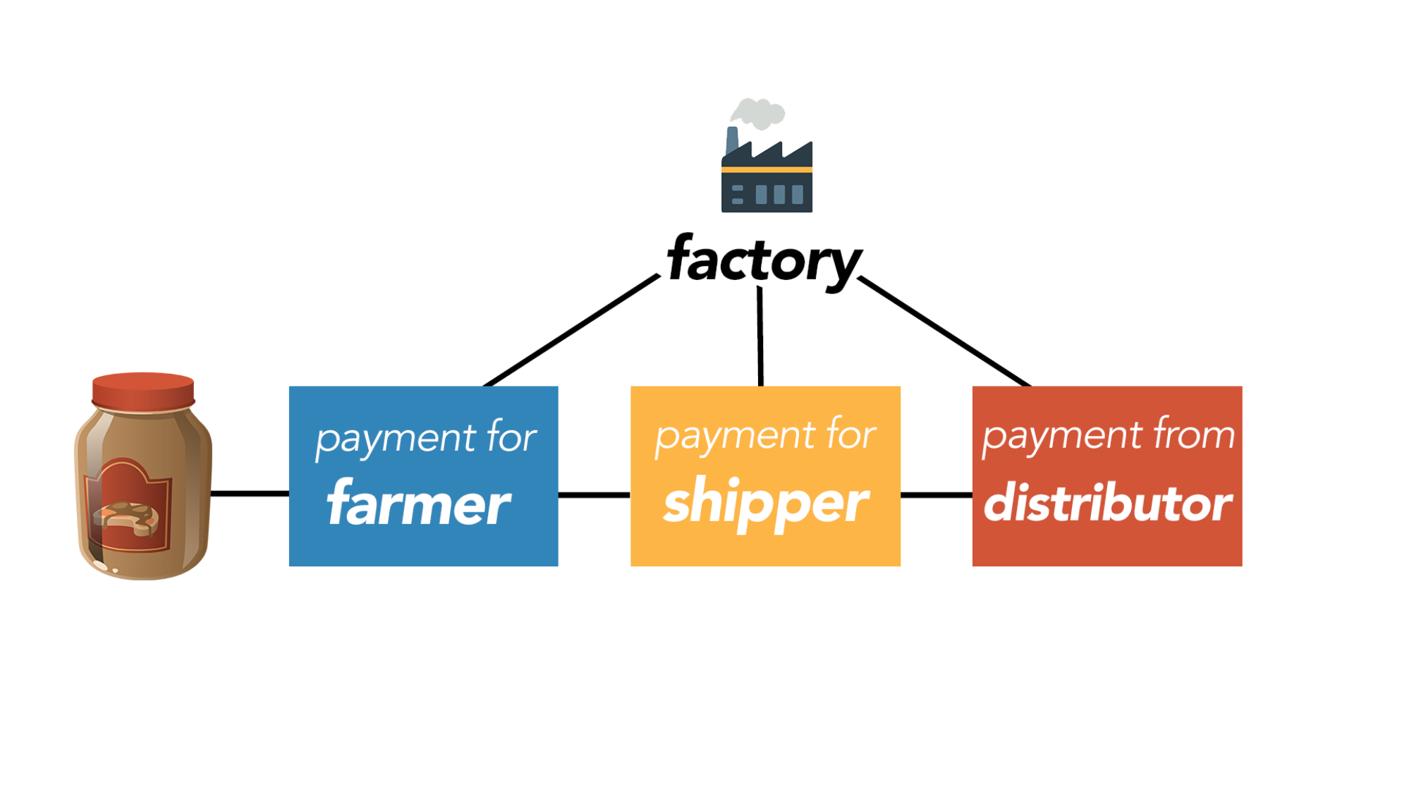
Seamless integration of any number of players with no loss of data consistency

Slide 16
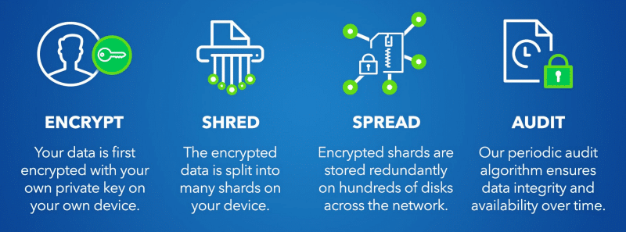
Data Storage ( CLOUD )
Your data. Your Control. Your Privacy.

Slide 17
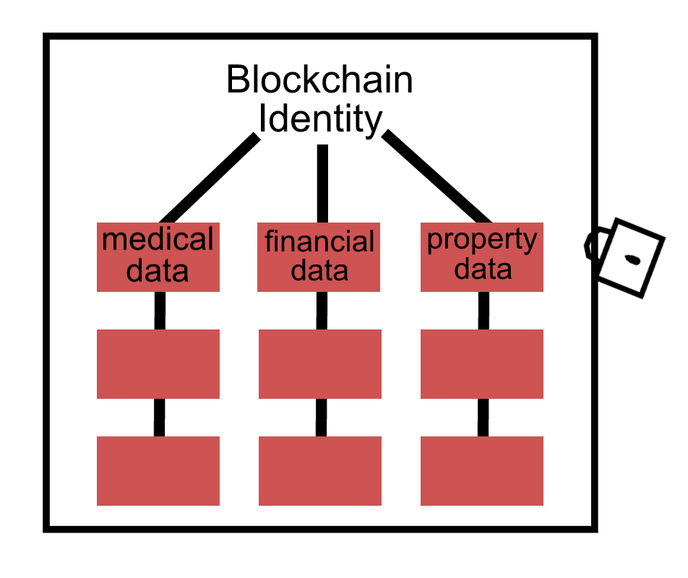
Identification and Authorization
Aadhar Card (India)
Land Registration (Ireland, Netherland)
MIT Certification

Slide 18
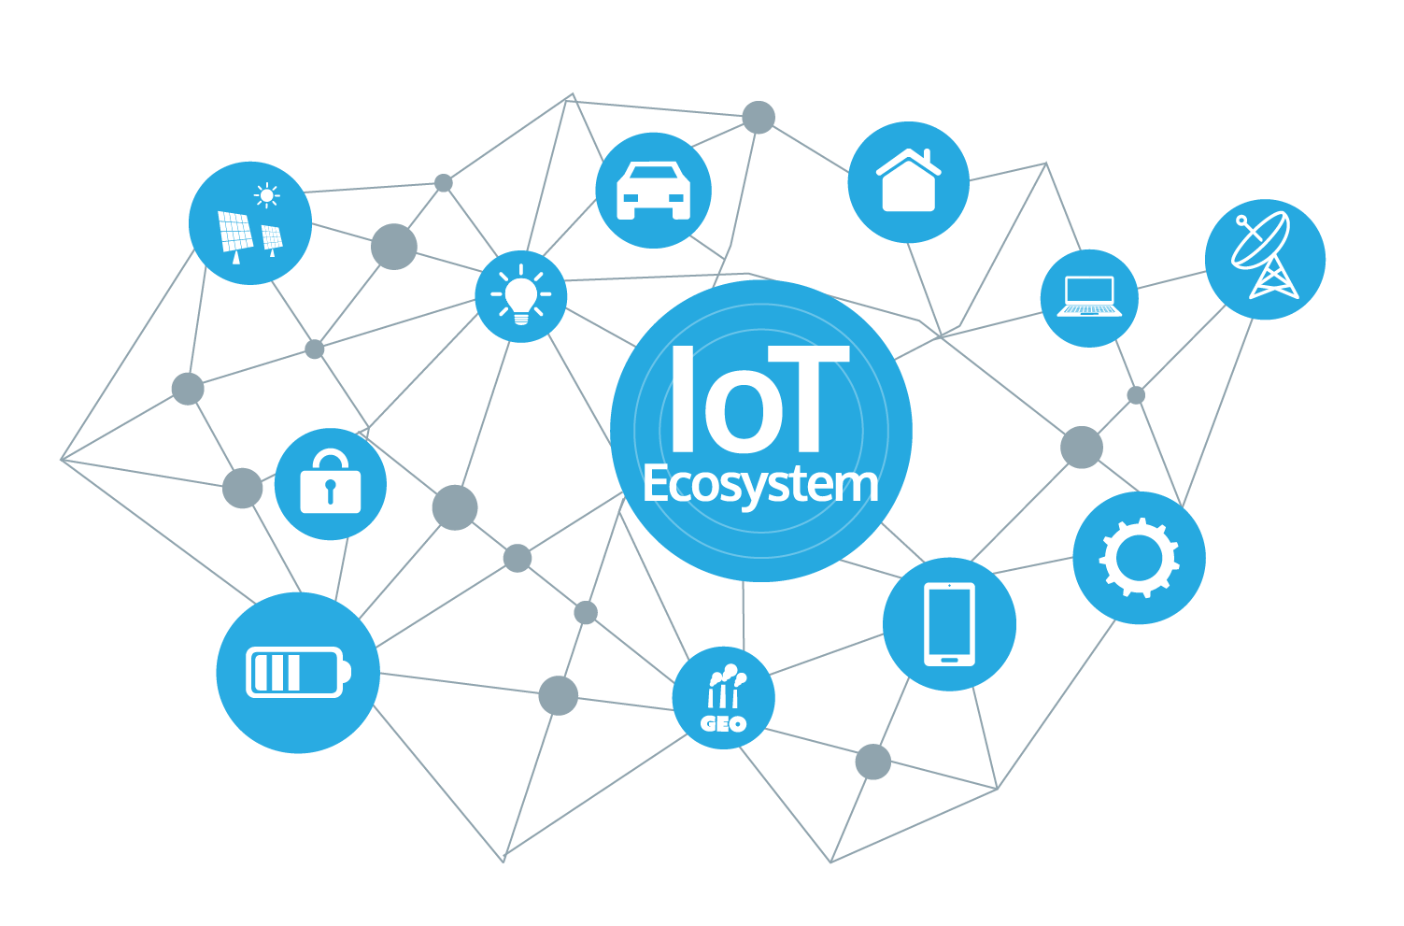
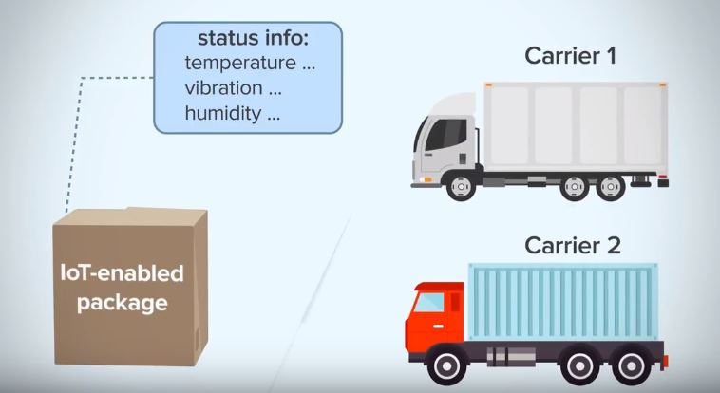
Internet Of Things
Players of this field
IOTA
IBM

Slide 19
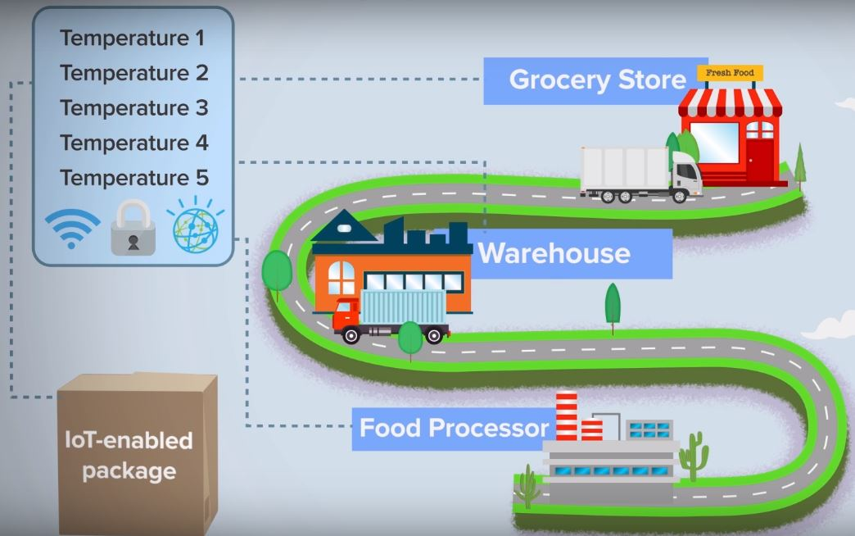

Slide 20
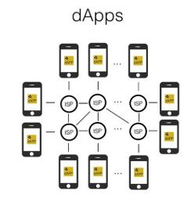
Wait, Blockchain is way more important than you think !
Game ( Crypto Kitties, Virtual Nation, Pet Dog )
Healthcare
Business and Market
Asset Management: Trade Processing and Settlement
Insurance: Claims processing
Payments: Cross-Border Payments
Your car/ smartphone
Smart Appliances
Blockchain music
Blockchain Government
Public value/ community
Blockchain Identity
Blockchain Messenger
Blockchain Storage
Blockchain Certification
Honest Review
Transparent Transaction
and way more ……...

Slide 21
Problems
Ultimate Job Killer
Is Complete decentralization good ?
Revenue and Remittance
Energy Consumption

Slide 22
Scope in Nepal ?
Fintech - the most anticipated market !
Land Registration
Emerging field. More Opportunity.
and all of the above use cases….

Slide 23
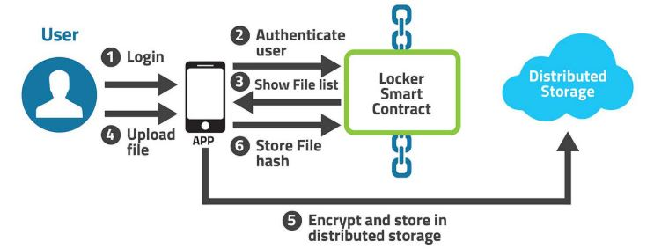
BLOCKCHAIN POWERED DECENTRALIZED DISTRIBUTED DATABASE (CLOUD)

Slide 24
Some more blockchain projects in Pulchowk
Blockchain Messenger
Blockchain Based Identification System
Blockchain Based Certification
Blockchain Based Health Record System

Slide 25
Nepal’s first “Blockchain Meetup”
Coming up ….
Pulchowk Blockchain Lab

Slide 26
Any Queries ?

Slide 27
References
https://www.youtube.com/watch?v=SSo_EIwHSd4&t=112s
https://www.youtube.com/watch?v=3xGLc-zz9cA&t=230s
https://en.wikipedia.org/wiki/Blockchain
https://storj.io/
https://coinweez.com/beginners-guide-dapps/
https://www.pcmag.com/feature/361189/the-coolest-blockchain-startups-at-consensus/9
https://www.youtube.com/watch?v=FtK65VH5OBg

Slide 28
Thank You !!
Sagar Bhusal
IOE, Pulchowk Campus
071bct551@pcampus.edu.np
Bipin Khatiwada
IOE, Pulchowk Campus
071bct512bipin@pcampus.edu.np

