Slide 1
Distributed System
CACS352

Slide 2
Unit 6: Coordination
Clock Synchronization
Logical Clocks
Mutual Exclusion
Election Algorithm
Location System
Distributed Event Matching
Gossip-based Coordination

Slide 3
Introduction
In the previous chapters, we have looked at processes and communication between processes.
Closely related is how processes cooperate and synchronize with one another.
Cooperation is partly supported by means of naming, which allows processes to at least share resources, or entities in general.
In this chapter, we mainly concentrate on how processes can synchronize.
For example, it is important that multiple processes do not simultaneously access a shared resource, such as printer, but instead cooperate in granting each other temporary exclusive access.
Another example is that multiple processes may sometimes need to agree on the ordering of events, such as whether message m1 from process P was sent before or after message m2 from process Q.

Slide 4
Clock Synchronization
In a centralized system, time is unambiguous.
When a process wants to know the time, it makes a system call and the kernel tells it.
If process A asks for the time and then a little later process B asks for the time, the value that B gets will be higher than (or possibly equal to) the value A got.
It will certainly not be lower.
In a distributed system, achieving agreement on time is not trivial.

Slide 5
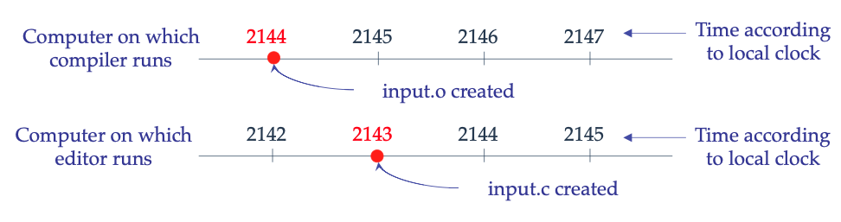
Clock Synchronization
Example: UNIX make examines the times at which all the source and object files were last modified:
If time (input.c) > time(input.o) then recompile input.c
If time (input.c) < time(input.o) then no compilation is needed
What could happen in a distributed system in which there were no global agreement on time ?

Slide 6
Clock Synchronization
Synchronization is coordination with respect to time, and refers to the ordering of events and execution of instructions in time.
It is often important to know when events occurred and in what order they occurred.
Clock synchronization deals with understanding the temporal ordering of events produced by concurrent processes.
It is useful for synchronizing senders and receivers of messages, controlling joint activity, and the serializing concurrent access to shared objects.
The goal is that multiple unrelated processes running on different machines should be in agreement with and be able to make consistent decisions about the ordering of events in a system.

Slide 7
Clock Synchronization
Distributed system uses distributed algorithms.
They have the following properties:
The relevant information is scattered among multiple machines.
Processes make decisions based only on local information.
A single point failure in the system should be avoided.
No common clock or other precise global time source exists.
Main objective: it is generally not acceptable/possible/desirable to send all the requests to a single manager process, which examines them all and grants or denies requests based on information in its tables.

Slide 8
Logical Clock
A computer clock usually consists of three components-a quartz crystal that oscillates at a well- defined frequency, a counter register, and a constant register.
The constant register is used to store a constant value that is decided based on the frequency of oscillation of the quartz crystal.
The counter register is used to keep track of the oscillations of the quartz crystal.
That is, the value in the counter register is decremented by 1 for each oscillation of the quartz crystal.
When the value of the counter register becomes zero, an interrupt is generated and its value is reinitialized to the value in the constant register.
Each interrupt is called a clock tick.

Slide 9
Logical Clock
To make the computer clock function as an ordinary clock used by us in our day-today life, the following things are done:
The value in the constant register is chosen so that 60 clock ticks occur in a second.
The computer clock is synchronized with real time (external clock). For this, two more values are stored in the system a fixed starting date and time and the number of ticks.
For example, in UNIX, time begins at 0000 on January 1, 1970.
At the time of initial booting, the system asks the operator to enter the current date and time.
The system converts the entered value to the number of ticks after the fixed starting date and time.
At every clock tick, the interrupt service routine increments the value of the number of ticks to keep the clock running.

Slide 10
Lamport’s Logical Clocks
In a classic paper, Lamport (1978) showed that although clock synchronization is possible, it need not be absolute.
If two processes do not interact, it is not necessary that their clocks be synchronized because the lack of synchronization would not be observable and thus could not cause problems.
Furthermore, he pointed out that what usually matters is not that all processes agree on exactly what time it is, but rather that they agree on the order in which events occur.
In the make example, what counts is whether input.c is older or newer than input.o, not their absolute creation times.

Slide 11
Logical Clocks VS Physical Clocks
For algorithms where only internal consistency of clocks matters (not whether clocks are close to real time), we speak of logical clocks.
For algorithms where clocks must not only be the same, but also must not deviate from real-time, we speak of physical clocks.

Slide 12
Lamport’s Logical Clocks
To synchronize logical clocks, Lamport defined a relation called happens-before.
If a and b are events in the same process, and a happens-before b, then a~b is true.
If a is the event of a message being sent by one process, and b is the event of the same message being received by another process, then a~b is also true
If two events, a and b, happen in different processes that do not exchange messages , then a~b is not true, but neither is b~a.
These events are said to be concurrent (a||b).
happens-before is transitive: a~b and b~c => a~c

Slide 13
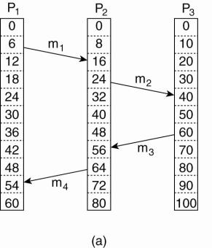
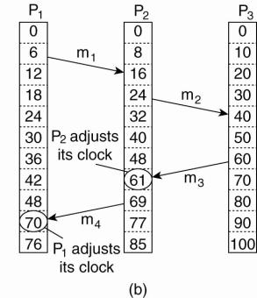
Lamport’s Algorithm Example
Capturing happens-before relation
Three processes, each with its own clock. The clocks run at different rates.
Lamport's algorithm corrects the clocks.

Slide 14
Lamport’s Algorithm Example
The processes run on different machines, each with its own clock, running at its own speed.
When the clock has ticked 6 times in process P1, it has ticked 8 times in process P2 and 10 times in process P3.
Each clock runs at a constant rate, but the rates are different due to differences in the crystals.
At time 6, process P1 sends message m1 to process P2, the clock in process P2 reads 16 when it arrives.
If the message carries the starting time, 6, in it, process P2 will conclude that it took 10 ticks to make the journey.
m3 leaves process P3 at 60 and arrives at P2 at 56.
m4 from P2 to P1 leaves at 64 and arrives at 54.

Slide 15
Lamport’s Algorithm Example

Slide 16
Lamport’s Algorithm Example
These values are clearly impossible. It is this situation that must be prevented.
Since m3 left at 60, it must arrive at 61 or later.
Each message carries the sending time according to the sender's clock.
When a message arrives and the receiver's clock shows a value prior to the time the message was sent, the receiver fast forwards its clock to be one more than the sending time.

Slide 17
Lamport’s Algorithm Example

Slide 18
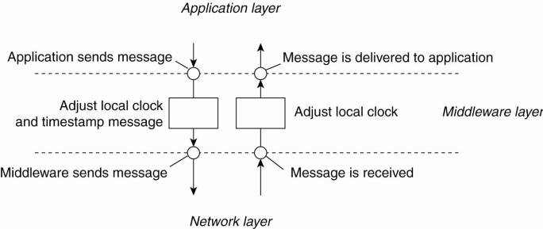
Lamport’s Algorithm Example
Adjustments take place in middleware layer.

Slide 19
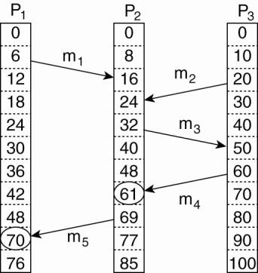
Vector Clocks
Lamport's clocks do not guarantee that if C(a) < C(b) that a causally preceded b:
Event a: m1 is received at T = 16.
Event b: m2 is sent at T=20.
We cannot conclude that a causally
precedes b

Slide 20
Vector Clocks
The problem is that Lamport clocks do not capture causality.
Causality can be captured by means of vector clocks.
A vector clock VC (a) assigned to an event a has the property that if VC (a) < VC (b) for some event b, then event a is known to causally precede event b.
Vector clocks are constructed by letting each process P, maintain a vector VCi with the following two properties:
VCj[i] is the number of events that have occurred so far at Pi. In other words, VCj [i] is the local logical clock at process Pi.
If VCj [u] = k then Pi knows that k events have occurred at Pj. It is thus Pi'S knowledge of the local time at Pj.

Slide 21
Physical Clocks
Nearly all computers have a circuit for keeping track of time.
A computer timer is usually a precisely machined quartz crystal.
When the system is booted, it usually asks the user to enter the date and time, which is then converted to the number of ticks after some known starting date and stored in memory.
Most computers have a special battery-backed up CMOS RAM so that the date and time need not be entered on subsequent boots.
At every clock tick, the interrupt service procedure adds one to the time stored in memory.
In this way, the (software) clock is kept up to date.

Slide 22
Physical Clocks
With a single computer and a single clock, it does not matter much if this clock is off by a small amount.
Since all processes on the machine use the same. clock, they will still be internally consistent.
As soon as multiple CPUs are introduced, each with its own clock, the situation changes radically.
Although the frequency at which a crystal oscillator runs is usually fairly stable, it is impossible to guarantee that the crystals in different computers all run at exactly the same frequency.

Slide 23
Physical Clocks
In some systems (e.g., real-time systems), the actual clock time is important.
Under these circumstances, external physical clocks are needed.
For reasons of efficiency and redundancy, multiple physical clocks are generally considered desirable, which yields two problems:
How do we synchronize them with real world clocks? and
How do we synchronize the clocks with each other?
Extras: mechanical clock, mean solar second, skew clock, atomic clock, BIR, TAI, leap second.

Slide 24
Physical Clocks
The basis of all modern civil timekeeping is called Universal Coordinated Time, abbreviated as UTC.
To provide UTC to people who need precise time, some 40 shortwave radio stations around the world broadcast a short pulse at the start of each UTC second.
The accuracy of these stations is about ± 1msec.
But due to random atmospheric fluctuations that can affect the length of the signal path, in practice the accuracy is no better than ± 10msec.

Slide 25
Physical Clocks
Several earth satellites also offer a UTC service.
The Geostationary Environment Operational Satellite can provide UTC accurately to 0.5 msec, and some other satellites do even better.
Using either shortwave radio or satellite services requires an accurate knowledge of the relative position of the sender and receiver, in order to compensate for the signal propagation delay.
Radio receivers for WWV, GEOS, and the other UTC sources are commercially available.
i.e UTC receivers are commercially available and many computers are equipped with one.

Slide 26
Physical Clocks – Extras
Most electric power companies synchronize the timing of their 60-Hz or 50- Hz clocks to UTC, so when BIH announces a leap second, the power companies raise their frequency to 61 Hz or 51 Hz for 60 or 50 sec. to advance all the clocks in their distribution area.
Since 1 sec is a noticeable interval for a computer, an operating system that needs to keep accurate time over a period of years must have special software to account for leap seconds as they are announced (unless they use the power line for time, which is usually too crude).
The total number of leap seconds introduced into UTC so far is about 30.
To provide UTC to people who need precise time, the National Institute of Standard Time (NIST) operates a shortwave radio station with call letters WWV from Fort Collins, Colorado.
WWV broadcasts a short pulse at the start of each UTC second.
The accuracy of WWV itself is about ±1 msec, but due to random atmospheric fluctuations that can affect the length of the signal path, in practice the accuracy is no better than ±10 msec.
In England, the station MSF, operating from Rugby, Warwickshire, provides a similar service, as do stations in several other countries.

Slide 27
Clock Synchronization Algorithms
Suppose we have a distributed system with a UTC receiver somewhere in it, we still have to distribute its time to each machine.
If no machines have UTC receivers, each machine keeps track of its own time, and the goal is to keep all the machines together as well as possible.
All the algorithms have the same underlying model of the system.
Each machine is assumed to have a timer that causes an interrupt H times a second.
When this timer goes off, the interrupt handler adds 1 to a software clock that keeps track of the number of ticks (interrupts) since some agreed upon time in the past.
Let us call the value of this clock C.

Slide 28
Clock Synchronization Algorithms
There is a clock in machine p that ticks on each timer interrupt. Denote the value of that clock by Cp(t), where t is UTC time.
Ideally, we have that for each machine p, Cp(t) = t, or, in other words, dC/dt = 1.
Real timers do not interrupt exactly H times a second.
Theoretically, a timer with H =60 should generate 216,000 ticks per hour.
In practice, the relative error obtainable with modem timer chips is about 10⁻⁵ , meaning that a particular machine can get a value in the range 215,998 to 216,002 ticks per hour.

Slide 29

Clock Synchronization Algorithms
More precisely, if there exists some constant p such that
the timer can be said to be working within its specification.
The constant p is specified by the manufacturer and is known as the maximum drift rate.
Note that the maximum drift rate specifies to what extent a clock's skew is allowed to fluctuate.

Slide 30
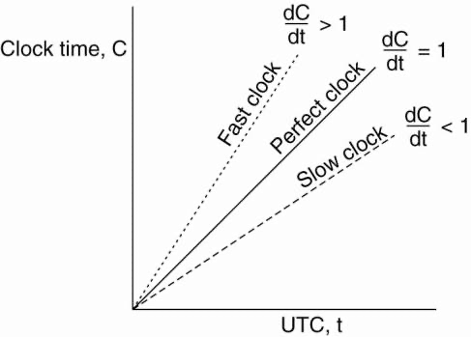
Clock Synchronization Algorithms
If two clocks are drifting from UTC in the opposite direction, at a time dt after they were synchronized, they may be as much as 2ρ Δt apart.
If the operating system designers want to guarantee that no two clocks ever differ by more than δ, clocks must be resynchronized (in software) at least every δ / (2 ρ) seconds.
The various algorithms differ in precisely how this resynchronization is done.

Slide 31
Network Time Protocol
NTP is a protocol designed to synchronize the clocks of computers over a network.
A common approach in many protocols and originally proposed by Cristian (1989) is to let clients contact a time server.
Principle I: Every machine asks a time server (Cristian 1989) for the accurate time at least once every δ / (2 ρ) seconds (Network Time Protocol).
But you need an accurate measure of round trip delay, including interrupt handling and processing incoming messages.
Principle II: Let the time server scan all machines periodically, calculate an average, and inform each machine how it should adjust its time relative to its present time.
Okay, you'll probably get every machine in sync.
Note: you don't even need to propagate UTC time.

Slide 32
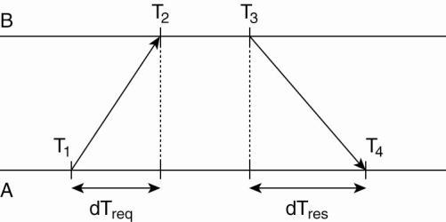
Network Time Protocol (Cristian’s Algorithm)
The problem, of course, is that when contacting the server, message delays will have outdated the reported time.
The trick is to find a good estimation for these delays.

Slide 33
Network Time Protocol
A will send a request to B, timestamped with value T1 .
B will record the time of receipt T2 (taken from its own local clock), and return a response timestamped with value T3, piggybacking the previously recorded value T2.
A records the time of the response's arrival, T4.
Assume that the propagation delay from A to B is the same as B to A, meaning that T2 - T1 = T4 -T3.
A can estimate its offset relative to B as

Slide 34
Network Time Protocol
If A's clock is fast i.e, θ < 0, A cannot set its clock backward.
It is NOT allowed
Must slow down clock gradually.
An example:
Timer is set to generate 100 interrupts per second.
each interrupt would add 10 msec to the time.
When slowing down, the interrupt routine adds only 9 msec each time until the correction has been made.
Vice versa for advancing

Slide 35

Network Time Protocol
In the case of the network time protocol (NTP), this protocol is set up pair-wise between servers.
In other words, B will also probe A for its current time.
The offset θ is computed, along with the estimation δ for the delay:
Eight pairs of (θ,δ) values are buffered, finally taking the minimal value found for δ as the best estimation for the delay between the two servers, and subsequently the associated value θ as the most reliable estimation of the offset.

Slide 36
The Berkely Algorithm
In many algorithms such as NTP, the time server is passive.
Other machines periodically ask it for the time.
All it does is respond to their queries.
In Berkeley UNIX, exactly the opposite approach is taken (Gusella and Zatti, 1989).
Here the time server (actually, a time daemon) is active, polling every machine from time to time to ask what time it is there.
Based on the answers, it computes an average time and tells all the other machines to advance their clocks to the new time or slow their clocks down until some specified reduction has been achieved.
This method is suitable for a system in which no machine has a WWV receiver.
The time daemon's time must be set manually by the operator periodically.

Slide 37
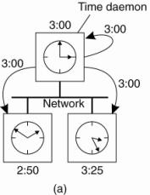
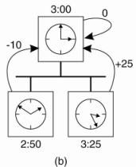
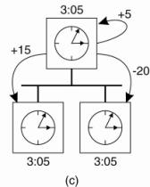
The Berkely Algorithm
The time daemon asks all the other machines for their clock values.
The machines answer.
The time daemon tells everyone how to adjust their clock.

Slide 38
The Berkely Algorithm
at 3:00, the time daemon tells the other machines its time and asks for theirs.
they respond with how far ahead or behind the time daemon they are.
the time daemon computes the average and tells each machine how to adjust its clock.

Slide 39
Mutual Exclusion
Fundamental to distributed systems is the concurrency and collaboration among multiple processes.
In many cases, this also means that processes will need to simultaneously access the same resources.
To prevent that such concurrent accesses corrupt the resource, or make it inconsistent, solutions are needed to grant mutual exclusive access by processes.
There are many algorithms, we take a look at some of the more important distributed algorithms that have been proposed.
A recent survey of distributed algorithms for mutual exclusion is provided by Saxena and Rai (2003). Older, but still relevant is Velazquez (1993).

Slide 40
Mutual Exclusion Algorithm
Distributed mutual exclusion algorithms can be classified into two different categories.
In token-based solutions, mutual exclusion is achieved by passing a special message between the processes, known as a token.
There is only one token available and who ever has that token is allowed to access the shared resource.
When finished, the token is passed on to a next process.
If a process having the token is not interested in accessing the resource, it simply passes it on.
Advantages: avoid starvation, deadlocks
Disadvantages: Lost token

Slide 41
Mutual Exclusion Algorithm
As an alternative, many distributed mutual exclusion algorithms follow a permission-based approach.
In this case, a process wanting to access the resource first requires the permission of other processes.
There are many different ways toward granting such a permission and in the sections that follow we will consider a few of them.

Slide 42
Centralized Algorithm
The most straightforward way to achieve mutual exclusion in a distributed system is to simulate how it is done in a one-processor system.
One process is elected as the coordinator.
Whenever a process wants to access a shared resource, it sends a request message to the coordinator stating which resource it wants to access and asking for permission.
If no other process is currently accessing that resource, the coordinator sends back a reply granting permission.
When the reply arrives, the requesting process can go ahead.

Slide 43
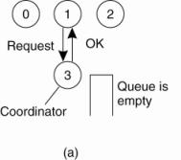
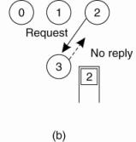
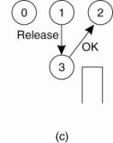
Centralized Algorithm
Process 1 asks the coordinator for permission to access a shared resource. Permission is granted.
Process 2 then asks permission to access the same resource. The coordinator does not reply.
When process 1 releases the resource, it tells the coordinator, which then replies to 2.

Slide 44
Centralized Algorithm
It is easy to see that the algorithm guarantees mutual exclusion: the coordinator only lets one process at a time to the resource.
It is also fair, since requests are granted in the order in which they are received.
No process ever waits forever (no starvation).
The scheme is easy to implement, too, and requires only three messages per use of resource (request, grant, release).
It's simplicity makes an attractive solution for many practical situations.
The centralized approach also has shortcomings.
The coordinator is a single point of failure, so if it crashes, the entire system may go down.
If processes normally block after making a request, they cannot distinguish a dead coordinator from "permission denied" since in both cases no message comes back.
In addition, in a large system, a single coordinator can become a performance bottleneck.
Nevertheless, the benefits coming from its simplicity outweigh in many cases the potential drawbacks.

Slide 45
Distibuted Algorithm
Deterministic distributed mutual exclusion algorithm
Lamport's 1978 paper on clock synchronization presented the first.
Ricart and Agrawala (1981) made it more efficient.
Requires that there be a total ordering of all events in the system
for any pair of events - it must be unambiguous which one actually happened first.
Lamport's algorithm is one way to achieve this ordering and can be used to provide time- stamps for distributed mutual exclusion.

Slide 46
Distibuted Algorithm
When a process wants to access a shared resource, it builds a message containing the name of the resource, its process number, and the current (logical) time.
It then sends the message to all other processes, conceptually including itself.
The sending of messages is assumed to be reliable; that is, no message is lost.
When a process receives a request message from another process, the action it takes depends on its own state with respect to the resource named in the message.

Slide 47
Distibuted Algorithm
Three different cases have to be clearly distinguished:
If the receiver is not accessing the resource and does not want to access it, it sends back an OK message to the sender.
If the receiver already has access to the resource, it simply does not reply.
Instead, it queues the request.
If the receiver wants to access the resource as well but has not yet done so, it compares the timestamp of the incoming message with the one contained in the message that it has sent everyone.
The lowest one wins.
If the incoming message has a lower timestamp, the receiver sends back an OK message.
If its own message has a lower timestamp, the receiver queues the incoming request and sends nothing.

Slide 48
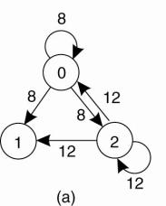
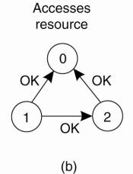
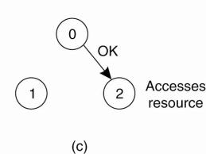
Distibuted Algorithm
After sending out requests asking permission, a process waits until everyone else has given permission – then proceeds.
When finished, it sends OK messages to all processes on its queue and deletes them all from the queue.
Suppose that two processes try to simultaneously access the resource.
Two processes want to access a shared resource at the same moment.
Process 0 has the lowest timestamp, so it wins.
When process 0 is done, it sends an OK also, so 2 can now go ahead.

Slide 49
Distibuted Algorithm
Process 0 sends everyone a request with timestamp 8, while at the same time, process 2 sends everyone a request with timestamp 12.
Process 1 is not interested in the resource, so it sends OK to both senders.
Processes 0 and 2 both see the conflict and compare timestamps.
Process 2 sees that it has lost, so it grants permission to 0 by sending OK. Process 0 now queues the request from 2 for later processing and access the resource.
When it is finished, it removes the request from 2 from its queue and sends an OK message to process 2, allowing the latter to go ahead.
The algorithm works because in the case of a conflict, the lowest timestamp wins and everyone agrees on the ordering of the timestamps.

Slide 50
Distibuted Algorithm
Advantages:
Mutual exclusion is guaranteed without deadlock or starvation.
The number of messages required per entry is now 2(n - 1), where the total number of processes in the system is n.
No single point of failure exists.
Problem 1
Single point of failure has been replaced by n points of failure.
If any process crashes, it will fail to respond to requests.
Silence will be interpreted (incorrectly) as denial of permission, thus blocking all subsequent attempts by all processes to enter all critical regions.
Since the probability of one of the n processes failing is at least n times as large as a single coordinator failing,
we have managed to replace a poor algorithm with one that is more than n times worse and requires much more network traffic as well.

Slide 51
Distibuted Algorithm
Solution 1:
When a request comes in, the receiver always sends a reply, either granting or denying permission.
Whenever either a request or a reply is lost, the sender times out and keeps trying until either a reply comes back or the sender concludes that the destination is dead.
After a request is denied, the sender should block waiting for a subsequent OK message

Slide 52
Distibuted Algorithm
Problem 2:
Either a multicast communication primitive must be used or each process must maintain the group membership list itself, including processes entering the group, leaving the group, and crashing.
The method works best with small groups of processes that never change their group memberships.
Problem 3:
A centralized algorithm that handles all requests can lead to a bottlenecks.
In the distributed algorithm, all processes are involved in all decisions concerning accessing the shared resource.
If one process is unable to handle the load, it is unlikely that forcing everyone to do exactly the same thing in parallel is not going to help much.

Slide 53
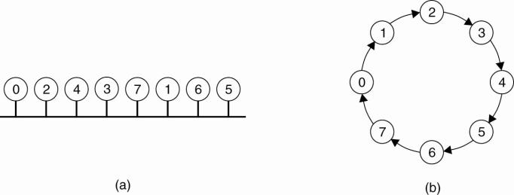
Token Ring Algorithm
A completely different approach to deterministically achieving mutual exclusion in a distributed system.
Here we have a bus network, Fig. (a), (e.g., Ethernet), with no inherent ordering of the processes.
In software, a logical ring is constructed in which each process is assigned a position in the ring, (b).
The ring positions may be allocated in numerical order of network addresses or some other means.
It does not matter what the ordering is.
All that matters is that each process knows who is next in line after itself.

Slide 54
Token Ring Algorithm
When the ring is initialized, process 0 is given a token.
The token circulates around the ring.
It is passed from process k to process k+1 (modulo the ring size) in point-to-point messages.
When a process acquires the token from its neighbor, it checks to see if it needs to access the shared resource.
If so, the process goes ahead, does all the work it needs to, and releases the resources.
After it has finished, it passes the token along the ring.
It is not permitted to immediately enter the resource again using the same token.
If a process is handed the token by its neighbor and is not interested in the resource, it just passes the token along.
As a consequence, when no processes need the resource, the token just circulates at high speed around the ring.

Slide 55
Token Ring Algorithm
Advantages:
Only one process has the token at any instant, so only one process can actually get to the resource.
Since the token circulates among the processes in a well-defined order, starvation cannot occur.
Once a process decides it wants to have access to the resource, at worst it will have to wait for every other process to use the resource.
Problems:
If the token is ever lost, it must be regenerated
Dead processes:
If a process receiving the token must acknowledge receipt, a dead process will be detected when its neighbor tries to give it the token and fails.
At that point the dead process can be removed from the group, and the token holder can throw the token over the head of the dead process to the next member down the line, or the one after that, if necessary.

Slide 56
Election Algorithms
Many distributed algorithms require one process to act as coordinator, initiator, or otherwise perform some special role.
In general, it does not matter which process takes on this special responsibility, but one of them has to do it.
Here we will look at algorithms for electing a coordinator (using this as a generic name for the special process).
If all processes are exactly the same, with no distinguishing characteristics, there is no way to select one of them to be special.
Consequently, we will assume that each process has a unique number, for example, its network address (for simplicity, we will assume one process per machine).
In general, election algorithms attempt to locate the process with the highest process number and designate it as coordinator.
The algorithms differ in the way they do the location.

Slide 57
Election Algorithms
Furthermore, we also assume that every process knows the process number of every other process.
What the processes do not know is which ones are currently up and which ones are currently down.
The goal of an election algorithm is to ensure that when an election starts, it concludes with all processes agreeing on who the new coordinator is to be.

Slide 58
Bully Algorithm
Election by Bullying (Garcia-Molina 1982):
Principle:
Each process has an associated priority (weight).
The process with the highest priority should always be elected as the coordinator.
Issue: How do we find the heaviest process?
Any process can just start an election by sending an election message to all other processes (assuming you don't know the weights of the others).
If a process P_{heavy} receives an election message from a lighter process P_{light}, it sends a take-over message to P_{light}.
P_{light} is out of the race.
If a process doesn't get a take-over message back, it wins, and sends a victory message to all other processes.

Slide 59
Bully Algorithm
The group consists of eight processes, numbered from 0 to 7.
Previously process 7 was the coordinator, but it has just crashed.
Process 4 is the first one to notice this, so it sends ELECTION messages to all the processes higher than it, namely 5, 6, and 7,
Processes 5 and 6 respond, telling 4 to stop.
Now 5 and 6 each hold an election.
Process 6 tells 5 to stop.
Process 6 wins and tells everyone

Slide 60
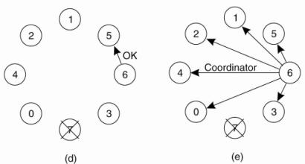
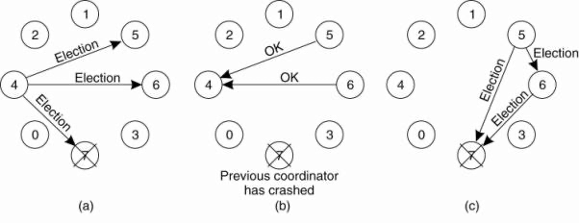
Bully Algorithm
The group consists of eight processes, numbered from 0 to 7.
Previously process 7 was the coordinator, but it has just crashed.
Process 4 is the first one to notice this, so it sends ELECTION messages to all the processes higher than it, namely 5, 6, and 7,
Processes 5 and 6 respond, telling 4 to stop.
Now 5 and 6 each hold an election.
Process 6 tells 5 to stop.
Process 6 wins and tells everyone

Slide 61
Bully Algorithm
If a process that was previously down comes back up, it holds an election.
If it happens to be the highest-numbered process currently running, it will win the election and take over the coordinator's job.
Thus the biggest guy in town always wins, hence the name "bully algorithm."

Slide 62
Ring Algorithm
Another election algorithm is based on the use of a ring.
Unlike some ring algorithms, this one does not use a token.
We assume that the processes are physically or logically ordered, so that each process knows who its successor is.
When any process notices that the coordinator is not functioning, it builds an ELECTION message containing its own process number and sends the message to its successor.
If the successor is down, the sender skips over the successor and goes to the next member along the ring. or the one after that, until a running process is located.
If a message is passed on, the sender adds itself to the list.
When it gets back to the initiator, everyone had a chance to make its presence known.
The initiator sends a coordinator message around the ring containing a list of all living processes. The one with the highest priority is elected as coordinator

Slide 63
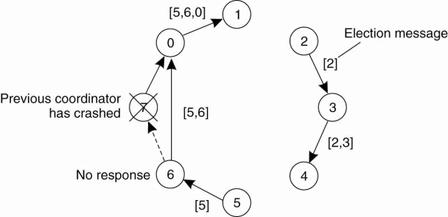
Ring Algorithm
What happens if two processes, 2 and 5, discover simultaneously that the previous coordinator, process 7, has crashed.
Each builds an ELECTION message and each starts circulating its message, independent of the other.
Both messages will complete a circuit, and both 2 and 5 will convert them into COORDINATOR messages, with exactly the same members and in the same order.
When both have completed a second circuit, both will be removed.

Slide 64
Location System
Large distributed systems that are dispersed across a wide area network is often necessary to take proximity into account.
Distributed systems for locating people and equipment will be at the heart of tomorrow's active offices.
Annotating a resource database with location information allows location-based heuristics for control and interaction to be constructed.
Technology of a system for locating people and equipment.

Slide 65
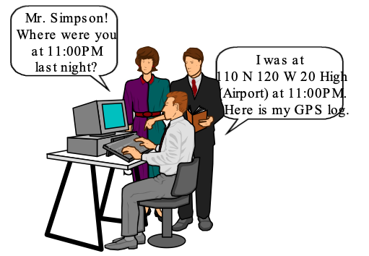
Location System

Slide 66
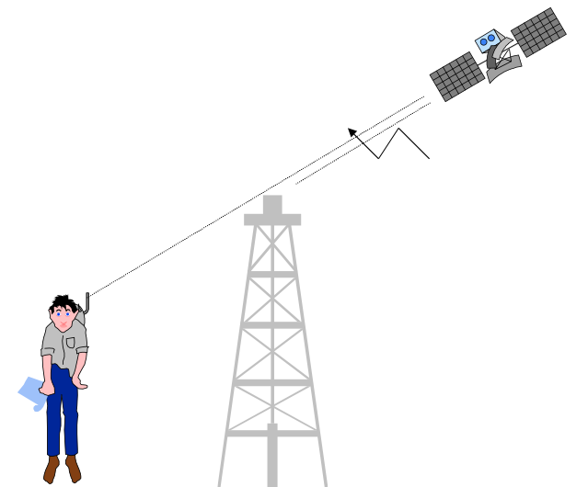
Global Positioning System (GPS)

Slide 67
Distributed Event Matching
Also called Notification filtering.
Is at the heart of publish - subscribe systems.
Goes like this:
A process specifies through a subscription S in which events it is interested.
When a process publishes a notification N on the occurrence of an event, the system needs to see if S matches N.
In the case of a match, the system should send the notification N, possibly including the data associated with the event that took place, to the subscriber.

Slide 68
Distributed Event Matching - Centralized
Simple implementation – a fully centralized server that handles all subscriptions and notifications.
A subscriber simply submits a subscription, which is subsequently stored.
When a publisher submits a notification, it is checked against each and every subscription,
And when a match is found, the notification is copied and forwarded to the associated subscriber.
Not a scalable solution.
Feasible for high processing server.
This can be scaled up by deterministically dividing the work across multiple servers.

Slide 69
Gossip – Based Coordination
Is a procedure or process of computer peer-to-peer communication that is based on the way epidemics spread.
Some distributed systems use peer-to-peer gossip to ensure that data is disseminated to all members of a group.
Some ad-hoc networks have no central registry and the only way to spread common data is to rely on each member to pass it along to their neighbors.
Aggregation
A peer – sampling service
Gossip – based overlay construction

Slide 70
Gossip – Based Coordination
Gossip protocols can be used to propagate information in a manner rather similar to the way that a viral infection spreads in a biological population.
Indeed, the mathematics of epidemics are often used to model the mathematics of gossip communication.
The term epidemic algorithm is sometimes employed when describing a software system in which this kind of gossip-based information propagation is employed.

Slide 71
Refrences
http://www.nitjsr.ac.in/course_assignment/CS02CS802%20Distributed%20Operating%20System%20(DOS)Unit-3%20Synchronization.pdf

