Slide 1
Front End Development with AngularJS
Presented by:
Bipin Upadhyaya

Slide 2
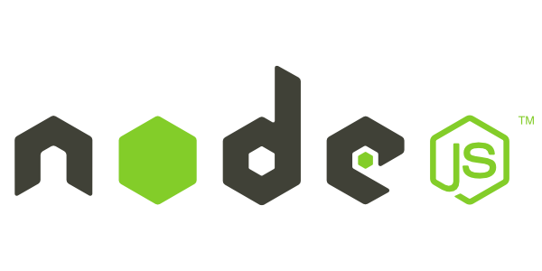

Node package manager
npm init
Node.js Package Management (NPM)
Package manager for Node.js modules
Initializes an empty Node.js project with package.json file

Slide 3

Let’s start bootstrapping
(you no longer have to write the boilerplate)

Slide 4

Client side package manager
Bower is to the web browser what NPM is to Node.js. It is a package manager for your front-end development libraries like jQuery, Bootstrap and so on.
bower search <query>
bower install <package>#<version>
Some commands (self explanatory)
bower uninstall <package>
npm install -g bower
bower list

Slide 5


Automate your frontend workflows
npm install -g grunt-cli
npm install -g gulp
Grunt and Gulp make it easy to incorporate best practices and automate the tedious parts of web development.
Notes:
Bascially you create the project (scaffolding, dependency management) 2) Develop (write css, JS), 3) Test 4) Build (Preporcess, minify, optimize images) and finally deploy. There tools makes the build process easy.

Slide 6


Yoman: Web scaffolding tool for modern app
npm install -g yo
3 types of tools for improving productivity and satisfaction when building a web app
yo scaffolds out a new application, writing your build configuration ad pulling relevant build tasks and package manager dependencies that you might need for your build.

Slide 7
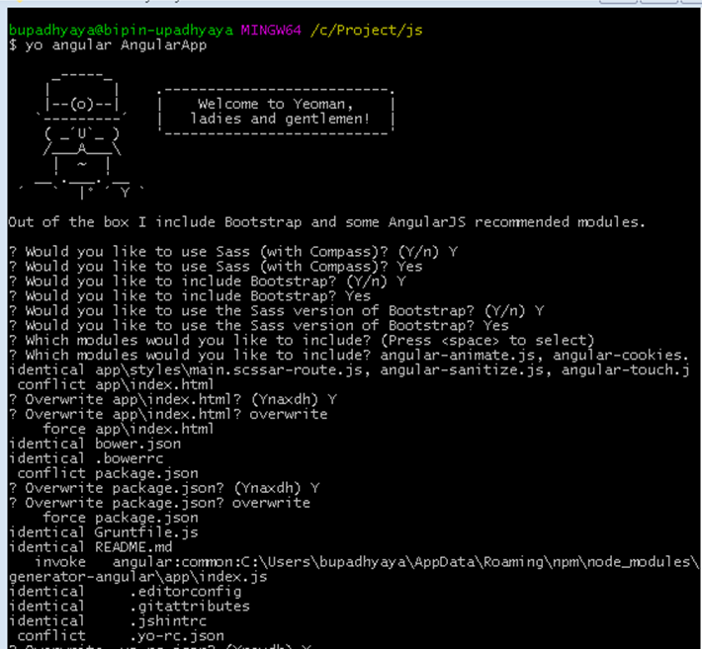
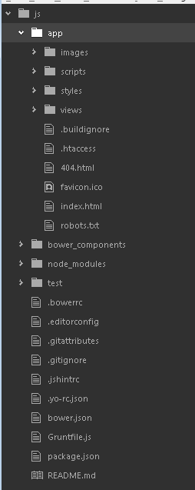

Slide 8
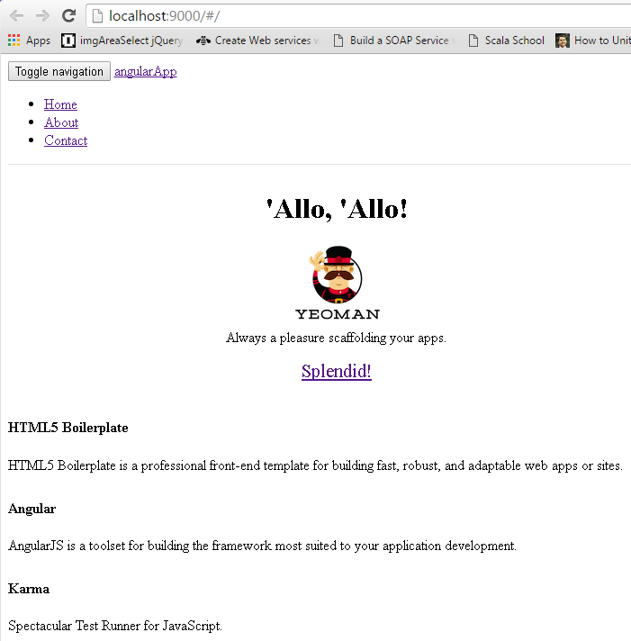
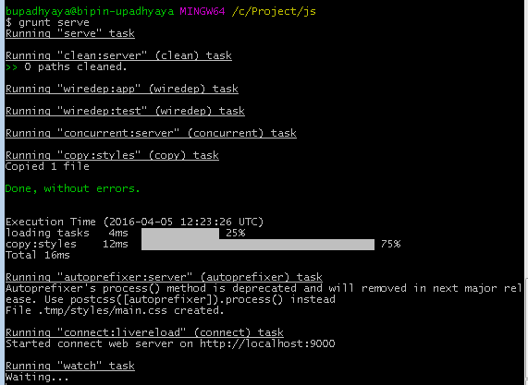
$ grunt serve

Slide 9
Angular MVC Architecture Pattern
Layers
View: Defines visual appearance
Model: Defines data model of the app (JS objects)
Controller: Adds behavior
Workflow
User interacts with the view
Changes the model, call controller
Controller manipulates the model, interacts with service
Angular JS detects model changes and updates the view

Slide 10
Angular Concepts and Terminology
Data Binding | Syncing of the data between the Scope and the HTML (two ways)
Scope | Context where the model data is stored so that templates and controllers can access
Directive | Allows developer to extend HTML with own elements and attributes (reusable pieces)
Template | HTML with additional markup used to describe what should be displayed
Compiler | Processes the template to generate HTML for the browser
Dependency Injection | Fetching and setting up all the functionality needed by a component
Module | A container for all the parts of an application
Service | A way of packaging functionality to make it available to any view

Slide 11
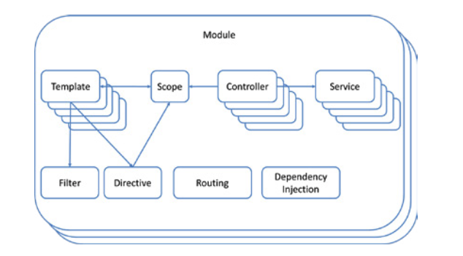
Angular Ecosystem
Ref. 1

Slide 12
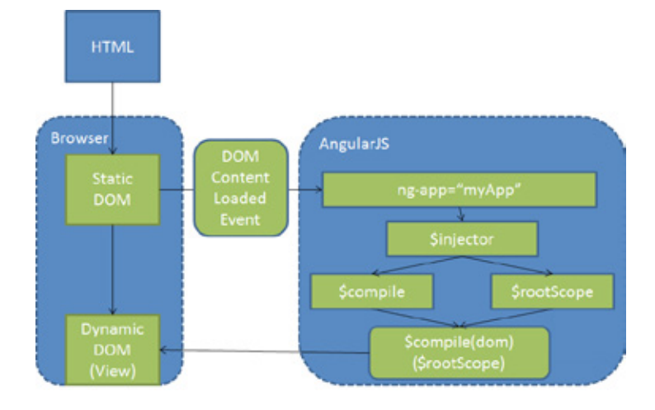
Automatically bootstrapping AngularJS
Ref. 1
Notes:
Manual Bootstrapping
angular.element(document).ready(function() {
angular.module(‘myApp’, []);
angular.bootstrap(document, [‘myApp’]);
});

Slide 13
Creating a Module
What's the Array for?
var demoApp = angular.module(‘AngularApp', []);
var demoApp = angular.module('demoApp',
['helperModule']);
Module that demoApp depends on

Slide 14
Module Phases
Config
RUN
happens early while the application is still being built. Only provider services and constant services are ready for dependency injection at this stage.
happens once the module has loaded all of its services and dependencies.
var module = angular.module(‘AngularApp', []); module.config([function() { alert('I run first'); }]); module.run([function() { alert('I run second'); }]);
Notes:
When a module runs it has two phases that you can link into.
The config phase runs early, before most services, objects, and data are available within the JavaScript.
The run phase happens after the services, objects, and data have been defined.
There are times when you will want to run some code before those service, objects, and data are defined. We’ll see that in a bit.

Slide 15
Module Components and Dependency Injection
AngularJS lets you inject services (either from its own module or from other modules) with the following pattern:
var module = angular.module(‘AngularApp', []); module.service('serviceA', function() { ... }); module.service('serviceB', function(serviceA) { ... });

Slide 16
Using Directives and Data Binding
Directive
<!DOCTYPE html>
<html ng-app= “AngularApp”>
<head>
<title></title>
</head>
<body>
<div class="container">
Name: <input type="text" ng-model="name" /> {{ name }}
</div>
<script src=“scripts/angular.js"></script>
</body>
</html>
Directive
Data Binding Expression

Slide 17
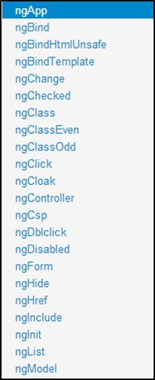
Iterating with the ng-repeat Directive
<html data-ng-app="">
...
<div class="container" data-ng-init="names=['Dave','Napur','Heedy','Shriva']">
<h3>Looping with the ng-repeat Directive</h3>
<ul>
<li data-ng-repeat="name in names">{{ name }}</li>
</ul>
</div>
...
</html>
Iterate through names

Slide 18
Naming Custom Directive
When defining a directive in JavaScript, the name is in camel case format:
When we activate that directive we use a lower case form:
module.directive('myDirective', [function() { ... }]);
<my-directive></my-directive> <div my-directive></div>

Slide 19
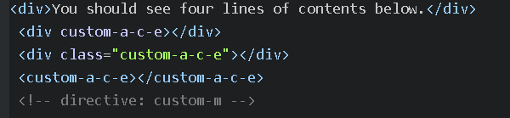
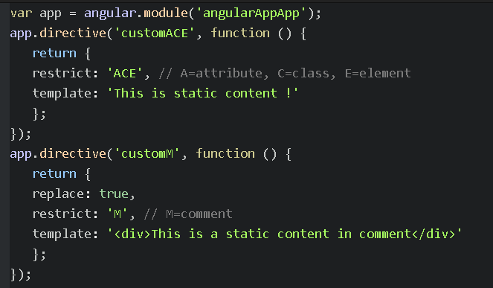
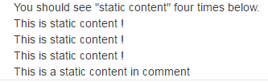
Example Custom Directive
Use it in HMTL
Define the directive
Output in browser
comment directives must set replace to true

Slide 20
Modules are Containers
<html ng-app="moduleName">
Module
Config
Filter
Directive
Factory
Controller
Service
Routes
Provider
Value
Notes:
A container for code for the different parts of your applications.
A module is used to define services that are reusable by both the HTML document and other modules:
Controller
Directive
Constant, Value
Factory, Provider, Service
Filter
Best Practice: Divide your code into modules with distinct functionality. Don’t put everything in one module.

Slide 21
Defining Routes
var demoApp = angular.module(‘AngularApp', ['ngRoute']);
demoApp.config(function ($routeProvider) {
$routeProvider
.when('/',
{
controller: 'SimpleController',
templateUrl:'View1.html'
})
.when('/view2',
{
controller: 'SimpleController',
templateUrl:'View2.html'
})
.otherwise({ redirectTo: '/' });
});
Define Module Routes

Slide 22
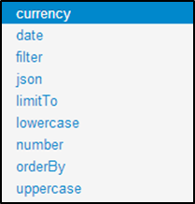
Filters
Formats the value of an expression for display to the user.
Filter can be used in view templates, controllers or services & it is easy to define your own filter.
<ul>
<li ng-repeat="cust in customers | orderBy:'name'"> {{ cust.name | uppercase }} </li>
</ul>
Order customers by name property
Filter customers by model value
<input type="text" ng-model="nameText" />
<ul>
<li ng-repeat="cust in customers | filter:nameText | orderBy:'name'"> {{ cust.name }} - {{ cust.city }}</li>
</ul>

Slide 23
Creating a Controller in a Module
var demoApp = angular.module(‘AngularApp', []);
demoApp.controller('SimpleController', function ($scope) {
$scope.customers = [
{ name: 'Dave Jones', city: 'Phoenix' },
{ name: 'Jamie Riley', city: 'Atlanta' },
{ name: 'Heedy Wahlin', city: 'Chandler' },
{ name: 'Thomas Winter', city: 'Seattle' }
];
});
Define a Module
Define a Controller

Slide 24
Creating a View and Controller
<div class="container" ng-controller="SimpleController">
<h3>Adding a Simple Controller</h3>
<ul>
<li data-ng-repeat="cust in customers"> {{ cust.name }} - {{ cust.city }} </li>
</ul>
</div>
<script>
function SimpleController($scope) { $scope.customers = [
{ name: 'Dave Jones', city: 'Phoenix' },
{ name: 'Jamie Riley', city: 'Atlanta' },
{ name: 'Heedy Wahlin', city: 'Chandler' },
{ name: 'Thomas Winter', city: 'Seattle' }
];
}
</script>
Define the controller to use
Access $scope
$scope injected dynamically
Basic controller

Slide 25
Value
The value recipe stores a value within an injectable service.
A value can store any service type: a string, a number, a function, and object, etc.
This value of this service can now be injected into any controller, filter, or service.
//define a module var myModule = angular.module(‘AngularApp', []); //define a value myModule.value('clientId', 'a12345654321x'); //define a controller that injects the value myModule.controller('myController', ['$scope', 'clientId', function ($scope, clientId) { $scope.clientId = clientId; }]);
Notes:
The value is a pretty basic service that allows you to store any type of data into a service.
**
It can be a simple data type, an object, a function, or whatever.
**
The value can now be injected into any controller, filter, or service.
What if you defined this service in Module X and your in Module Y?
Don’t worry about it. Make sure that Module Y includes Module X as a dependency, then inject the service from Module X.
**
In the code example you see how we define the service and how we inject it.

Slide 26
Service
The service recipe will generate a singleton of an instantiated object.
//define a service myModule.service('person', [function() { this.first = 'John'; this.last = 'Jones'; this.name = function() { return this.first + ' ' + this.last; }; }]); //inject the person service myModule.controller('myController', ['$scope', 'person', function($scope, person) { $scope.name = person.name(); }]);
$http
$q
$timeout
…..
Notes:
We write a function as if it were a constructor, using the “this” keyword to set property names and functions that are part of the constructor.
When you first inject this service into another controller, filter, or service it will build a singleton from the constructor.
Any subsequent injections of the service will get the same singleton.

Slide 27
JS Testing
Angular is designed to be testable (behavior-view separation, pre-bundled mocks, dependency injection).
Unit tests (ensure that the JavaScript code in our application is operating correctly) - Karma Test Runner + Jasmine.
Jasmine describes the test in natural language.
Notes:
End-to-end tests (ensure that the application as a whole operates as expected) - Protractor E2E test framework for Angular.

Slide 28
TestSuite begins with a call to describe()
describe ("A simple test", function (){
it("contains a spec with expectations", function(){
expect(true).toEqual(true);
});
});
TestCase (or spec) begins with a it
Testcase contains one or more matchers

Slide 29
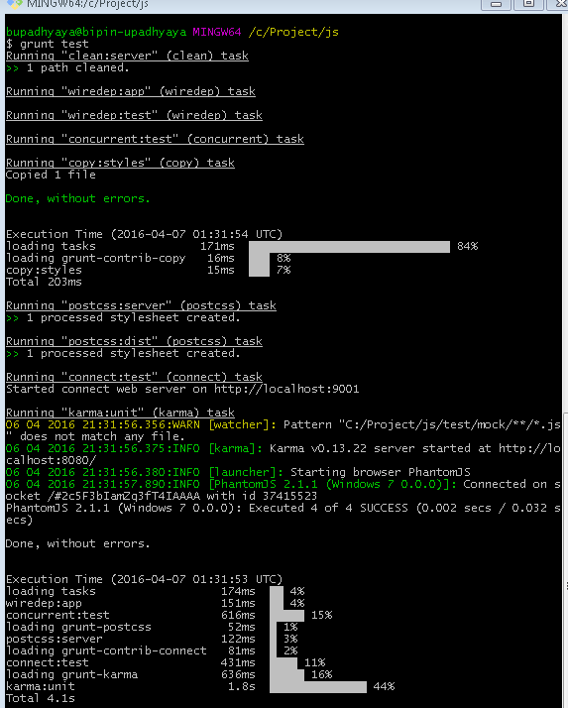

Generating components through yo generates the necessary skeleton for tests

Slide 30
References
http://cdn.tsq.me/ebook/AngularJS%20Test%20Driven.pdf
https://docs.angularjs.org/guide
https://dzone.com/refcardz/angularjs-essentials

