Slide 1
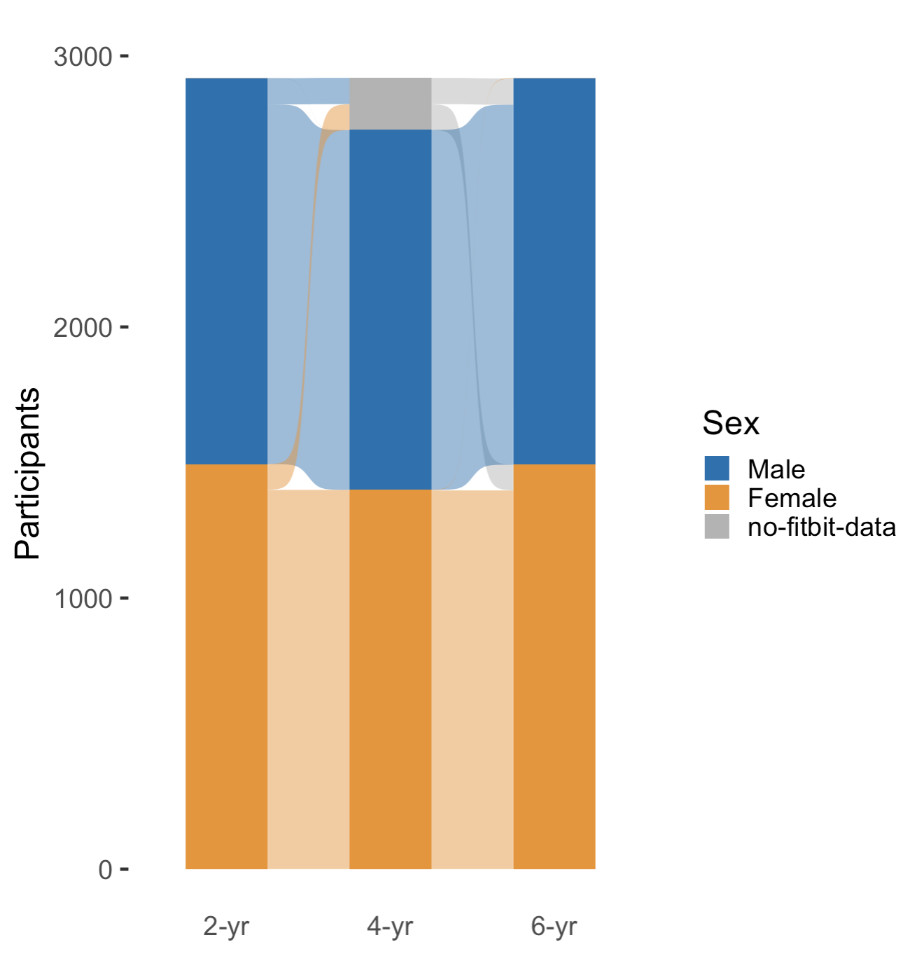
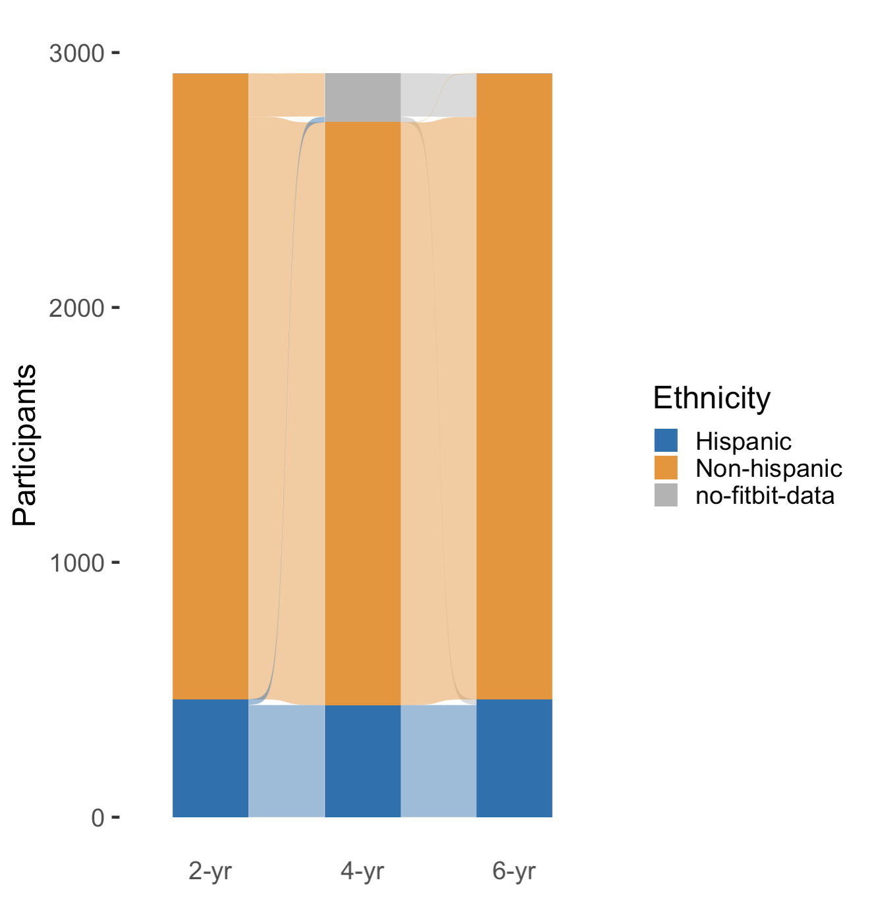
COHORT
N = 2,919

Slide 2
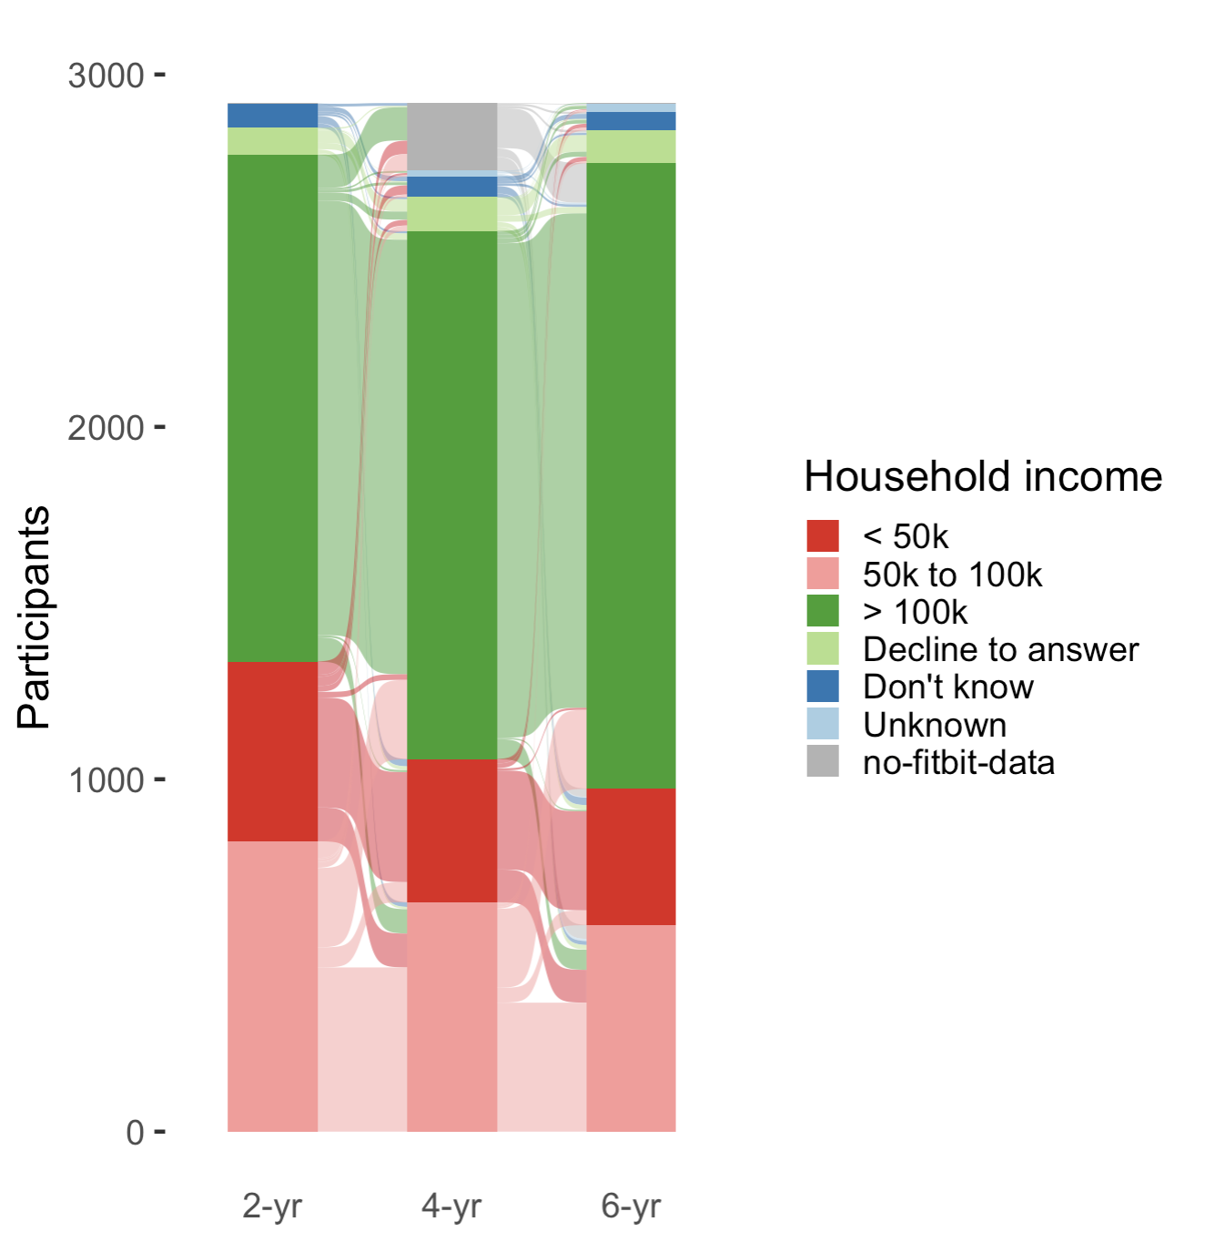
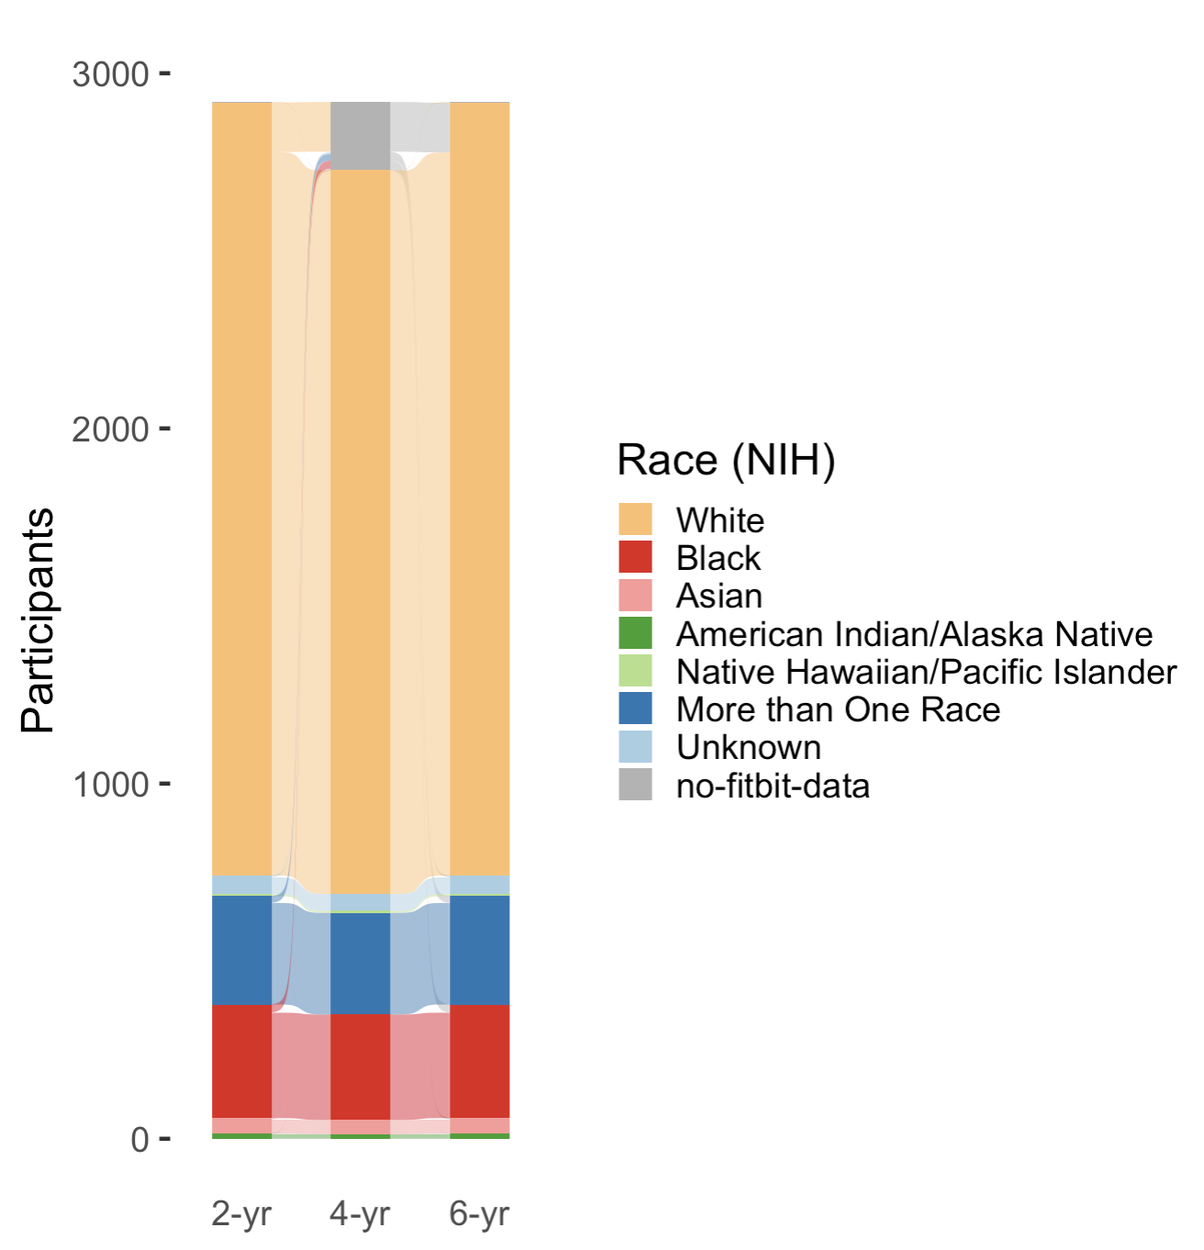
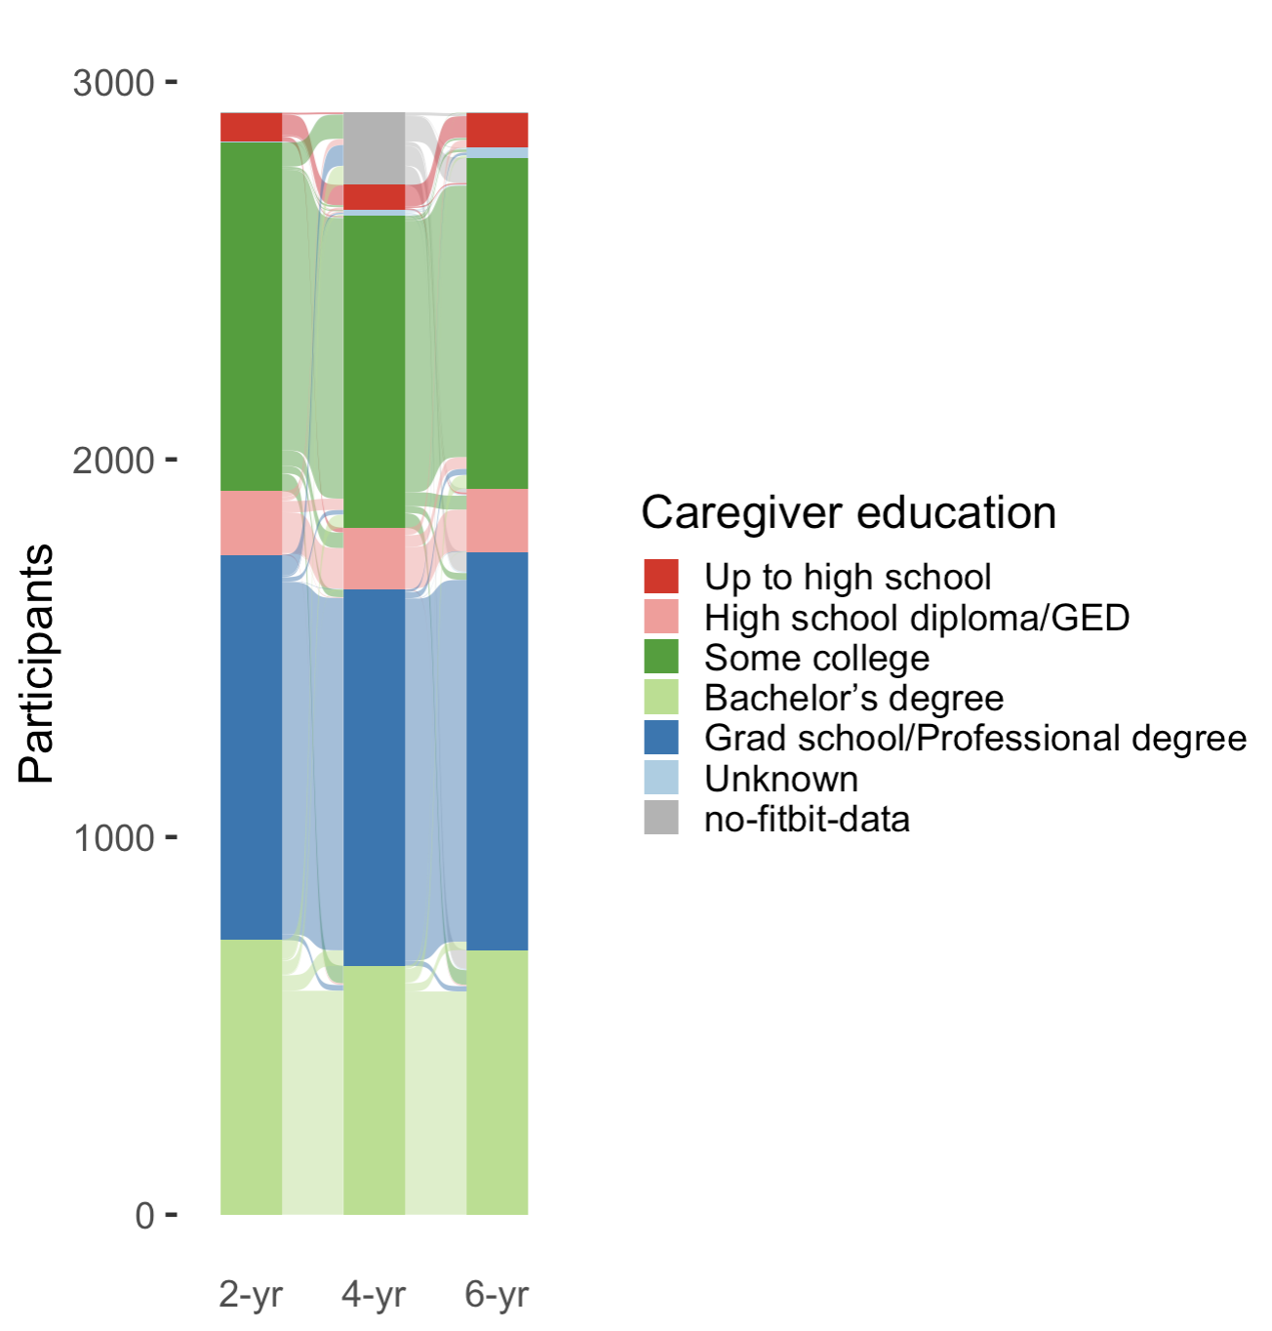
COHORT
N = 2,919

Slide 3
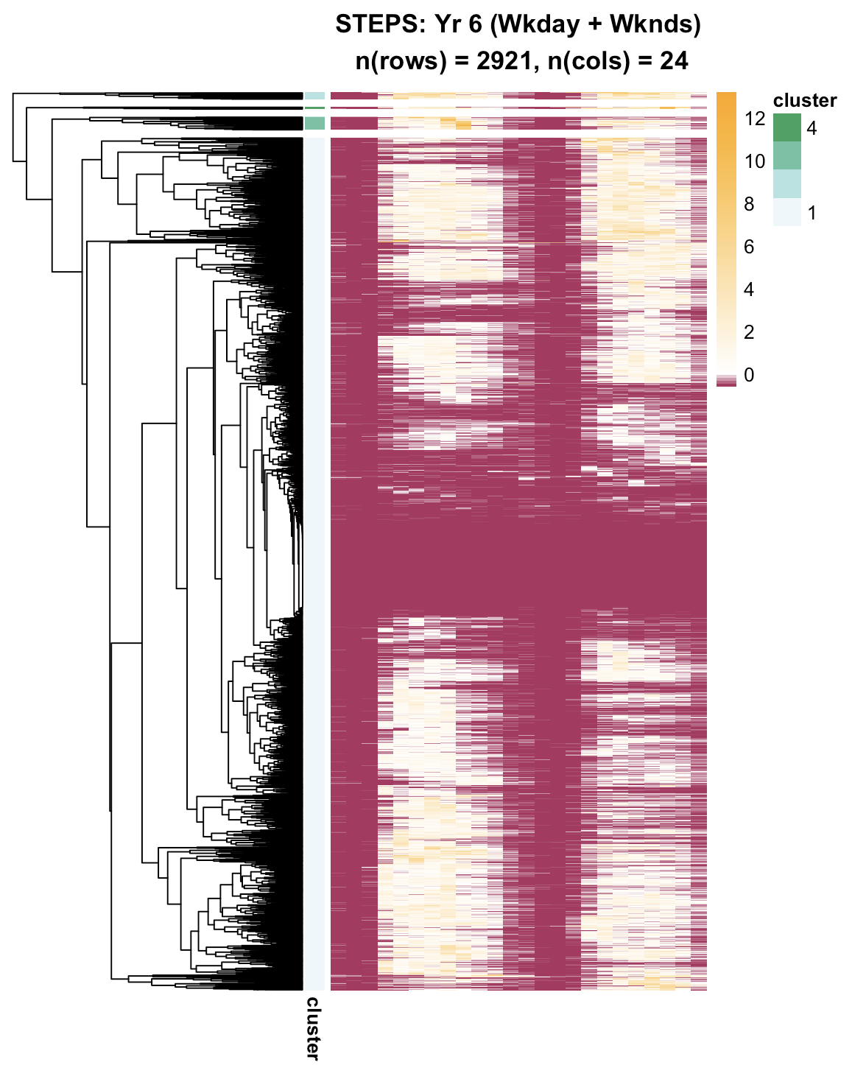
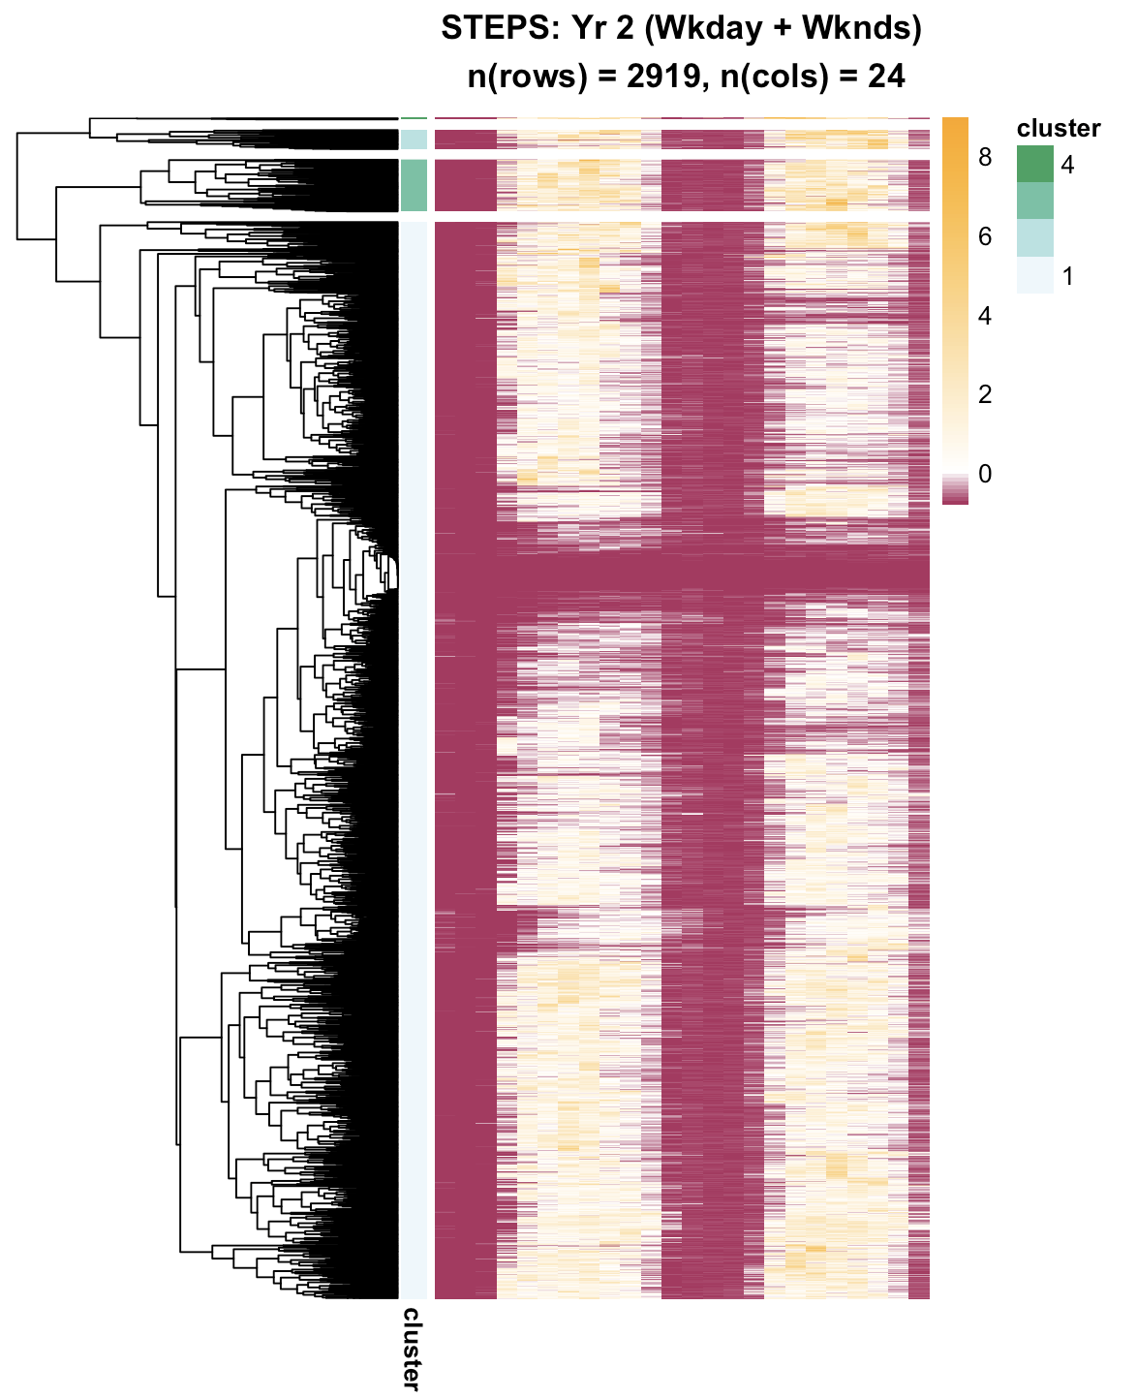
Year 2
Year 6
Weekday
WEEKEND
Weekday
WEEKEND
STEPS
1
5
9
13
17
21
1
5
9
13
17
21
1
5
9
13
17
21
1
5
9
13
17
21

Slide 4
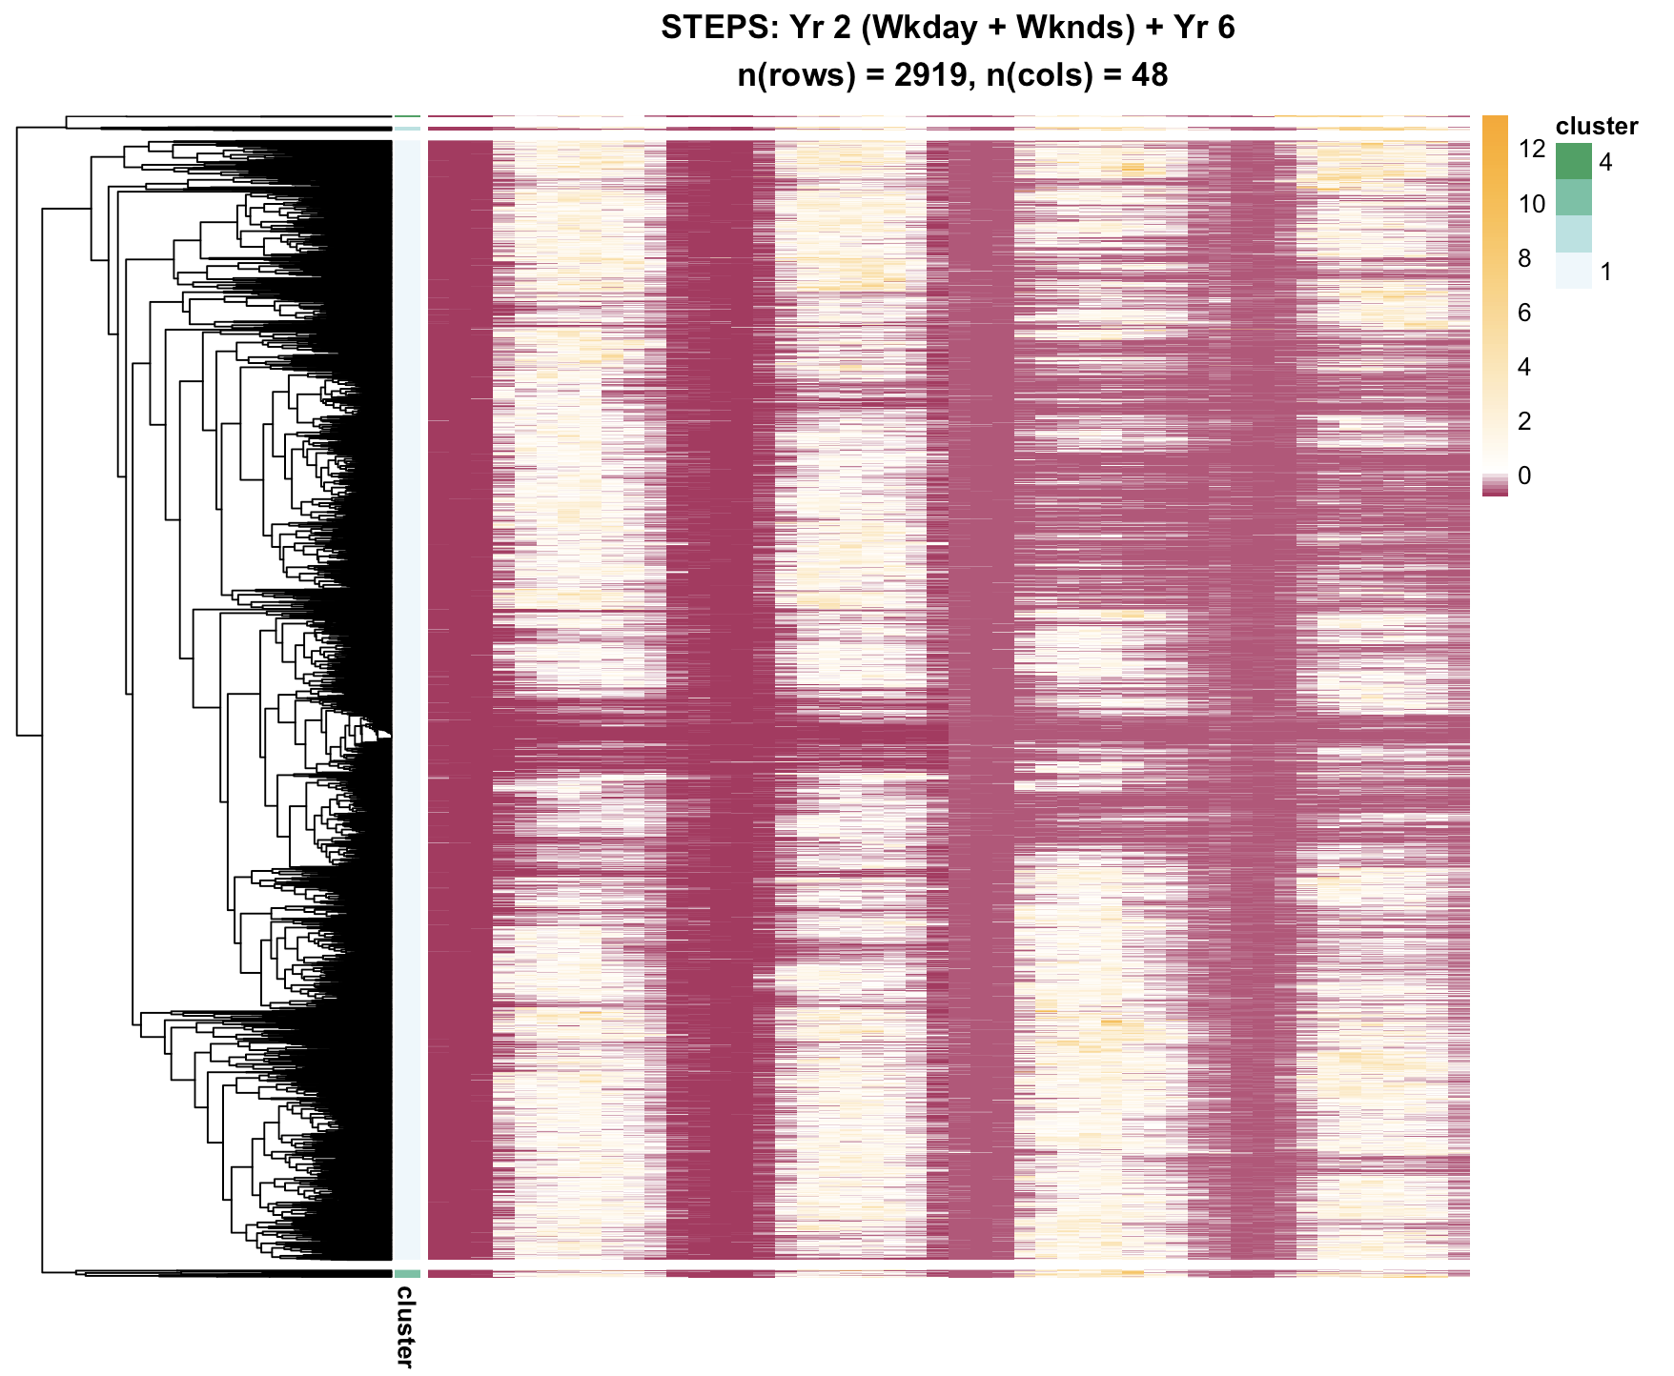
Year 2
Year 6
Weekday
WEEKEND
Weekday
WEEKEND
STEPS
1
5
9
13
17
21
1
5
9
13
17
21
1
5
9
13
17
21
1
5
9
13
17
21

Slide 5
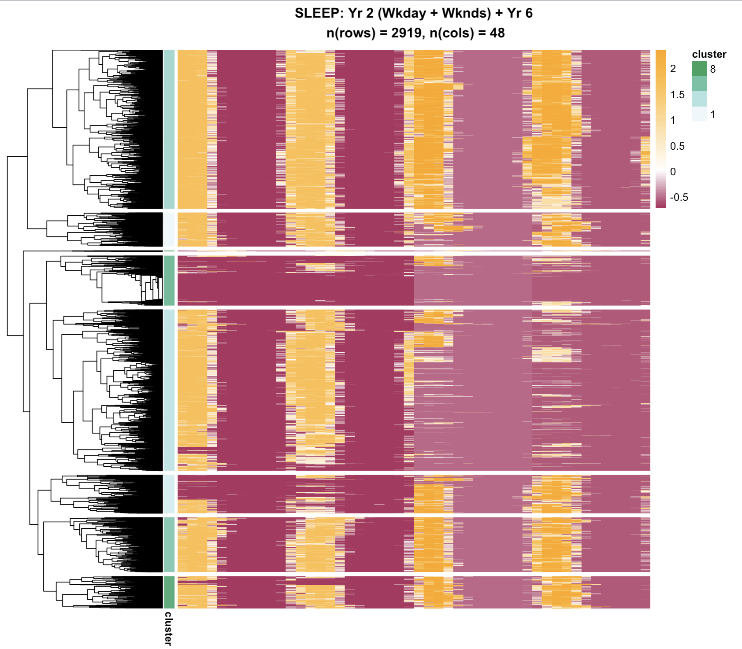
Year 2
Year 6
Weekday
WEEKEND
Weekday
WEEKEND
SLEEP
1
5
9
13
17
21
1
5
9
13
17
21
1
5
9
13
17
21
1
5
9
13
17
21

Slide 6
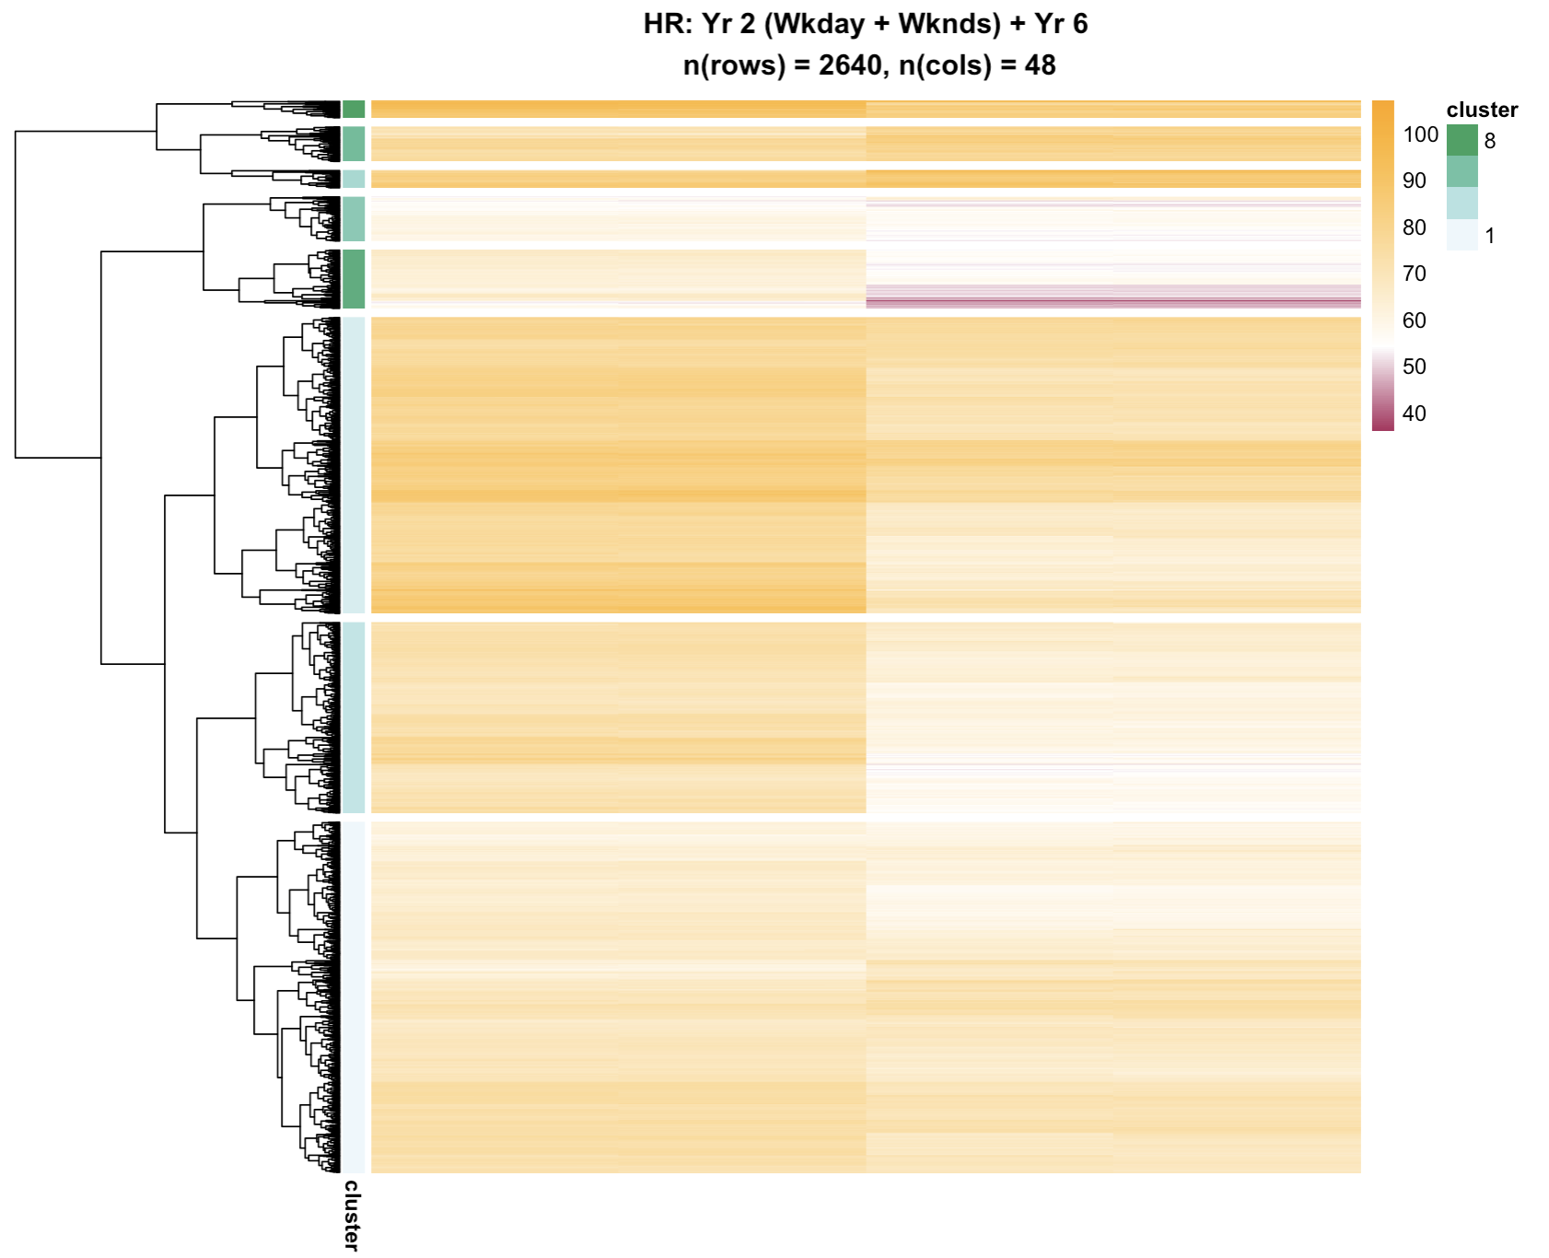

Year 2
Year 6
Weekday
WEEKEND
Weekday
WEEKEND
Heart
Rate
1
5
9
13
17
21
1
5
9
13
17
21
1
5
9
13
17
21
1
5
9
13
17
21

