Slide 1
Shortest Path Algorithms
Gaurav Naukudkar 160001040
Biplab Kumar Sahoo 160001015

Slide 2
Dijkstra’s Algorithm

Slide 3
Pseudocode
Assumptions - path from source to all nodes exist
- there is no edge with negative weights
Func Dijkstra(graph, source)
d[source]=0 -O(1)
Create vertex set min_heap -O(1)
For (each vertex v in graph)
if(v!=source) -O(V)
d[v]=infinite -O(V)
prev[v]=undef -O(V)

Slide 4
min_heap.add_with_priority (V, prev [v], d[v]) -O(logV)
While (min_heap is not empty)
u=extract_min -O(V)
for (each neibour v of u) -O(V)
temp=d[u]+length(u,v) -O(V+E)
if(temp<d[v]) -O(V+E)
d[v]=temp -O(V+E)
prev[v]=u -O(V+E)
min_heap.decrease_priority(v,temp) -O(VlogV)
return d[], prev[]

Slide 5
IMPLEMENTATION
#include <limits.h>
#include <math.h>
#include <stdio.h>
#include <stdlib.h>
struct AdjacencyListNode{
int destination;
int weight;
struct AdjacencyListNode *next;
};
struct AdjacencyList{
struct AdjacenceyListNode *head;
};
struct Graph{
int nv;
struct AdjacencyListNode *l;
};
struct AdjacencyListNode* createNode(int vertex,int wt){
struct AdjacencyListNode *node=(struct AdjacencyListNode *)malloc(sizeof(struct AdjacencyListNode));
node->destination=vertex;
node->weight=wt;
node->next=NULL;
return node;
}

Slide 6
void createGraph(struct Graph *g,int V){
g->nv=V;
struct AdjacencyListNode *list=(struct AdjacencyListNode *)malloc(V*sizeof(struct AdjacencyListNode));
g->l=list;
for(int i=0;i<V;i++){
g->l[i].destination=i;
g->l[i].weight=0;
g->l[i].next=NULL;
}
}
void addEdge(struct Graph *g,int source,int destination,int weight){
struct AdjacencyListNode *node=createNode(destination, weight);
node->next=g->l[source].next;
g->l[source].next=node;
node=createNode(source, weight);
node->next=g->l[destination].next;
g->l[destination].next=node;
}
struct MinHeapNode{
int v;
int distance;
};
struct MinHeap{
int size;
struct MinHeapNode *array;
};

Slide 7
struct MinHeap* createMinHeap(int size){
struct MinHeap *heap=(struct MinHeap*)malloc(size * sizeof(struct MinHeap));
heap->size=size;
heap->array=(struct MinHeapNode *)malloc(size * sizeof(struct MinHeapNode));
return heap;
}
struct MinHeapNode* createHeapNode(int vertex,int distance){
struct MinHeapNode *node=(struct MinHeapNode*)malloc(sizeof(struct MinHeapNode));
node->v=vertex;
node->distance=distance;
return node;
}
struct MinHeapNode* extractMin(struct MinHeap *heap){
heap->size=heap->size-1;
struct MinHeapNode *root=(struct MinHeapNode *)malloc(sizeof(struct MinHeapNode));
root->v=heap->array[0].v;
root->distance=heap->array[0].distance;
struct MinHeapNode *leaf=(struct MinHeapNode *)malloc(sizeof(struct MinHeapNode));
leaf->v=heap->array[heap->size].v;
leaf->distance=heap->array[heap->size].distance;
heap->array[0].v=leaf->v;
heap->array[0].distance=leaf->distance;
int i=0;
int left,right;
int tempv,tempdistance;

Slide 8
while(i<heap->size){
left=2*i+1;
right=2*i+2;
if(heap->array[left].distance <= heap->array[right].distance && heap->array[left].distance <= heap->array[i].distance){
tempv=heap->array[left].v;
tempdistance=heap->array[left].distance;
heap->array[left].v=heap->array[i].v;
heap->array[left].distance=heap->array[i].distance;
heap->array[i].v=tempv;
heap->array[i].distance=tempdistance;
i=left;
}
else if(heap->array[right].distance <= heap->array[left].distance && heap->array[right].distance <= heap->array[i].distance){
tempv=heap->array[right].v;
tempdistance=heap->array[right].distance;
heap->array[right].v=heap->array[i].v;
heap->array[right].distance=heap->array[i].distance;
heap->array[i].v=tempv;
heap->array[i].distance=tempdistance;
i=right;
}
else{
break;
}
}
return root;
}

Slide 9
bool isInMinHeap(struct MinHeap *heap,int v,int i){
if(i < heap->size){
if(heap->array[i].v == v){
return true;
}
else{
return (isInMinHeap(heap,v,2*i+1) || isInMinHeap(heap,v,2*i+2));
}
}
else{
return false;
}
}
int findPosition(struct MinHeap *heap,int vertex){
int i=0;
while(i < heap->size){
if(heap->array[i].v == vertex){
break;
}
else{
i++;
}
}
return i;
}
void decreasePriority(struct MinHeap *heap,int vertex){
int position=findPosition(heap,vertex);
int parent;
int tempv,tempdistance;

Slide 10
while(position > 0){
if(position%2 == 0){
parent=(position/2)-1;
}
else{
parent=position/2;
}
if(heap->array[position].distance < heap->array[parent].distance){
tempv=heap->array[position].v;
tempdistance=heap->array[position].distance;
heap->array[position].v=heap->array[parent].v;
heap->array[position].distance=heap->array[parent].distance;
heap->array[parent].v=tempv;
heap->array[parent].distance=tempdistance;
position=parent;
}
else{
break;
}
}
}
int* dijkstra(struct Graph *g,int source){
int n=g->nv;
int *d=(int *)malloc(n*sizeof(int));
struct MinHeap *heap=createMinHeap(n);
int i;

Slide 11
for(i=0;i<n;i++){
if(i!=source){
d[i]=INT_MAX;
heap->array[i].v=i;
heap->array[i].distance=d[i];
}
}
d[source]=0;
heap->array[source].v=source;
heap->array[source].distance=d[source];
decreasePriority(heap,source);
while(heap->size>1){
struct MinHeapNode *node=extractMin(heap);
int u=node->v;
struct AdjacencyListNode *adjacent=g->l[u].next;
while(adjacent!=NULL){
int v=adjacent->destination;
int wt=adjacent->weight;
if((d[u] + wt) < d[v] && isInMinHeap(heap,v,0)){
d[v]=d[u]+wt;
int pos=findPosition(heap,v);
heap->array[pos].distance=d[v];
decreasePriority(heap,v);
}
adjacent=adjacent->next;
}
}
return d;

Slide 12
int main(){
struct Graph *g=(struct Graph*)malloc(sizeof(struct Graph));
printf("Enter the number of vertices in the graph\n");
int V;
scanf("%d",&V);
createGraph(g,V);
int src,des,wt,i;
printf("Enter the number of edges in the graph\n");
int E;
scanf("%d",&E);
printf("Enter info about the edges\n");
for(i=0;i<E;i++){
scanf("%d %d %d",&src,&des,&wt);
addEdge(g,src,des,wt);
}
printf("Enter source vertex\n");
scanf("%d",&src);
int *a=dijkstra(g,src);
for(i=0;i<V;i++){
printf("Shortest path from source %d to destination %d is of length %d\n",src,i,a[i]);
}
return 0;
}

Slide 13
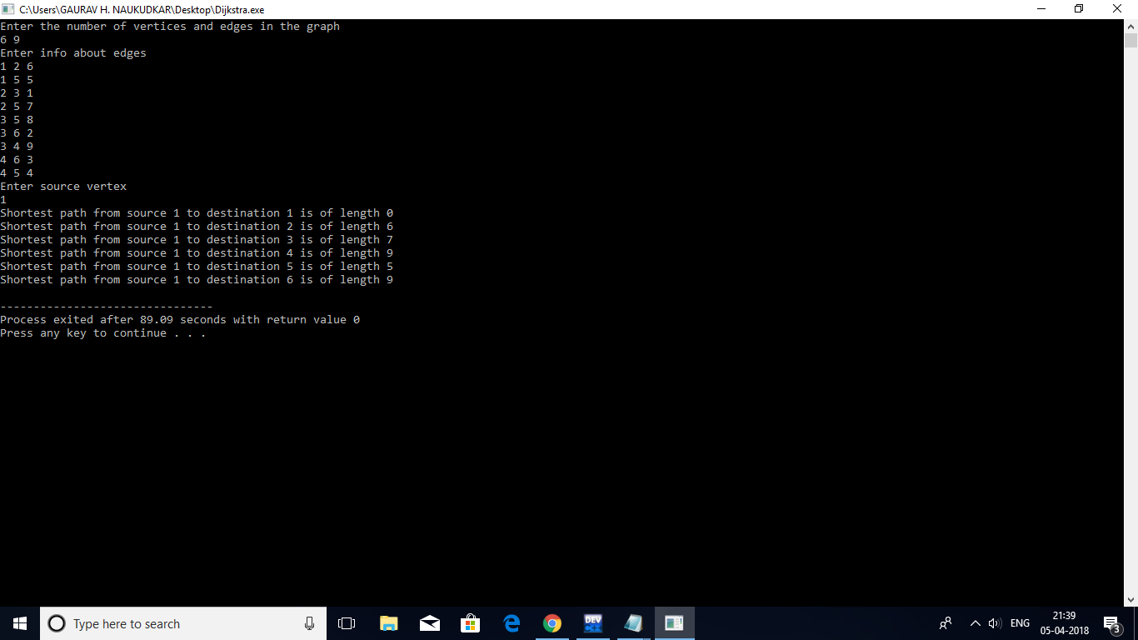
OUTPUT

Slide 14
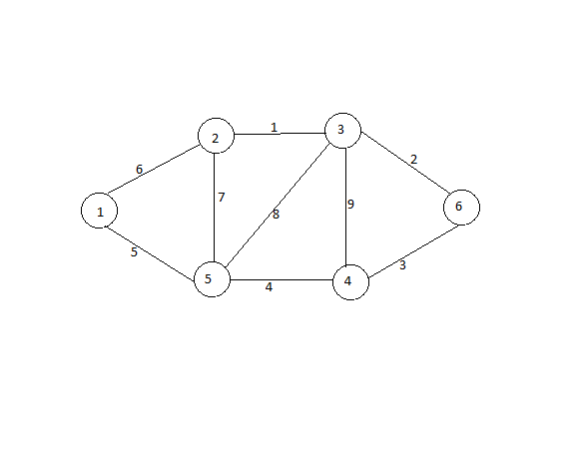
EXAMPLE
Consider the following weighted undirected graph where source is the vertex 1 and we will find the shortest path to every vertex.

Slide 15
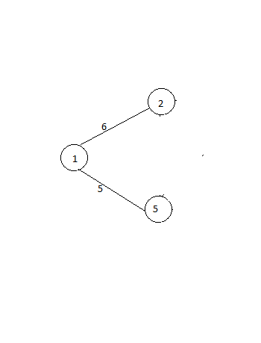
Initially d[v] is initialised to infinite for every vertex except source for which d[source]=0. Create a min heap and add every vertex to the heap. Initially the extract min function will return the source vertex that is 1 and the neighbours of 1 are 2 and 5. So according to the algorithm d[2] and d[5] will be updated to 6 and 5 respectively because d[1]+length (1,2) < d[2] and d[1]+length (1,5) < d[5].

Slide 16
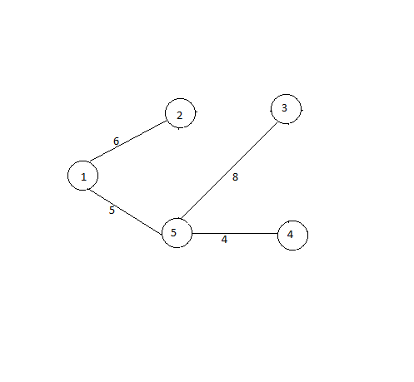
Now the extract min function will return 5 and the neighbours of 5 are 3 and 4 so d[3] and d[4] will be updated to 13 and 9 respectively because d[5]+length (5,3) < d[3] and d[5]+length (5,4) < d[4].

Slide 17
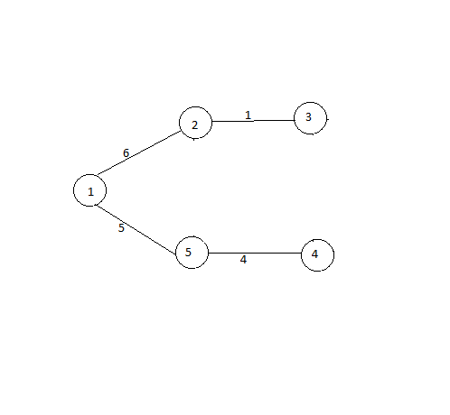
Now the extract min function will return 2 and the neighbours of 2 are 1, 3 and 5 so d[3] will be updated to 7 because d[2]+length (2,3) < d[3] and d[1] and d[5] won’t be updated because d[2]+length (1,2) > d[1] and d[2]+length (2,5) > d[5].

Slide 18
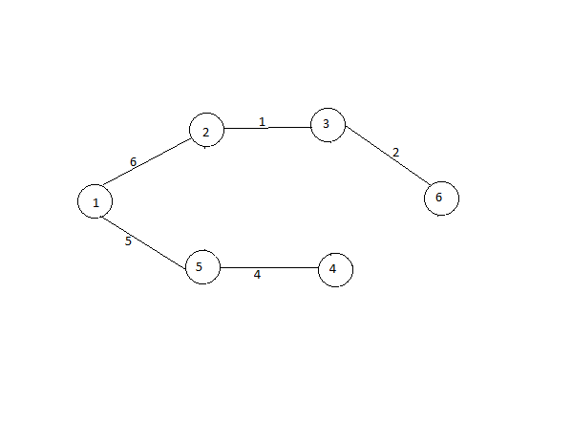
Now the extract min function will return 3 and the neighbours of 3 are 2, 4, 5 and 6 so d[6] will be updated to 10 because d[3]+length (6,3) < d[6] and d[2], d[4] and d[5] won’t be updated because d[3]+length (3,2) > d[2], d[3]+length (3,4) > d[4] and d[3]+length (3,5) > d[5]. So now the algorithm will terminate and shortest path length for every vertex is stored in array d[].

Slide 19
Bellman-Ford Algorithm

Slide 20
Pseudococde
Assumption – no negative weight cycle should be present in the graph otherwise shortest path will be negative of infinity
Func bellman_ford(graph, source)
Create an array d[n] (n represents no. of vertices) -O(V)
For each v belongs to V v!=source
d[v]=infinite -O(V)
d[source]=0 -O(1)

Slide 21
For i from 1 to n-1
For each node v belonging to V
For each edge(v,w) belonging to E -O(V)
if (d[v]!=infinite) and (d[v]+weight(v,w)<d[w]) -O(VE)
d[w]=d[v]+weight(v,w) -O(VE)
Return d[]

Slide 22
IMPLEMENTATION
#include <stdio.h>
#include <stdlib.h>
#include <limits.h>
#include <math.h>
struct Edge{
int s;
int d;
int w;
};
struct Graph{
int nv;
int ne;
struct Edge *e;
};
void createGraph(struct Graph *g){
printf("Enter the info of the edges \n");
int i;
struct Edge *edges=(struct Edge*)malloc((g->ne)*sizeof(struct Edge));
g->e=edges;
for(i=0;i<(g->ne);i++){
int source,destination,weight;
scanf("%d %d %d",&source,&destination,&weight);
g->e[i].s=source;
g->e[i].d=destination;
g->e[i].w=weight;
}
}

Slide 23
int* bellmanFord(struct Graph *g,int source){
int *d=(int *)malloc((g->nv)*sizeof(int));
int i,j;
for(i=0;i<(g->nv);i++){
if(i==source){
d[i]=0;
}
else{
d[i]=INT_MAX;
}
}
for(i=1;i<(g->nv);i++){
for(j=0;j<(g->ne);j++){
int u=g->e[j].s;
int v=g->e[j].d;
int wt=g->e[j].w;
if((d[u]!=INT_MAX) && (d[v] > (d[u]+wt))){
d[v]=d[u]+wt;
}
}
}
return d;
}

Slide 24
int main(){
int n,m,src,des,i;
struct Graph *g=(struct Graph*)malloc(sizeof(struct Graph));
printf("Enter the number of vertices and edges in the graph\n");
scanf("%d %d",&n,&m);
g->nv=n;
g->ne=m;
createGraph(g);
printf("Enter source\n");
scanf("%d",&src);
int *a=bellmanFord(g,src);
for(i=0;i<n;i++){
printf("Shortest path from source %d to destination %d is of length %d\n",src,i,a[i]);
}
return 0;
}

Slide 25
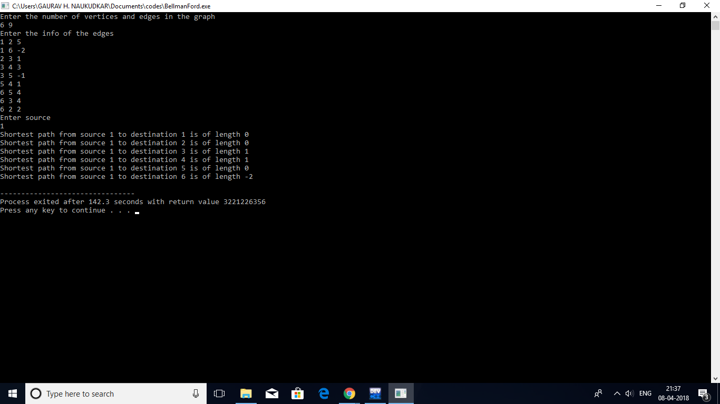
OUTPUT

Slide 26
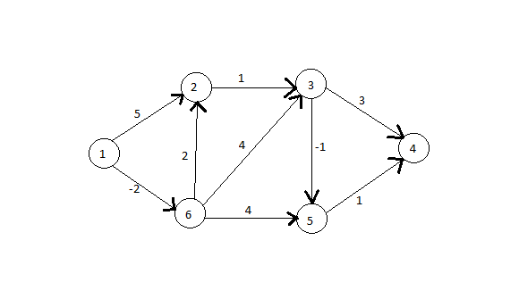
EXAMPLE
Consider the following graph in which 1 is the source vertex. We will find the shortest path from source to all nodes.
Any order can be followed while selecting edges. We have selected the order (1,6), (1,2), (2,3), (6,2), (6,3), (3,5), (6,5), (3,4) and (5,4) during every iteration.

Slide 27
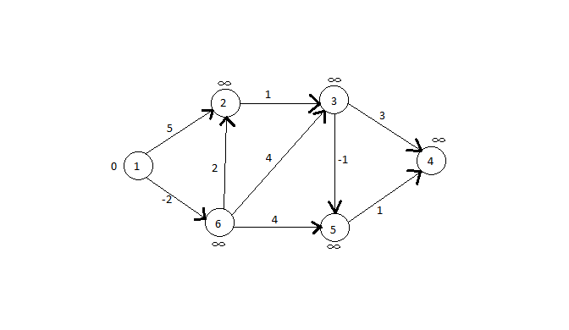
According to this pseudocode d[] of all vertices is initialized as infinity except the source.

Slide 28
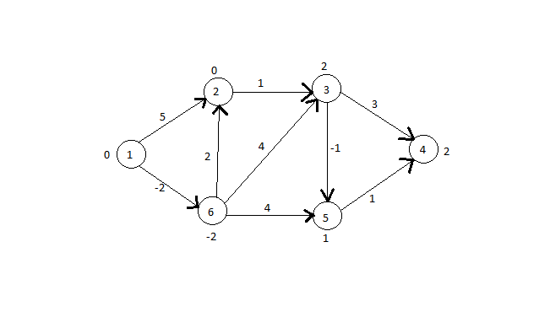
If we consider the edges in the order specified earlier we can see that d[2], d[3], d[4], d[5] and d[6] will be update to 0, 2, 2, 1 and -2 respectively as for edge (1,6) d[1]+weight(1,6)=-2<d[6], for edge(1,2) d[1]+weight(1,2)=5<d[2], for edge(2,3) d[2]+weight(2,3)=6<d[3],for edge(6,2) d[6]+weight(6,2)=0<d[2], for edge(6,3) d[6]+weight(6,3)=2<d[3], for edge(3,5) d[3]+weight(3,5)=1<d[5], for edge(6,5) d[6]+weight(6,5)=2>d[5],for edge(3,4) d[3]+weight(3,4)=5<d[4] and for edge(5,4) d[5]+weight(5,4)=2<d[4].

Slide 29
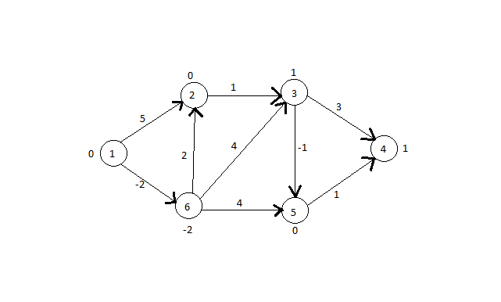
So in this iteration d[3], d[4] and d[5] will be updated to 1, 1 and 0 respectively. Since for edge(2,3) d[2]+weight(2,3)=1<d[3], for edge(3,5) d[3]+weight(3,5)=0<d[5] and for edge (5,4) d[5]+weight(5,4)=1<d[4].
For the next successive iterations there will be no changes in d[] so this graph shows the length of the shortest path.

Slide 30
JOHNSON’S ALGORITHM

Slide 31
PSEUDOCODE
Assumption- No negative weight cycles allowed
Func johnson(graph G,source)
Vertex S -O(1)
G’=G+edges from S to each v belonging to V -O(V)
bellmanford(G’,S) -O(VE)
For(i from 0 to |V|-1)
h[i]=bellmanford.d[i]; -O(V)
For(each edge (u,v) in graph G)
update weight (u,v) to weight+h[u]-h[v]; -O(E)
For(i from 0 to |V|)
dijkstra(G,i) -O(V.VlogV)

Slide 32
IMPLEMENTATION
#include <stdio.h>
#include <stdlib.h>
#include <limits.h>
#include <stdbool.h>
#include <math.h>
struct Edge{
int src;
int des;
int wt;
};
struct Graph{
int nv;
int ne;
struct Edge *e;
};
void createGraph(struct Graph *g,int n,int m){
g->nv=n;
g->ne=m;
struct Edge *edges=(struct Edge *)malloc(m*sizeof(struct Edge));
g->e=edges;
int i,u,v,w;
printf("Enter info about edges \n");

Slide 33
for(i=0;i<m;i++){
scanf("%d %d %d",&u,&v,&w);
g->e[i].src=u;
g->e[i].des=v;
g->e[i].wt=w;
}
}
int* bellmanFord(struct Graph *g,int source){
int *d=(int *)malloc((g->nv)*sizeof(int));
int i,j;
for(i=0;i<(g->nv);i++){
if(i==source){
d[i]=0;
}
else{
d[i]=INT_MAX;
}
}
for(i=1;i<(g->nv);i++){
for(j=0;j<(g->ne);j++){
int u=g->e[j].src;
int v=g->e[j].des;
int wt=g->e[j].wt;
if((d[u]!=INT_MAX) && ((d[u]+wt) < d[v])){
d[v]=d[u]+wt;
}
}
}return d;}

Slide 34
int isInV(int *V,int VSize,int u){
int i,f=0;
for(i=0;i<VSize;i++){
if(V[i]==u){
f=1;
break;
}
}
return f;
}
int* dijkstra(struct Graph *g,int source){
int *d=(int *)malloc((g->nv)*sizeof(int));
int i,j;
for(i=0;i<(g->nv);i++){
if(i==source){
d[i]=0;
}
else{
d[i]=INT_MAX;
}
}
int *V=(int *)malloc((g->nv)*sizeof(int));
int VSize=0;
V[0]=source;
VSize++;
j=VSize;
int tempSrc,tempDest,tempWt,min;

Slide 35
while(j < (g->nv)){
min=INT_MAX;
for(i=0;i<(g->ne);i++){
int u=g->e[i].src;
int v=g->e[i].des;
int w=g->e[i].wt;
int x=isInV(V,VSize,u);
int y=isInV(V,VSize,v);
if(x==1 && y==0 && (d[u]+w)<min){
min=d[u]+w;
tempSrc=u;
tempDest=v;
tempWt=w;
}
}
if(min!=INT_MAX){
V[VSize]=tempDest;
VSize++;
d[tempDest]=d[tempSrc]+tempWt;
j++;
}
else{
j++;
}
}
return d;
}

Slide 36
void johnson(struct Graph *g){
struct Graph *g1=(struct Graph *)malloc(sizeof(struct Graph));
g1->nv=g->nv+1;
g1->ne=g->ne+g->nv;
struct Edge *edges=(struct Edge *)malloc((g1->ne)*sizeof(struct Edge));
g1->e=edges;
int i,j;
for(i=0;i<(g->ne);i++){
g1->e[i].src=g->e[i].src;
g1->e[i].des=g->e[i].des;
g1->e[i].wt=g->e[i].wt;
}
for(i=(g->ne);i<(g1->ne);i++){
g1->e[i].src=g->nv;
g1->e[i].des=i-(g->ne);
g1->e[i].wt=0;
}
int *h=bellmanFord(g1,g->nv);
for(i=0;i<(g->ne);i++){
int u=g->e[i].src;
int v=g->e[i].des;
g->e[i].wt+=h[u]-h[v];
}
for(i=0;i<(g->nv);i++){
int *d=dijkstra(g,i);
for(j=0;j<(g->nv);j++){
if(d[j]!=INT_MAX){
printf("Shortest path from source %d to destination %d is of length %d\n",i,j,d[j]-h[i]+h[j]);
}

Slide 37
else{
printf("There does not exist a path from source %d to destination %d \n",i,j);
}
}
printf("\n");
}
}
int main(){
int n,m;
printf("Enter number of vertices and edges in the graph \n");
scanf("%d %d",&n,&m);
struct Graph *g=(struct Graph *)malloc(sizeof(struct Graph));
createGraph(g,n,m);
johnson(g);
return 0;
}

Slide 38
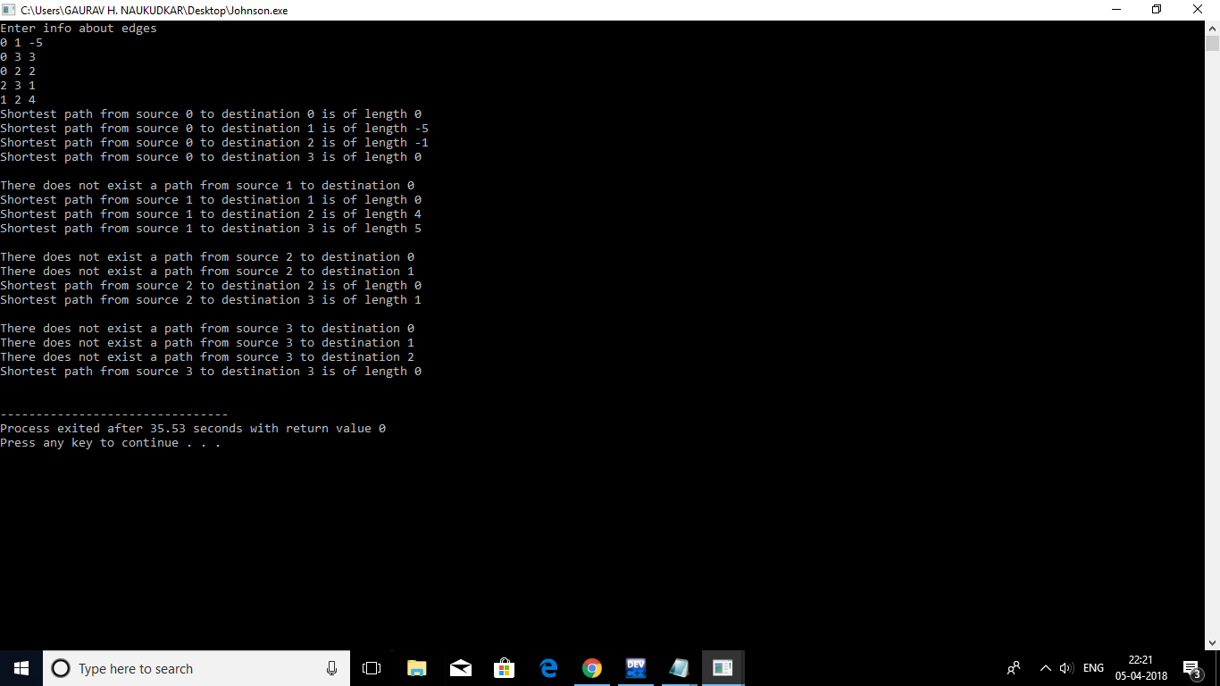
OUTPUT

Slide 39
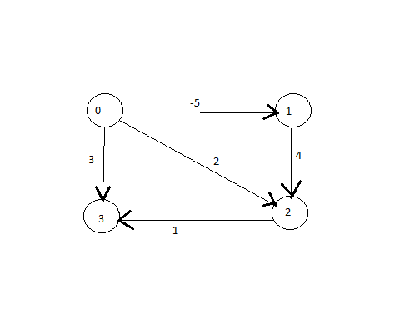
EXAMPLE
Consider the following weighted directed graph . We are going to find shortest path between every pair of vertices in the graph.

Slide 40
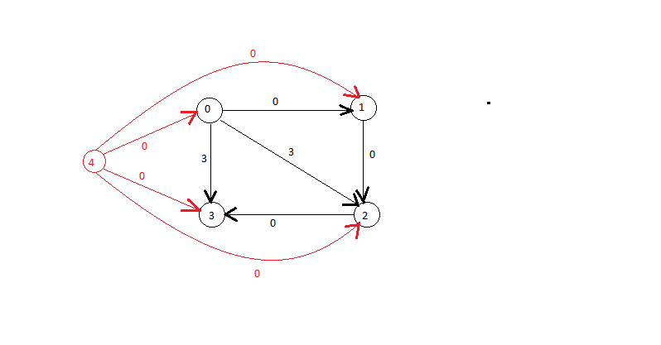
Add an extra vertex 4 to the graph and add extra edges of weight 0 from that vertex to every other vertex. Now apply belmanford algorithm to this graph to find shortest paths considering the new vertex as the source.

Slide 41
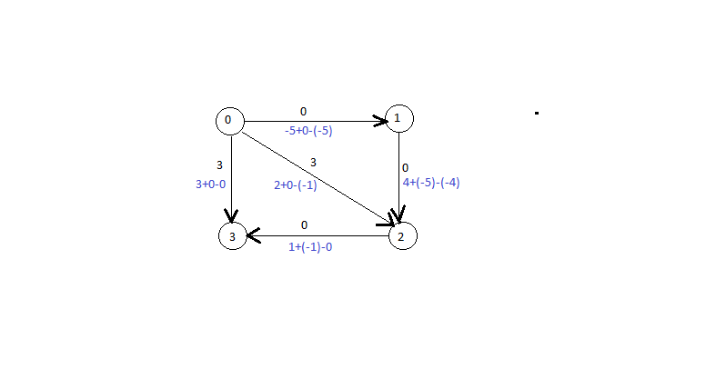
The Belman-Ford algorithm will return the above graph with shortest path as indicated by the values near the vertices. Then we have to update the weight of each edge in the original graph using the formula weight (u,v)=weight(u,v)+h[u]-h[v]. Now apply dijkstra algorithm

Slide 42
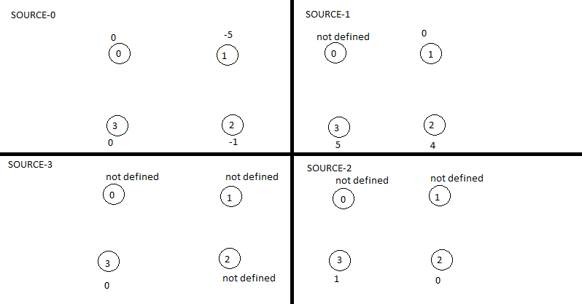
After applying Dijkstra with different vertices as source we get the following shortest (we need to subtract h[source]-h[destination] from the shortest path obtained by Dijkstra’s Algorithm for every pair of (source, destination)).

Slide 43
Floyd Warshall Algorithm

Slide 44
PSEUDOCODE
Assumption - Negative weight cycles are not allowed
- Applicable only for directed graphs
Func floyd_warshall(graph,|V|)
For(k from 0 to |V|-1)
for(i from 0 to |V|-1) -O(V)
for(j from 0 to |V|-1) -O(V.V)
if((G[i][k]+G[k][j])<(G[i][j])) -O(V.V.V)
G[i][j]=G[i][k]+G[k][j] -O(V.V.V)
Return G

Slide 45
IMPLEMENTATION
#include <stdio.h>
#include <stdlib.h>
#include <limits.h>
#include <math.h>
void createGraph(int **g,int m){
int i,src,des,wt;
printf("Enter info about edges \n");
for(i=0;i<m;i++){
scanf("%d %d %d",&src,&des,&wt);
g[src][des]=wt;
}
}
void print(int **g,int n){
int i,j;
for(i=0;i<n;i++){
for(j=0;j<n;j++){
if(g[i][j] == INT_MAX){
printf("There does not exist a path from source %d to destination %d\n",i,j);
}
else{
printf("Shortest path from source %d to destination %d is of length %d\n",i,j,g[i][j]);
}
}
printf("\n");
}
}

Slide 46
void warshall(int **g,int n){
int i,j,k;
for(k=0;k<n;k++){
for(i=0;i<n;i++){
for(j=0;j<n;j++){
if((g[i][k] + g[k][j]) < g[i][j] && (g[i][k] != INT_MAX) && (g[k][j] != INT_MAX)){
g[i][j]=g[i][k] + g[k][j];
}
}
}
}
print(g,n);
}
int main(){
int n,m,i,j;
printf("Enter the number of vertices and edges in the graph \n");
scanf("%d %d",&n,&m);
int **g=(int **)malloc(n*sizeof(int *));
for(i=0;i<n;i++){
g[i]=(int *)malloc(n*sizeof(int));
}
for(i=0;i<n;i++){
for(j=0;j<n;j++){
if(i == j){
g[i][j]=0;
}
}

Slide 47
else{
g[i][j]=INT_MAX;
}
}
}
createGraph(g,m);
warshall(g,n);
return 0;

Slide 48
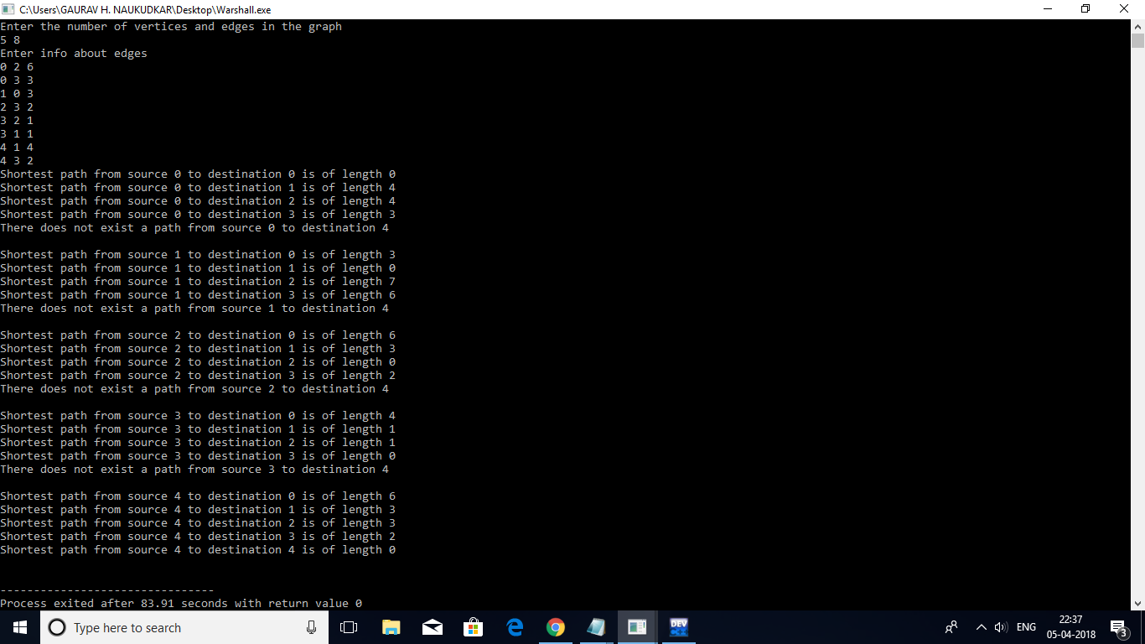
OUTPUT

Slide 49
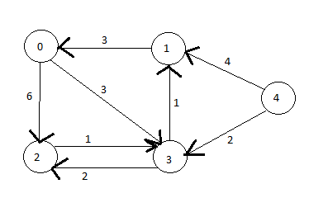
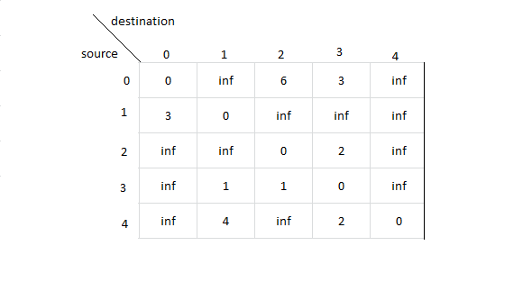
EXAMPLE
Consider the above graph. It’s matrix representation will be as above shown where G[u][v] represents path length from source u to destinaation v.

Slide 50
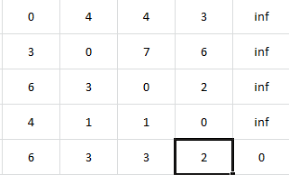
Applying Floyd Warshall’s algorithm to the previous graph will yield the above results (shortest path from source to destination shown in matrix form).

Slide 51
DIJKTRA Vs bellman-ford
TIME complexity analysis

Slide 52
DIJkSTRA’S
BELLMAN-FORD
As we see in the pseudocode the highest order step is having complexity in order VlogV. So, the complexity is VlogV.
Applicable on both directed and undirected graphs.
This is a greedy approach of solving shortest path problems.
No negative weights are allowed on edges in the graph.
In this algorithm’s pseudocode the highest order of complexity seen was VE. Hence the complexity is VE.
Applicable only on directed graph.
This is a dynamic programming algorithm.
Negative edge weights are allowed but there should not exist any cycle in the graph with edge weights summing to negative.

Slide 53
JOHNSON vs floyd warshall
Time and space complexity analysis

Slide 54
JOHNSON’s
FLOYD WARSHALL
This is an algorithm that comprises of both Bellman-Ford and Dijkstra’s usage. The step which has max complexity has both of them involved that is why the complexity is of order VE+V.VlogV.
This algorithm has zero space complexity.
It’s algorithm involves both greedy and dynamic approach.
This algorithm as we can see has 3 nested loops which makes the algorithm really small but the complexity extremely high. The operation completely inside the 3 loops will have complexity of V.V.V which is the order of whole algorithm.
This algorithm has space complexity of V.V.
This algorithm is purely dynamic form of implementation of code.

Slide 55
Application of shortest path algorithms

Slide 56
Flight routes connecting different cities
As we know that the shortest path algorithms could be applied to compute optimized route for transportation systems. In our case we are trying to find optimized flight routes. We have made two matrices showing the distance between the cities in kilometres and the time taken to travel from one city to another in minutes. The product of respective elements of these two matrices will give us the edge weights of the final directed graph we are about to work on. After this we can apply any of the shortest path algorithms to find the optimized path length and path. The cities we have considered are given below along with their indices that are used in the matrices.
1. Mumbai 5. Ahmedabad
2. Chennai 6. Delhi
3. Kolkata 7. Bhopal
4. Hyderabad 8. Guwahati

Slide 57
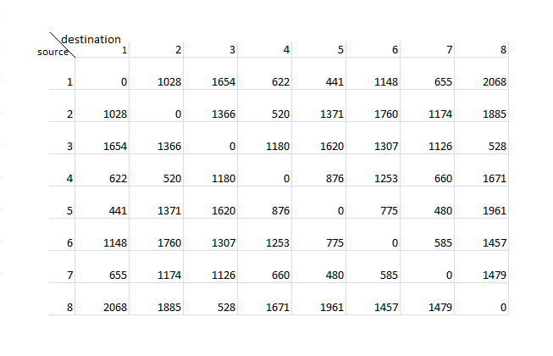
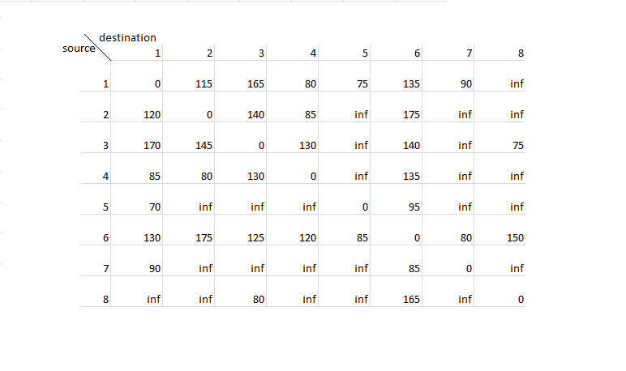
Flight routes
Distance
duration

Slide 58
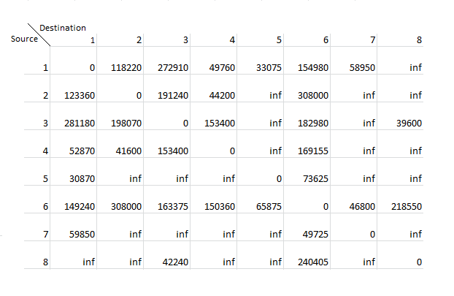
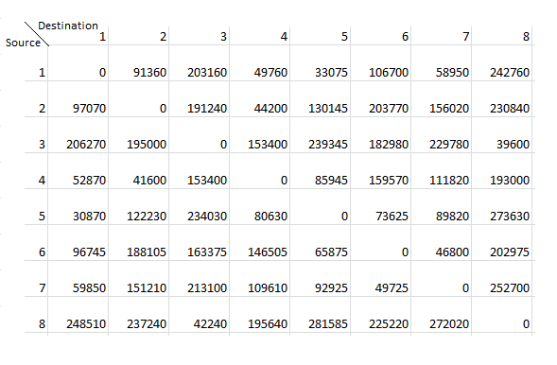
Final matrices
input
output

