Slide 1






















Root
CDE
ADE
BDE
ABD
ABE
ABC
ACD
ACE
ACF
BCD
BCE
BCF
ABD, ABE, ABF, ADE, ADF, AEF, BDE, BDF, BEF,DEF
3-itemsets from the transaction

Slide 2
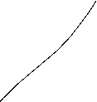



ABDEF
A [BDEF]
B [DEF]
D[EF]
AB [DEF]
AD [EF]
AE [F]
BD [EF]
BE [F]
ABD,
ABE,
ABF
ADE,
ADF
AEF
BDE,
BDF
BEF
DEF

