Slide 1
CSS++

Slide 2
Contents
CSS functions
flex layout
grid layout
transform(2d)
blend-mode
background-clip
filter
backdrop-filter
clip-path

Slide 3
CSS functions
color: var(--gray); Used to insert the value of a CSS variable.
width: calc(100% - 2px); Lets you perform calculations when specifying CSS property values.
width: min(10px, 5%); Lets you set the smallest value from a list of comma-separated expressions.
width: max(10px, 5%); Lets you set the largest value from a list of comma-separated expressions.
content: attr(data-color); Used to retrieve the value of an attribute of the selected element.

Slide 4
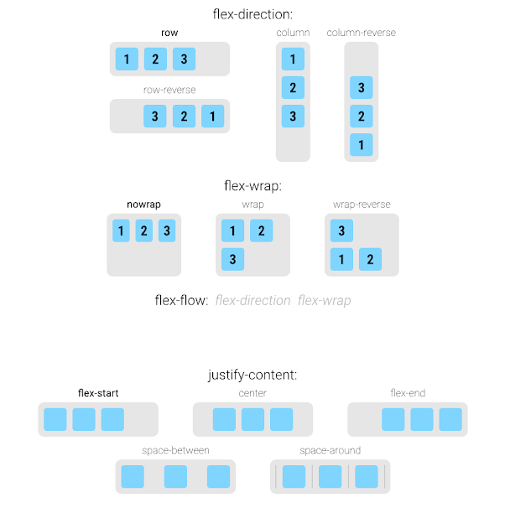
flex layout
Aims at providing a more efficient way to lay out, align and distribute space among items in a container, even when their size is unknown and/or dynamic (thus the word “flex”).
CSS-Tricks: A Complete Guide to Flexbox

Slide 5
grid layout
A two-dimensional grid-based layout system that, compared to any web layout system of the past, completely changes the way we design user interfaces.
CSS-Tricks: A Complete Guide to Grid

Slide 6
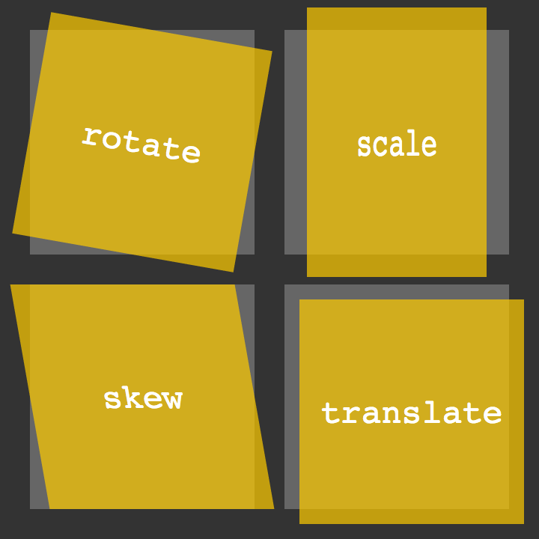
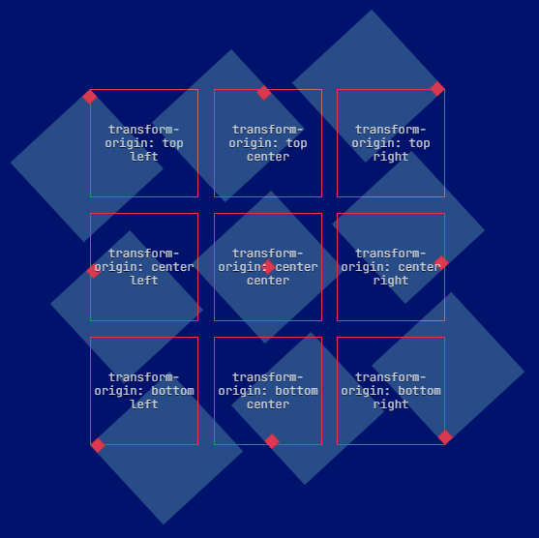
Transform (2d)
transform: translate(20%); transform: rotate(20deg); transform: scale(2); transform: skew(20deg);
Also...
transform-origin: top left;
Used in conjunction with CSS transforms, letting you change the point of origin of a transform.

Slide 7
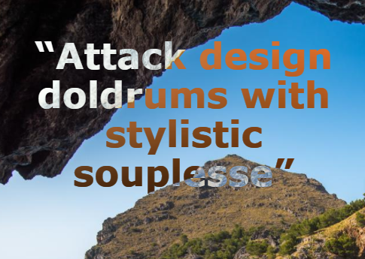
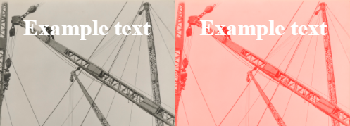
blend-mode
mix-blend-mode: difference; Defines how an element’s content should blend with its background.
background-blend-mode: difference; Defines how an element’s background-image should blend with its background-color.

Slide 8


background-clip
Lets you control how far a background image or color extends beyond an element’s padding or content.
background-clip: border-box; background-clip: padding-box; background-clip: content-box;

Slide 9
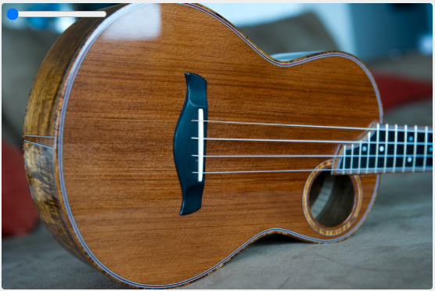
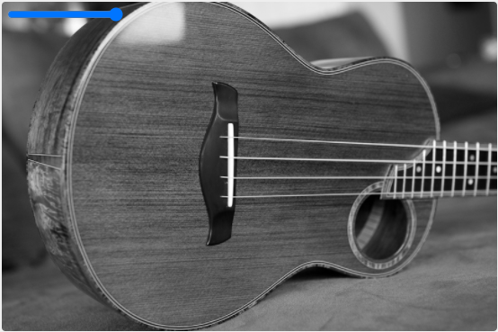
filter
Used to achieve varying visual effects, sort of like Photoshop filters for the browser.
blur()
brightness()
contrast()
drop-shadow()
grayscale()
hue-rotate()
invert()
opacity()
saturate()
sepia()
url()
Learn more: https://css-tricks.com/almanac/properties/f/filter/

Slide 10
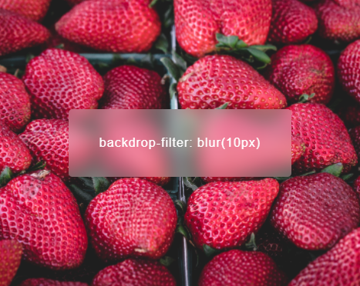
backdrop-filter
Used to apply filter effects (grayscale, contrast, blur, etc) to the background/backdrop of an element has the same effect as the filter property.
backdrop-filter: blur(10px);
*** Firefox: Available only under a flag. User must explicitly enable it.

Slide 11
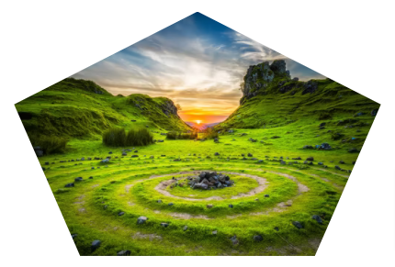
clip-path
Used to specify a specific region of an element to display, with the rest being hidden (or “clipped”) away.
clip-path: polygon(50% 0%, 100% 38%, 82% 100%, 18% 100%, 0% 38%);

