Slide 1
HTML

Slide 2
What is HTML?
Everyone knows what HTML stands for, right?
It’s a language for the web browsers.
Contains instructions for browsers and information for human.
The browser follows the instruction for the presentation of the information to the human.

Slide 3
Building blocks
The most basic building blocks of HTML are
Elements (i.e. tags)
Attributes (provides additional information about an element)

Slide 4
HTML Elements
HTML elements are also called tags.
An element usually starts with <tag_name> (opening tag) and ends with </tag_name> (closing tag).
A element (parent) can have other elements (childs) within its opening and closing tags depending on the type of element it is.
Some elements do not have a closing tag. These elements cannot have any children. These elements are called void elements or singleton tags and they look like this: <tag_name /> or just <tag_name>.
Best practice is to use lowercase for tag names.

Slide 5
HTML Elements
Example:
<div>
<p>Another element</p>
</div>
<br>
<img src="nature.png" alt="" />
In this example
- <div> is a parent, <p> is a child of <div> - <br> is a void element or singleton tag, and a sibling of <div> - <img> is another void element, and a sibling of <div> and <br>

Slide 6
HTML page
An HTML page, at least, should have the following elements:
DOCTYPE declaration
<html>
<head>
<title>
<body>

Slide 7
DOCTYPE
DOCTYPE defines the type of the document. It tells the browser the kind of the page it is going to render. All html page should have its DOCTYPE declaration set on the first line.
It’s best to use HTML5 for developing web application, since almost all popular browsers support all (or most) features of it.
DOCTYPE declaration:
https://www.w3.org/QA/2002/04/valid-dtd-list.html

Slide 8
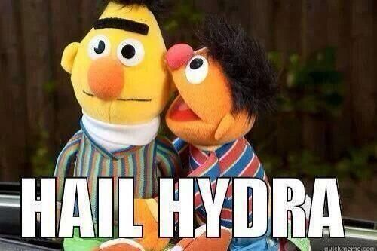
DOCTYPE

Slide 9
<html>
<html> is THE container.
It is a wrapper for everything from the page content to any other piece of information related to the page or instruction for the browser.
It has only two child elements, <head> and <body>.
Just like most other html element, it has a opening and a closing tag. Everything else in that page are inside these tags, except the DOCTYPE declaration.

Slide 10
Example
<!DOCTYPE html>
<html>
<!-- everything else -->
</html>

Slide 11
<head>
<head> contains some information that the browsers use.
Contents inside the <head> are not rendered but they help to render the page correctly.
It is the first child element of the <html> element.
Just like most other html element, it has a opening and a closing tag.

Slide 12
Example
<!DOCTYPE html>
<html>
<head>
<!-- information for the browsers -->
</head>
...
</html>

Slide 13
<title>
<title> is a piece of information for the browsers.
It is contained in the <head>.
It tells the browser, the title of the page, that is currently being rendered. The browser then shows this information in the tab bar or the title bar of the browser.
Displays a title for the page in search engine results.
Just like most other html element, it has a opening and a closing tag.

Slide 14
Example
<!DOCTYPE html>
<html>
<head>
<title>Title of the page</title>
</head>
...
</html>

Slide 15
<body>
<body> contains actual content of the page that is presented to a visitor.
It is the second and last child element of the <html> element.
Just like most other html element, it has a opening and a closing tag.

Slide 16
Example
<!DOCTYPE html>
<html>
<head>
<!-- information for the browsers -->
</head>
<body>
<!-- page content -->
</body>
</html>

Slide 17
Types of HTML Elements
There two types of HTML elements that used for presenting information to a visitor.
Block elements
Inline elements

Slide 18
Block elements
Takes a whole block or row in a page regardless of the content by default, any element after it is displayed in the next line.
This behavior can be changed using css style property ‘display’.
Width is 100% of its container but can be changed using css style property ‘width’.
Height can be variable (depending on the content) or fixed (set using css style property ‘height’).
Block elements are usually used as containers. Some of which can contain anything (e.g. other containers, text, img etc). Others are basically text containers.
<h1>, <div>, <p>, <table>, <ul>, <ol> etc are block elements.

Slide 19
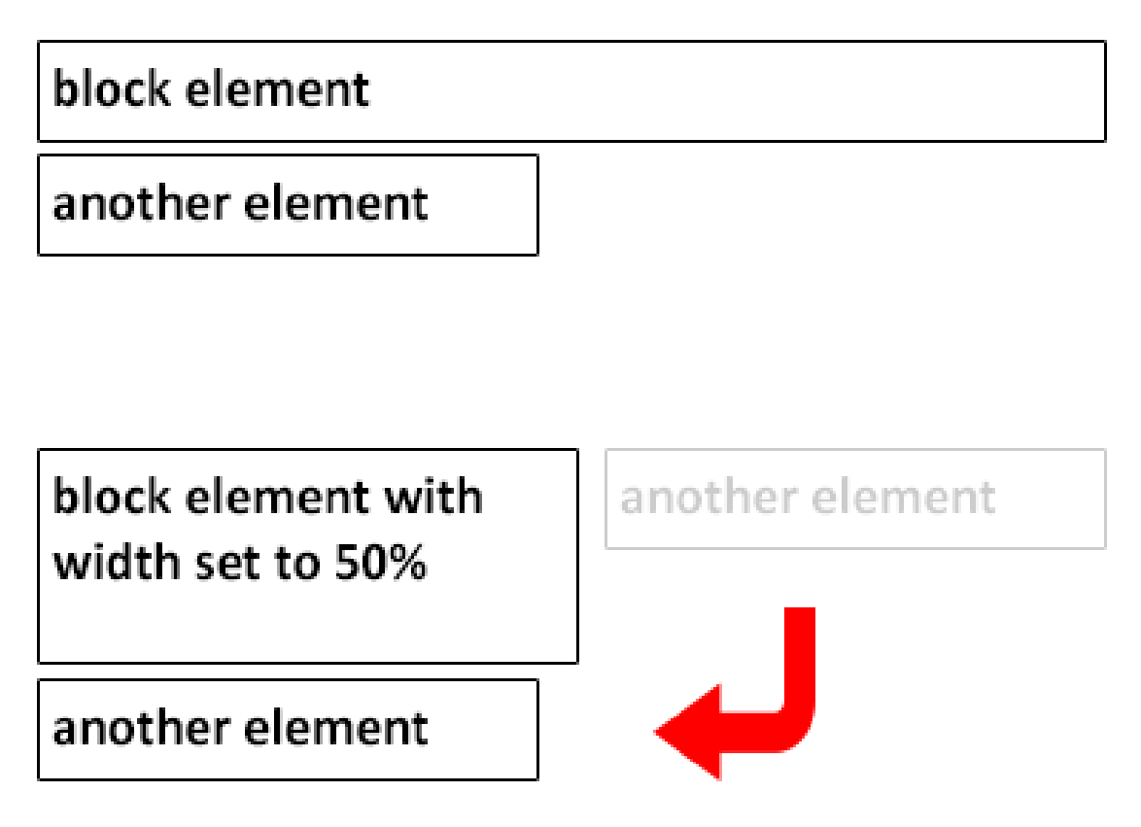

Slide 20
Inline elements
Takes only as much space as necessary for the content.
Two inline elements will sit in the same level if there is enough space for both, that’s why they are called inline (in line) elements.
This behavior can be changed using css style property ‘display’.
Width and height are auto and cannot be changed using css style properties, unless the ‘display’ property is changed.
Inline elements are usually text containers.
They are not suitable for having block elements as child.
<label>, <span>, <input>, <a> etc are inline elements.

Slide 21
Attributes
Attributes are properties of elements.
Different elements have different attributes.
Most common and frequently used attributes are “id” and “class”, which are usually used for javascript and/or styling purposes.
Attributes are usually optional, but sometimes required whether it has a value or not.
Some of the required attributes are:
href for <a>
src for <img>
type for <input> etc.

Slide 22
[data-*] attributes
HTML5 supports [data-*] attributes which can be used to store some additional information related to that element. The asterisk (*) part of the attribute can be ABSOLUTELY ANYTHING. An element can have any number of [data-*] attributes. Following is an example:
<div data-id="container" data-source="source" data-expired="false">
<!-- more html -->
</div>

Slide 23
HTML Entities
Some characters are reserved in HTML. Most commonly < and > , which are used for tags. Characters like these should be replaced with HTML entities otherwise they might be misinterpreted by the browser as HTML reserved character. Following are some of the most commonly used entities:
Entity | Description | Output
&nbsp; | Non-breaking space
&lt; | Less than | <
&gt; | Greater than | >
&amp; | Ampersand | &
&copy; | Copyright | ©
&reg; | Registered trademark | ®

Slide 24
Let’s take a look at some Elements

Slide 25
<link>
Usually placed in <head>.
Do not have a closing tag.
Used to link favicon or external css file, can used for other resources as well.
Only used by the browser, not rendered.
Examples of <link> :
For favicon - <link rel="icon" href="favicon.ico" type="image/x-icon" />
For external css file - <link rel="stylesheet" href="styles.css" />

Slide 26
<script>
<script> can be placed in <head> or <body>.
Have the closing tag.
Used to write javascript or link external js file.
Examples of <script> :
For external js file - <script src="scripts.js"><script>
For external css file - <script> // custom javascript... <script>

Slide 27
<meta>
Used to specify page description, keywords, author, and other metadata.
Meta data is used by browsers (how to display content), by search engines (keywords), and other web services.
Examples of <meta> :
<meta charset="UTF-8">
<meta name="keywords" content="HTML, CSS, XML, XHTML, JavaScript">
<meta http-equiv="refresh" content="30">

Slide 28
Headings
HTML headings are used as page header (not page title) or section heading.
Text inside headings are bold by default. But they should not be used for that purpose.
Useful for search engines.
Headings are defined with <h1> to <h6> tags.
<h1> defines the most important heading. <h6> defines the least important heading.

Slide 29
Line Break
Works as a new line character for HTML.
Defined with <br> tag.

Slide 30
Horizontal Rules
Horizontal rules separates two section.
Draws a horizontal line.
Defined with <hr> tag.

Slide 31
Un-ordered List
Defined with <ul> tag.
Can only have <li> as child element, which is a block container element.
Rendered as a list with bullet points (<li>).
Example:
<ul> <li>content</li> <li>content</li> <li>content</li> </ul>

Slide 32
Ordered List
Defined with <ol> tag.
Similar to <ul> in terms of behavior.
Unlike <ul>, <ol> renders numeric points instead of bullets.
Example:
<ol> <li>content</li> <li>content</li> <li>content</li> </ol>

Slide 33
Paragraphs
Defined with <p> tag.
Block element.
Container for text.
Cannot contain other block container elements like <div>, <ul>, <ol>
Example:
<p>A paragraph ...</p>

Slide 34
Hyperlinks
Defined with <a> tag.
Inline element.
Can contain some other block elements like <div>, <p>
Attribute “href” contains the link of the page it points to.
Attribute “target” tells the browser where to open this link i.e. the same window or in a new window. If “target” is not set, the link will open in the same window. “target” set to “_blank” to open in new window.
Example:
<a href="some_page_url">Link Text</a>

Slide 35
<input>
Inline element.
Do no have closing tag.
Can be of various types (e.g. text, password, button, submit, reset, checkbox, radio etc).
Attribute “type” specifies the type of input.
Example:
<input type="checkbox" /> <input type="radio" /> <input type="text" />

Slide 36
<select>
Inline element.
Can only have <option> as child.
Renders a drop-down list.
Only one option can be selected at a time, unless “multiple” attribute is set.
Example:
<select multiple="multiple"> <option value="1">1</option> <option value="2">2</option> <option value="3">3</option> </select>

Slide 37
Text formatting elements
There are some inline elements which are used for formatting texts.
- <strong> : bold
- <em> : italic
- <ins> : underline
- <del> : strikethrough
- <mark> :
- <sup> : superscript
- <sub> : subscript
highlight

Slide 38
Iframes
Defined with <iframe> tag.
Used to display a web page within a web page.
Must have “src” attribute, which contains the link of the page that will be display within the iframe.
Do not have any child elements
Example:
<iframe src="some_page_url" width="200" height="200"></iframe>

Slide 39
Images
Defined with <img> tag.
Do not have a closing tag.
Must have “src” attribute, which contains the link of the image.
Must have “alt” attribute, which specifies alternate text for the image and will be visible in case the image could not be loaded.
Example:
<img src="html5.gif" alt="The official HTML5 Icon">

Slide 40
Tables
Defined with <table> tag.
Used for presenting data as a table-like structure.
Usually consists have <tr> tags (represents a table row).
<tr> tags contain <td> (table data) or <th> (table header).
<td> and <th> both represents a table cell, where <td> is used for data and <th> is used for header.
Tables are heavy and suggested to avoid using unless necessary.

Slide 41
Example of <table>
<table style="width:100%"> <tr> <th>First Name</th> <th>Last Name</th> <th>Age</th> </tr> <tr> <td>Jill</td> <td>Smith</td> <td>50</td> </tr> <tr> <td>Eve</td> <td>Jackson</td> <td>94</td> </tr> </table>

Slide 42
Example of a simple page
<!DOCTYPE html>
<html>
<!-- other elements -->
<title>Title of the page</title>
<link rel="stylesheet" href="styles.css" />
</head>
<body>
<div class="content">
<img src="html5.gif" alt="The official HTML5 Icon">
<p>The content...</p>
</div>
<script src="scripts.js"></script>
</body>
</html>

Slide 43
More Examples
More examples can be found at: http://www.w3schools.com/html/html_examples.asp

Slide 44
There’s more than what we’ve just seen so far...

Slide 45

DOM

Slide 46

The Dev Tools

Slide 47
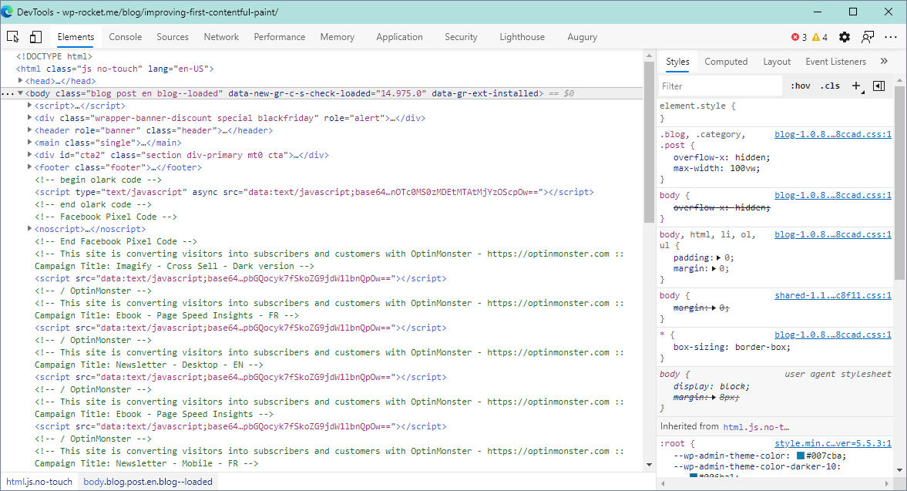

Slide 48
Editors
There are a lot of HTML editors out there. Some of the powerful ones are:
VS Code
Visual Studio
Sublime Text
WebStorm
PhpStorm
Adobe Dreamweaver
and many more…

Slide 49
HTML Validation
There are rules to follow when writing HTML.
Even if these rules are ignored, it doesn’t break a page (beware SOMETIMES it does).
Best practice is to follow these rules.
HTML can be validated at: http://validator.w3.org/

Slide 50
HTML5
HTML5 IS THE LATEST AND GREATEST VERSION OF HTML WITH A LOT OF GOODIES.

Slide 51


Slide 52
New elements in HTML5
A lot of new elements has been introduced in HTML 5. Some of which are as follows
<header>
<footer>
<nav>
<section>
<article>
<aside>
<figure>
<canvas>
<audio>
<video>

Slide 53
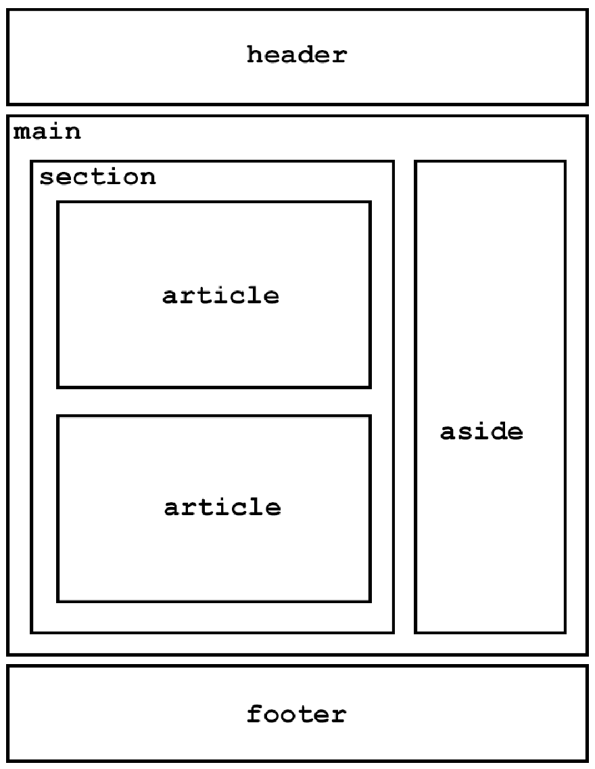

Slide 54
Canvas
Just like the name suggests HTML5 Canvas is a container for drawing. It has several methods for graphics related tasks.
<canvas id="myCanvas" width="200" height="100" style="border:1px solid #000000;"></canvas>
var c = document.getElementById("myCanvas");
var ctx = c.getContext("2d");
ctx.fillStyle = "#FF0000";
ctx.fillRect(0, 0, 150, 75);
The code above draws a rectangle in the canvas.

Slide 55
Audio
HTML5 standard for embedding audio files in a page.
<audio controls>
<source src="sample.ogg" type="audio/ogg">
<source src="sample.mp3" type="audio/mpeg">
Your browser does not support the audio element.
</audio>
It’s not supported in IE8 and below.

Slide 56
Attributes for <audio>
autoplay
controls
loop
muted
preload
src

Slide 57
Video
HTML5 standard for embedding video in a page.
<video width="320" height="240" controls>
<source src="sample.mp4" type="video/mp4">
<source src="sample.ogg" type="video/ogg">
Your browser does not support the video element.
</video>
It’s not supported in IE8 and below.

Slide 58
Attributes for <video>
autoplay
controls
height
width
loop
muted
poster
preload
src

Slide 59

New APIs in HTML5

Slide 60
New APIs in HTML5
HTML 5 comes with a lot of APIs which can be used using JS. Some of which are as follows
History
Fetch
Resize Observers
Geolocation
Storage
Web Workers
Service Workers
And a lot more: https://developer.mozilla.org/en-US/docs/Web/API

Slide 61


