Slide 1
Electric Field and Potential Profile
Faculty – Dr. Naresh Kumar Emani Name- Bipul Biswas
Roll No. EE24MTECH12003

Slide 2



Doping profile of material-1
N_{a} = 10¹⁷ ${cm}^{−3}$
N_{d} = 10¹⁷ ${cm}^{−3}$
Silicon P-Type
Silicon N-Type
L=1 $μ$m=1∗${10}^{−4}$ cm

Slide 3
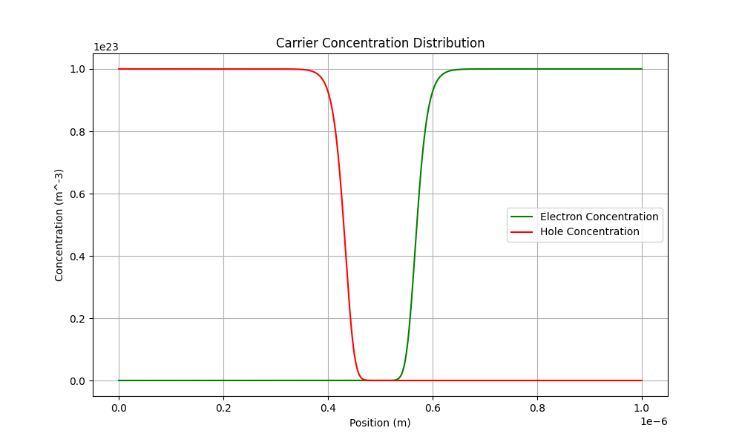
Electrons and Holes Profile

Slide 4
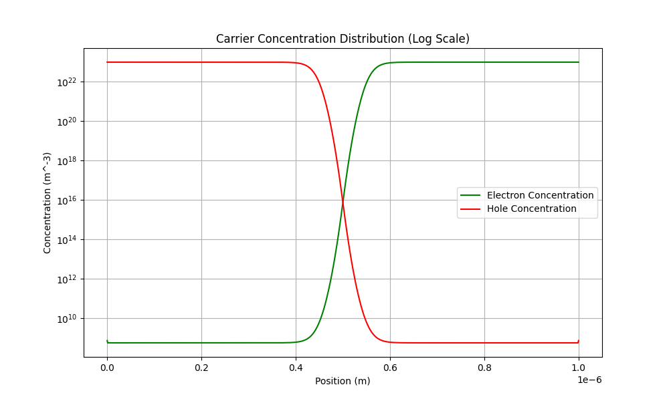
Electrons and Holes Profile

Slide 5
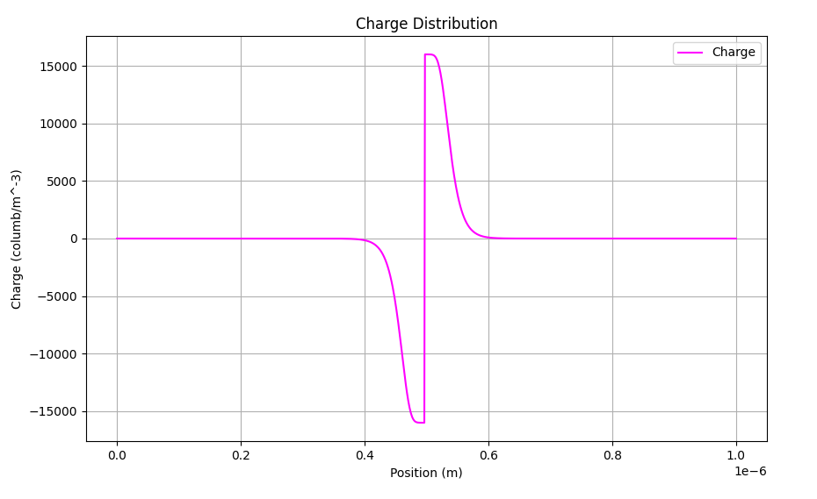
Charge Profile

Slide 6
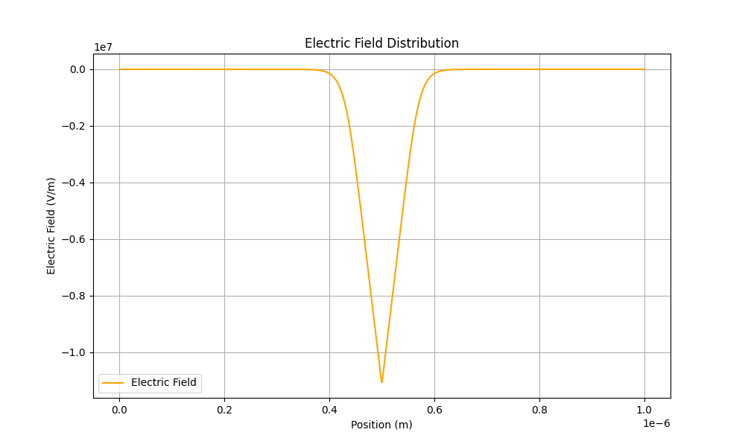
Electric Field Profile
Electric | Field (V/m)
Maximum | -1.10535e+07
Minimum | -1.94289e-06

Slide 7
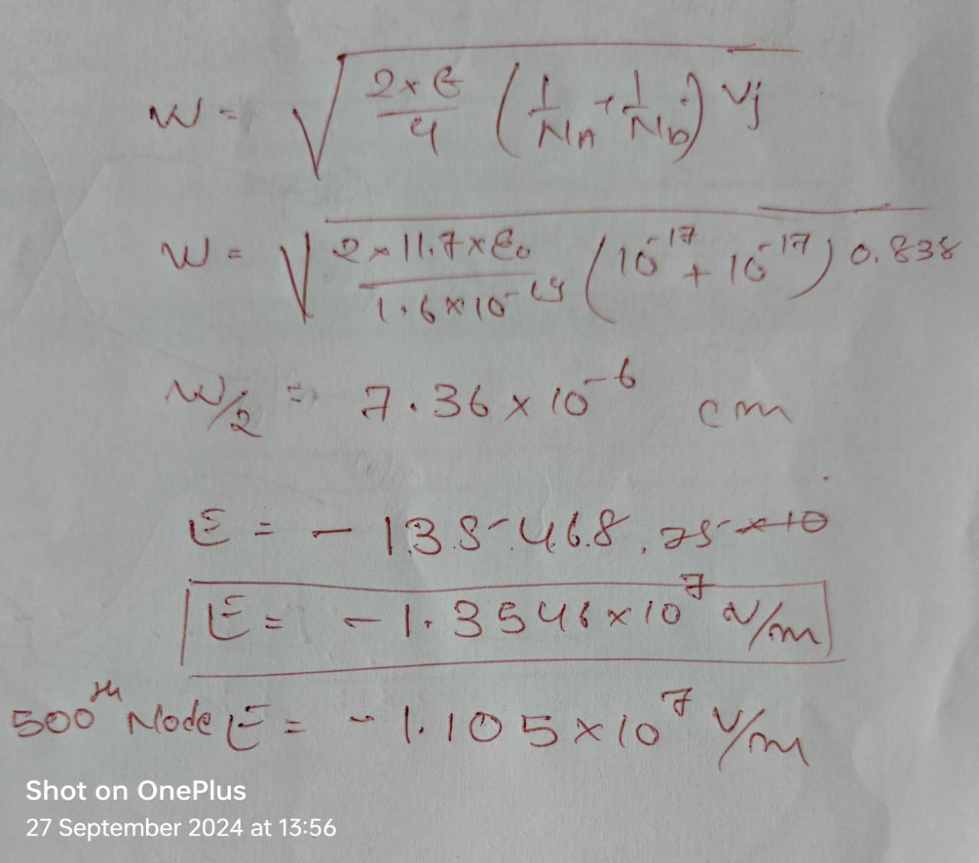

Slide 8
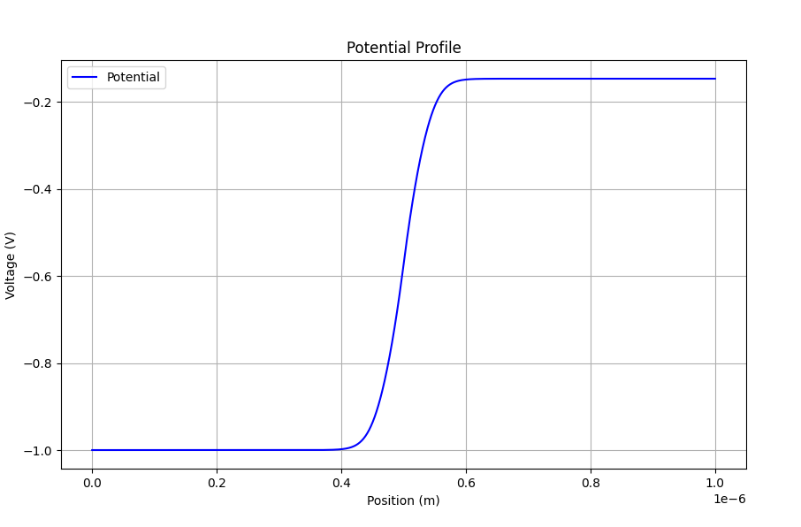
Potential profile
Voltage | (V)
Maximum | -0.14650
minimum | -0.99924
Potential Difference = 0.8527 V

Slide 9
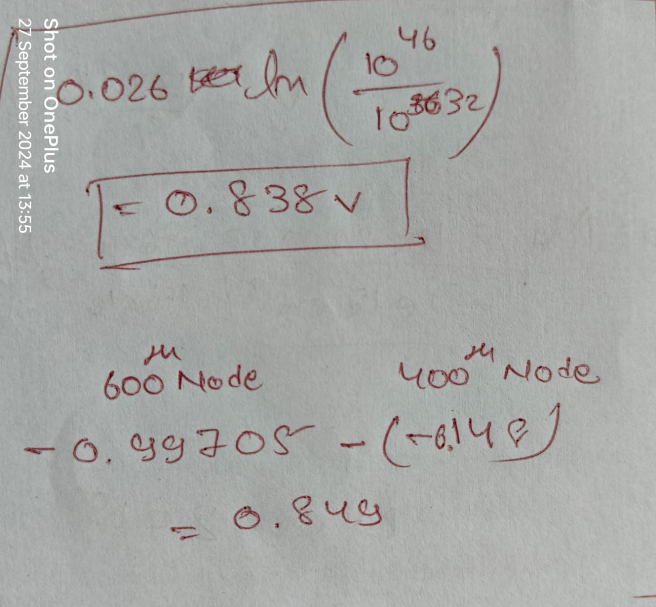

Slide 10



Doping profile of material-2
N_{a} = 10¹⁵ ${cm}^{−3}$
N_{a} = 10¹⁷ ${cm}^{−3}$
Silicon p-Type
Silicon P-Type
L = 1 $μ$m = 1∗${10}^{−4}$ cm

Slide 11
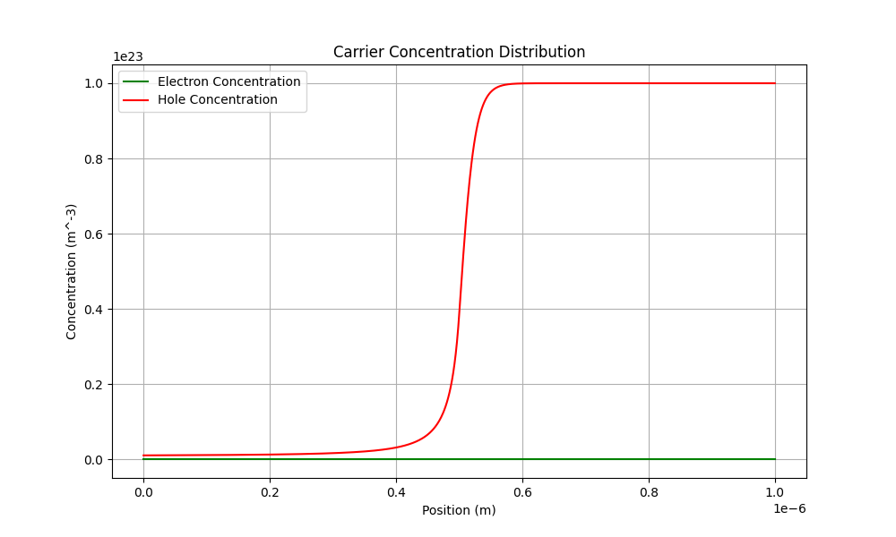
Electrons and holes Profile

Slide 12
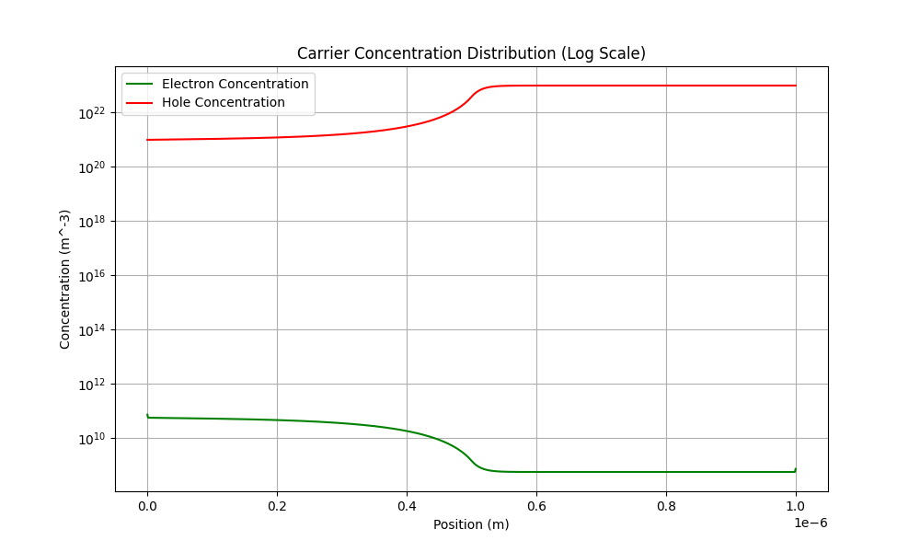
Electrons and Holes Profile

Slide 13
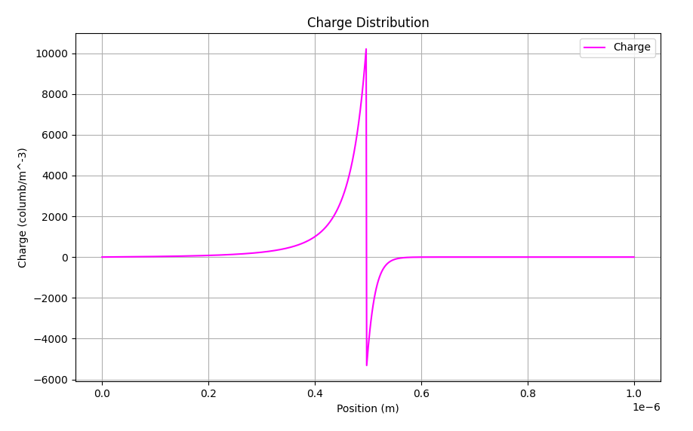
Charge Profile

Slide 14
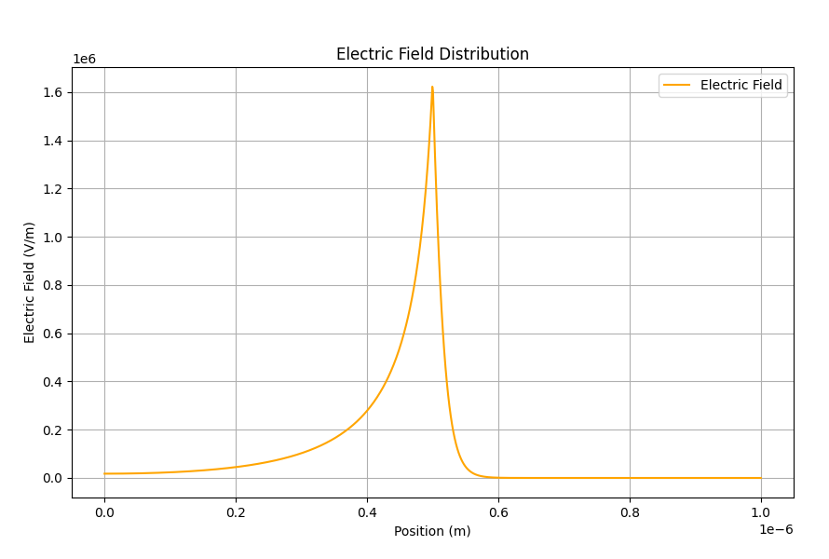
Electric Field Profile
Electric | Field (V/m)
Maximum | 1.62277e+06
Minimum | 1.88738e-06

Slide 15
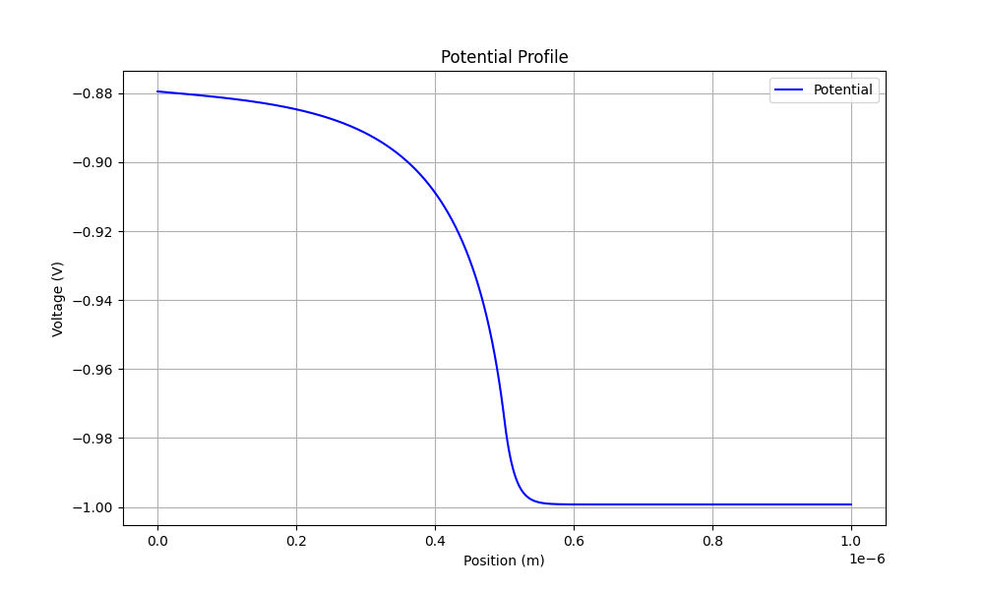
Potential Profile
Voltage | (V)
Maximum | -0.879511
minimum | -0.999245
Potential Difference = 0.1197 V

Slide 16



Doping profile of material-3
N_{d} = 10¹⁵ ${cm}^{−3}$
N_{d} = 10¹⁷ ${cm}^{−3}$
Silicon N-Type
Silicon N-Type
L = 1 $μ$m = 1∗${10}^{−4}$ cm

Slide 17
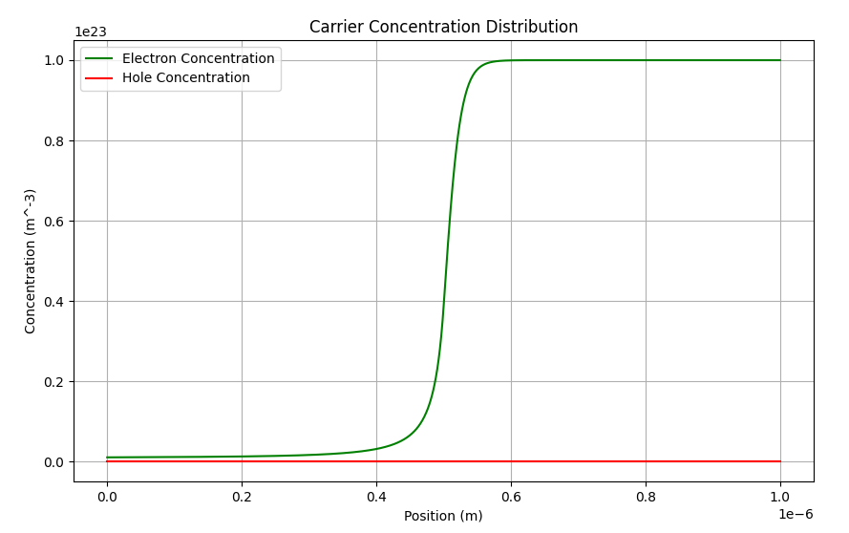
Electrons and Holes Profile

Slide 18
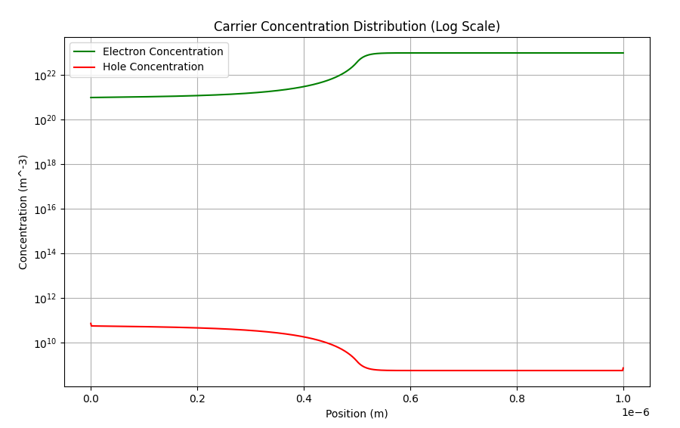
Electrons and Holes Profile

Slide 19
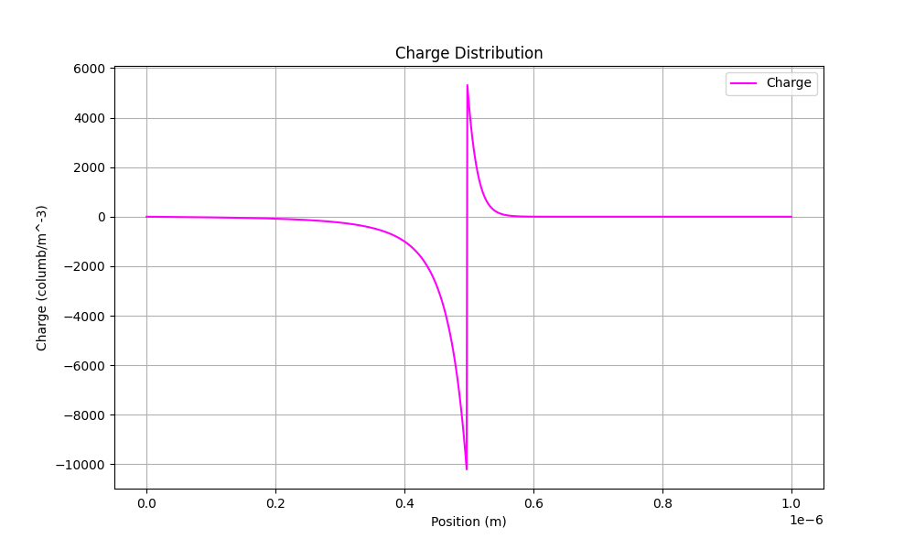
Charge Profile

Slide 20
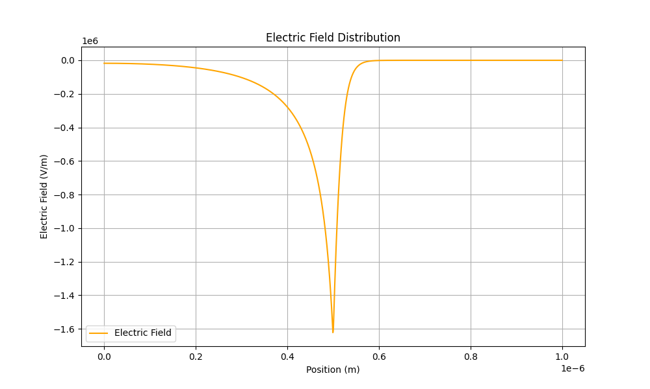
Electric Field Profile
Electric | Field (V/m)
Maximum | -1.62277e+06
Minimum | -1.91513e-06

Slide 21
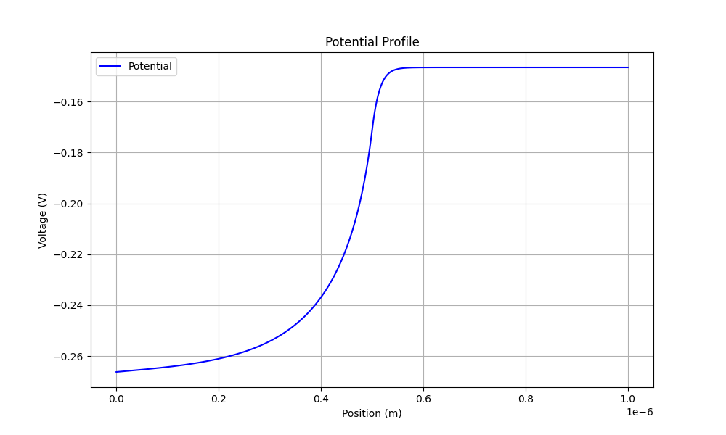
Potential Profile
Voltage | (V)
Maximum | -0.14650
minimum | -0.26623
Potential Difference = -0.11973 V

Slide 22


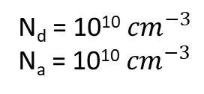
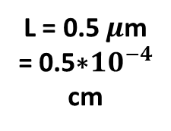

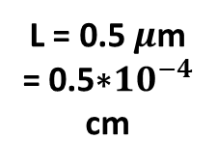
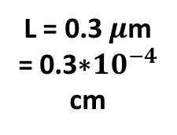

Doping profile of material-4
N_{d} = 10¹⁰ ${cm}^{−3}$
N_{a} = 10¹⁰ ${cm}^{−3}$
N_{a} = 10¹⁶ ${cm}^{−3}$
N_{d} = 10¹⁶ ${cm}^{−3}$
Intrinsic
L = 0.5 $μ$m = 0.5∗${10}^{−4}$ cm
L = 0.3 $μ$m = 0.3∗${10}^{−4}$ cm
L = 0.5 $μ$m = 0.5∗${10}^{−4}$ cm

Slide 23
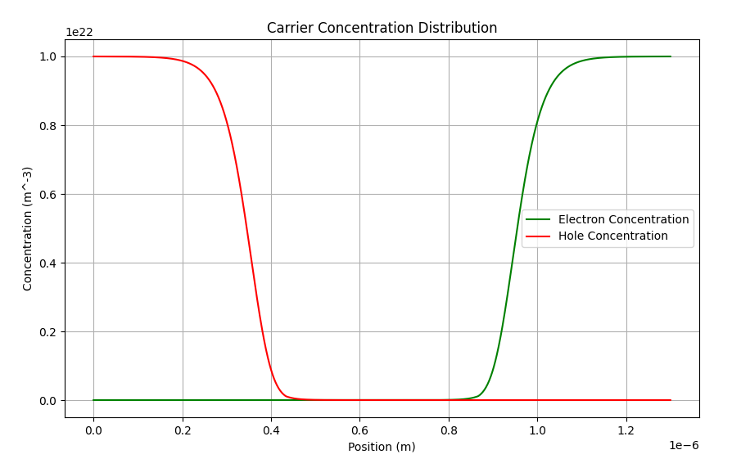
Electrons and holes Profile

Slide 24
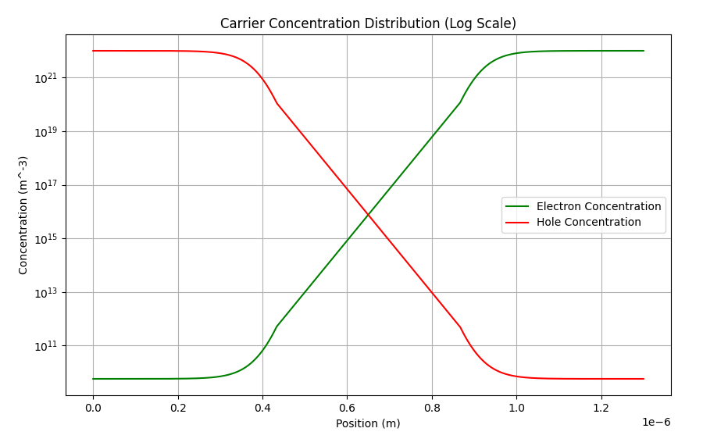
Electrons and Holes Profile

Slide 25
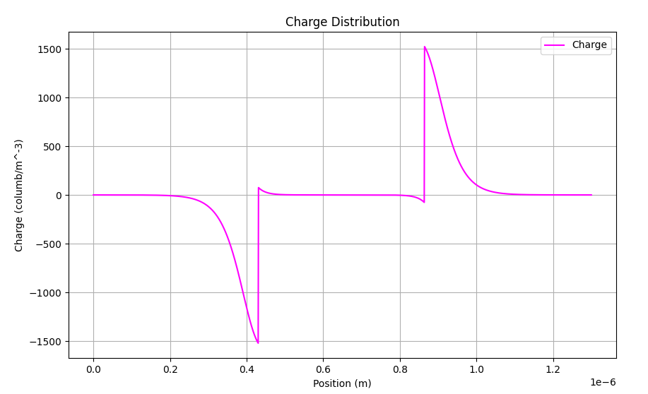
Charge Profile

Slide 26
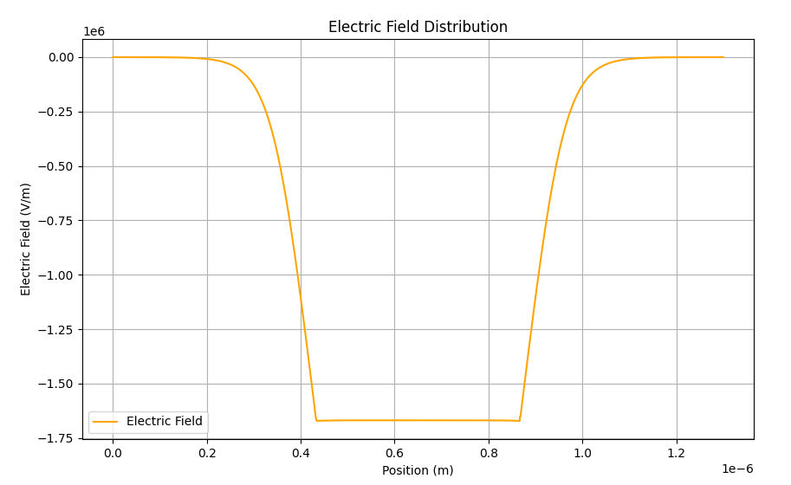
Electric Field Profile
Electric | Field (V/m)
Maximum | -59.6051
Minimum | -1.66873e+06

Slide 27
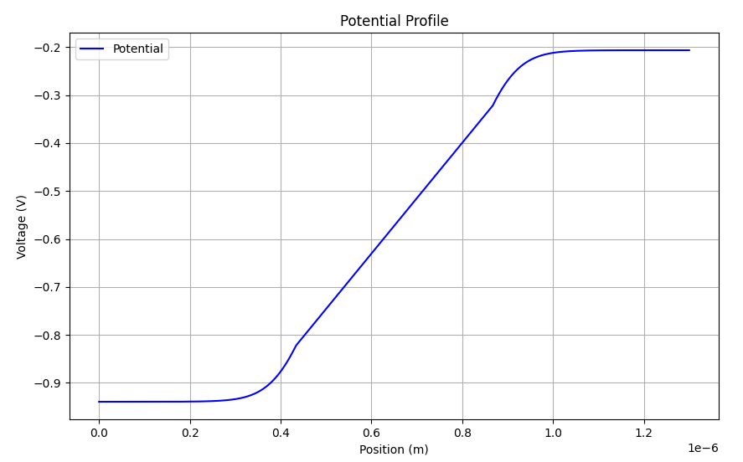
Potential Profile
Voltage | (V)
Maximum | -0.20637
minimum | -0.93937
Potential Difference = -0.733 V

Slide 28

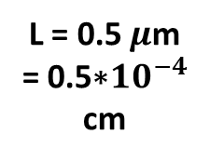

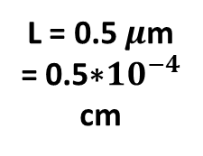
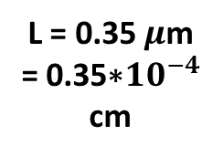

Doping profile of material-5
N_{a} = 10¹⁷ ${cm}^{−3}$
N_{d} = 5*10¹⁵ ${cm}^{−3}$
N_{d} = 10¹⁶ ${cm}^{−3}$
L = 0.5 $μ$m = 0.5∗${10}^{−4}$ cm
L = 0.35 $μ$m = 0.35∗${10}^{−4}$ cm
L = 0.5 $μ$m = 0.5∗${10}^{−4}$ cm

Slide 29
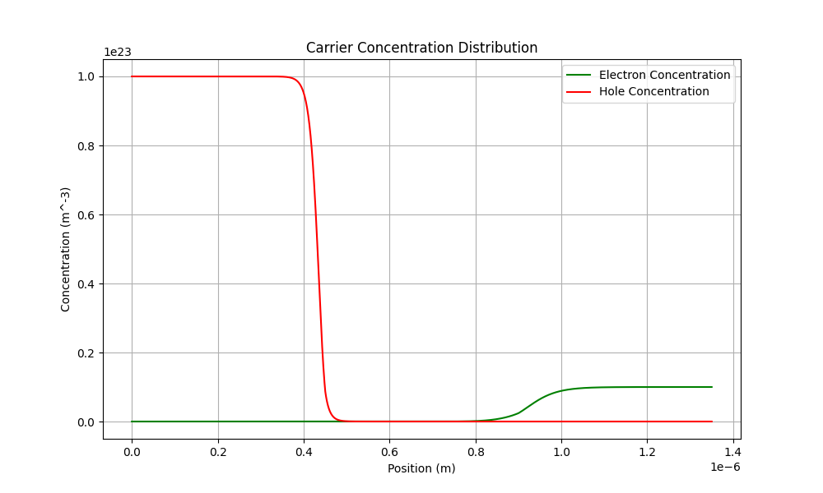
Electrons and holes Profile

Slide 30
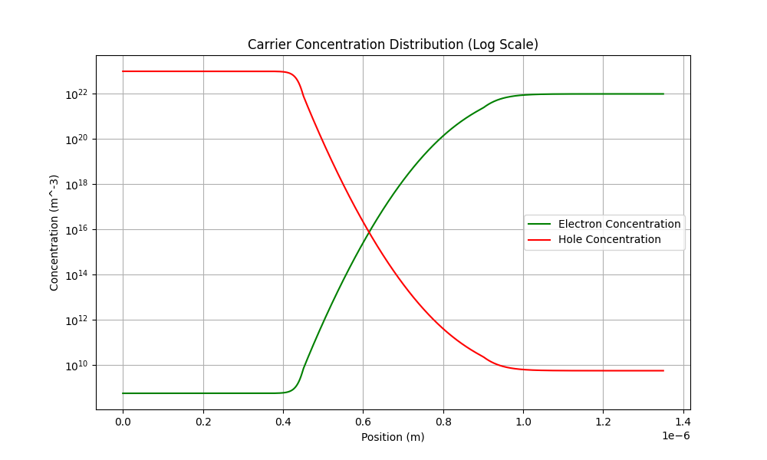
Electrons and Holes Profile

Slide 31
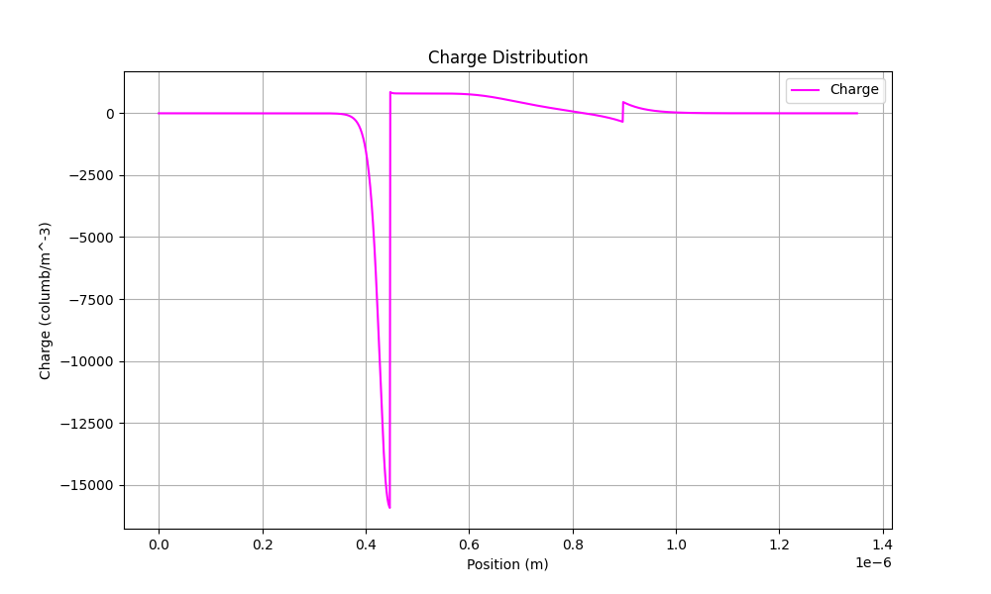
Charge Profile

Slide 32
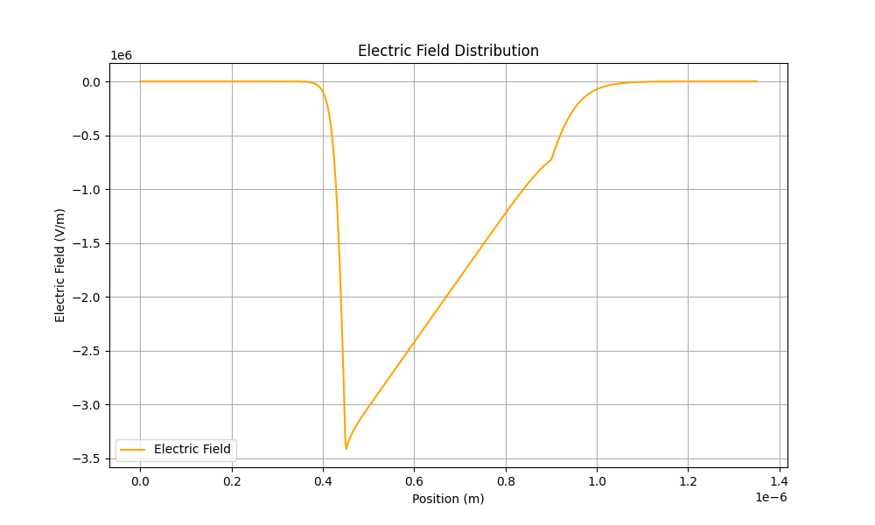
Electric Field Profile
Point-2
Electric | Field (V/m)
Maximum | -1.88738e-06
Point-2 | -7.13114e+5
Minimum | -3.41353e+6

Slide 33
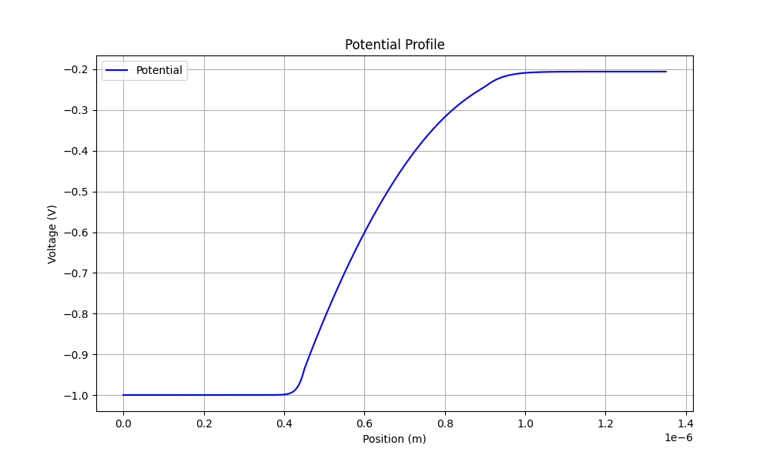
Potential Profile
Voltage | (V)
Maximum | -0.206371
Minimum | -0.999245
Potential Difference = -0.7928 V

Slide 34
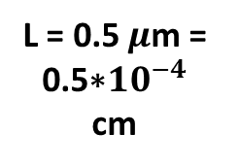
Doping profile of material-6
N_{a} = 10¹⁷ ${cm}^{−3}$
N_{d} = 5*10¹⁵ ${cm}^{−3}$
N_{d} = 10¹⁶ ${cm}^{−3}$
L = 0.5 $μ$m = 0.5∗${10}^{−4}$ cm
L = 0.5 $μ$m = 0.5∗${10}^{−4}$ cm
L = 0.5 $μ$m = 0.5∗${10}^{−4}$ cm

Slide 35
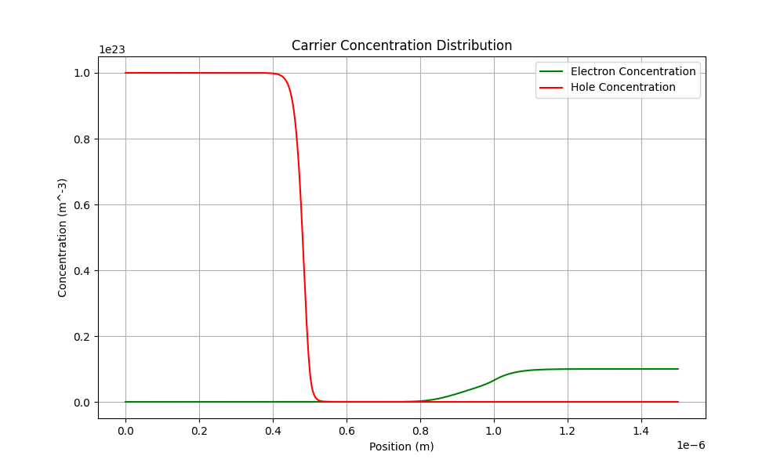
Electrons and holes Profile

Slide 36
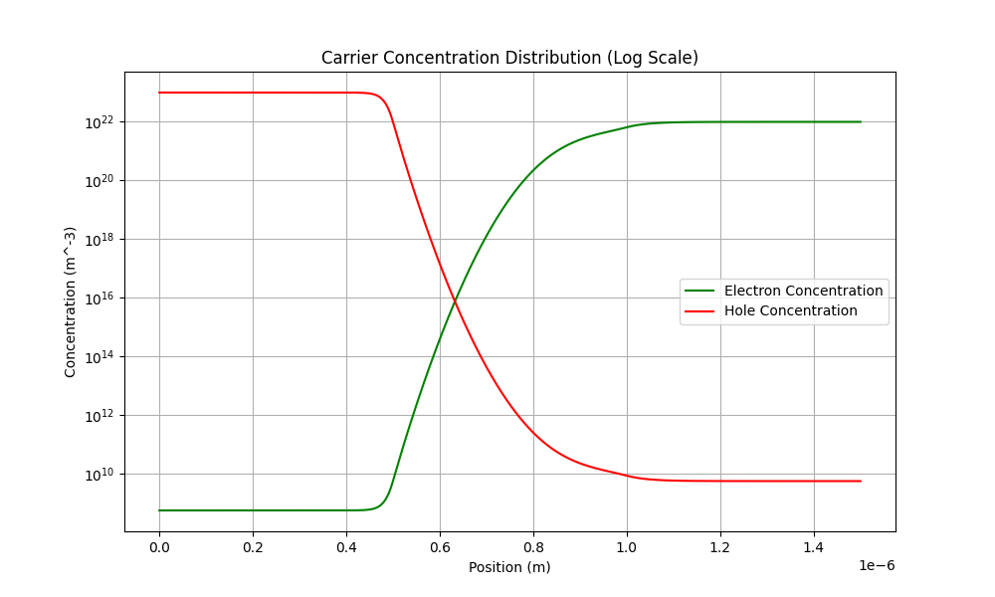
Electrons and holes Profile

Slide 37
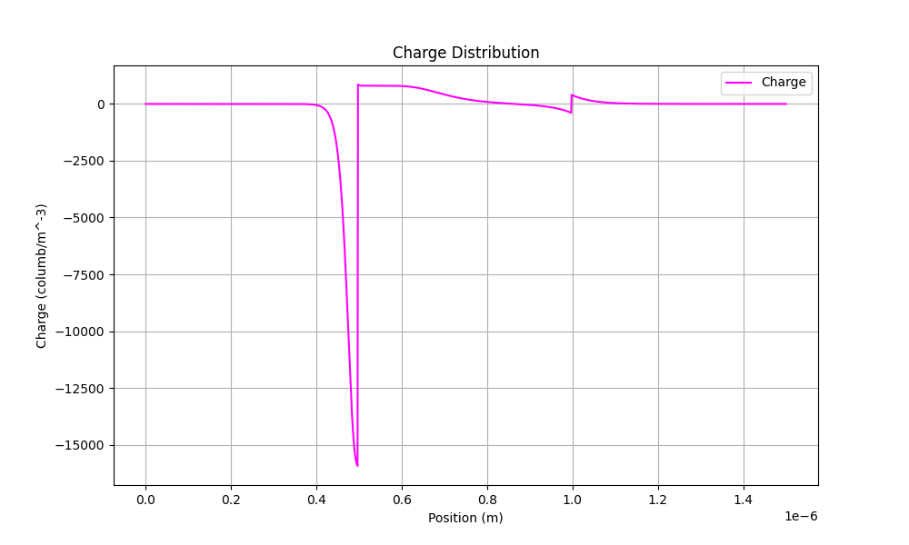
Charge Profile

Slide 38
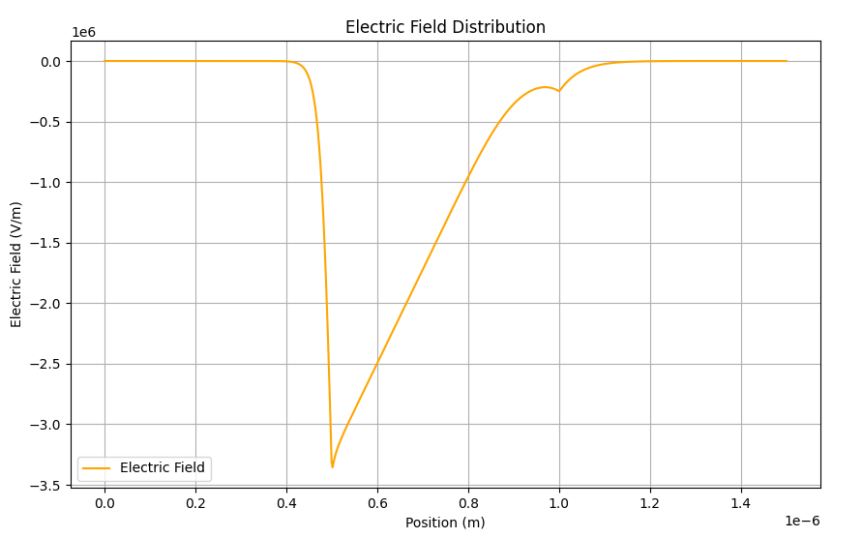
Electric Field Profile

Slide 39
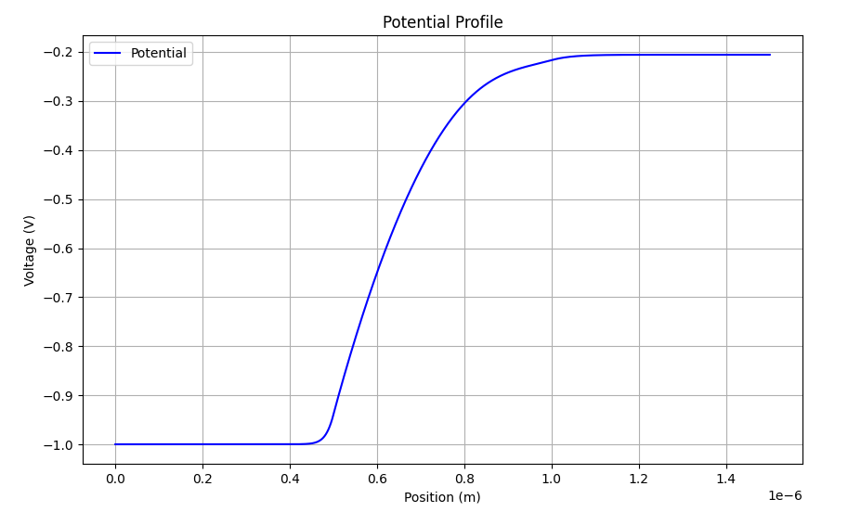
Potential Profile

