Slide 1
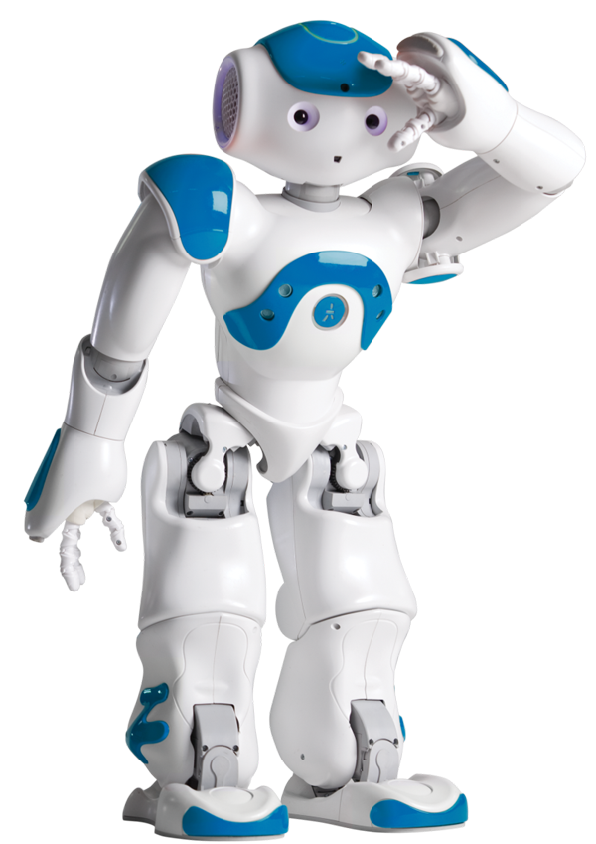
ROBOTICS | BEGINS

Slide 2

ROBOTICS |INTRODUCTION
The branch of technology that deals with the design, construction, operation, and application of robots as well as computer systems for their control, sensory feedback, and information processing is Robotics.
This Field overlaps with electronics, computer science, artificial intelligence, nanotechnology, bioengineering and branches of science.
A Robot can be defined as a programmable, self-controlled, with presence of artificial intelligence consisting of electronic, electrical, or mechanical units combining all , must possesses mobility.

Slide 3
ROBOTICS | HISTORY
The term word ‘Robot' was first used to denote fictional humanoid character in play R.U.R. Rossum's Universal Robots by the Czech writer, Karel Capek.
He introduced actually the term ‘Robota’ comes from Czech word meaning ‘Forced Labour’.

Slide 4
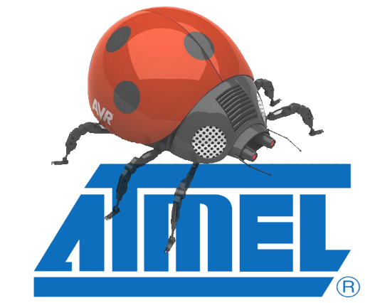
ROBOTICS | The LAWS
Science – Fiction author Isaac Asimov suggested three principles to guide the behaviour of Robots and smart machines .
Asimov’s three Laws of Robotics:
Robots must never harm human beings.
Robots must follow instructions from humans without violating rule one.
Robots must protect themselves without violating the other rules.

Slide 5
ROBOT | CHARACTERISTICS
Mobility: It must possess some form of movement.
Programmability: It can be programmed to accomplish a large variety of tasks. After being programmed, it operates automatically. The reason why a robot is multitasking unit.
Sensors: On around the device that are able to sense the environment and gives useful feedback to the device.
Mechanical Capability: Enabling it to act on its environment rather than merely function as a data processing or computational device.
Flexibility: It can operate using a range of programs and manipulates in a variety of ways.

Slide 6
ROBOT | TYPES
Mobile Robots : Robots that move freely in their environment, these includes indoor robots, outdoor robots, terrain robots, etc based on the environment and need.
Robotic Arms : Stationary robots that have agile and precise end-effectors, usually used in construction (e.g., car manufacturing plants).
Autonomous Robots : These are a combination of vehicle and computer controller along with required sensor as their tool.
Soft Robots : Robots that use soft computing approaches e.g., fuzzy logic, neural networks.
Mimicking Robots : Robots that learn by mimicking like facial gestures, voice recognization
& list is too long to continue . .

Slide 7
ROBOT |Mechanism
SENSORS
CONTROLLER
ACTUATORS

