Slide 1
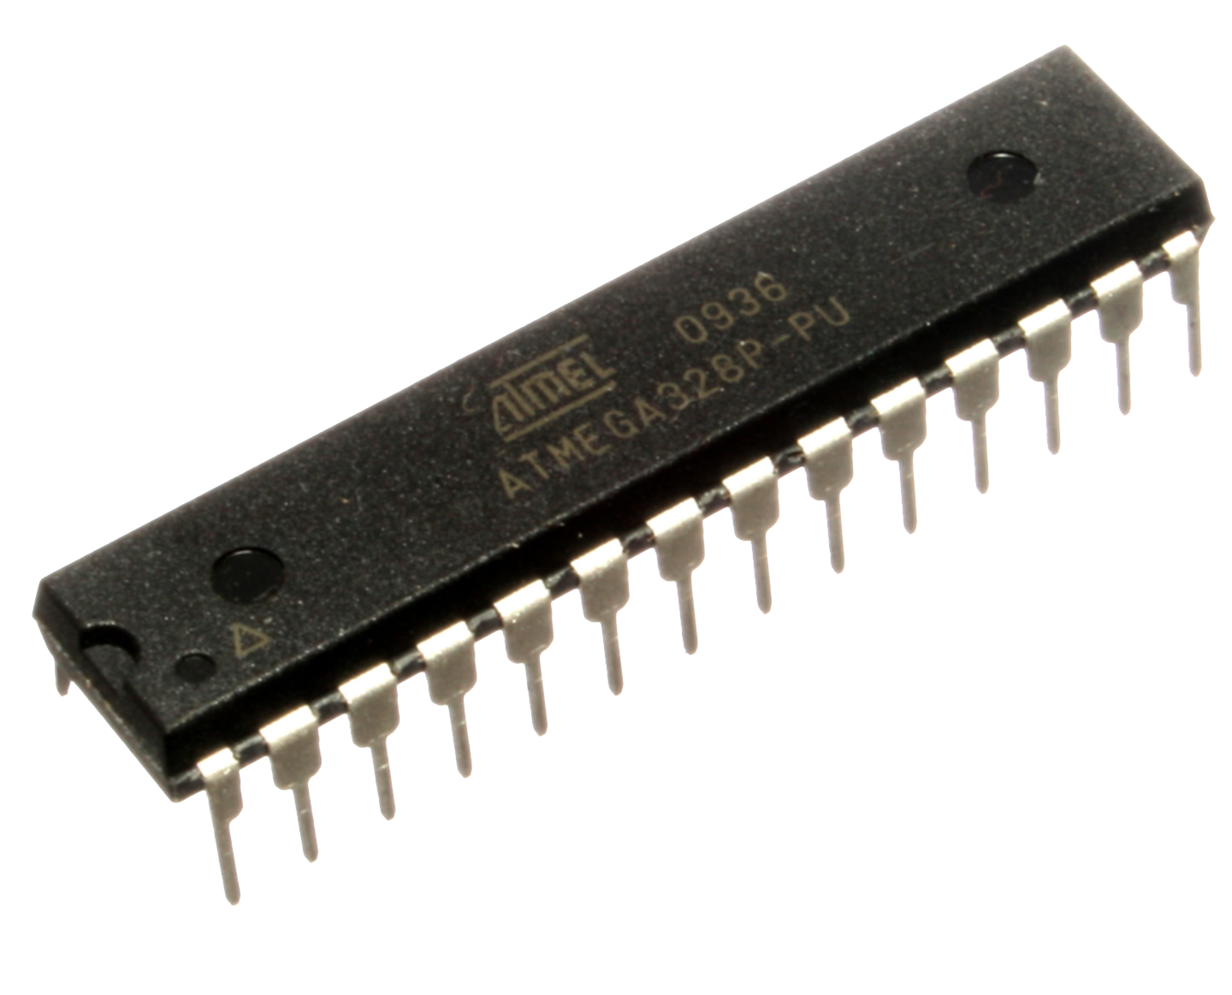
AVR MICROCONTROLLER

Slide 2

Microcontroller | AVR
The acronym of AVR stands for the initial AVR architecture designers: Alf-Egil Bogen & Vegard Wollen.
Statically sometimes it is elongated as Advance Virtual RISC.
Advance modified Harvard Architecture 8-Bit RISC single chip micro-controller
On-Chip a mini system
On chip memory : Flash, SRAM, EEPROM
I/O & multitasking Ports

Slide 3
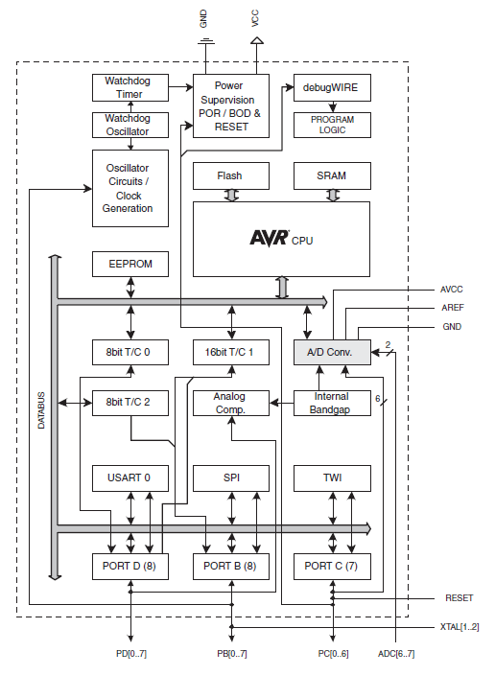
Microcontroller | AVR Architecture
Harvard Architecture:
Separate Instruction and Data paths. Faster and simultaneous access to data and instructions.
Pipelining Concept
RISC:
Reduced Instruction Set computing rather than CISC i.e. x86
Simpler Instructions execute faster
Optimized most used instruction.

Slide 4
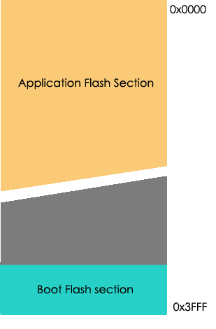
Microcontroller | Program Memory Map
FLASH:
In system reprogrammable non-volatile program space storage is 8KB (for Atmega8) 16KB(Atmega 16). A separate memory space partitioned for Boot Flash section.
SRAM:
Temporary values, stack of volatile type memory, memory size 1KB
EEPROM:
512B of space availability storage space for long-term.

Slide 5
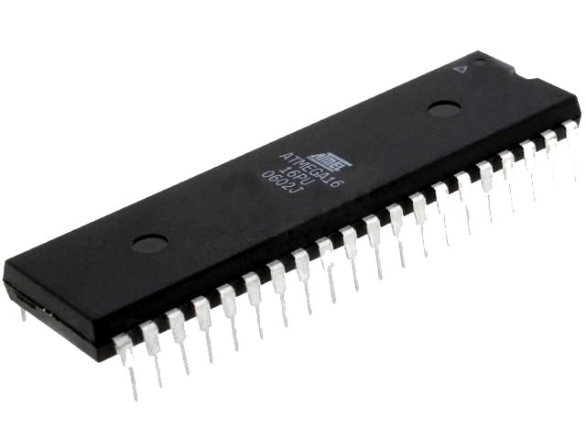
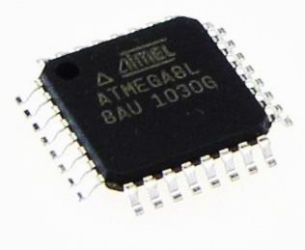
Microcontroller | AVR Packages
PDIP:
Plastic dual-in-line Package abbreviated as PDIP is a chip-package with rectangular housing and two parallel rows of Electrical connecting pins.
TQFP:
Thin Quad Flat Package abbreviated as TQFP is a chip-package with quad housing with “gull wing” leads extending from each of four sides.

Slide 6
| ATMEGA 8 |

Slide 7
ATMega 8 | Features
ATmega 8 is a 28/32 Pin, 8 bit micro-controller based on AVR RISC Architecture.
The low-power Atmel 8-Bit AVR RISC based microcontroller combines 8KB of programmable flash memory, 1 KB of SRAM, 512K EEPROM.
Supports Harvard Architecture and single Level- Pipelining concept.
Operating Voltage : 2.7-5.5Volts
Complete System on a Chip :
On Board Memory ( FLASH, SRAM & EEPROM)
On Board Peripherals

Slide 8
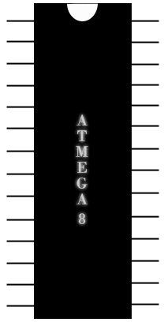
ATMega 8 | PINOUT
(RESET) PC6
PC5(ADC5/SCL)
(RXD) PD0
PC4(ADC4/SDA)
(TXD) PD1
PC3(ADC3)
(INT0) PD2
PC2(ADC2)
(INT1) PD3
PC1(ADC1)
(XCK/T0) PD4
PC0(ADC0)
Vcc
GND
GND
AREF
(XTAL1/TOSC1) PB6
AVCC
(XTAL2/TOSC2) PB7
PB5(SCK)
(T1) PD5
PB4(MISO)
(AIN0) PD6
PB3(MOSI/OC2)
(AIN1) PD7
PB2(SS/OC1B)
(ICP1) PB0
PB1(OC1A)

Slide 9
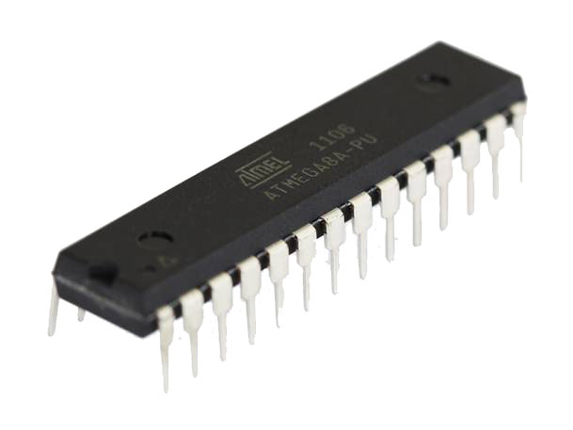
ATMEGA 8 | Features
Atmel Atmega 8 is the heart of AVR Development Board
This 28 Pin microcontroller features 16 MIPS throughput capability at 16MHz. Although there is an internal Timer of 1 MHz which gives 1 MIPS.
I/O :
Three Ports: PORT B , PORT C , PORT D of total 23 I/O Pins.
ADC Pins : A0 to A5
USART: PD0 (RXD) PD1(TXD)
PWM: OC0A, OC1A, OC1B, OC2A, OC2B
Power: Chip operates in between 2.5V to 5.5V
PDIP type Atmega8

Slide 10
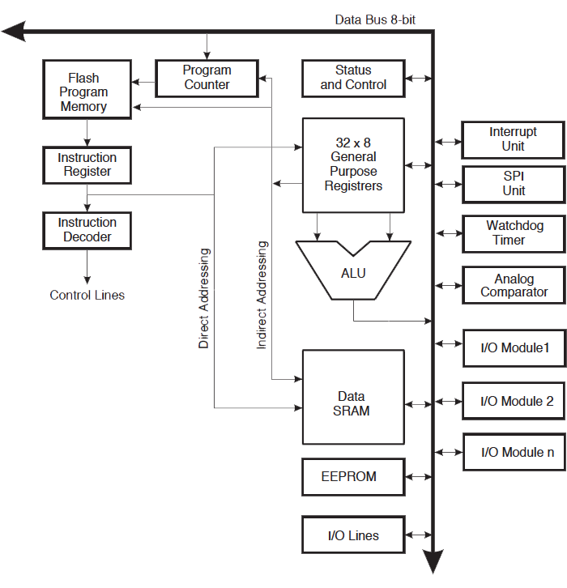
ATMEGA 8 | Peripheral Features
PORT Features
Two 8-bit Timer/Counters with Separate Prescalers and Compare Modes
One 16-bit Timer/Counter with Separate Prescaler
6 Channel 10 Bit Analog to Digital
Master / Slave SPI serial interface
Three PWM Channels
Byte-oriented 2 Wire serial interface
Programmable watchdog Timer
Programmable Serial USART/UART

Slide 11
| ATMEGA 16 |

Slide 12
ATMEGA 16 | Features
Atmel Atmega 16 is a 40 Pin 16 KB In-System Self Programmable Flash Memory.
This microcontroller features 16 MIPS throughput capability at 16MHz. Although there is an internal Timer of 1 MHz which gives 1 MIPS.
I/O :
Four Ports: PORTA , PORT B , PORT C , PORT D of total 32 I/O Pins.
ADC Pins : A0 to A7
USART: PD0 (RXD) PD1(TXD)
PWM: Four PWM Channels
Power: Chip operates in between 2.5V to 5.5V
PDIP type Atmega16

Slide 13
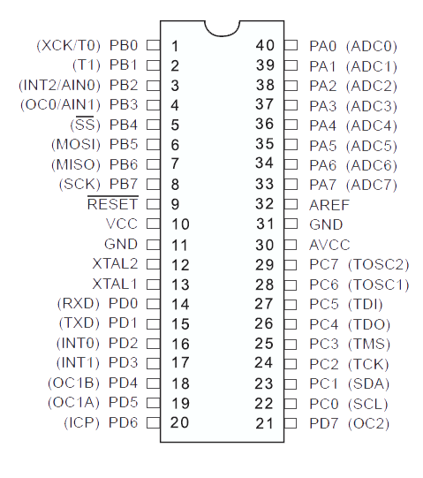
Microcontroller |PIN Diagram

Slide 14
ATMega 16 | Features
PORT Features:
Two 8-bit Timer/Counters with Separate Prescalers and Compare Modes
One 16-bit Timer/Counter with Separate Prescaler
8 Channel 10 Bit Analog to Digital
Master / Slave SPI serial interface
Four PWM Channels
Byte-oriented 2 Wire serial interface
Programmable watchdog Timer
Programmable Serial USART/UART
Programming of Flash, EEPROM, Fuses, and Lock Bits through the JTAG Interface

Slide 15
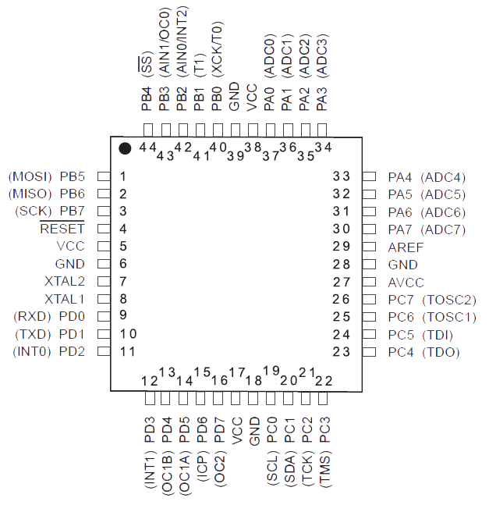
Microcontroller | PDIP Vs TQFP

