Slide 1
|MOTORS|

Slide 2

MOTORS | Types
AC motor
DC motors
DC Geared motor
Stepper motor
Servo motor

Slide 3
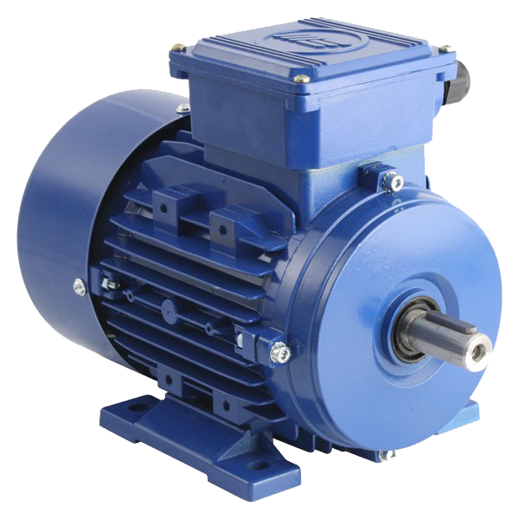
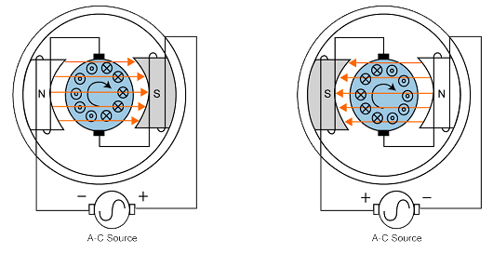
MOTORS | AC
Motors which converts alternating signal into rotational motion.
Requires a high AC supply , generally not preferred for robotics
otherwise there will be requirement of AC to DC
Examples: Water pump, fans

Slide 4
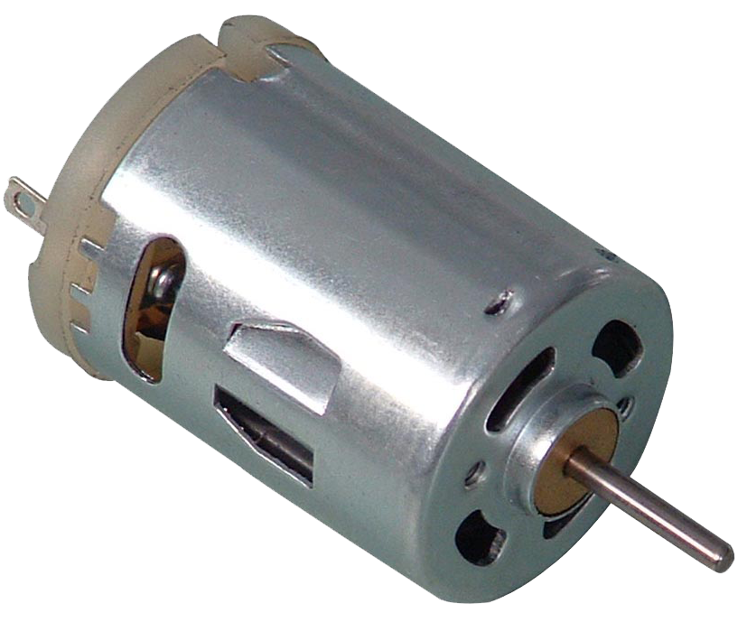
MOTORS | DC
Motors which converts direct signal current into rotational motion.
Mechanism of dc motor is simply based on electricity flowing
through metal winding simply knowing electromagnetism
phenomenon.
In robotics, they are preferred over AC as the motor and the ICs
all requires DC

Slide 5
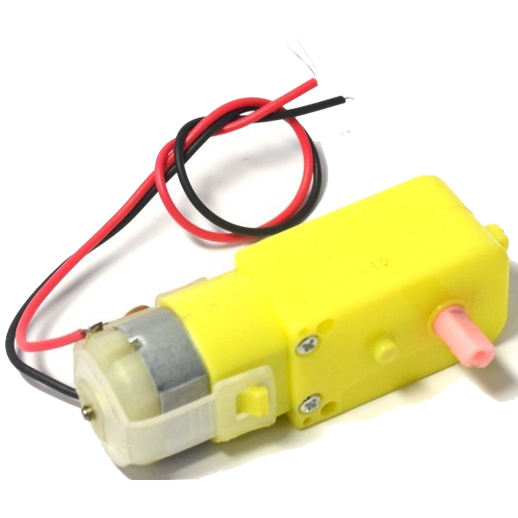
MOTORS | DC Geared Motor
Though operational phenomenon is similar to DC Motor it is having gear arrangement
attached with motor.
DC geared motors are most commonly used motor in Robotics as these
having considerable torque. For a robot we require a hold over
motion the same delivered by DC Geared.

Slide 6
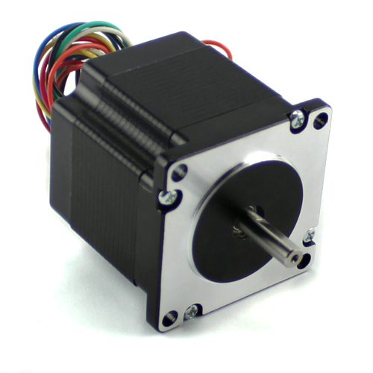
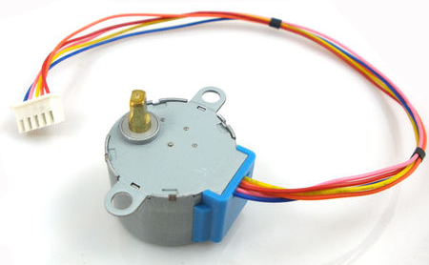
ARDUINO | Stepper Motor
A Stepper motor is an electromechanical device which converts electrical pulses into discrete mechanical movements.
The stepper motor's position can then be commanded to
move and hold at one of these steps without any feedback
sensor as long as the motor is carefully sized to the
application.
Types:
    Unipolar: Which moves in one direction only
    Bipolar: Which moves in both directions

Slide 7
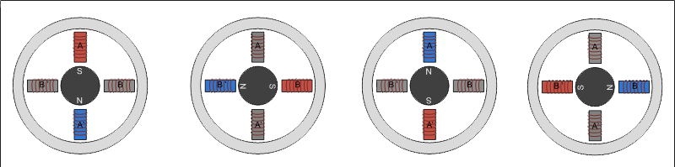
ARDUINO | Stepper Working
Single coil excitation
1 0 0 0
0 1 0 0
0 0 1 0
0 0 0 1
Double coil excitation
1 1 0 0
0 1 1 0
0 0 1 1
1 0 0 1

Slide 8
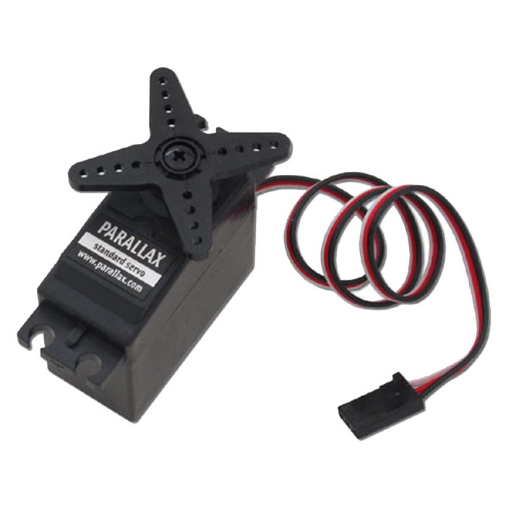
ARDUINO | Servo Motor
This is simple electrical motor, controlled with the help of servomechanism. Servo motor is a special type of motor which is automatically operated up to certain limit for a given command with help of error-sensing feedback to correct the performance.
Servo-motors works on Pulse Width Modulation . The microcontroller
communicates through communication wire to send pulses in resultant
of that servo rotates from 0 to 180.

Slide 9
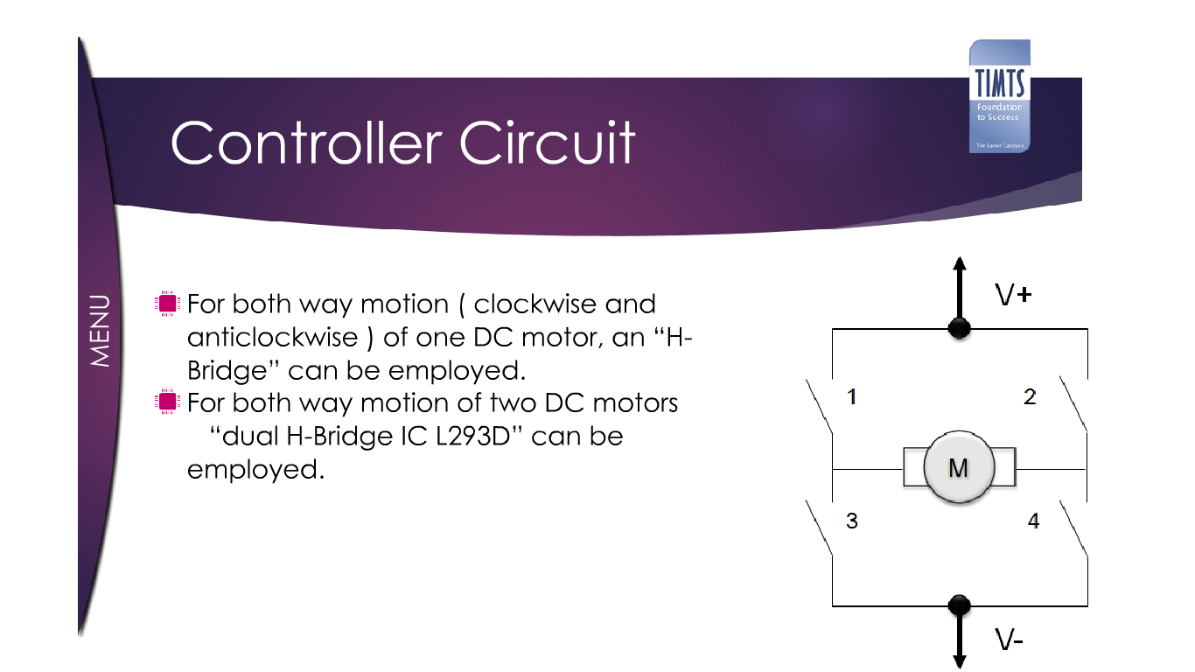
ARDUINO | H-Bridge
H-bridge sometimes called a "full bridge" is so named because it has four switching elements at the "corners" of the H and the motor forms the cross bar.
It is used to control one motor at the same time, and is able to
rotate in both direction.
L293D motor driver IC is having two H-Bridges as a nuclear part.

Slide 10
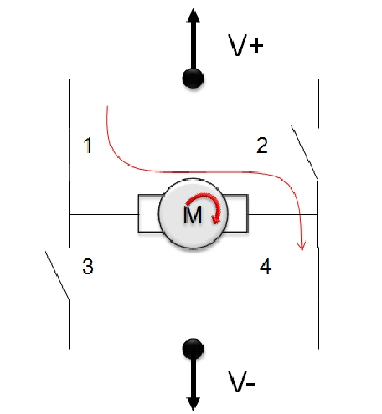

ARDUINO | Servo Motor
S1 | S2 | S3 | S4 | Movement
ON | OFF | OFF | ON | Clockwise
OFF | ON | ON | OFF | Anticlockwise
ON | ON | OFF | OFF | No Movement
OFF | OFF | ON | ON | No Movement

