Slide 1
|SENSORS|

Slide 2

SENSOR| INTRODUCTION
A sensor is a device whose purpose to sense (i.e. to detect) changes in physical environment. It detect events or changes in quantities and provides a corresponding output, generally as an electrical or optical signal.
Example:
A temperature sensor converts temperature to an output voltage.

Slide 3
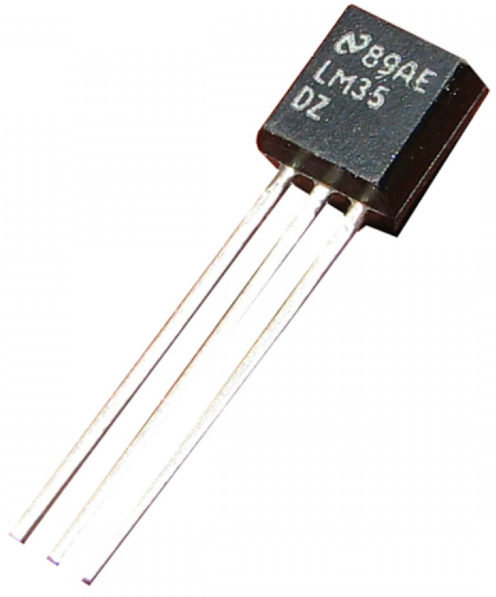
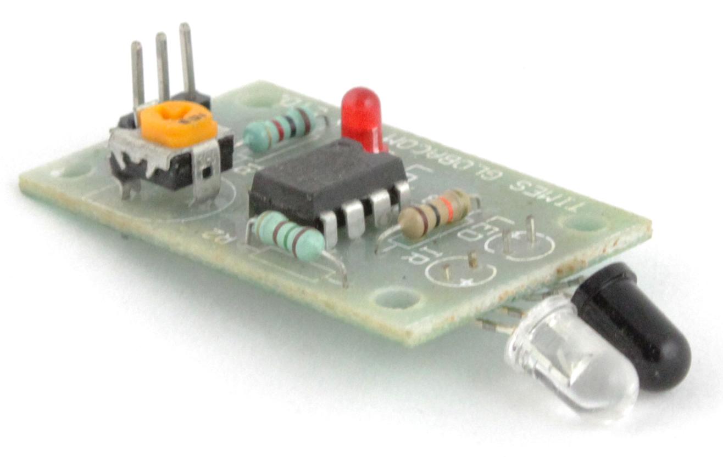
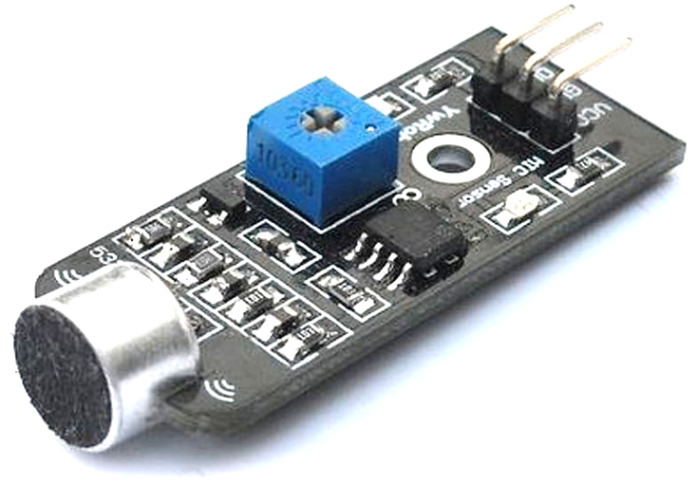
SENSOR| TYPES
There are many types of sensor available for different purpose.
Most common sensors i.e. use for educational purpose.
IR (infrared) Sensor
Sound Sensor
Temperature Sensor

Slide 4
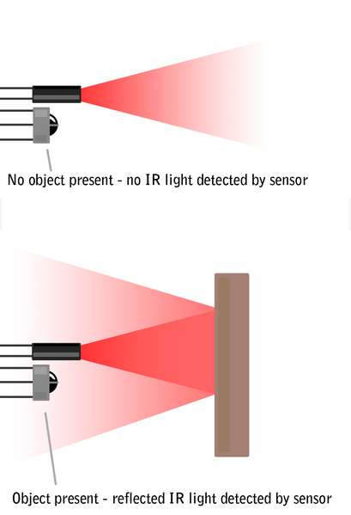
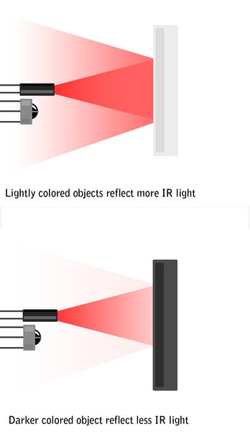
IR SENSOR| Working Principle
An IR sensor is used to detect obstacles in front of the robot or to differentiate between colour depending on the configuration of the sensor.
No object present – No IR light detected by sensor
Lightly coloured objects reflect max. IR light
object present – reflected IR light detected by sensor
Dark coloured objects reflect less IR light

Slide 5
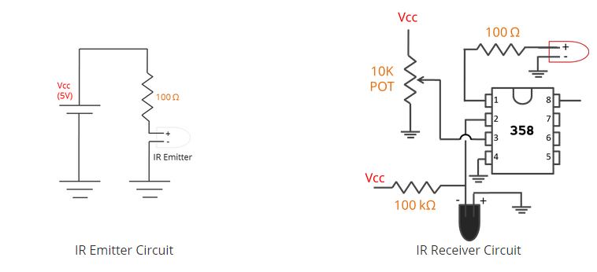
IR SENSOR| Circuit Diagram

Slide 6
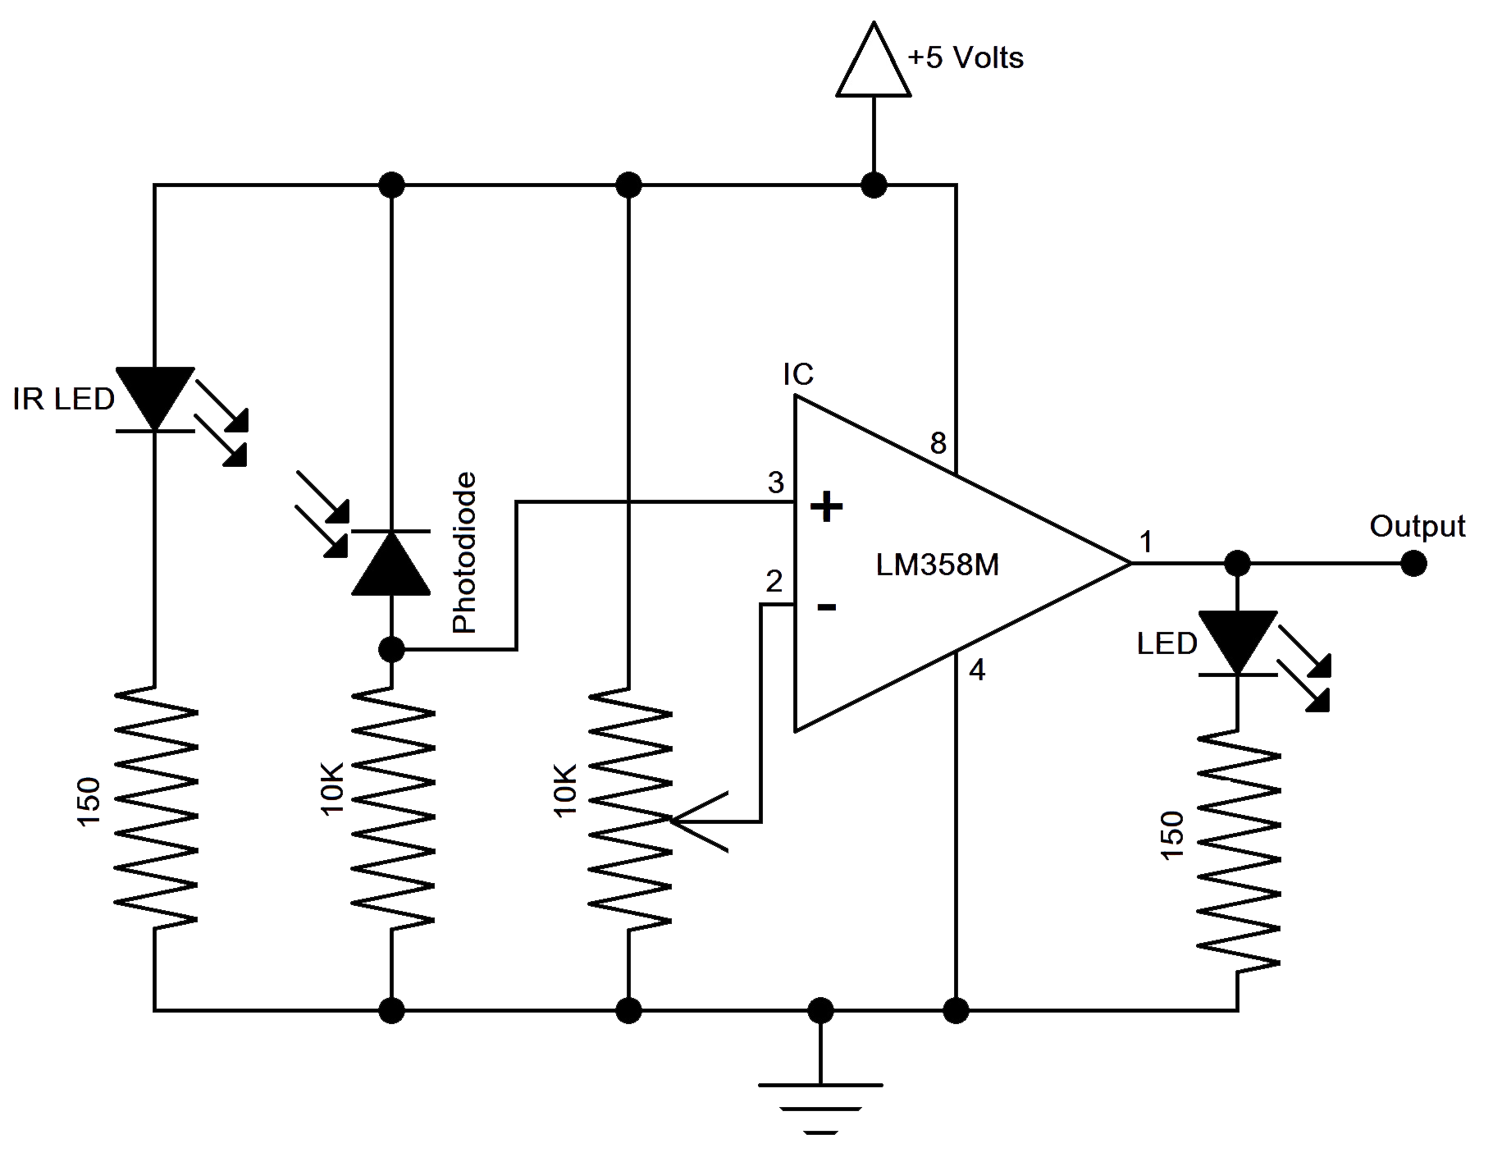
IR SENSOR| Circuit Diagram

Slide 7
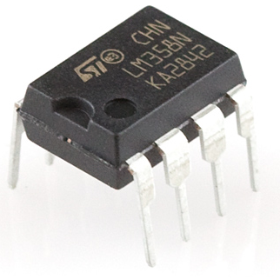
IR SENSOR| LM358 Comparator
LM358 is a comparator IC Which compares two voltages or currents and switch it at output to indicate which is larger.
It is an Op-amp.

Slide 8
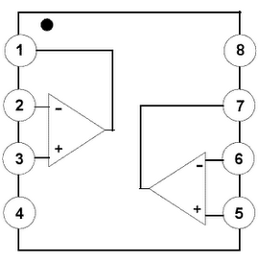
IR SENSOR| LM358 PIN
Output 1
Vcc
Input 1 ( - )
Output 2
Input 1 ( + )
Input 2 ( - )
GND
Input 2 ( + )

Slide 9
SENSOR| Temperature Sensor LM35
The LM35 is an integrated circuit sensor that can be used to measure temperature with an electrical output proportional to the temperature.
The scaling factor is 10mV/˚C.
Voltage at Output pin in milliVolts = (reading from ADC) * (5000/1024) This formula converts the number 0-1023 from the ADC into 0-5000mV (= 5V)

Slide 10
SENSOR| Sound Sensor
The Sound Sensor is a device witch sense the sound.
Sound sensor having a microphone with an internal amplifier.
The sensor measure the variations in pressure (of the air).
555 Timer plays a vital role in its working

Slide 11
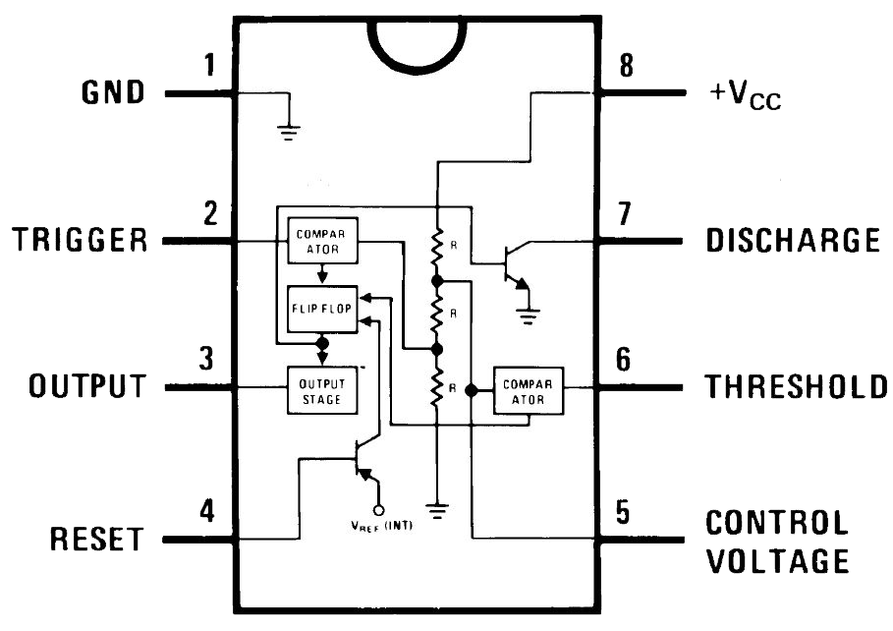
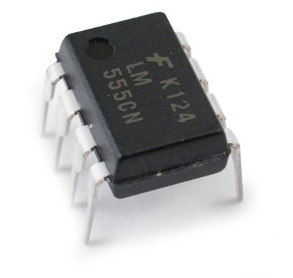
SOUND SENSOR| 555 Timer IC
The 555 Timer IC is an integrated circuit implementing a variety of timer and multivibrator applications.
Operating Modes:
Monostable Mode
Bistable Mode
Astable Mode

Slide 12
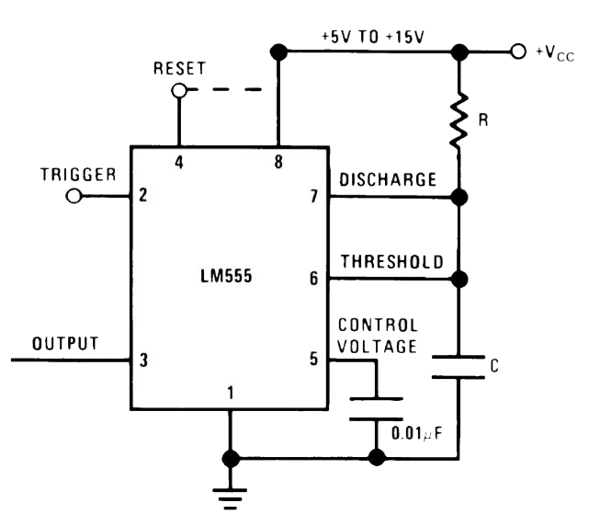
555 Timer IC |Monostable Mode
Monostable Mode is great for creating time delays. In this mode an external trigger causes the 555 timer to output a pulse of an adjustable duration. In this the 555 Timer functions as a “one shot”.
The pulse begins when 555 timer receives a trigger signal. The width of pulse is determined by time constant of an RC network, which consists of a capacitor (C) & Resistor (R).
The pulse width can be lengthened or shortened to the need of specific application by adjusting the values of R & C. T = 1.1 X R X C

Slide 13
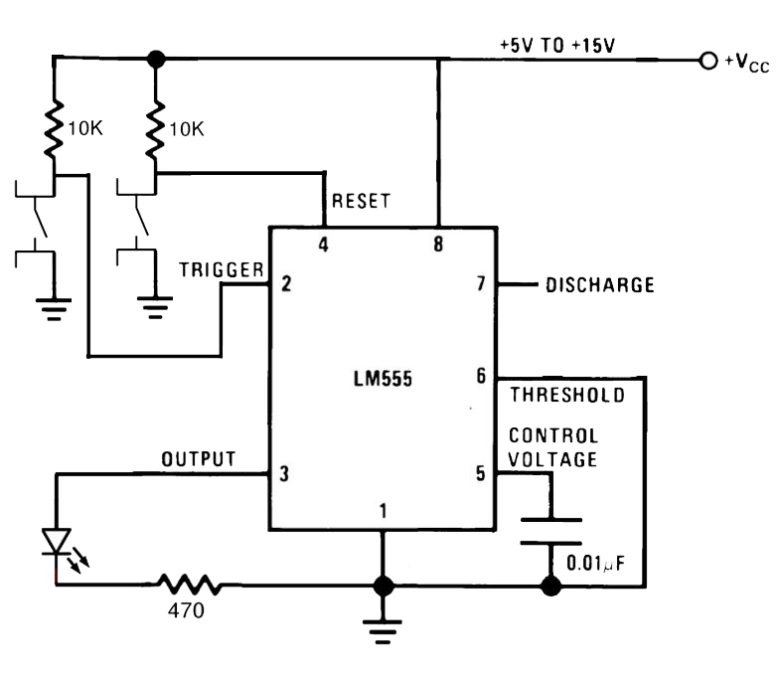
555 Timer IC |Bistable Modes
Bistable Mode causes the 555 timer to toggle its output between high and low states depending on the state of two inputs , just like flip-flop.
The trigger & reset inputs (pin 2 and 4 resp.)are held high via. Pull up registers while threshold input is simply grounded.
Thus configured , pulling the trigger momentarily to ground acts as ‘set’ and transitions the output pin (pin3) to Vcc.

Slide 14
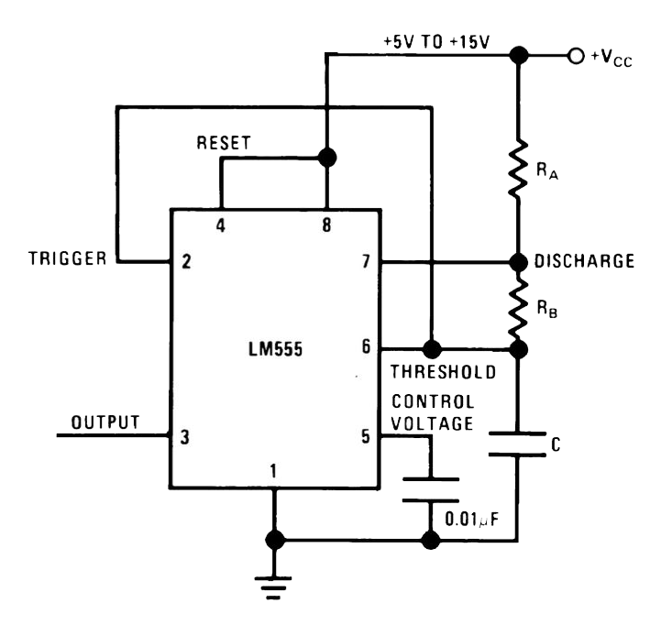
555 Timer IC |Astable Modes
In Astable mode, the 555 timer puts out a continuous stream of rectangular pulses having a specific frequency.
Resistor R1 is connected between Vcc and the discharge pin (PIN 7) and another resistor (R2) is connected between the discharge pin and the trigger (pin2) and threshold (pin 6) pins that share common node.
Hence, the capacitor is charged through RA and RB and discharged only through RB.
T = 1.1 X (RA+RB) X C

Slide 15
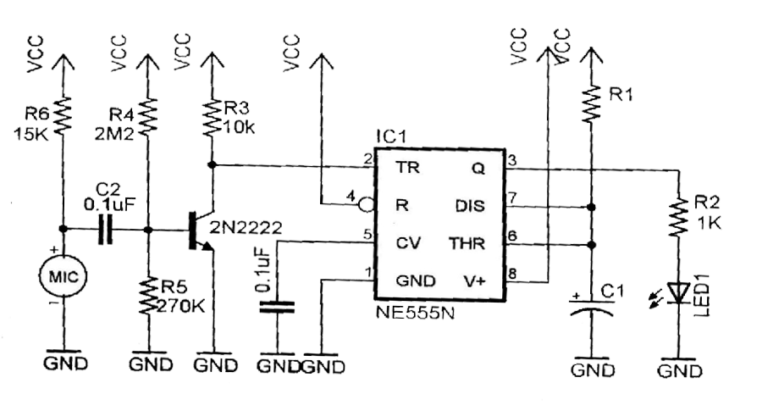
SOUND SENSOR | CIRCUIT

