Slide 1

DR. B.R. AMBEDKAR NATIONAL INSTITUE OF TECHNOLOGY JALANDHAR
Online Classroom
Group members:- Supervisor:-
Rohit Chandekar 18104075 DR. B S SAINI
Bipul Singh 18104021 DR. R K SUNKARIA
Parvej Alam 18104050

Slide 2
TABLE OF CONTENTS:-
Introduction
Problem statement
Literature survey with references
Different phases of project
Work done or methodology
Conclusion

Slide 3
Introduction:-
As we all know that we are currently facing a unprecedented covid 19 pandemic which has brought death to million of people and millions people affected due to this virus.
Also it is very tough to know the presence
of corona virus ,so we want to make a device which can enable us to restrict Ourselves from this dangerous corona virus . As we know covid 19 pandemic has made physical teaching learning process extremely impossible , we want to make an web application which helps students to

Slide 4
submit their practical and assignments online easily.
This is a role-based module in which the teachers
and student can perform any operation on the data.
the lecturer who will receive and evaluate the
student work.
Also it gives the ability for the student
to submit the assignment from different locations
served by internet.

Slide 5
Problem Statement
The COVID-19 has resulted in schools shut all across the world. Globally, over 1.2 billion children are out of the classroom. As a result, education has changed dramatically, with the distinctive rise of e-learning, whereby teaching is undertaken remotely and on digital platforms. Research suggests that online learning has been shown to increase retention of information, and take less time, meaning the changes coronavirus have caused might be here to stay.
With this sudden shift away from the classroom in many parts of the globe, some are wondering whether the adoption of online learning will continue to persist

Slide 6
post-pandemic, and how such a shift would impact the
worldwide education market. Even before COVID-19, there was already high growth and adoption in education technology, with global edtech investments reaching US$18.66 billion in 2019 and the overall market for online education projected to reach $350 Billion by 2025. Whether it is language apps, virtual tutoring, video conferencing tools, or online learning software there has been a significant surge in usage since COVID-19. So we need an app which increases students interactivity with teachers and among them as well.

Slide 7
Literature survey with reference:-
This project we have devised by going through various websites , documentation ,ppt. The following are the links of various websites which we have taken as reference for making our project:-
Click on below to view link:-
1.Python
2. Django
3. Sqllite3
4. Frontend development documentation

Slide 8
Different phases of project :-
1. Identification of the problem
2. Thinking appropriate solution to problem.
3. We took references from various e-books, blogs, articles and documentations.
4. Devising the required features to the apps and
Building the app in development phase.
5.Testing our app and move to the production mode.
6. Finalizing our project.

Slide 9
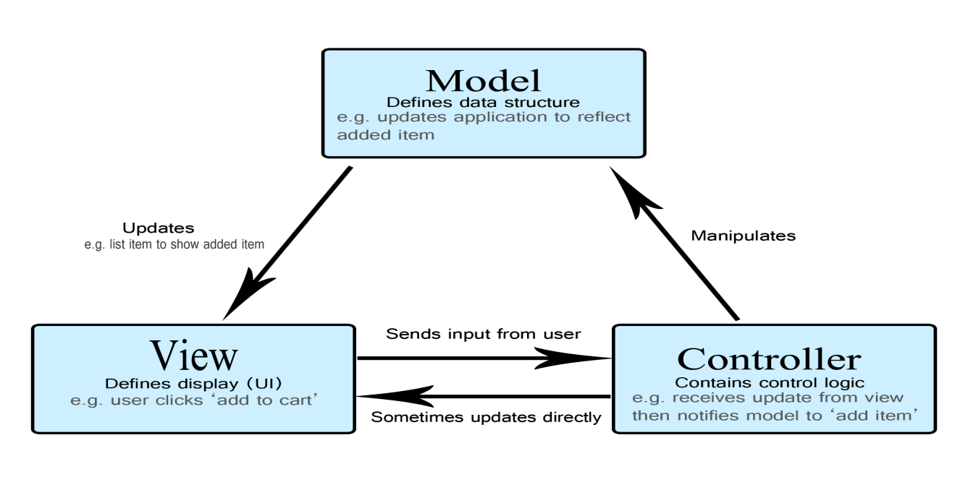
Work done or Methodology:-
We have build this web applications using MVC architecture which is an architectural pattern that separates an application into three main logical components: the model, the view, and the controller.

Slide 10
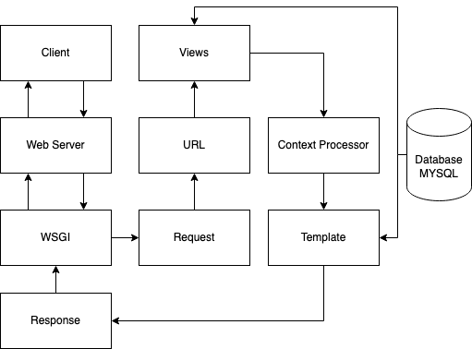
We have build this application using Django, a high level Python web framework and to have persistent data we have used MySQL as our database.
.

Slide 11
Student Features:-
Manage Student Profile– For theStudent profile, The student update his/her information details.
Registration– For the registration, The student need to register first to create their own account
View Assignment and exam– For the assignment and exam, The student can view their assignment and exam through this website.
Login – By default the student need to login first to enable to access the system.
View Course– For the course, The student can view all their courses.

Slide 12
Teachers Features:-
Manage Teacher Profile– For the teacher profile, The teacher can update his/her information details.
Registration– For the registration, The teacher need to register first to create their own account.
Create Course– For the add course, The teacher can add and update course information.
Login – By default the teacher need to login first to enable to access the system.
Create Exam – For the exam, The teacher can create and update exam information.
Create Assignment – For the assignment, The teacher can create and update assignment information.

Slide 13
Conclusion:-
The purpose of this project has been to create an application where the lost interactivity and interest of student is promoted.
Created various features for student and teachers, where student can login into the desired classes and do the submissions.
To increase the interactivity we wanted to create a feed where students and teachers both can participate in the discussion to any problems, sharing of resources. So basically we wanted to create a social media for learning.

Slide 14


