Slide 1
Normalisation
Normalisation process – enables you to identify the existence of potential problems, called updating anomalies, in the design of a relational database
Normalisation is a process for assigning attributes to entities.
Aim
  to design good tables
  to minimise data redundancy and hence avoid problems with insert, update & delete

Slide 2
Normalisation Benefits
Reduce duplicate data and wasted storage.
Prevent insert, update, and delete anomalies.
Improve data consistency and integrity.
Make the schema easier to maintain and evolve.

Slide 3
Normalisation
Normalisation works through a series of stages called normal forms:
  First normal form (1NF)
  Second normal form (2NF)
  Third normal form (3NF)
  Fourth normal form (4NF)
Normal form – possesses a certain desirable collection of properties

Slide 4
Normalisation
Starts with a heap of data - usually some form of required output e.g. a report
Put it all into one table
  draw a dependency diagram
  apply the normalisation rules
  create new tables as required

Slide 5
Super Key & Candidate Key
both used to uniquely identify rows (tuples) in a database table, where all candidate keys are super keys, but not all super keys are candidate keys
Super Key
Definition: Any group of one or more columns that can uniquely find a row in a table.
Redundancy: It can have extra, unnecessary columns that are not needed for uniqueness.
Candidate Key
Definition: A super key that has no extra or unneeded columns. It is the smallest possible group of columns that can uniquely find a row.
Minimality: If you remove any column from a candidate key, it loses its ability to uniquely find the row.
Role: One candidate key is chosen to be the primary key, while the leftover candidate keys become alternate keys.

Slide 6
Normalisation
1NF (First Normal Form)
  no repeating groups
  Primary Key defined
  single valued attributes
2NF (Second Normal Form)
  1NF
  no partial dependencies
3NF (Third Normal Form)
  2NF
  no transitive dependencies

Slide 7
Dependency Diagram
What is a Determinant?
  StudentID => StudentName
  StudentID determines StudentName
  StudentID is a Determinant
StudentName depends on StudentID
There is a Dependency between StudentName and StudentID

Slide 8
Partial dependency
an attribute is dependent on PART of the key

Slide 9
Transitive dependency
an attribute is dependent on a NON-KEY attribute

Slide 10
The Need for Normalisation
Case of a Software Development Company
  Software project - Project number, Name, Employees assigned to the project.
  Employee - Employee number, Name, Job classification
  The company charges its clients by billing the hours spent on each project. The hourly billing rate is dependent on the employee’s position.
  Periodically, a report is generated.

Slide 11
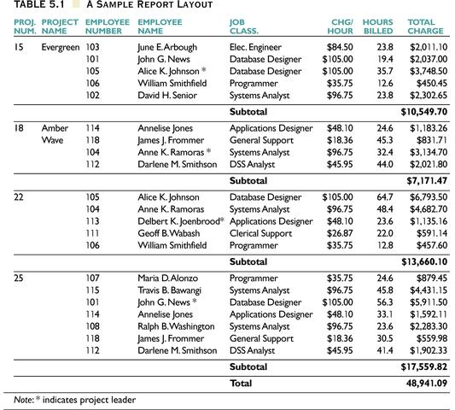

Slide 12
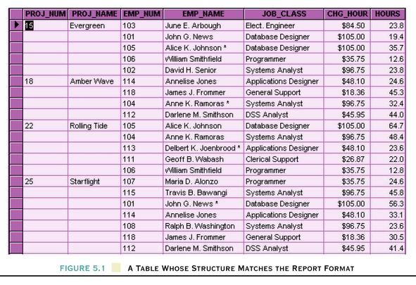
A Table Whose Structure Matches the Report Format

Slide 13
Problems with the Figure 5.1
The project number is intended to be a primary key, but it contains nulls.
The table displays data redundancies.
The table entries invite data inconsistencies.
The data redundancies yield the following anomalies:
  Update anomalies.
  Addition anomalies.
  Deletion anomalies.

Slide 14
Update Anomalies
Update
  Information is in multiple rows, difficult to update
Inconsistent data
  Because of the duplication, a row that is not updated causes inconsistency
Additions
  Dummy records are required to add new unused dependent rows
Deletions
  Risk deleting other data

Slide 15
Conversion to First Normal Form
A relational table must not contain repeating groups.
Repeating groups can be eliminated by adding the appropriate entry in at least the primary key column(s).

Slide 16
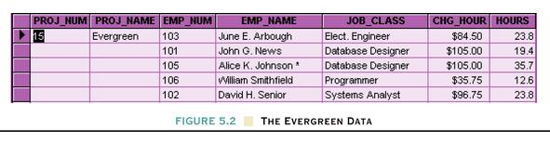
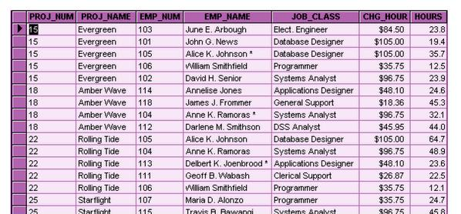
First Normal Form

Slide 17
1NF Definition
The term first normal form (1NF) describes the tabular format in which:
  All the key attributes are defined.
  There are no repeating groups in the table.
  All attributes are dependent on the primary key.
  There are no multi-valued attributes

Slide 18
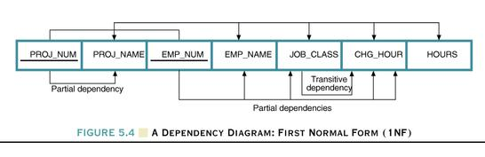
Dependency Diagram
The primary key components are bold, underlined, and shaded in a different color.
The arrows above entities indicate all desirable dependencies, ie, dependencies that are based on PK.
The arrows below the dependency diagram indicate less desirable dependencies - partial dependencies and transitive dependencies.

Slide 19
2NF Definition
A table is in 2NF if:
  It is in 1NF and
  It includes no partial dependencies; that is, no attribute is dependent on only a portion of the primary key.
  (It is still possible for a table in 2NF to exhibit transitive dependency; that is, one or more attributes may be functionally dependent on nonkey attributes.)

Slide 20
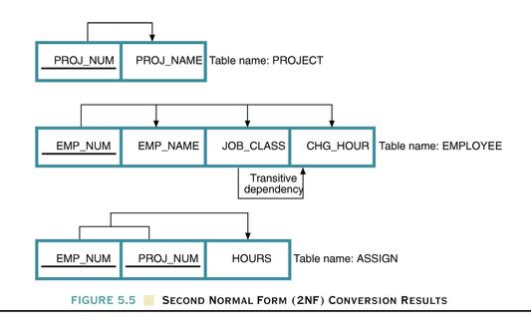
Second Normal Form (2NF) Conversion Results

Slide 21
3NF Definition
A table is in 3NF if:
  It is in 2NF and
  It contains no transitive dependencies.

Slide 22
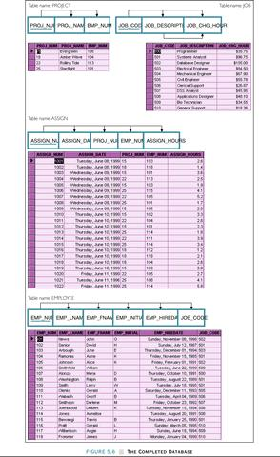

Slide 23
Unnormalised Record
Order Num | Order Date | Cust Num | Cust Name | Cust Address | Prod Num | Prod Name | Qty Ordered | Prod Price | Prod Total | Order Total
0101 | 1/9/04 | C21 | Bloggs | …. | 56 | Pen | 3 | $2.30 | $6.90 | $19.90
 |  |  |  | …. | 59 | Pencil | 5 | $1.20 | $6.00 | $19.90
 |  |  |  | …. | 48 | Ruler | 2 | $3.50 | $7.00 | $19.90
0102 | 2/9/04 | C22 | Jones | …. | 59 | Pencil | 1 | $1.20 | $1.20 | $1.20
 |  |  |  | …. | 56 | Pen | 2 | $2.30 | $6.40 | $6.40

Slide 24
First Normal Form (1NF)
Order Num | Order Date | Cust Num | Cust Name | Cust Address | Prod Num | Prod Name | Qty Ordered | Prod Price | Prod Total | Order Total
0101 | 1/9/04 | C21 | Bloggs | …. | 56 | Pen | 3 | $2.30 | $6.90 | $19.90
0101 | 1/9/04 | C21 | Bloggs | …. | 59 | Pencil | 5 | $1.20 | $6.00 | $19.90
0101 | 1/9/04 | C21 | Bloggs | …. | 48 | Ruler | 2 | $3.50 | $7.00 | $19.90
0102 | 2/9/04 | C22 | Jones | …. | 59 | Pencil | 1 | $1.20 | $1.20 | $1.20
0102 | 2/9/04 | C22 | Jones | …. | 56 | Pen | 2 | $2.30 | $6.40 | $6.40

Slide 25
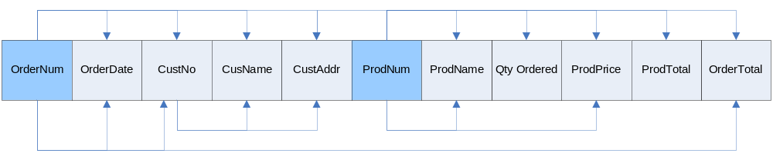
Dependency Diagram

Slide 26
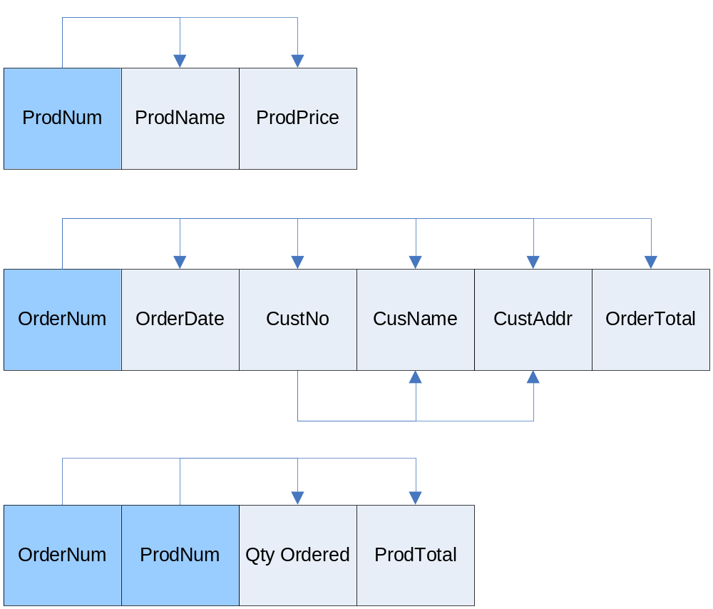
Second Normal Form (2NF)
Obtained by removing attributes which are dependent on part of the primary key.

Slide 27
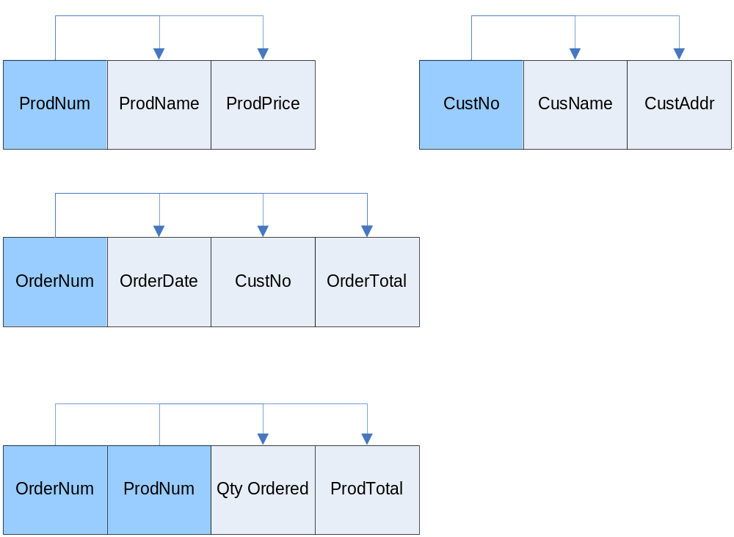
Third Normal Form (3NF)
Obtained by removing attributes which are dependent on a non-key attribute.

Slide 28
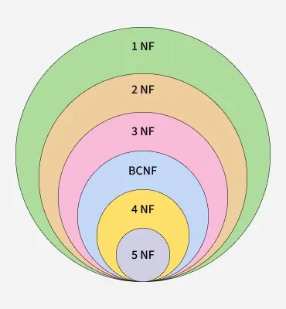
Normal Forms (5NF)

Slide 29
Boyce-Codd NF
The normal forms become stricter as we move from 1NF → 2NF → 3NF → BCNF:
1NF: Each field must hold atomic (indivisible) values.
2NF: No partial dependency on a primary key.
3NF: No transitive dependency on a primary key.
BCNF: Every determinant must be a candidate key.
Why Do We Need BCNF?
2NF and 3NF may allow anomalies if a functional dependency exists where the determinant is not a superkey.
BCNF handles edge cases where 3NF fails to remove all redundancy, especially in tables with multiple candidate keys.
Prevents update, insert, and delete anomalies by ensuring every determinant is a superkey.
Makes database design more robust and easier to maintain over time.
Improves data consistency and clarity by removing hidden or indirect dependencies.

Slide 30
Boyce-Codd NF
Lecturer | Student | Course
Amit | John | Database
Amit | Claire | PHP
Amit | John | Python
Tim | Claire | Database
Tim | Sandy | Python
FD: { (student, Teacher) -> subject, (student, subject) -> Teacher, (Teacher) -> subject}
divided into two relations R1(Teacher, Subject) and R2(Student, Teacher)
Lecturer | Course
Amit | Database
Tim | Database
Amit | Python
Tim | Python
Amit | PHP
Student | Lecturer
John | Database
John | Python
Claire | PHP
Claire | Database
Sandy | Python

Slide 31
4 NF
StudentID | OfferNum | TextNo
S1 | O1 | T1
S1 | O2 | T2
S2 | O1 | T2
S2 | O2 | T1
StudentID | OfferNum
S1 | O1
S1 | O2
S2 | O1
S2 | O2
OfferNum | TextNo
O1 | T1
O1 | T2
O2 | T1
O2 | T2

Slide 32
4 NF
A course can have multiple lecturers, a course can also have multiple textbook authors but instructors and authors are independent of each other. This creates two independent multivalued dependencies:
Course ->-> Lecturer
Course ->-> Text_Author
Course | Lecturer | Text_Author
Adv DB | Amit | T1
Adv DB | Tim | T2
Python | Amit | T3
Python | Tim | T4
Python | Tony | T4
Course | Lecturer
Adv DB | Amit
Adv DB | Tim
Python | Amit
Python | Tim
Python | Tony
Course | Text_Author
Adv DB | T1
Adv DB | T2
Python | T3
Python | T4
Key Idea: 4NF eliminates redundancy caused by multivalued dependencies by separating independent one-to-many relationships into different tables.

Slide 33
5 NF
It is already in 4NF
It cannot be broken down into smaller tables without losing data
No multi-valued dependency should exist
Course | Lecturer | Year
DB | Amit | 1
Python | Amit | 1
Python | Tim | 1
PHP | Amit | 2
Course | Year
DB | 1
Python | 1
PHP | 2
Year | Lecturer
1 | Amit
1 | Tim
2 | Amit
T1 ⨝ T2
Course | Year | Lecturer
DB | 1 | Amit
DB | 1 | Tim
Python | 1 | Amit
Python | 1 | Tim
PHP | 2 | Amit
This breaks the rule of 5NF i.e. non-loss decomposition

Slide 34
5 NF
Fix non-loss decomposition
Course | Lecturer
DB | Amit
Python | Tim
Python | Amit
PHP | Amit
T1 ⨝ T2⨝ T3
Course | Year | Lecturer
DB | 1 | Amit
Python | 1 | Amit
Python | 1 | Tim
PHP | 2 | Amit

Slide 35
Over Normalisation
Challenges: Too many tables may result in multiple joins, making queries slow and difficult to manage.
Additional processing required for joins in overly normalized databases may hurt performance, especially in large-scale systems.
When to Use Normalization and Denormalization
Normalization is best suited for transactional systems where data integrity is paramount, such as banking systems and enterprise applications.
Denormalization is ideal for read-heavy applications like data warehousing and reporting systems where performance and query speed are more critical than data integrity.

