Slide 1
STUDY ON FMCG INDUSTRY

Slide 2
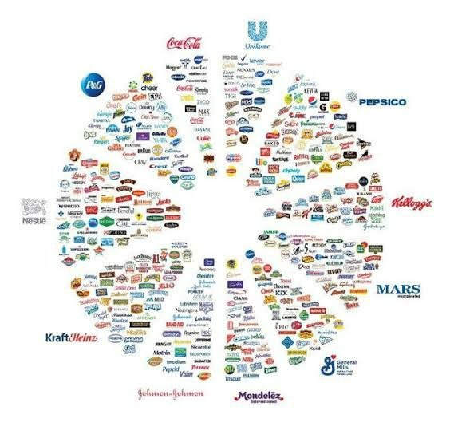
Introduction
Fast-moving consumer products.
Products that are sold quickly and at relatively low cost.
FMCG is one of the key contributors to the Indian economy.
It is the fourth largest sector in Indian economy.
High consumer demand.
Low profit margin & High volume sales.
Durable goods, Non durable goods & services.

Slide 3
FMCG Market in India and Worldwide
The contribution of FMCG to GDP is 10%.
India’s FMCG market was valued at $110 billion in 2020.
The global FMCG market size was valued at $10,020 billion in 2017.
Household and Personal care being the leading segment accounting 50% of the share.
Global market is projected to reach $15361 & Indian market is project to $220 billion by 2025.

Slide 4
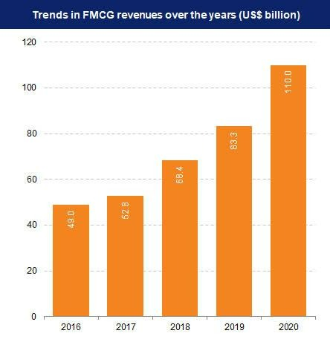
Year on Year Growth

Slide 5
Top Global Companies
Nestle is world’s largest food and beverage company with a revenue of $94 billion and covering 187 countries worldwide.
Procter & Gamble Company (P&G) specialized in personal care and hygiene products with a revenue of $67 billion.
PepsiCo is one of the leading food and beverage company with a revenue of $65 billion.

Slide 6
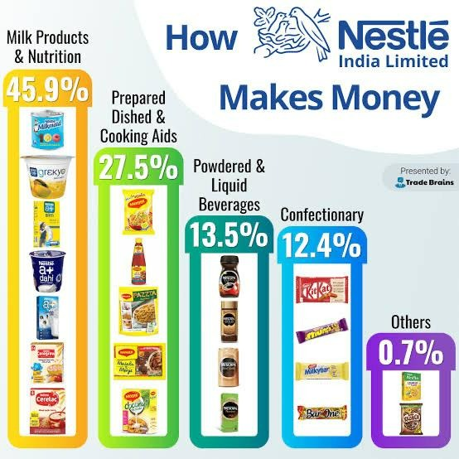
Category Distribution in Nestle

Slide 7
Growth of the Industry
With a growth rate of 14.7%, it is projected to be $220 billion by 2025.
Global revenue growth of food in 2021 was 7.3%.
Global Revenue growth of beauty and personal care in 2021 was 6.7%
In last 10 years, the revenue in FMCG industry in India has been growing at the rate of 21.4%.

Slide 8
Impact Of Covid
Demand for essential products.
Consumer shift in channel preferences was evident.
Increased focus on hygiene and personal wellbeing.
Product with biggest increase in purchase was sanitizers & disinfectants.
As consumers stayed home, they ate more biscuits, used more dishwashing gel and soap, and applied more disinfectants.

Slide 9
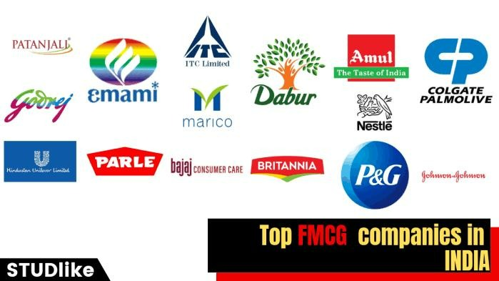
India’s top 10 FMCG Companies

Slide 10
FMCG Market Breakup in India

Slide 11
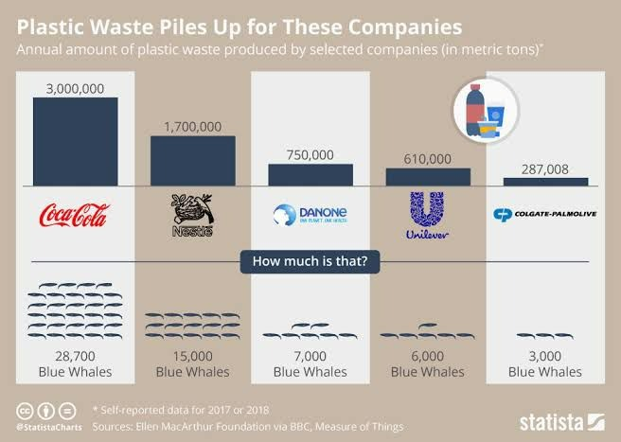
Plastic Waste By Companies

Slide 12
THANK YOU

