Slide 1
Standard Single Purpose Processors: Peripherals

Slide 2
Introduction
Single-purpose processors
  Performs specific computation task
  Custom single-purpose processors
    Designed by us for a unique task
  Standard single-purpose processors
    “Off-the-shelf” -- pre-designed for a common task
    a.k.a., peripherals
    serial transmission
    analog/digital conversions

Slide 3
Timers, counters, watchdog timers
Timer: measures time intervals
  To generate timed output events
    e.g., hold traffic light green for 10 s
  To measure input events
    e.g., measure a car’s speed
Based on counting clock pulses
    E.g., let Clk period be 10 ns
    And we count 20,000 Clk pulses
    Then 200 microseconds have passed
    16-bit counter would count up to 65,535*10 ns = 655.35 microsec., resolution = 10 ns
    Top: indicates top count reached, wrap-around
Basic timer
Clk
16-bit up counter
16
Cnt
Top
Reset

Slide 4
Counters
Counter: like a timer, but counts pulses on a general input signal rather than clock
  e.g., count cars passing over a sensor
  Can often configure device as either a timer or counter
Timer/counter
Clk
2x1 mux
16-bit up counter
Cnt
16
Cnt_in
Top
Reset
Mode

Slide 5
Other timer structures
Interval timer
  Indicates when desired time interval has passed
  We set terminal count to desired interval
    Number of clock cycles = Desired time interval / Clock period
Cascaded counters
Prescaler
  Divides clock
  Increases range, decreases resolution
16/32-bit timer
Clk
16-bit up counter
Cnt1
Timer with a terminal count
16
Top1
Clk
16-bit up counter
Cnt
16
16-bit up counter
16
Cnt2
Reset
Top2
=
Top
Time with prescaler
Clk
Prescaler
16-bit up counter
Terminal count
Mode

Slide 6
Example: Reaction Timer
indicator light
reaction button
/* main.c */
#define MS_INIT 63535
void main(void){
int count_milliseconds = 0;
configure timer mode
set Cnt to MS_INIT
wait a random amount of time
turn on indicator light
start timer
while (user has not pushed reaction button){
if(Top) {
stop timer
set Cnt to MS_INIT
start timer
reset Top
count_milliseconds++;
}
}
turn light off
printf(“time: %i ms“, count_milliseconds);
}
LCD
time: 100 ms
Measure time between turning light on and user pushing button
  16-bit timer, clk period is 83.33 ns, counter increments every 6 cycles
  Resolution = 6*83.33=0.5 microsec.
  Range = 65535*0.5 microseconds = 32.77 milliseconds
  Want program to count millisec., so initialize counter to 65535 – 1000/0.5 = 63535

Slide 7
Watchdog timer
Must reset timer every X time unit, else timer generates a signal
Common use: detect failure, self-reset
Another use: timeouts
  e.g., ATM machine
  16-bit timer, 2 microsec. resolution
  timereg value = 2*(2¹⁶-1)–X = 131070–X
  For 2 min., X = 120,000 microsec.
osc
clk
overflow
overflow
to system reset
or
interrupt
prescaler
scalereg
timereg
checkreg
/* main.c */
main(){
wait until card inserted
call watchdog_reset_routine
while(transaction in progress){
if(button pressed){
perform corresponding action
call watchdog_reset_routine
}
/* if watchdog_reset_routine not called every < 2 minutes, interrupt_service_routine is called */
}
watchdog_reset_routine(){
/* checkreg is set so we can load value into timereg. Zero is loaded into scalereg and 11070 is loaded into timereg */
checkreg = 1
scalereg = 0
timereg = 11070
}
void interrupt_service_routine(){
eject card
reset screen
}

Slide 8
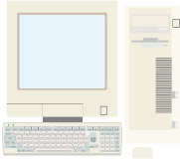
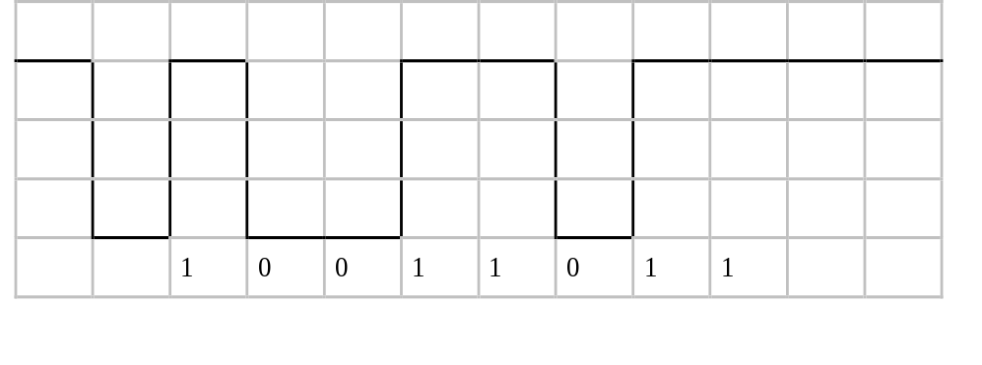
Serial Transmission Using UARTs
UART: Universal Asynchronous Receiver Transmitter
  Takes parallel data and transmits serially
  Receives serial data and converts to parallel
Parity: extra bit for simple error checking
Start bit, stop bit
Baud rate
  signal changes per second
  bit rate usually higher
embedded device
1
0
1
0
1
0
1
1
1
0
0
1
1
0
1
1
1
0
0
1
1
0
1
1
Sending UART
Receiving UART
start bit
end bit
data

Slide 9
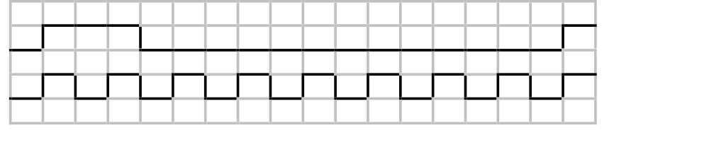
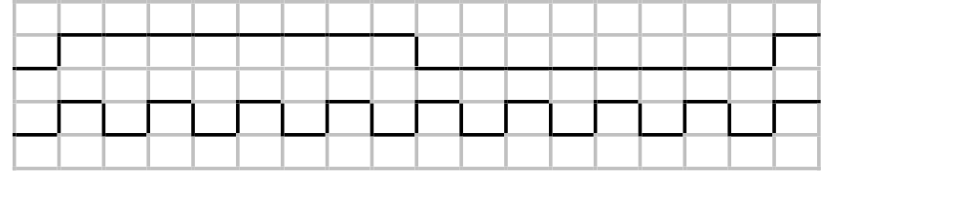
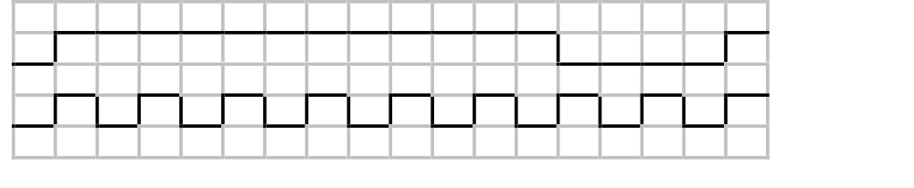
Pulse width modulator
Generates pulses with specific high/low times
Duty cycle: % time high
  Square wave: 50% duty cycle
Common use: control average voltage to electric device
  Simpler than DC-DC converter or digital-analog converter
  DC motor speed, dimmer lights
Another use: encode commands, receiver uses timer to decode
pwm_o
clk
25% duty cycle – average pwm_o is 1.25V
pwm_o
clk
50% duty cycle – average pwm_o is 2.5V.
pwm_o
clk
75% duty cycle – average pwm_o is 3.75V.

Slide 10
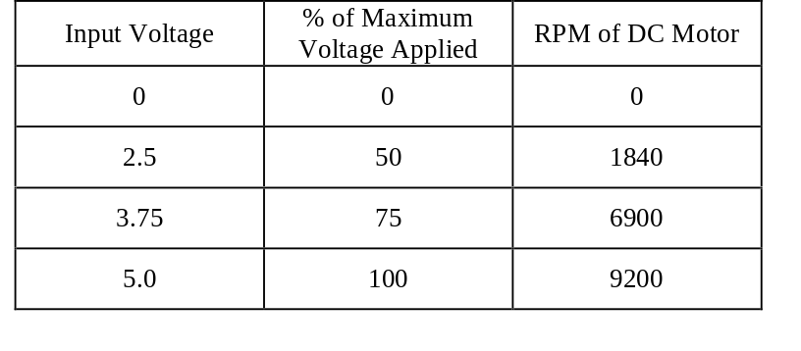
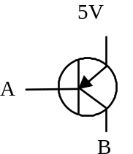
Controlling a DC motor with a PWM
clk
clk_div
counter
( 0 – 254)
controls how fast the counter increments
8-bit
comparator
counter < cycle_high,
pwm_o = 1
counter >= cycle_high,
pwm_o = 0
pwm_o
cycle_high
Relationship between applied voltage and speed of the DC Motor
Internal Structure of PWM
void main(void){
/* controls period */
PWMP = 0xff;
/* controls duty cycle */
PWM1 = 0x7f;
while(1){};
}
The PWM alone cannot drive the DC motor, a possible way to implement a driver is shown below using an MJE3055T NPN transistor.
5V
DC
MOTOR
From processor

Slide 11
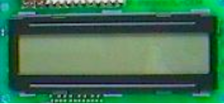
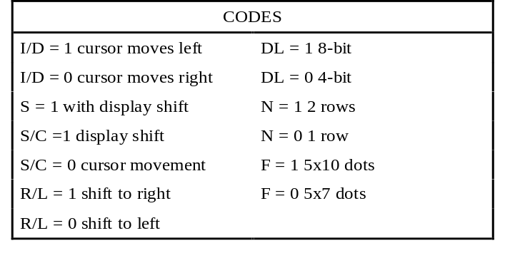
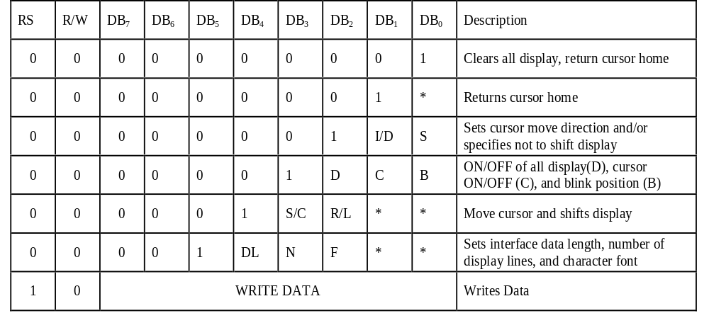
LCD controller
E
void WriteChar(char c){
RS = 1; /* indicate data being sent */
DATA_BUS = c; /* send data to LCD */
EnableLCD(45); /* toggle the LCD with appropriate delay */
}
communications bus
R/W
RS
DB7–DB0
microcontroller
8
LCD controller

