Slide 1
DMA

Slide 2
Direct memory access
Buffering
  Temporarily storing data in memory before processing
  Data accumulated in peripherals commonly buffered
Microprocessor could handle this with ISR
  Storing and restoring microprocessor state inefficient
  Regular program must wait
DMA controller more efficient
  Separate single-purpose processor
  Microprocessor relinquishes control of system bus to DMA controller
  Microprocessor can meanwhile execute its regular program
    No inefficient storing and restoring state due to ISR call
    Regular program need not wait unless it requires the system bus
      Harvard archictecture – processor can fetch and execute instructions as long as they don’t access data memory – if they do, processor stalls

Slide 3
Peripheral to memory transfer without DMA, using vectored interrupt
Time
1(a): μP is executing its main program.
1(b): P1 receives input data in a register with address 0x8000.
2: P1 asserts Int to request servicing by the microprocessor.
3: After completing instruction at 100, μP sees Int asserted, saves the PC’s value of 100, and asserts Inta.
4: P1 detects Inta and puts interrupt address vector 16 on the data bus.
5(a): μP jumps to the address on the bus (16). The ISR there reads data from 0x8000 and then writes it to 0x0001, which is in memory.
5(b): After being read, P1 deasserts Int.
6: The ISR returns, thus restoring PC to 100+1=101, where μP resumes executing.

Slide 4
Peripheral to memory transfer without DMA, using vectored interrupt
1(a): μP is executing its main program
1(b): P1 receives input data in a register with address 0x8000.
Program memory
μP
Data memory
ISR
0x0000
0x0001
16:
MOV R0, 0x8000
17:
# modifies R0
18:
MOV 0x0001, R0
System bus
19:
RETI # ISR return
...
Main program
Inta
P1
...
Int
100:
instruction
16
101:
instruction
PC
0x8000

Slide 5
Peripheral to memory transfer without DMA, using vectored interrupt
2: P1 asserts Int to request servicing by the microprocessor
Program memory
μP
Data memory
ISR
0x0000
0x0001
16:
MOV R0, 0x8000
17:
# modifies R0
18:
MOV 0x0001, R0
System bus
19:
RETI # ISR return
...
Main program
Inta
P1
...
Int
100:
instruction
Int
16
101:
instruction
PC
1
0x8000
100

Slide 6
Peripheral to memory transfer without DMA, using vectored interrupt
3: After completing instruction at 100, μP sees Int asserted, saves the PC’s value of 100, and asserts Inta.
Program memory
μP
Data memory
ISR
0x0000
0x0001
16:
MOV R0, 0x8000
17:
# modifies R0
18:
MOV 0x0001, R0
System bus
19:
RETI # ISR return
...
1
Inta
Main program
Inta
P1
...
Int
100:
instruction
16
101:
instruction
PC
0x8000
100
100

Slide 7
Peripheral to memory transfer without DMA, using vectored interrupt (cont’)
4: P1 detects Inta and puts interrupt address vector 16 on the data bus.
Program memory
μP
Data memory
ISR
0x0000
0x0001
16:
MOV R0, 0x8000
17:
# modifies R0
System bus
18:
MOV 0x0001, R0
16
System bus
19:
RETI # ISR return
...
Main program
Inta
P1
...
Int
16
100:
instruction
16
101:
instruction
PC
0x8000
100

Slide 8
Peripheral to memory transfer without DMA, using vectored interrupt (cont’)
5(a): μP jumps to the address on the bus (16). The ISR there reads data from 0x8000 and then writes it to 0x0001, which is in memory.
5(b): After being read, P1 de-asserts Int.
μP
Data memory
Program memory
Data memory
0x0000
0x0001
ISR
0x0001
ISR
ISR
16:
16:
16:
MOV R0, 0x8000
MOV R0, 0x8000
MOV R0, 0x8000
17:
17:
17:
# modifies R0
# modifies R0
# modifies R0
System bus
18:
System bus
18:
18:
MOV 0x8001, R0
MOV 0x8001, R0
MOV 0x0001, R0
19:
19:
19:
RETI # ISR return
RETI # ISR return
...
RETI # ISR return
...
...
Main program
Inta
Main program
Main program
P1
...
P1
...
...
Int
100:
Int
16
100:
100:
instruction
instruction
instruction
PC
0
101:
101:
101:
instruction
instruction
instruction
0x8000
0x8000
100

Slide 9
Peripheral to memory transfer without DMA, using vectored interrupt (cont’)
6: The ISR returns, thus restoring PC to 100+1=101, where μP resumes executing.
Program memory
μP
Data memory
ISR
0x0000
0x0001
ISR
16:
16:
MOV R0, 0x8000
MOV R0, 0x8000
17:
17:
# modifies R0
# modifies R0
18:
System bus
18:
MOV 0x8001, R0
MOV 0x0001, R0
19:
19:
RETI # ISR return
...
RETI # ISR return
...
Main program
Inta
Main program
P1
...
...
Int
100:
16
100:
instruction
instruction
PC
101:
101:
instruction
instruction
+1
0x8000
100
100

Slide 10
Peripheral to memory transfer with DMA
1(a): μP is executing its main program. It has already configured the DMA ctrl registers.
1(b): P1 receives input data in a register with address 0x8000.
Time
4: After executing instruction 100, μP sees Dreq asserted, releases the system bus, asserts Dack, and resumes execution. μP stalls only if it needs the system bus to continue executing.
3: DMA ctrl asserts Dreq to request control of system bus.
2: P1 asserts req to request servicing by DMA ctrl.
5: (a) DMA ctrl asserts ack (b) reads data from 0x8000 and (b) writes that data to 0x0001.
6:. DMA de-asserts Dreq and ack completing handshake with P1.
7(a): μP de-asserts Dack and resumes control of the bus.
7(b): P1 de-asserts req.

Slide 11
Peripheral to memory transfer with DMA (cont’)
1(a): μP is executing its main program. It has already configured the DMA ctrl registers
1(b): P1 receives input data in a register with address 0x8000.
Program memory
μP
Data memory
0x0000
0x0001
No ISR needed!
System bus
...
Dack
DMA ctrl
P1
Main program
Dreq
...
0x0001
ack
100:
instruction
PC
0x8000
req
101:
instruction
0x8000
100

Slide 12
Peripheral to memory transfer with DMA (cont’)
2: P1 asserts req to request servicing
by DMA ctrl.
3: DMA ctrl asserts Dreq to request control of system bus
Program memory
μP
Data memory
0x0000
0x0001
No ISR needed!
System bus
...
Dack
DMA ctrl
DMA ctrl
P1
P1
Main program
Dreq
P1
...
Dreq
0x0001
ack
100:
instruction
1
PC
req
101:
instruction
0x8000
req
0x8000
100
1

Slide 13
Peripheral to memory transfer with DMA (cont’)
4: After executing instruction 100, μP sees Dreq asserted, releases the system bus, asserts Dack, and resumes execution, μP stalls only if it needs the system bus to continue executing.
Program memory
μP
Data memory
0x0000
0x0001
No ISR needed!
System bus
...
Dack
1
Main program
Dack
DMA ctrl
P1
...
Dreq
0x0001
ack
100:
instruction
PC
0x8000
req
101:
instruction
0x8000
100

Slide 14
Peripheral to memory transfer with DMA (cont’)
5: DMA ctrl (a) asserts ack, (b) reads data from 0x8000, and (c) writes that data to 0x0001.
(Meanwhile, processor still executing if not stalled!)
μP
Data memory
Program memory
Data memory
0x0000
0x0001
0x0000
0x0001
No ISR needed!
System bus
System bus
...
Dack
DMA ctrl
P1
Main program
Dreq
DMA ctrl
1
P1
...
ack
ack
0x0001
ack
0x0001
100:
instruction
PC
req
0x8000
req
0x8000
0x8000
101:
instruction
0x8000
100

Slide 15
Peripheral to memory transfer with DMA (cont’)
6: DMA de-asserts Dreq and ack completing the handshake with P1.
Program memory
μP
Data memory
0x0000
0x0001
No ISR needed!
System bus
...
Dack
DMA ctrl
P1
Main program
Dreq
0
...
Dreq
ack
0
0x0001
ack
100:
instruction
PC
0x8000
req
101:
instruction
0x8000
100

Slide 16
ISA bus DMA cycles
Processor
Memory
ISA-Bus
R
A
R
DMA
A
I/O Device
DMA Memory-Write Bus Cycle
DMA Memory-Read Bus Cycle
CYCLE
CLOCK
D[7-0]
A[19-0]
ALE
/IOR
/MEMW
CHRDY
C1 C2 C3 C4 C5 C6 C7
CYCLE
CLOCK
D[7-0]
A[19-0]
ALE
/MEMR
/IOW
CHRDY
C1 C2 C3 C4 C5 C6 C7
DATA
DATA
ADDRESS
ADDRESS

Slide 17
Arbitration: Priority arbiter
Consider the situation where multiple peripherals request service from single resource (e.g., microprocessor, DMA controller) simultaneously - which gets serviced first?
Priority arbiter
  Single-purpose processor
  Peripherals make requests to arbiter, arbiter makes requests to resource
  Arbiter connected to system bus for configuration only
Micro-processor
System bus
7
Inta
5
Priority
arbiter
Peripheral1
Peripheral2
Int
3
Ireq1
2
2
Iack1
6
Ireq2
Iack2

Slide 18
Arbitration using a priority arbiter
Micro-processor
System bus
7
Inta
5
Priority
arbiter
Peripheral1
Peripheral2
Int
3
Ireq1
2
2
Iack1
6
Ireq2
Iack2
1. Microprocessor is executing its program.
2. Peripheral1 needs servicing so asserts Ireq1. Peripheral2 also needs servicing so asserts Ireq2.
3. Priority arbiter sees at least one Ireq input asserted, so asserts Int.
4. Microprocessor stops executing its program and stores its state.
5. Microprocessor asserts Inta.
6. Priority arbiter asserts Iack1 to acknowledge Peripheral1.
7. Peripheral1 puts its interrupt address vector on the system bus
8. Microprocessor jumps to the address of ISR read from data bus, ISR executes and returns
(and completes handshake with arbiter).
9. Microprocessor resumes executing its program.

Slide 19
Arbitration: Priority arbiter
Types of priority
    Fixed priority
      each peripheral has unique rank
      highest rank chosen first with simultaneous requests
      preferred when clear difference in rank between peripherals
    Rotating priority (round-robin)
      priority changed based on history of servicing
      better distribution of servicing especially among peripherals with similar priority demands

Slide 20
Arbitration: Daisy-chain arbitration
Arbitration done by peripherals
  Built into peripheral or external logic added
    req input and ack output added to each peripheral
Peripherals connected to each other in daisy-chain manner
  One peripheral connected to resource, all others connected “upstream”
  Peripheral’s req flows “downstream” to resource, resource’s ack flows “upstream” to requesting peripheral
  Closest peripheral has highest priority
μP
System bus
Peripheral1
Peripheral2
Inta
Ack_in
Ack_out
Ack_in
Ack_out
Int
Req_out
Req_in
Req_out
Req_in
0
Daisy-chain aware peripherals

Slide 21
Arbitration: Daisy-chain arbitration
Pros/cons
  Easy to add/remove peripheral - no system redesign needed
  Does not support rotating priority
  One broken peripheral can cause loss of access to other peripherals
Micro-processor
μP
System bus
System bus
Inta
Priority
arbiter
Peripheral1
Peripheral2
Int
Peripheral1
Peripheral2
Inta
Ack_in
Ack_out
Ack_in
Ack_out
Ireq1
Int
Req_out
Req_in
Req_out
Req_in
0
Iack1
Ireq2
Iack2
Daisy-chain aware peripherals

Slide 22
Network-oriented arbitration
When multiple microprocessors share a bus (sometimes called a network)
  Arbitration typically built into bus protocol
  Separate processors may try to write simultaneously causing collisions
    Data must be resent
    Don’t want to start sending again at same time
      statistical methods can be used to reduce chances
Typically used for connecting multiple distant chips
  Trend – use to connect multiple on-chip processors

Slide 23
Example: Vectored interrupt using an interrupt table
Processor
Fixed priority: i.e., Peripheral1 has highest priority
Keyword “_at_” followed by memory address forces compiler to place variables in specific memory locations
  e.g., memory-mapped registers in arbiter, peripherals
A peripheral’s index into interrupt table is sent to memory-mapped register in arbiter
Peripherals receive external data and raise interrupt
MASK
IDX0
IDX1
ENABLE
DATA
MEMORY
Priority Arbiter
Memory Bus
Peripheral 1
Peripheral 2
Jump Table
void Peripheral1_ISR(void) {
unsigned char data;
data = PERIPHERAL1_DATA_REG;
}
// do something with the data
unsigned char ARBITER_MASK_REG _at_ 0xfff0;
unsigned char ARBITER_CH0_INDEX_REG _at_ 0xfff1;
unsigned char ARBITER_CH1_INDEX_REG _at_ 0xfff2;
unsigned char ARBITER_ENABLE_REG _at_ 0xfff3;
unsigned char PERIPHERAL1_DATA_REG _at_ 0xffe0;
unsigned char PERIPHERAL2_DATA_REG _at_ 0xffe1;
unsigned void* INTERRUPT_LOOKUP_TABLE[256] _at_ 0x0100;
void Peripheral2_ISR(void) {
unsigned char data;
data = PERIPHERAL2_DATA_REG;
}
// do something with the data
void InitializePeripherals(void) {
ARBITER_MASK_REG = 0x03;
// enable both channels
ARBITER_CH0_INDEX_REG = 13;
ARBITER_CH1_INDEX_REG = 17;
void main() {
INTERRUPT_LOOKUP_TABLE[13] = (void*)Peripheral1_ISR;
InitializePeripherals();
INTERRUPT_LOOKUP_TABLE[17] = (void*)Peripheral2_ISR;
for(;;) {} // main program goes here
}
ARBITER_ENABLE_REG = 1;
}

Slide 24
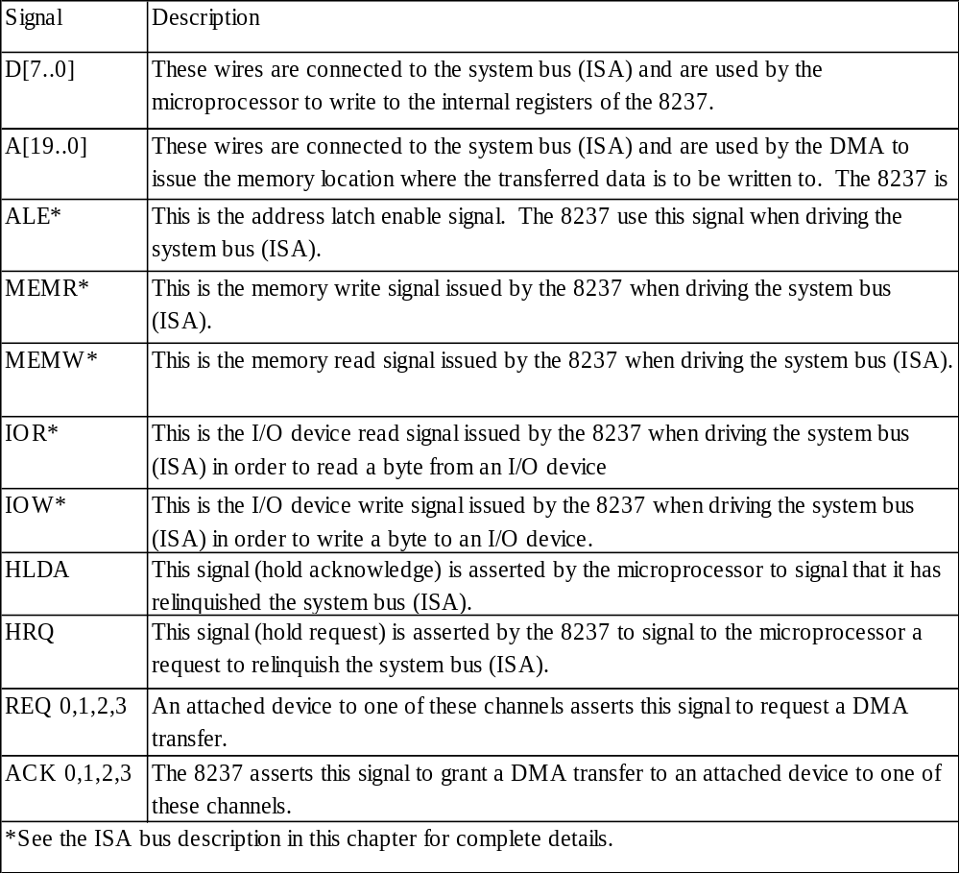
Intel 8237 DMA controller
D[7..0]
A[19..0]
ALE
MEMR
MEMW
IOR
IOW
HLDA
HRQ
Intel 8237
REQ 0
ACK 0
REQ 1
ACK 1
REQ 2
ACK 2
REQ 3
ACK 3

Slide 25
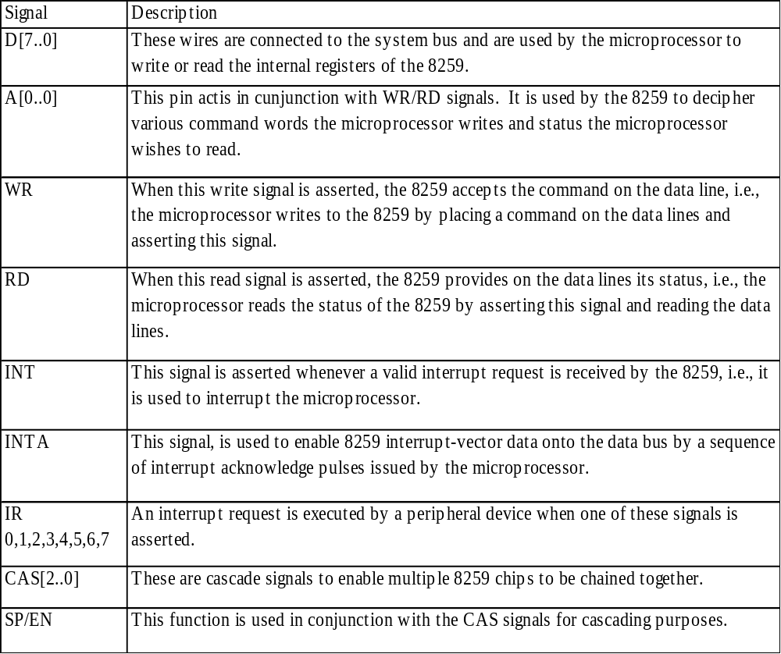
Intel 8259 programmable priority controller
D[7..0]
A[0..0]
RD
WR
INT
INTA
CAS[2..0]
SP/EN
Intel 8259
IR0
IR1
IR2
IR3
IR4
IR5
IR6
IR7

Slide 26
Multilevel bus architectures
Don’t want one bus for all communication
  Peripherals would need high-speed, processor-specific bus interface
    excess gates, power consumption, and cost; less portable
  Too many peripherals slows down bus
Processor-local bus
  High speed, wide, most frequent communication
  Connects microprocessor, cache, memory controllers, etc.
Peripheral bus
  Lower speed, narrower, less frequent communication
  Typically industry standard bus (ISA, PCI) for portability
Micro-
processor
Cache
Memory
controller
DMA
controller
Processor-local bus
Peripheral
Peripheral
Peripheral
Bridge
Peripheral bus
Bridge
  Single-purpose processor converts communication between busses

