Slide 1
H3B
Anthony - Harvard University
Biraj - Howard University
Eric - Harvard University
Naren - Boston University

Slide 2
Problem Statement
How do we make computer science more appealing to middle school and high school students?

Slide 3
Project Review
Most coding websites are not appealing - lack colors, lack designs, etc. We focused on making a coding website aimed to be more appealing for middle school and high school students.

Slide 4
Technologies Used
HTML
JavaScript
Open AI
Python

Slide 5
Drawbacks to Hack
We spent more time planning than working
(it was hard narrowing our many ideas to one idea)

Slide 6
Challenges Faced
We had trouble implementing our code on replit
(it was a challenge choosing different coding languages/libraries)
We wanted to use ChatGPT but there was no API available, so we used OpenAI instead.

Slide 7
Learning Lessons
We realized our ideas were too big to be completed in one day
(it was the first Hackathon for three of us)

Slide 8
Global Impact
Our goal was to excite middle school and high school students (especially, brown and black students) about computer science

Slide 9
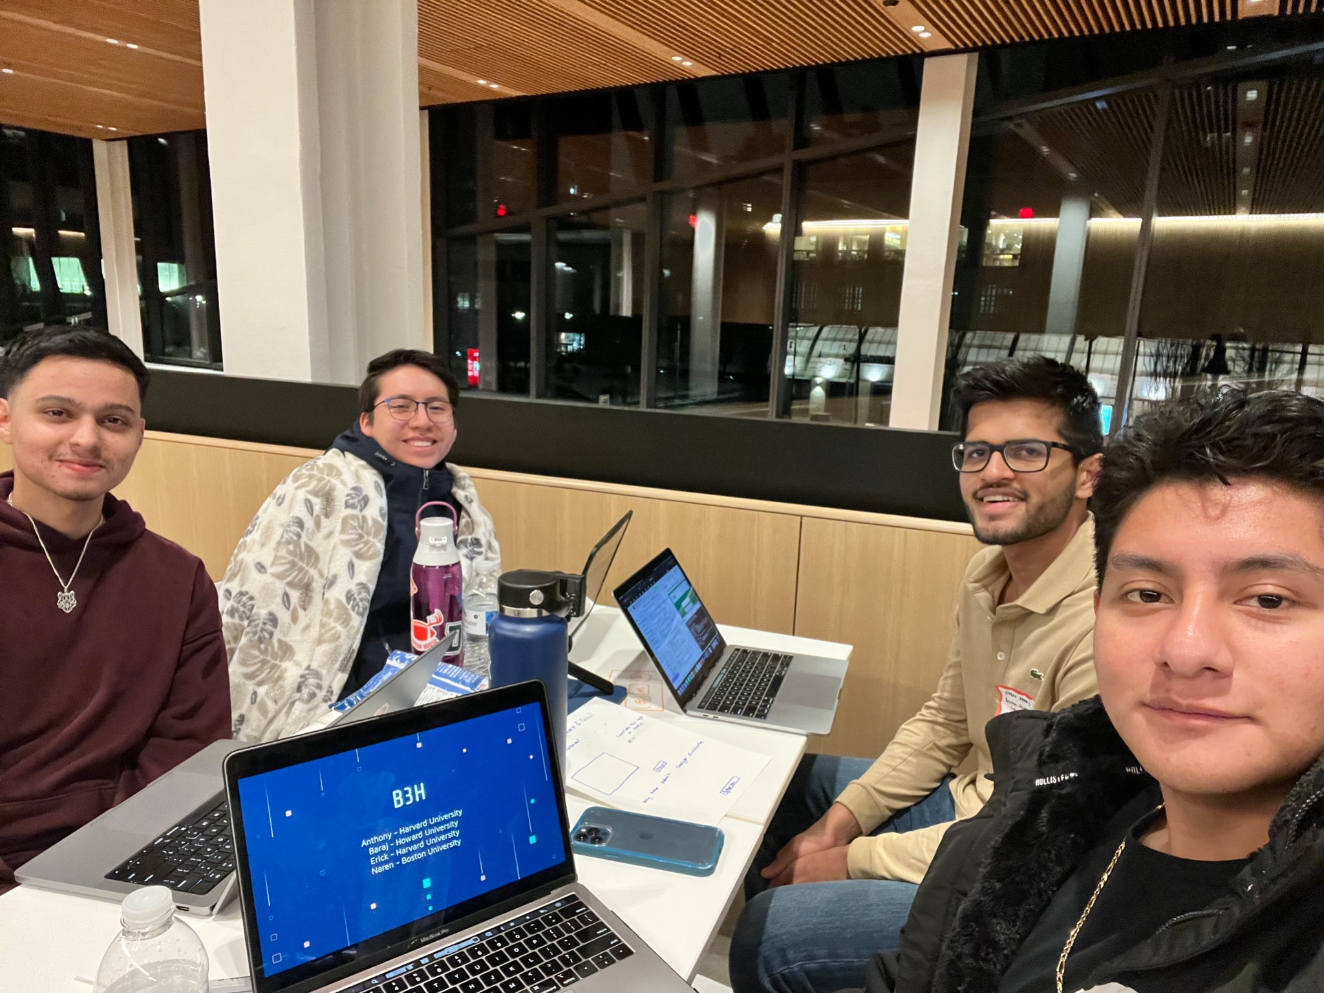
Favorite Memory

