Slide 1
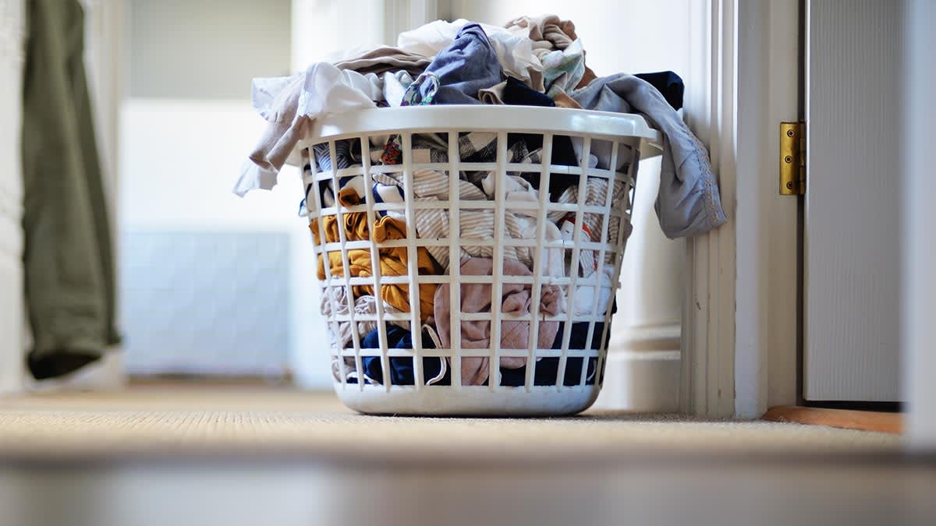
The Project Titled on
LAUNDRY MANAGEMENT
SYSTEM

Slide 2





Desktop-based Laundry Management System. Designed to simplify daily laundry operations. Allows owners to add and manage customer orders. Tracks order progress by updating laundry status. Generates bills for completed orders quickly and accurately.
TEAM MEMBERS
SAMRAT ADHIKARI
SHUVAM ADHIKARI
PRAJWAL BADAL
MILAN AWASTHI
BIRAT KUMAR BARAL
ABOUT OUR
PROJECT

Slide 3
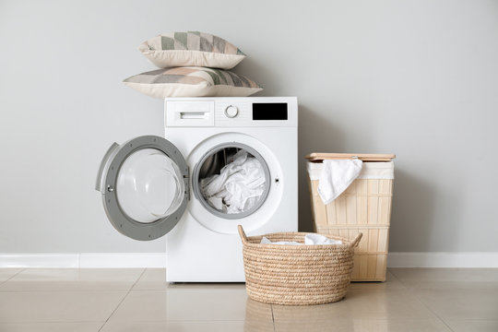

Desktop-based Laundry Management System. Designed to simplify daily laundry operations. Allows owners to add and manage customer orders. Tracks order progress by updating laundry status. Generates bills for completed orders quickly and accurately.
ABOUT OUR
PROJECT
OBJECTIVES

Slide 4
ABOUT OUR
PROJECT
To develop a desktop-based application for efficient Laundry management.
OBJECTIVES

Slide 5
ABOUT OUR
PROJECT
To develop a desktop-based application for efficient Laundry management.
To maintain customer information and laundry order records in a centralized database.
OBJECTIVES

Slide 6
ABOUT OUR
PROJECT
To develop a desktop-based application for efficient Laundry management.
To maintain customer information and laundry order records in a centralized database.
OBJECTIVES
To simplify the tracking of laundry orders and generate invoices accurately.

Slide 7
ABOUT OUR
PROJECT
To develop a desktop-based application for efficient Laundry management.
To maintain customer information and laundry order records in a centralized database.
OBJECTIVES
To simplify the tracking of laundry orders and generate invoices accurately.
To reduce manual paperwork and improve the overall efficiency of daily laun-dry operations.

Slide 8
ABOUT OUR
PROJECT
To develop a desktop-based application for efficient Laundry management.
SMRT SYSTEM
CLEAN CLOUD
To maintain customer information and laundry order records in a centralized database.
OBJECTIVES
To simplify the tracking of laundry orders and generate invoices accurately.
To reduce manual paperwork and improve the overall efficiency of daily laun-dry operations.
RELATED WORKS
Manual Laundry Management

Slide 9
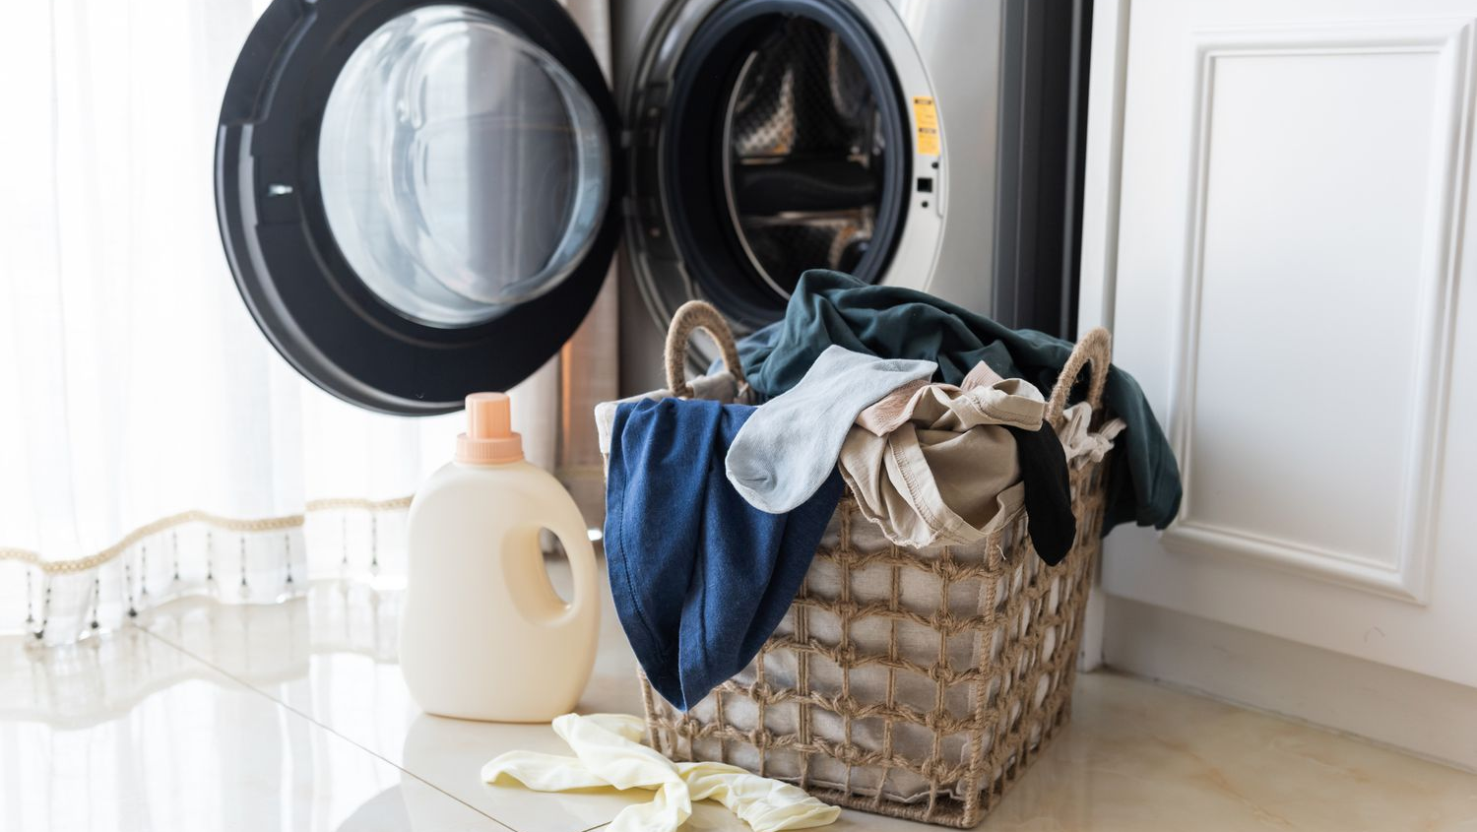

OBJECTIVES
SMRT SYSTEM
CLEAN CLOUD
RELATED WORKS
Manual Laundry Management
NEXT
IMPLEMENTED FEATURES

Slide 10
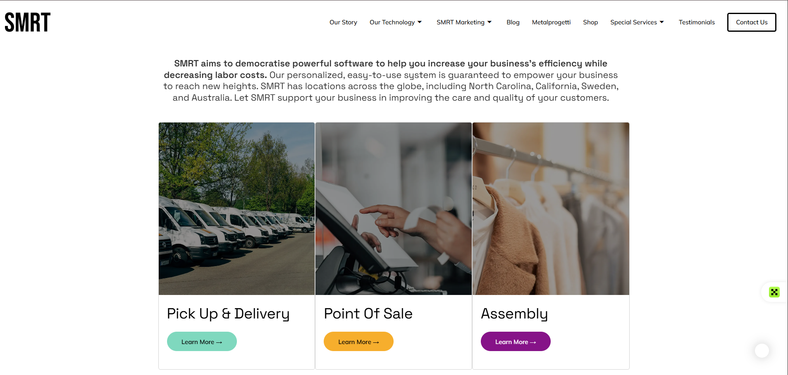
OBJECTIVES
SMRT SYSTEM
BACK

Slide 11
Manual Laundry Management
BACK

Slide 12
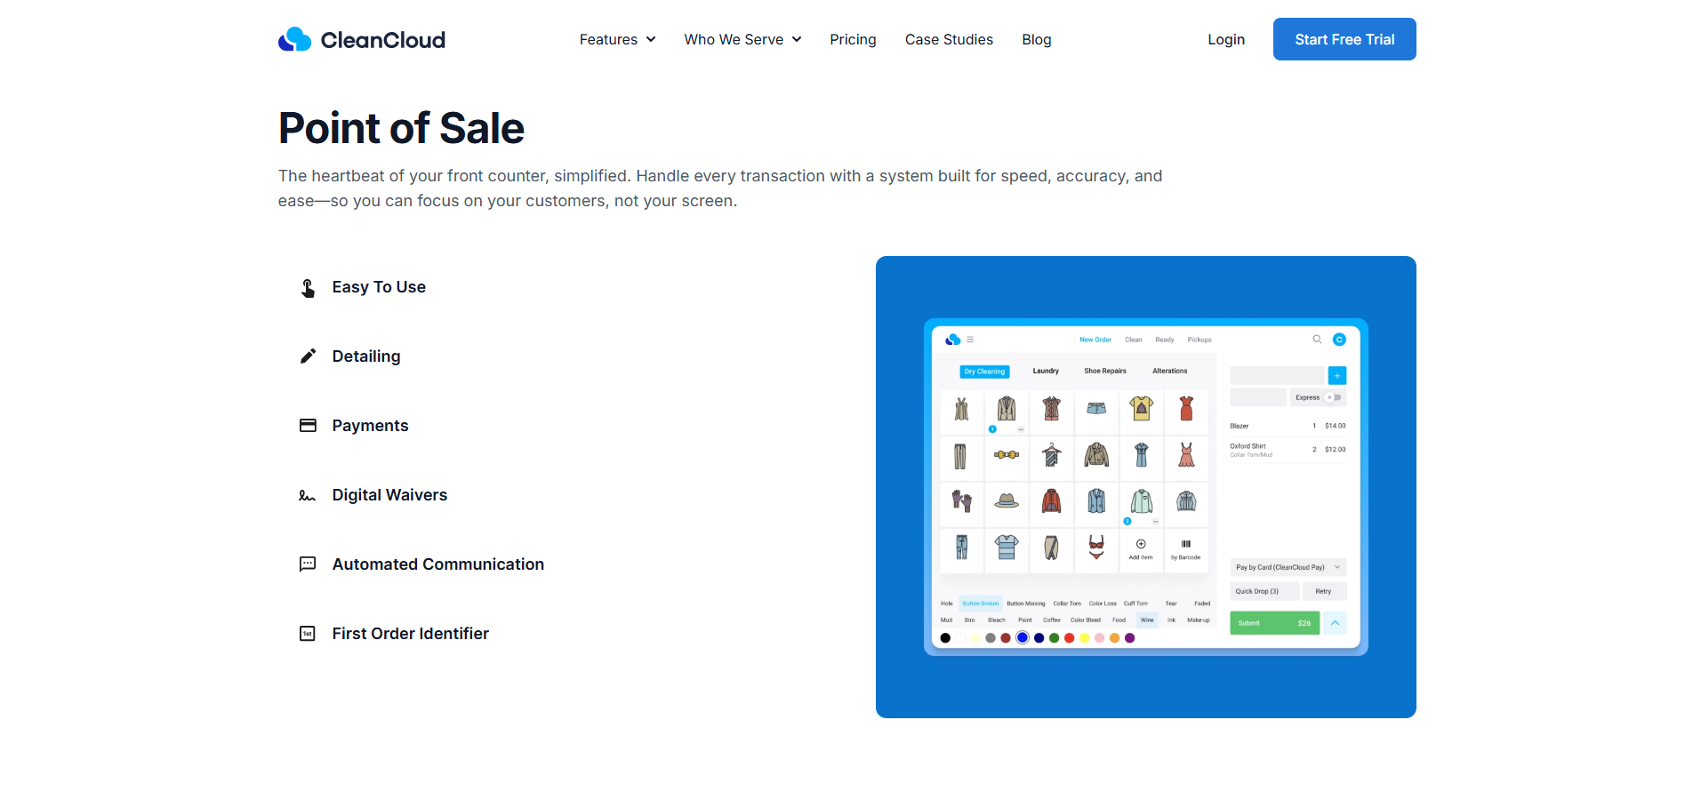
OBJECTIVES
CLEAN CLOUD
BACK

Slide 13
IMPLEMENTED FEATURES
USER AUTHENTICATION
CUSTOMER MANAGEMENT
LAUNDRY ORDER MANAGEMENT
GARMENT STATUS TRACKING
INVOICE GENERATION
SEARCH AND RECORD MANAGEMENT

Slide 14
IMPLEMENTED FEATURES
USER AUTHENTICATION
CUSTOMER MANAGEMENT
LAUNDRY ORDER MANAGEMENT
GARMENT STATUS TRACKING
INVOICE GENERATION
SEARCH AND RECORD MANAGEMENT

Slide 15
IMPLEMENTED FEATURES
USER AUTHENTICATION
CUSTOMER MANAGEMENT
LAUNDRY ORDER MANAGEMENT
GARMENT STATUS TRACKING
INVOICE GENERATION
SEARCH AND RECORD MANAGEMENT

Slide 16
IMPLEMENTED FEATURES
USER AUTHENTICATION
CUSTOMER MANAGEMENT
LAUNDRY ORDER MANAGEMENT
GARMENT STATUS TRACKING
INVOICE GENERATION
SEARCH AND RECORD MANAGEMENT

Slide 17
IMPLEMENTED FEATURES
USER AUTHENTICATION
CUSTOMER MANAGEMENT
LAUNDRY ORDER MANAGEMENT
GARMENT STATUS TRACKING
INVOICE GENERATION
SEARCH AND RECORD MANAGEMENT

Slide 18
IMPLEMENTED FEATURES
USER AUTHENTICATION
CUSTOMER MANAGEMENT
LAUNDRY ORDER MANAGEMENT
GARMENT STATUS TRACKING
INVOICE GENERATION
SEARCH AND RECORD MANAGEMENT

Slide 19

IMPLEMENTED FEATURES
USER AUTHENTICATION
CUSTOMER MANAGEMENT
LAUNDRY ORDER MANAGEMENT
GARMENT STATUS TRACKING
INVOICE GENERATION
SEARCH AND RECORD MANAGEMENT
TOOLS USED

Slide 20




TOOLS USED
01
02
03
04
QT (FRAMEWORK)
C++ (PROGRAMMING LANGUAGE)
SQLite
(DATABASE SERVER)
GITHUB
(STORE CODE AND COLLABORATION)

Slide 21

TOOLS USED
01
02
03
04
QT (FRAMEWORK)
C++ (PROGRAMMING LANGUAGE)
SQLite
(DATABASE SERVER)
GITHUB
(STORE CODE AND COLLABORATION)
CONCLUSION
Successfully developed a desktop-based Laundry Management System. Simplifies order management, billing, and status tracking. Improves efficiency and reduces manual work

Slide 22

TOOLS USED
Successfully developed a desktop-based Laundry Management System. Simplifies order management, billing, and status tracking. Improves efficiency and reduces manual work
CONCLUSION
LIMITATION
The application is designed as a desktop-based system and is limited to the Windows operating system.
The system is intended for a single laundry shop and does not support multi-branch management.
Online booking, payment processing, and customer notification features are not included in the current implementation.
The system has been tested under normal operating conditions, and extensive performance and scalability testing were beyond the scope of this project.
Reporting and data analytics features are limited and can be further improved in future versions

Slide 23

CONCLUSION
The application is designed as a desktop-based system and is limited to the Windows operating system.
The system is intended for a single laundry shop and does not support multi-branch management.
Online booking, payment processing, and customer notification features are not included in the current implementation.
The system has been tested under normal operating conditions, and extensive performance and scalability testing were beyond the scope of this project.
Reporting and data analytics features are limited and can be further improved in future versions
LIMITATION
FUTURE IMPROVEMENT
Develop a web-based or mobile application to enable remote access for customers and staff.
Integrate online payment methods to simplify the billing process.
Implement SMS or email notifications to inform customers when their laundry is ready for pickup.
Add reporting and analytics features to provide insights into orders, revenue, and customer activity.
Extend the system to support multiple laundry branches with centralized data management.
Improve system security by implementing role-based access control and enhanced data protection mechanisms.

Slide 24
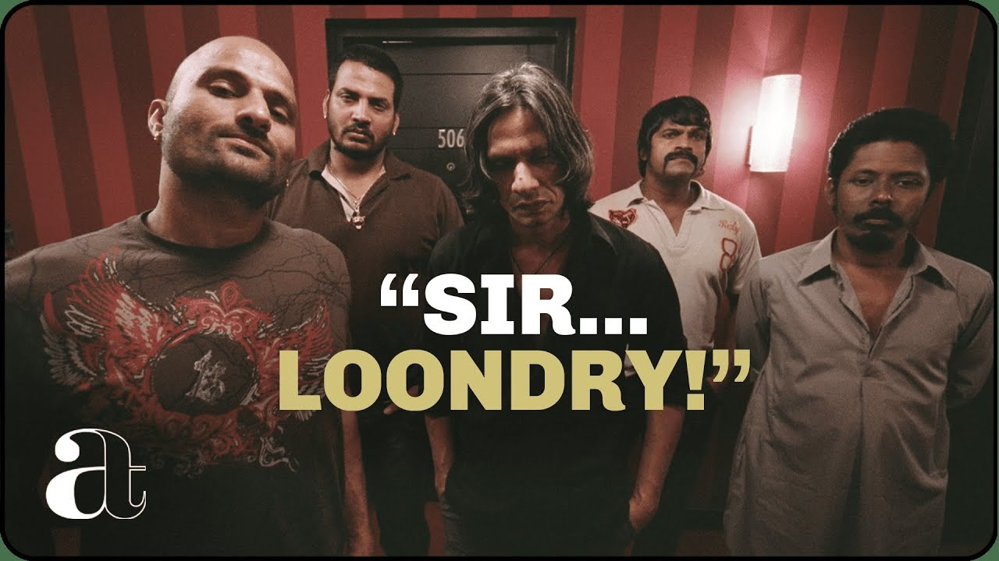
The application is designed as a desktop-based system and is limited to the Windows operating system.
The system is intended for a single laundry shop and does not support multi-branch management.
Online booking, payment processing, and customer notification features are not included in the current implementation.
The system has been tested under normal operating conditions, and extensive performance and scalability testing were beyond the scope of this project.
Reporting and data analytics features are limited and can be further improved in future versions
LIMITATION
Develop a web-based or mobile application to enable remote access for customers and staff.
Integrate online payment methods to simplify the billing process.
Implement SMS or email notifications to inform customers when their laundry is ready for pickup.
Add reporting and analytics features to provide insights into orders, revenue, and customer activity.
Extend the system to support multiple laundry branches with centralized data management.
Improve system security by implementing role-based access control and enhanced data protection mechanisms.
FUTURE IMPROVEMENT
ANY QUERIES?

Slide 25
THANK YOU

