Slide 1

DAY 2: KOTLIN PLAYGROUNDS

Slide 2
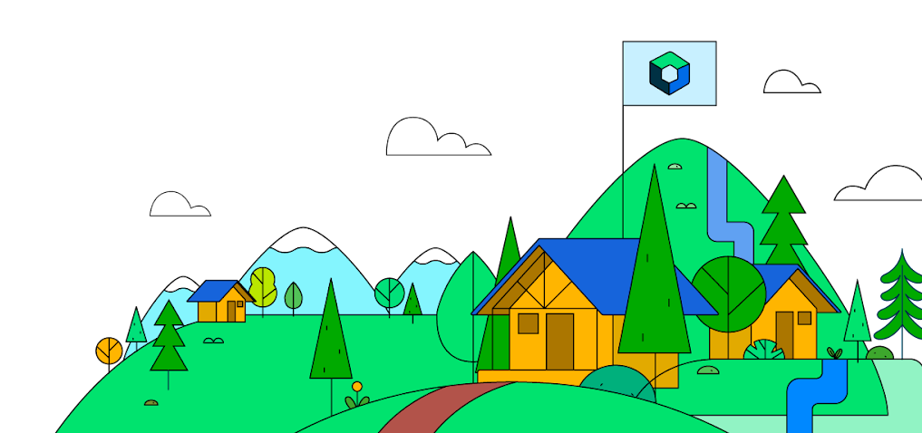
WHAT IS JETPACK COMPOSE?
Android's modern toolkit for building native UI
Simplifies and accelerates UI development on Android

Slide 3
Why Jetpack Compose?
Less code
Do more with less code and avoid entire classes of bugs. Code is simpler and easier to maintain.
Intuitive
Just describe your UI, and Compose takes care of the rest. As app state changes, your UI automatically updates.
Accelerates Development
Compatible with all your existing code so you can adopt when and where you want. Iterate fast with live previews and full Android Studio support.
Powerful
Create beautiful apps with direct access to the Android platform APIs and built-in support for Material Design, Dark theme, animations, and more.

Slide 4

What you will learn today
CREATING TEXT COMPOSABLE.
USING DIFFERENT FONTSIZES,PADDING AND VARIOUS OTHER MODIFIERS..
INSERTING IMAGES INTO YOUR APP.
AND FINALLY YOUR FIRST APP.

Slide 5
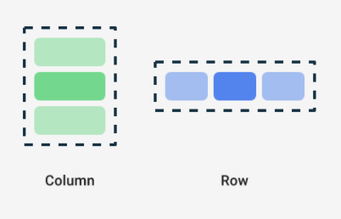
ROW && COLUMN VISUALIZATION

Slide 6

Row { Text("First column") Text("Second column") } }

Slide 7
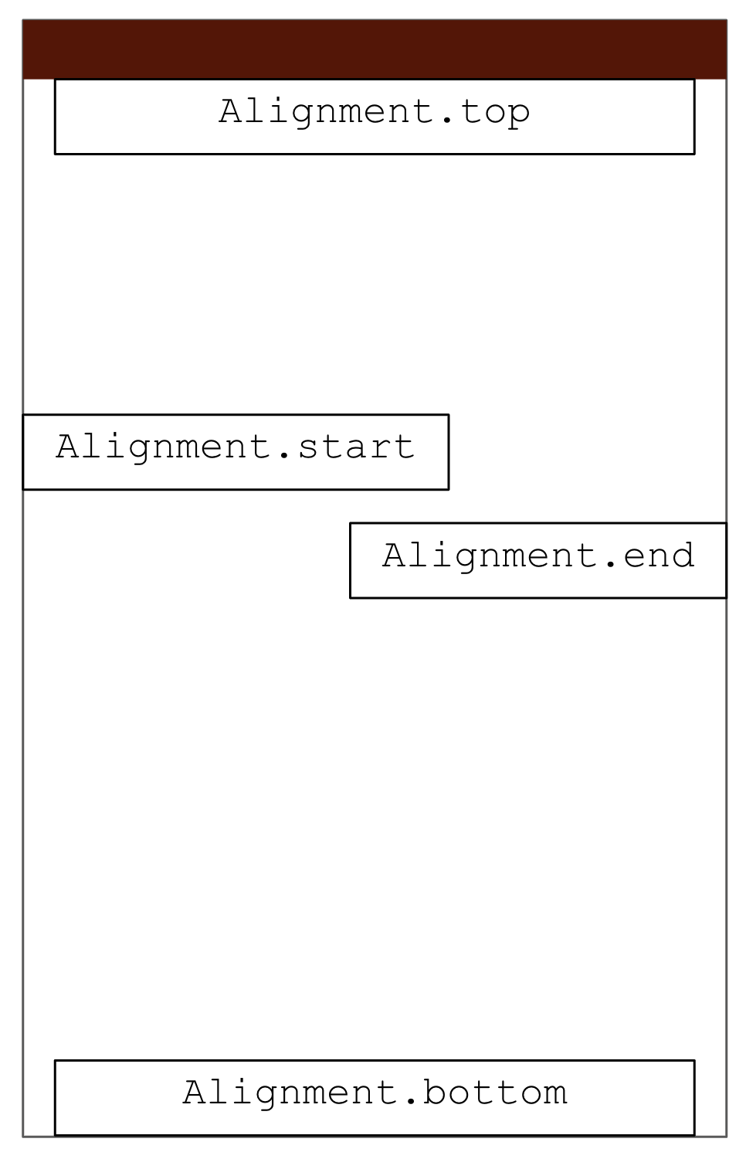
Alignment Visualization

Slide 8


THANK YOU
This work is licensed under the Apache 2.0 License

