Slide 1

Instructor Kick-off
Analyze A/B Test Results
© 2019 Udacity. All rights reserved.

Slide 2
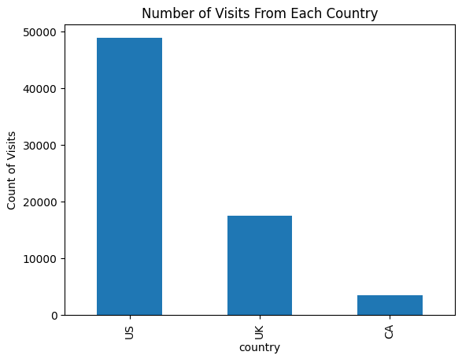
How Was The Experiment Implemented?​
Total Variant Visitors: 35211
Total Control Participants:​ 34678​

Slide 3
Conversion Rates
 | U.S. | U.K. | CA
Control | 10.7% | 10.2% | 9.4%
Treatment | 15.8% | 14.9% | 15.4%
Executive Summary: Referring to the table above, it seems that the treatment has consistently positive impact on conversion rate, averaging about a 5.26% in increase. Conversely, with a large disparity in sample sizes for each of the countries, I do not believe we can state if the country of residence has a statistically significant effect. The sample size for CA users is 14 times less than that of the US, while the UK is only 3 times less.

Slide 4
Experiment Results
Treatment Conversion Rate: 13.138%
Control Conversion Rate:​ 13.305%
Delta in Treatment vs. Control Conversion Rate:​ -0.167%
p-value:​ 0.0
Conclusion:​ Because our p-value is smaller than 0.05, our Type I margin of error, we will reject the null hypothesis, which is that the control conversion rate is greater than or equal to the treatment conversion rate. We do this in favor of the alternative hypothesis, which is that the control convrate is less than the treatment convrate. This is because the p-value indicates that the results are unlikely to obtain this effect given our data, assuming the null hypothesis is true.

Slide 5
Country Results
Conclusion:​ Using a logistic regression model, it was determined that the p-values for results from visitors in the US and UK are greater than 0.05, which suggests that they do not impact conversion rate in a manner that is statistically significant. Therefore, we can conclude that the country the user contacts the web site from is unlikely to impact their conversion rate. Meanwhile, the p-value for the type of page the user is given remains at 0.0
There may be confounding variables due to the countries that were selected, the number of countries tested in, and the duration and frequency of testing.

