Slide 1
Sorting Algorithms

Slide 2
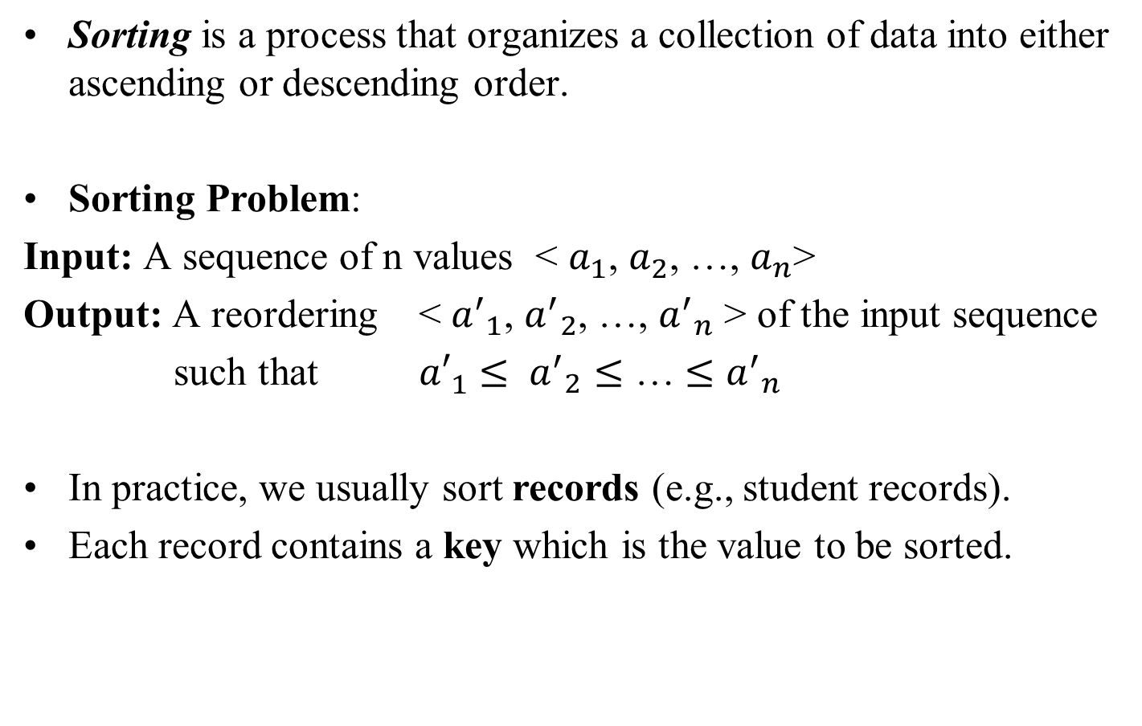
Sorting

Slide 3
Sorting
An internal sort requires that the collection of data fit entirely in the computer’s main memory.
We can use an external sort when the collection of data cannot fit in the computer’s main memory all at once but must reside in secondary storage such as on a disk.
We will analyze only internal sorting algorithms.
Any significant amount of computer output is generally arranged in some sorted order so that it can be interpreted.
Sorting also has indirect uses. An initial sort of the data can significantly enhance the performance of an algorithm.
Majority of programming projects use a sort somewhere, and in many cases, the sorting cost determines the running time.

Slide 4
Sorting Algorithms
There are many sorting algorithms, such as:
  Insertion Sort
  Selection Sort
  Bubble Sort
  Merge Sort
  Heap Sort
  Quick Sort
The first three are the foundations for faster and more efficient algorithms.

Slide 5
Sorting Algorithms
Sorting Algorithm | Applicable Data Structure | Suitable Storage Medium
Insertion Sort | Array, Linked Lists | Internal Sorting
Selection Sort | Array, Linked Lists | Internal, External Sorting
Bubble Sort | Array, Linked Lists | Internal Sorting
Merge Sort | Array, Linked Lists | Internal, External Sorting
Heap Sort | Array, Tree | Internal Sorting
Quick Sort | Array, Tree | Internal Sorting

Slide 6
Insertion Sort
Insertion sort is a simple sorting algorithm that is appropriate for small inputs.
  Most common sorting technique used by card players.
The list is divided into two parts: sorted and unsorted.
In each pass, the first element of the unsorted part is picked up, transferred to the sorted sublist, and inserted at the appropriate place.
A list of n elements will take at most n-1 passes to sort the data.

Slide 7
Insertion Sort: Example
7 | 3 | 5 | 8 | 2 | 9 | 4 | 15 | 6
Original List
Sorted
Unsorted
7 | 3 | 5 | 8 | 2 | 9 | 4 | 15 | 6
Pass 1
3 | 7 | 5 | 8 | 2 | 9 | 4 | 15 | 6
Pass 2
3 | 5 | 7 | 8 | 2 | 9 | 4 | 15 | 6
Pass 3
3 | 5 | 7 | 8 | 2 | 9 | 4 | 15 | 6
Pass 4
2 | 3 | 5 | 7 | 8 | 9 | 4 | 15 | 6
Pass 5

Slide 8
Insertion Sort: Example (cont.)
Sorted
Unsorted
2 | 3 | 5 | 7 | 8 | 9 | 4 | 15 | 6
2 | 3 | 4 | 5 | 7 | 8 | 9 | 15 | 6
2 | 3 | 4 | 5 | 7 | 8 | 9 | 15 | 6
2 | 3 | 4 | 5 | 6 | 7 | 8 | 9 | 15
Pass 6
Pass 7
Pass 8
Pass 9

Slide 9
Insertion Sort Algorithm
void insertionSort(int D[], int n)
{
int i, k, key;
for (i = 1; i < n; i++)
{
key = D[i];
for (k = i-1; k>=0 && key <= D[k]; k--)
D[k+1] = D[k]; // shift operation
D[k+1] = key; // insert key
}
}

Slide 10
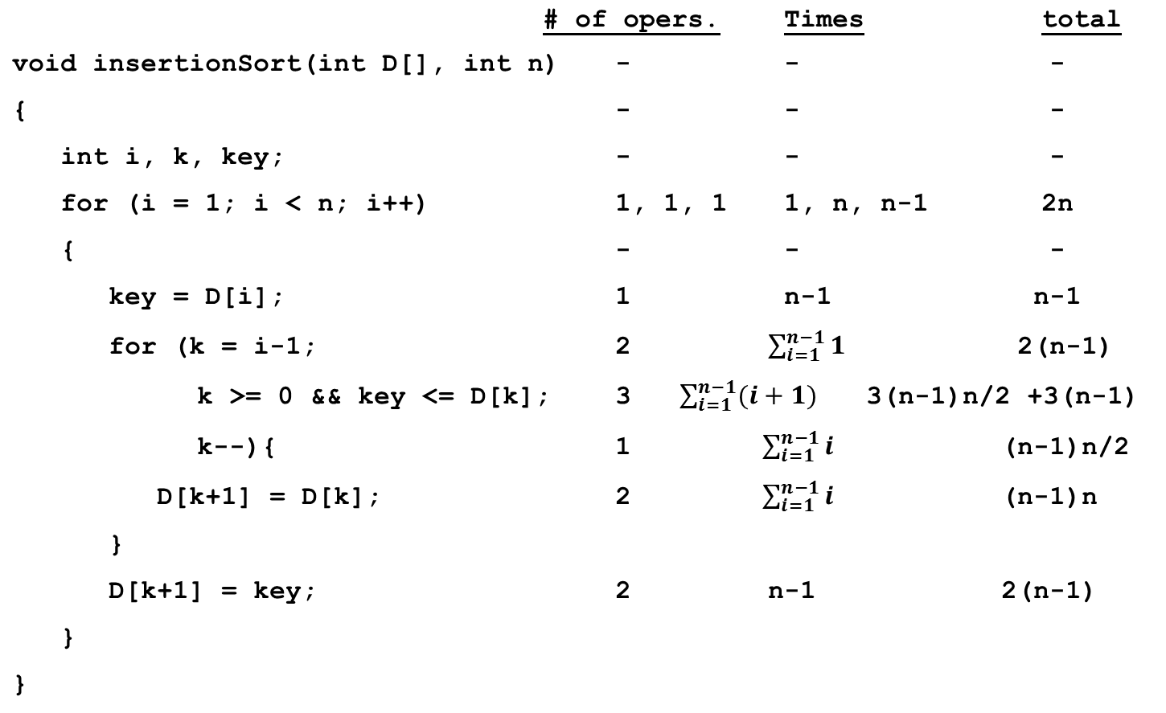
Analysis of Insertion Sort Algorithm

Slide 11
Analysis of Insertion Sort Algorithm
Running time depends on not only the size of the array but also the contents of the array.
Best-case: ➔ O(n)
  Array is already sorted in ascending order.
  Inner loop will not be executed.
  The number of moves: 0 ➔ O(1)
  The number of key comparisons: (n-1) ➔ O(n)
Worst-case: ➔ O(n²)
  Array is in reverse order:
  Inner loop is executed i-1 times, for i = 1,2,3, …, n-1
  The number of moves: (1+2+...+n-1)= n*(n-1)/2 ➔ O(n²)
  The number of key comparisons: (1+2+...+n-1)= n*(n-1)/2 ➔ O(n²)
Average-case: ➔ O(n²)
  We have to look at all possible initial data organizations.
So, Insertion Sort is O(n²)

Slide 12
Analysis of Insertion Sort Algorithm
Which running time will be used to characterize this algorithm?
  Best, worst or average?
Worst:
  Longest running time (this is the upper limit for the algorithm)
  It is guaranteed that the algorithm will not be worse than this.
Sometimes we are interested in average case. But there are some problems with the average case.
  It is difficult to figure out the average case. i.e. what is average input?
  Are we going to assume all possible inputs are equally likely?
  In fact for most algorithms average case is same as the worst case.

Slide 13
Comments on Insertion Sort
Advantage of insertion sort:
It is suitable to insert new elements into sorted arrays without destroying the "sorted" property of the array.
Disadvantage of insertion sort:
To insert an element into the sorted part of the array, too many elements must be shifted.
→ Not suitable for external sort!

Slide 14
Selection Sort
The array to be sorted is divided into two sublists, sorted and unsorted, which are divided by an imaginary wall.
Take the first element in the array, then find the minimum value in the array.
If the minimum value is not the first element, exchange these two values. So, the sorted part of the array has 1 element, and the unsorted part has n-1 elements.
Take the second element in the array, and find the minimum value in the unsorted part.
If the minimum value is not the second element, exchange these two values. So, the sorted part of the array has 2 elements, and the unsorted part has n-2 elements.
Continue the above process until the array becomes sorted .
A list of n elements requires at most n-1 passes to completely sort the data.

Slide 15
Selection Sort: Example
7 | 3 | 5 | 8 | 2 | 9 | 4 | 15 | 6
Original List
Unsorted
7 | 3 | 5 | 8 | 2 | 9 | 4 | 15 | 6
Pass 1
Sorted
Unsorted
2 | 3 | 5 | 8 | 7 | 9 | 4 | 15 | 6
After Pass 1
2 | 3 | 5 | 8 | 7 | 9 | 4 | 15 | 6
Pass 2

Slide 16
Selection Sort: Example (cont.)
Sorted
Unsorted
2 | 3 | 5 | 8 | 7 | 9 | 4 | 15 | 6
Pass 3
2 | 3 | 4 | 8 | 7 | 9 | 5 | 15 | 6
Pass 4
2 | 3 | 4 | 5 | 7 | 9 | 8 | 15 | 6
Pass 5
2 | 3 | 4 | 5 | 6 | 9 | 8 | 15 | 7
Pass 6
2 | 3 | 4 | 5 | 6 | 7 | 8 | 15 | 9
Pass 7
2 | 3 | 4 | 5 | 6 | 7 | 8 | 15 | 9
Pass 8
2 | 3 | 4 | 5 | 6 | 7 | 8 | 9 | 15

Slide 17
Selection Sort Algorithm
void selectionSort(int D[], int n) {
int i, index, j, min;
for (i = 0; i < (n-1); i++) {
min = D[n-1];
index = n-1;
for (j = i; j < (n-1); j++){
if (D[j] < min){
min = D[j];
index = j;
}
}
if (i != index){
D[index] = D[i];
D[i] = min;
}
}
}

Slide 18
Analysis of Selection Sort
In general, we compare keys and exchange (or move) items in a sorting algorithm.
➔ So, to analyze a sorting algorithm we should count the number of key comparisons and the number of exchanges or moves.
    Ignoring other operations does not affect our final result.
In selectionSort function, the outer for loop executes n-1 times.
We make exchange operation once at each iteration.
➔ Total # of exchanges: n-1
➔ Total # of Moves: 3*(n-1)
(Each exchange has three moves)

Slide 19
Analysis of Selection Sort (cont.)
The inner for loop executes the size of the unsorted part minus 1 (from 0 to n-2), and in each iteration we make one key comparison.
➔ # of key comparisons = 1+2+...+n-1 = n*(n-1)/2
➔ So, Selection sort is O(n²)
The best case, the worst case, and the average case of the selection sort algorithm are same. ➔ all of them are O(n²)
  This means that the behavior of the selection sort algorithm does not depend on the initial organization of data.
  Since O(n²) grows so rapidly, the selection sort algorithm is appropriate only for small n.
  Although the selection sort algorithm requires O(n²) key comparisons, it only requires O(n) exchanges (moves).
  A selection sort could be a good choice if data moves are costly but key comparisons are not costly (short keys, long records).
  If an element is in its right position, no exchange is made. So, the algorithm is suitable for nearly sorted arrays.

Slide 20
Comparison of N, logN and N²
N O(LogN) O(N²)
16 4 256
64 6 4K
256 8 64K
1,024 10 1M
16,384 14 256M
131,072 17 16G
262,144 18 6.87E+10
524,288 19 2.74E+11
1,048,576 20 1.09E+12
1,073,741,824 30 1.15E+18

Slide 21
Bubble Sort
It resembles the movement of waves at the sea side. At each iteration of the algorithm,
  small values move towards the left, and
  large values move towards the right of the array.
It starts from the 1st element in the array. The 1st and the 2nd elements are compared, if the 1st value is greater, then these two values are exchanged.
Then, 2nd and 3rd elements are compared. If 2nd element is greater then, these two values are exchanged.
The above process continues until the array becomes sorted.
Given a list of n elements, bubble sort requires up to n-1 passes to sort the data.

Slide 22
Bubble Sort: Example
7 | 3 | 5 | 8 | 2 | 9 | 4 | 15 | 6
Original List
In the 1st pass:
7 | 3 | 5 | 8 | 2 | 9 | 4 | 15 | 6
3 | 7 | 5 | 8 | 2 | 9 | 4 | 15 | 6
3 | 5 | 7 | 8 | 2 | 9 | 4 | 15 | 6
3 | 5 | 7 | 8 | 2 | 9 | 4 | 15 | 6
3 | 5 | 7 | 2 | 8 | 9 | 4 | 15 | 6
3 | 5 | 7 | 2 | 8 | 9 | 4 | 15 | 6
3 | 5 | 7 | 2 | 8 | 4 | 9 | 15 | 6

Slide 23
Bubble Sort: Example (cont.)
3 | 5 | 7 | 2 | 8 | 4 | 9 | 15 | 6
3 | 5 | 7 | 2 | 8 | 4 | 9 | 6 | 15
In the 2nd pass:
Largest element
3 | 5 | 7 | 2 | 8 | 4 | 9 | 6 | 15
3 | 5 | 7 | 2 | 8 | 4 | 9 | 6 | 15
3 | 5 | 7 | 2 | 8 | 4 | 9 | 6 | 15
3 | 5 | 2 | 7 | 8 | 4 | 9 | 6 | 15
3 | 5 | 2 | 7 | 8 | 4 | 9 | 6 | 15
3 | 5 | 2 | 7 | 4 | 8 | 9 | 6 | 15

Slide 24
Bubble Sort Algorithm
void bubleSort(int D[], int n)
{
int temp, k, move;
for (move = 0; move < (n-1); move++){
for (k = 0; k < (n-1-move); k++){
if (D[k] > D[k+1]){ //exchange the values
temp = D[k];
D[k] = D[k+1];
D[k+1] = temp;
}
}
}
}

Slide 25
Analysis of Bubble Sort
Best-case: ➔ O(n²)
  Array is already sorted in ascending order.
  The number of moves: 0 ➔ O(1)
  The number of key comparisons: ➔ O(n²)
  It can be O(n) algorithm if a flag variable is employed to check that whether there is a move or not.
Worst-case: ➔ O(n²)
  Array is in reverse order:
  Outer loop is executed n-1 times,
  The number of moves: 3*(1+2+...+n-1) = 3 * n*(n-1)/2 ➔ O(n²)
  The number of key comparisons: (1+2+...+n-1)= n*(n-1)/2 ➔ O(n²)
Average-case: ➔ O(n²)
  We have to look at all possible initial data organizations.
So, Bubble Sort is O(n²)

Slide 26
Comments on Bubble Sort
Advantage of bubble sort algorithm:
  Implementation is easy.
Disadvantage of bubble sort algorithm:
  Not efficient.
  It can only be used for small arrays whose elements are nearly sorted.

Slide 27
Mergesort
Mergesort algorithm is one of two important divide-and-conquer sorting algorithms (the other one is quicksort).
It is a recursive algorithm.
  It divides the array into two parts,
  Then continues to divide each part into two parts until each part has just one element.
  After that, merges each part in sorted order until all the subparts are merged into one sorted array.

Slide 28
Mergesort: Example
7 | 3 | 5 | 8 | 2 | 9 | 4 | 15 | 6
divide
7 | 3 | 5 | 8 | 2
9 | 4 | 15 | 6
divide
divide
7 | 3 | 5
8 | 2
9 | 4
15 | 6
divide
divide
divide
divide
7 | 3
5
8
2
9
4
15
6
merge
merge
merge
divide
2 | 8
4 | 9
6 | 15
7
3
merge
merge
3 | 7
4 | 6 | 9 | 15
merge
3 | 5 | 7
merge
merge
2 | 3 | 5 | 7 | 8
2 | 3 | 4 | 5 | 6 | 7 | 8 | 9 | 15

Slide 29
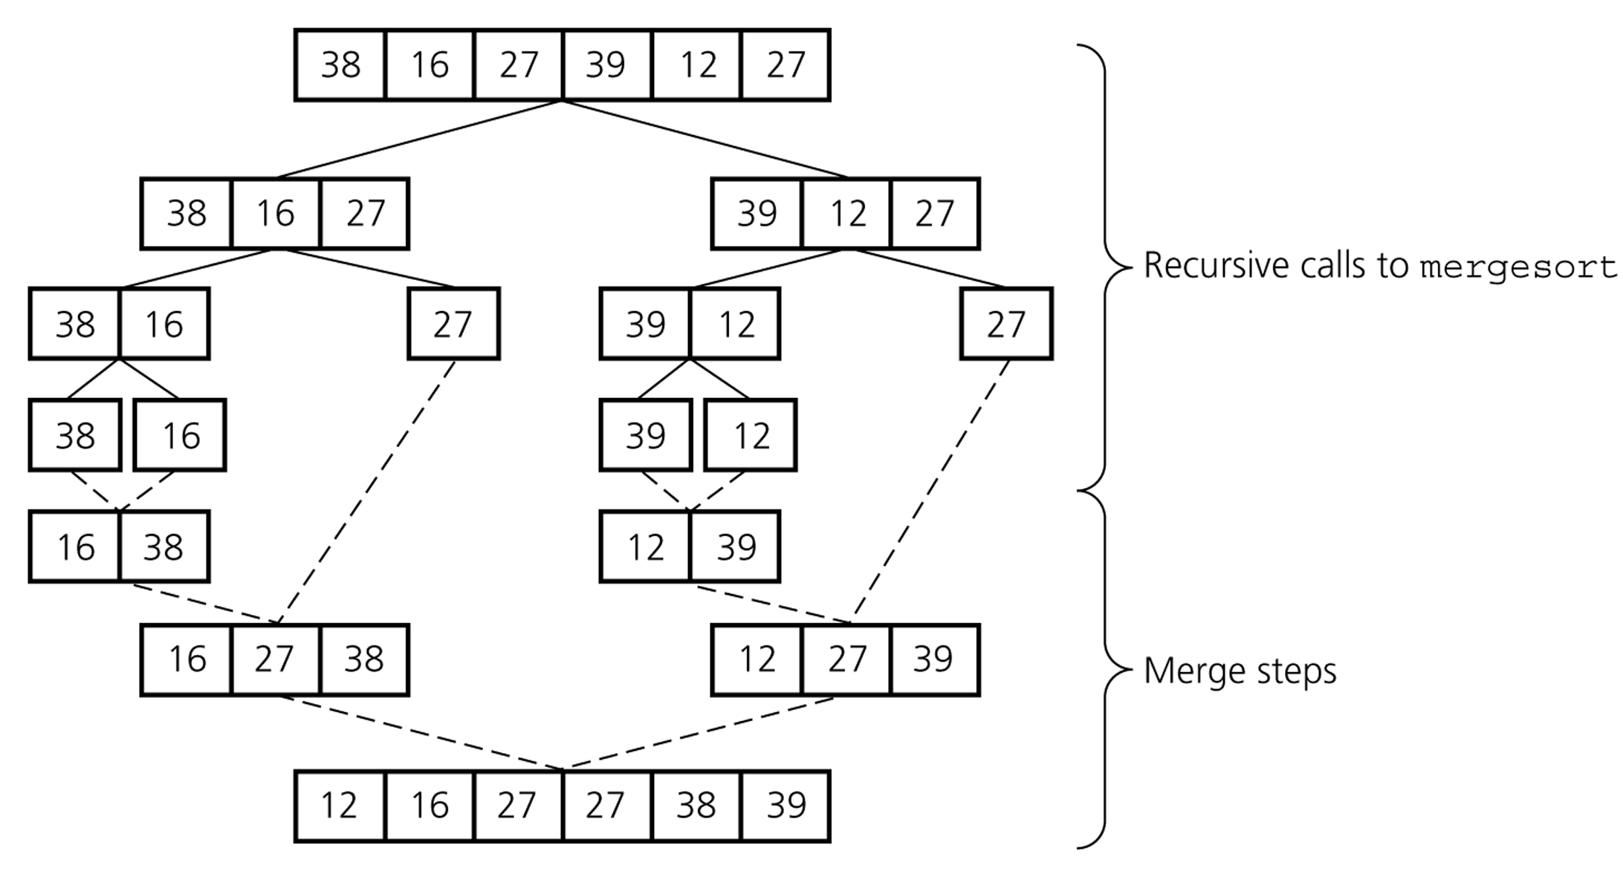
Mergesort : Example2

Slide 30
Mergesort Algorithm
void mergesort(int D[], int left, int right) {
int k;
if (left < right) {
k = (left + right)/2; // index of midpoint
mergesort(D, left, k);
mergesort(D, k+1, right);
// merge the two halves
merge(D, left, k, right);
}
}

Slide 31
Merge Algorithm
const int MAX_SIZE = maximum-number-of-items-in-array;
void merge(int D[], int left, int k, int right) {
int i, j, l = 0;
int M[MAX_SIZE]; // temporary array
for (i=left, j=k+1; (i <= k) && (j <= right); ) {
if (D[i] < D[j]) {
M[l] = D[i];
i++;
l++;
}
else {
M[l] = D[j];
j++;
l++
}
}

Slide 32
Merge Algorithm (cont.)
// copy the remaining elements to M
while (i <= k){
M[l] = D[i];
i++;
l++;
}
while (j <= right){
M[l] = D[j];
j++;
l++;
}
// copy M to D
for (i = left, l = 0; i <= right; i++, l++)
D[i] = M[l];
}

Slide 33
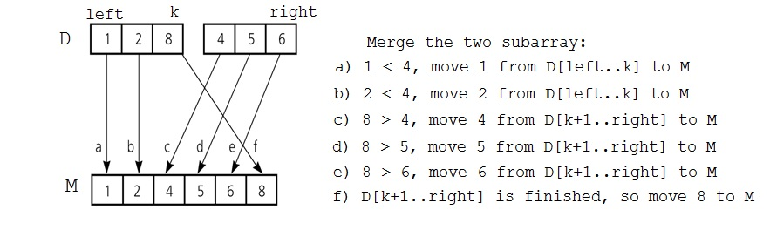
Analysis of Merge
A worst-case instance of the merge step in mergesort

Slide 34
Analysis of Merge (cont.)
0 k-1
0 k-1
Merging two sorted arrays of size k
Best-case:
  All the elements in the first array are smaller (or larger) than all the elements in the second array.
  The number of moves: 2k + 2k → O(k)
  The number of key comparisons: k → O(k)
Worst-case:
  The number of moves: 2k + 2k → O(k)
  The number of key comparisons: 2k-1 → O(k)
 | ......
 | ......
0 2k-1
 | ......

Slide 35
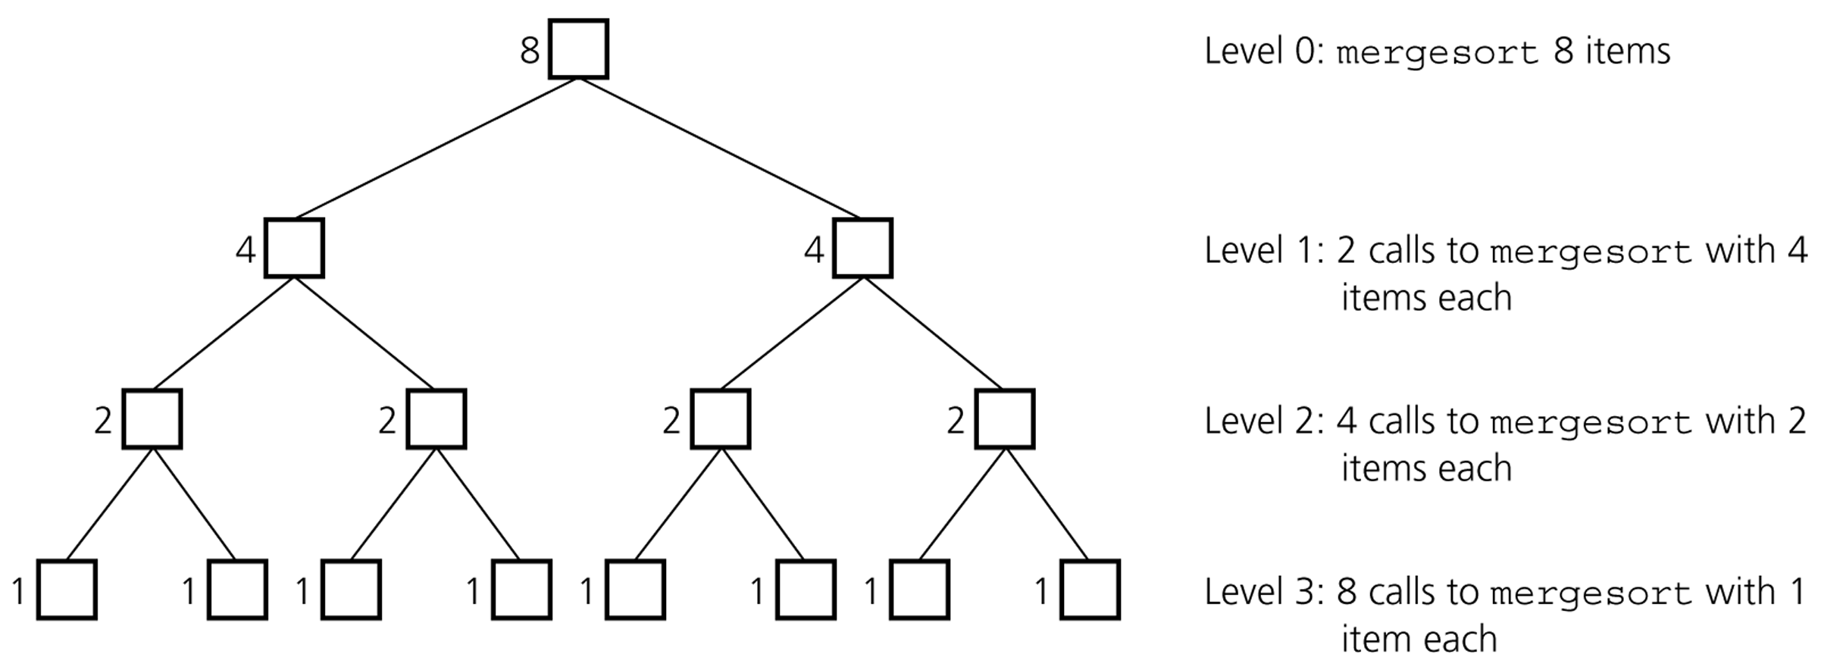
Analysis of Mergesort
Levels of recursive calls to mergesort, given an array of eight items

Slide 36
Analysis of Mergesort
n
level 0 : size n
n/2
n/2
level 1 : size n/2 = n/2¹
level 2 : size n/4 = n/2²
n/2²
n/2²
n/2²
n/2²
.
.
.
.
.
.
level m-1 : size 2
. . . . . . . . . . . . . . . . .
level m: size 1
n/2^{m} = 1
n/2^{m} = 1
If n/2^{m} = 1 → n = 2^{m} → m = log₂n

Slide 37
Analysis of Mergesort
Worst-case –
Mergesort divides the array having n elements log₂n times, and then merges each part.
Merge operation runs in O(n) time. Since to merge two subarrays having n/2 elements, merge operation reads and copies each subarray just once, then copies the temporary array having n elements to the original array.
So, the running time of the mergesort algorithm is
➔ O (n * log₂n )
If n/2^{m} = 1 → n = 2^{m} → m = log₂n

Slide 38
Analysis of Mergesort
Mergesort is extremely efficient algorithm with respect to time.
  Both worst case and average cases are O (n * log₂n )
But, mergesort requires an extra array whose size equals to the size of the original array.
If we use a linked list, we do not need an extra array
  But, we need space for the links
  And, it will be difficult to divide the list into half ( O(n) )

