Slide 1
CEN 213
Data Structures
SERKAN KARTAL
DEPARTMENT OF COMPUTER ENGINEERING
ÇUKUROVA UNIVERSITY
CEN 213 DATA STRUCTURES

Slide 2
CEN 213
Instructor: Serkan KARTAL
Email: skartal@cu.edu.tr
Lecture Materials:
  https://ceng.cu.edu.tr/skartal/
  Microsoft Teams
Lab Hours: See your teaching assistant Res. Asst. Kerem KESKİN for lab sessions.
Students who have registered to CEN213, must also register to CEN215 Data Structures Lab course.
CEN 213 DATA STRUCTURES

Slide 3
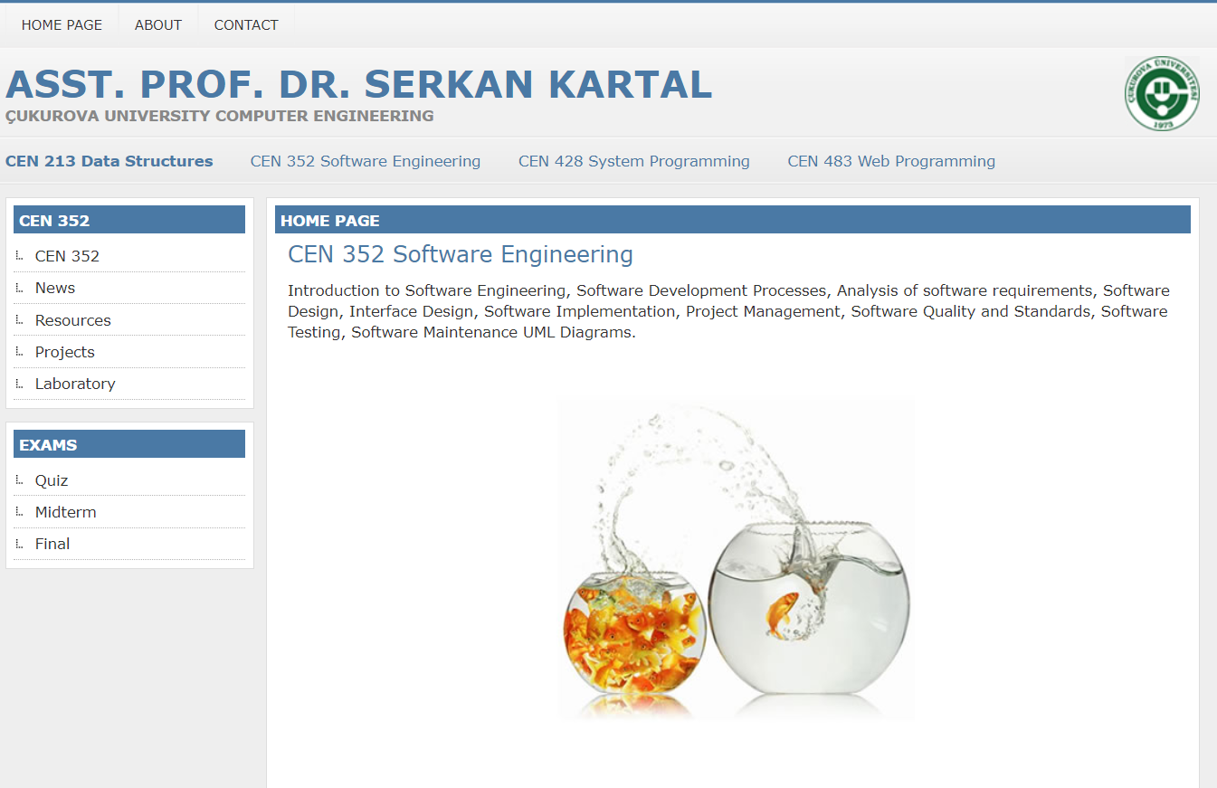
web address
https://ceng.cu.edu.tr/skartal/

Slide 4
Course Description
Course Objectives:
To learn basic algorithm analysis methods, and be able to compare the performance of algorithms,
To introduce abstract concepts for data organization and manipulation,
To learn how to use these concepts in problem solving.
Text Book and References
Mark Allen Weiss, Data Structures and Algorithm Analysis in C++ (3rd ed.), Addison Wesley, 2006.
Rifat Çölkesen, Veri Yapıları ve Algoritmalar, Papatya Yayıncılık, 2003.
Any book or material in C programming.
CEN 213 DATA STRUCTURES

Slide 5
Grading
For the course
  Midterm 40 %
  Final 60 %
CEN 213 DATA STRUCTURES

Slide 6
Course Outline
Introduction to algorithm analysis
Sorting
Searching
Hashing
Linked Lists
Stacks
Queues
Trees
Graphs
CEN 213 DATA STRUCTURES

Slide 7
Let's create confusion first.
What is your best searching algorithm?
What is your best sorting algorithm?
If an unknown number of data will be loaded into the system, what is the most suitable data type to store these data? What are the advantages and disadvantages?
What is the fastest way to access data stored in memory?

Slide 8
Welcome and Enjoy!

