Slide 1
Machine Learning
Kaggle Project
Housing Prices :Advanced Regression Techniques

Slide 2
Table of Contents
Data Imputation
Data Exploration
Linear Regression
Regularization
Tree Regression
Models Comparison

Slide 3
Data Imputation
NA=None, for categorical e.g. Alley, Fence
Impute majority class, if really missing
LotFrontage = median of rows with same LotConfig, Neighborhood
For Trees, recode quality ordinals as numeric
Create new feature: storyCount by classify tree from MSSubClass, HouseStyle, X2ndFlrSF
Drop sales zoned Commercial
Drop sales between family members

Slide 4
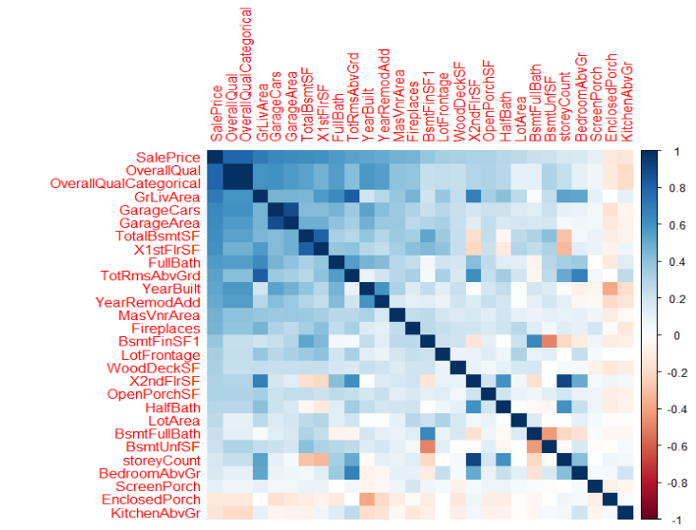
Data Exploration

Slide 5
Linear Regression
Step I
Step II
Step III
Correlation
p-values
T-statistic
Forward AIC
Forward BIC
Adjusted R^2
VIF()
AIC()
InfluencePlot
Data Engineering

Slide 6
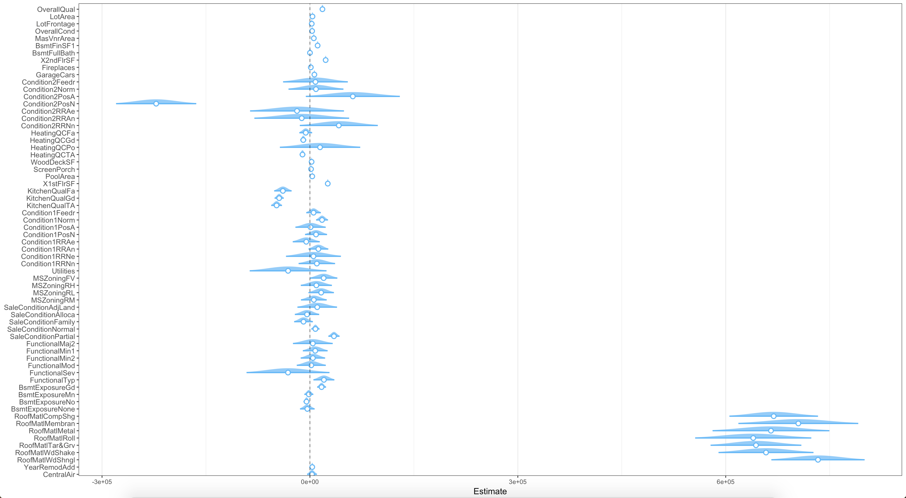
Linear Regression

Slide 7
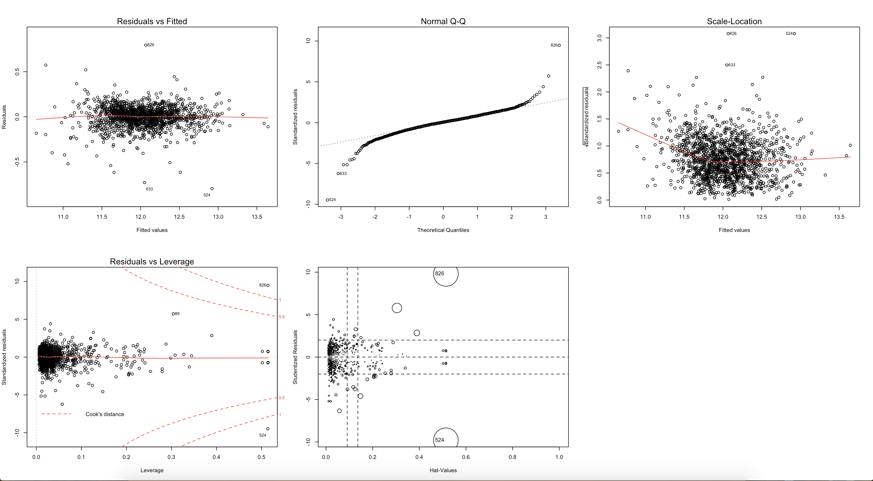
Linear Regression

Slide 8
Regularization
Ridge, Lasso and Elasticnet
Problem with Linear model
Linear Model with regularization
Shrink the betas and improve multicollinearity

Slide 9
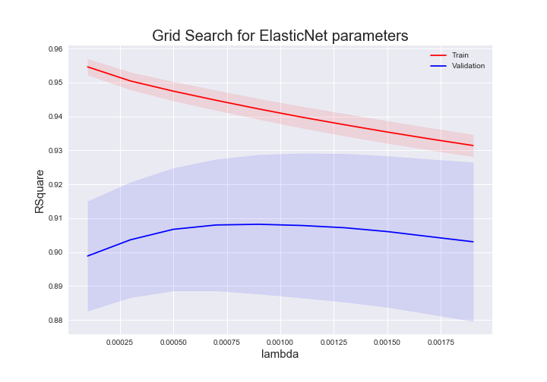
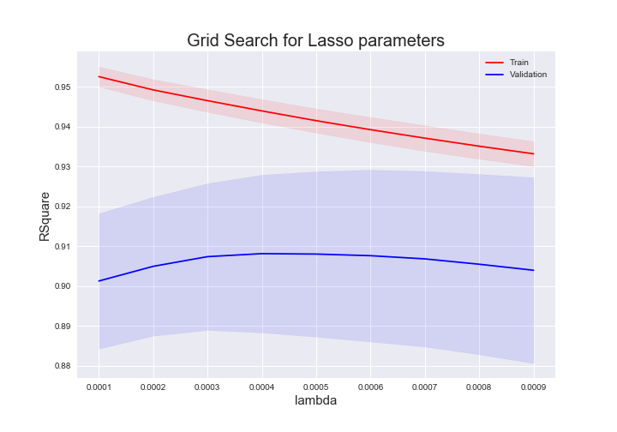
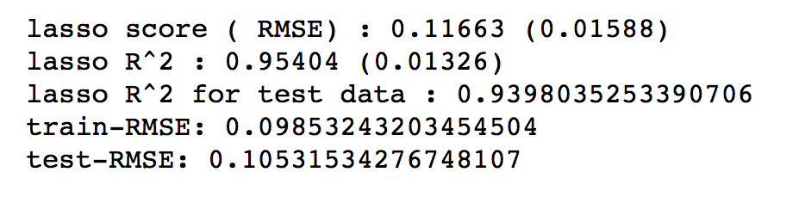
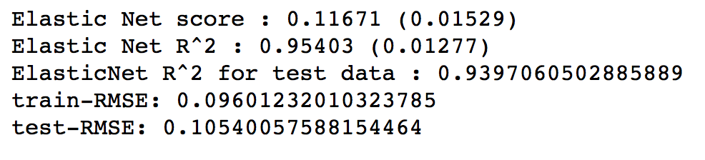
Parameter tunings
Tuning hyperparameters
Until alpha=~0.0003, the RMSE and R^2 in the validation fold improve, which tells us there is some amount of multi-collinearity that Lasso would improve by throwing some betas away

Slide 10
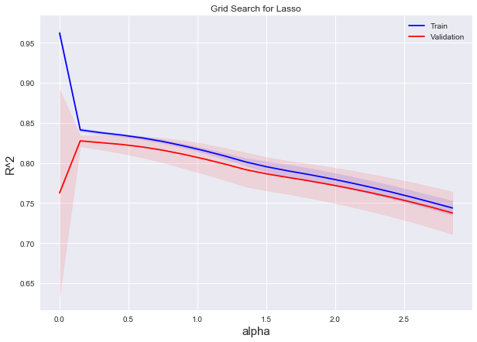
Fast grid search (logarithmic)

Slide 11
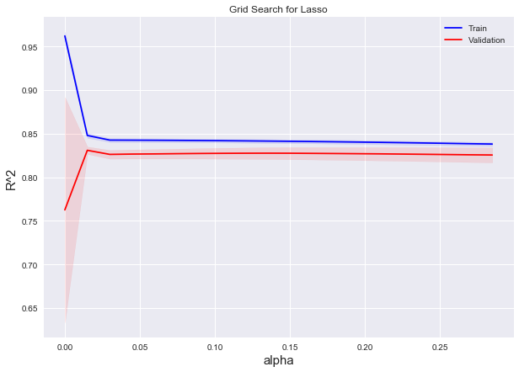
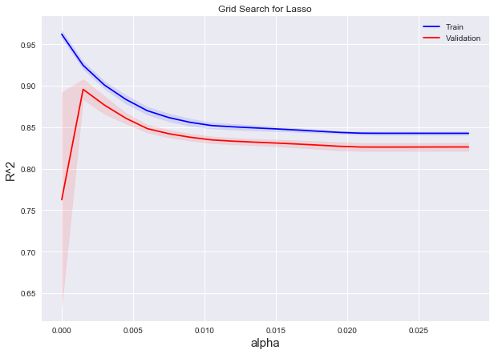

Slide 12
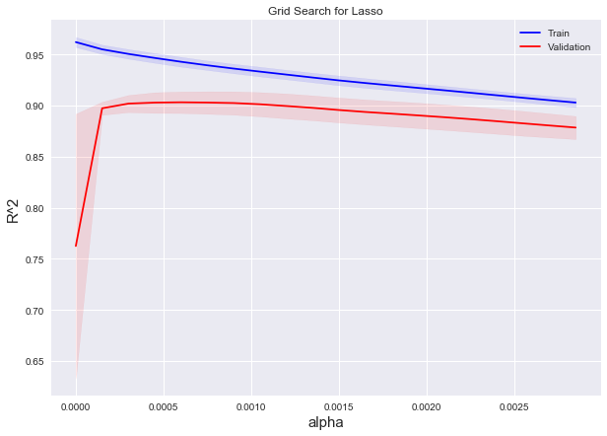
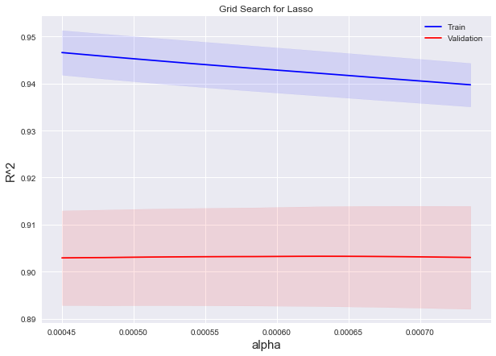

Slide 13
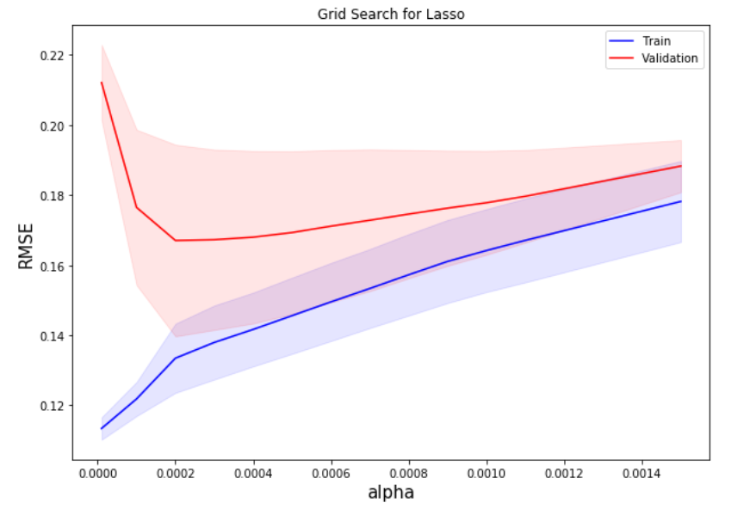
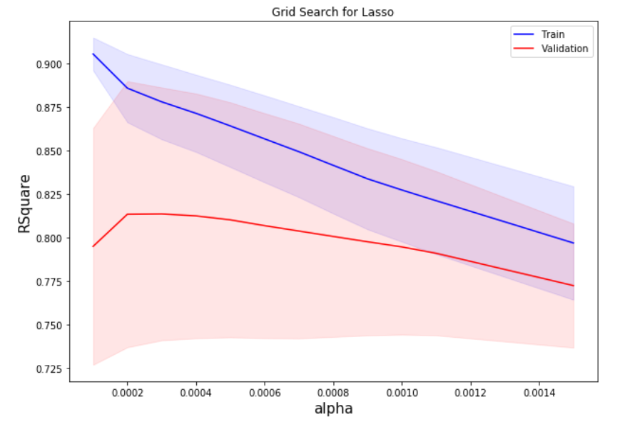

Lasso
Tuning hyperparameters
Until alpha=~0.0003, the RMSE and R^2 in the validation fold improve, which tells us there is some amount of multi-collinearity that Lasso would improve by throwing some betas away

Slide 14
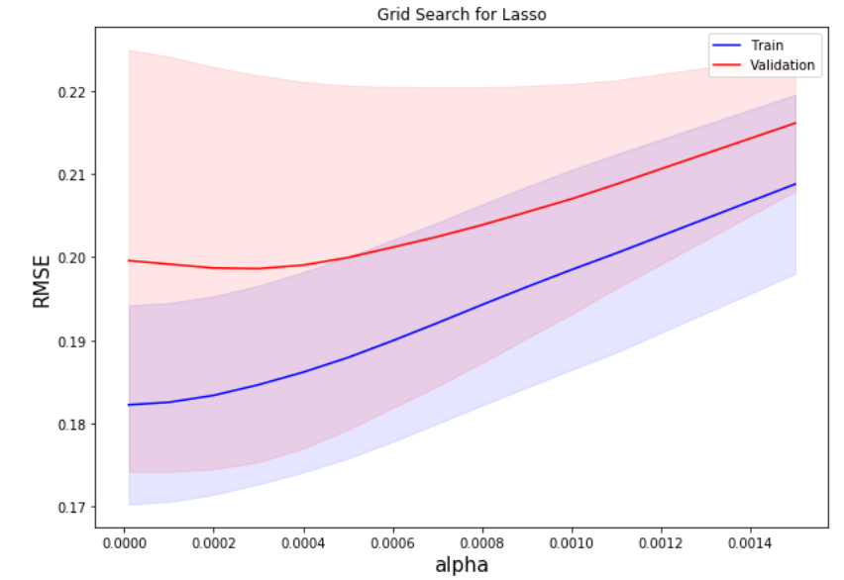
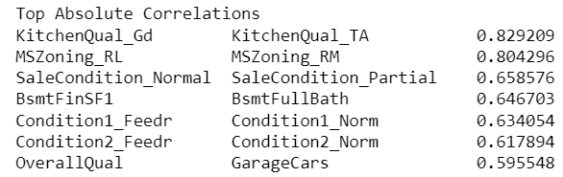
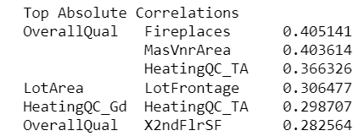
Lasso and Correlation

Slide 15
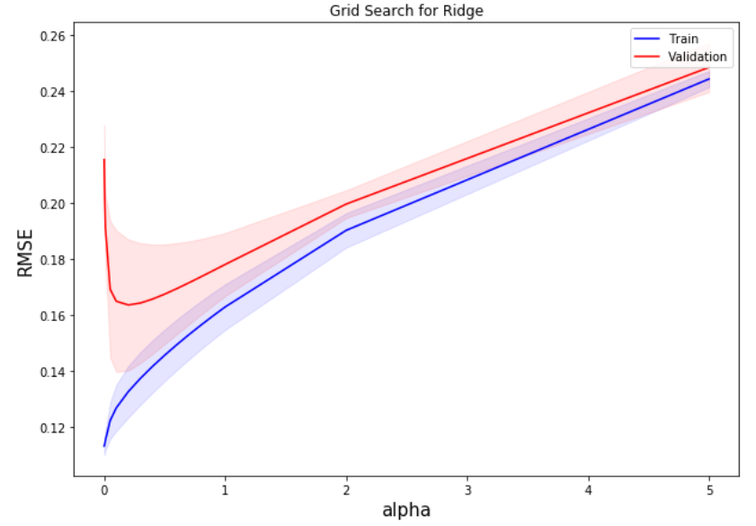
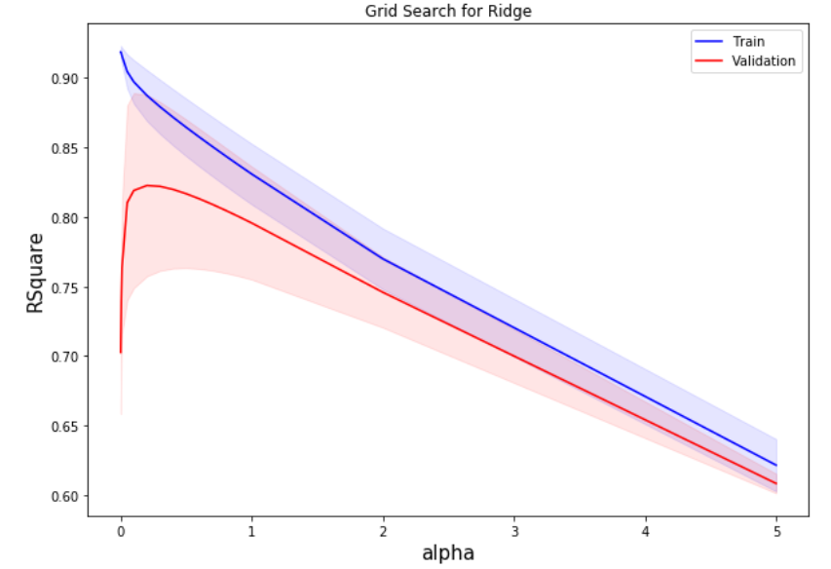
Ridge
Until alpha=~0.0003, the RMSE and R^2 in the validation fold improve, which tells us there is some amount of multi-collinearity that would Lasso would improve by throwing some betas away

Slide 16
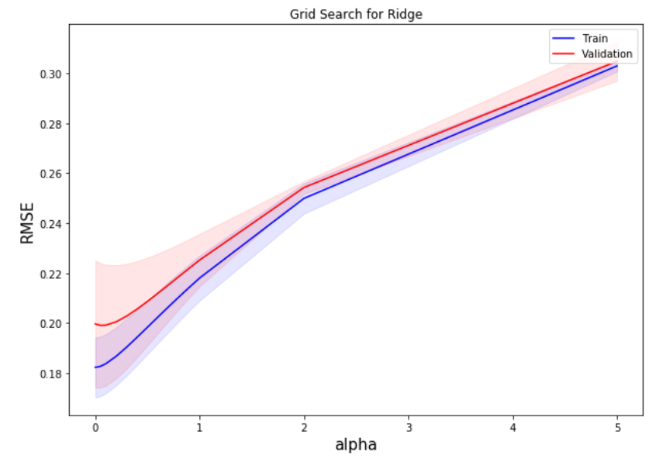
Ridge and Correlation

Slide 17
Tree Regression
Random Forest
Tree-specific engineering:
Select subset of top 35+ features
Numerically code quality etc.
Dummies on the rest of them
90 columns

Slide 18

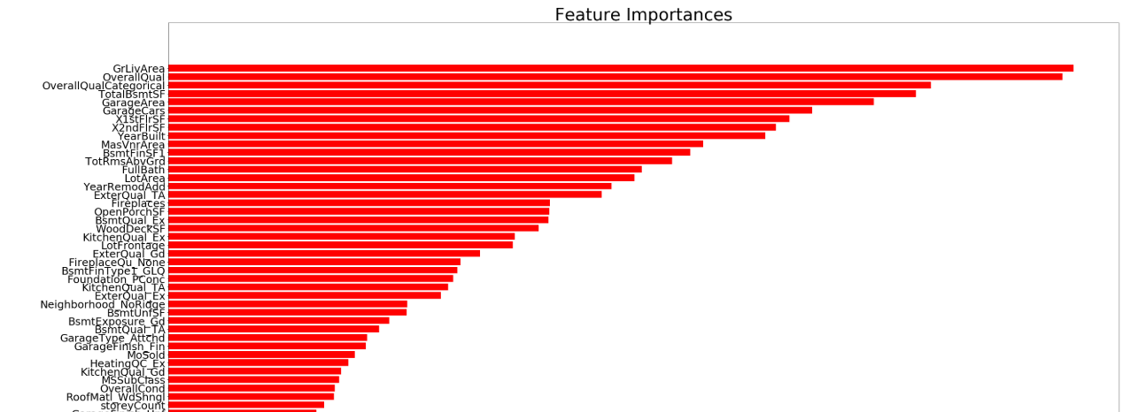
Random Forest

Slide 19
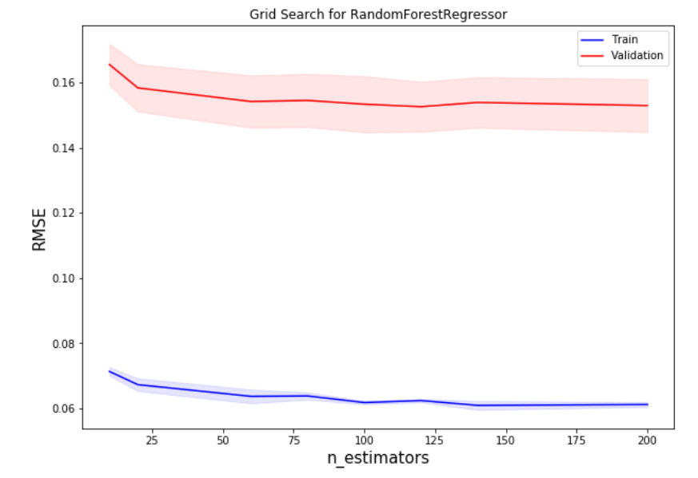
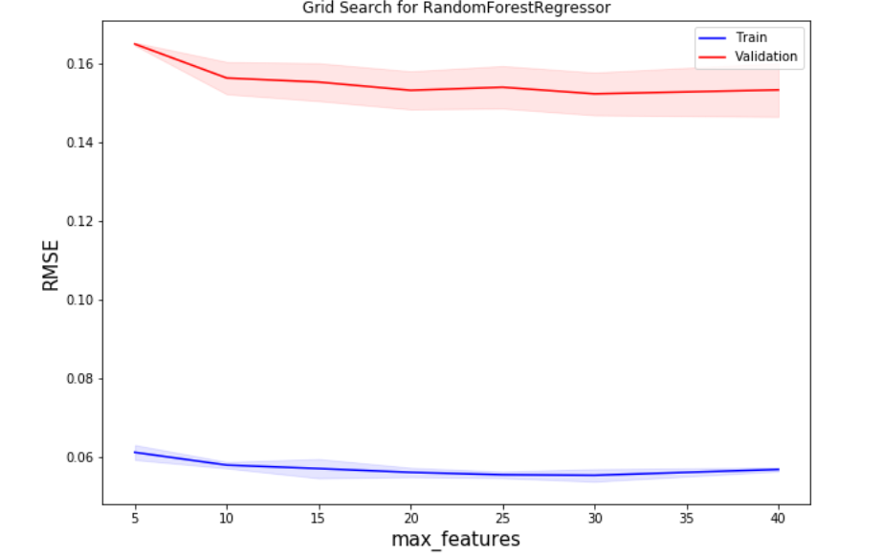
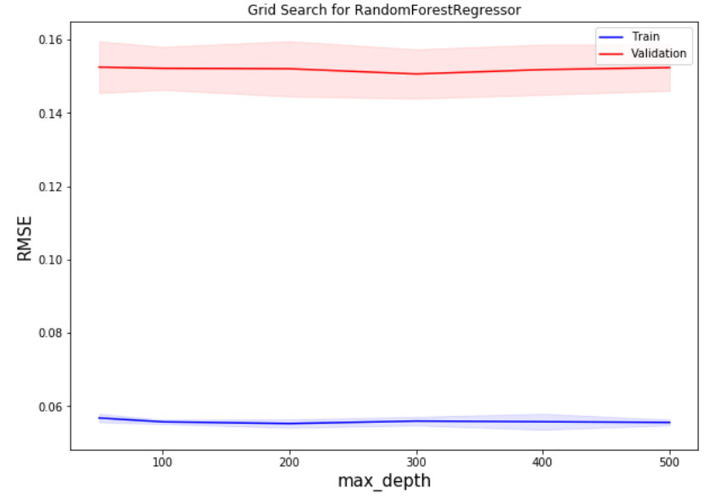
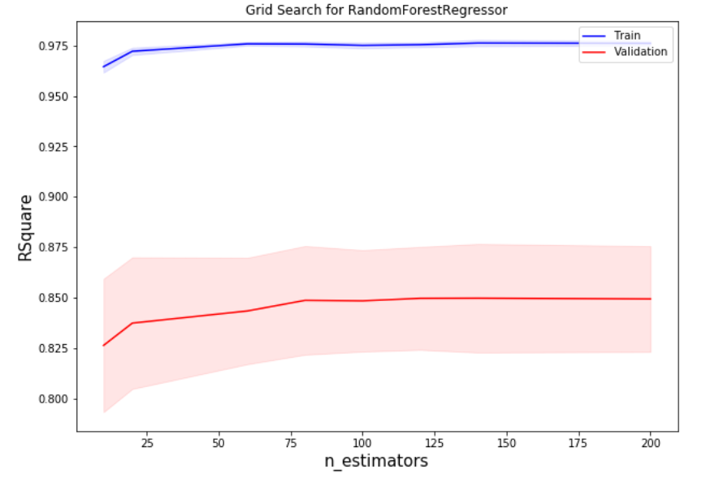
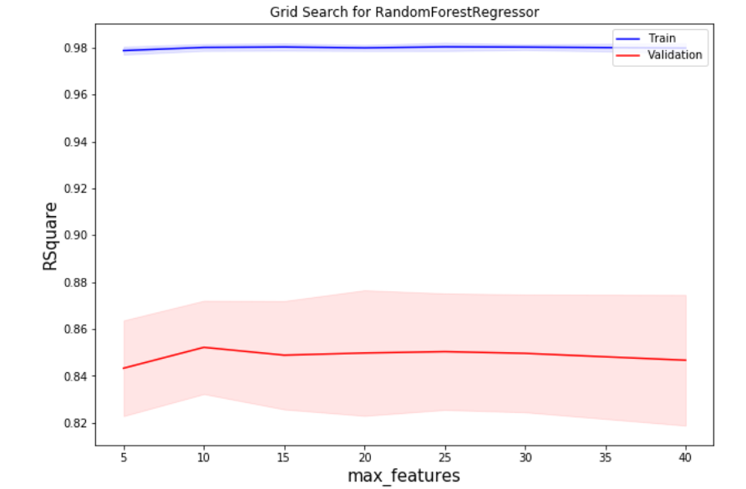
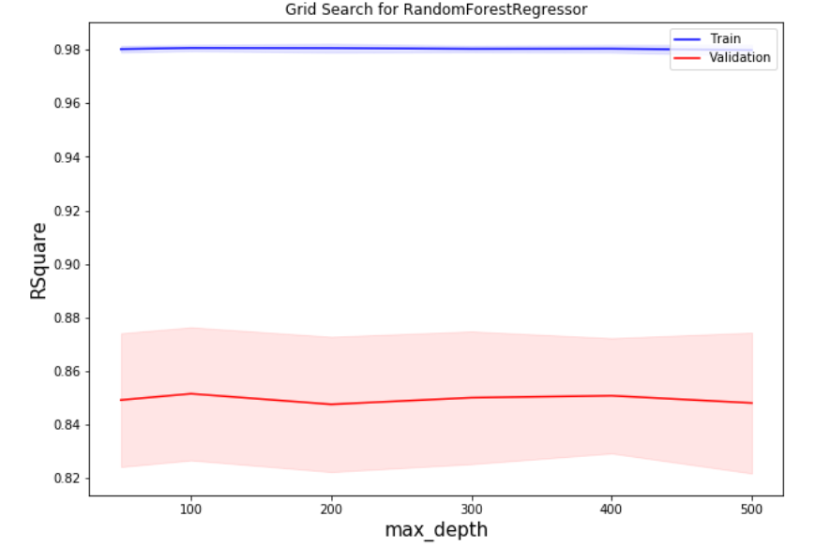
Random Forest

Slide 20
Tree Regression
Boosting
More generic than trees
Booster = “gbtree” is just default
Booster = “gblinear” alternative
Includes regularization capabilities
Alpha: L1-norm on leaf predictions, grid: 0.5
Lambda: L2-norm on leaves, grid: 0.7
Gamma: larger means more, on tree complexity.

Slide 21
Tree Regression
Boosting
Gradient Boosting
~13.28 sec to train
~0.02 sec to predict
XGB
~1.25 sec to train
~0.012 sec to predict

Slide 22
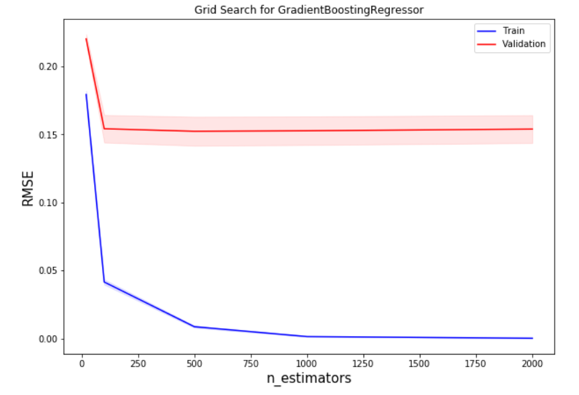
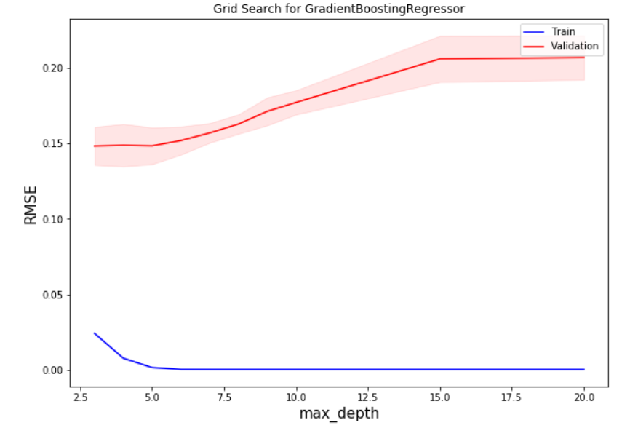
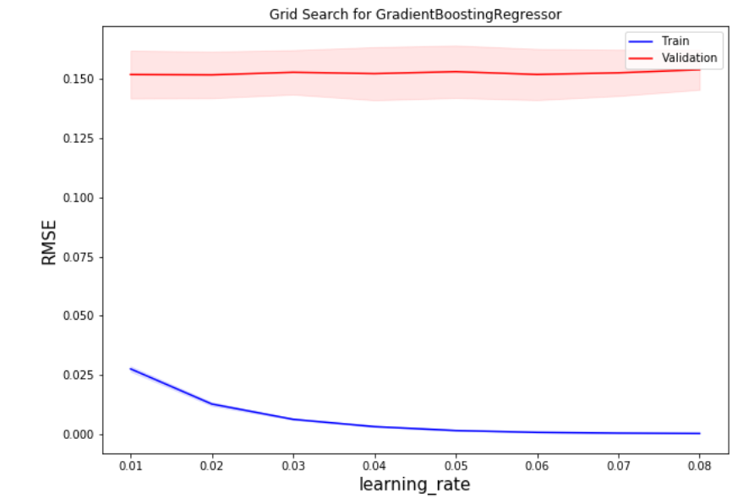
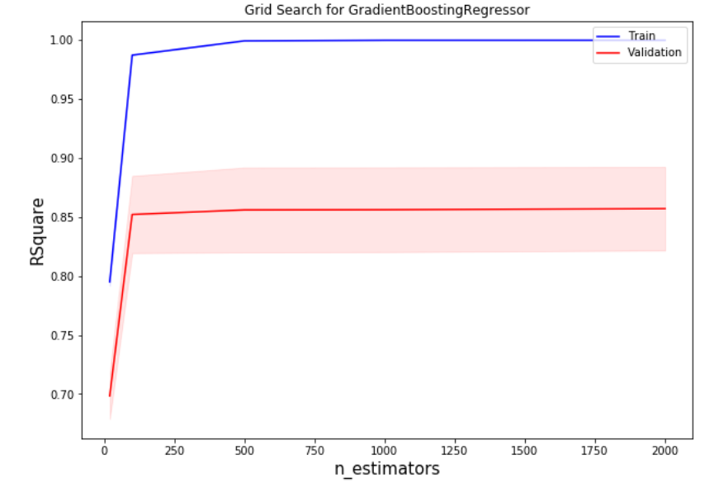
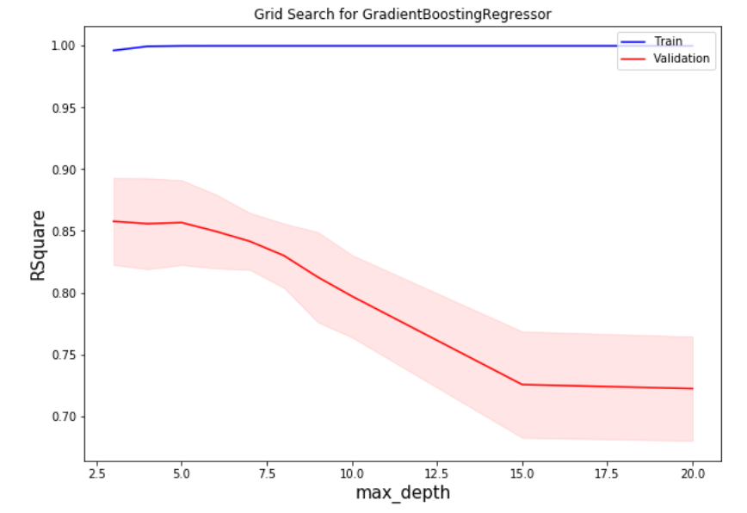
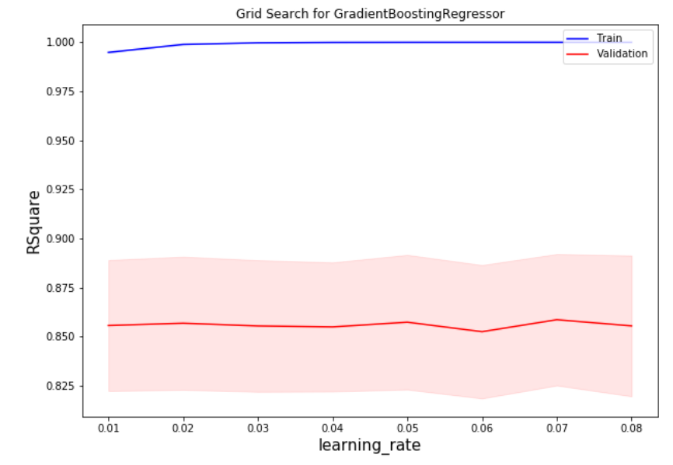
Gradient Boosting

Slide 23
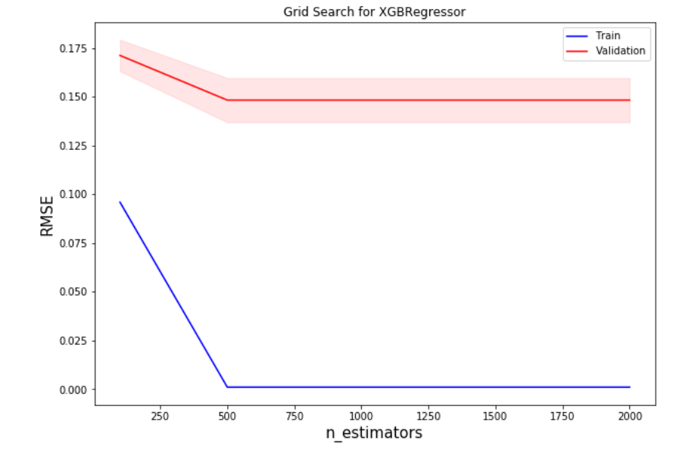
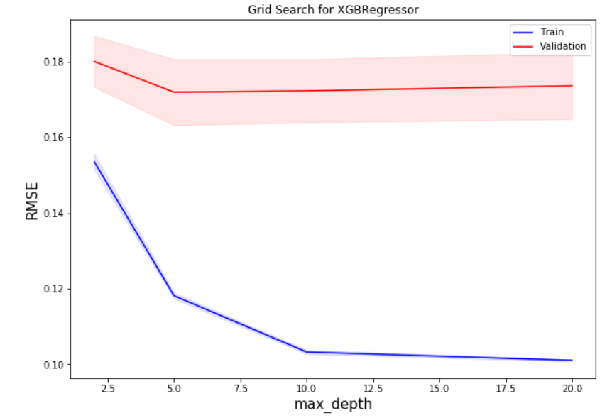
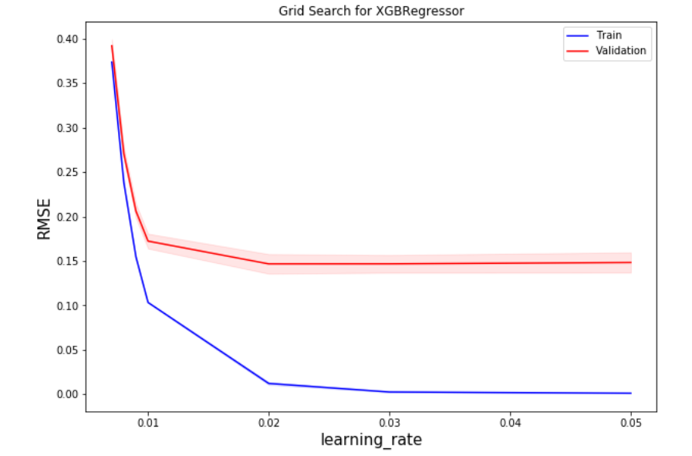
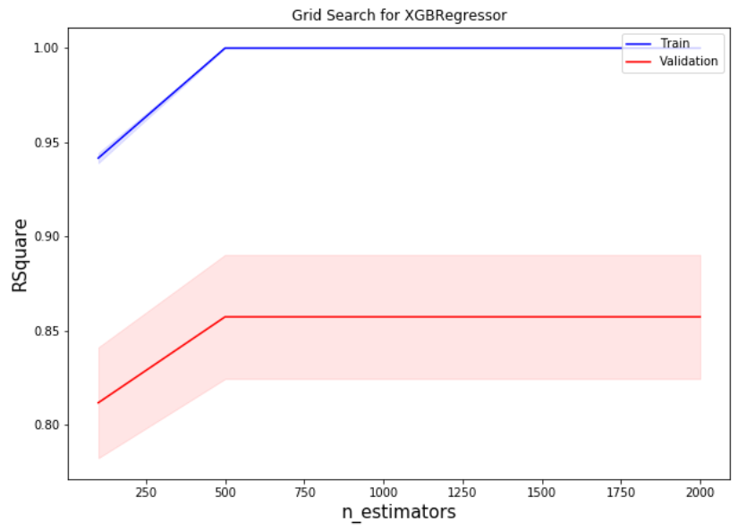
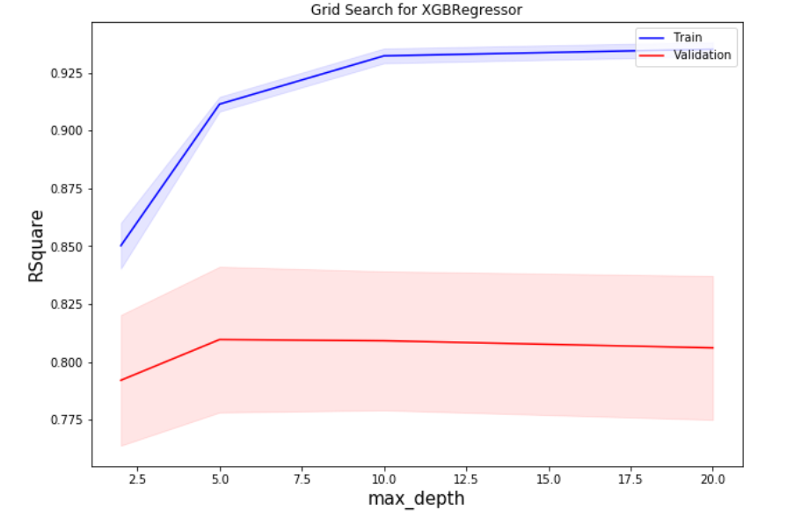
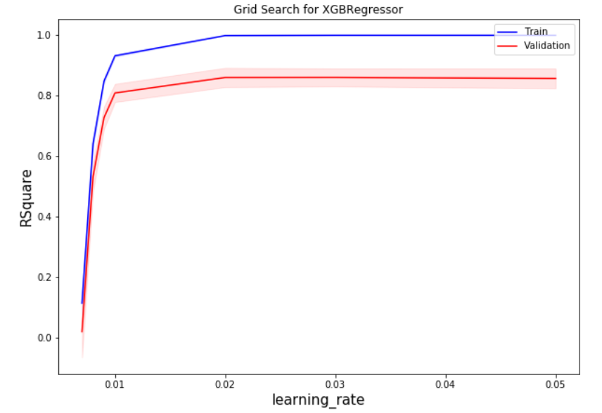
XGBoost

Slide 24
Models Comparison
Linear
Ridge
Elastic
Lasso
Tree
Boosting
MSE
RMSE

