Slide 1
Meaningful
Programming

Slide 2
Semantic Web Concepts
Individuals are globally identified by URI and are called 'resources'
Triples: Subject → Predicate → Object
Resources can belong to many classes
Axioms about classes of individuals are collected into Ontologies
Ontologies are open.
'Triplification' of data → 'Linked Data'
'Webizing' of programming languages – Use URIs for symbols.
Favour Categorization over Construction
We assume that someone else created the object.

Slide 3
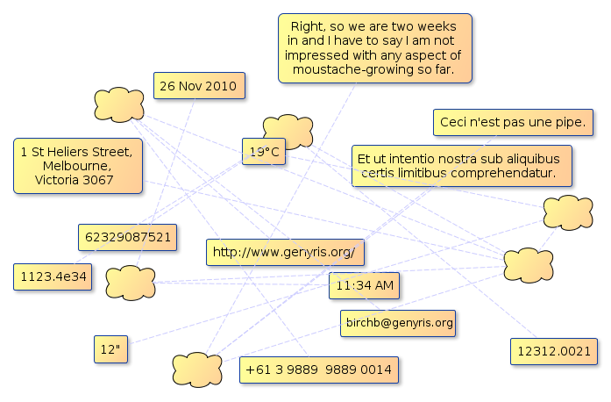
Strings

Slide 4
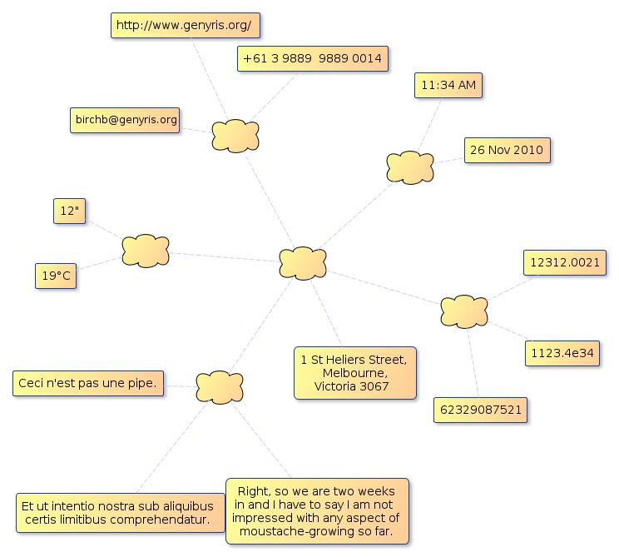

Slide 5
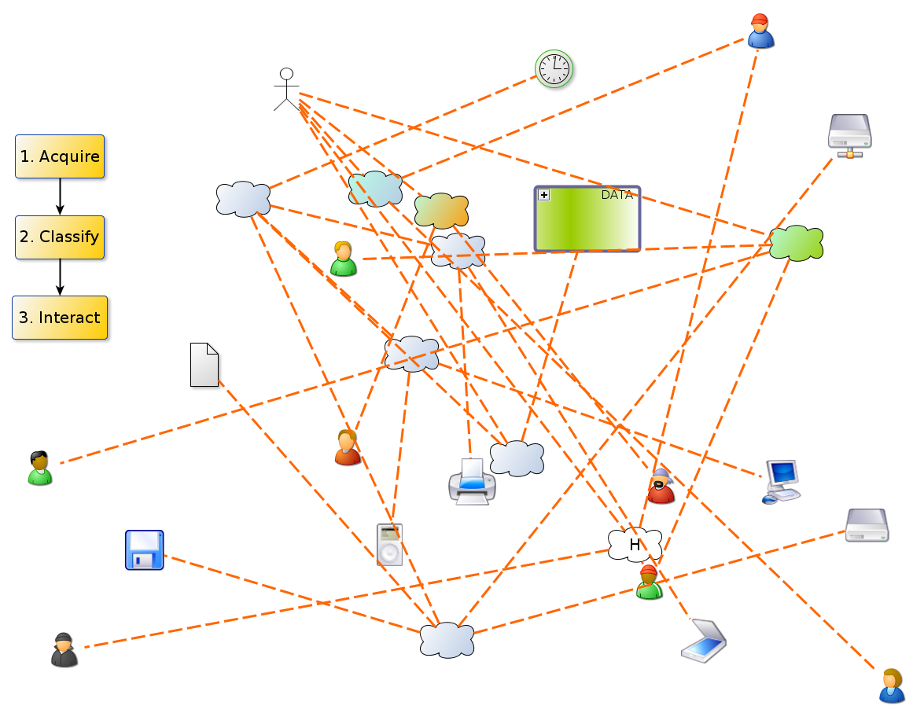
Data Structures

Slide 6
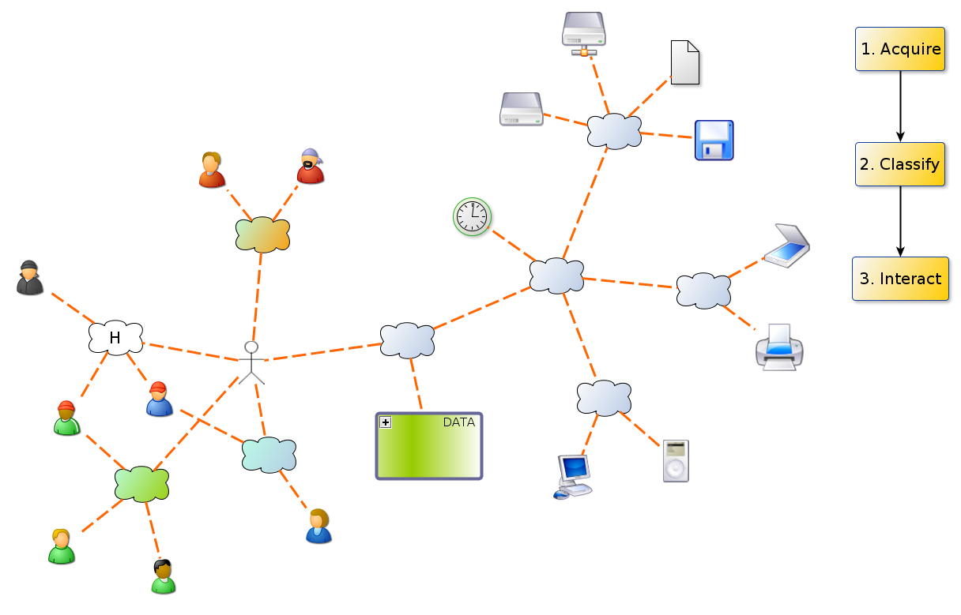

Slide 7
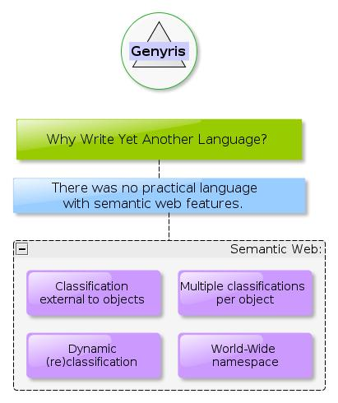

Slide 8
Lisp 1
In Lisp, all objects had 'attribute lists'
In MACLISP this was reduced to 'getprop' and 'putprop' which allows Symbols to have properties

Slide 9
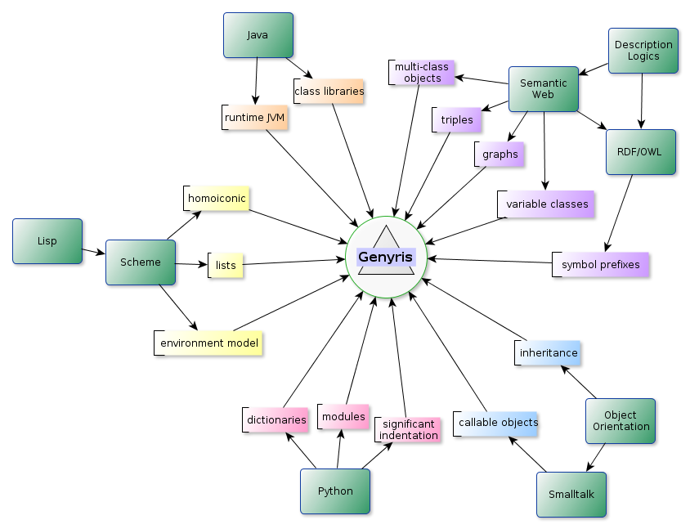

Slide 10
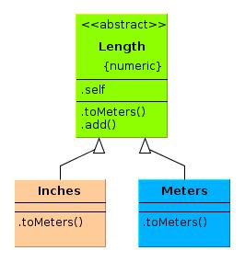

Slide 11
class Length()
def .toMeters()
raise "Oops - you invoked an abstract class."
class Inches(Length)
def .toMeters()
tag Meters (* .self 0.0254)
class Meters(Length)
def .toMeters() .self
Length
def .add(other)
tag Meters
+ (.toMeters)
other (.toMeters)

Slide 12
define a-meter
tag Meters 1
define a-foot (tag Inches 12)
assert
equal?
a-foot (.add a-meter)
1.3048

Slide 13
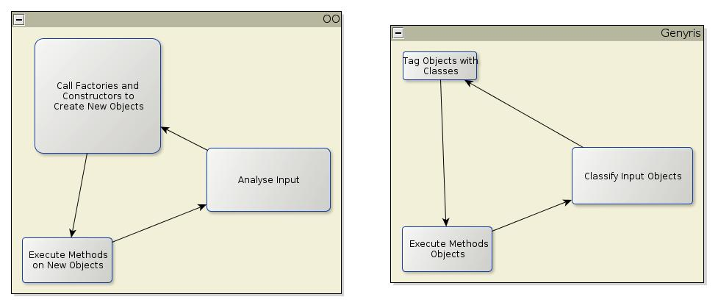
Open World

Slide 14
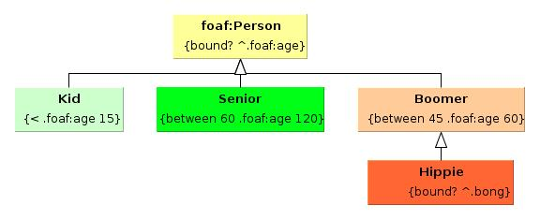

Slide 15
@prefix foaf 'http://xmlns.com/foaf/0.1/'
class foaf:Person ()
def .valid? (obj)
# simple type inference from foaf:age to foaf:Person
obj
bound? ^.foaf:age
class Kid (foaf:Person)
def .valid? (obj)
obj
< .foaf:age 15
class Senior (foaf:Person)
def .valid? (obj)
obj
between 60 .foaf:age 120
class Boomer (foaf:Person)
def .valid? (obj)
obj
between 45 .foaf:age 60

Slide 16
define neil
dict
.foaf:name = "Neil Wheedon Watkins Pye"
.foaf:age = 49
.bong = true
define vyvyan
dict
.foaf:name = "Vyvyan"
.foaf:age = 49

Slide 17
class foaf:name
define rick
dict
.name = (tag foaf:name "Rick") # not legal in RDF !!

Slide 18
classify foaf:Person neil
classify foaf:Person vyvyan
assert
and
is-instance? neil Hippie
is-instance? vyvyan Boomer
is-instance? rick!name foaf:name

Slide 19
Description Logics?
DL | OWL | Genyris
Concept | Class | Class
Role | Property | Property
Individual | Object | Thing
Axiom | RDF, OWL | ???
:-) | Triplestores: - query | Graphs
:-) | Rules Engines: Subsumption Instance Checking Role Checking Class Consistency | ???

Slide 20
Questions?

Slide 21
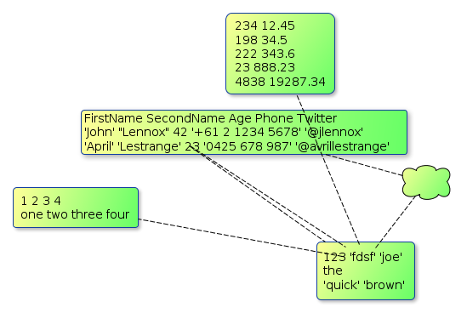

Slide 22
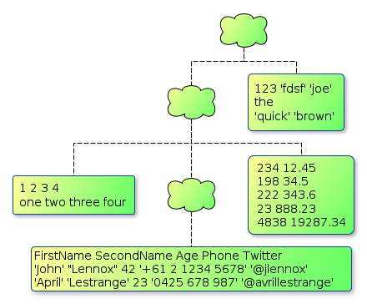

Slide 23
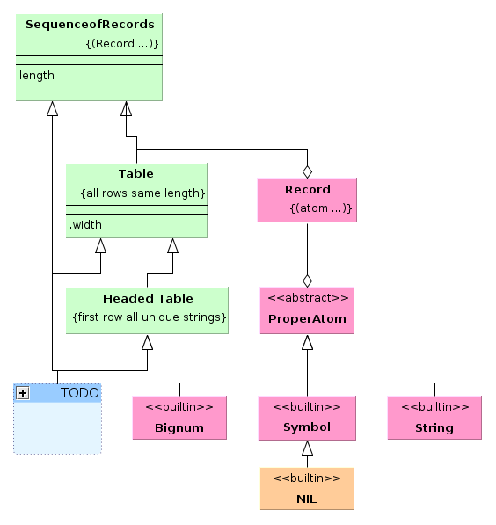

Slide 24
@prefix : "http://www.genyris.org/lang/types#"
class :ProperAtom()
# atomic atoms !
def .valid?(obj)
or
is-instance? obj String
is-instance? obj Bignum
is-instance? obj Symbol
class :Record()
# a list of proper atoms
def .valid?(obj)
cond
(is-instance? obj Pair)
cond
obj!right # end of the list?
and
:ProperAtom!valid? obj!left
:Record!valid? obj!right
else
:ProperAtom!valid? obj!left
def .same-type?(type record)
and
is-instance? record!left type
cond
record!right # more in the list?
:Record!same-type? type record!right
else
true
def .unique?(record)
and
not (member? record!left record!right)
cond
record!right # more in the list?
:Record!unique? record!right
else
true
class :SequenceOfRecords()
# A list of records
def .valid?(obj)
cond
(is-instance? obj Pair)
cond
obj!right # end of the list?
and
:Record!valid? obj!left
:SequenceOfRecords!valid? obj!right
else
:Record!valid? obj!left
class :Table(:SequenceOfRecords)
# A list of equal-length records
def .valid?(obj)
define mylength (length obj!left)
cond
obj!right
cond
(equal? mylength (:Table!valid? obj!right))
mylength
else # end of the list
mylength
# method returns the width of the table
def .width()
length (.self .left)
class :HeadedTable(:Table)
# A list of equal-length records with a first-row
# header of unique strings or symbols
def .valid?(obj)
and
:Record!unique? obj!left
or
:Record!same-type? String obj!left
:Record!same-type? Symbol obj!left

