Slide 1
birdhouse: supporting web processing services for climate data
Stephan Kindermann¹, Carsten Ehbrecht¹, Nils Hempelmann² et. al.
1. German Climate Computing Center, Germany
2. Le Laboratoire des Sciences du Climat et de l'Environnement, France

Slide 2
Climate Data volume grows quickly
But on client side:
Limited storage/compute capacities
“download and
process at home”
Processing
in or close to
Data archives
Web Processing Service
Submit jobs on a Server
close to the data

Slide 3

Server-Client Side
Server - Side
Client - Side
Birdhouse
WPS
for
Climate model data analyses
Submit
Job
Data
Data
Monitor
Expert
Outputs

Slide 4
What does Birdhouse provide ?
Customizable installation of Web Processing Services using conda, buildout and ansible.
Provides WPS as Docker Container.
Web-based and Terminal WPS clients.
Security Proxy Twitcher for OGC/WPS sevices.
Data Access : ESGF, Thredds, OpenStack Cloud, …
WPS for compliance checks and climate impact.
Supports PyWPS 3.x and 4.x … but not restricted to it (Zoo, GeoServer WPS, COWS, 52North, ...)

Slide 5

Birdhouse - Ecosystem
https://github.com/bird-house/
Security - Twitcher
ESGF
Climate
Model
Data
WPS - GUI
Phoenix
Catalogue Service for the Web (CSW)
Register
Link
Web Mapping Service
(ncWMS)
WPS
Flyingpigeon
Climate Impact
Extreme Events
WPS
Hummingbird
Data
Quality Checker
WPS
Malleefowl
ESGF
Search & Fetch
Other WPS
OGC-based
External
Services
Other
Data
Archives
Local Data
Storage
Publish
Results
Process Outputs

Slide 6
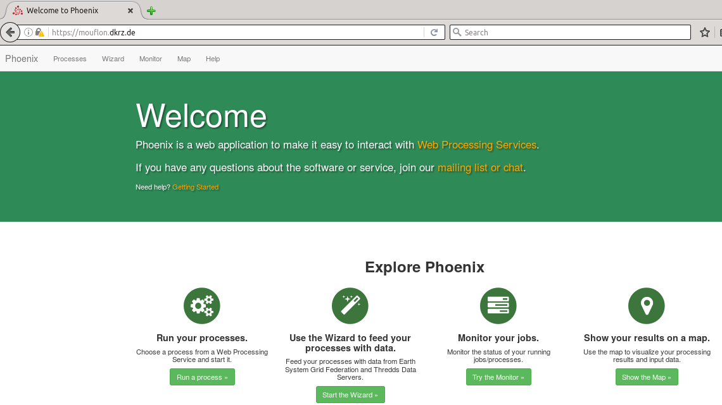
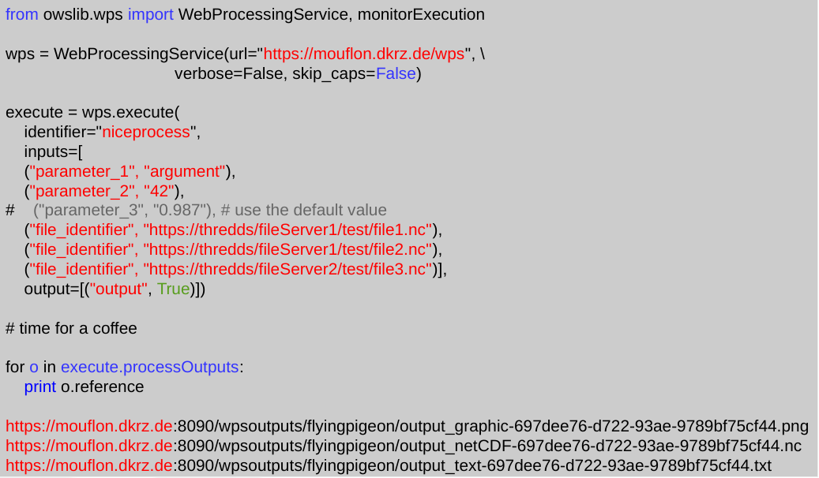
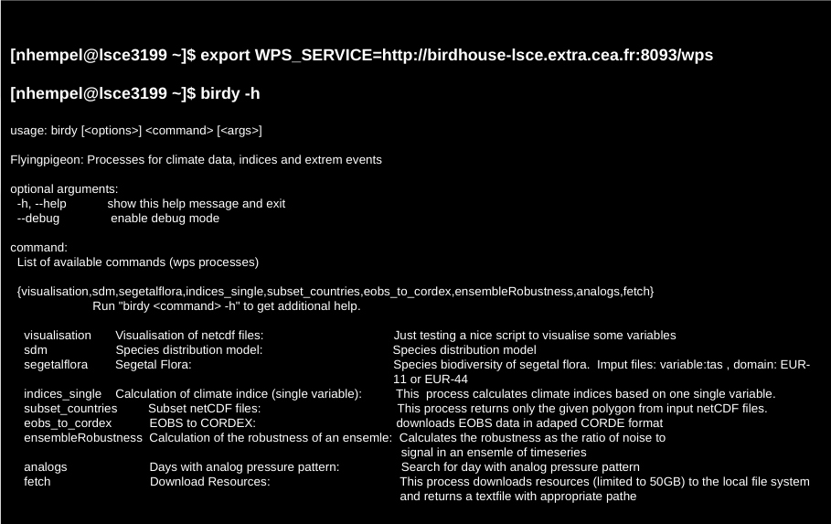
Client Side
Web Browser
GUI
Authentication with
OAuth or OpenID
Script language
Terminal Call
Token authentication

Slide 7
Security
GUI
Terminal or
Script language
Basic
Authentication
Token
Authentication
Twitcher
Token generation and
Service registration
( XML-RPC API )
WSGI Application Server
( gunicorn )
Access Token Storage
( MongoDB )
OWS Security Middleware
( WSGI, Tween )
Token Validation
OWS Service Registry
OWS Proxy
( WSGI App )
Get Service URL
Registration
Service
( WPS / WMS )
Delegation

Slide 8
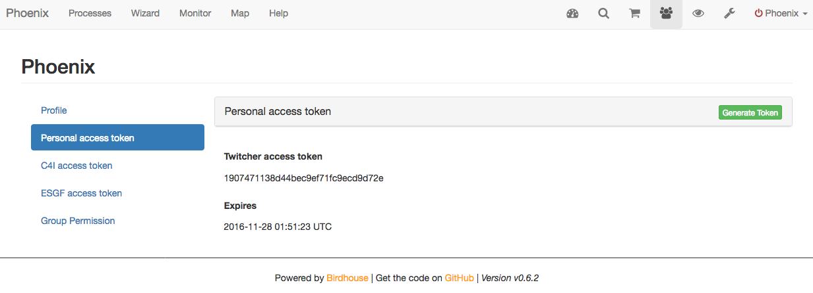
Security Token
The token-based Security Proxy is similar to the Climate4Impact approach :
https://dev.knmi.nl/projects/impactportal/wiki/API

Slide 9
Script language
from owslib.wps import WebProcessingService, monitorExecution
# using wps url with access token db6c...
wps = WebProcessingService(
url="https://mouflon.dkrz.de/ows/proxy/flyingpigeon/db6c1293d0444d919dcc3ce48fa610f7 ", \
verify=False,
verbose=False, skip_caps=False,
)
execute = wps.execute(
identifier="niceprocess",
inputs=[
("parameter_1", "argument"),
("parameter_2", "42"),
# ("parameter_3", "0.987"), # use the default value
("file_identifier", "https://thredds/fileServer1/test/file1.nc"),
("file_identifier", "https://thredds/fileServer1/test/file2.nc"),
("file_identifier", "https://thredds/fileServer2/test/file3.nc")],
output=[("output", True)])
for o in execute.processOutputs:
print o.reference
https://mouflon.dkrz.de:8090/wpsoutputs/flyingpigeon/output_graphic-697dee76-d722-93ae-9789bf75cf44.png
https://mouflon.dkrz.de:8090/wpsoutputs/flyingpigeon/output_netCDF-697dee76-d722-93ae-9789bf75cf44.nc

Slide 10

Deployment with conda and buildout
Using conda package manager to setup an
environment with all used software components
(python, R, matplotlib, PyWPS, ...)
Using buildout to setup PyWPS with all services
(supervisor, gunicorn, nginx) and configuration
files.
To install a Bird just run :
$ git clone https://github.com/bird-house/emu.git
$ cd emu
$ make clean install
$ make start
http://conda.pydata.org/docs/
http://www.buildout.org/en/latest/
http://birdhouse.readthedocs.io/en/latest/installation.html

Slide 11
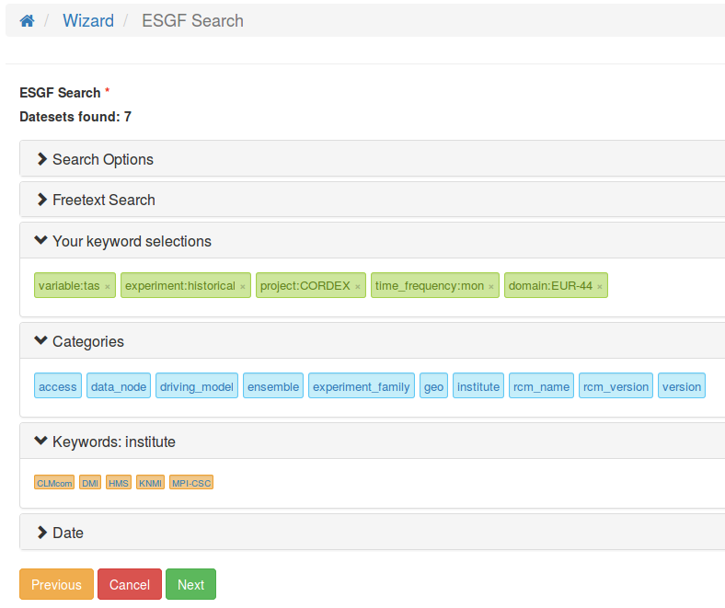
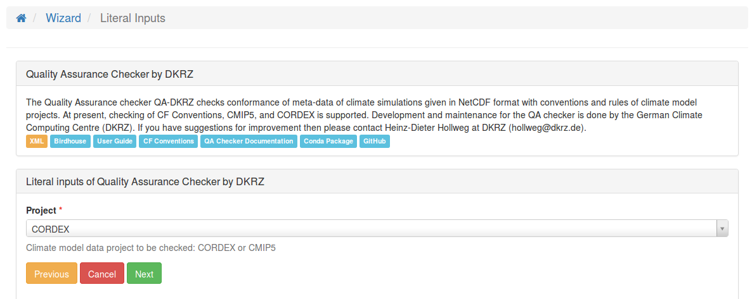
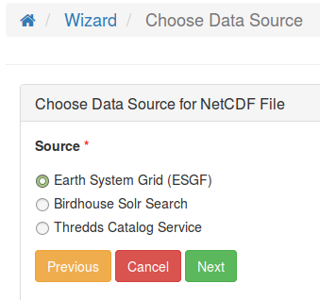
Wizard : Using ESGF – search
1. Use the Wizard to select Process
and enter Parameters
3. Select Datasets with ESGF Search Widget
2. Choose ESGF
as Input Source
for NetCDF Files

Slide 12
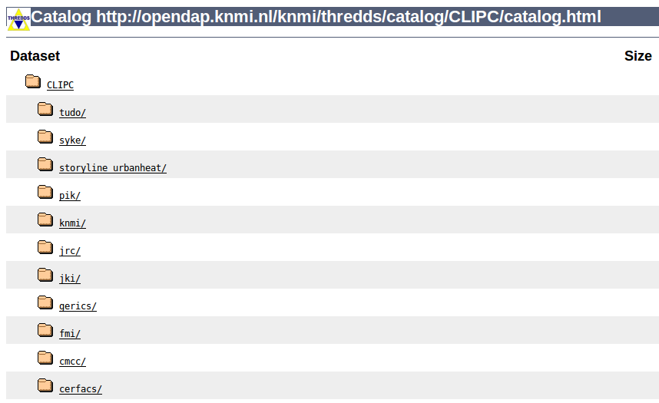
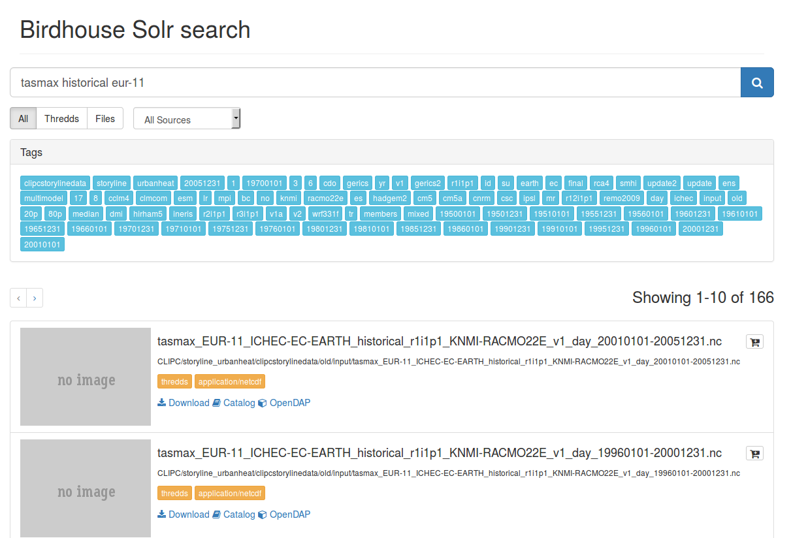
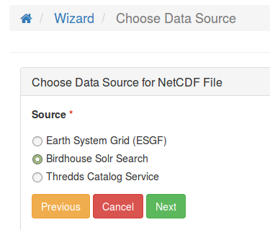
Solr Index for Thredds Catalogs ( bird-feeder )
Run bird-feeder to create Solr Search
Index for Thredds Data Catalogs and local filesystem
Wizard :
Choose Solr Search
or Thredds Catalog
as Input Source

Slide 13
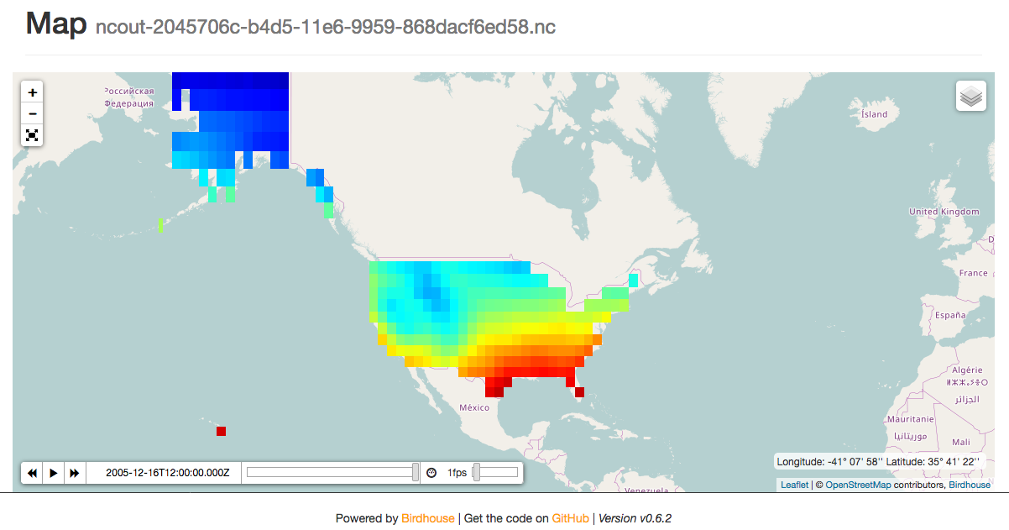

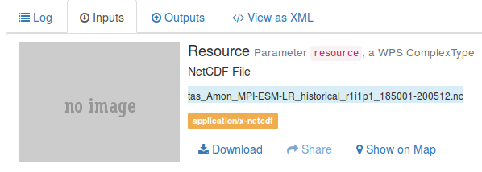
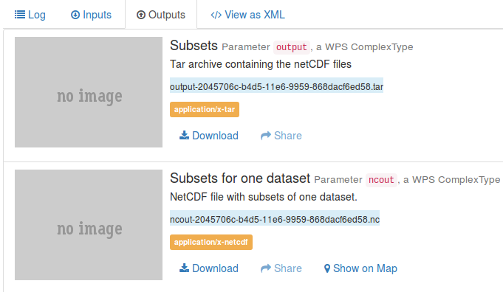
Web Map Service : Show NetCDF Files on Map
Solr Search
Preview
Process Inputs
Show Map
Process Outputs
Possible Web Map Services :
ncWMS, Adaguc (KNMI), sci-wms (planned)

Slide 14
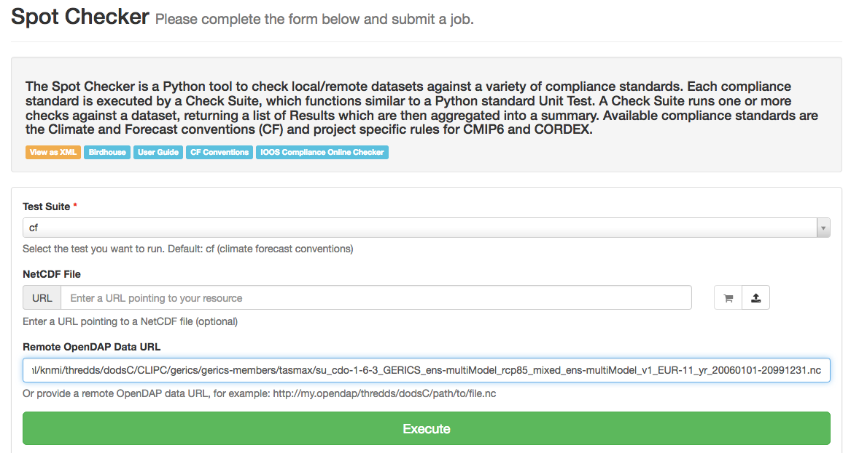
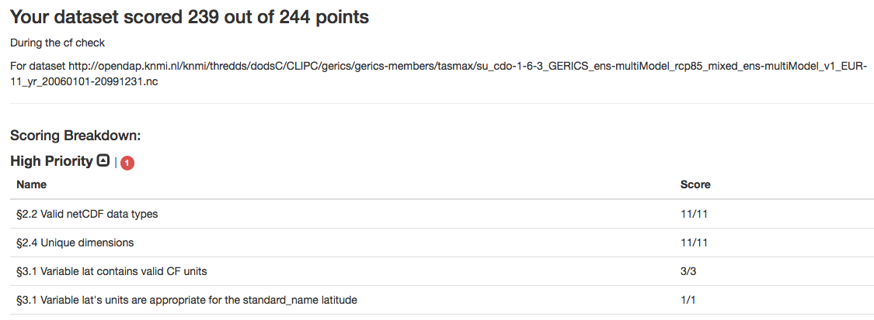
SpotChecker : Metadata Compliance Checks
Run SpotChecker on NetCDF file :
File URL, OpenDAP URL or uploaded File.
Perform compliance checks :
CF conventions, CORDEX, CMIP5, ...
Using IOOS Compliance-Checker and
DKRZ Quality Assurance Checker.
Check reports in HTML and YAML format.

Slide 15
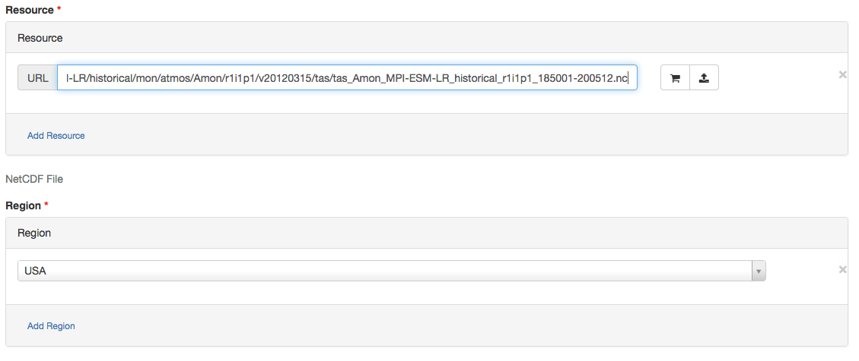
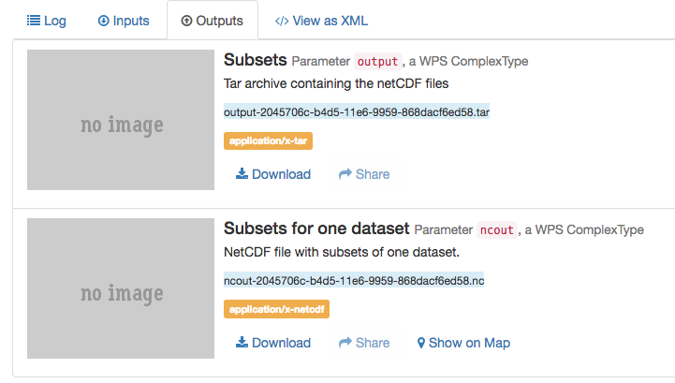
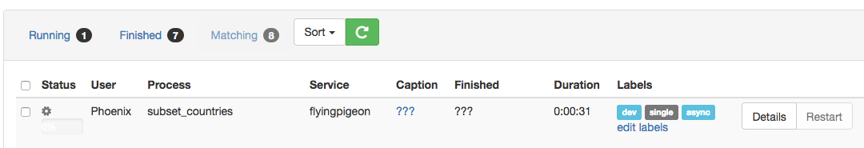
Subsetting : Region USA
Enter NetCDF File URL and USA clipping Region
Show Map
Execute Job
Show
Outputs
Monitor Job Execution

Slide 16
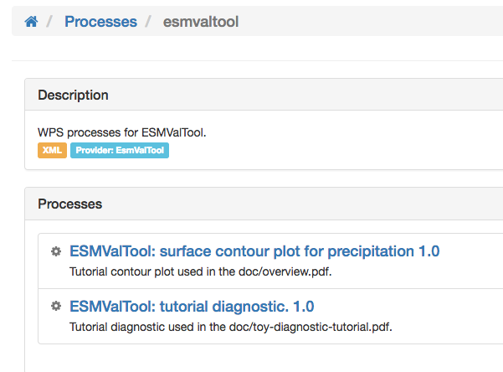
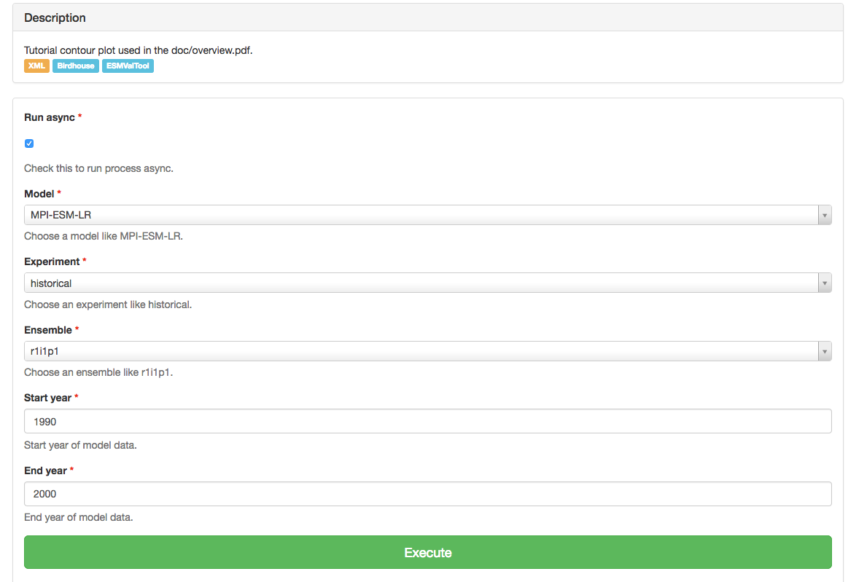
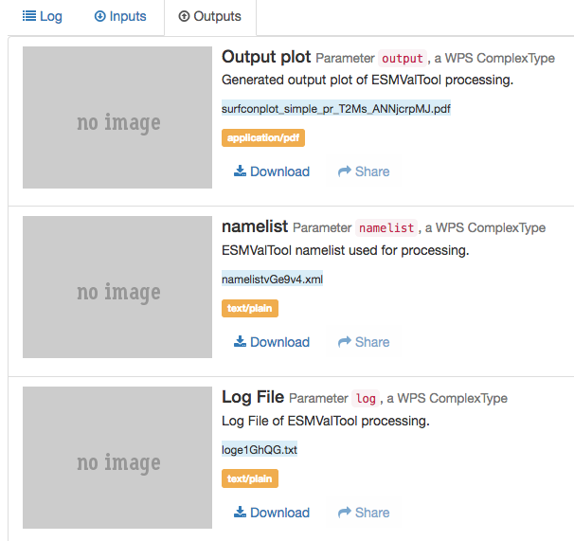
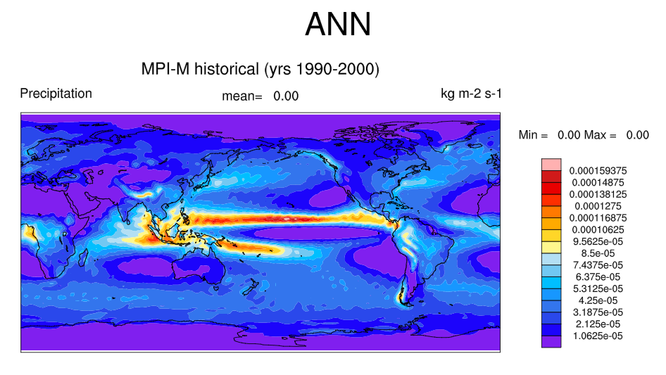
ESMValTool Diagnostics as Web Processing Service
1. Choose ESMVal Process
2. Enter Input Parameters
3. Outputs : plot, namelist, log
Show
Plot
ESMValTool namelist is generated by the WPS process.
Data is retrieved by the ESMValTool ESGF coupling module.

Slide 17
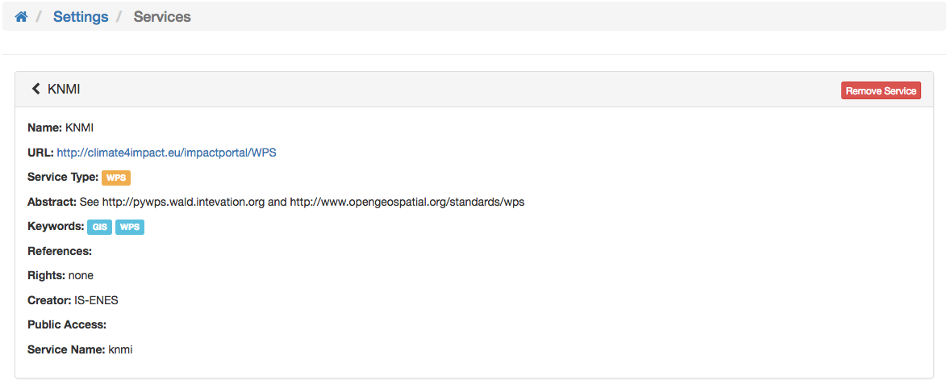
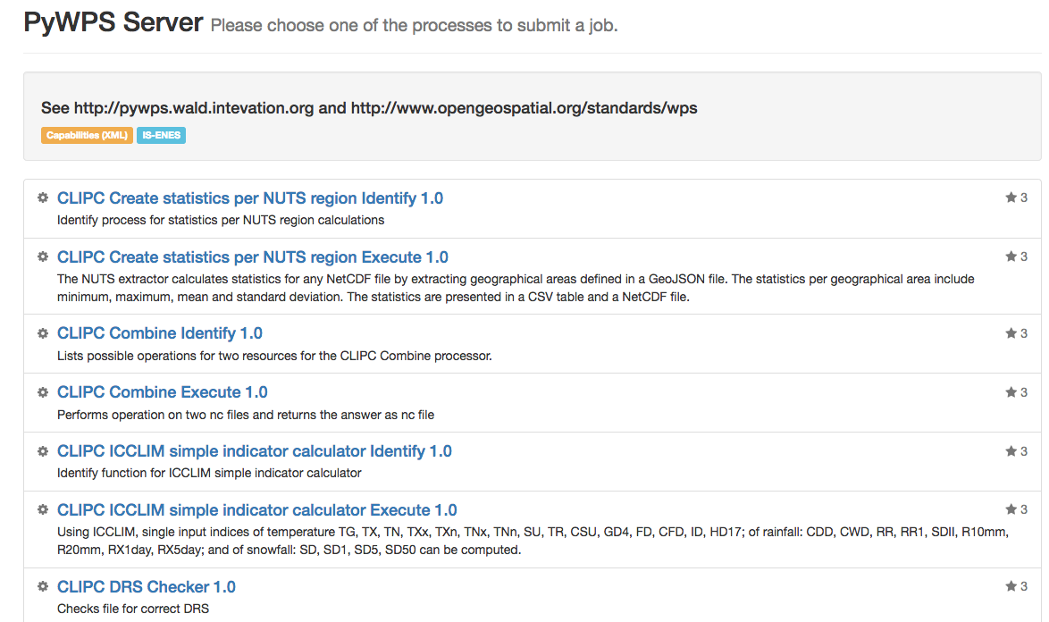
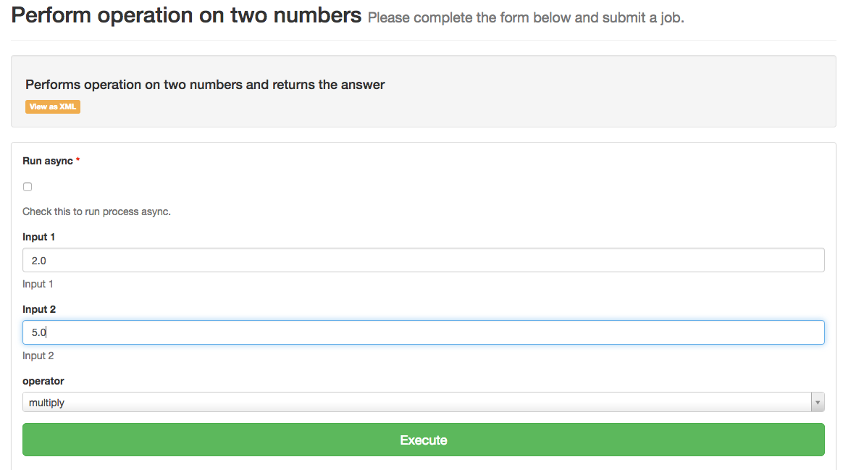
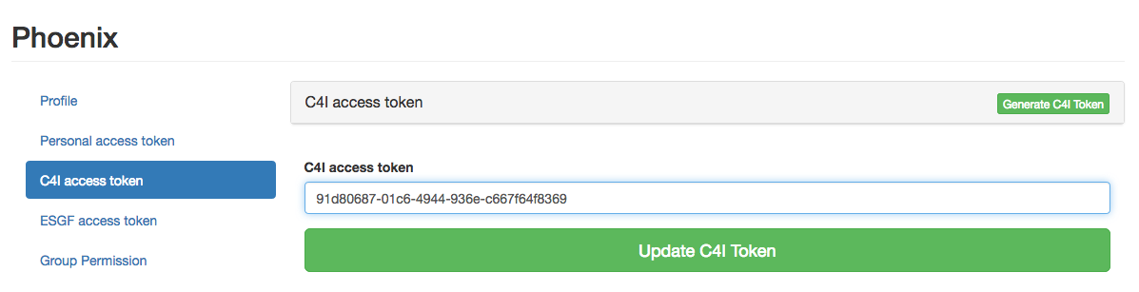
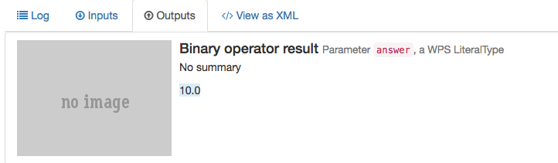
Accessing Remote WPS : Climate4Impact WPS at KNMI
Register C4I WPS URL
Run a Process : operation on two numbers
Update C4I Access Token

Slide 18
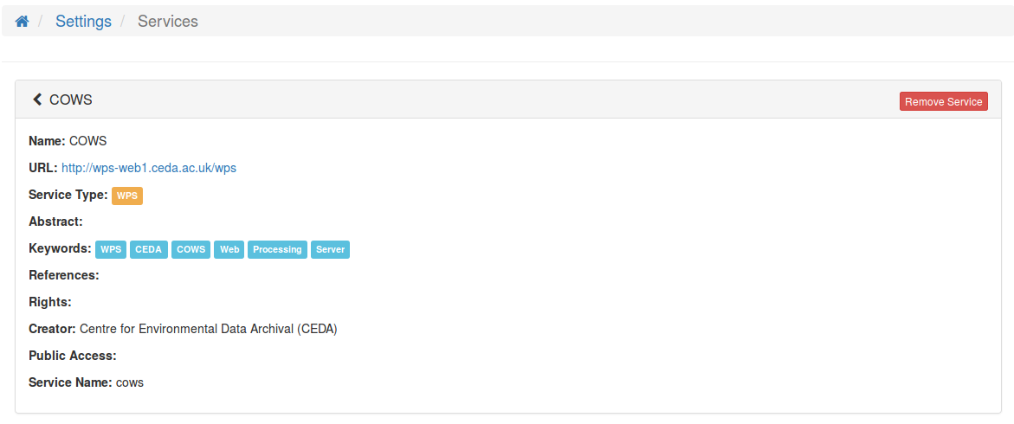
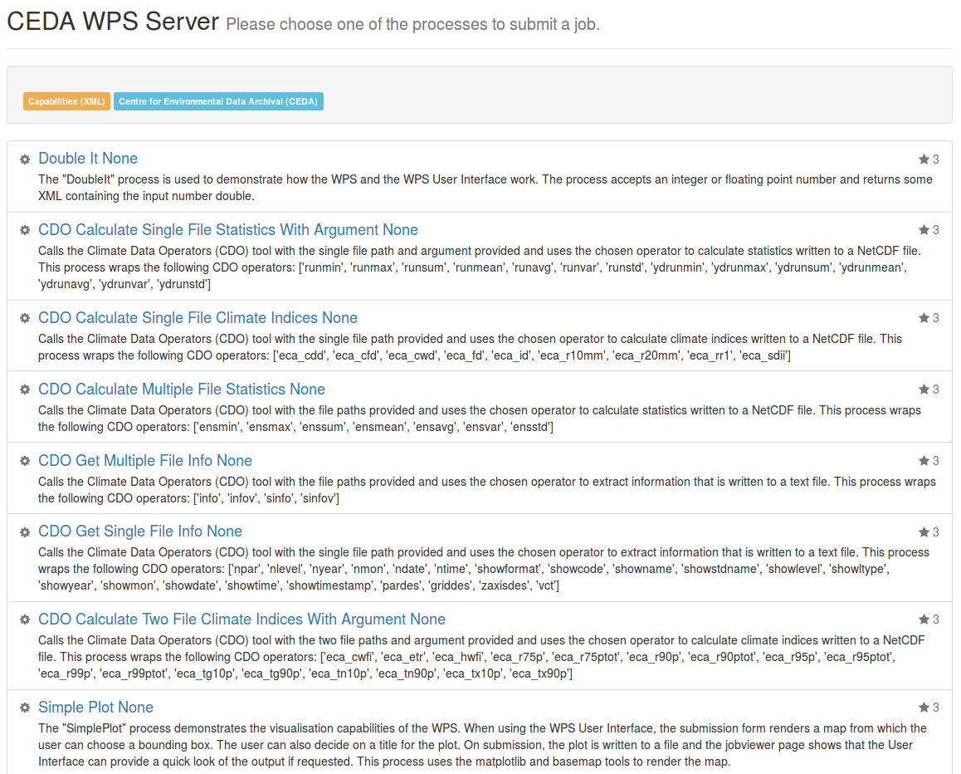
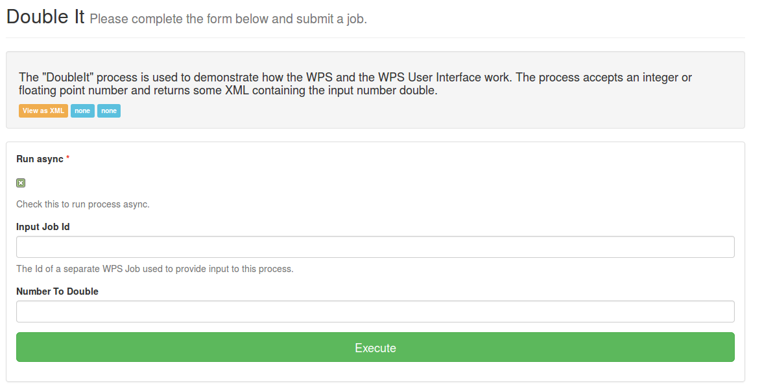
Accessing Remote WPS : COWS WPS at CEDA
Register COWS WPS URL
Run a Process : Double It

Slide 19

Copernicus Extensions for PyWPS
Using PyWPS-4 : ready for WPS 2.0 (pause, resume, delete)
Attach batch processing with SLURM etc ...
Optionally run processes in Docker Container.
Delegation to SLURM and Docker is handled internally of PyWPS (new feature in PyWPS-4).
WPS Process definition and code is not changed when run as batch job or in a docker container.

Slide 20
https://github.com/bird-house
http://birdhouse.readthedocs.org/en/latest/
https://gitter.im/bird-house/birdhouse
https://lists.dkrz.de/mailman/listinfo/wps
https://lists.dkrz.de/mailman/listinfo/wps-dev
DEMO GUI: https://mouflon.dkrz.de

Slide 21

Contact :
wps@dkrz.de
Thanks to :
Carmen Alvarez-Castro, Katharina Berger, Patrick Brockmann, Carsten Ehbrecht, Wolfgang Falk, Nils Hempelmann, Heinz-Dieter Hollweg, Jörg Hoffmann, Nikolay Kadygrov, Stephan Kindermann, Florian Klemme, Nikolay Koldunov, Ben Koziol, Cathy Nangini, Sabine Radanovics, Seckmag, Robert Vautard, Pascal Yiou , …. , et. al.

Slide 22
Terminal Call
[nhempel@lsce3199 ~]$ conda install -c birdhouse birdhouse-birdy
[nhempel@lsce3199 ~]$ birdy -h
usage: birdy [<options>] <command> [<args>]
Flyingpigeon: Processes for climate data, indices and extreme events
optional arguments:
-h, --help show this help message and exit
--debug enable debug mode
--token TOKEN, -t TOKEN
Token to access the WPS service.
command:
List of available commands (wps processes)

Slide 23
Terminal Call
[nhempel@lsce3199 ~]$ export WPS_SERVICE=https://mouflon.dkrz.de/ows/proxy/flyingpigeon
[nhempel@lsce3199 ~]$ birdy –token 0c6d305b0f42452cbdcf31c7ac74f1e1 \ analogs_detection --experiment 'NCEP_slp'
INFO:Execution status: ProcessAccepted
INFO:Execution status: ProcessStarted
INFO:Execution status: ProcessSucceeded
INFO:Output:
INFO:analogs=http://mouflon.dkrz.de/wpsoutputs/flyingpigeon/analogs-08bce60c-6a41-11e6-be7a-8fdf4b12fcf5.txt (text/plain)
INFO:config=http://mouflon.dkrz.de/wpsoutputs/flyingpigeon/config-08bce60c-6a41-11e6-be7a-8fdf4b12fcf5.txt (text/plain)
[nhempel@lsce3199 ~]$
http://twitcher.readthedocs.io/en/latest/tutorial.html

Slide 24
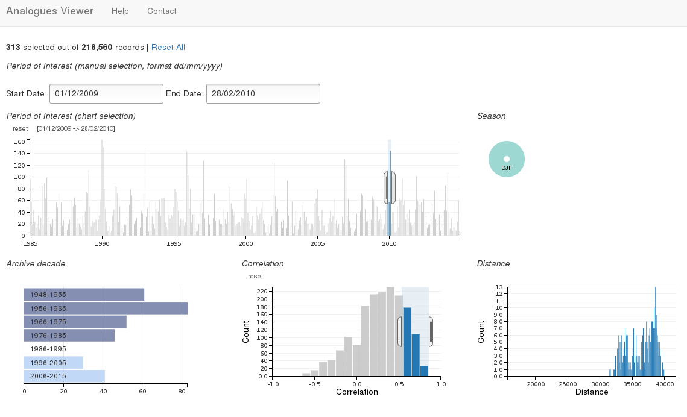
Analogues of atmospheric Circulation
Process
Analogues
Detection
Local
Storage
Data
fetch
Analogues
Results
Sea Surface
Pressure
Geopotential
Height
Process
Analogues
Viewer

