Slide 1
DKRZ ESGF related infrastructure and CMIP6 services

Slide 2
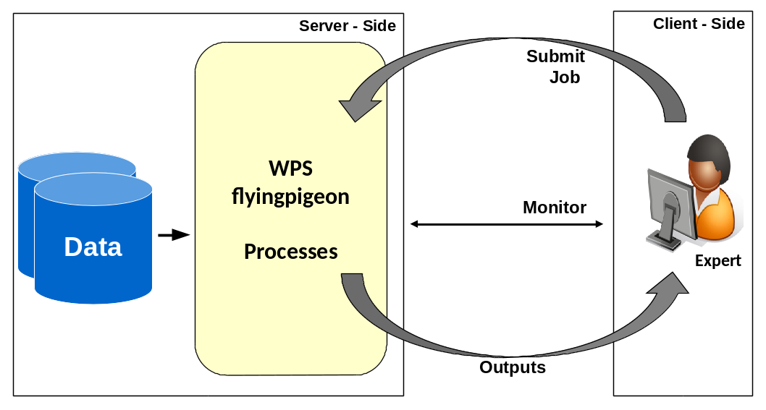
Server-Client Side

Slide 3
What does Birdhouse provide?
  Customizable installation of Web Processing Services using conda, buildout and ansible.
  Provides WPS as Docker Container.
  Web-based and Terminal WPS clients.
  Security Proxy Twitcher for OGC/WPS services.
  Data Access: ESGF, Thredds, OpenStack, ...
  WPS for compliance checks and climate impact.
  Supports PyWPS 3. and 4.x … but not restricted to it (others: Zoo, GeoServer, COWS, 52North).
  Supports to setup a WPS for your own use cases.

Slide 4
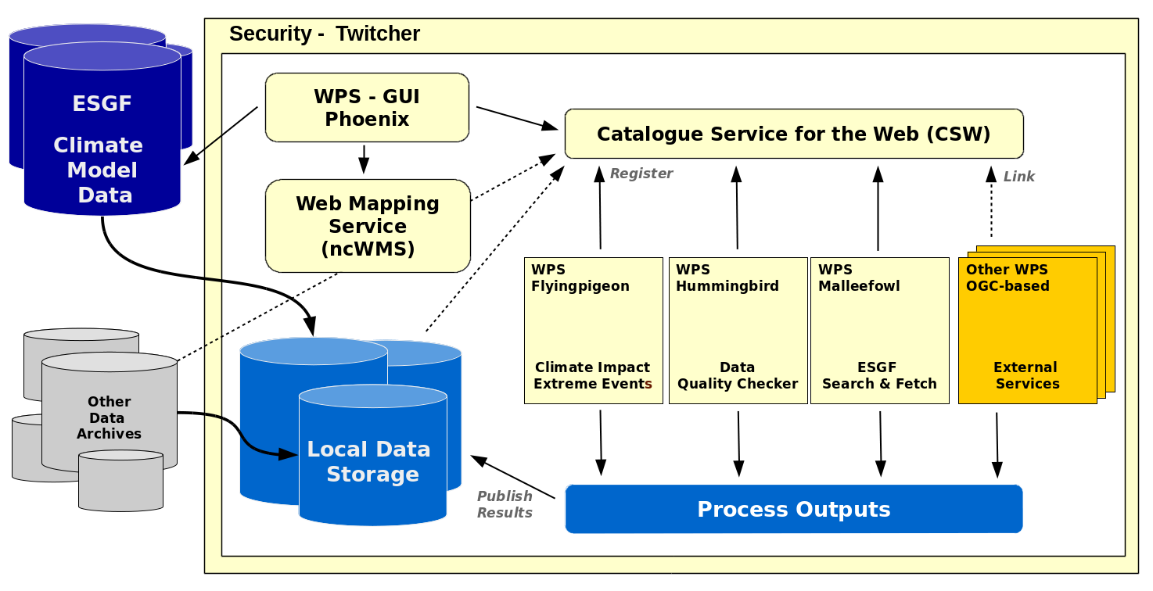
Birdhouse - Ecosystem http://bird-house.github.io/

Slide 5
Client Side

Slide 6
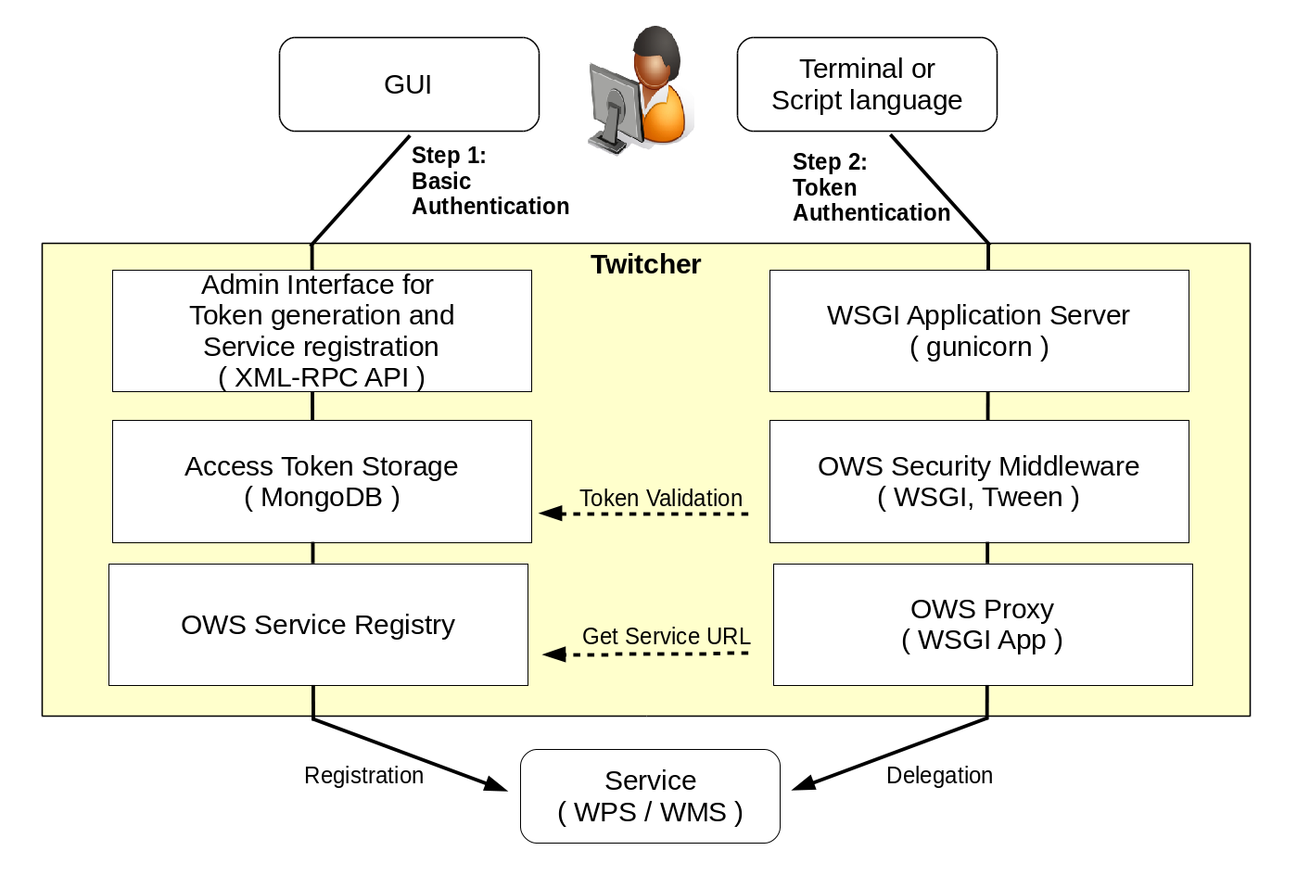
Security – Twitcher Security Proxy

Slide 7
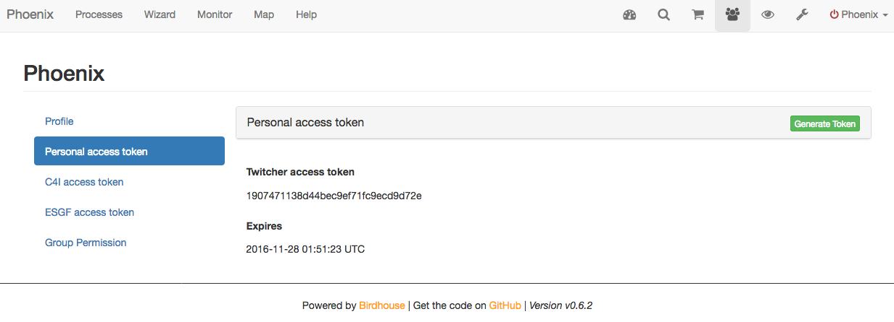
Security Token
The token-based Security Proxy is similar to the Climate4Impact approach:
https://dev.knmi.nl/projects/impactportal/wiki/API

Slide 8
Script language
from owslib.wps import WebProcessingService, monitorExecution
# using wps url with access token db6c...
wps = WebProcessingService(
url="https://mouflon.dkrz.de/ows/proxy/flyingpigeon/db6c1293d0444d919dcc3ce48fa610f7 ", \
verify=False,
verbose=False, skip_caps=False,
)
execute = wps.execute(
identifier="niceprocess",
inputs=[
("parameter_1", "argument"),
("parameter_2", "42"),
# ("parameter_3", "0.987"), # use the default value
("file_identifier", "https://thredds/fileServer1/test/file1.nc"),
("file_identifier", "https://thredds/fileServer1/test/file2.nc"),
("file_identifier", "https://thredds/fileServer2/test/file3.nc")],
output=[("output", True)])
for o in execute.processOutputs:
print o.reference
https://mouflon.dkrz.de:8090/wpsoutputs/flyingpigeon/output_graphic-697dee76-d722-93ae-9789bf75cf44.png
https://mouflon.dkrz.de:8090/wpsoutputs/flyingpigeon/output_netCDF-697dee76-d722-93ae-9789bf75cf44.nc

Slide 9

Deployment with conda and buildout
Using conda package manager to setup an environment with all used software components (Python, R, matplotlib, PyWPS, …).
Using Buildout to setup PyWPS with all services (supervisor, gunicorn, nginx) and configuration files.
To install a Bird just run:
$ git clone https://github.com/bird-house/emu
$ cd emu
$ make clean install
$ make start
$ http://localhost:8094/wps
“Manage the Chaos”
http://conda.pydata.org/docs/
http://www.buildout.org/en/latest/
http://birdhouse.readthedocs.io/en/latest/installation.html

Slide 10
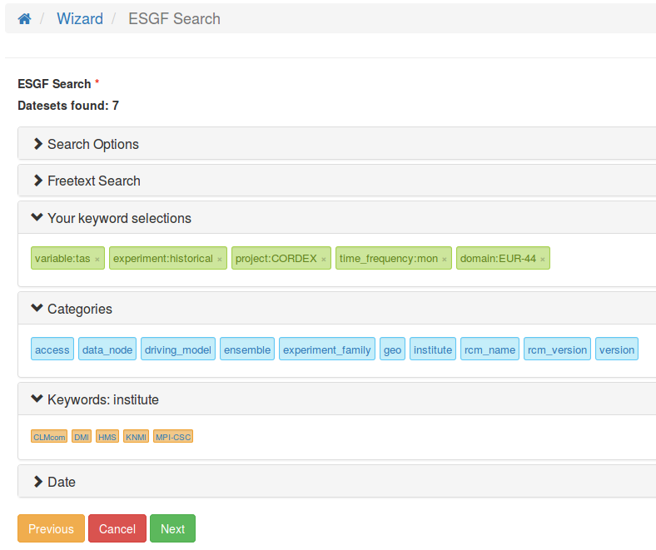
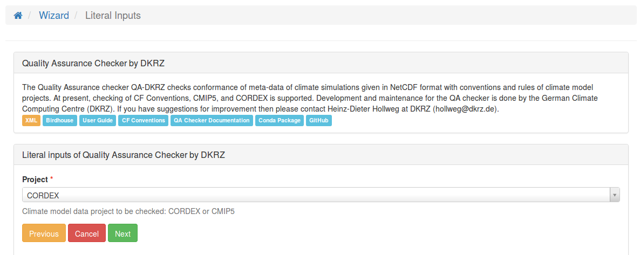
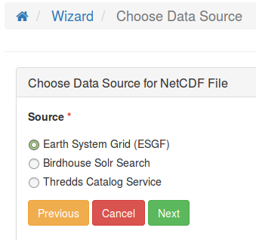
Wizard: Using ESGF-Search
1. Use the Wizard to select Process
and enter Parameters
3. Select Datasets with ESGF Search Widget
2. Choose ESGF as Input Source for NetCDF Files

Slide 11
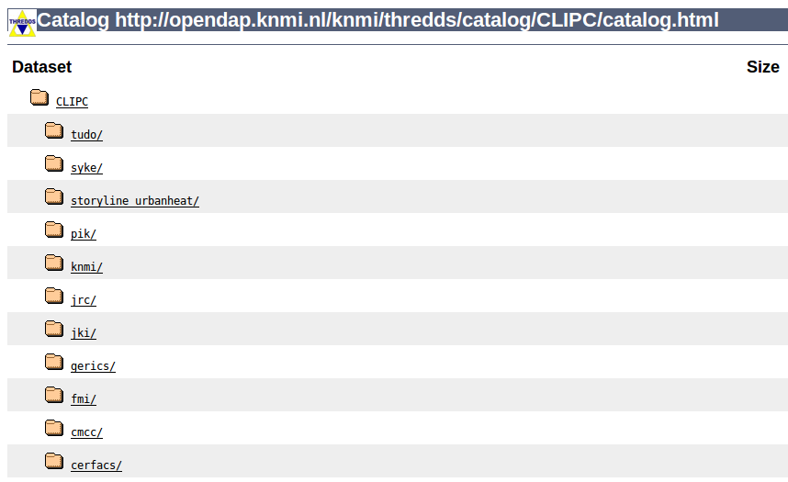
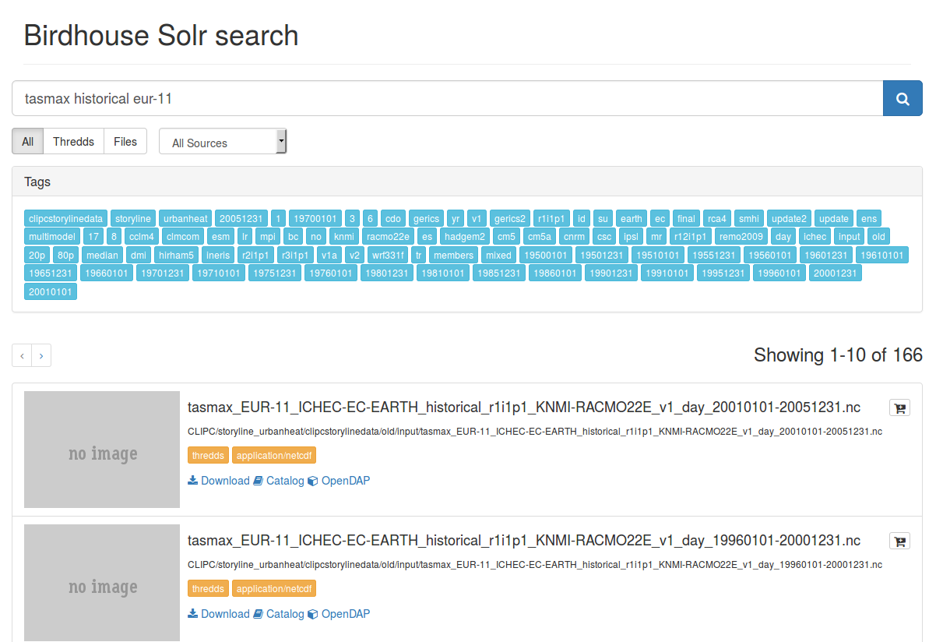
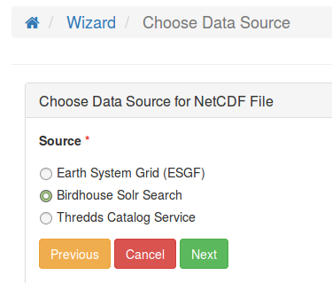
Solr Index for Thredds Catalogs (bird-feeder)
Run bird-feeder to create Solr Search Index for Thredds Data Catalogs and local filesystems.
Wizard:
Choose Solr Search of Thredds Catalog as Input Source
Preview

Slide 12
..
Additional slides

Slide 13
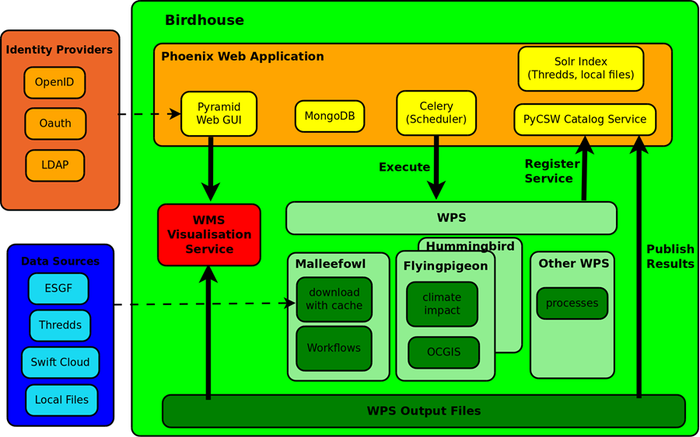
The Birdhouse approach

