Slide 1
birdhouse: a collection of web processing services for climate data
Carsten Ehbrecht¹, Nils Hempelmann² et. al.
1. German Climate Computing Center, Germany
2. Le Laboratoire des Sciences du Climat et de l'Environnement, France

Slide 2
Climate Data volume grows quickly
But on client side:
Limited storage/compute capacities
“download and
process at home”
Processing
in or close to
Data archives
Web Processing Service
Submit jobs on a Server
close to the data

Slide 3

Server-Client Side
Server - Side
Client - Side
Birdhouse
WPS
for
Climate model data analyses
Submit
Job
Data
Data
Monitor
Expert
Outputs

Slide 4

Birdhouse - Ecosystem
https://github.com/bird-house/
Security - Twitcher
ESGF
Climate
Model
Data
WPS - GUI
Phoenix
Catalogue Service for the Web (CSW)
Register
Link
Web Mapping Service
(ncWMS)
WPS
Flyingpigeon
Climate Impact
Extreme Events
WPS
Hummingbird
Data
Quality Checker
WPS
Malleefowl
ESGF
Search & Fetch
Other WPS
OGC-based
External
Services
Other
Data
Archives
Local Data
Storage
Publish
Results
Process Outputs

Slide 5
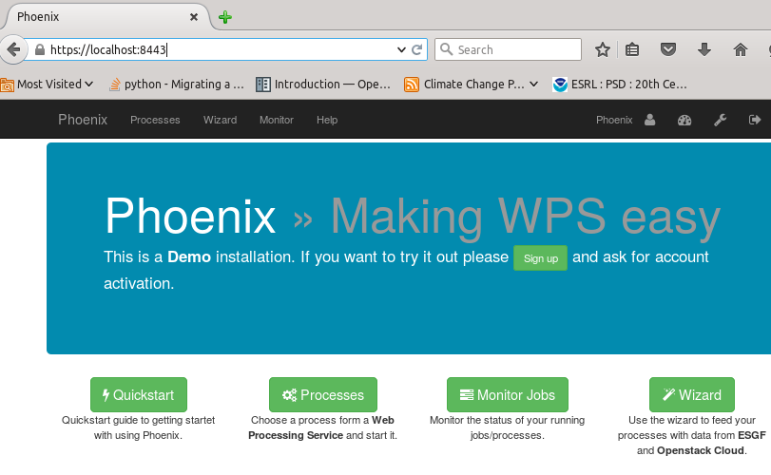
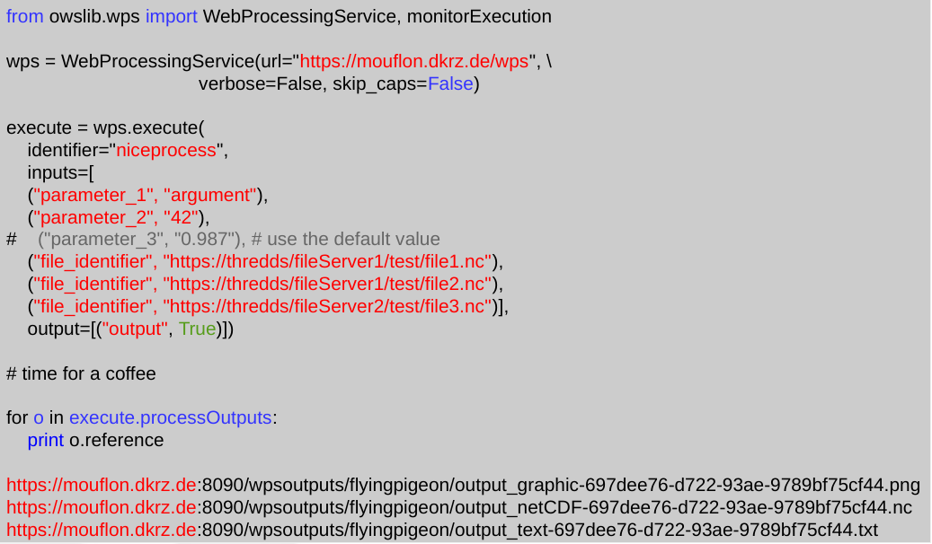
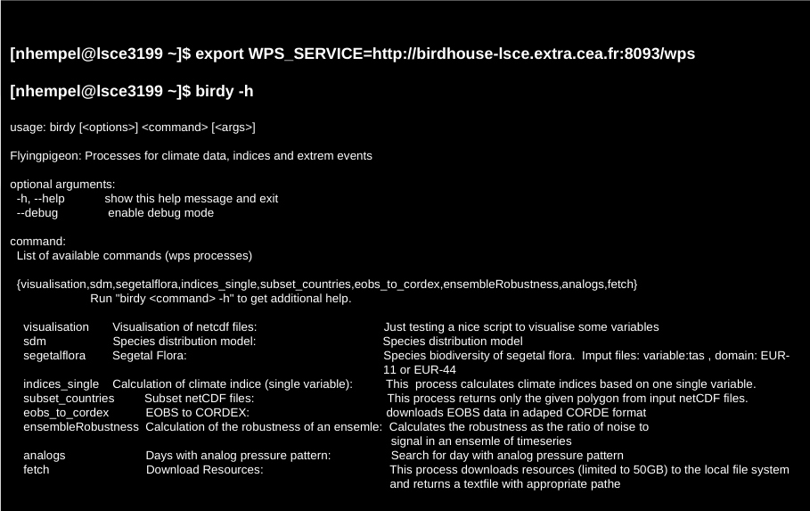
Client Side
Web Browser
GUI
Authentication with
OAuth or OpenID
Script language
Terminal Call
Token autentication

Slide 6
Security
GUI
Terminal or
Script language
Basic
Authentication
Token
Authentication
Twitcher
Token generation and
Service registration
( XML-RPC API )
WSGI Application Server
( gunicorn )
Access Token Storage
( MongoDB )
OWS Security Middleware
( WSGI, Tween )
Token Validation
OWS Service Registry
OWS Proxy
( WSGI App )
Get Service URL
Registration
Service
( WPS / WMS )
Delegation

Slide 7
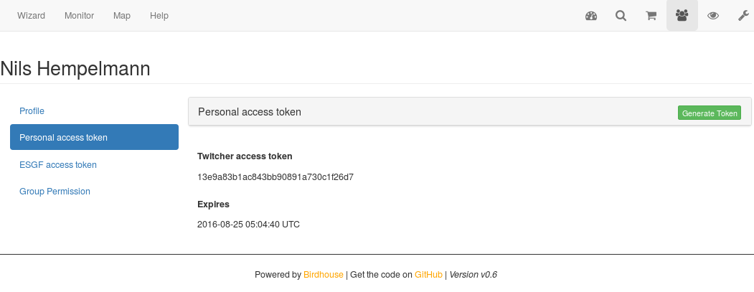
Security Token

Slide 8
Python Call
from owslib.wps import WebProcessingService, monitorExecution
wps = WebProcessingService(url="https://mouflon.dkrz.de/wps", \
verbose=False, skip_caps=False,)
execute = wps.execute(
identifier="niceprocess",
inputs=[
("parameter_1", "argument"),
("parameter_2", "42"),
# ("parameter_3", "0.987"), # use the default value
("file_identifier", "https://thredds/fileServer1/test/file1.nc"),
("file_identifier", "https://thredds/fileServer1/test/file2.nc"),
("file_identifier", "https://thredds/fileServer2/test/file3.nc")],
output=[("output", True)])
# time for a coffee
### output
for o in execute.processOutputs:
print o.reference
https://mouflon.dkrz.de:8090/wpsoutputs/flyingpigeon/output_graphic-697dee76-d722-93ae-9789bf75cf44.png
https://mouflon.dkrz.de:8090/wpsoutputs/flyingpigeon/output_netCDF-697dee76-d722-93ae-9789bf75cf44.nc
https://mouflon.dkrz.de:8090/wpsoutputs/flyingpigeon/output_text-697dee76-d722-93ae-9789bf75cf44.txt

Slide 9
Terminal Call
[nhempel@lsce3199 ~]$ conda install -c birdhouse birdhouse-birdy
[nhempel@lsce3199 ~]$ export WPS_SERVICE=http://your.computeprovider.de:8093/wps
[nhempel@lsce3199 ~]$ birdy -h
usage: birdy [<options>] <command> [<args>]
Flyingpigeon: Processes for climate data, indices and extreme events
optional arguments:
-h, --help show this help message and exit
--debug enable debug mode
--token TOKEN, -t TOKEN
Token to access the WPS service.
command:
List of available commands (wps processes)

Slide 10
Terminal Call
[nhempel@lsce3199 ~]$ birdy –token 0c6d305b0f42452cbdcf31c7ac74f1e1 \ analogs_detection --experiment 'NCEP_slp'
INFO:Execution status: ProcessAccepted
INFO:Execution status: ProcessStarted
INFO:Execution status: ProcessSucceeded
INFO:Output:
INFO:analogs=http://localhost:8090/wpsoutputs/flyingpigeon/analogs-08bce60c-6a41-11e6-be7a-8fdf4b12fcf5.txt (text/plain)
INFO:config=http://localhost:8090/wpsoutputs/flyingpigeon/config-08bce60c-6a41-11e6-be7a-8fdf4b12fcf5.txt (text/plain)
[nhempel@lsce3199 ~]$

Slide 11

Deployment with conda and buildout
Using conda package manager to setup an
environment with all used software components
(python, R, matplotlib, PyWPS, ...)
Using buildout to setup PyWPS with all services
(supervisor, gunicorn, nginx) and configuration
files.
To install a Bird just run :
$ git clone ...
$ make install
$ make start
http://conda.pydata.org/docs/
http://www.buildout.org/en/latest/
http://birdhouse.readthedocs.io/en/latest/installation.html

Slide 12
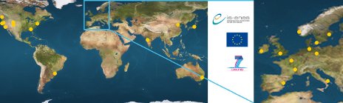
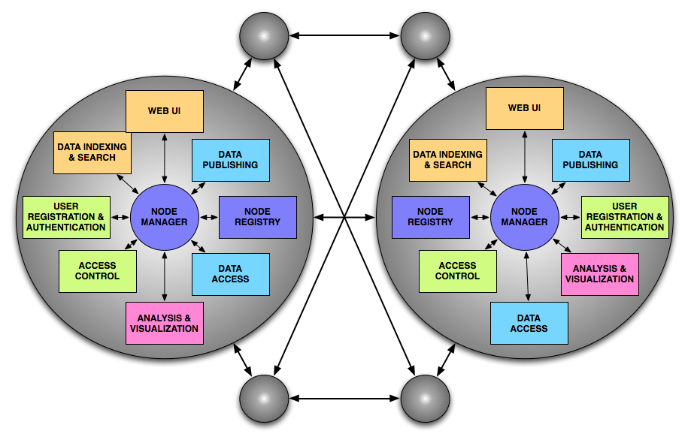
Earth System Grid Federation
https://esgf-data.dkrz.de/

Slide 13
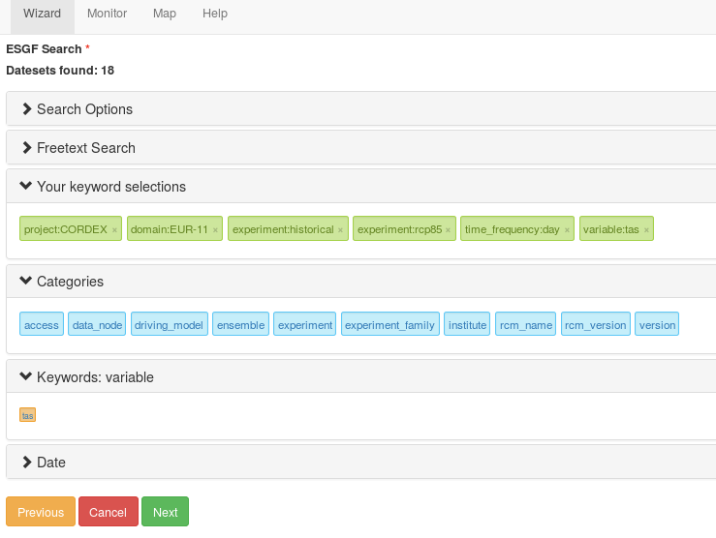
ESGF – search

Slide 14
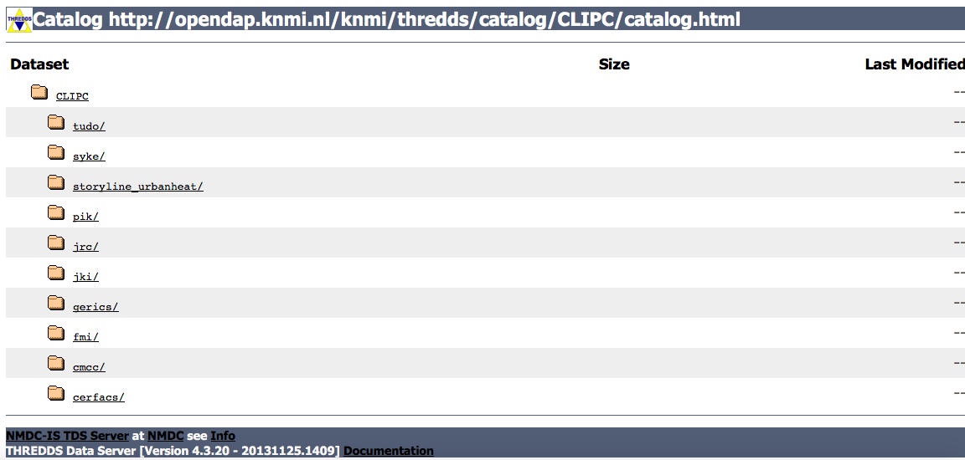
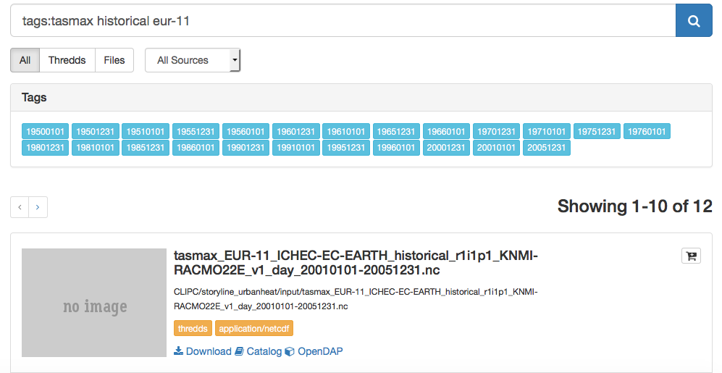
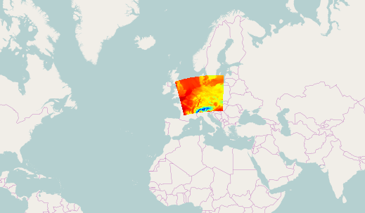
Solr Index for Thredds Data Catalogs
Run bird-feeder to create Solr search
Index for Thredds Data Catalogs
Select data in solr search view
and run process
Subsetting

Slide 15
Hummingbird – quality checks for netCDF Data (technical)
NetCDF Metadata - Retrieve Metadata of NetCDF File
CF Checker by NCAS Computational Modelling Services (NCAS-CMS) - The NetCDF Climate Forcast Conventions compliance checker. This process allows you to run the compliance checker to check that the contents of a NetCDF file comply with the Climate and Forecasts (CF) Metadata Convention. The CF-checker was developed at the Hadley Centre for Climate Prediction and Research, UK Met Office by Rosalyn Hatcher. This work was supported by PRISM (PRogramme for Integrated Earth System Modelling). Development and maintenance for the CF-checker has now been taken over by the NCAS Computational Modelling Services (NCAS-CMS). If you have suggestions for improvement then please contact Rosalyn Hatcher at NCAS-CMS (r.s.hatcher@reading.ac.uk).
CF Checker by DKRZ - The NetCDF Climate Forcast Conventions compliance checker by DKRZ. This process allows you to run the compliance checker to check that the contents of a NetCDF file comply with the Climate and Forecasts (CF) Metadata Convention. The CF Conformance checker applies to conventions 1.4 -1.7draft. Development and maintenance for the CF-checker is done by the German Climate Computing Centre (DKRZ). If you have suggestions for improvement then please contact Heinz-Dieter Hollweg at DKRZ (hollweg@dkrz.de).
Quality Assurance Checker by DKRZ - The Quality Assurance checker QA-DKRZ checks conformance of meta-data of climate simulations given in NetCDF format with conventions and rules of climate model projects. At present, checking of CF Conventions, CMIP5, and CORDEX is supported. Development and maintenance for the QA checker is done by the German Climate Computing Centre (DKRZ). If you have suggestions for improvement then please contact Heinz-Dieter Hollweg at DKRZ (hollweg@dkrz.de).
IOOS Compliance Checker - The IOOS Compliance Checker is a Python tool to check local/remote datasets against a variety of compliance standards. Each compliance standard is executed by a Check Suite, which functions similar to a Python standard Unit Test. A Check Suite runs one or more checks against a dataset, returning a list of Results which are then aggregated into a summary. Development and maintenance for the compliance checker is done by the Integrated Ocean Observing System (IOOS).

Slide 16
Flyingpigeon - - Climate Impact and extrem events
Subset continents - Returns only the selected polygon for each input dataset
Subset countries - Returns only the selected polygon for each input dataset
Subset Points - Extract Timeseries for specified coordinates from gridded datasets
Climate indices -- Simple - Climate indices based on one single input variable.
Climate indices -- Percentile - Climate indices based on one single input variable and the percentile of a reference period.
Weather Regimes -- Reanalyses data - Weather Regimes based on pressure patterns, fetching selected Realayses Datasets
Weather Regimes -- Climate model data - Weather Regimes based on pressure patterns, fetching selected Realayses Datasets
Weather Regimes -- Projection of Weather Regimes - Weather Regimes detection based on trained reference statistics
Analogs -- Detection - Search for days with analog pressure pattern
Analogs -- Viewer - Visualisation of text output of analogue process
Segetal Flora - Species biodiversity of segetal flora. Imput files: variable:tas , domain: EUR-11 or EUR-44
SDM -- GBIF search - Species distribution model for tree species based on GBIF presens/absence data and climate indices
SDM -- csv table - Species distribution model for tree species based on GBIF presens/absence data and climate indices
Timeseries plots - Plots of the filesmeans over time. Spagetti and uncertainty plot
Download Resources - This process downloads resources (limited to 50GB) to the local file system of the birdhouse compute provider

Slide 17
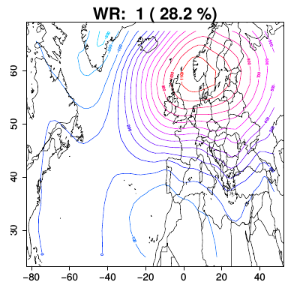
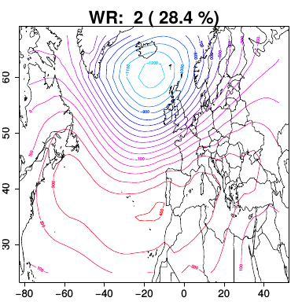
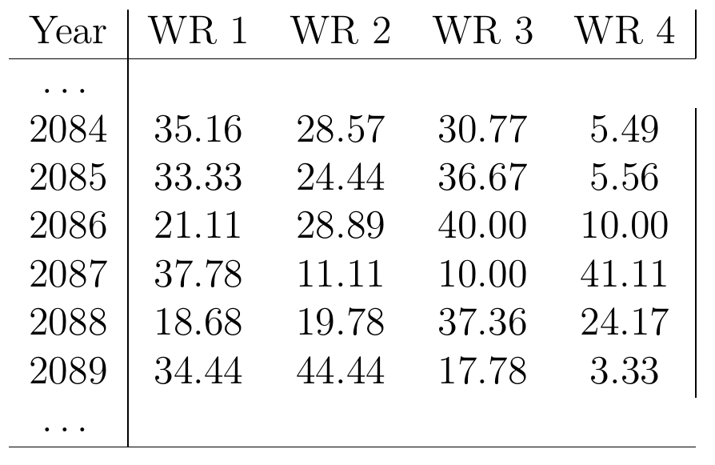
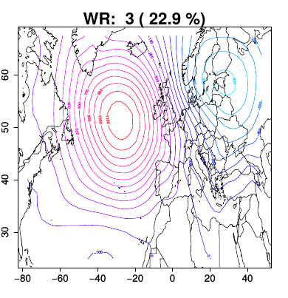
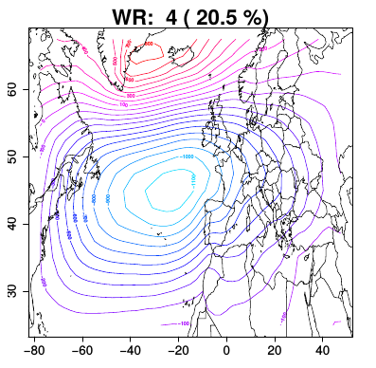
Weather regimes
Trained Weather regimes
Projected on other Dataset

Slide 18
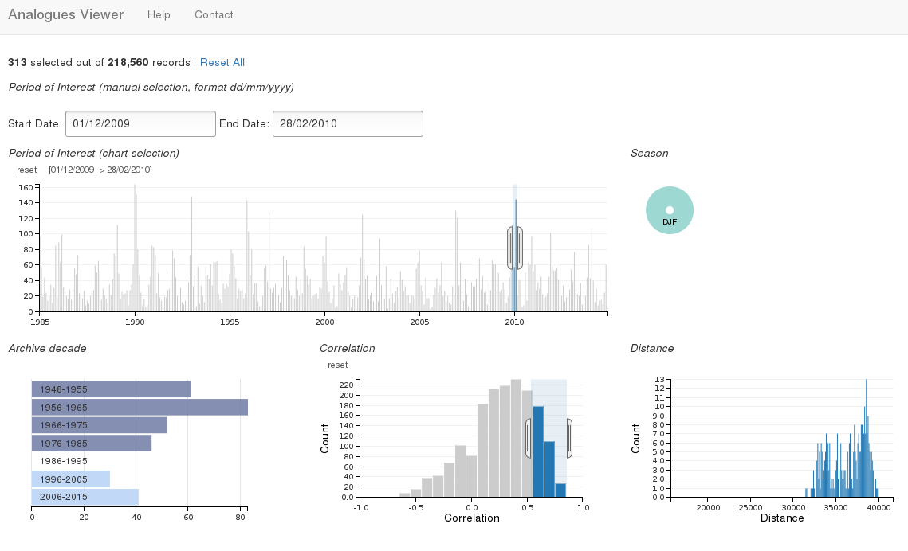
Analogues of atmospheric Circulation
Process
Analogues
Detection
Local
Storage
Data
fetch
Analogues
Results
Sea Surface
Pressure
Geopotential
Height
Process
Analogues
Viewer

Slide 19
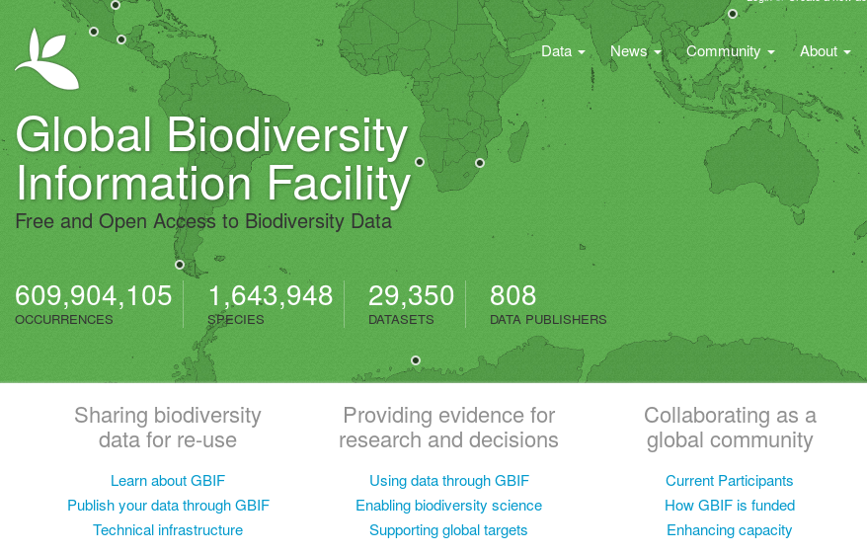
non climate Data

Slide 20
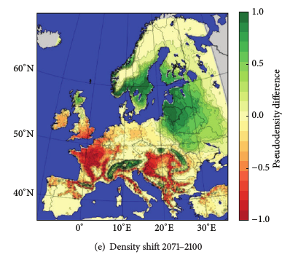
Tree Species distribution model
Climate
Data
Temperature
Precipitation
Process
Species
Distribution
Model
Climate
Indices
Probability
Favorability
Reference
Period
GBIF
Tree
Occurence
Trained
Statistics
PA - Matrix
http://www.gbif.org/
Falk et al. 2013

Slide 21
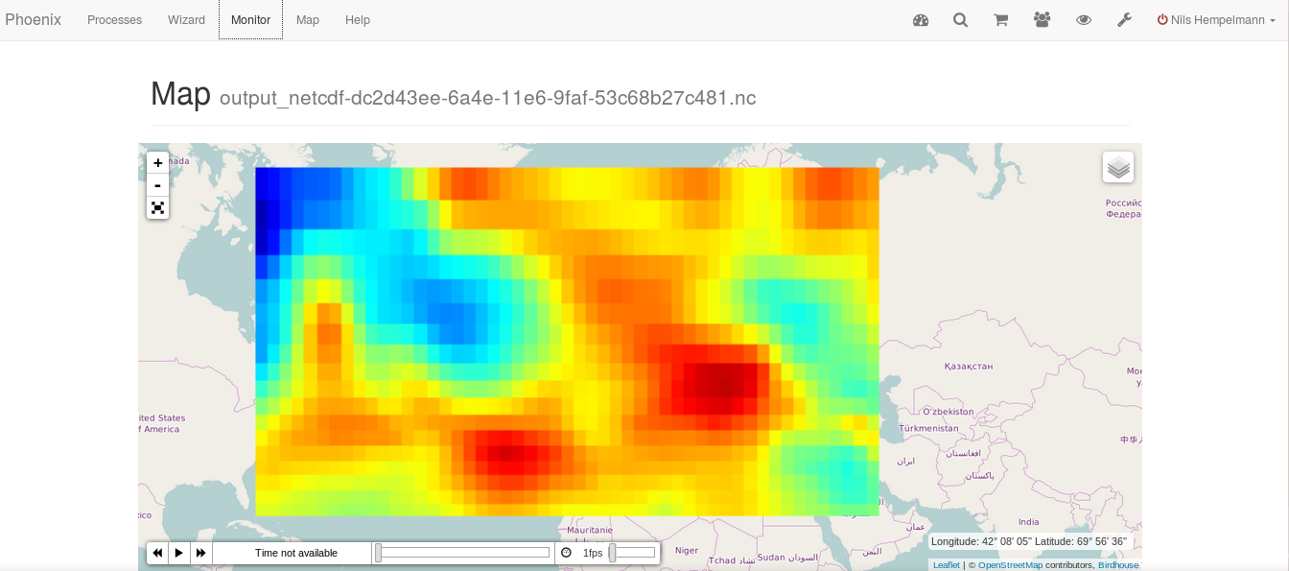
Web Mapping Server

Slide 22
https://github.com/bird-house
http://birdhouse.readthedocs.org/en/latest/
https://gitter.im/bird-house/birdhouse
https://lists.dkrz.de/mailman/listinfo/wps
https://lists.dkrz.de/mailman/listinfo/wps-dev
DEMO GUI: https://mouflon.dkrz.de

Slide 23

Contact :
ehbrecht[a]dkrz.de
info[a]nilshempelmann.de
Thanks to :
Carmen Alvarez-Castro, Patrick Brockmann, Carsten Ehbrecht, Wolfgang Falk, Nils Hempelmann, Heinz-Dieter Hollweg, Jörg Hoffmann, Nikolay Kadygrov, Stephan Kindermann, Florian Klemme, Nikolay Koldunov, Ben Koziol, Cathy Nangini, Sabine Radanovics, Seckmag, Robert Vautard, Pascal Yiou , …. , et. al.

