Slide 1
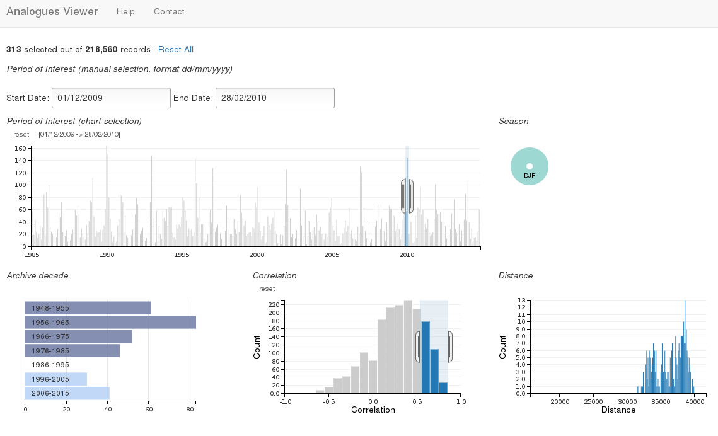
Process
Analogues
Detection
Local
Storage
Data
fetch
Analogues
Results
Sea Surface
Pressure
Geopotential
Height
Process
Analogues
Viewer

