Slide 1






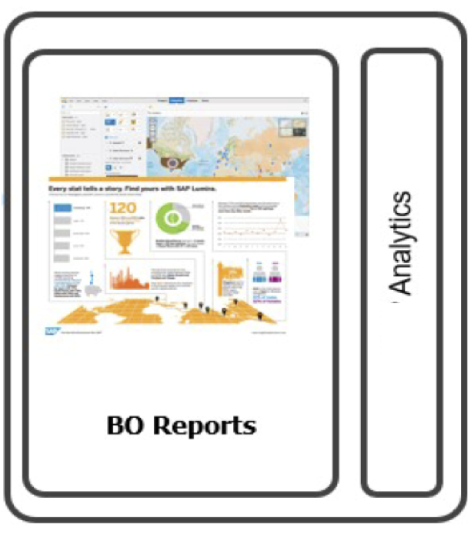
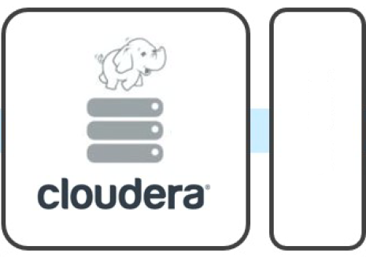








Data Source
Artificial Intelligence (AI)
Product
Dam, River Data
Satellite Images
Big Data
Dam Data
In Memory Data
Platform
Hadoop
Rainfall, Weather forecast
Solution/Application
Land use
GIS
Sharing Report
Thai Water Plan
Water Community
Research
Data Base/Solution/Application

