Slide 1





AI Powered, Full Stack Form Filler
Team :
Tanvika Padole – tanvikapadole.22@stvincentngp.edu.in
Bhumika Soor – bhumikasoor.22@stvincentngp.edu.in
Tanishq Palandurkar – tanishqpalandurkar.22@stvincentngp.edu.in
Guide: Hrishikesh Mahure
Disclaimer: The content is curated for educational purposes only.
Notes:
Slides: Prepare a short slide deck (10-12 slides) summarizing the project objectives, methodology, and key results.

Slide 2
AI Powered, Full Stack Form Filler
OUTLINE
Abstract of the Project
Problem Statement
Proposed Solution
System Architecture
Live Demo of the Project
Embedded Video of Project
Conclusion
Future Scope

Slide 3
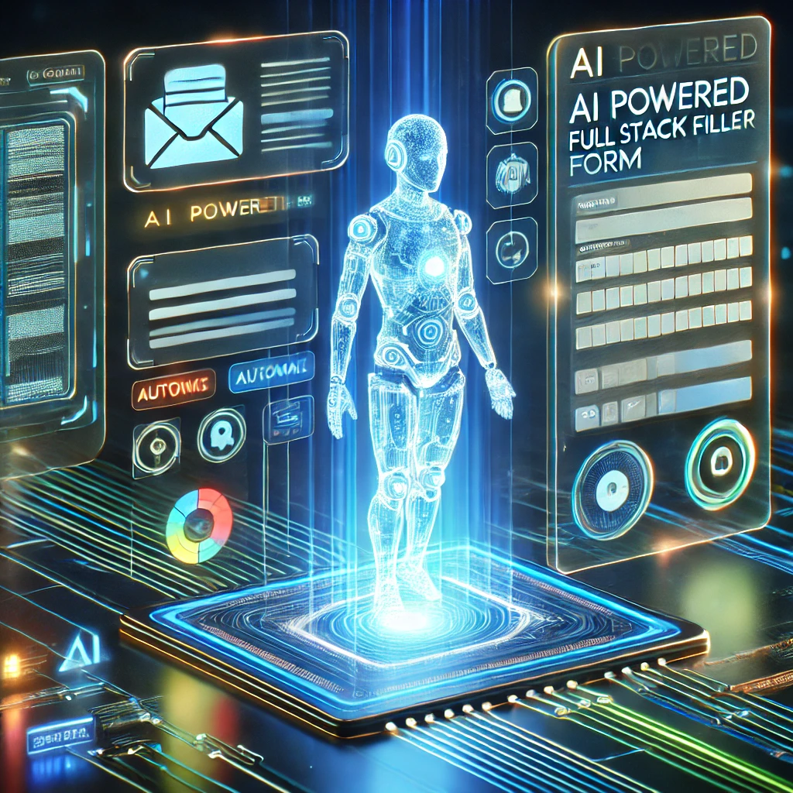
Abstract
AI Powered, Full Stack Form Filler
Applying to many companies might be difficult for fresher, even if they have the necessary qualifications and skills. This tiresome and repeated procedure takes up time and energy that would be better used for interview preparation and skill development. An AI-powered online application is suggested as a solution to this issue, automating the job application procedure.
Users can upload resumes, link their portfolios (e.g., GitHub, LinkedIn), and enter personal information in the application. The software uses Natural Language Processing (NLP) to scrape and analyse the job description after receiving the URL of an application. This allows it to detect important needs such as experiences, qualifications, and talents. The user's data is then intelligently mapped to the job criteria, customising their profile and emphasising pertinent projects and talents.

Slide 4

Problem Statement
AI Powered, Full Stack Form Filler
Fresh graduates often struggle with the repetitive and time-consuming task of applying to hundreds of companies despite being qualified and skilled. To address this challenge, a web app is needed to automate job applications by using their personal information, resumes, and portfolios.This process, which involves filling out extensive forms and manually inputting the same data repeatedly, detracts from their ability to focus on skill-building and interview preparation.

Slide 5
Proposed Solution
AI Powered, Full Stack Form Filler
To address this issue, an AI-powered full-stack web application is developed to automate the job application process. Users submit their personal details, resumes, and portfolio links (e.g., GitHub, LinkedIn). By providing the URL of a job application, the system scrapes and processes the job description using Natural Language Processing (NLP) to identify relevant requirements. It maps the candidate’s skills, experiences, and qualifications to the job criteria and dynamically fills out the application form. The system ensures accuracy, completeness, and customization, reducing manual effort and improving the overall application experience.

Slide 6
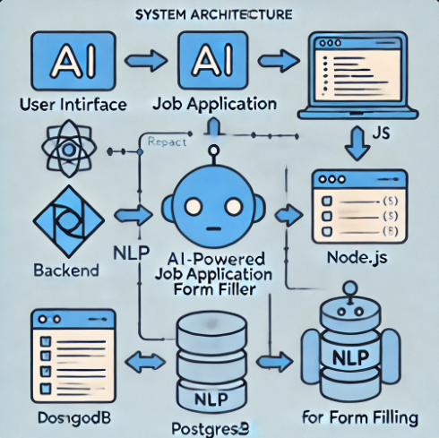
System Architecture
AI Powered, Full Stack Form Filler

Slide 7
Live Demo of Project
AI Powered, Full Stack Form Filler
A live demonstration of the project can be accessed through the following link: github link: https://github.com/birdiegyal/ai-form-filler-monorepo
Project link: https://ai-form-filler-monorepo-frontend.vercel.app/signup
Live demo link: https://drive.google.com/file/d/12ulQY8lt7u0fMj8xaWHs-xYNg5JjPG53/view?usp=drivesdk

Slide 8
Conclusion
AI Powered, Full Stack Form Filler
The AI-powered form filler addresses the inefficiencies faced by freshers during the job application process. By automating repetitive tasks and leveraging personalized data, it allows candidates to focus on building skills and preparing for interviews. This innovative solution simplifies the job search experience and bridges the gap between potential employers and skilled candidates.

Slide 9
Future Scope
AI Powered, Full Stack Form Filler
Integration with Major Job Portals: Extend support for platforms like LinkedIn, Glassdoor, and Indeed for seamless application submission.
Custom Resume Building: Automatically generate tailored resumes for each job application.
Advanced Analytics: Provide insights into market trends, demand for specific skills, and personalized career recommendations.
Mobile App Development: Launch a mobile version for easier accessibility on-the-go.
AI-Driven Interview Preparation: Integrate mock interview features based on job descriptions.
This project has the potential to revolutionize the job application process and make it more accessible and efficient for freshers entering the workforce.

Slide 10
References:
AI Powered, Full Stack Form Filler
For the AI-powered full-stack form filler project, several references can guide both the development and conceptualization. Key research papers, such as "Automated Form Filling using AI and NLP," explore the use of Natural Language Processing (NLP) to automate form filling. Articles like "Web Scraping and Automation Techniques" discuss best practices for data extraction and form handling. The book "Hands-On Natural Language Processing with Python" by Rajesh Arumugam provides valuable insights into building NLP systems, while "Automate the Boring Stuff with Python" by Al Sweigart offers practical guidance on automating repetitive tasks.

Slide 11
AI Powered, Full Stack Form Filler
Thank you!
Notes:
thank you very much for joining this PPT, keep learning.
11

