Slide 1
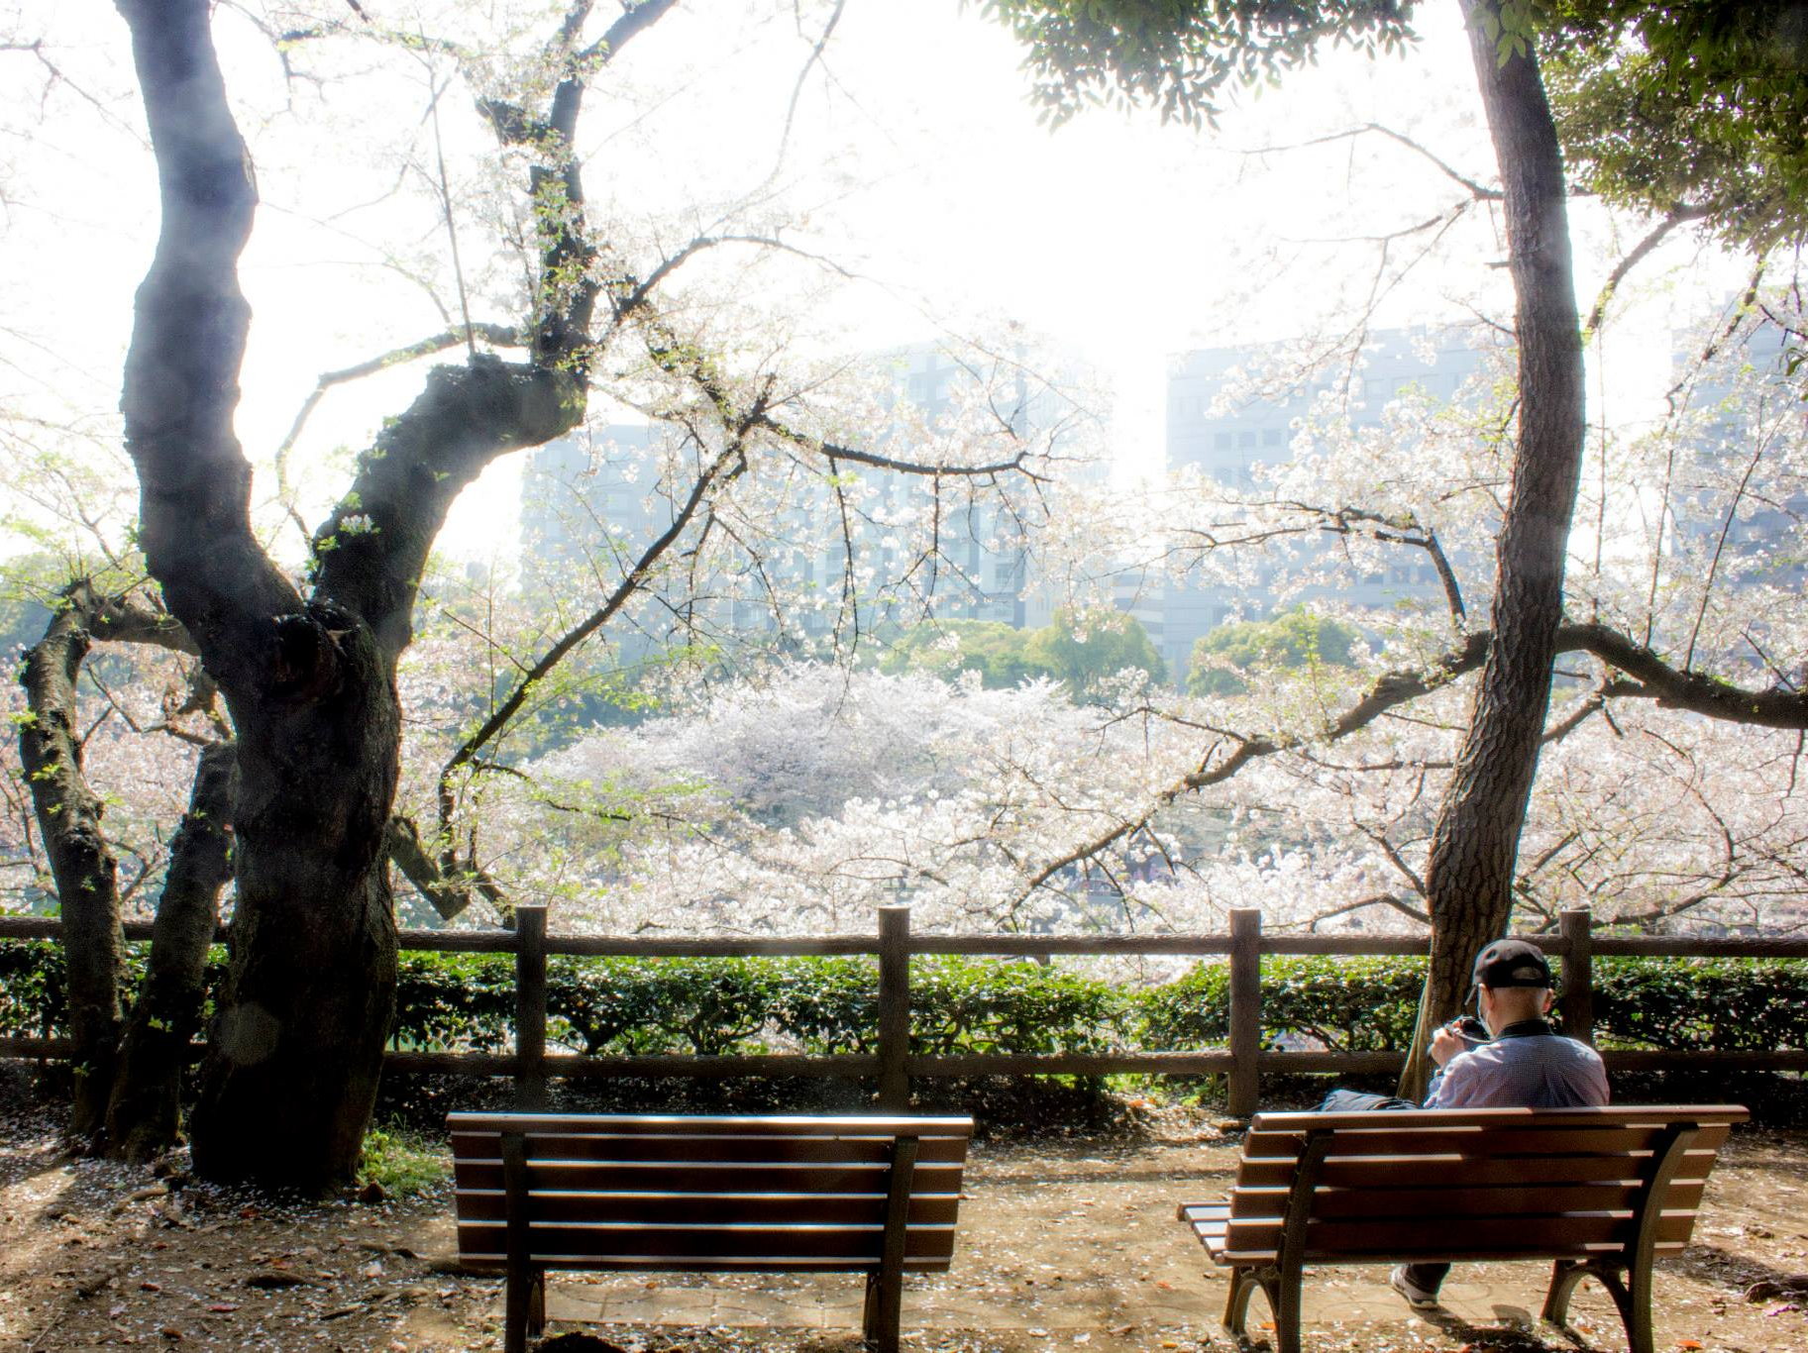
GO – A.I.
Matthew Bird

Slide 2
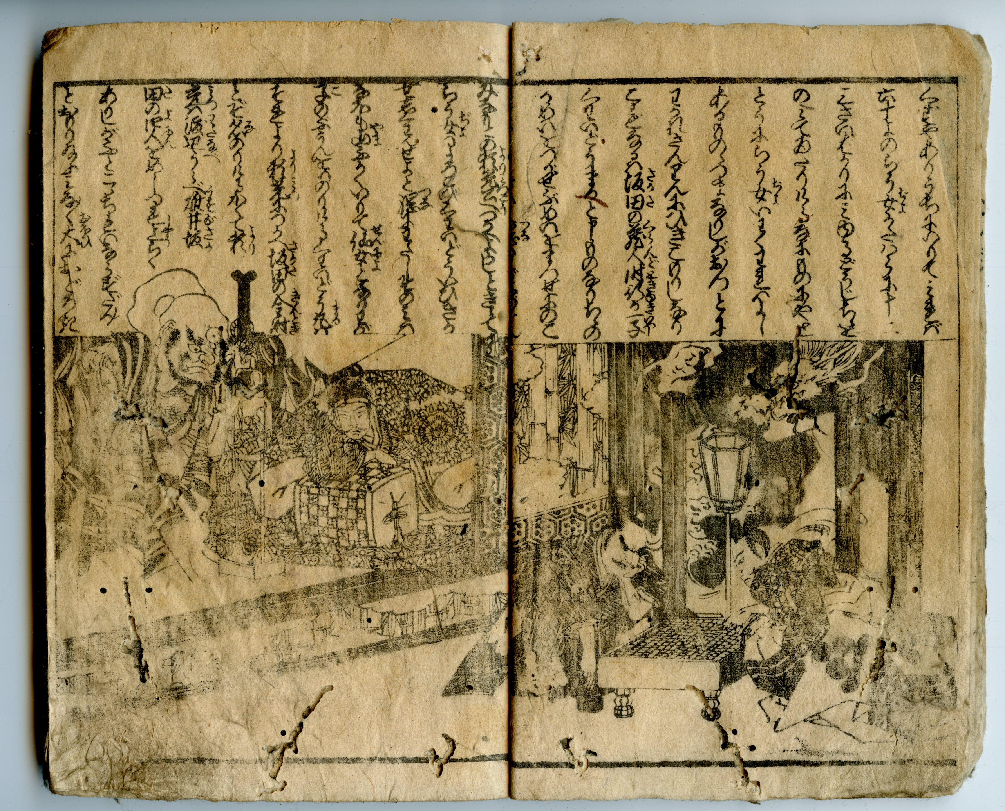
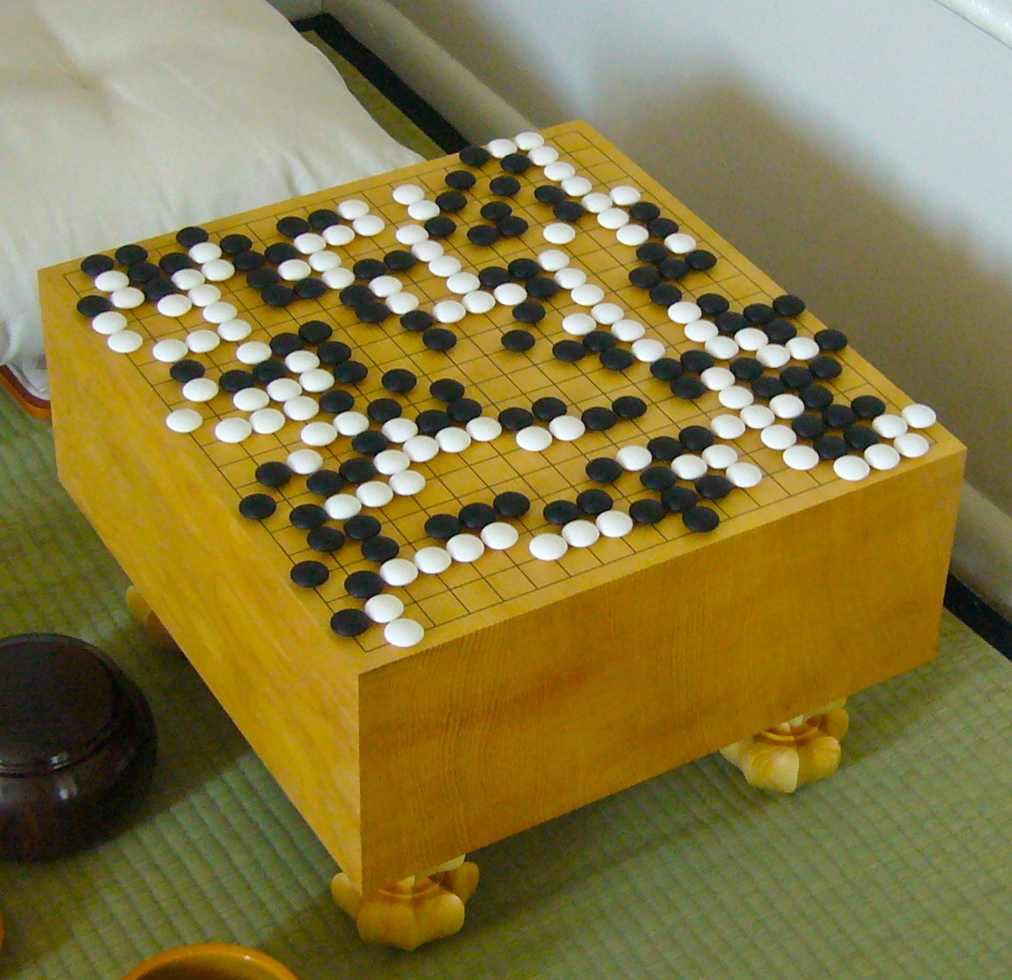
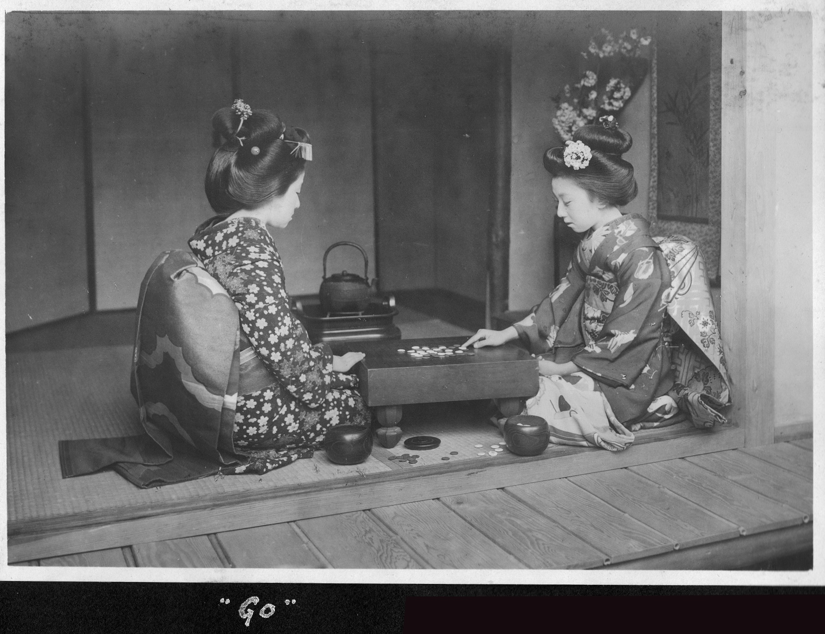
Go
Predates written history
Simplistic binary rule-set
Supercomputers lose to humans
The holy grail of computer science

Slide 3
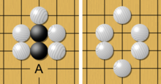
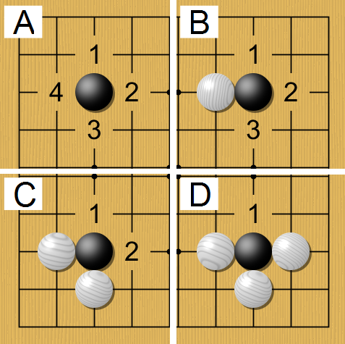
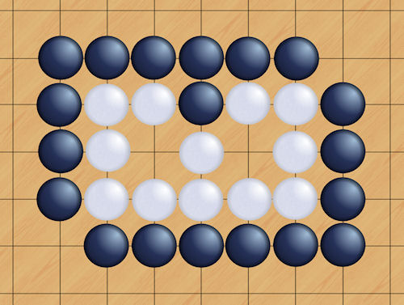
Rules
Capture
Liberties
Life

Slide 4
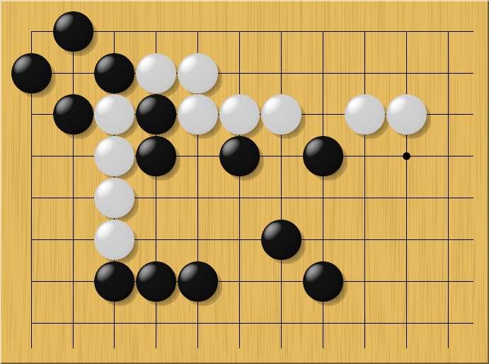



Log Complexity

Slide 5
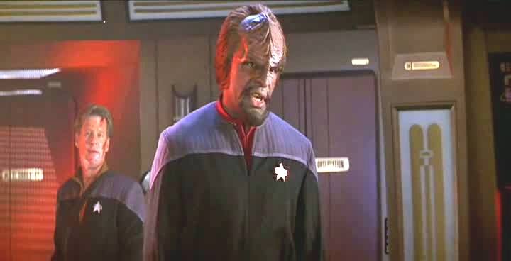
Exhaustive Techniques
OUR WEAPONS ARE USELESS AGAINST THEM!

Slide 6
Today
10dan
Pro Human
Todays Algorithms
Rank
Fuseki (Framework)
Joseki (tight patterns)
10kyu
1
30
Move Number
60

Slide 7
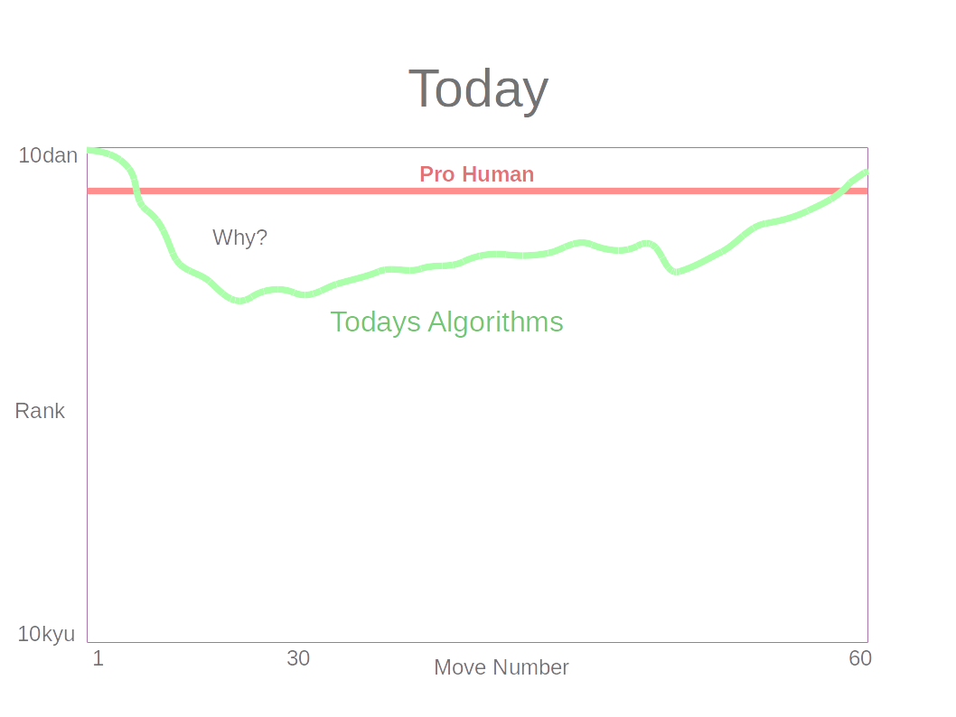
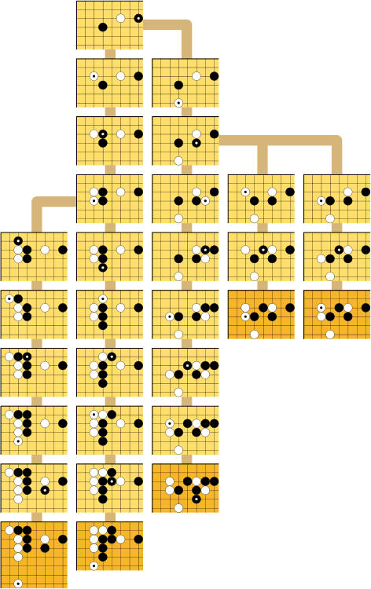
Proverbs
Pattern
Matching
Monte-Carlo
Alpha-Beta Pruning
1
30
Move Number
60

Slide 8
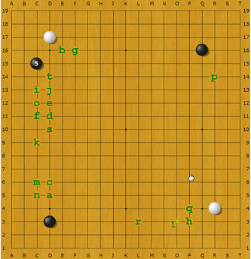
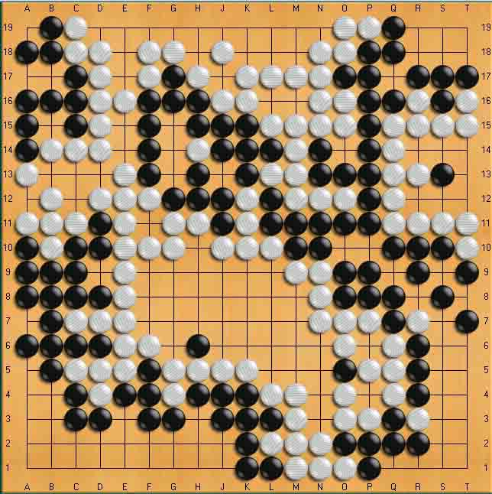
Joseki
Endgame
Fuseki (Framework)
CPU strength
Difficult to find
Important to get right
Smaller space
Suited for Monte-Carlo

Slide 9
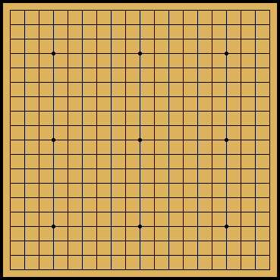
Depth Sliced Modeling
1 game
Random Forest
15
Train
Move count
1
Model # 15
Predict
Model # 16
Potential next move

Slide 10
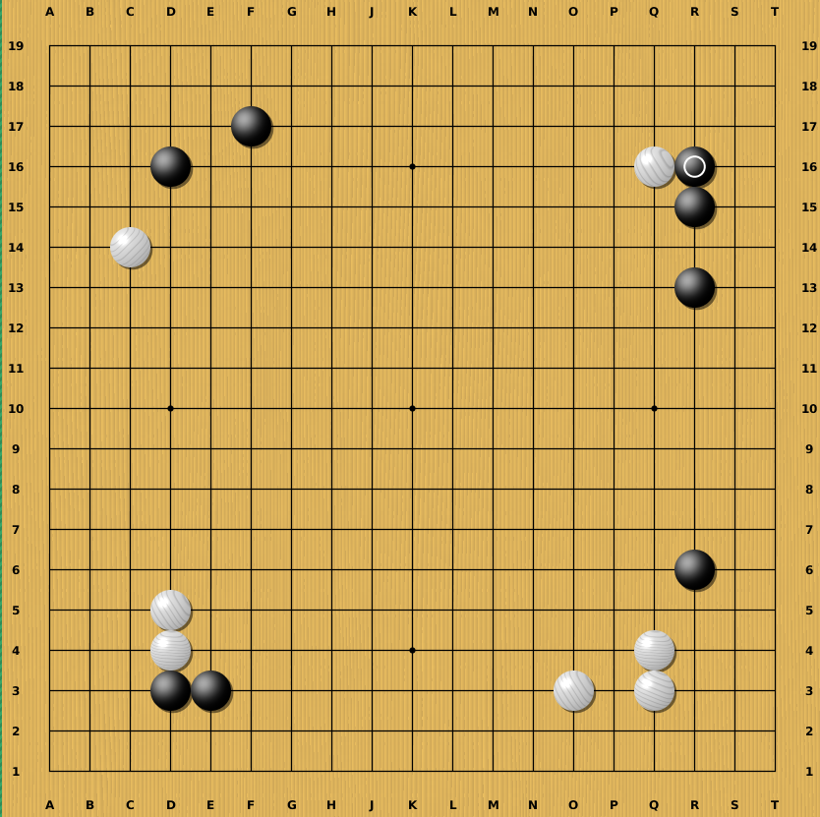
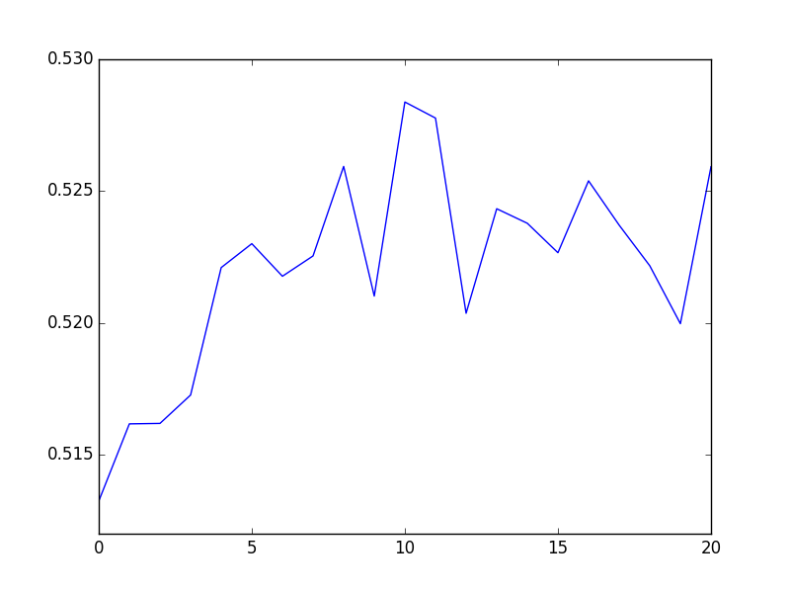
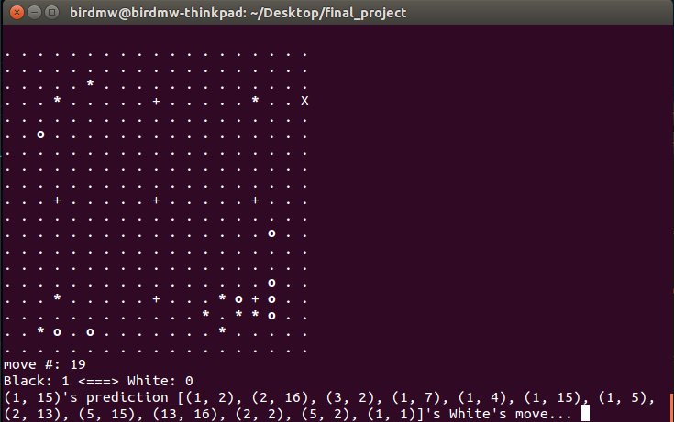
Results
GO-AI vs. Human
Poor Joseki
  Expected but easily remedied
Framework play (Fuseki)
is very strong
AUC
MOVE_COUNT

Slide 11
Next
Prune bad patterns (Joseki)
Look-ahead (alpha-beta pruning)
Guided drilling (multi-arm bandit)
Variable model complexity by depth

Slide 12
Questions?

