Slide 1
Topics
A regional network of Clinical Trials Registries
Requirements and compliance with ICTRP standards and best practices
How the regional platform is being developed

Slide 2
I am Luciano Ramalho...
A new hire at BIREME
  consultant since Aug. 2009, employee Jan. 2010
  software development supervisor
  report to Renato Murasaki (MTI)
A veteran of the Web
  since 1994, as CTO of Brasil Online at Abril S/A, the 1st national news and entertainment portal
A veteran of Open Source
  active contributor since 1998
Library and IS degree (almost)

Slide 3
A regional network of
Clinical Trials Registries

Slide 4
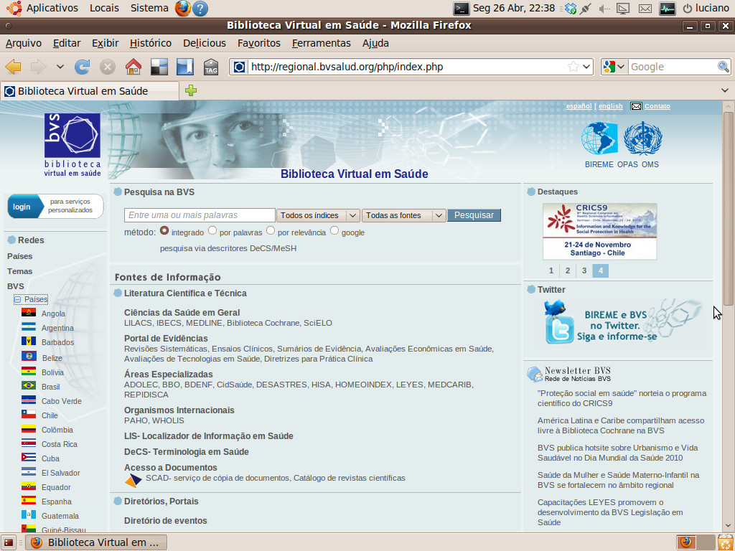
Current LA&C networks

Slide 5
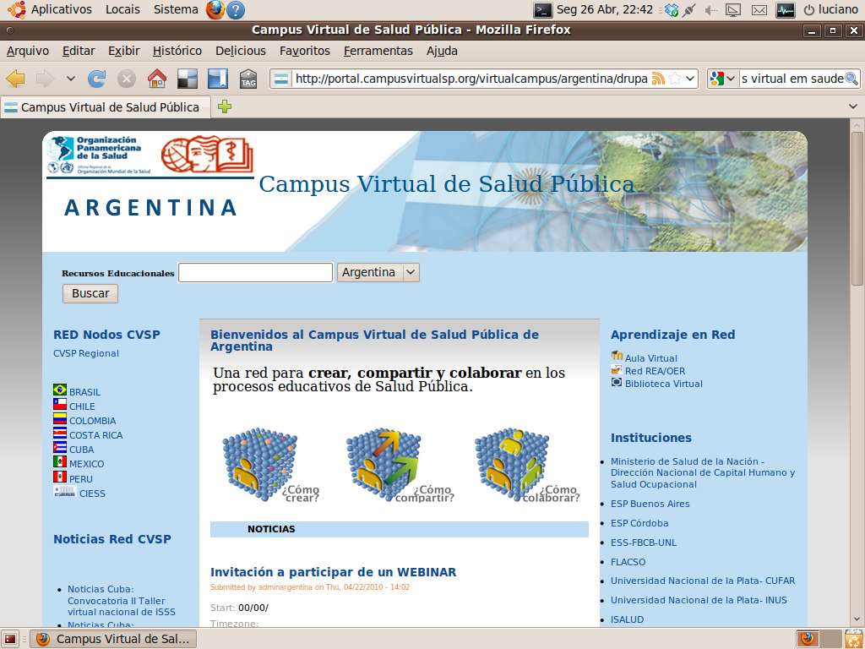

Slide 6
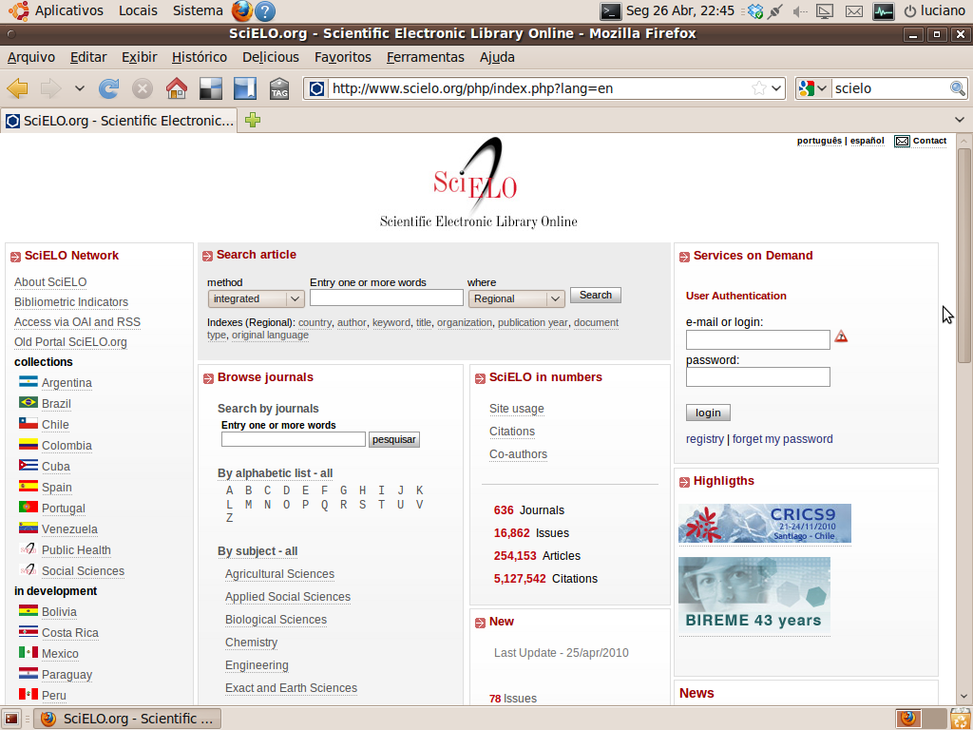

Slide 7
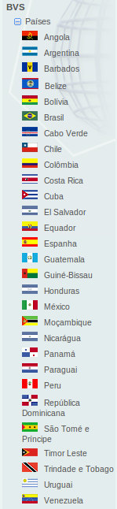
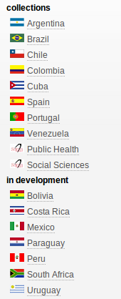
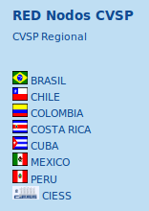
Existing regional networks
Scielo
VHL / BVS
Virtual Campi

Slide 8
A regional network of
Clinical Trial Registries
Following the successful model of VHL, CVSP, Scielo and ScienTI
Countries may choose to host their own registries, or use our hosting facilities
Countries may choose to develop their own software, or adapt and use the open platform we are presenting today
Developing national capabilities to monitor clinical trials

Slide 9
LA&C CTR Platform
Interoperability among countries,
ICTRP/WHO and LA&C CT Repository
CTR Platform
CTR Platform
Country D
Country E
ICTRP/WHO
Repository
LA&C
CT Repository
Hosted at BIREME/PAHO/WHO
CTR Platform
CTR Platform
CTR Platform
Countries C and E do not have
records compliant to ICTRP criteria
Country A
Country B
Country C
LA&C countries

Slide 10
Distribution of CT records
ICTRP/WHO
Repository
LA&C
CT Repository
ICTRP
compliant
records
other
records
(eg. non-English)

Slide 11
Requirements and compliance with
ICTRP standards and best practices

Slide 12
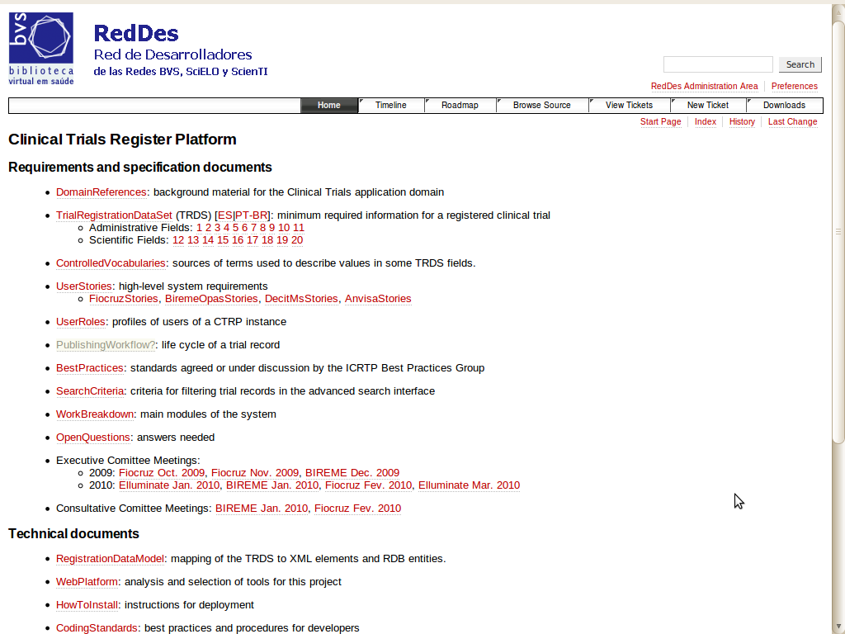
project documentation
and status:
public and live
http://reddes.bvsalud.org/projects/clinical-trials

Slide 13
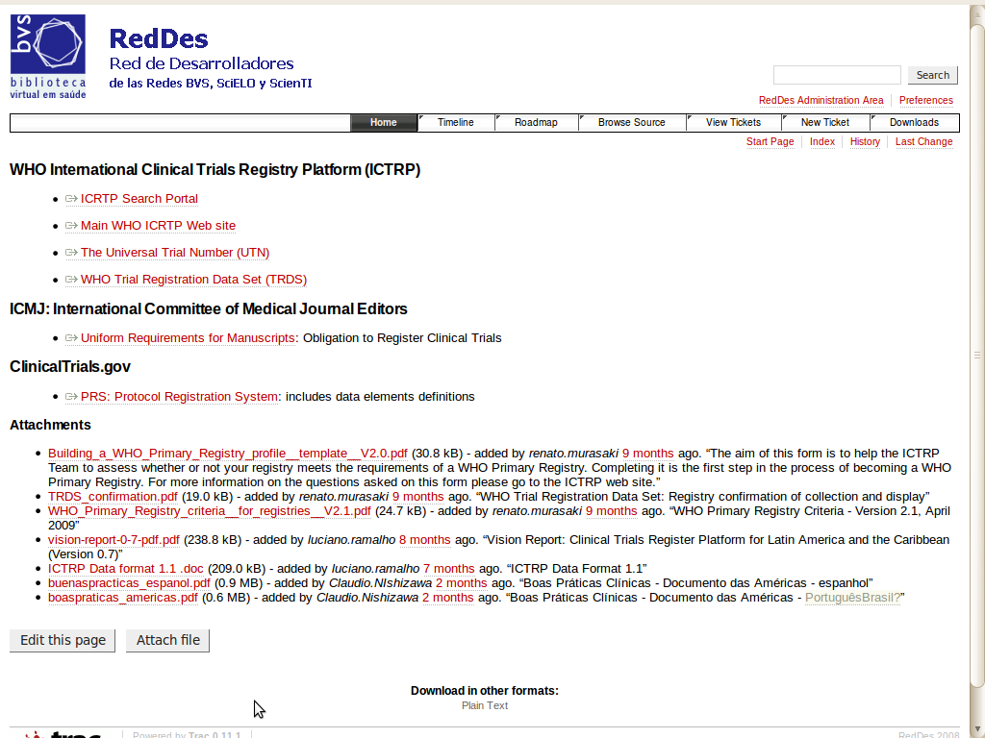
domain
references
http://reddes.bvsalud.org/projects/clinical-trials

Slide 14
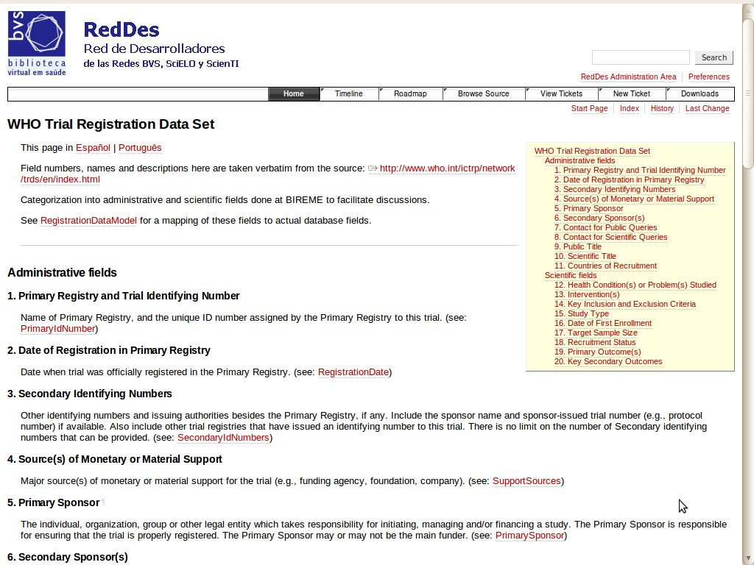
TRDS-20 field
descriptions
in English
http://reddes.bvsalud.org/projects/clinical-trials

Slide 15
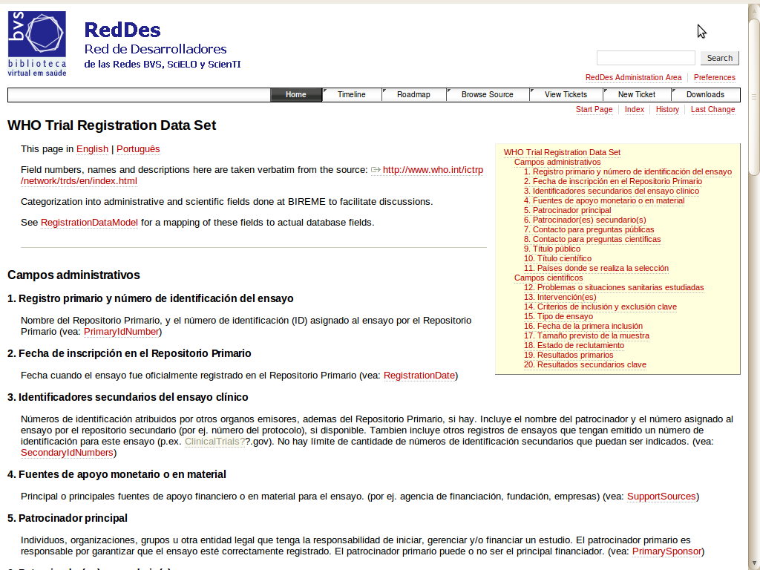
TRDS-20 field
descriptions
in Spanish
http://reddes.bvsalud.org/projects/clinical-trials

Slide 16
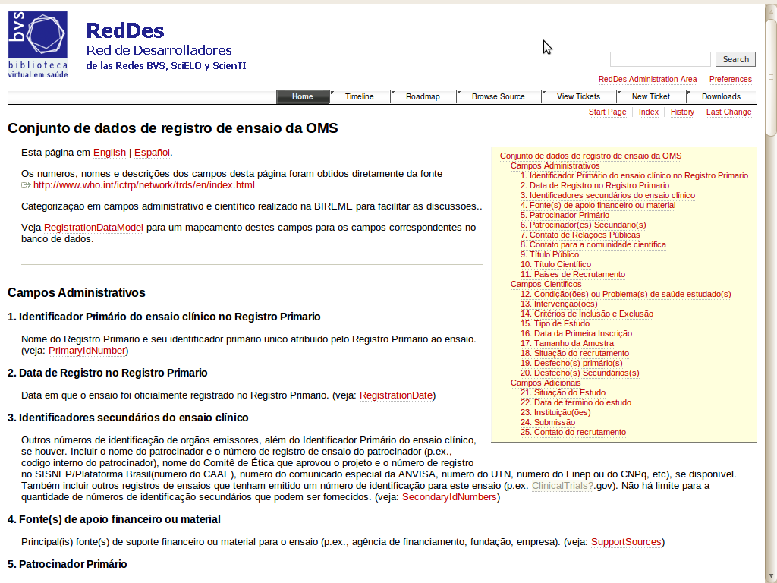
TRDS-20 field
descriptions
in Portuguese
http://reddes.bvsalud.org/projects/clinical-trials

Slide 17
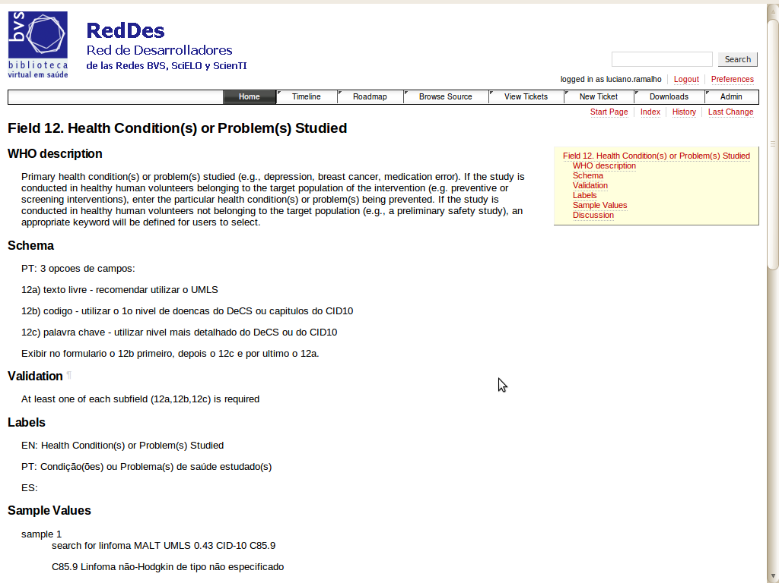
discussion
page for one
of the TRDS
fields

Slide 18
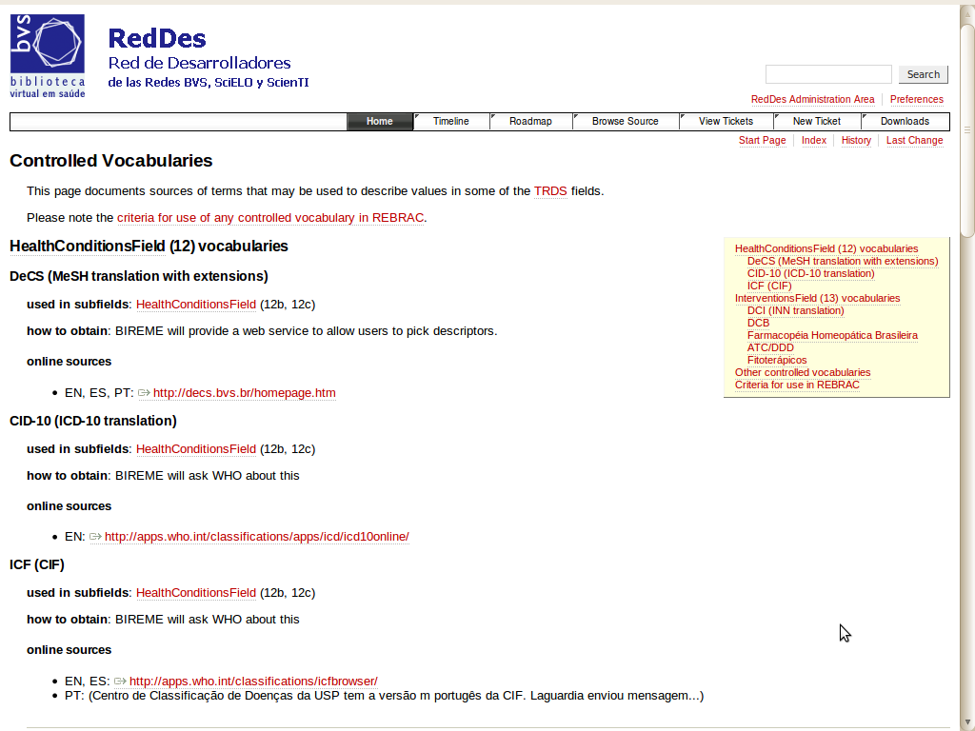
dicussion page
for controlled
vocabularies

Slide 19
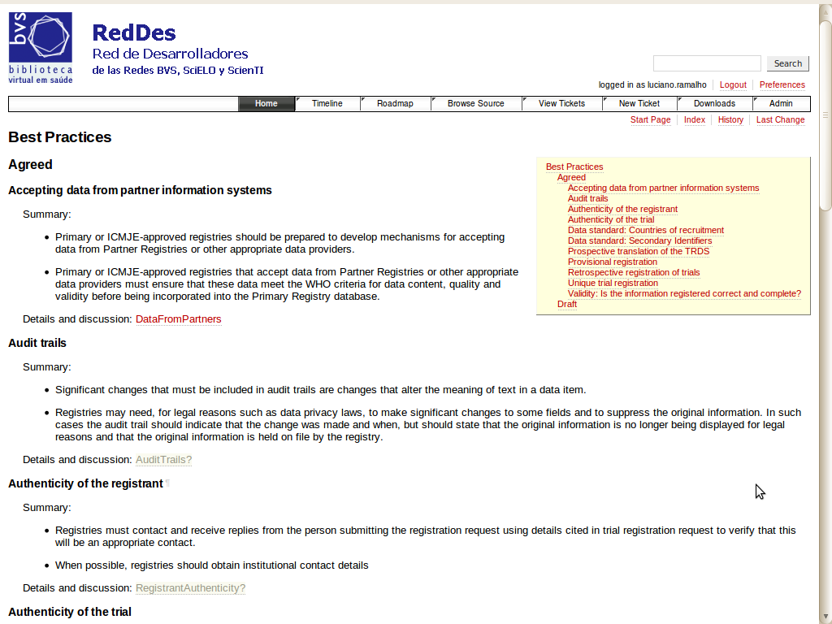
ICTRP best
practices
summary

Slide 20
How the regional platform is being developed

Slide 21
Think regional, act national
Brazilian National Clinical Trials Registry
  EnsaiosClinicos.gov.br
  Currently at http://ec.beta.bvsalud.org
  primary registry but restricted to trials in Brazil
Team
  BIREME, MS, Fiocruz, Anvisa, PAHO office
Funding
  50% PAHO
  50% Ministério da Saúde do Brasil
  and Fiocruz

Slide 22
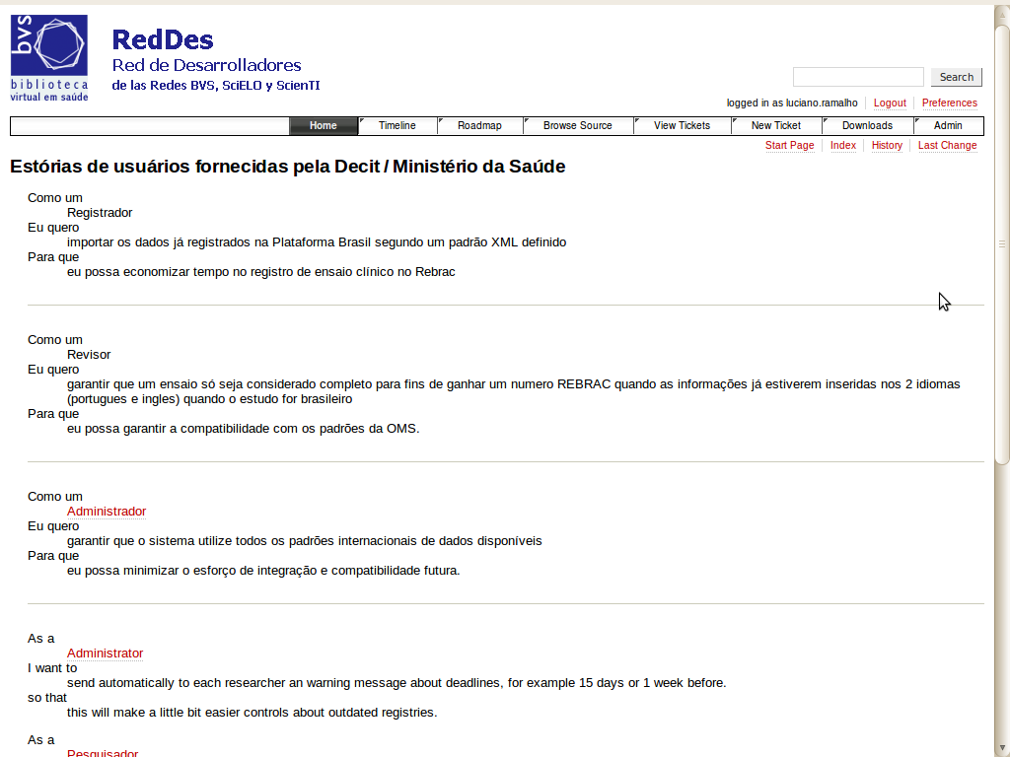
user stories contributed by:
Fiocruz
Ministério da Saúde
ANVISA
BIREME
http://reddes.bvsalud.org/projects/clinical-trials

Slide 23
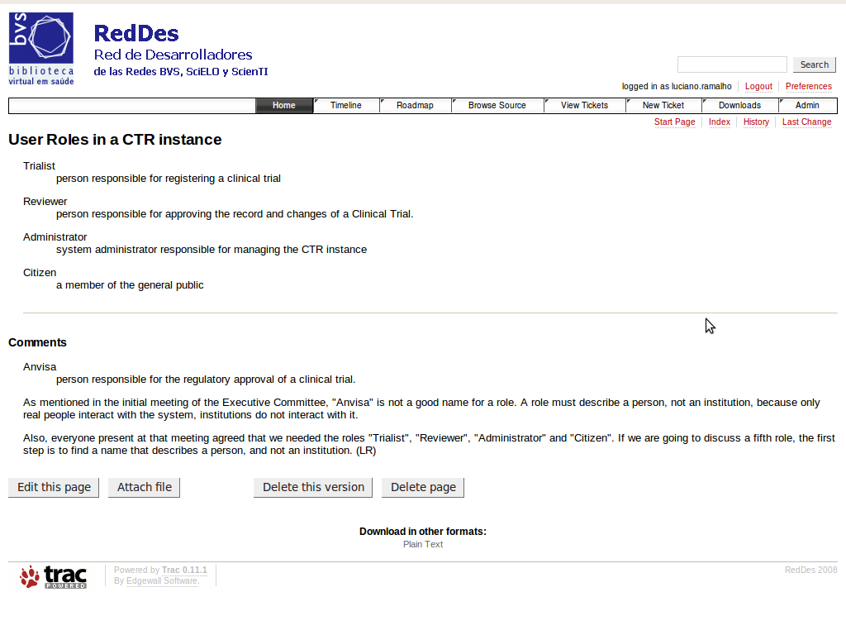
defined user roles:
trialist
reviewer
administrator
citizen (public)

Slide 24
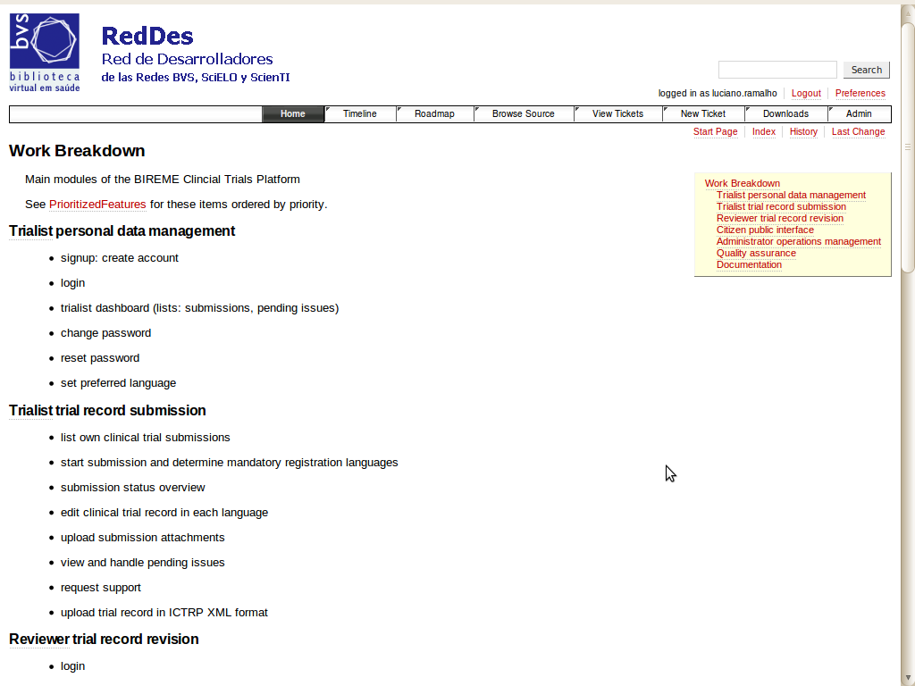
work breakdown
structure: what
needs to be built

Slide 25
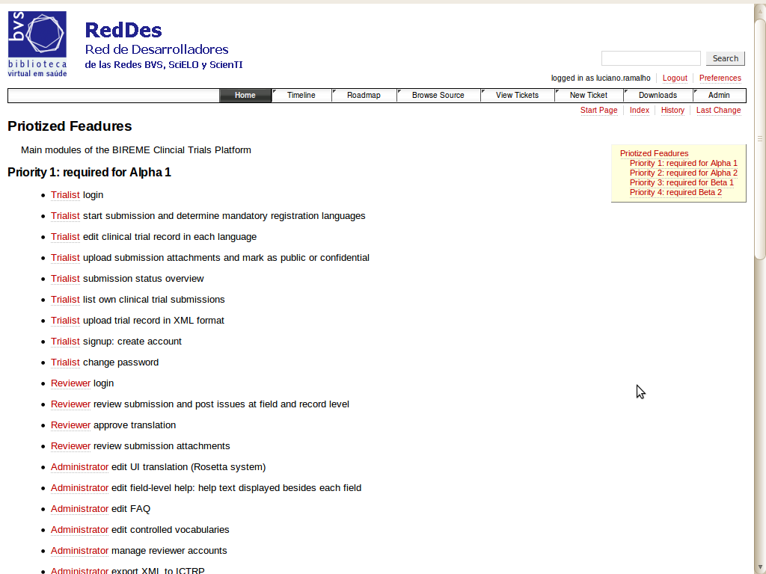
prioritized
work breakdown
structure: what
needs to be built
and when

Slide 26
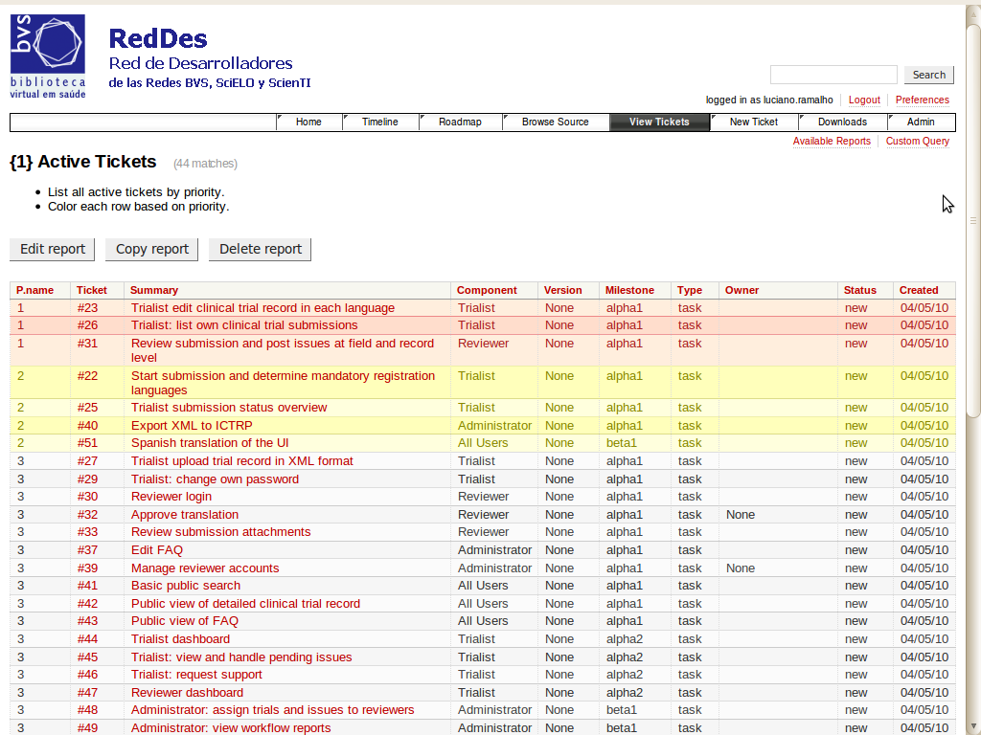
development
tracking:
each ticket is
a feature do be
implemented
or a bug to be fixed

Slide 27
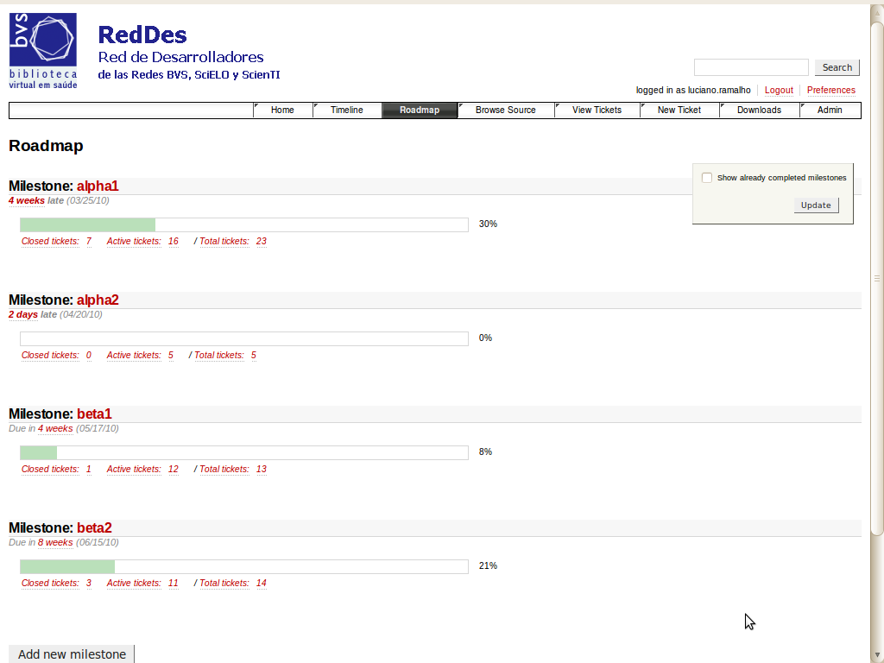
roadmap shows
progress for
each milestone

Slide 28
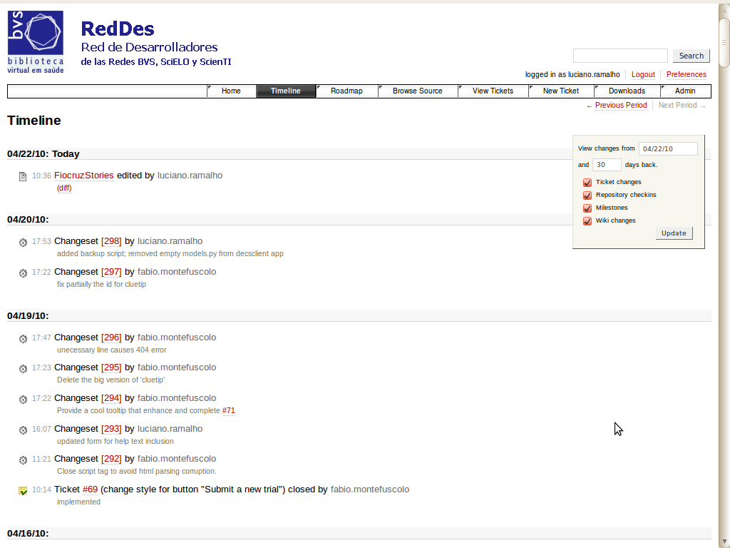
timeline shows
changes to
documentation
and code in
real time

Slide 29
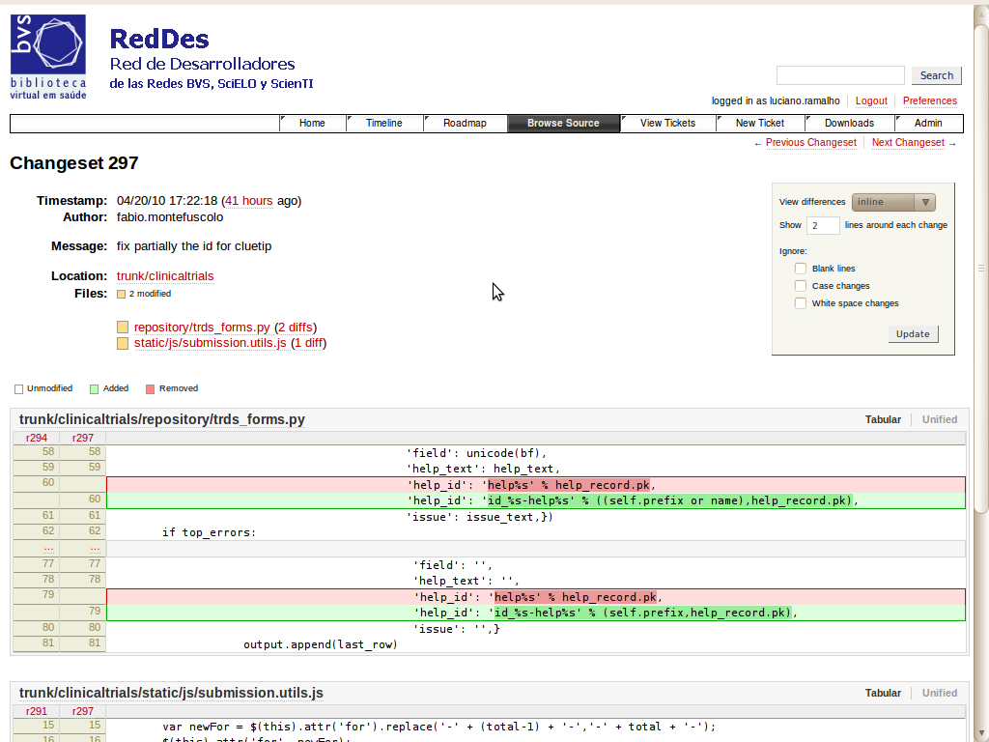
changes are
displayed down
to each line
of code

Slide 30
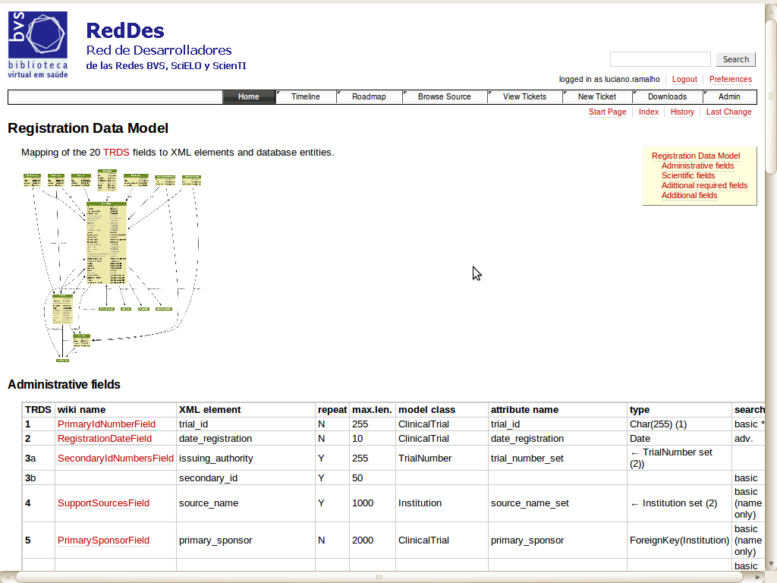
data model:
mapping of
ICTRP XML
fields to
a relational
database
schema

Slide 31
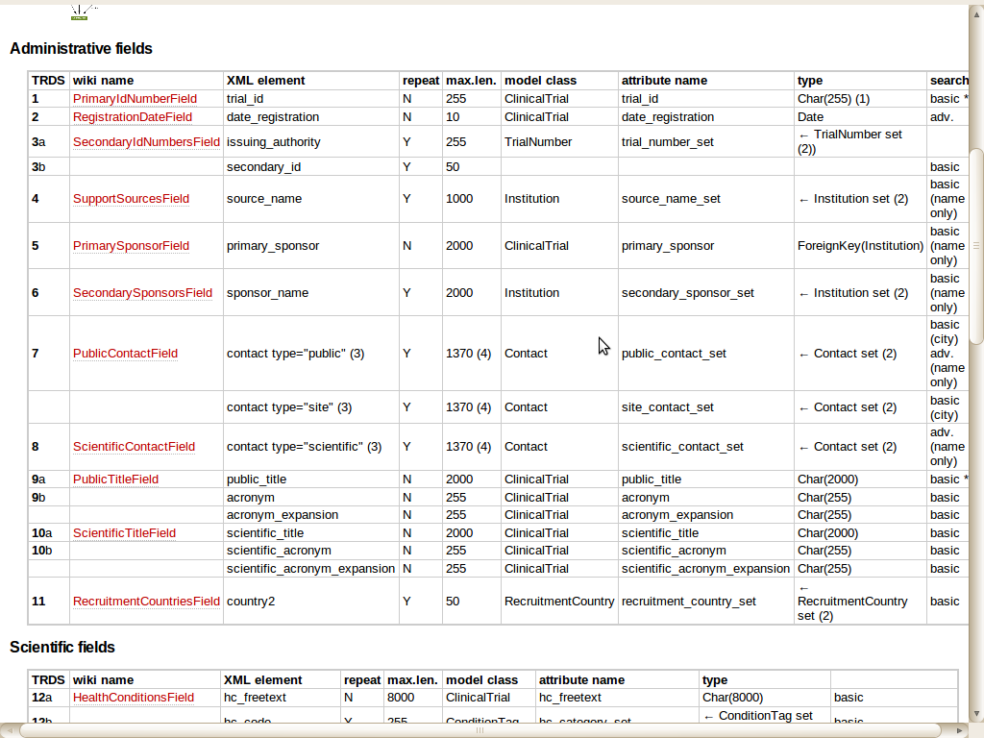
data model:
mapping of
ICTRP XML
fields to
a relational
database
schema

Slide 32
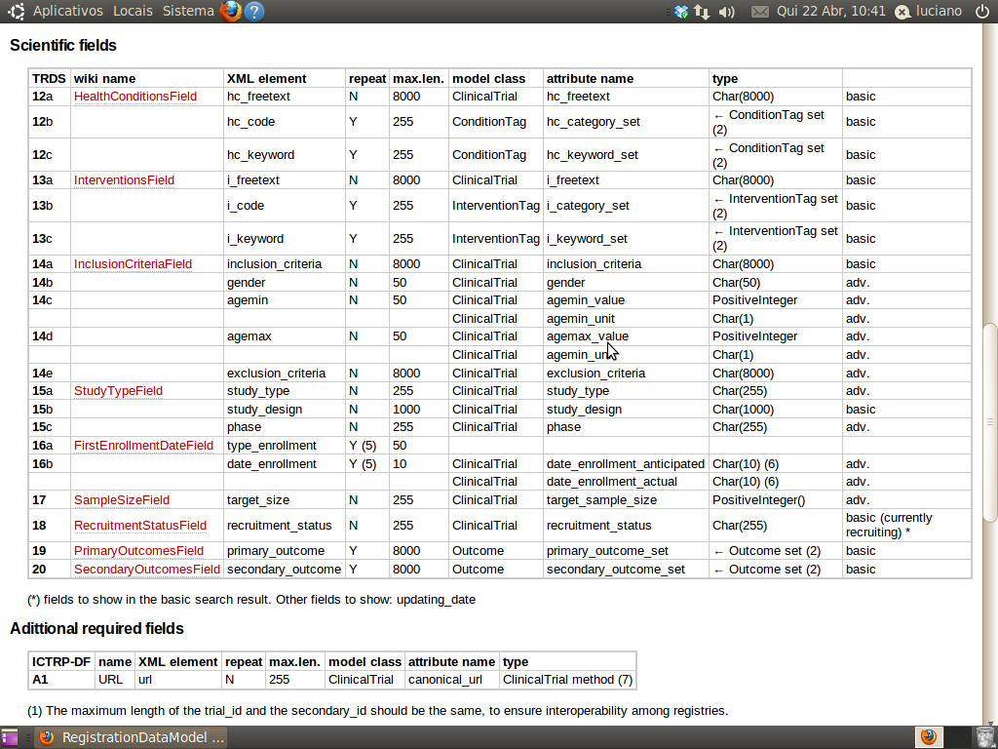
data model:
mapping of
ICTRP XML
fields to
a relational
database
schema
http://reddes.bvsalud.org/projects/clinical-trials

Slide 33
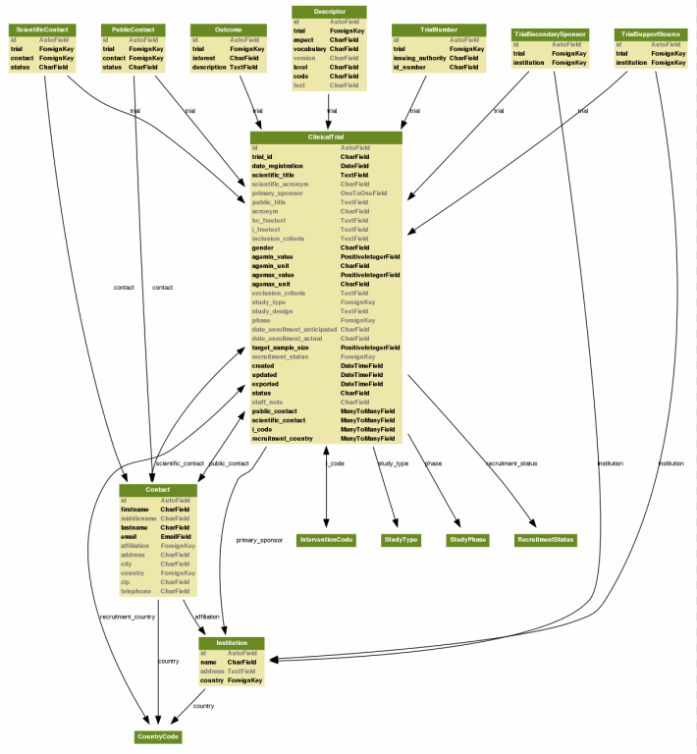
A relational, SQL database
data model:
mapping of
ICTRP XML
fields to
a relational
database
schema

Slide 35
Software foundations
Written in Python, a modern, easy to learn programming language
  used by Google, RedHat, Novell, MIT etc.
Leverages Django, a modern, easy to learn web development toolkit
  used by Washington Post, Tabblo, Focus.com etc.
Relational database storage
  compatible with Oracle, PosgreSQL and MySQL

Slide 36
Software features
Multi-lingual
  user interface and content can be translated to any language or set of languages
  CT registry operators can edit help text, vocabularies etc. at any time
Multi-platform
  runs on any modern computer (Windows, MacOSX, Linux, FreeBSD...)
Modular
  functionality is split into reusable
  modules

Slide 37
Software modules
Field-level
help and
FAQ
Controled
vocabularies
mgmt
CTR
submission
and
review
Trialist
and Reviewer
issue
tracking
CTR
submission
and
review
User
registration
CTR
search
engine
CTR
search
engine
CTR
repository/
data import,
export

Slide 38
Fields which need translation
1. Primary Registry and Trial Identifying Number
2. Date of Registration in Primary Registry
3. Secondary Identifying Numbers
4. Source(s) of Monetary or Material Support
5. Primary Sponsor
6. Secondary Sponsor(s)
7. Contact for Public Queries
8. Contact for Scientific Queries
9. Public Title
10. Scientific Title
only 8 fields
out of 20 need
translation

Slide 39
Fields which need translation
11. Countries of Recruitment
12. Health Condition(s) or Problem(s) Studied
13. Intervention(s)
14. Key Inclusion and Exclusion Criteria
15. Study Type
16. Date of First Enrollment
17. Target Sample Size
18. Recruitment Status
19. Primary Outcome(s)
20. Key Secondary Outcome(s)
only 8 fields
out of 20 need
translation

Slide 40
Workflow: publishing process
State of each mandatory translation
Full record
draft
started
rejected
pending
submitted
approved
published

Slide 41
What is Open Source Software
Open Source Software is¹
  Software licensed with a copyright licensecompliant with the Open Source Definition (OSD)
  Software is distributed with its source code in a human readable format
  Software is developed in an open and collaborative way by groups of developers
¹ Quoted from “Learn About Open Source”, a presentation
by Alolita Sharma of the Open Source Initiative
http://www.opensource.org/osi-open-source-education

Slide 42
A key point: the “fishbowl”
“Software developed in an open and collaborative way by groups of developers"
It is not enough to freely distribute the software and put the source code in
an open repository
Strategic and tactical decisions must be made in an open way, allowing and encouraging participation
  Usually, via a public mailing list and
  meetings open to all interested parties

Slide 43
Sustainable development
Participation fosters an active community
An active community provides:
  Better, more qualified feedback
  Content contributions in the form of documentation, presentations, best practices, translations etc.
  Software contributions in the form of bug fixes, patches, add-ons and core enhancements
This leads to sustainable software development

Slide 44
Designed for Wide Deployment
Multi-lingual user interface, help system and repository
Multi-platform language and toolkit
Mainstream database technology
Technical documentation in English
Source code in English
Standard Open Source procedures and best practices

Slide 45
Thank you
Luciano Ramalho
luciano.ramalho@bireme.org
software development supervisor
BIREME/PAHO/WHO

