Slide 1
Developing an Open Source
Clinical Trials Registry
for Latin America
and The Caribbean
Luciano Ramalho
luciano.ramalho@bireme.org
software development supervisor
BIREME/PAHO/WHO

Slide 2
Topics
A regional network of Clinical Trials Registries
Requirements and compliance with ICTRP standards and best practices
How the regional platform is being developed

Slide 3
I am Luciano Ramalho...
A new hire at BIREME
  consultant since Aug. 2009, employee Jan. 2010
  software development supervisor
  report to Renato Murasaki (MTI)
A veteran of the Web
  since 1994, as CTO of Brasil Online at Abril S/A, the 1st national news and entertainment portal
A veteran of Open Source
  active contributor since 1998
Library and IS degree (almost)

Slide 4
A regional network of
Clinical Trials Registries

Slide 5
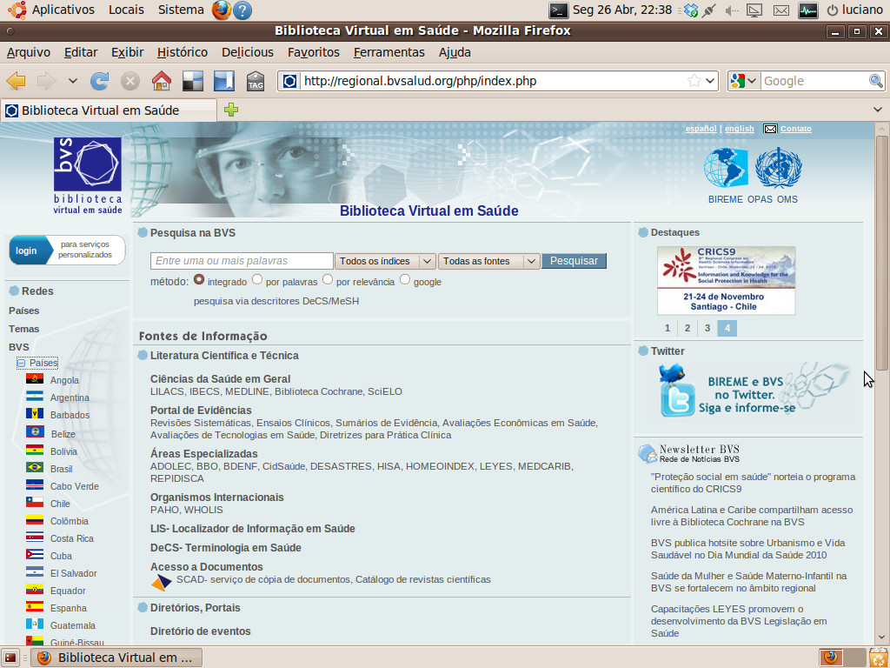
Current LA&C networks

Slide 6
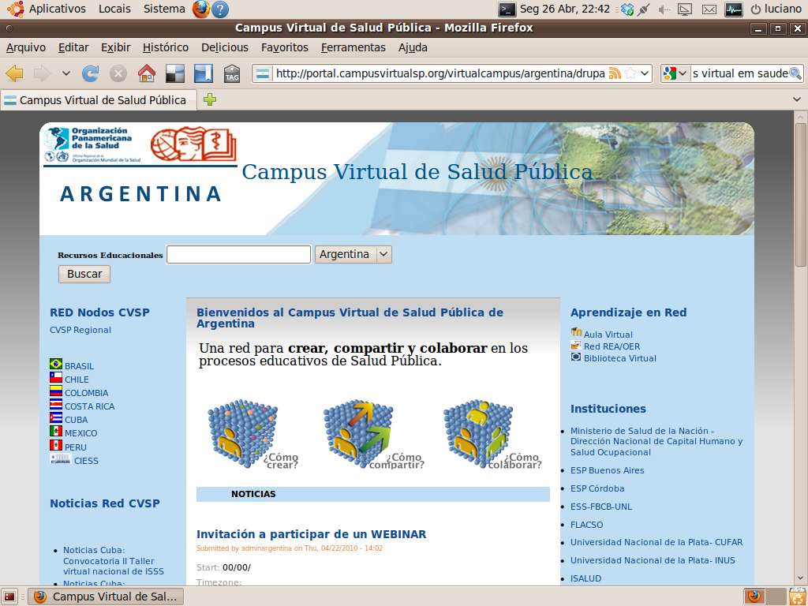

Slide 7
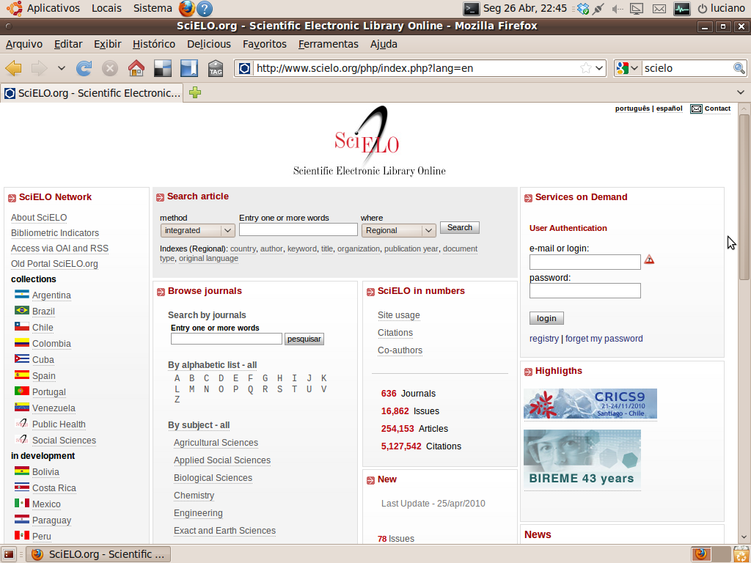

Slide 8
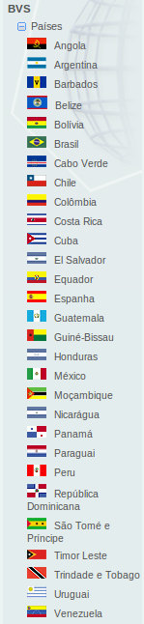
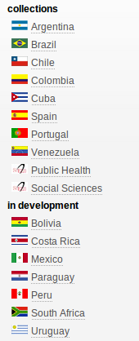
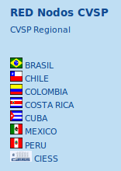
Existing regional networks
Scielo
VHL / BVS
Virtual Campi

Slide 9
A regional network of
Clinical Trial Registries
Following the successful model of VHL, CVSP, Scielo and ScienTI
Countries may choose to host their own registries, or use our hosting facilities
Countries may choose to develop their own software, or adapt and use the open platform we are presenting today
Developing national capabilities to monitor clinical trials

Slide 10
LA&C CTR Platform
Interoperability among countries,
ICTRP/WHO and LA&C CT Repository
CTR Platform
CTR Platform
Country D
Country E
ICTRP/WHO
Repository
LA&C
CT Repository
Hosted at BIREME/PAHO/WHO
CTR Platform
CTR Platform
CTR Platform
Countries C and E do not have
records compliant to ICTRP criteria
Country A
Country B
Country C
LA&C countries

Slide 11
Distribution of CT records
ICTRP/WHO
Repository
LA&C
CT Repository
ICTRP
compliant
records
other
records
(eg. non-English)

Slide 12
Requirements and compliance with
ICTRP standards and best practices

Slide 13
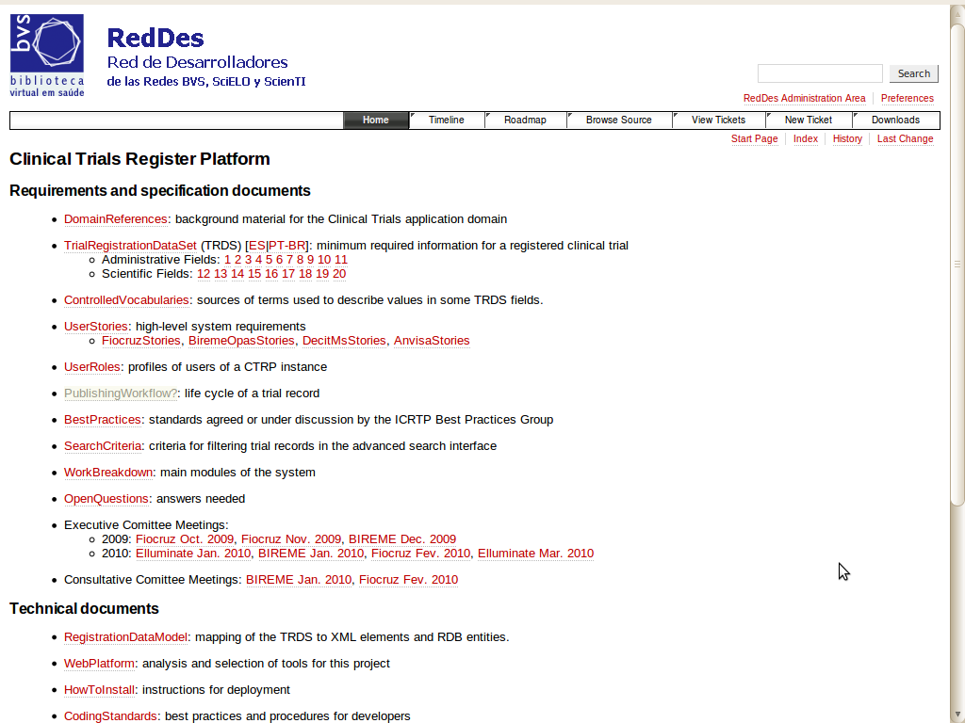
project documentation
and status:
public and live
http://reddes.bvsalud.org/projects/clinical-trials

Slide 14
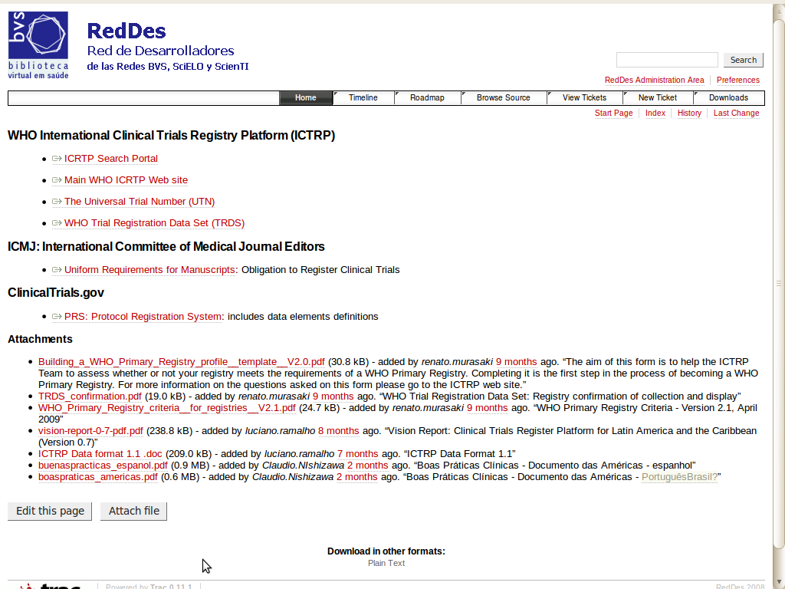
domain
references
http://reddes.bvsalud.org/projects/clinical-trials

Slide 15
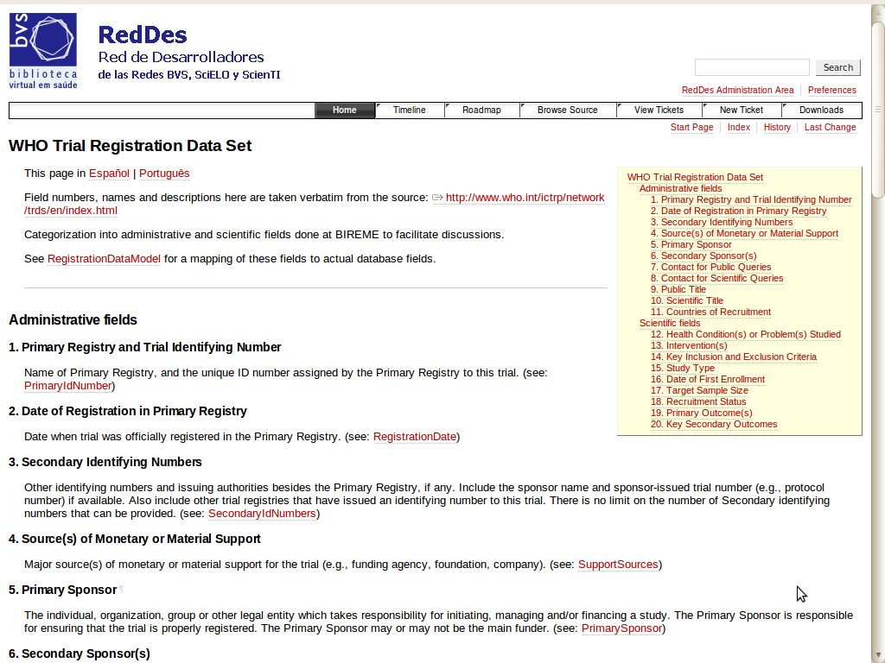
TRDS-20 field
descriptions
in English
http://reddes.bvsalud.org/projects/clinical-trials

Slide 16
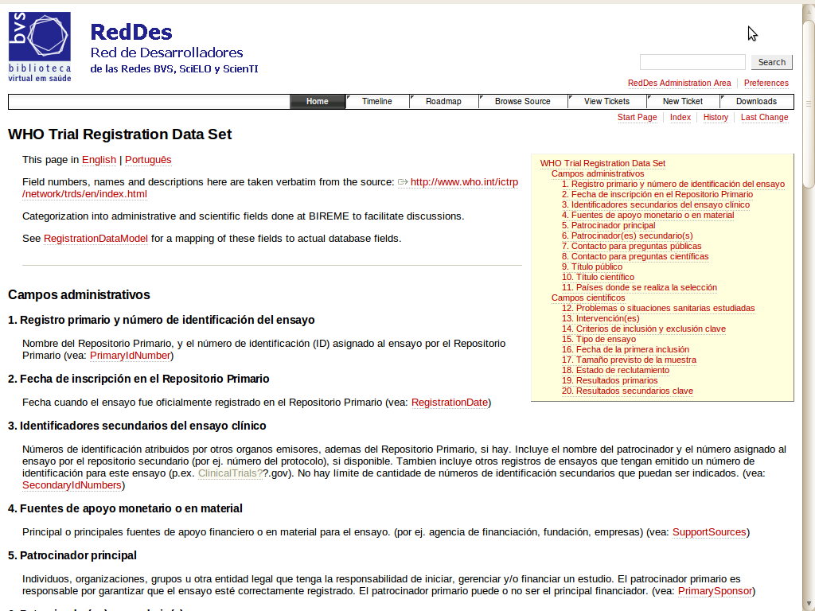
TRDS-20 field
descriptions
in Spanish
http://reddes.bvsalud.org/projects/clinical-trials

Slide 17
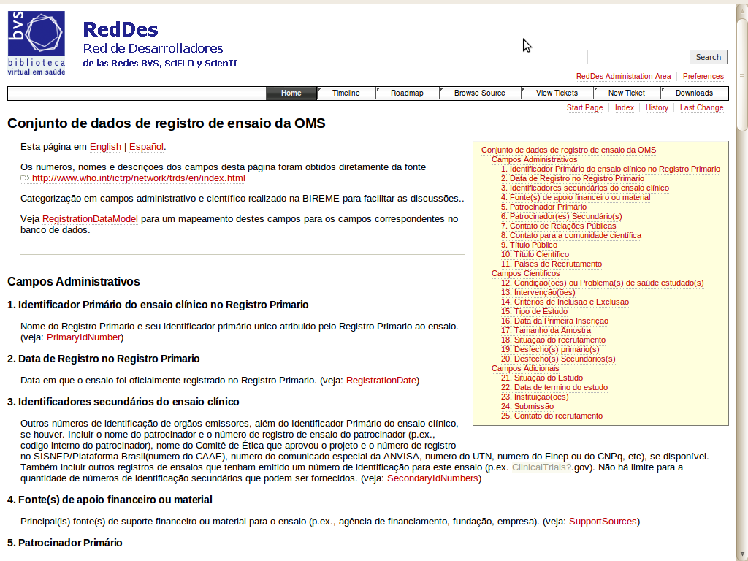
TRDS-20 field
descriptions
in Portuguese
http://reddes.bvsalud.org/projects/clinical-trials

Slide 18
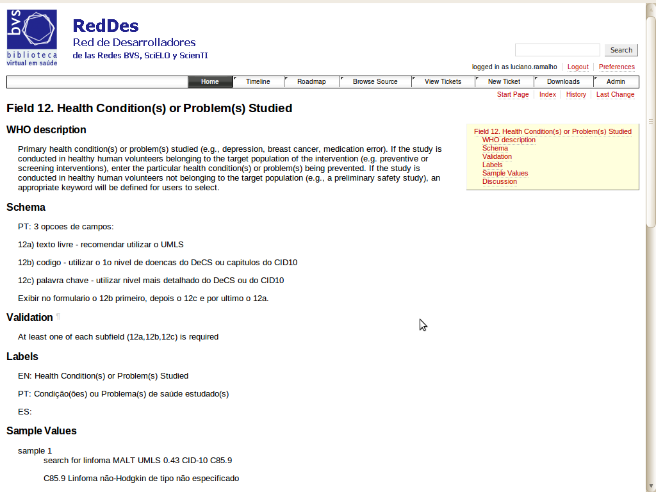
discussion
page for one
of the TRDS
fields

Slide 19
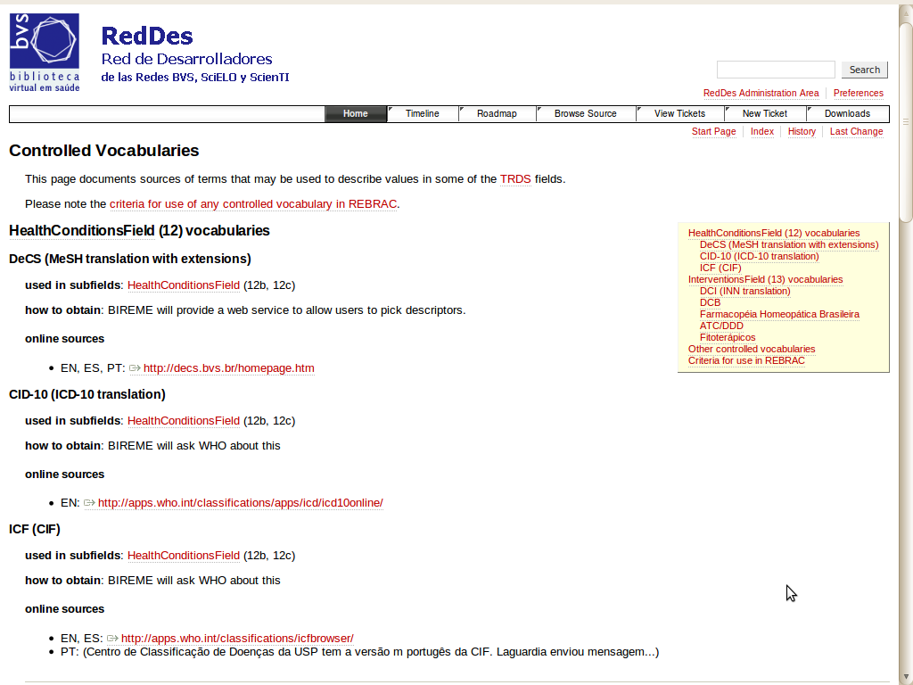
dicussion page
for controlled
vocabularies

Slide 20
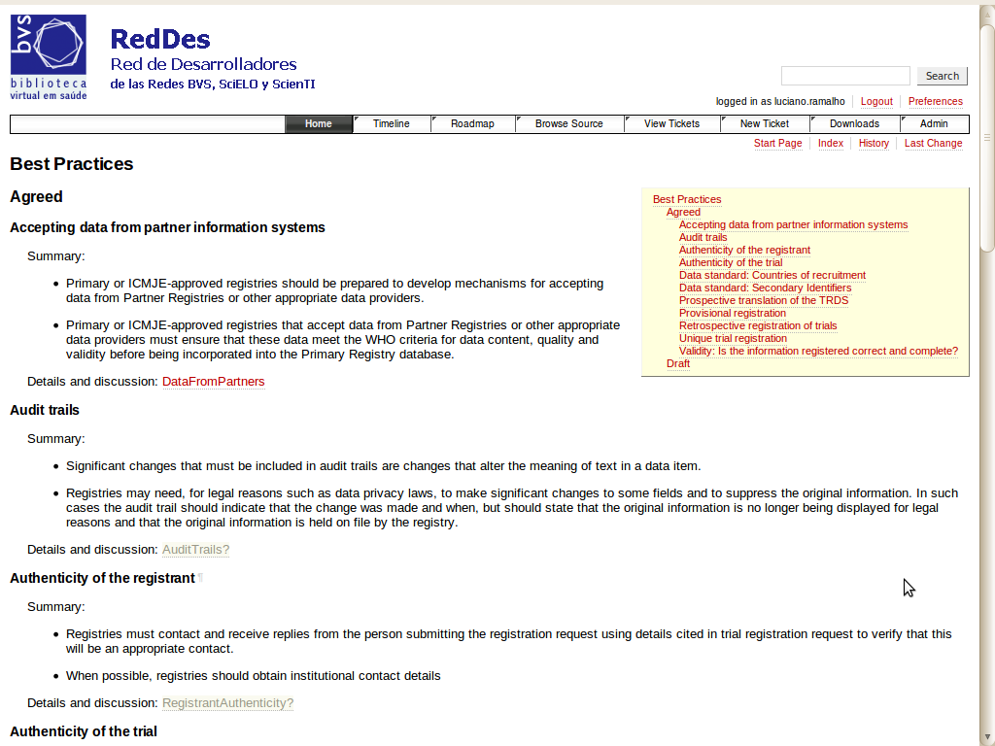
ICTRP best
practices
summary

Slide 21
How the regional platform is being developed

Slide 22
Think regional, act national
Brazilian National Clinical Trials Registry
  EnsaiosClinicos.gov.br
  Currently at http://ec.beta.bvsalud.org
  primary registry but restricted to trials in Brazil
Team
  BIREME, MS, Fiocruz, Anvisa, PAHO office
Funding
  50% PAHO
  50% Ministério da Saúde do Brasil
  and Fiocruz

Slide 23
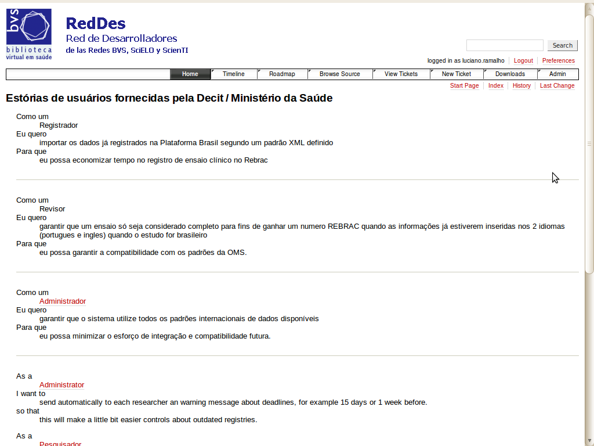
user stories contributed by:
Fiocruz
Ministério da Saúde
ANVISA
BIREME
http://reddes.bvsalud.org/projects/clinical-trials

Slide 24
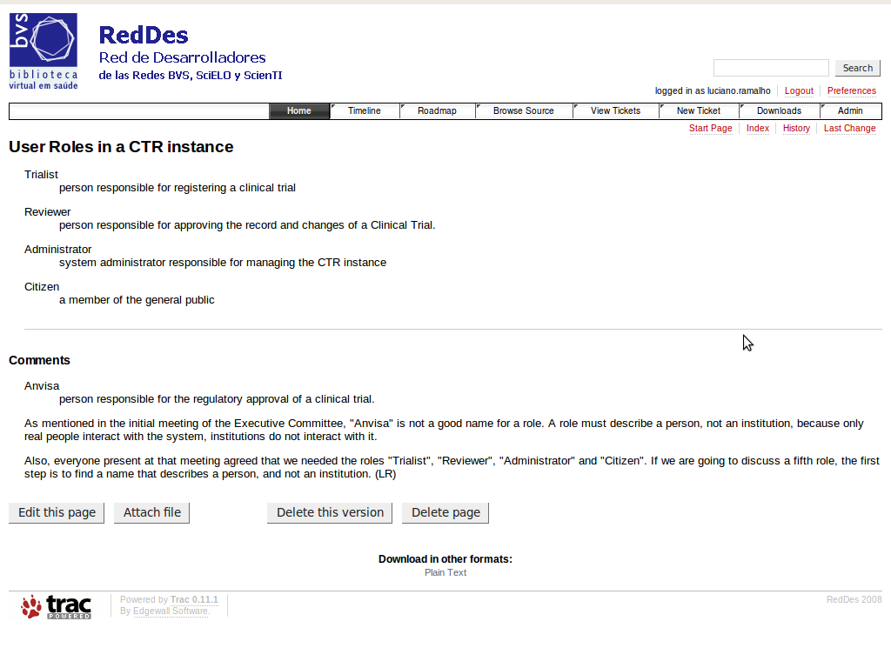
defined user roles:
trialist
reviewer
administrator
citizen (public)

Slide 25
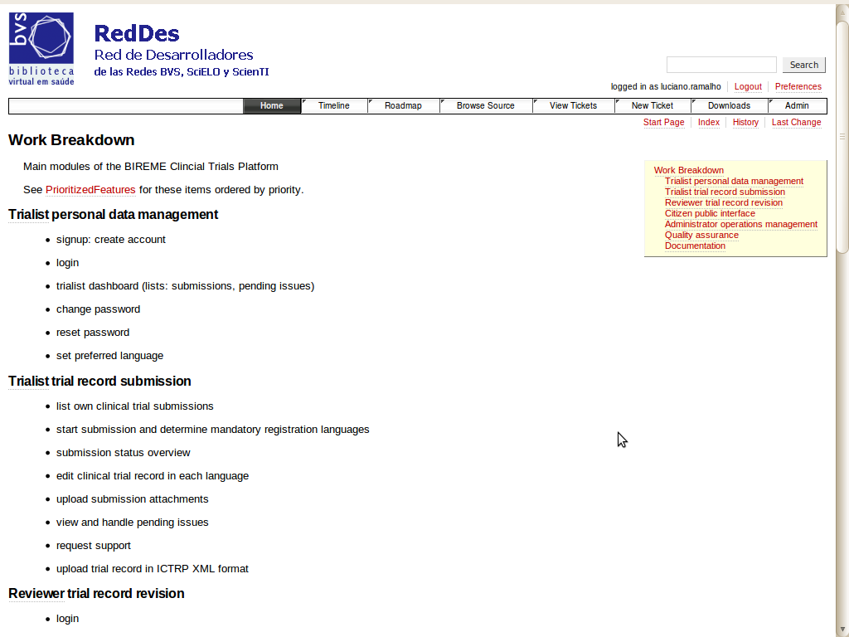
work breakdown
structure: what
needs to be built

Slide 26
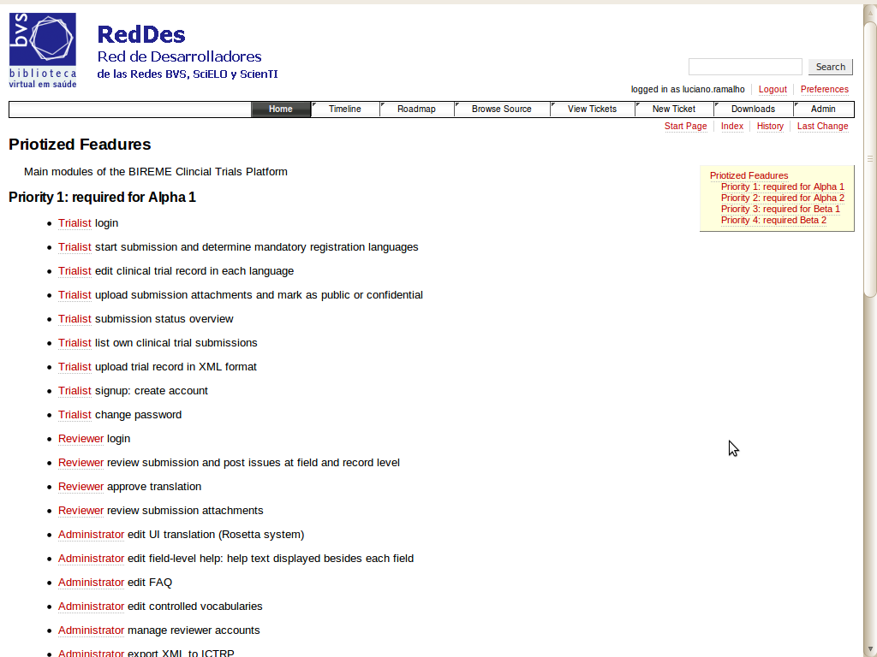
prioritized
work breakdown
structure: what
needs to be built
and when

Slide 27
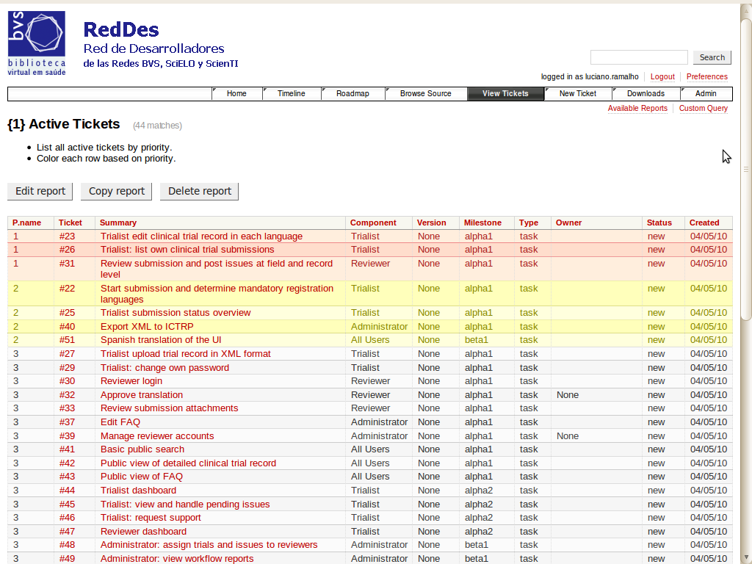
development
tracking:
each ticket is
a feature do be
implemented
or a bug to be fixed

Slide 28
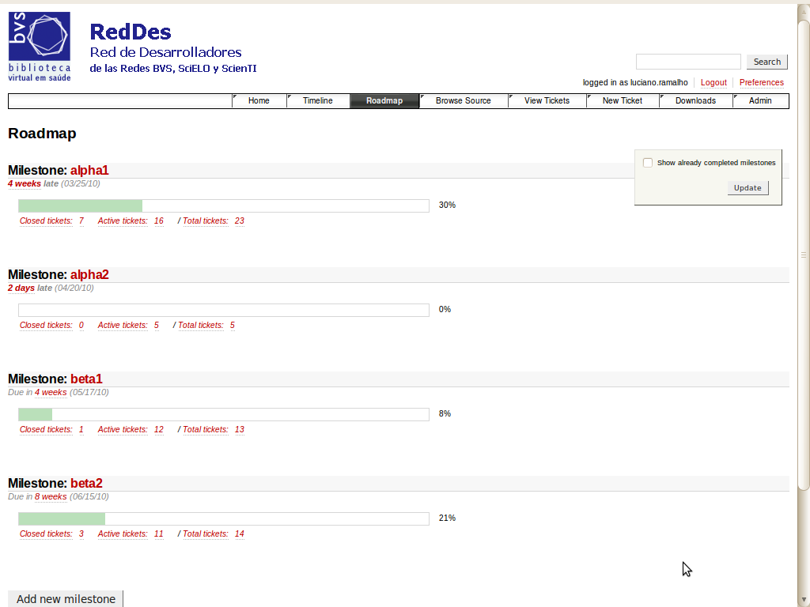
roadmap shows
progress for
each milestone

Slide 29
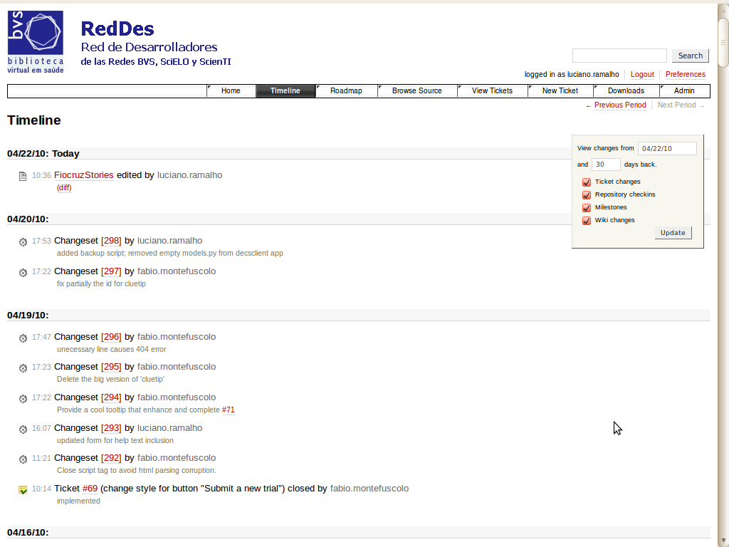
timeline shows
changes to
documentation
and code in
real time

Slide 30
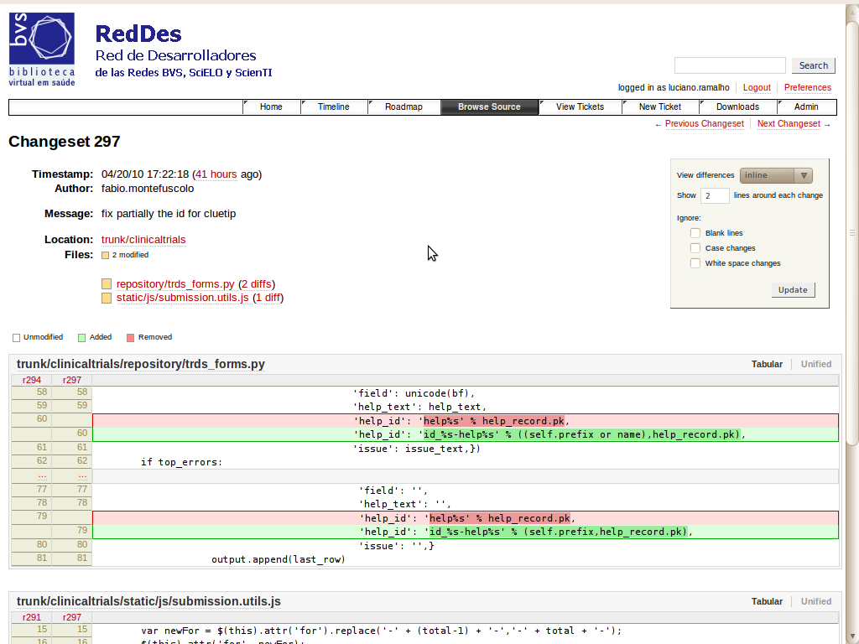
changes are
displayed down
to each line
of code

Slide 31
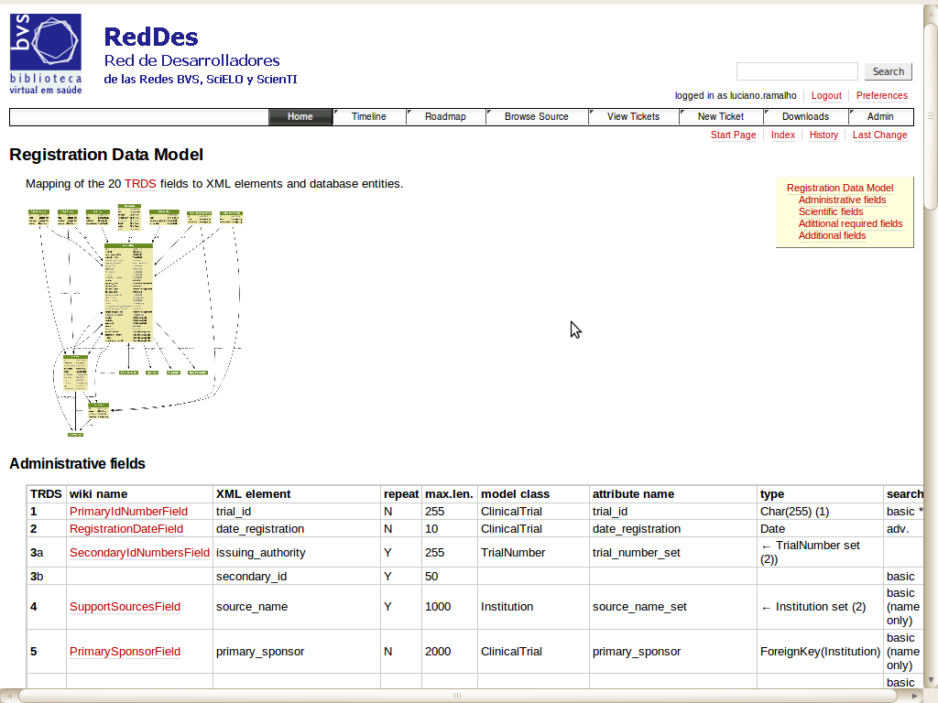
data model:
mapping of
ICTRP XML
fields to
a relational
database
schema

Slide 32
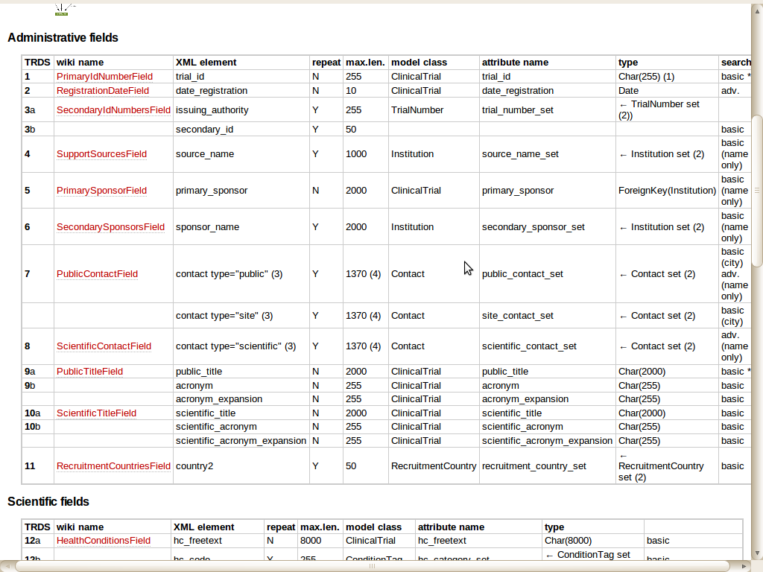
data model:
mapping of
ICTRP XML
fields to
a relational
database
schema

Slide 33
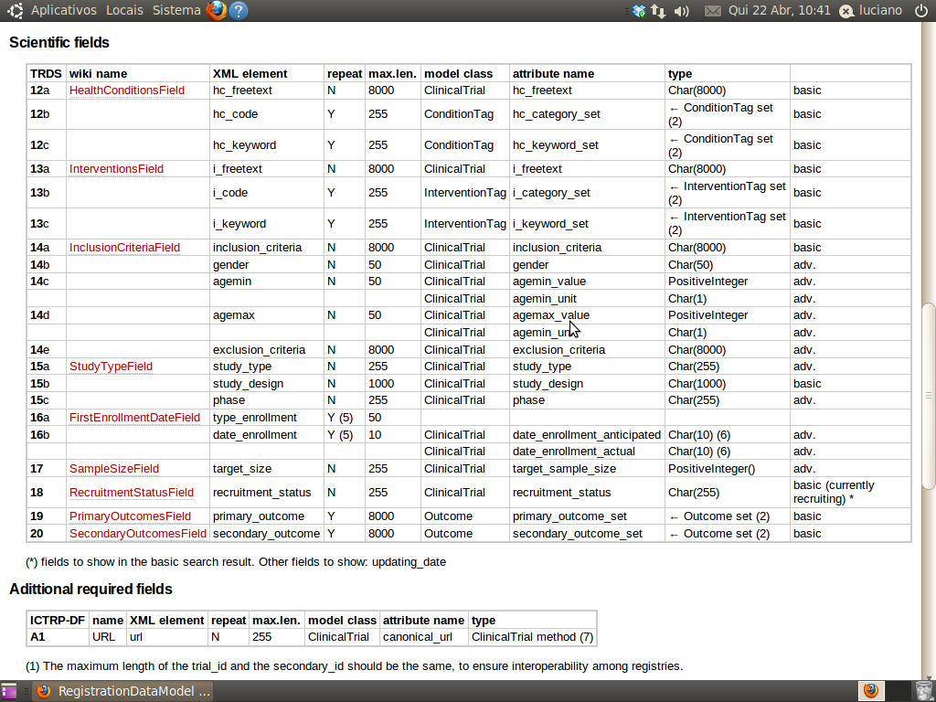
data model:
mapping of
ICTRP XML
fields to
a relational
database
schema
http://reddes.bvsalud.org/projects/clinical-trials

Slide 34
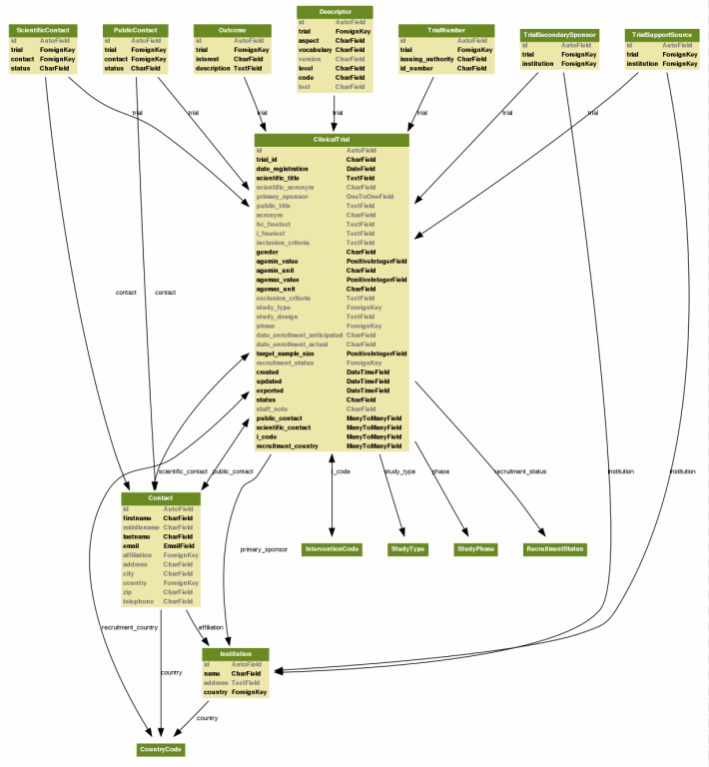
A relational, SQL database
data model:
mapping of
ICTRP XML
fields to
a relational
database
schema

Slide 36
Software foundations
Written in Python, a modern, easy to learn programming language
  used by Google, RedHat, Novell, MIT etc.
Leverages Django, a modern, easy to learn web development toolkit
  used by Washington Post, Tabblo, Focus.com etc.
Relational database storage
  compatible with Oracle, PosgreSQL and MySQL

Slide 37
Software features
Multi-lingual
  user interface and content can be translated to any language or set of languages
  CT registry operators can edit help text, vocabularies etc. at any time
Multi-platform
  runs on any modern computer (Windows, MacOSX, Linux, FreeBSD...)
Modular
  functionality is split into reusable
  modules

Slide 38
Software modules
Field-level
help and
FAQ
Controled
vocabularies
mgmt
CTR
submission
and
review
Trialist
and Reviewer
issue
tracking
CTR
submission
and
review
User
registration
CTR
search
engine
CTR
search
engine
CTR
repository/
data import,
export

Slide 39
Fields which need translation
1. Primary Registry and Trial Identifying Number
2. Date of Registration in Primary Registry
3. Secondary Identifying Numbers
4. Source(s) of Monetary or Material Support
5. Primary Sponsor
6. Secondary Sponsor(s)
7. Contact for Public Queries
8. Contact for Scientific Queries
9. Public Title
10. Scientific Title
only 8 fields
out of 20 need
translation

Slide 40
Fields which need translation
11. Countries of Recruitment
12. Health Condition(s) or Problem(s) Studied
13. Intervention(s)
14. Key Inclusion and Exclusion Criteria
15. Study Type
16. Date of First Enrollment
17. Target Sample Size
18. Recruitment Status
19. Primary Outcome(s)
20. Key Secondary Outcome(s)
only 8 fields
out of 20 need
translation

Slide 41
Workflow: publishing process
State of each mandatory translation
Full record
draft
started
rejected
pending
submitted
approved
published

Slide 42
What is Open Source Software
Open Source Software is¹
  Software licensed with a copyright licensecompliant with the Open Source Definition (OSD)
  Software is distributed with its source code in a human readable format
  Software is developed in an open and collaborative way by groups of developers
¹ Quoted from “Learn About Open Source”, a presentation
by Alolita Sharma of the Open Source Initiative
http://www.opensource.org/osi-open-source-education

Slide 43
A key point: the “fishbowl”
“Software developed in an open and collaborative way by groups of developers"
It is not enough to freely distribute the software and put the source code in
an open repository
Strategic and tactical decisions must be made in an open way, allowing and encouraging participation
  Usually, via a public mailing list and
  meetings open to all interested parties

Slide 44
Sustainable development
Participation fosters an active community
An active community provides:
  Better, more qualified feedback
  Content contributions in the form of documentation, presentations, best practices, translations etc.
  Software contributions in the form of bug fixes, patches, add-ons and core enhancements
This leads to sustainable software development

Slide 45
Designed for Wide Deployment
Multi-lingual user interface, help system and repository
Multi-platform language and toolkit
Mainstream database technology
Technical documentation in English
Source code in English
Standard Open Source procedures and best practices

Slide 46
Demo

Slide 47
at this time,
only logged-in
users may
browse

Slide 48
first step
of user
registration

Slide 49
second step
of user
registration

Slide 50
activated account:
trialist may submit
trial records

Slide 51
new submission:
scientific title is required
to identify pending
submission

Slide 52
new submission:
recruitment countries
and primary sponsor
are required to determine
mandatory translations

Slide 53
TRDS 20 fields
and subfields
are split across
8 screens with
an additional
screen for file
upload
this is a summary
display of pending
issues for one
record

Slide 54
help text can be
edited and translated
by operators at any
time

Slide 55
trial
identification
section

Slide 56
UTN:
a required field
in the trial
identification
section

Slide 57
sponsors and
supporters
can be shared
among trials by
the same trialist

Slide 58
health condition:
free text,
general and
specific descriptors

Slide 59
DeCS
integration

Slide 60
DeCS
integration

Slide 61
recruitment
status

Slide 62
structured
sub-fields
for inclusion
and exclusion
criteria

Slide 63
study type:
several
controlled
vocabularies
for easier
meta-analysis

Slide 64
study type:
several
controlled
vocabularies
for easier
meta-analysis

Slide 65
any number
of primary
and secondary
outcomes

Slide 66
three types of contacts:
general public contacts,
scientific contacts and
site contacts

Slide 67
files may be
attached to
a CT record
submission

Slide 68
main modules:
assistance,
authentication,
registration,
repository,
review,
tickets,
vocabularies

Slide 69
field-level
help entries
are generated
automatically
from forms

Slide 70
field-level
help:
editing and
translation

Slide 71
field-level
help:
editing and
translation

Slide 72
FAQ
category
editing

Slide 73
user
management

Slide 74
reviewer search
trial records
filtered by
several criteria

Slide 75
health condition
and intervention
descriptors
currently in
use

Slide 76
editing a
controlled
vocabulary

Slide 77
another controlled
vocabulary:
ES and PT
translations missing

Slide 78
Roadmap: Brazil instance
Beta on May 20
Launch on or about June 20
Assisted operation for the following six months
  Fiocruz manages content and users
  BIREME hosts platform and maintains software
Transfer of hosting and software maintenance to Fiocruz after six months

Slide 79
Roadmap: regional instance
Set up Comité Consultivo Regional
  coordinated by PAHO
  country representatives
  BIREME
Next steps are up to the CCR...

Slide 80
Thank you
Luciano Ramalho
luciano.ramalho@bireme.org
software development supervisor
BIREME/PAHO/WHO

