Slide 1

Old Book Store
Presented by:
Birendra Chaudhary
Dilli Raj Bhatta
Kaustub Pant
Santosh Chaudhary

Slide 2
Abstract
Old Book Store is a web-based platform for buying and selling used books.
Promotes reuse and sustainability, reducing paper waste.
Users can register, list, buy, and communicate with others easily.
Admin monitors books, users, and transactions.
Built with Python Flask, MySQL, HTML, and CSS.
Demonstrates sustainable and efficient online book trading.

Slide 3
Chapter1:Introduction
Background:
The digital era has changed book trading; traditional bookstores face limits.
Online systems solve space, access, and cost issues.
Objectives:
Build user-friendly old book trading system.
Secure login, wishlist, messaging, and admin dashboard.
Scope & Applicability:
Web-based platform for community/college use.
Simulated payments only (no real gateway).
Useful for academic and local book exchange.
Achievements:
Fully functional prototype with secure login, book uploads, and admin panel.

Slide 4
Chapter 2: Survey of Technologies
Purpose: Review similar systems and tools for book exchange.
Reviewed Works:
ReBook: PHP/MySQL system for college-level exchange.
Django-based Online Bookstore: Python web framework with admin features.
OLX & Quikr: General resale platforms lacking structured book management.
E-Library Model: For schools; limited scalability.
Conclusion:
Need for a dedicated, scalable, sustainable old-book trading platform.

Slide 5
Chapter 3: Requirements and Analysis
Problem Definition:
No structured, accessible system for second-hand books.
Functional Requirements:
User registration/login
Book listing/search
Wishlist, order & messaging system
Admin panel for monitoring
Non-Functional Requirements:
Reliability, security, responsive UI, and data integrity
System Requirements:
Hardware: i3 processor, 4GB RAM
Software: Windows/Linux, Flask, MySQL, VS Code

Slide 6
Chapter 4: Design
Purpose: Define structure and UI of the system.
Components:
System Architecture: Client–Server model using Flask & MySQL
Database Design: ER diagram defining relationships between users, books, and orders
Interface Design:
  User pages: Home, Login, Buy, Sell, Wishlist, Orders, Messages
  Admin pages: Dashboard, User/Book/Payment management
Goal: Scalable, modular, and easy-to-use design.

Slide 7
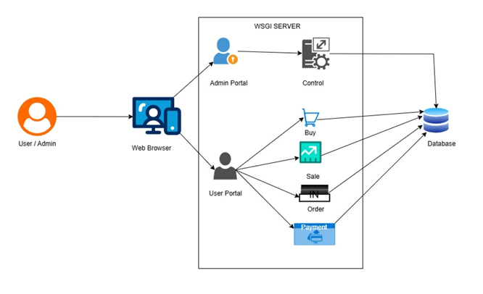
System Design Overview
System Architecture:

Slide 8
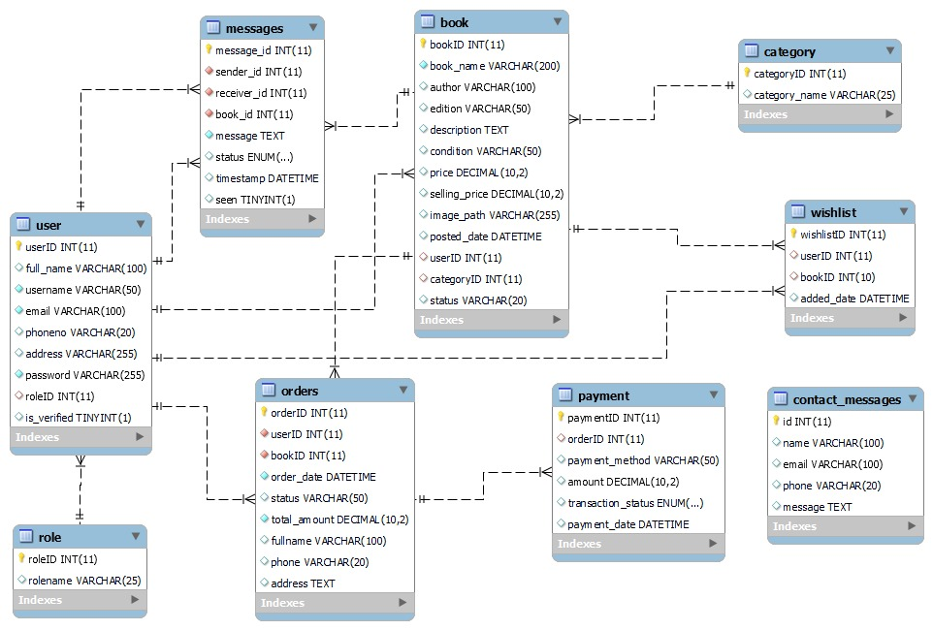
Database Design

Slide 9
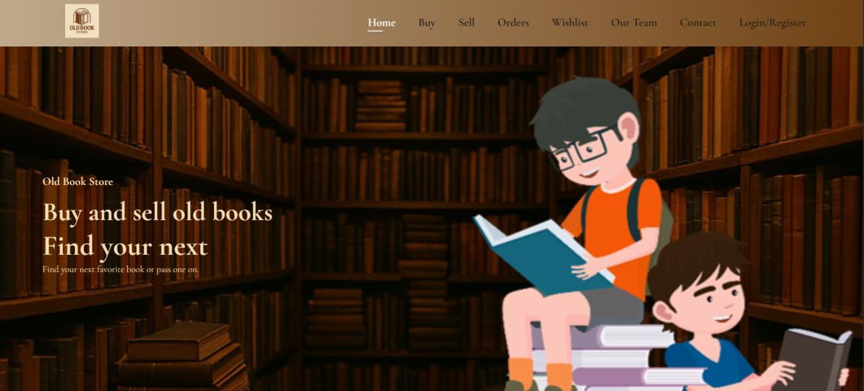
User Interface
Home Page

Slide 10
User Interface
Home Page

Slide 11
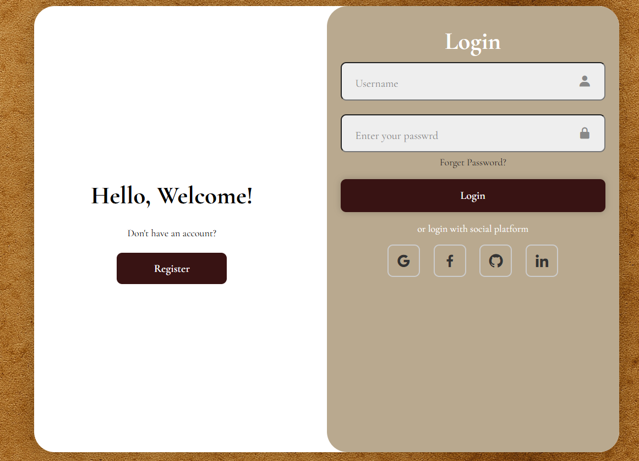
User Interface
Login Page:

Slide 12
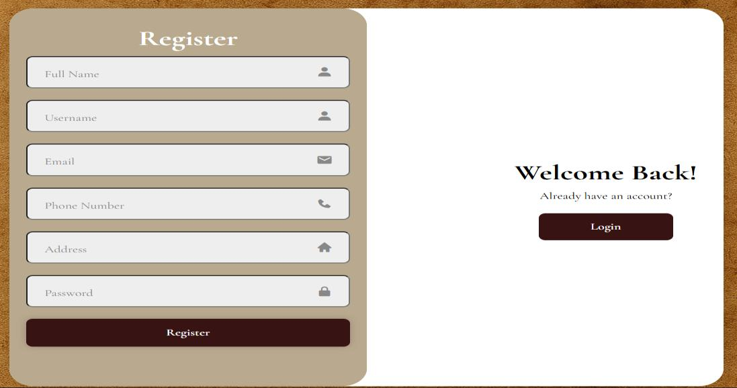
User Interface
Registration Page :

Slide 13
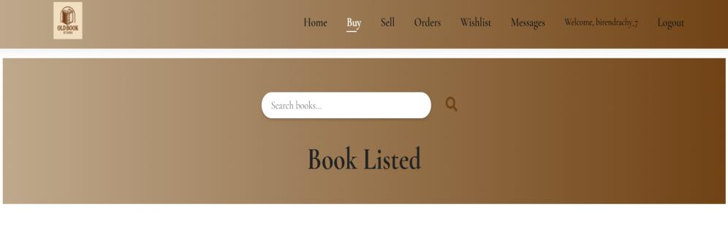
User Interface
Book Listed Page:

Slide 14
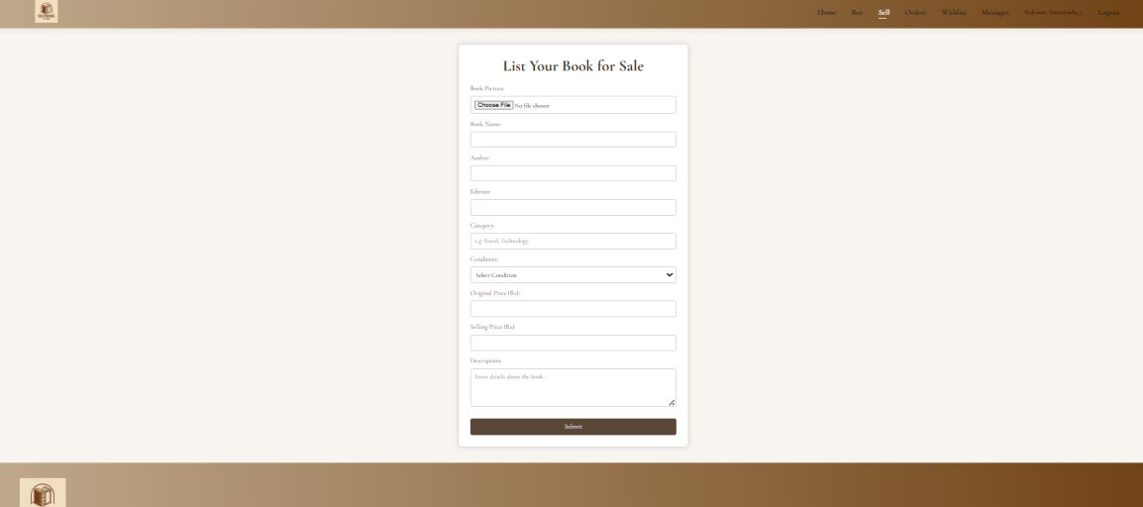
User Interface
Selling Page:

Slide 15
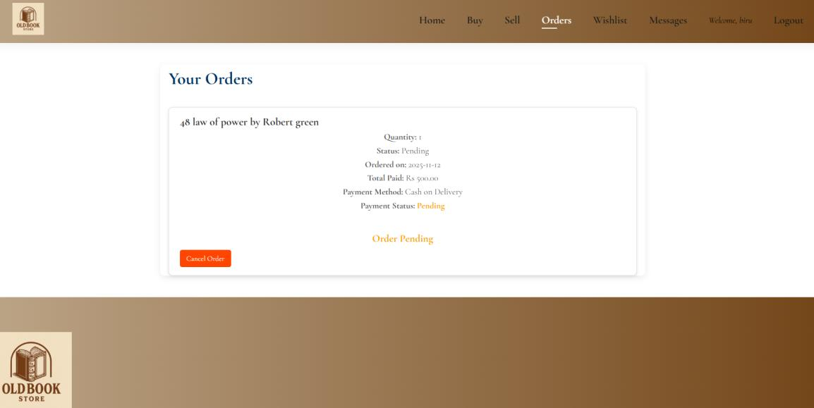
User Interface
Order Page:

Slide 16
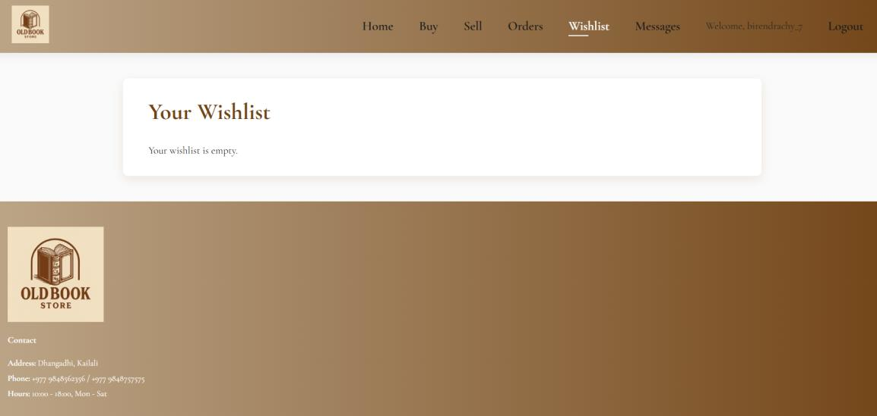
User Interface
Wishlist Page

Slide 17
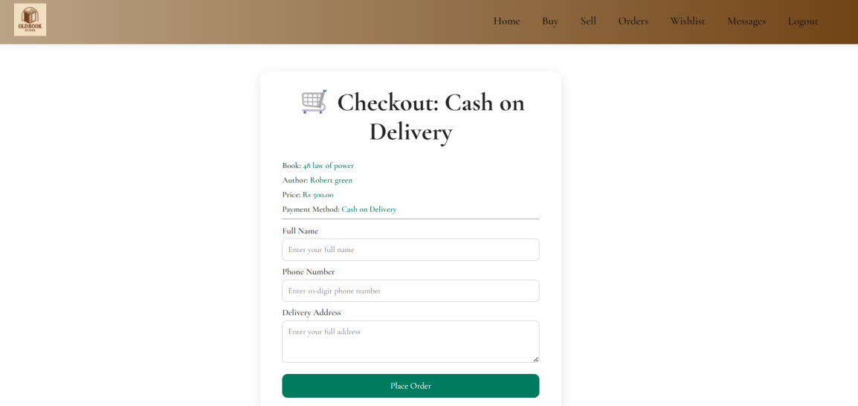
User Interface
Checkout

Slide 18
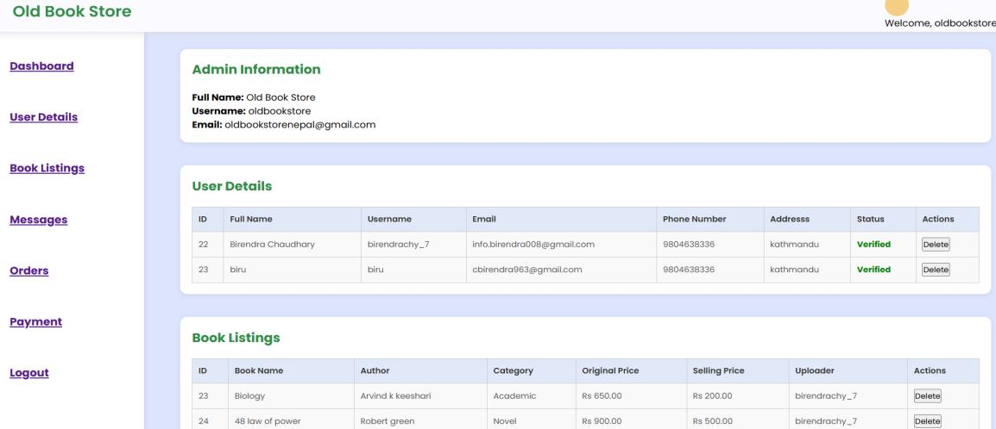
User Interface
Admin Page

Slide 19
Chapter 5: Implementation and Testing
Implementation:
Developed in Python Flask (MVC structure)
HTML/CSS/JS for frontend
MySQL database
Testing Phases:
Unit Testing: Individual module verification
Integration Testing: Module interaction verification
Beta Testing: User feedback for UI and performance
Improvements:
Dynamic admin panel
Email verification
Password reset
Optimized database performance

Slide 20
Chapter 6: Results and Discussion
Performance Results:
All test cases passed successfully
Stable performance under normal load
Secure login and data validation
CRUD operations for books and orders worked correctly
User Guide:
Registration/Login: Verify via email
Buying: Search → Checkout → Simulated payment
Selling: Upload book details & image
Wishlist: Save/remove books
Messaging: Buyer-seller communication
Admin: Manage users, books, and payments

Slide 21
Chapter 7: Conclusion & Recommendations
Conclusion:
Developed a user-friendly, sustainable old-book marketplace.
Promotes reuse and affordable access to books.
Built using Flask, MySQL, HTML, and CSS.
Significance:
Environmental – reduces paper waste
Economic – low-cost learning materials
Educational – practical web development example
Technical – scalable Flask-based MVC application
Future Recommendations:
Integrate real payment gateways (eSewa, Khalti, Stripe)
Add delivery tracking and logistics system
Develop mobile app version (Flutter/React Native)
Implement real-time chat and push notifications
Strengthen data security (2FA, encryption)

