Slide 1

Local Pie Shop
MDP Project
Group Members:
Sl.# | Name
1 | Biren Sharma
3 | Jobin Joseph
4 | Shantanu Bahuguna
5 | Yogesh Sharma

Slide 2
Objectives
To develop responsive and easy to use web application for selling pie online which will enable pie shop to grow in digital market

Slide 3
Features
User Registration
User Login
Product Categories
Add to cart
Payment gateway
Admin login
Add products

Slide 4
Tools and Technology Used
HTML 5
CSS3
Bootstrap4
JavaScript
MySQL
PHP
GitHub
VS Code Editor
XAMPP

Slide 5
Methodology:
We are using PHP for backend development and HTML for frontend development.
We have used Bootstrap to give our web application a user friendly and stylish interface.
We are using MySQL DBMS as it provides us with the flexibility and on demand scalability.

Slide 6
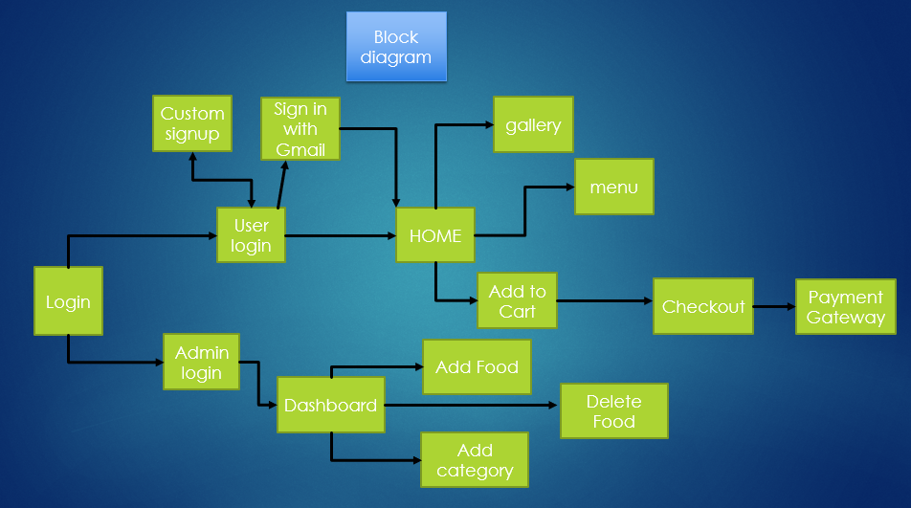

Slide 7
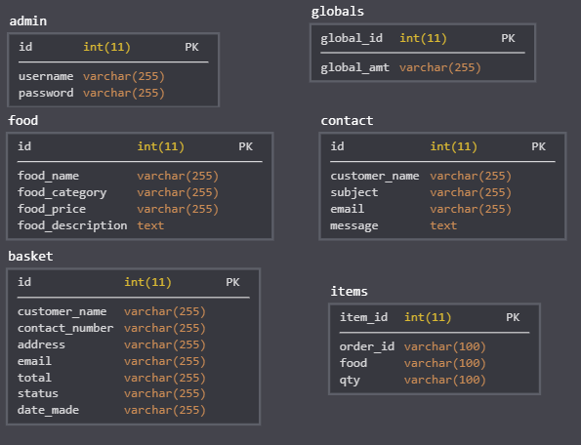
Database

Slide 8
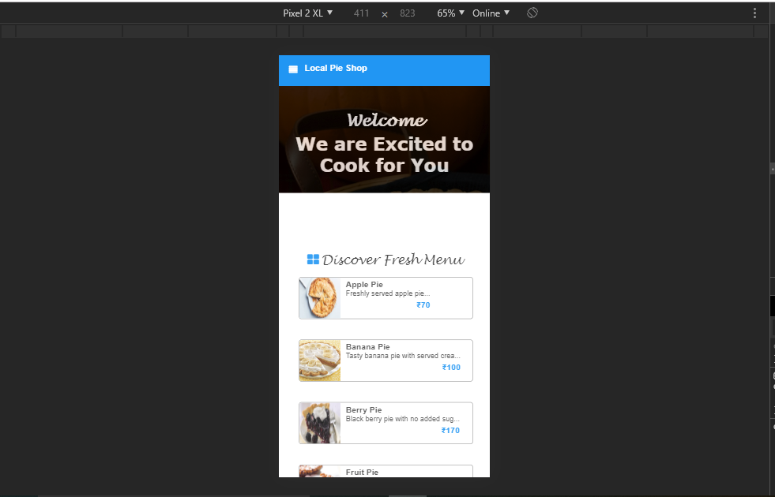
Responsive design

Slide 9
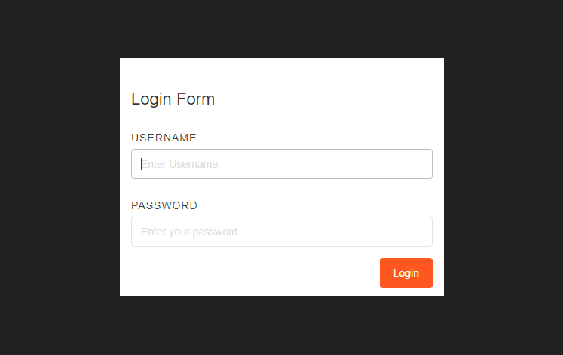
Login

Slide 10
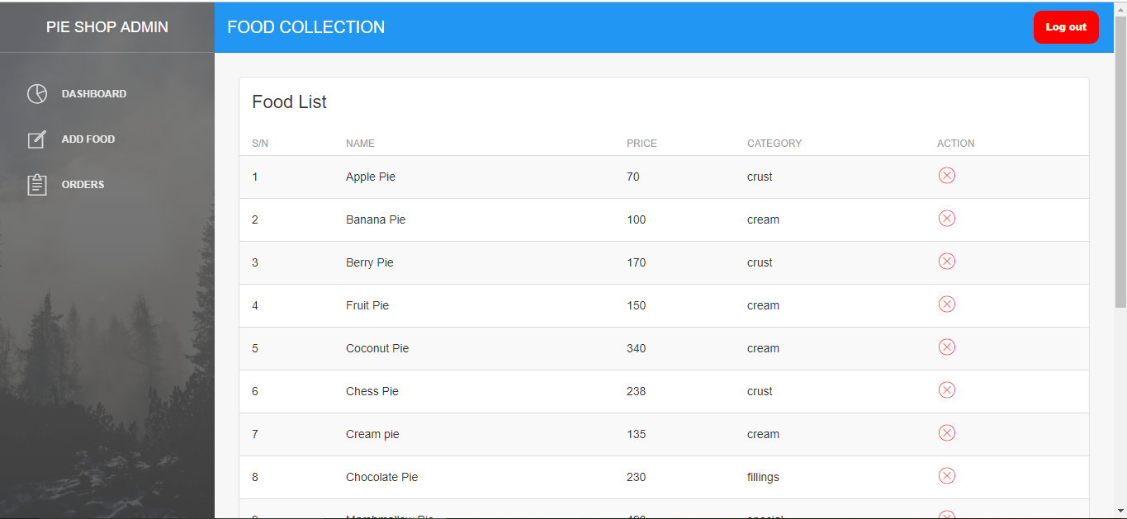
Admin

Slide 11
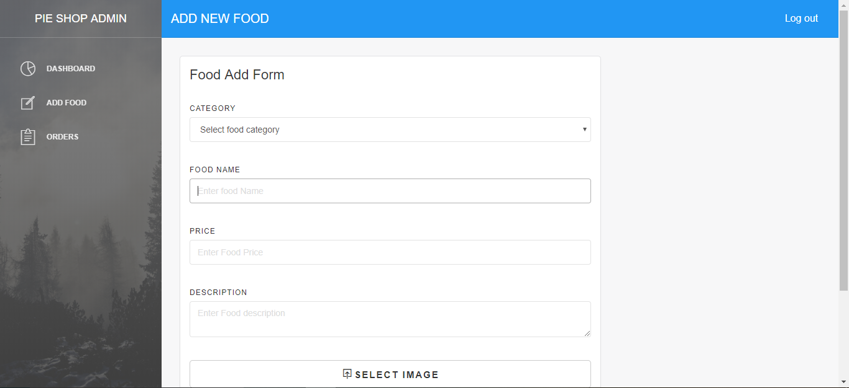
Admin

Slide 12
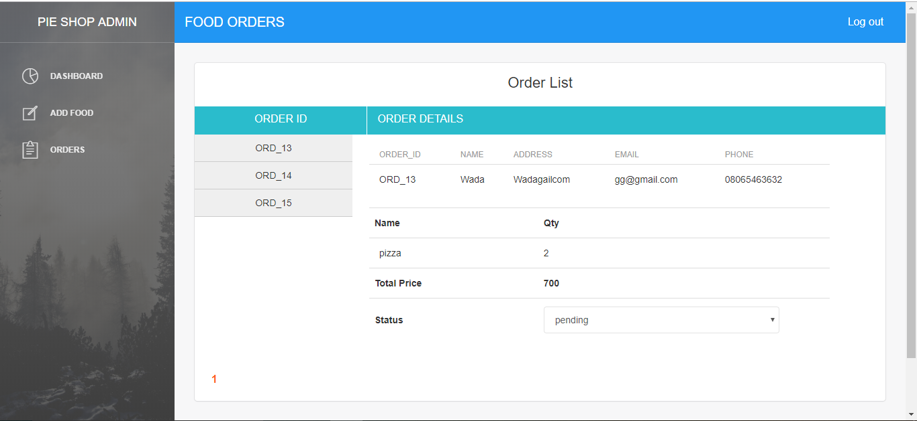
Admin

Slide 13
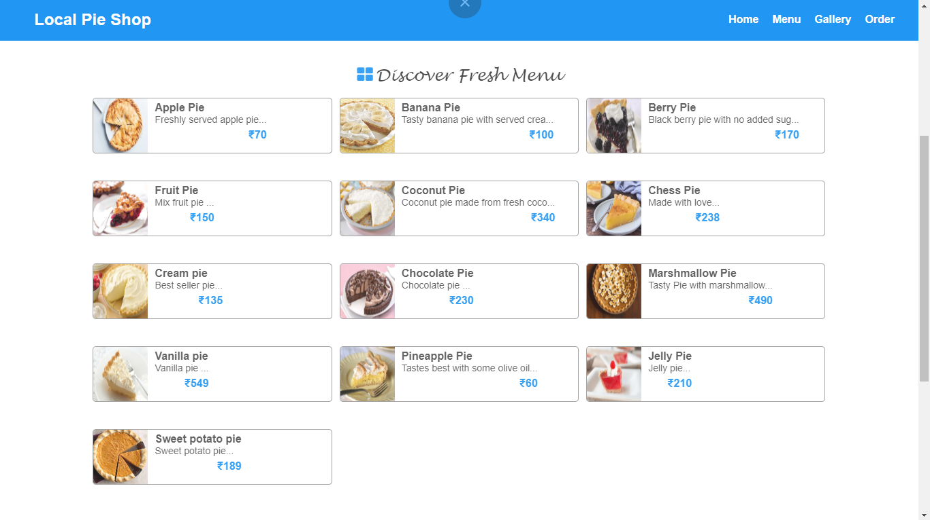
User Dashboard

Slide 14
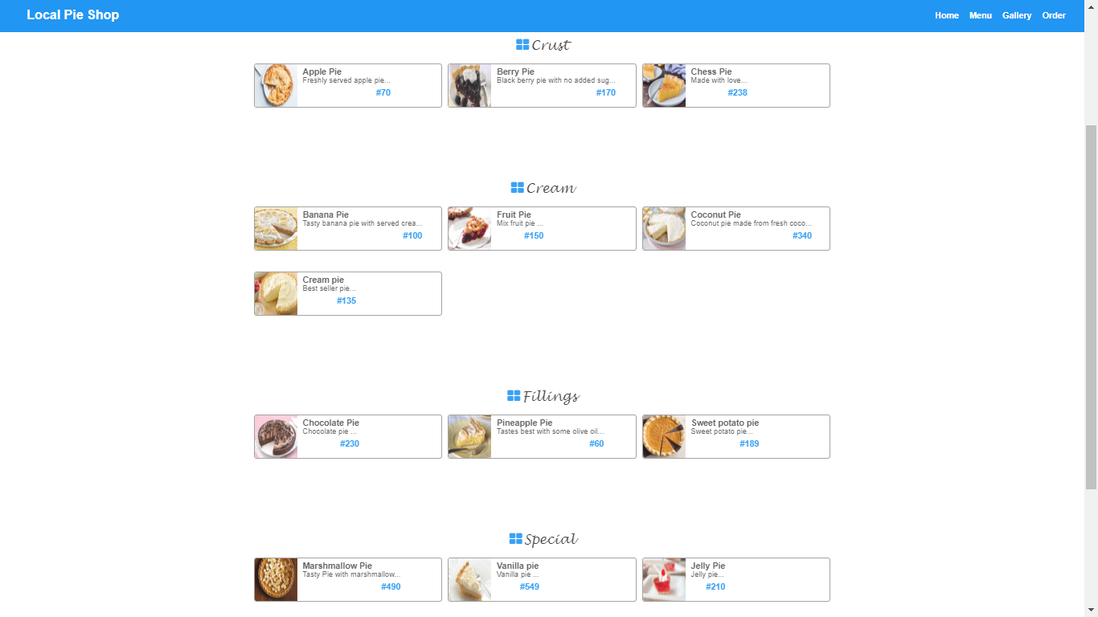
Menu

Slide 15
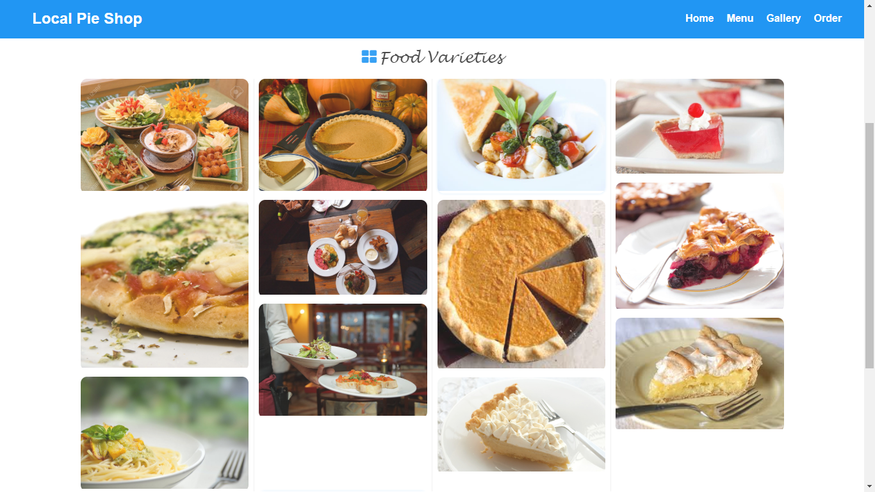
Gallery

Slide 16
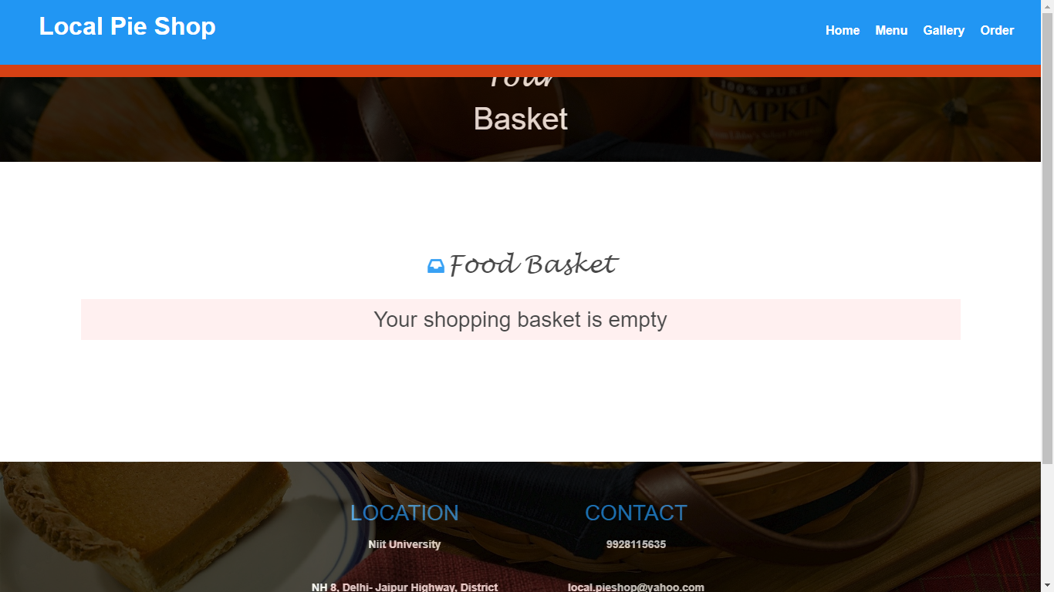
Basket

Slide 17
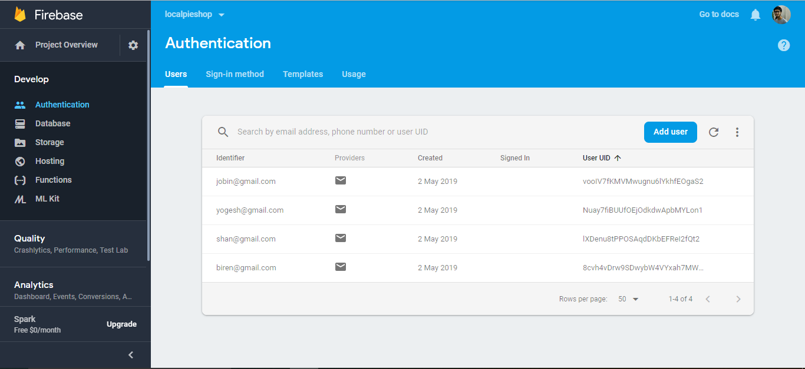
Firebase Users

Slide 18
THANK YOU

