Slide 1

Every Voice. Every Insight.
AI-powered Voice of Customer analytics
Transforming customer feedback into structured insight and actionable business intelligence.
Customer Feedback
AI Analysis
Actionable Insight

Slide 2
THE JOURNEY
From problem to proof
1
2
3
THE PROBLEM
THE APPROACH
THE VALUE
Why customer voice is difficult to scale
Turning customer language into structured insight
From AI output to business action
4
5
6
THE TEST
THE LEARNINGS
THE NEXT STEP
Evaluating the AI behind the experience
What building the MVP revealed
Where InsightCX could go from here
7
SEE IT IN ACTION
Live demo
InsightCX
2

Slide 3
THE PROBLEM
Customer feedback contains the answers — but they're buried in text.
“The sofa is beautiful, but delivery was two days late.”
“The assembly instructions were impossible to follow.”
“Returning the table was surprisingly easy.”
“I couldn't find any information about my order.”
Hundreds of comments
Unstructured customer language
Manual analysis
Slow / inconsistent insight
Missed opportunities
Can an LLM turn that unstructured customer voice into something we can actually analyze?
InsightCX
3

Slide 4
THE BUSINESS SCENARIO
A home-furnishing retailer — and hundreds of customer voices
CUSTOMER JOURNEY
Discover
Purchase
Delivery
Assembly
Use
FEEDBACK SOURCES
NPS
Recommendation / loyalty feedback
Measures likelihood to recommend on a 0–10 scale, indicating overall customer loyalty and advocacy.
CSAT
Customer satisfaction feedback
Measures satisfaction with a specific experience on a 1–5 scale, helping identify how well the customer’s expectations were met.
TEST DATASET
Several hundred feedback records across multiple weeks
(Positive · Neutral · Negative)
KEY CX THEMES
Delivery
Product quality & assembly
Returns
Website experience
Payment / billing
Brand loyalty
A controlled scenario for testing AI functionality — not production data.
InsightCX
4

Slide 5
INSIGHTCX OVERVIEW
From customer voice to business insight
1
2
3
ANALYZE
INTERPRET
INGEST
Turn each comment into structured CX data
Turn feedback patterns into actionable insight
Bring customer feedback into one place
Sentiment · Emotion · Themes
Priority · Confidence · Summary
Customer health · Trends
Business impact · Leadership priorities
NPS · CSAT · Customer comments
Raw customer voice
“The sofa looks great, but delivery was two days late…”
Executive insight
→
Negative
Delivery
High priority
AI EVALUATION
Consistency · Latency · Tokens · Cost
InsightCX
5

Slide 6
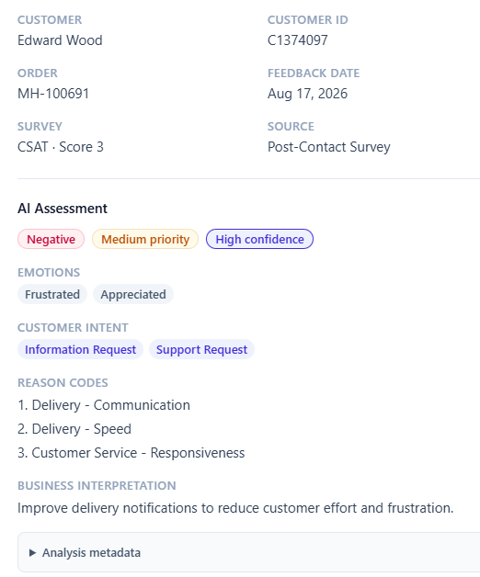
LLM CAPABILITY 1 OF 2
Turning customer language into structured CX data
NATURAL LANGUAGE
STRUCTURED OUTPUT
“The area rug showed up two days late with no explanation. Customer service was helpful when I asked about the delay, but I would’ve liked to know what was going on without having to contact them.”
Once the LLM output is structured, it stops being just text and becomes data the application can work with.
Customers describe the same experience in many different ways — the application needs consistent categories for analysis.
Feedback Explorer — AI Assessment
InsightCX
6

Slide 7
LLM CAPABILITY 2 OF 2
From individual comments to executive insight
WHAT IS THIS CUSTOMER SAYING?
WHAT DOES IT MEAN FOR THE BUSINESS?
Feedback Analysis → Individual comment
Executive Insights → Aggregated feedback
What happened?
What does it mean?
1. Sentiment
1. Customer health
2. Themes
2. Business impact
3. Priority
3. Leadership priorities
4. Summary
4. Recommended actions
FROM ANALYSIS TO INSIGHT
1
2
3
4
Hundreds of customer comments
Patterns across feedback
Business interpretation
Recommended action
TRANSFORMATION
“Delivery reliability is emerging as a significant driver of customer dissatisfaction.”
“Leadership priority: investigate delivery reliability and communication around delays.”
InsightCX
7

Slide 8
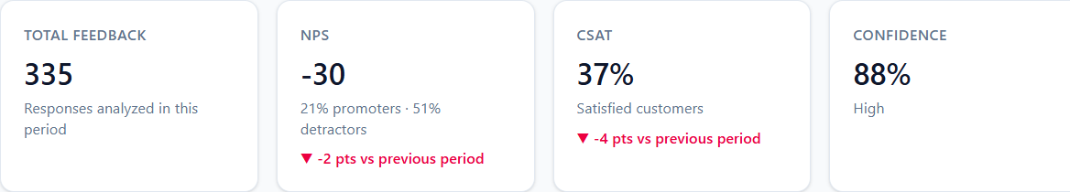
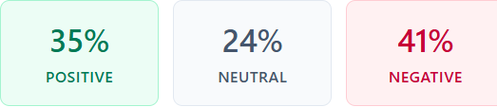
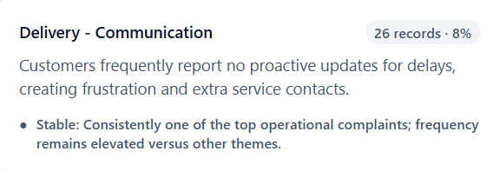
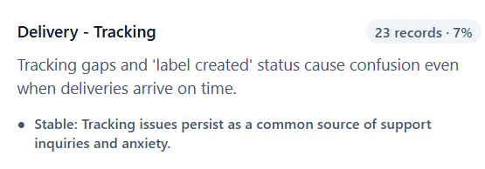
THE DASHBOARD
Making customer health visible
1
Customer health, NPS & CSAT at a glance
2
Sentiment breakdown
3
Two of several business drivers surfaced from structured feedback — ranked by impact and evidence-backed.
InsightCX
8

Slide 9
BUSINESS IMPACT
From customer voice to action
1
2
3
4
CUSTOMER SIGNAL
PATTERN
INTERPRETATION
ACTION
Delivery appears in a large share of negative feedback
Delivery is disproportionately represented among detractors
Delivery may be a customer-health driver
Investigate carrier performance and delivery communication
InsightCX is intended to augment CX expertise, not replace it.
InsightCX
9

Slide 10
AI EVALUATION
A first benchmark — not the full picture
CURRENT MVP EVALUATION
WHAT'S STILL MISSING
25-record evaluation subset · same task & prompts · identical dataset (v1)
GPT-5-mini
GPT-4.1-mini
GPT-4o-mini
1
Agreement
Latency
Tokens
Cost
STRUCTURED FEEDBACK
Initial benchmark → deeper quality validation needed
Model | Latency (ms) | Tokens/Rec. | Cost/Rec. | Agreement
gpt-5-mini | 12,642 | 2,265 | $0.0028 | 100%
gpt-4.1-mini | 12,762 | 2,180 | $0.0023 | 100%
gpt-4o-mini | 14,197 | 2,210 | $0.0009 | 92%
2
EXECUTIVE INSIGHT
Evaluation framework still to be developed
Based on a 25-record benchmark run per model (same dataset & prompts, v1).
The MVP establishes an evaluation starting point — not a complete quality framework.
InsightCX
10

Slide 11
LESSONS LEARNED
What it took to build InsightCX
Integrating an LLM is relatively easy — designing useful output, handling variability, and evaluating whether the result is actually useful are the harder problems.
1
2
Domain knowledge still matters
Understanding the CX problem helped shape the AI requirements and interpret the results.
Creating meaningful test data
Building realistic, varied feedback capable of revealing genuine patterns.
3
4
Evaluating AI, not just using it
Comparing models across quality, consistency, latency and cost.
Integrating a full-stack AI application
Connecting Flask, database, LLM services and React while learning the stack.
InsightCX
11

Slide 12
WHAT'S NEXT
Taking InsightCX beyond the MVP
Human-in-the-loop
Allow users to review, validate and correct AI classifications, creating a feedback loop to improve analysis quality.
Trend analysis
Track themes, sentiment and customer issues over time to identify emerging problems and measure whether actions are working.
Advanced evaluation
Introduce ground-truth datasets and formal quality metrics to systematically measure and improve AI performance.
Not a committed roadmap — potential next steps based on what the MVP surfaced.
InsightCX
12

Slide 13
LIVE DEMO
From current state to new insight
1
2
3
4
REVIEW
ADD
GENERATE
COMPARE
Review current-state insights
Upload new customer feedback
Generate a new executive summary
Review changes in the Executive Brief
What is happening today?
Introduce a new set of customer voices
Turn the updated feedback into business insight
What changed — and what does it mean?
New customer feedback → updated analysis → changed business insight
InsightCX
13

Slide 14
InsightCX is about using AI to make customer feedback more structured, scalable and actionable — so CX teams can spend less time processing feedback and more time acting on it.
Every Voice. Every Insight.

