Slide 1
BDT Project : Spark Streaming
Birhane Gebre
StudentId : 610828
September 2021

Slide 2
Project brief description
Project idea
Real Time tweets analysis to get hashtags in given time interval.
Motive
My country, Ethiopia, now in civil war, so I want to know twitter hashtags that motivate peace.
Technology and tools used
Java
Spark, Kafka, HBase , Cloudera QuickStart VM.
Eclipse IDE

Slide 3
Selected Technology to implement the project
Criteria | My selection
Part-1 : source data | Twitter streaming
Part-2 : Integration & storage | Kafka & HBase
Part-3: Simple demo | Kafka
Part-4: video | OBS Studio

Slide 4
Project architecture and Data flow
Source Twitter streaming
Spark Streaming
Kafka
KafkaConsumer
UI
HBase
Data source | Stream processing | Process & storage | presentation
Twitter API | Spark | Kafka & HBase | Hue

Slide 5
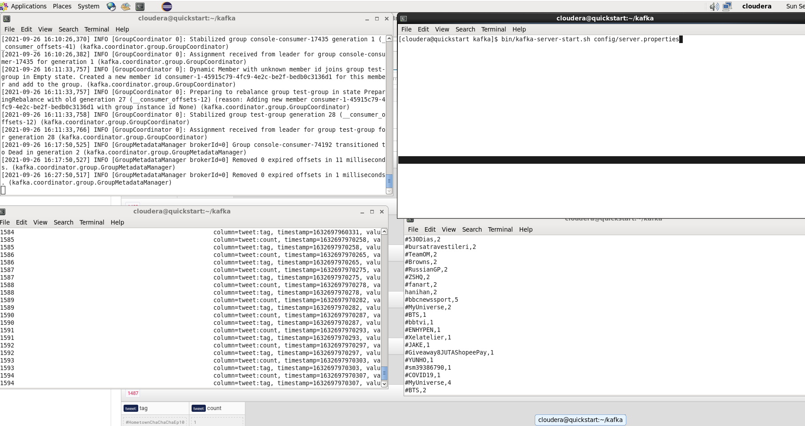
Sample configuration (Kafka)

Slide 6
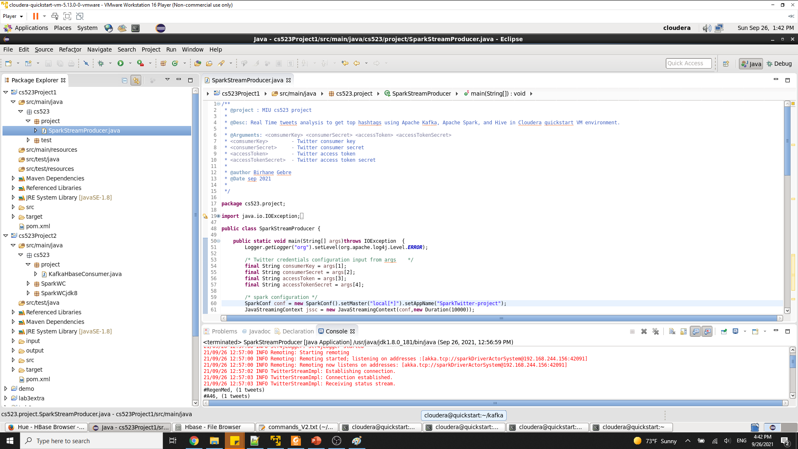
Sample code (stream producer)

Slide 7
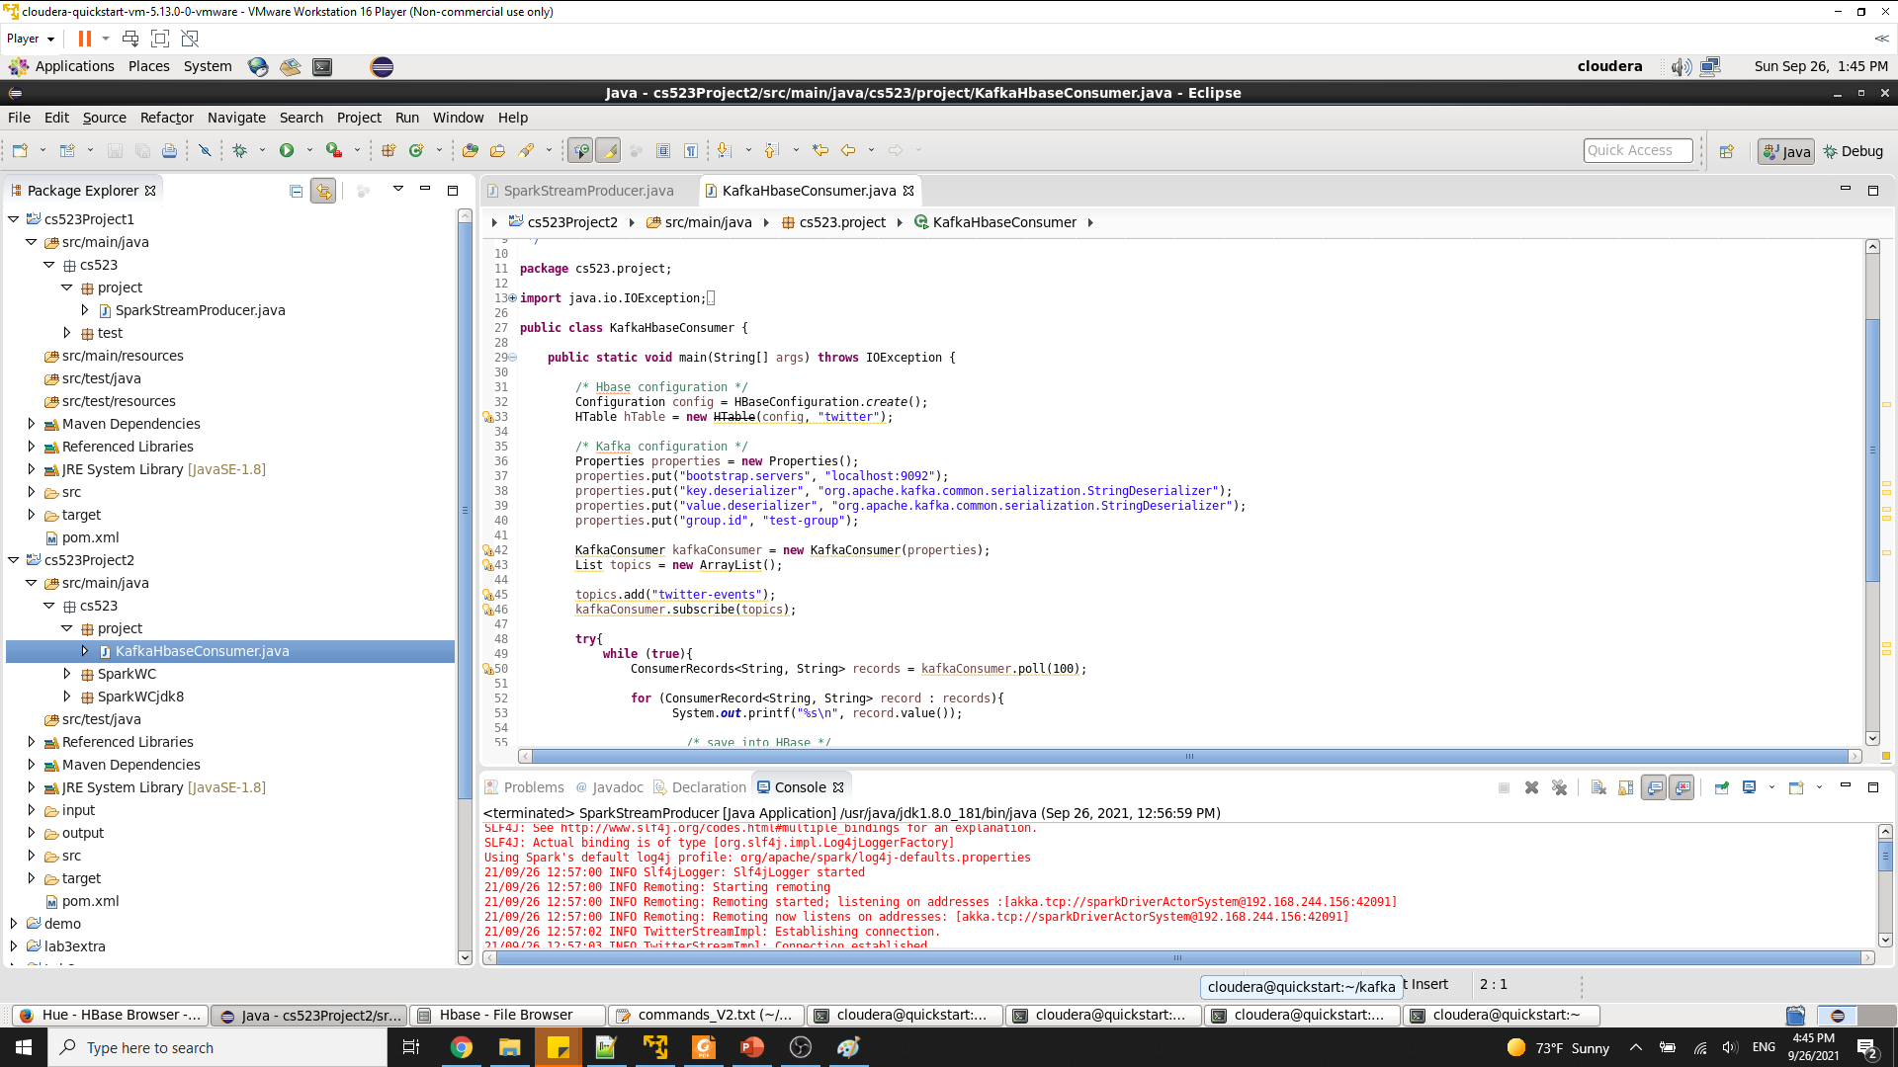
Sample code (stream consumer)

Slide 8
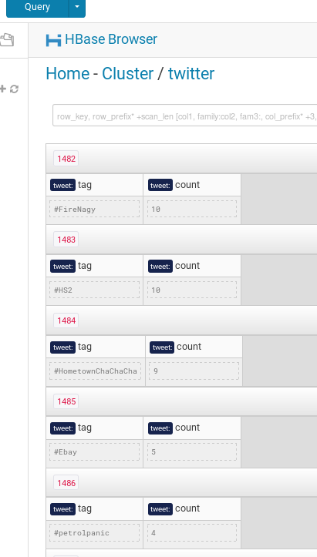
Sample output (Hue)

Slide 9
Deliverability
Source code
Readme.md
presentation (PowerPoint)
Video record

Slide 10
My experience about the project
Learned
Twitter API
Apache spark streaming
Kafka
OBS studio recoding
Challenged
Cloudera QuickStart VM issues
Recommend
Cloudera QuickStart VM issues has to be replaced, it is old,

Slide 11
Thank you.

