Slide 1
Object Oriented Programming
Computer Engineering Department
JAVA Programming Course
Assoc. Prof. Dr. Ahmet Sayar
Kocaeli University – Summer 2021

Slide 2
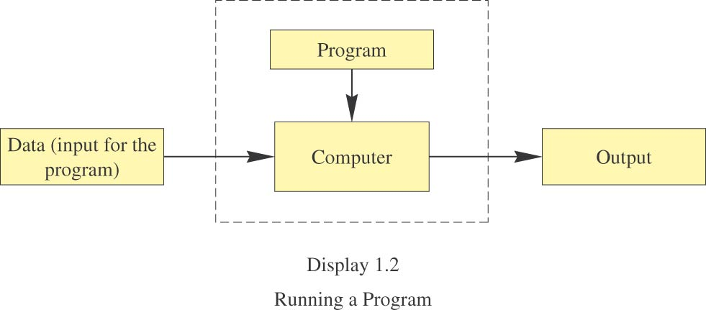
Running a Program
Sometimes the computer and the program are considered to be one unit.
Programmers typically find this view to be more convenient.

Slide 3
Programming Languages
High-level languages are relatively easy to write and to understand.
Java, Pascal, FORTRAN, C, C++, BASIC, Visual Basic, etc.
Unfortunately, computer hardware does not understand high-level languages.
Therefore, a high-level language program must be translated into a low-level language.
Assembly language

Slide 4
Compilers
A compiler translates a program from a high-level language to a low-level language the computer can run.
You compile a program by running the compiler on the high-level-language version of the program called the source program.
Compilers produce machine- or assembly-language programs called object programs.

Slide 5
Compilers, cont.
Most high-level languages need a different compiler for each type of computer and for each operating system.
Most compilers are very large programs that are expensive to produce.

Slide 6
Java Byte-Code
The Java compiler does not translate a Java program into assembly language or machine language for a particular computer.
Instead, it translates a Java program into byte-code.
Byte-code is the machine language for a hypothetical computer (or interpreter) called the Java Virtual Machine.

Slide 7
Java Byte-Code, cont.
A byte-code program is easy to translate into machine language for any particular computer.
A program called an interpreter translates each byte-code instruction, executing the resulting machine-language instructions on the particular computer before translating the next byte-code instruction.

Slide 8
Compiling, Interpreting, Running
Use the compiler to translate the Java program into byte-code (done using the compile command).
Use the byte-code interpreter for your computer to translate each byte-code instruction into machine language and to run the resulting machine-language instructions (done using the run command).

Slide 9
Portability
After compiling a Java program into byte-code, that byte-code can be used on any computer with a byte-code interpreter and without a need to recompile.
Byte-code can be sent over the Internet and used anywhere in the world.
This makes Java suitable for Internet applications.
Compile once run everywhere!

Slide 10
Class Loader
A Java program typically consists of several pieces called classes.
Import java.io.*;
Each class may have a separate author and each is compiled (translated into byte-code) separately.
A class loader (called a linker in other programming languages) automatically connects the classes together.
Notes:
Loader vs linker?

Slide 11
Object-Oriented Programming
Our world consists of objects (people, trees, cars, cities, airline reservations, etc.).
Objects can perform actions which effect themselves and other objects in the world.
Object-oriented programming (OOP) treats a program as a collection of objects that interact by means of actions.

Slide 12
OOP Terminology
Objects, appropriately, are called objects.
Actions are called methods.
Objects of the same kind have the same type and belong to the same class.
Objects within a class have a common set of methods and the same kinds of data
but each object can have it’s own data values.
Notes:
Class vs object?

Slide 13
OOP Design Principles
OOP adheres to three primary design principles:
encapsulation
polymorphism
inheritance.

Slide 14
Introduction to Encapsulation
The data and methods associated with any particular class are encapsulated (“put together in a capsule”), but only part of the contents is made accessible.
Encapsulation provides a means of using the class, but it omits the details of how the class works.
Encapsulation often is called information hiding.

Slide 15
Introduction to Polymorphism
From the Greek meaning “many forms”
The same program instruction adapts to mean different things in different contexts.
A method name, used as an instruction, produces results that depend on the class of the object that used the method.
everyday analogy: “take time to recreate” causes different people to do different activities

Slide 16
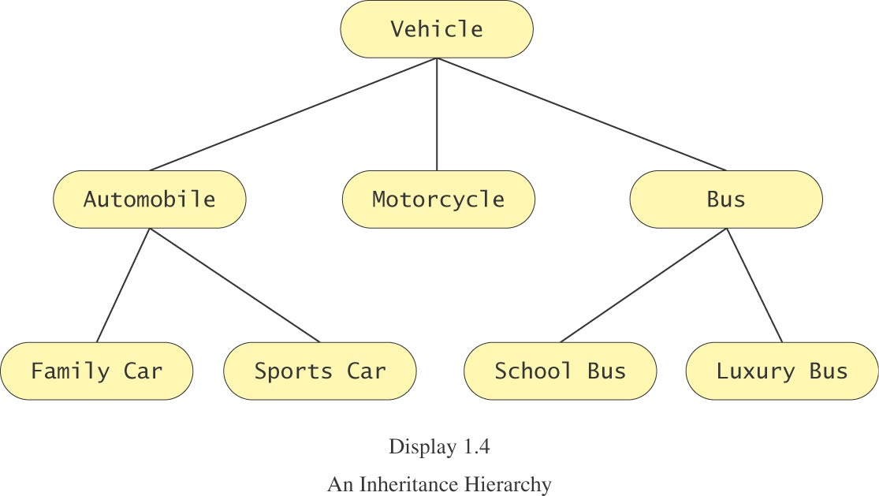
Introduction to Inheritance
Classes can be organized using inheritance.

Slide 17
Introduction to Inheritance, cont.
A class at lower levels inherits all the characteristics of classes above it in the hierarchy.
At each level, classifications become more specialized by adding other characteristics.
Higher classes are more inclusive; lower classes are less inclusive.

Slide 18
Errors
An error in a program is called a bug.
Eliminating errors is called debugging.
Three kinds or errors
syntax errors
runtime errors
logic errors

Slide 19
Syntax Errors
Grammatical mistakes in a program
the grammatical rules for writing a program are very strict
The compiler catches syntax errors and prints an error message.
Example: using a period where a program expects a comma

Slide 20
Runtime Errors
Errors that are detected when your program is running, but not during compilation
When the computer detects an error, it terminates the program and prints an error message.
Example: attempting to divide by 0

Slide 21
Logic Errors
Errors that are not detected during compilation or while running, but which cause the program to produce incorrect results
Example: an attempt to calculate a Fahrenheit temperature from a Celsius temperature by multiplying by 9/5 and adding 23 instead of 32

Slide 22
Sample class
package Lab_1;
/**
*
* @author asayar
*/
public class HelloWorld {
public static void main (String args[]) {
System.out.println("Hello World!");
System.out.println(args[0]);
}
}

Slide 23
package Lab_1;
import java.util.Scanner;
public class ReadingKeyboardInt {
public static void main(String[] args)
{
System.out.println("I will add two numbers for you.");
System.out.println("Enter two whole numbers on a line:");
int n1, n2;
Scanner keyboard = new Scanner(System.in);
n1 = keyboard.nextInt( );
n2 = keyboard.nextInt( );
System.out.println("The sum of those two numbers is");
System.out.println(n1 + n2);
}
}
Notes:
Enter two whole numbers on a line:
3 5 enter
Or
3 enter
5 enter
Both works
Ikisi de ayni sonuc

Slide 24
Run Rime Error (Causing Exception)
Hatali giris yapilirsa
S 5 gibi; s sayi degil!!!!
How about entry
2 3 8
Exception in thread "main" java.util.InputMismatchException
at java.util.Scanner.throwFor(Scanner.java:840)
at java.util.Scanner.next(Scanner.java:1461)
at java.util.Scanner.nextInt(Scanner.java:2091)
at java.util.Scanner.nextInt(Scanner.java:2050)
at Test.main(Test.java:65)
Java Result: 1

Slide 25
package Lab_1;
import java.util.Scanner;
public class ReadingKeyboardString {
public static void main(String[] args)
{
Scanner keyboard = new Scanner(System.in);
String word1, word2, word3;
System.out.println("Enter a line of text with three words:");
word1 = keyboard.next( );
word2 = keyboard.next( );
word3 = keyboard.next( );
System.out.println("With space corrected, you entered:");
System.out.println(word1 + " " + word2+ " " + word3);
}
}

Slide 26
package Lab_1;
import java.util.*;
public class EggBasket2 {
public static void main(String[] args) {
int numberOfBaskets, eggsPerBasket, totalEggs;
Scanner keyboard = new Scanner(System.in);
System.out.println("Enter the number of eggs in each basket:");
eggsPerBasket = keyboard.nextInt( );
System.out.println("Enter the number of baskets:");
numberOfBaskets = keyboard.nextInt( );
totalEggs = numberOfBaskets * eggsPerBasket;
System.out.println("If you have");
System.out.println(eggsPerBasket + " eggs per basket and");
System.out.println(numberOfBaskets + " baskets, then");
System.out.println("the total number of eggs is " + totalEggs);
System.out.println("Now we take two eggs out of each basket.");
eggsPerBasket = eggsPerBasket - 2;
totalEggs = numberOfBaskets * eggsPerBasket;
System.out.println("You now have");
System.out.println(eggsPerBasket + " eggs per basket and");
System.out.println(numberOfBaskets + " baskets.");
System.out.println("The new total number of eggs is "
+ totalEggs);
}
}

